Slide 1
Video 28 (Topic 6.2): The Cost of Debt
FIN 614: Financial Management
Larry Schrenk, Instructor

Slide 2
Topics
What is the Cost of Debt?
Tax Effects
Calculating the Cost of Debt

Slide 3
Cost of Debt
Cost to the Firm to Secure Debt Financing
Required Rate of Return to Debt Holders

Slide 4
Debt and Taxes
Distinguish
Pre-Tax Cost of Debt r_{d}
After-Tax Cost of Debt r_{d}(1 – τ_{c})
τ_{c} is the Corporate Tax Rate
Asymmetry in Federal Tax Code
Interest Payments are Deductible
Dividends are not Deductible
Federal Subsidy of Debt Financing

Slide 5
Tax Effect
Effect
Dividends: $1 costs $1
Interest Payments: $1 costs $1(1- τ_{c})
If τ_{c} = 30%, $1(1- 0.30) = $0.70
Required Return on Bond
r_{d}(1- τ_{c})

Slide 6
WACC Goal
Minimize Cost
Cost of Capital
Debt Ratio

Slide 7
Debt Trade-Off
Why Not All Debt Financing?
Trade-Off
Tax Subsidy
Financial Distress

Slide 8
Tax Effects and Financial Distress▪
Value of firm with debt subsidy
Value of firm with debt subsidy and financial distress
Maximum firm value
Value of Firm
D*
Debt

Slide 9
Determining the Cost of Debt
Method 1: Current Bond Yields (YTM)
Your firm’s semi-annual bond with a par value of $1,000, four years to maturity, and a coupon rate of 8% is now selling for 775.45. What is its YTM?
N = 8; I% = ???; PV = -775.45; PMT = 40; FV = 1000; P/Y = 2
I% (YTM) = 15.78%

Slide 10
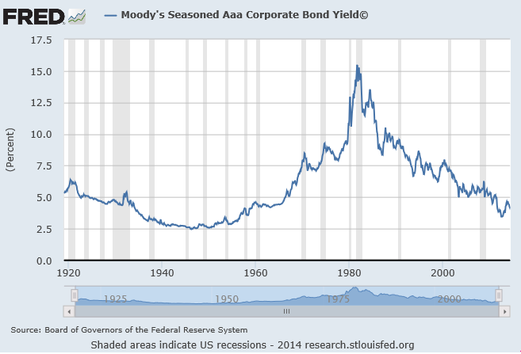
Determining the Cost of Debt
Method 2: Bond Rating
FRED (http://research.stlouisfed.org/fred2/) has data on bond yields by rating
Moody's Seasoned Aaa Corporate Bond Yield
2014-06: 4.25%

Slide 11
Cost of Debt Problems
Embedded Options
Call, Conversion Provisions
Leases

Slide 12
Video 28 (Topic 6.2): The Cost of Debt
FIN 614: Financial Management
Larry Schrenk, Instructor

