Slide 1
Coding and Chatbots
MIS112-Week 8

Slide 2
Monday
Chatbot Basics
MIS112 AI Assistant
Notes:
Have them try two prompts’
‘What is Prompt Engineering?’
‘Explain ‘Prompt Engineering’ in detail
Compare the results, see if it uses the term ‘prompt engineering is an ART, ask it to explain why!

Slide 3
Introduction to Chatbots
Definition and role in business
Customer service, sales, HR, other applications
A chatbot is a computer program designed to simulate human conversation
They can answer questions, provide information, and perform simple tasks automatically
In business, they save time, reduce costs, and provide 24/7/365 customer support
Notes:
Explain to students that chatbots are essentially digital assistants. They simulate human conversations by responding to text or voice input. Stress their role in business: saving costs, increasing efficiency, and providing 24/7 support.

Slide 4
This Week
Monday-install software, lecture
Do Lab01-Exercise04-
https://eprofessor.azurewebsites.net/mis112/lab01/lab01.html
Python
LM Studio
Wednesday-do lab
Friday-Midterm

Slide 5
Coding Basics for Chatbots
Inputs, outputs, conditional logic
Frontend vs backend
Inputs: what the user types or says
Outputs: the chatbot’s reply or action
Conditional logic: rules (if/then) that decide how the bot responds
Frontend: what the user sees (website interface)
Backend: the hidden processing (Python code and AI model)
Notes:
Walk through simple concepts: input is what the user types, output is the bot’s reply. Conditional logic means the bot follows rules to decide answers. Introduce frontend vs backend as the visible vs hidden parts of a chatbot system.

Slide 6
Current Chatbot Architecture
Frontend interface (HTML/CSS/JS)
Backend logic (Python/Node)
Large Language Model integration (LM Studio)
Frontend interface: usually HTML/CSS/JS to capture user input
Backend logic: written in Python or Node.js, sends user input to AI model
AI Model: like LM Studio, processes the request and generates a response
Together these parts create the chatbot system
Notes:
Use a diagram to show how frontend, backend, and AI model connect. Give an analogy: frontend is the store counter, backend is the storeroom, and the AI model is the expert answering customer questions.

Slide 7
Chatbot Architecture Over Time
Initial Deployment – Rule-Based
Simple decision trees for FAQs and scripted workflows.
Fast to build, limited flexibility
Early AI Integration – NLP Add-ons
Incorporation of Natural Language Processing (NLP) to understand user intent and entities
Improves accuracy but still narrow in scope.
Hybrid Models – Rule + AI
Blend of predefined flows with AI-driven responses.
Offers reliability with flexibility
Context Awareness
Use of memory and conversation history.
Chatbots adapt to prior interactions for more personalized conversations
Integration with Business Systems
Connection to CRM, ERP, or databases via APIs.
Enables real-time data retrieval (e.g., order tracking, account lookup)
Continuous Learning and Updates
Regular refinement based on user feedback, analytics, and retraining models
Chatbots become smarter and more efficient
Notes:
Use a diagram to show how frontend, backend, and AI model connect. Give an analogy: frontend is the store counter, backend is the storeroom, and the AI model is the expert answering customer questions.

Slide 8
Chatbot Architecture-Future
Future Direction – Multimodal & Generative AI
Expansion into voice, images, and generative reasoning – https://krybe.co
Business chatbots will handle broader tasks (customer support, sales, analysis)
Key Takeaway
Chatbot design is not static—architectures evolve as business needs, user expectations, and AI technologies advance
Notes:
Mention that Methmini is doing internship with krybe.co AI voice interaction
Use a diagram to show how frontend, backend, and AI model connect. Give an analogy: frontend is the store counter, backend is the storeroom, and the AI model is the expert answering customer questions.

Slide 9
LM Studio Setup
Running a local model
Enable CORS in settings
Server communication
LM Studio lets you run AI models locally on your laptop
You must enable CORS (Cross-Origin Resource Sharing) to let webpages talk to LM Studio
A Python web server allows your browser to load the chatbot page and send requests
Notes:
Explain that LM Studio is software that lets us run AI models locally on our laptops. Mention CORS as a security setting that allows web pages to communicate with LM Studio. Students should understand why a local server is needed.

Slide 10
Business Examples
Customer support bots
HR onboarding assistants
Customer support bots: instantly answer FAQs (shipping times, order status)
HR onboarding bots: guide new employees through common questions and training
Sales bots: recommend products and help customers compare features
Notes:
Give relatable examples: a chatbot on Amazon answering order questions, or a company onboarding tool that guides new hires. Emphasize real value: reducing wait times and helping employees.

Slide 11
Interactive Exercise 1
Poll: Where have you interacted with chatbots?
Discuss experiences-both good and bad

Slide 12
Interactive Exercise 2
Think-pair-share: How might chatbots improve schoolwork?

Slide 13
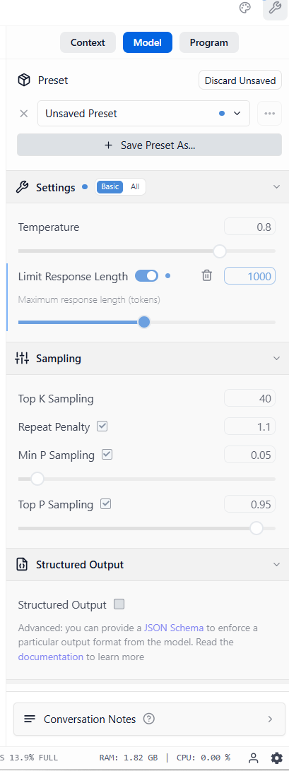
Interactive Exercise 3
Guided demo: Run a simple prompt in LM Studio
Phi-3-mini-4k-instruct
What were the parameters-tokens/sec, tokens, time to first token?
Learn to delete chats, and create new chat
Example-’what is a large language model?’
Vary temperature, Top K, response length…

Slide 14
Preview Activity
Explore sample Python web page code
Open a copy of index.html
Use MIS112 chatbot to explain
NOTE: if you botch .html code, get another copy
Hands-on testing with LM Studio
Make sure it is installed and updated
Make sure model is downloaded

Slide 16
Wednesday
Coding

Slide 17
Recap
Chatbot basics
LM Studio setup
Chatbots simulate conversations with users
They need coding: inputs, outputs, logic
LM Studio runs a chatbot model locally
Notes:
Remind students of Monday’s key points. Highlight that chatbots are practical AI systems they can build today using LM Studio.

Slide 18
Python + Webpage Integration
Connecting Python to LM Studio API
fetch/POST in web chat forms
Python acts as a bridge between a web page and LM Studio
The web page (HTML/JS) collects input, then sends it to Python
Python forwards the request to LM Studio, which returns the chatbot’s reply
fetch/POST: JavaScript commands used to send data from the page to the server
Notes:
Explain that Python connects the chatbot’s web interface to LM Studio. Show a simple fetch/POST command and how it transfers text from webpage to model. Compare it to sending a letter (input) and receiving a reply (output).

Slide 19
Code Walkthrough
Review index.html
Review steamPunk.html
index.html: simple chatbot interface with a text box and send button
steamPunk.html: a stylized chatbot page with decorative design
Both send user input to LM Studio running on port 1234
Notes:
Point out the differences between index.html (simple) and steamPunk.html (stylized). Reassure students they don’t need to fully understand all the code, just the flow of data.

Slide 20
Code Explanation
Load index.html; steamPunk.html into MIS112 chatbot and ask for explanation
Ask chatbot what changes could be made
Notes:
Point out the differences between index.html (simple) and steamPunk.html (stylized). Reassure students they don’t need to fully understand all the code, just the flow of data.

Slide 21
Business Examples
Embedded chatbots on websites
AI assistants for sales data queries
Customer support bots: instantly answer FAQs (shipping times, order status)
HR onboarding bots: guide new employees through common questions and training
Sales bots: recommend products and help customers compare features
Note: lab has simple chatbots, real ones can be much more complex with access to databases
Future chatbots: on your phone, voice-interactive, video interactive??
Notes:
Give relatable examples: a chatbot on Amazon answering order questions, or a company onboarding tool that guides new hires. Emphasize real value: reducing wait times and helping employees.

Slide 22
Interactive Exercise 1
Poll: Would you trust a chatbot for purchase recommendations?
Why or why not?
What are some possible problems?

Slide 23
Interactive Exercise 2
Group analysis: Identify risks in local chatbots

Slide 24
Interactive Exercise 3
Group analysis: Identify benefits of local chatbots

Slide 25
Interactive Exercise 4
Guided practice: Modify chatbot interface text in index.html
Modifying Javascript <script> is tricky
Tip-have the chatbot do it!
Prompt:
update this <script> block to add ‘max_tokens=100
If you have enough context, let chatbot handle entire file!

Slide 26
Preview Lab
Introduce, decide on Navigator, Builder, Scribe roles
Navigator (directs)
Builder (codes/tests)
Scribe (documents)

Slide 27
Before Friday Lab
Make sure LM Studio is installed
Make sure Python is installed
Get files, see next page

Slide 28
Before Lab
Copy from OneDrive ReadOnly: MIS112_ReadOnly/Lab08_Files/
Copy files to: C:\Users\StarID\html
file.html
index.html
steamPunk.html
readme.txt (retrieve news article text from web)

Slide 30
Friday
Coding a Chatbot

Slide 31
Lab Roles
Navigator: makes decisions and guides the group
Builder: types code, runs commands, tests chatbot
Scribe: takes notes, records changes, prepares final summary
Notes:
Stress teamwork. Navigator gives direction, Builder types, Scribe records. Each role is important for collaboration and ensures equal participation.

Slide 32
Lab - Step 1
Start LM Studio, Developer Mode
Load model- phi-3-mini-4k-instruct
Verify it runs on port 1234 (start server)
Enable CORS
Serve on Local Network
Try test prompt
Notes:
Make sure LM Studio is running. Students may need help checking the port number. Demonstrate this live.

Slide 33
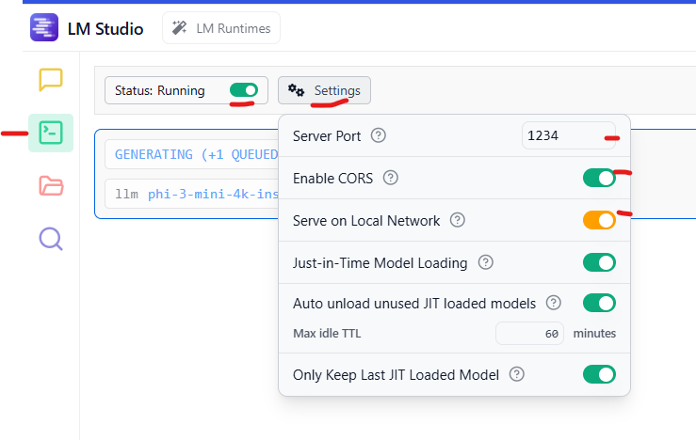
Lab - Step 1-Settings
Notes:
Make sure LM Studio is running. Students may need help checking the port number. Demonstrate this live.

Slide 34
Lab - Step 2
Run Python simple web server
Open Command Prompt on your laptop
Navigate to the project folder:
cd html
Should be at c:\users\StarID\html
Enter command:
python -m http.server 8000
Should see: Serving HTTP on :: port 8000 (http://[::]:8000/) ...
Open browser, navigate to:
http://localhost:8000
Notes:
Explain what a web server does: it allows the browser to load their HTML files. Use analogy: a web server is like a librarian handing out books (files) when requested.

Slide 35
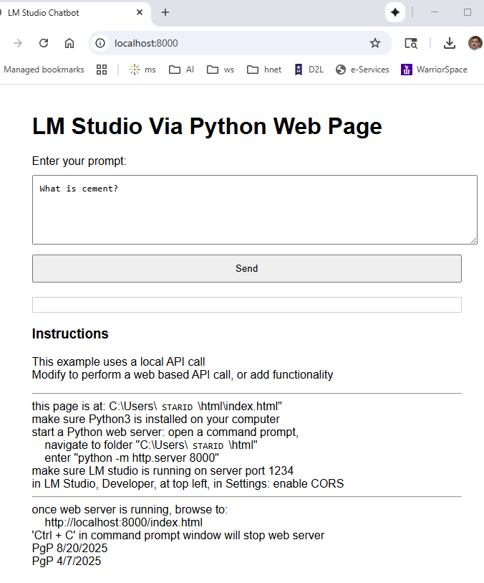
Lab - Step 2-Success
Notes:
Explain what a web server does: it allows the browser to load their HTML files. Use analogy: a web server is like a librarian handing out books (files) when requested.

Slide 36
Lab - Step 3
Enter prompt from web page, press ‘Send’
This sends prompt to LM Studio
Notes:
Point out the use of localhost — it means the computer is hosting its own webpage. No internet required for this lab.

Slide 37
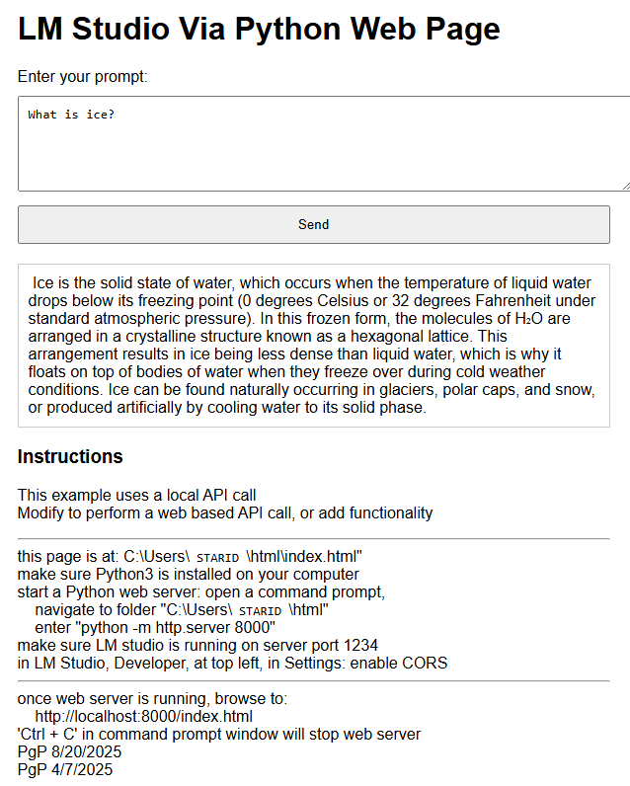
Lab - Step 3-Prompt Success
Notes:
Point out the use of localhost — it means the computer is hosting its own webpage. No internet required for this lab.

Slide 38
Lab - Step 4
Modify chatbot code, settings, prompt
Adjust temperature
Modify the chatbot code in index.html or steamPunk.html
Change the chatbot’s starting message (prompt)
Adjust temperature: lower = predictable, higher = creative
Notes:
Encourage creativity: change the chatbot’s greeting, experiment with temperature. Explain temperature as creativity dial — 0.2 is serious, 0.8 is imaginative.

Slide 39
Lab - Step 4-Modify Code
Ask chatbot how this javascript could be modified:
const payload = {
model: "local-model", // This is usually ignored by local servers
messages: [
{ role: "system", content: "You are a helpful assistant." },
{ role: "user", content: userMessage }
],
temperature: 0.7
};
Notes:
Encourage creativity: change the chatbot’s greeting, experiment with temperature. Explain temperature as creativity dial — 0.2 is serious, 0.8 is imaginative.

Slide 40
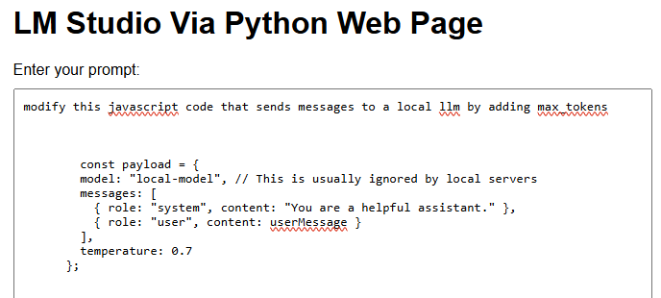
Lab - Step 4-Modify Code
Notes:
Encourage creativity: change the chatbot’s greeting, experiment with temperature. Explain temperature as creativity dial — 0.2 is serious, 0.8 is imaginative.

Slide 41
Lab - Step 5
Test chatbot interaction
Use group prompts
Test chatbot by entering different prompts
Try business scenarios: customer service questions, HR inquiries, sales pitches
Notes:
Encourage business-related prompts. Example: 'What’s the best way to welcome a new employee?' or 'Suggest ways to increase sales.'

Slide 42
Lab - Step 6
Copy internet news article to ‘readme.txt’
Load file.html
Enter prompt: summarize ‘readme.txt’
Evaluate the summarization
Try other files: customer service questions, HR inquiries, sales pitches.
Notes:
Encourage business-related prompts. Example: 'What’s the best way to welcome a new employee?' or 'Suggest ways to increase sales.'

Slide 43
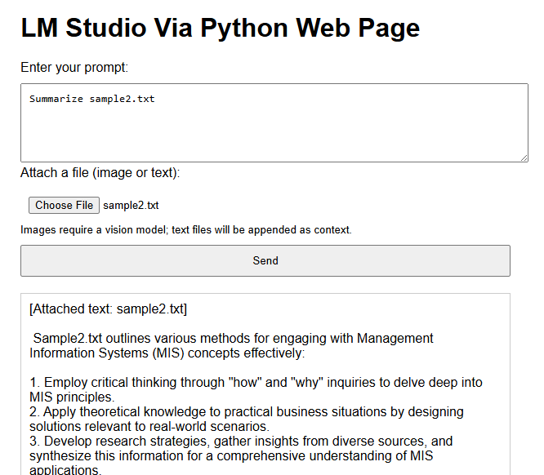
Lab-Step 6-Example Summary

Slide 44
Lab - Step 7
Troubleshooting common errors
CORS issues, server not running, port conflict
Common errors:
CORS not enabled in LM Studio (fix in settings)
LM Studio not running on port 1234
Web server not started or wrong port
Notes:
Go over common errors and how to fix them. Reassure students that errors are part of learning — troubleshooting is a valuable skill.

Slide 45
Lab - Step 8
Deliverable: One-page group summary
Include screenshots and business application ideas
Deliverable: group prepares one-page summary
Include screenshots of chatbot in action
Explain modifications made and possible business uses
Notes:
Guide students to create a professional summary. Tell them to document changes and reflect on business applications. Encourage screenshots as evidence of work.

Slide 46
Lab – Reflection 1
What surprised you about coding and chatbots?
How might you apply this in business?
Think about what was new or surprising in building a chatbot
Notes:
Ask open questions: What did you learn that you didn’t expect? How can this help in business? Encourage students to share examples from their own experiences.

Slide 47
Lab – Reflection 2
How could chatbots help in your future career in business or while you are in school?
What challenges do you see with using chatbots?
Notes:
Ask open questions: What did you learn that you didn’t expect? How can this help in business? Encourage students to share examples from their own experiences.

Slide 48
Lab – Reflection 3
Consider the situation 10 years from now
Will chatbots be commonplace?
What new features will chatbots have?
Notes:
Ask open questions: What did you learn that you didn’t expect? How can this help in business? Encourage students to share examples from their own experiences.

