Slide 1
MIS 112 - AI Unleased: Introduction to Generative AI
Topic 6: Computer Vision, Speech Recognition, and Multimodal AI Systems
Pat Paulson and Larry Schrenk, Instructors

Slide 2
Overview
Computer Vision
Speech Recognition
Multimodal Systems & Agents
Ethics, Bias & Fairness
Hands-On Friday: MultiSense Workshop

Slide 3
Content Note
In topic 5, we focused on how AI generates/creates images and audio. In this topic, we turn to how AI interprets/understands images and audio.

Slide 4

1. Computer Vision

Slide 5
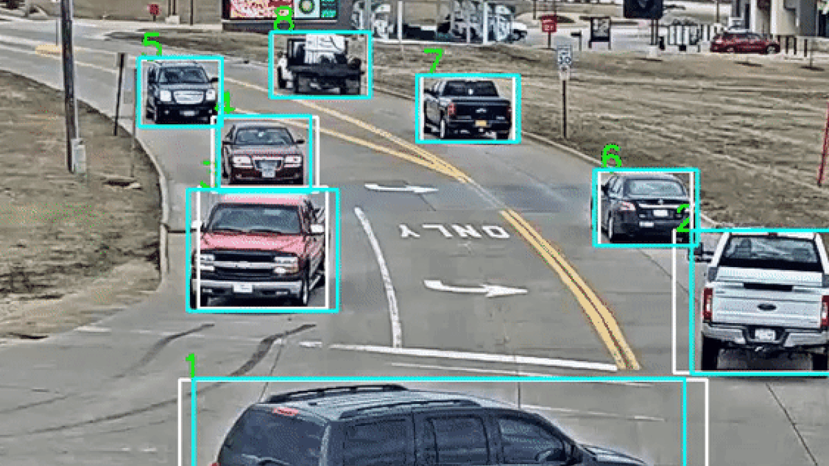
Computer Vision Sections
Overview
Convolutional Neural Networks (CNNs)
Applications
Computer Use
Demos
Future Developments

Slide 6
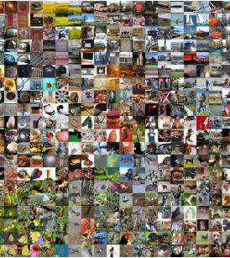
A. Overview
CV is image analysis
Object detection, segmentation, classification tasks
Convolutional Neural Networks (CNNs) for feature extraction
ImageNet
14m+ labeled images

Slide 7
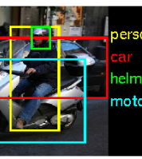
Detection, Segmentation, and Classification
Detection
Locates objects using bounding boxes
Segmentation
Dividing an image into meaningful parts
Classification
Assigns labels (CNN)

Slide 8
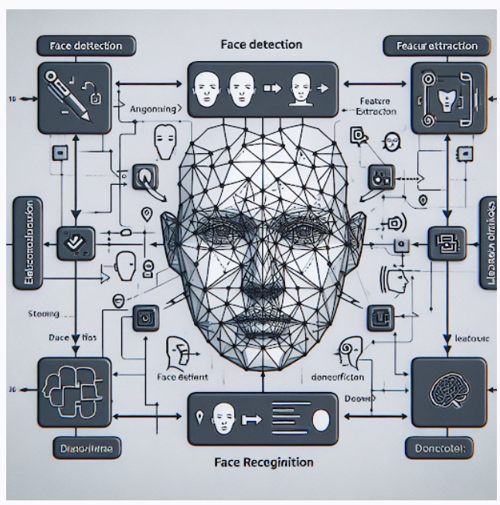
Feature Extraction
Detect image keypoints
Extract features using CNN layers
Reduce dimensions
Improve accuracy by selecting top features
Match feature descriptors across images
Ensure features resist lighting and size changes
Trade off extraction speed and accuracy

Slide 9
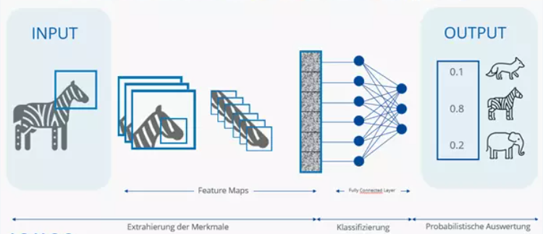
B. Convolutional Neural Networks (CNNs)
Generate feature maps to learn simple-to-complex features

Slide 10
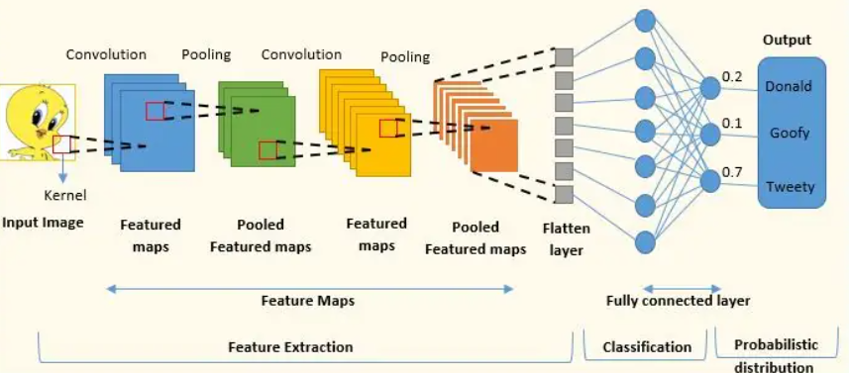
Convolutional Neural Networks (CNNs)
Convolution: Feature extraction
Pooling: Reduce dimensionality
Fully connected: Classification

Slide 11

C. Applications
Facial Recognition: Identify or verify people by analyzing facial features
Optical Character Recognition (OCR): Extract and convert text from images
Autonomous Vehicles: Detect lanes, obstacles, and traffic signs for safe navigation
Medical Imaging Analysis: Highlight anomalies in X-rays, MRIs, etc. for diagnostics
Quality Inspection: Spot defects on production lines through real-time imaging
Augmented Reality (AR): Overlay digital content onto real-world scenes for interactive experiences
Surveillance & Security: Monitor environments to detect unusual activities

Slide 12
D. Computer Use
Agent sees screen, understands UI, takes actions
Controls mouse/keyboard, files, apps, browser tabs
Mix of vision, planning, and tool calls

Slide 13
Core Architecture
Perception: screen OCR, DOM, window metadata
Reasoning: goal → plan → step-by-step actions
Action layer: click/type, file ops, API calls
Feedback loop: verify result, recover from errors

Slide 14
Practical Use Cases
Fill forms, scrape/download, reconcile spreadsheets
Batch rename, convert, move and tag files
System setup: install, configure, check health
Cross-app workflows: email → Excel → CMS updates

Slide 15
Building & Operating
Start simple: record task, write success checks
Prompt pattern: Goal • Context • Tools • Limits
Reliability: retries, checkpoints, idempotent steps
Governance: audit trails, KPIs, periodic reviews

Slide 16
E. Demo: Images
Google AI Studio: Gemini 2.5 Pro
Gazebo
Describe this image.
Create a image of this picture with box labels of important features, and provide a link to download it.
Person
Identify this person. Culbertson
Code
Explain this code.
Puzzle
Solved this puzzle.

Slide 17
Demo: Computer Vision I
Google AI Studio: Stream
WSU Course Search
How do I find courses in finance?
Can you tell me the likely content of FIN 450?
Tell me about Finance 377.
Who’s teaching it No thank you?

Slide 18
Demo: Computer Vision II
Google AI Studio: Stream
Writing Sample
Are there any spelling errors?
Are there any grammatical errors?
Are there any factual errors?

Slide 19
Demo: Computer Use
ChatGPT (Agent Mode)
Go to this website (https://connect.brookings.edu/register-to-watch-are-geopolitics-leading-to-fragmentation-of-the-international-financial-system?_gl=1*1i3bwn9*_ga*Njg5NjkxMzg5LjE3NTkxNDk0MDk.*_ga_PQL1XY12X1*czE3NTkxNDk0MDgkbzEkZzEkdDE3NTkxNDk0MzQkajM4JGwwJGgw) and register me for the event using this information: Lawrence; Schrenk; lschrenk@winona.edu; Winona State University; Associate Professor of Finance; Academic; Winona; Minnesota.

Slide 20
F. Future Developments
Emerging Vision Transformer (ViT) design improves accuracy
Self-supervised learning (SSL) reduces annotation costs
Synthetic data generation enhances robustness
3D reconstruction techniques
Spatio-temporal analysis supports dynamic object tracking
Multi-modal perception
GDPR compliance
General Data Protection Regulation (EU)

Slide 21
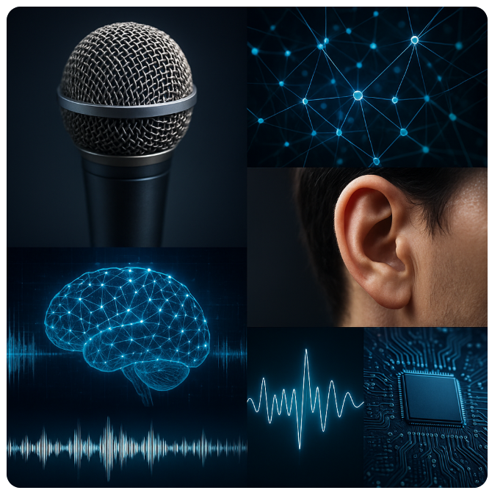
2. Speech Recognition

Slide 22
Speech Recognition
Overview
AI Models
Applications
Translation
Demos
Challenges and Future Developments

Slide 23
A. Overview
Automatic Speech Recognition (ASR) for audio-to-text conversion
Hidden Markov Models (HMMs) → neural nets (RNNs, CNNs, Transformers)
Speaker adaptation reduces WER; Domain adaptation tailors model to specific vocabulary (medical, legal)
Word Error Rate (WER) = (substitutions + deletions + insertions) / reference words

Slide 24
Phonemes vs. Acoustic Features
Actual linguistic units (phonemes) inferred from acoustic features
Waveform for /p/ and /b/ can overlap in noise, accents, or coarticulation.
Speech is continuous stream; No clear boundaries between phonemes
Same phoneme sounds different (“t” in top vs. stop).
Acoustic features are only probabilistically related to phonemes.

Slide 25
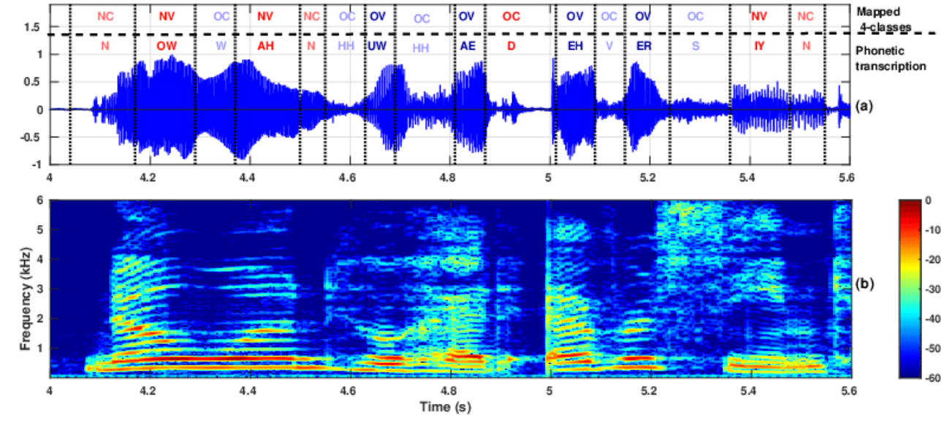
'no one who had ever seen’
The speech waveform and spectrogramEnglish ARPABET format
Four classes of interest, i,e. nasal consonant (NC), oral consonant (OC), nasalized vowel (NC), and oral vowel (OV)

Slide 26
B. AI Models: Hidden Markov Models (HMM)
Phonemes as hidden states.
Probability that a given state (phoneme) emits the observed features.
Algorithms (like Viterbi) to decode most likely phoneme sequence from observed signal.

Slide 27
Transition vs. Emission Probabilities
Phoneme sequence: /k/ → /æ/ → /t/
Observed sequence (~10–20 ms each): O₁, O₂, O₃, …, Oₙ
Transition probabilities: How likely to stay vs. move to next phoneme
Emission probabilities: How likely feature (e.g., O₃) comes from given phoneme

Slide 28
Example Probabilities
Transitions
P(/k/→/k/) = 0.6 (stay in /k/)
P(/k/→/æ/) = 0.4 (move to /æ/)
P(/æ/→/æ/) = 0.7,
P(/æ/→/t/) = 0.3
P(/t/→/t/) = 0.8
P(/t/→end) = 0.2
Emissions
P(O₂ | /k/) = 0.05
P(O₂ | /æ/) = 0.001
P(O₂ | /t/) = 0.0001

Slide 29
AI Models: Recurrent Neural Networks (RNN)
Neural network designed for sequential data.
Speech is sequential
Words unfold over time. Recognizing them requires context, not just isolated sounds.
Temporal dependencies
The way a sound is pronounced depends on surrounding sounds (coarticulation).
Variable length input
Speech signals are not fixed-length; RNNs naturally process sequences step by step.

Slide 30
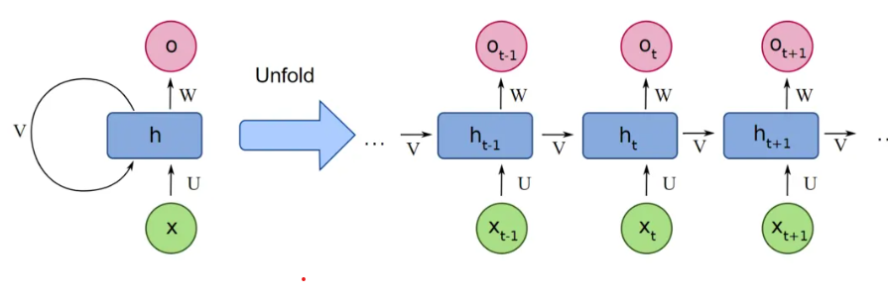
RNN Feedback Loop
Unlike feedforward networks, RNNs have a feedback loop
Output of one step is fed back as input to the next step.
A kind of "memory" of what came before
Critical for speech, where meaning depends on sequences of sounds

Slide 31
AI Models: Transformers
Self-Attention: Each audio frame (or feature vector) can attend to all others, capturing global context instead of just local sequences.
Parallelization: Unlike RNNs, Transformers process input sequences in parallel, making training much faster.
Scalability: They scale well with large datasets and benefit from pretraining + fine-tuning.

Slide 32
Transformers Advantages
HMM-free: No need for probabilistic state models or GMMs.
End-to-End: Directly maps audio → text.
Multilingual & Multitask: Same model handles transcription + translation.
Noise Robustness: Pretraining across diverse audio improves performance in real-world conditions..

Slide 33

C. Applications
Voice assistants (e.g., Siri, Alexa) for hands-free control
Transcription services for meetings, captions, accessibility
Call-center analytics to monitor customer interactions
In-car systems for navigation and texting

Slide 34
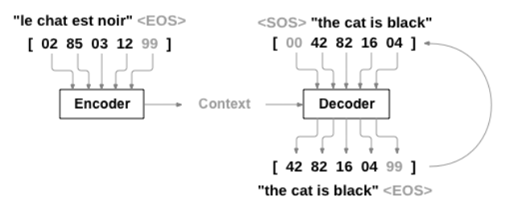
D. Translation
Tokenization splits input text
Converts tokens into vector representations
Transformer Architecture/Self-attention
Fine-tuning with domain data improves accuracy by 4%
NB: This is the same as text prediction.

Slide 35
E. Demo: Addpipe.com
“My name is Larry Schrenk.”
“I am teaching MIS 112 AI Unleashed”
“Pad kid poured curd pulled cod.”
Plosive consonants in quick succession (“p”, “d”, “k”)
Overlapping phonetic segments (e.g. “poured”, “curd”, “pulled”, “cod”)
Very low “phonemic redundancy” (few distinct, easy anchor sounds)
Small differences in pronunciation (accent, timing) can drastically shift the perceived sequence.

Slide 36
F. Challenges and Future Developments
Challenges
Accents and dialects
Background noise
Homophones (“there” vs. “their”)
Privacy concerns
Developments
Self-Supervised Pretraining
Multilingual Support
Real-Time Translation
Noise & Accent Robustness

Slide 37
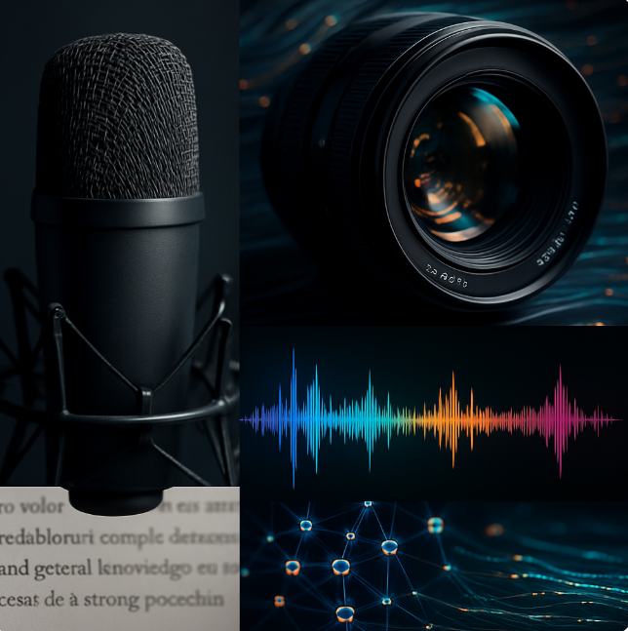
3. Multimodal Systems & Agents

Slide 38
Multimodal Systems
What is Multimodal AI?
Multimodal Large Language Model (MLLM)
Applications
Challenges and Future Developments

Slide 39
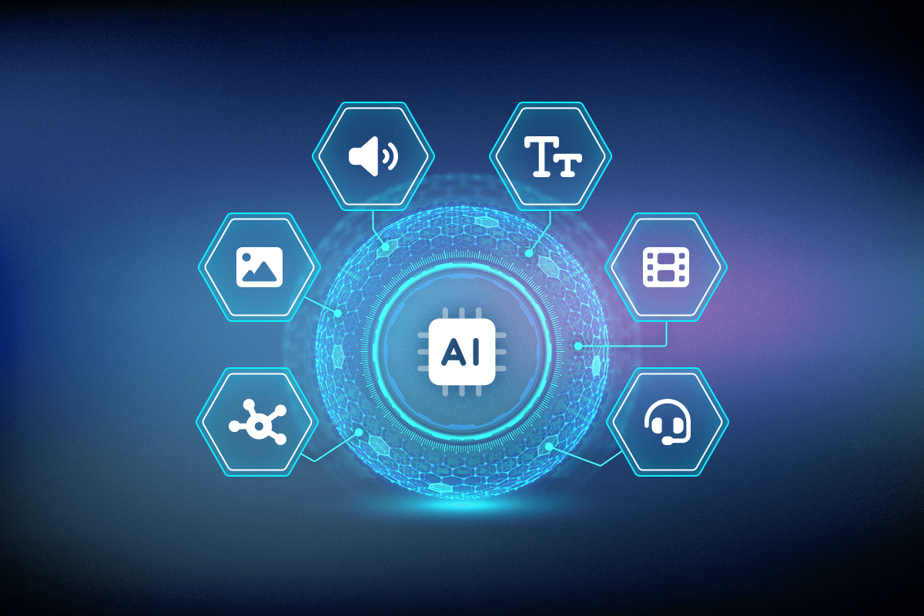
A. What is Multimodal AI?
Integrates text, image, audio data for richer understanding
Enables cross-modal reasoning
Fuse text, image, audio through cross-attention layers
Leveraging Transformer architectures
Supporting multimodal chatbots, robotics, medical imaging… Driving inclusive UX; implement 5+ sensory input modalities
State of the art AI models are now natively multimodal
Examples:
AI-Agent Examples
Siri (speech)
ChatGPT-Vision (text+image)

Slide 40
Why Multimodality Matters
Boosts accuracy via cross-modal feature fusion
Enables richer experiences through synchronized outputs
Supports robust decision-making
Accelerates multimodal search;
Unlocks new applications
Goal: Replicate the brain's innate ability to synthesize information from various senses to form a coherent and contextually rich perception of reality

Slide 41
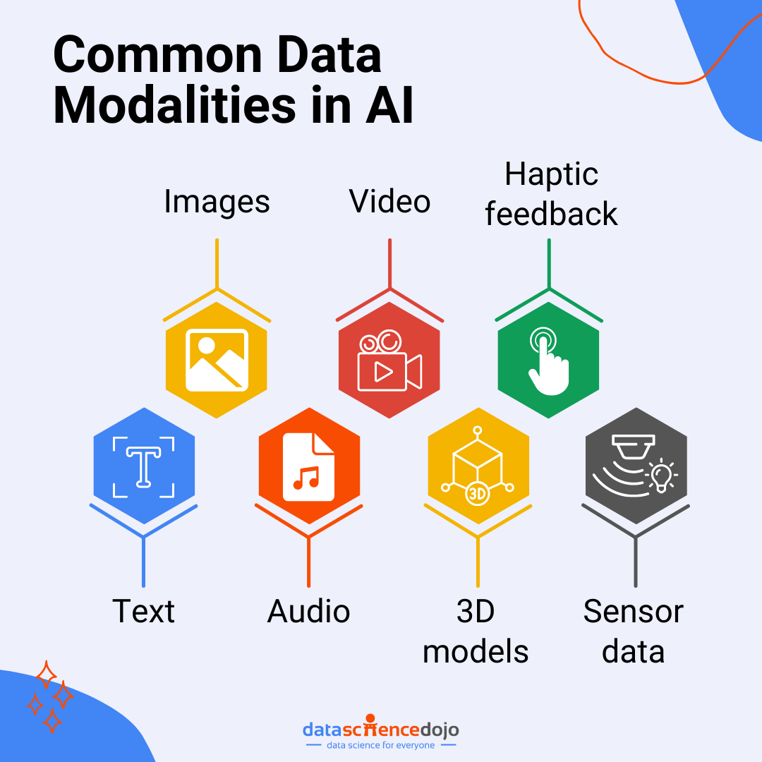
Modalities
Text: NLP converts sentences into 768-dimensional vector embeddings
Vision: CNNs extract 2048-feature maps from images efficiently
Audio: ASR transforms waveforms into 80-channel mel spectrograms
Sensor: Streams 100Hz vectors, enabling real-time gestures
Fusion: Early concatenation boosts multimodal accuracy

Slide 42
Five Multimodal Goals
Representation learns embeddings that summarize and relate data from multiple modalities.
Translation converts data between modalities, such as generating text from images or images from text.
Alignment identifies direct correspondences between elements across modalities, like matching words to image regions.
Fusion combines information from multiple modalities to improve prediction accuracy.
Co-Learning transfers knowledge from resource-rich modalities to resource-poor ones to boost performance

Slide 43
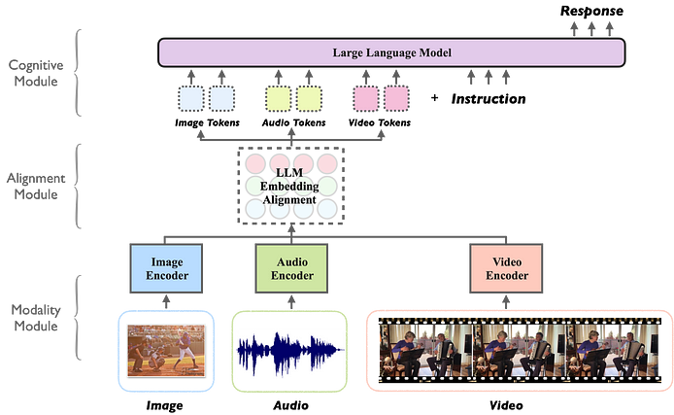
B. Multimodal Large Language Model (MLLM)
Layers:
Modality-specific encoders
Fusion module
Decoder/output module

Slide 44
Modality Interactions
Heterogeneity: Modalities have different structures and statistical properties
Connections: Modalities often contain complementary or redundant information
Interactions: Modalities influence each other when combined).

Slide 45
C. Applications
Video
Robotics
Games

Slide 46
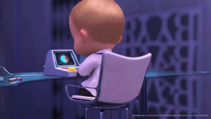
C.1 Video
GANs for video generation
Diffusion models for realistic images
Frame consistency across sequences
Process videos at 24 fps
Train models with 1000+ video clips
Fine-tune models for custom styles
Test quality using FID (Fréchet Inception Distance) metric

Slide 47
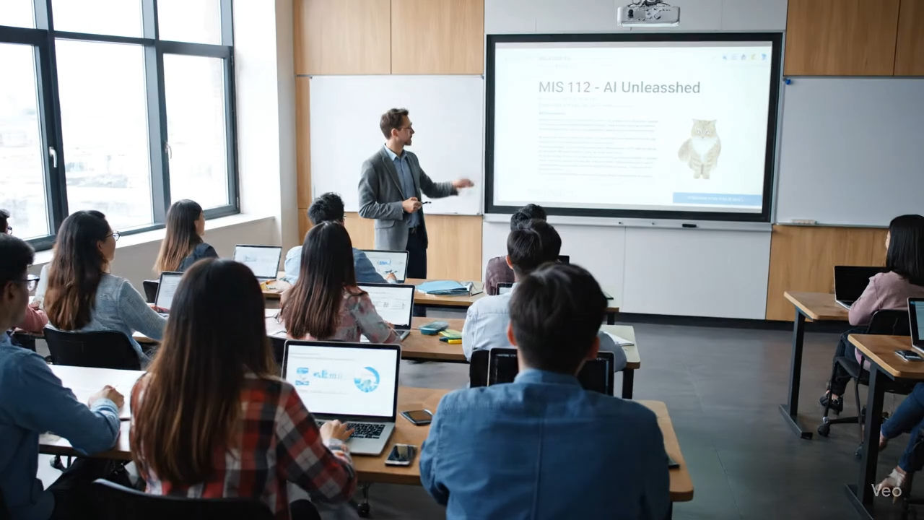
MIS 112 – AI Unleashed
Veo 3: Create a realistic video showing a classroom scene. The video should depict a diverse group of university students attentively watching an instructor at the front of the room. The instructor is teaching a course titled “MIS 112 – AI Unleashed”, which should be clearly displayed on a projector screen or whiteboard. During the video a cat should ride a Roomba across the room. Use a modern lecture hall setting with natural lighting, desks, and laptops visible. The atmosphere should feel academic, engaging, and professional, highlighting the theme of artificial intelligence in education.

Slide 48
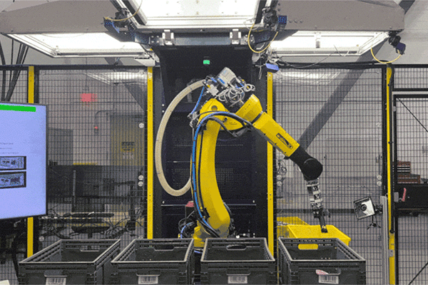
C.2 Robotics
AI robotics as smart robot machines
Sensors: Camera, touch, audio
Actuators: Wheels, arms, grippers
Robot movement planning process
Vision to detect and obstacle avoidance
Simple learning for robot task training
Safety rules like emergency stop buttons
Examples:
Warehouse robots
Healthcare robots for patient monitoring

Slide 49

C.3 Games
Gen AI enables dynamic content
RL trains agents for gameplay mechanics
NLP powers adaptive narrative dialogues
CV integrates real-world into gameplay
Performance metric win-rate percentage
GPU acceleration reduces model inference latency
Integrate RL for emergent behaviors

Slide 50
E. Challenges
Data scarcity and quality
Data heterogeneity
Computational complexity
Explainability
Training instability
Evaluation lack standardization
Scalability constraints

Slide 51
Future Developments
Enhanced fusion methods
Scalable foundation models
Self-supervised pretraining
Transformer architectures that generalize across text, image, audio inputs
Zero-shot classification
Regulatory frameworks standardize data privacy

Slide 52

4. Ethics, Bias & Fairness

Slide 53
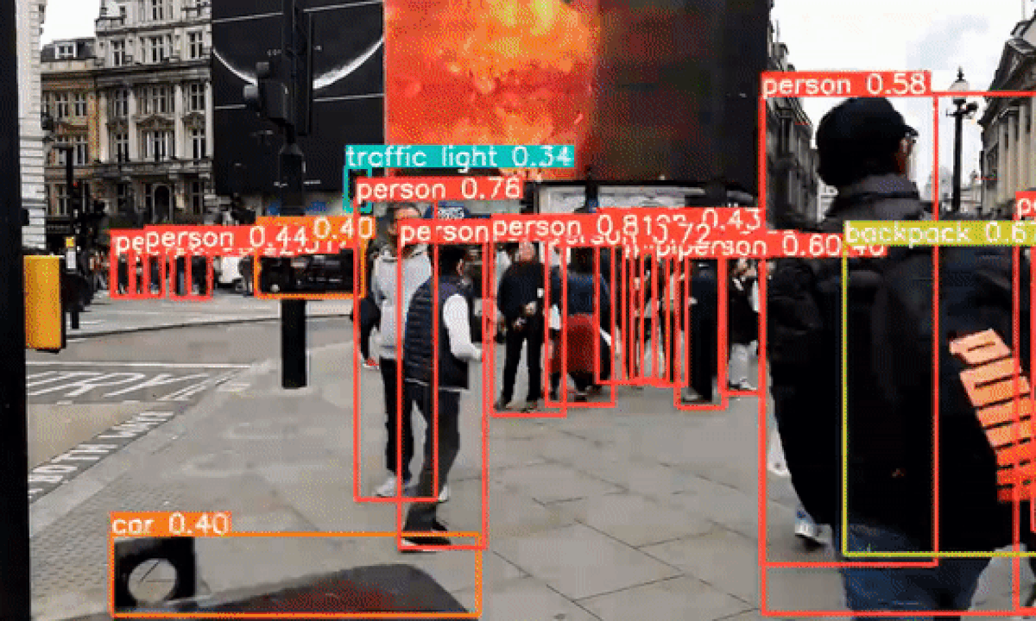
Computer Vision
Bias amplification
Privacy infringement
Surveillance overreach
Data security
Explainability and accountability
Regulatory
Consent frameworks lacking transparency

Slide 54
Speech Recognition
ASR (Automatic Speech Recognition) vulnerability to accent bias
Privacy risks from unauthorized voiceprint biometric data
GDPR mandates explicit consent
Cross-gender WER gender gap
Transparency frameworks increase
Security concerns

Slide 55
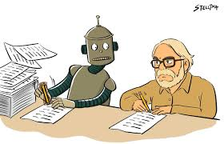
Multimodal AI
Bias Amplification
Privacy and Data Security
Multimodal Emotion Recognition (MER)
Misinformation and Copyright

Slide 56
5. Hands-On Friday: MultiSense Workshop

Slide 57
Friday Lab Prep
Make sure you can access:
MIS 112 Lab Report 5
Websites:
Qwen Image Fast
AI Jukebox
Google AI Studio (Nano Banana)

