Slide 1
MIS 112 - AI Unleased:
Introduction to Generative AI
Topic 5: Images and Audio Generation
Pat Paulson and Larry Schrenk, Instructors

Slide 2
Overview
Demo: Microsoft Copilot Studio
Image Generation Methods
  Note: Video Next Topic
Audio Generation Methods
Ethics & Legal Considerations
Hands-On Friday: AI Images & Audio

Slide 3
1. Demo: Microsoft Copilot Studio

Slide 4
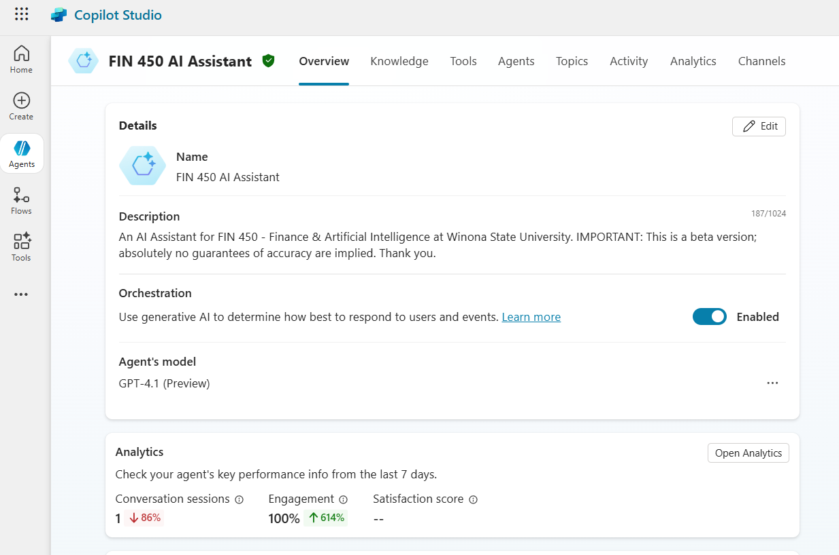
CPS: Overview
Name, Description
Orchestration
Agent’s Model
Analytics
Instructions
Knowledge
Web Search
Tools

Slide 5
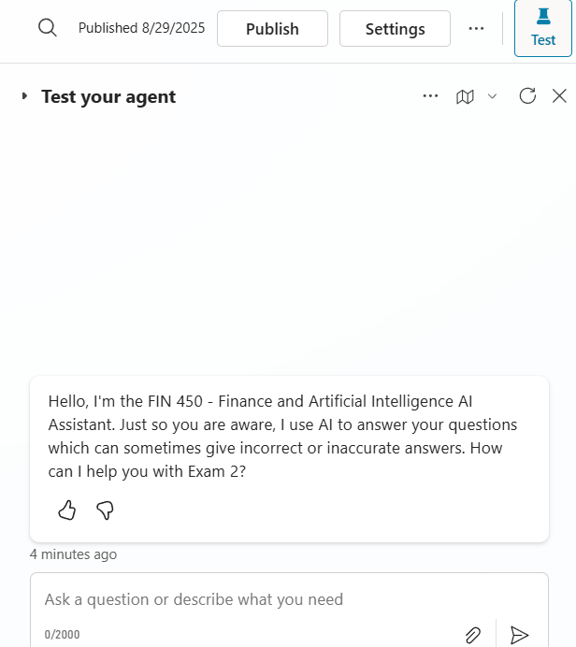
CPS: Test Your Agent
Opening Text
Window
Tracing

Slide 6
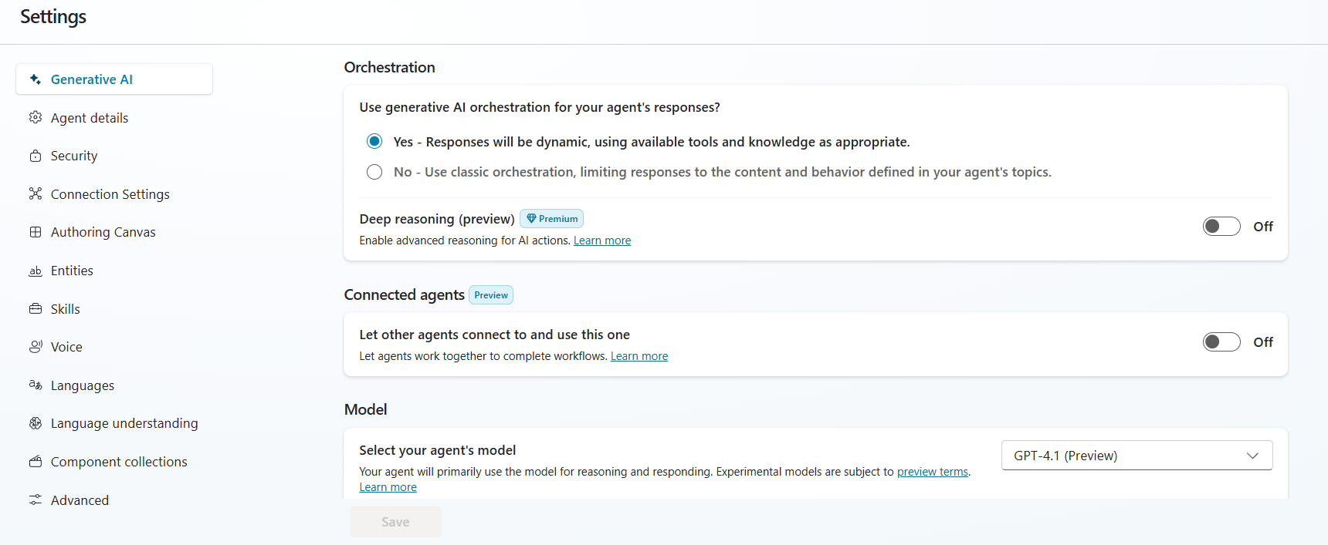
CPS: Settings
Generative AI
Agent Details
Security
Languages

Slide 7
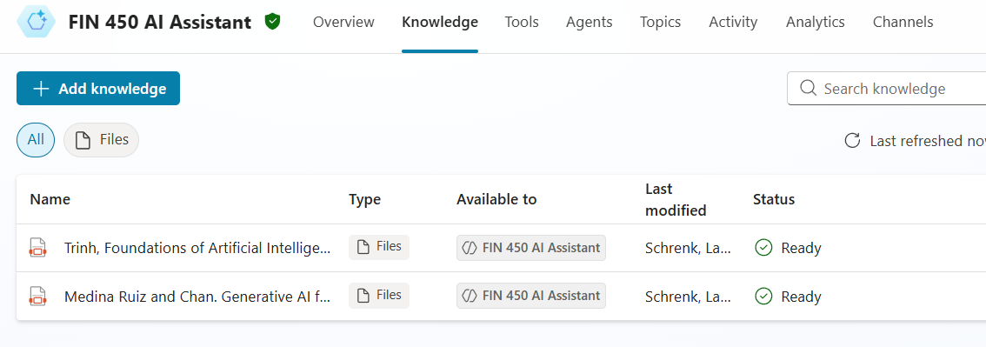
CPS: Knowledge
Files (RAG)
Websites

Slide 8
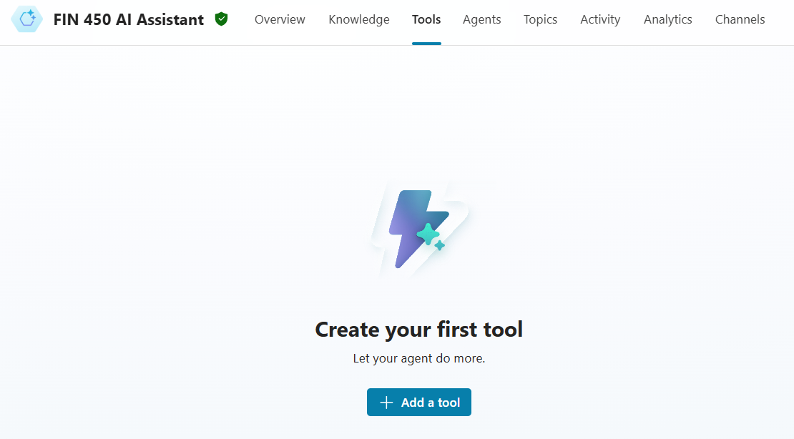
CPS: Tools
Microsoft Graph actions
SharePoint/OneDrive knowledge
Power Automate flow
Custom Connector
Dataverse / Power BI actions

Slide 9
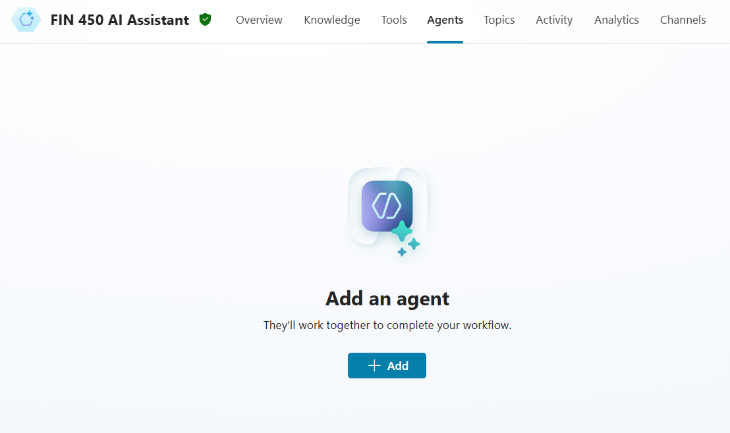
CPS: Agents
Financials Ingest & Normalize
Ratio & Diagnostics (DuPont)
Valuation & Scenario Engine
Risk, Compliance & Suitability (Reg BI/GIPS)
Excel/Sheets Modeling Copilot

Slide 10
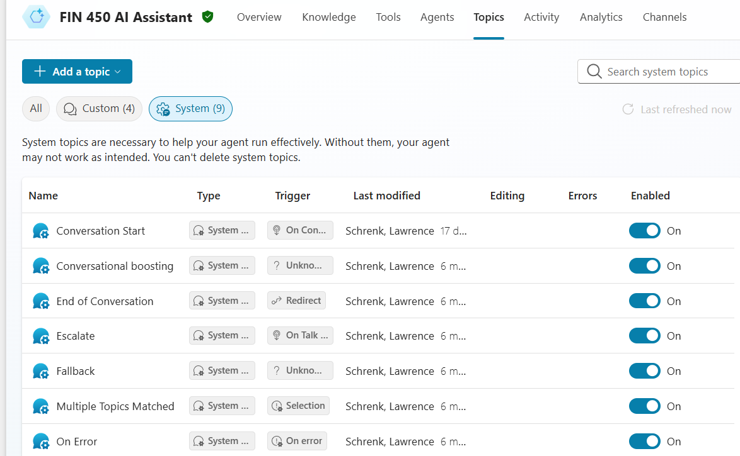
CPS: Topics
System
Custom

Slide 11
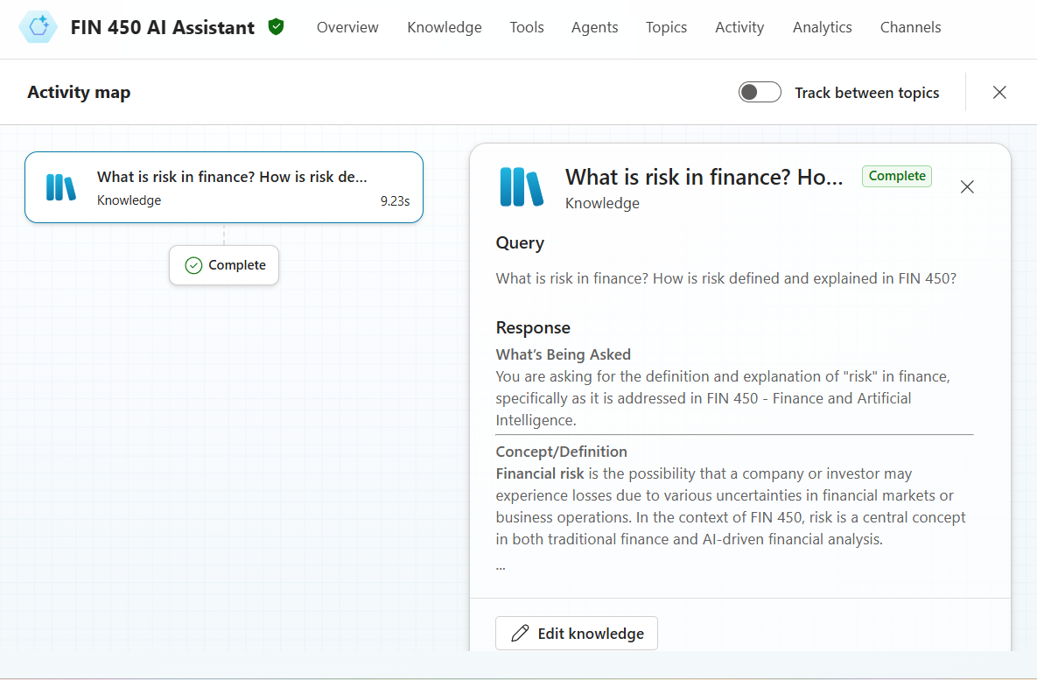
CPS: Activities
Tracing

Slide 12
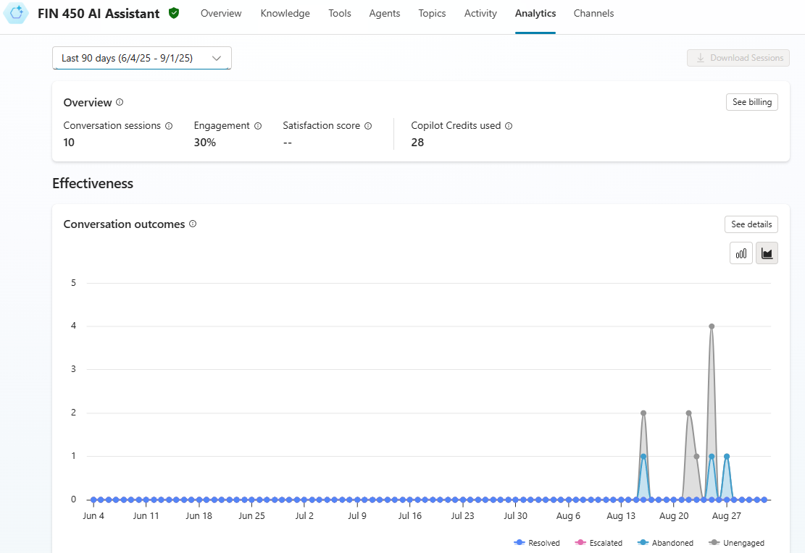
CPS: Analytics

Slide 13
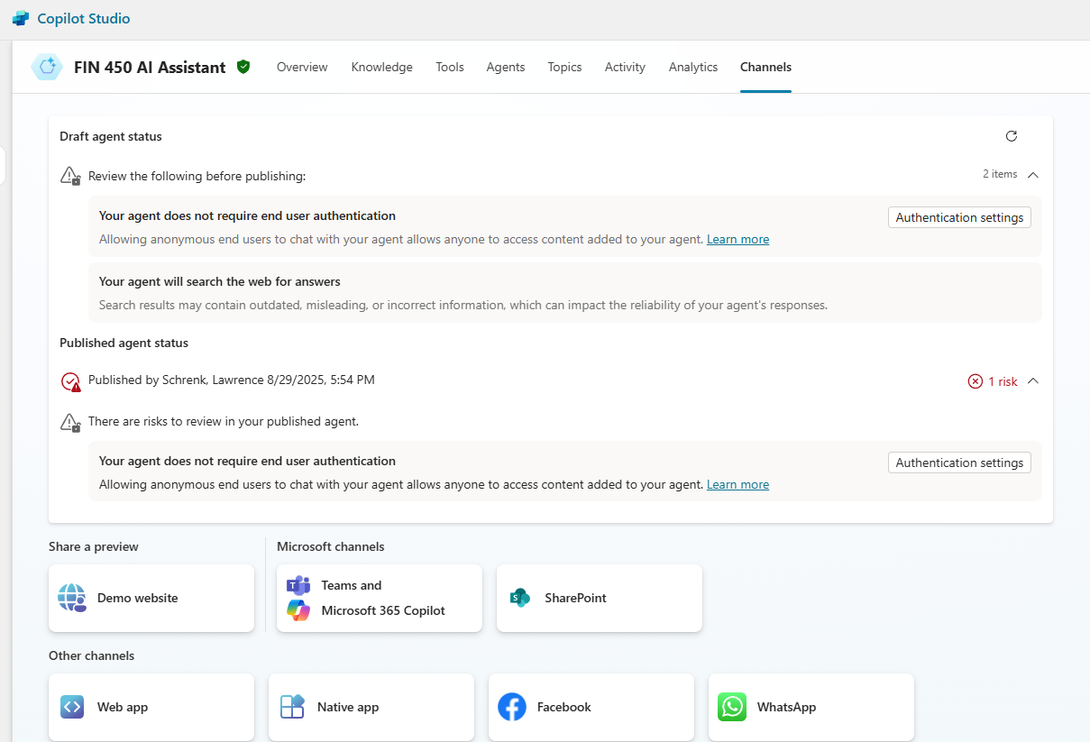
CPS: Channels

Slide 14
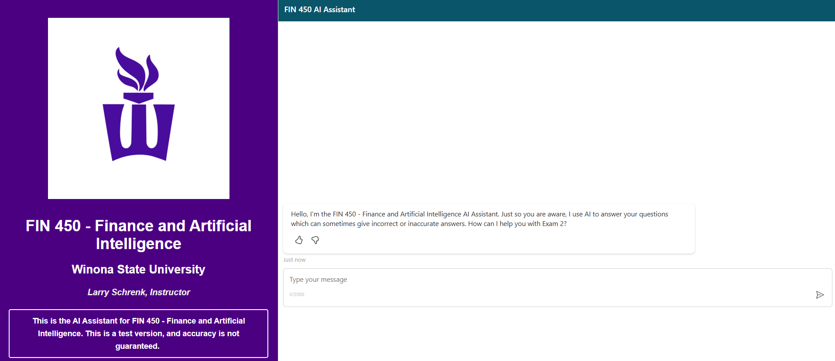
CPS: Website

Slide 15
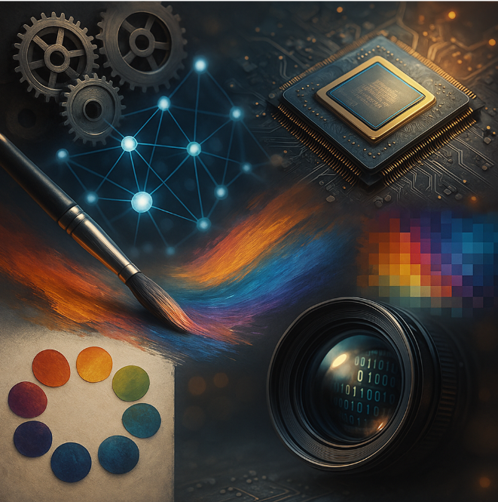
2. Image Generation
Methods

Slide 16
Image Generation Sections
Overview
Data Structures
AI Models
Prompting
Style Transfer
Nano Banana

Slide 17
A. Image Generation Overview
AI-driven artwork creation from text
Common techniques: GANs, diffusion, etc.
Prompt engineering for precise image manipulation
Importance of diverse training dataset
Open-source vs proprietary trade-offs
Integration with multimodal AI frameworks

Slide 18
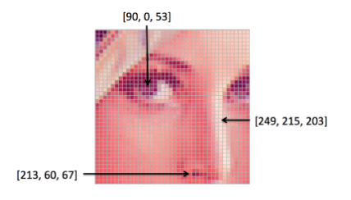
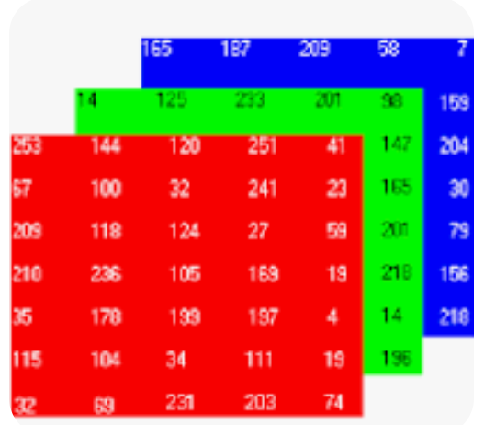
B. Image Data Structures
Pixel Arrays/Tensors
1920×1080×3
RGB pixel data (0, 255)
  White (255, 255, 255)
  Black (0,0,0)
  Winona Purple (75, 8, 161)
RGB Picker

Slide 19
C. AI Models
Variational Autoencoders (VAEs)
  Encoder → latent → decode
Generative Adversarial Networks (GANs)
  Two networks (Generator vs Discriminator) trained adversarially
Diffusion Models
  Noise-addition (forward) and denoising (reverse) processes

Slide 20
D. Prompting Suggestions
Add style tags such as watercolor or 3D
Specify composition angle, framing explicitly
Include lighting mood such as soft, harsh
Pick resolution like 512×512
Quantify elements, e.g., 3 objects, 2 colors
Test 5 variations per concept for best result
Use negative prompts to remove unwanted items
Upload image for style guidance
Expect 1–2 useful images per prompt

Slide 21
Prompting Example
ULTRA-DETAILED PROMPT:
Hyperrealistic 3D photoreal render of a university classroom lecture captured in cinematic detail. Composition & camera: 3/4 frontal-left angle, slight low-angle (camera pitched up ~8°) to convey authority — medium-wide shot showing professor from knees to top of head and classroom ceiling lights; students occupy foreground and midground with shallow foreground bokeh. Framing: professor placed on left third (rule of thirds), vanishing-point perspective toward back-right; leading lines from rows of desks guide eye to professor. Camera specs: full-frame equivalent, 35mm focal length, aperture f/2.2 for shallow depth of field, shutter 1/125s, ISO 200, subtle film grain. Resolution: 512×512, square crop.
Lighting mood & atmosphere: soft natural daylight key from large left-side windows (cool daylight, ~5600K) providing soft directional key light; warm tungsten overhead fill (~3200K) to add warmth to wood surfaces; subtle cinematic rim/backlight from right (warm, 10% intensity) to separate professor from background; gentle volumetric light beams through slight dust in air; soft shadows with mid-contrast; overall mood: focused, engaged, warm-academic, quietly energetic.
Scene quantification & layout (explicit counts & placement):
- 1 professor (male, mid-40s, light brown skin, short salt-and-pepper hair, trimmed beard, wearing navy blazer #1f3b6f, light blue button-down shirt, dark chinos). Pose: standing at lectern, right hand raised mid-gesture pointing to whiteboard, left hand holding a slim black marker; expressive face, mouth mid-sentence, eyes making eye-contact with students.
- 7 students visible (diverse ethnicities & genders): 3 in immediate foreground (blurred heads/shoulders), 4 in midground (clearly visible). Clothing: casual academic (cardigans, hoodies, button-downs). Two students taking notes on paper notebooks, three using laptops (open screens with soft glow), one student raising hand.
- 3 laptops (open, Apple-like silver, glow on faces), 4 spiral notebooks (scattered on desks), 2 reusable coffee cups (one stainless steel tumbler by professor, one ceramic cup near front student), 1 marker in professor's hand, 1 wooden lectern with small microphone, 1 wall-mounted projector screen (showing faint, out-of-focus slide), 1 whiteboard behind professor with faint handwritten equations/keywords (legible at close inspection), 2 large tall windows left wall, 3 industrial pendant lights on ceiling, 1 potted plant at back-right, 6 wooden desks in visible frame, 6 ergonomic chairs.
Color palette & textures:
- 2 dominant colors: deep navy (#1f3b6f) and warm walnut wood (#8b5a2b).
- Secondary palette: muted slate gray (#6b7280), cream/off-white for walls (#f3efe6).
- Textures: realistic human skin pores, fine fabric weave on blazer, subtle chalk/marker streaks on whiteboard, reflection on laptop screens, micro-scratches on lectern wood, dust motes in sunlight.
Micro-details & realism cues (explicit):
- Tiny chalk/marker smudges on professor's fingers; slightly worn leather on wristwatch; small crease lines in shirt sleeves; faint perspiration sheen on forehead consistent with warm stage lighting; visible stitch pattern on blazer lapel; individual hair strands catching rim light.
- Classroom signage: small laminated safety poster on right wall (blurry text, readable icon only); faint bluetooth microphone transmitter clipped to professor's belt.
- Screen content: projector shows a soft-blurred slide with a title line and 3 bullet points (no legible text required), light bloom but not overpowering.
- Ambient sounds implied: soft page rustling, low murmur (visualized as motion blur on a student's mouth).
Facial & expression details:
- Professor: engaged, mid-sentence with slight smile, eyebrows raised for emphasis; eyes sharp and directed to midground student who is asking a question.
- Students: attentive expressions; one smiling subtly, one furrowing brow in concentration, one looking down while writing.
Stylistic tags & finish:
- Style tags: photorealistic, hyperrealistic, cinematic, 3D-render, ultra-detailed, film-grain subtle, realistic DOF, ambient-occlusion, PBR materials.
- Mood keywords: focused, scholarly, warm, engaged, authentic.
Generation constraints & negatives:
- Resolution: 512x512. Aspect ratio: 1:1.
- Negative/anti-prompts: no watermark, no text overlays on faces, no extra limbs, no deformed anatomy, no cartoonish rendering, avoid over-saturation, avoid harsh specular highlights on skin, no obvious slicing/tiling artifacts, no low-poly look, no long fingers, no closed eyes.
- Output quality: high detail on professor and midground students; acceptable soft blur in foreground heads and background slide.
Optional sampling / tuning parameters (model-dependent):
- Sampler: Euler a or DPM++ (if available).
- Steps: 28–40.
- Guidance/CFG scale: 7.0–9.5.
- Seed: random (or set an integer for reproducibility).
- Additional passes: one light denoise pass to preserve skin texture.
SHORT SINGLE-LINE CONDENSED PROMPT (for models preferring short inputs):
Hyperrealistic 3D photoreal render, 3/4 frontal-left low-angle medium-wide shot (knees-to-ceiling) of a mid-40s male professor lecturing to 7 diverse students in a university classroom, soft daylight key from left + warm overhead fill + rim backlight, 1 professor, 7 students, 3 laptops, 4 notebooks, 2 windows, 1 whiteboard, 1 projector screen; deep navy (#1f3b6f) + walnut wood (#8b5a2b) palette, ultra-detailed skin/fabric textures, cinematic DOF (35mm, f/2.2), 512×512, photorealistic, no watermark, no text, no extra limbs.

Slide 22

Prompting Result
Nano Banana

Slide 23
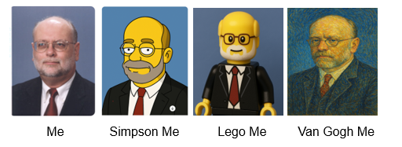
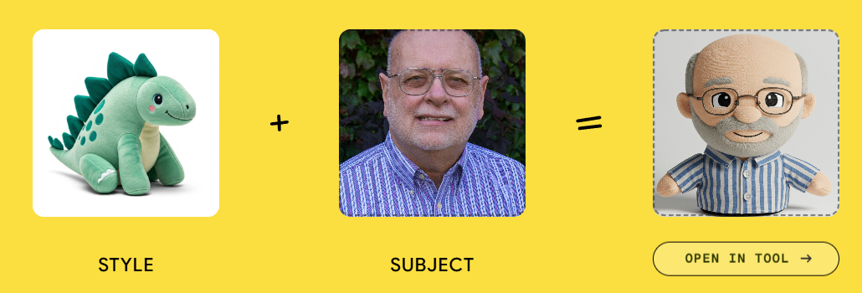
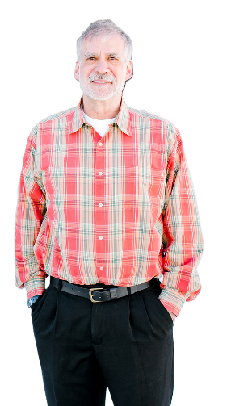
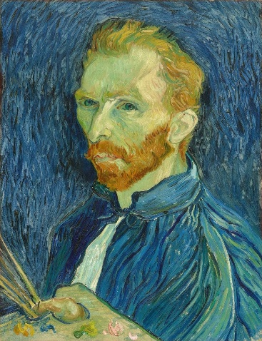
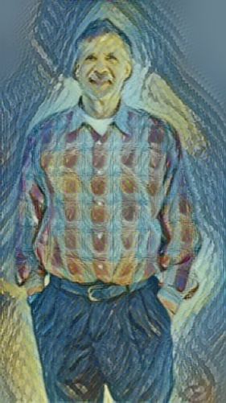
E. Style Transfer
Extract style features from art example
Extract content features from input
Combine features via simple loss function
Free Style Transfer
+ =

Slide 24
F. Nano Banana
Official name: Gemini 2.5 Flash Image Model
Developed by Google DeepMind
Launched August 2025 for public preview
Nicknamed "nano-banana"

Slide 25
Core Capabilities Overview
Creates images from text descriptions instantly
Edits existing photos using natural language
Blends multiple images into single composition
Maintains character consistency across different edits
Processes commands in under 2 seconds
Google AI Studio Demo

Slide 26
How Nano Banana Works
Uses transformer architecture with attention
Trained on millions of image-text pairs
Integrates Gemini's world knowledge
Processes prompts through neural network layers

Slide 27

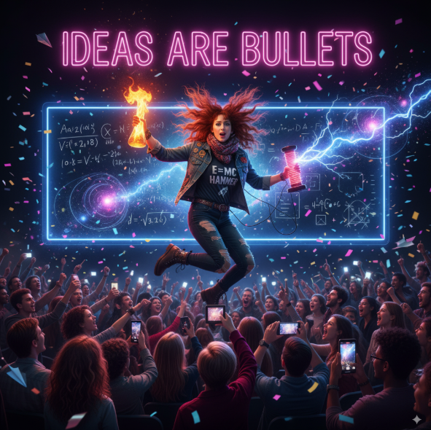
Temperature
Wild picture of a college professor lecturing
T = 0 T = 1

Slide 28
Character Consistency Technology
Preserves facial features across multiple generations
Maintains identity while changing environments completely
Uses advanced embedding techniques for likeness
Achieves 94% consistency rate in testing
Handles pets and objects alongside humans

Slide 29
Editing Features and Controls
Background replacement with single text command
Style transfer between different image elements
Object removal and addition seamlessly integrated
Multi-turn editing remembers previous commands automatically
Costume and location changes preserve identity

Slide 30
Real-World Use Cases
E-commerce platforms reduce photography costs 34%
Content teams create campaigns in hours
Game studios generate thousands of characters
Social media influencers enhance posts instantly

Slide 31
AI Safety Measures
SynthID invisible watermarking embedded in outputs
Visible watermarks indicate AI-generated content clearly
Follows Google's AI Principles for responsibility
Prevents creation of harmful or misleading content

Slide 32
Limitations and Challenges
Image quality degrades after multiple edits
Occasional misinterpretation of vague prompts occurs
Text rendering in images needs improvement
Factual representation requires ongoing development work

Slide 33
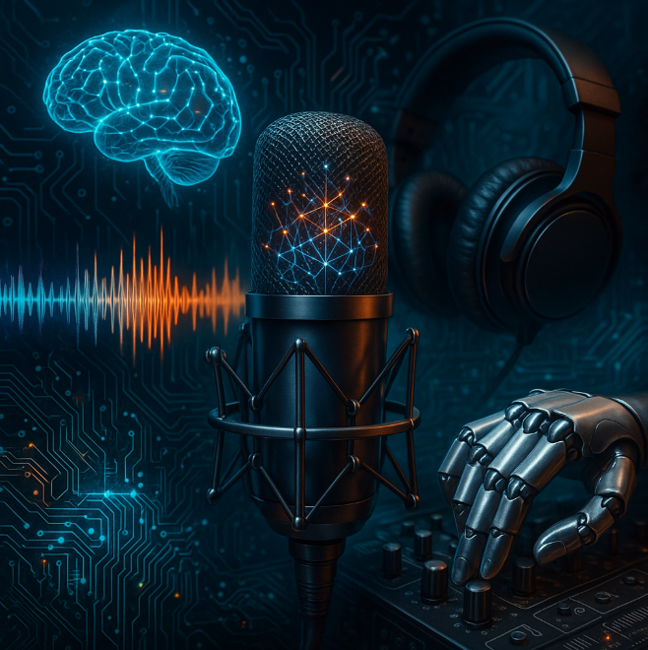
3. Audio Generation
Methods

Slide 34
Audio Generation
Overview
Data Structures
AI Models
Prompting
Style Transfer

Slide 35
A. Audio Generation Overview
Text-to-speech (TTS) models use WaveNet architecture
Generative adversarial networks (GANs) improve audio realism
CNNs extract spectral audio features efficiently
VAEs enable compact latent audio representation

Slide 36
Motives for Audio Generation
Composition of original music
Automating voice-over creation
Generating realistic text-to-speech
Interactive voice assistants and chatbots
Cloning celebrity or brand voices
Localizing audio content into multiple languages
Designing novel sound effects and textures for film
Assisting language learners with pronunciation models
Creating dynamic audio in VR/AR and immersive experiences
Augmenting datasets for training robust speech-recognition AI
Restoring or enhancing historical recordings and archives

Slide 37
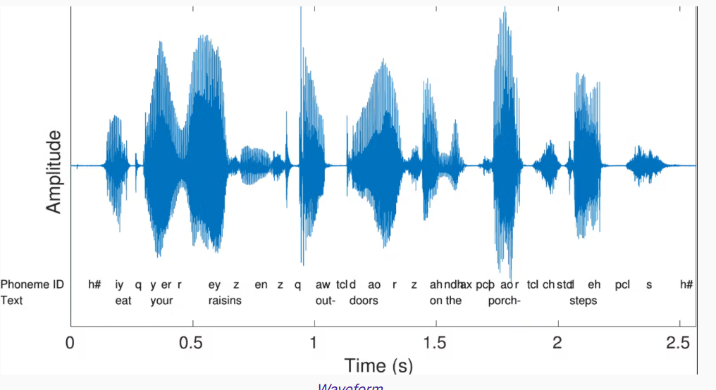
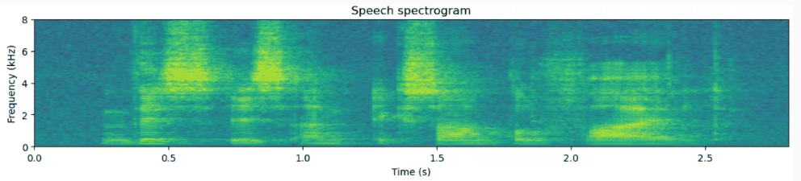
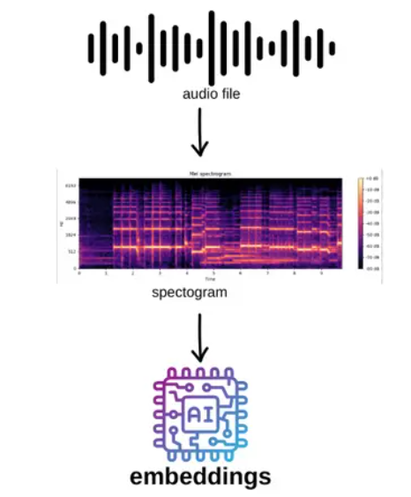
B. Audio Data Structures
Raw Audio Waveform: Audio as amplitude values over time
Spectrogram-Base: Audio split into short time frames
Audio Embedding: Neural nets map audio to vectors

Slide 38
C. AI Models
Autoregressive Waveform Models
  Generate one audio sample at a time conditioned on previous samples
Flow-based (Invertible) Models
  Learn exact likelihoods via invertible transformations
Transformer-based Sequence Models
  Self-attention captures long-range structure in learned audio tokens or spectrogram frames

Slide 39
D. Prompting Suggestions
Music
  Specify genre and desired mood
  Define instrumentation and arrangement style
  Set tempo in BPM and time signature
  Indicate key signature or tonal center
  Describe emotional tone and dynamic contour
  Mention particular instruments or sound sources
  Request melody motifs or harmonic progressionOutline song structure or arrangement sections
  Include vocal style and lyrical themes

Slide 40
Prompt Example
Genre / Mood: Dream-pop / wistful & luminous.
Instrumentation & Arrangement: airy Juno-style synth pad + warm Fender Rhodes, clean electric guitar arpeggio with chorus, upright bass (fingered), brushed acoustic kit, soft electronic percussion (shaker, low sub kick), ambient field-recording washes. Arrangement style: sparse verses → prechorus adds Rhodes pad → chorus full band with doubled lead vocal and synth lead countermelody.
Tempo / Time signature: 78 BPM, 4/4.
Key / Tonal center: C Major (tonal center C, allow modal color—mixolydian touches).
Emotional tone & dynamic contour: intimate, reflective verses (piano/voice low dynamic), gradual lift in prechorus, chorus opens into warm, spacious swell (moderate loudness increase), bridge provides a quiet, breathy breakdown then builds to a final, cathartic chorus.
Specific instruments / sound sources: Juno-106 style pad (long release), Fender Rhodes warm electric piano, clean Strat-style guitar with chorus & reverb, upright or electric bass with gentle compression, brushed drums (room mic bright), analog synth lead (slightly detuned), soft tape-saturation on the master. Include subtle seaside field recording underlay in intro/outro.
Melody motifs / harmonic progression: primary vocal motif: descending three-note idea (G → E → D) repeated with small ornamentation. Harmonic progression for chorus: I – V – vi – IV (C – G – Am – F). Verse uses IV – I – Vsus4 → V to create gentle tension. Request a short 4-bar synth countermelody that mirrors the vocal motif up a 3rd.
Song structure / arrangement sections: Intro (8 bars: pad + field wash), Verse 1 (16 bars: vocals + Rhodes + bass), Prechorus (8 bars: add shaker + subtle synth), Chorus (16 bars: full band + doubled vocal), Verse 2 (16 bars), Chorus (16), Bridge (8 bars: sparse, vocal breathy, build), Final Chorus (24 bars: extended with synth solo over last 8), Outro (8 bars: pad + field fade).
Vocal style & lyrical themes: warm, breathy female lead with close-mic intimacy; light doubles on choruses and 3-part background “oooh” pads. Lyrical theme: nostalgia and gentle reconciliation — concrete images (salt air, cracked pavement, late summer streetlight) with a hopeful last line. Keep lyrics concise and poetic, avoid clichés.
Deliverables & constraints: stereo 44.1kHz/24-bit, full mix + separated stems (vocals, drums, bass, keys, guitars, synths, ambients), tempo map and key labeled, provide 3 variations: (A) full produced, (B) acoustic demo (voice + Rhodes), (C) instrumental ambient mix. Provide a seed for reproducibility and a short 2-sentence explanation of creative choices. Keep final length ≈ 3:30.

Slide 41

Prompt Example
MusicGen Web (link)

Slide 42
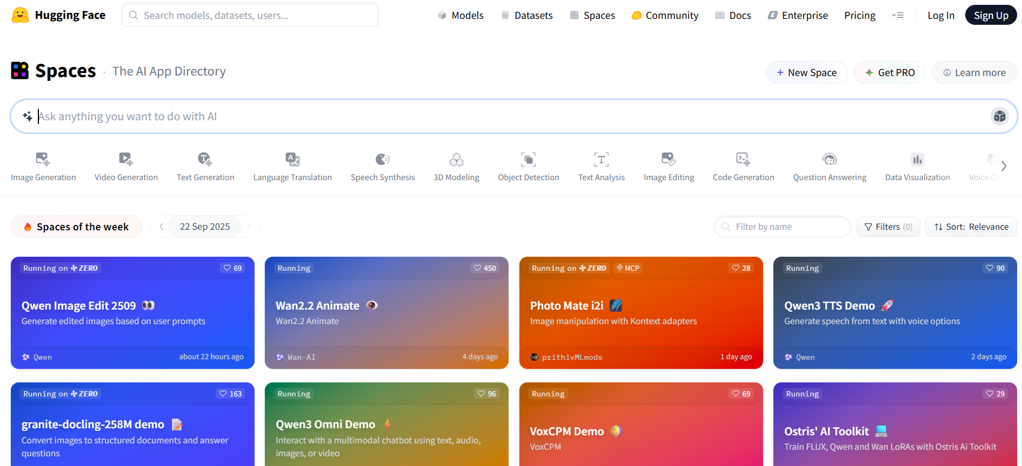
HuggingFace Places (link)

Slide 43

4. Ethics & Legal
Considerations

Slide 44
Ethical & Legal Considerations
Copyright grants creators exclusive ownership; infringement fines up to $150 000
Fair Use permits transformative use based on a four-factor analysis
GDPR requires explicit consent for data processing; biometric data breaches carry heavy fines
Creative Commons licenses clarify model usage rights, attribution, and reduce litigation risk
Deepfake detection protocols combat bias, defamation, and privacy violations

Slide 45
The MIS 112 Blues (Suno)
[Verse]
I walked into that classroom
Heart full of dread
MIS 112
It's messin' with my head
Generative AI
What's it all mean
Feels like I'm stuck in a techie dream
[Chorus]
Oh I got the MIS 112 blues
Don't know what to click or choose
The prompts are long
The answers are short
This AI thing's got me outta sorts
[Verse 2]
The teacher's talkin'
But it sounds like code
Neural nets and tokens
My brain's gonna explode
WSU walls echo with my groans
I'm just a student
Leave my mind alone
[Prechorus]
Why can't it write my essay right
Why can't it solve my pain tonight
[Chorus]
Oh I got the MIS 112 blues
I'm so lost I can't refuse
The screen's so bright
My future's dim
Drowning in this generative swim
[Bridge]
The syllabus laughed
Said "Welcome to the grind"
Every click I make
I leave hope behind
They said AI would help
It would make life sweet
But it’s my soul
Not my homework
It’s tryin’ to eat

Slide 46
5. Hands-On Friday: AI Images & Audio

Slide 47
Friday Lab Prep
Make sure you can access:
  MIS 112 Lab Report 5
Websites:
  Qwen Image Fast
  AI Jukebox
  Google AI Studio (Nano Banana)

