Slide 1
Creative AI
MIS112-Week 10

Slide 2
What is Creativity?
Creativity means producing something new and valuable.
Humans use imagination, experience, and context.
AI uses data patterns, probabilities, and algorithms.

Slide 3
Human vs AI Creativity
Humans bring emotions, culture, and originality.
AI re-combines patterns it has learned from data.
Key difference: humans invent; AI imitates and extends.
Notes:
Note that AI can bring in ‘patterns’ learned from other totally different subjects or topics

Slide 4
Why Study Creativity in AI?
Creative industries are being transformed by AI.
Businesses use it for speed, cost savings, and scale.
Students entering the workforce must understand and know the basics of using these tools.

Slide 5
What is Generative AI?
Generative AI creates new content such as text, images, music, or video.
It is trained on huge datasets of examples.
It predicts what 'comes next' in text, pixels, or sound waves.
Notes:
How much ‘creation’ do you need to obtain a copyright or other IP protection? We will be finding out….

Slide 6
Generative AI Process
Step 1: Input prompt from a user.
Step 2: AI model interprets prompt using patterns.
Step 3: AI produces an output (text, image, sound).
Notes:
Also RAG, show it a specific body of knowledge or use cases

Slide 7
Traditional Programming vs Generative AI
Traditional programming: Humans write rules explicitly.
Generative AI: System learns rules from data.
AI can surprise us with creative outputs.
Notes:
If AI has to learn the ‘rules’ how do you ensure that you agree with the rules it is using?

Slide 8
Applications in Business Creativity
Marketing: slogans, logos, ad campaigns.
Design: product concepts, packaging ideas.
Entertainment: music, film, animation.

Slide 9
Interactive: Generate a Slogan
Ask ChatGPT to write 3 slogans for a new coffee shop.
Compare: Which feels most creative?
Discuss: What role should humans play in editing?
Notes:
Human Role-? What should it be? Should there be one? If not, why do we need you???? Editing of both input (prompt) and output (response)

Slide 10
Creative AI in Visual Arts
AI creates posters, logos, and artwork.
Tools: Canva AI, Adobe Firefly, Runway ML.
Companies use AI to test quick design variations.

Slide 11
Example: Canva AI
Small businesses use Canva AI to create social media posts.
Non-designers can produce professional-looking graphics.
This saves time and reduces reliance on expensive agencies.
Notes:
Make sure you can log into: https://www.canva.com/ai/

Slide 12
Interactive: Spot the AI Art
Show two pictures: one AI-generated, one human-made.
Students vote: which is which?
Discussion: Why does this distinction matter to consumers?

Slide 13
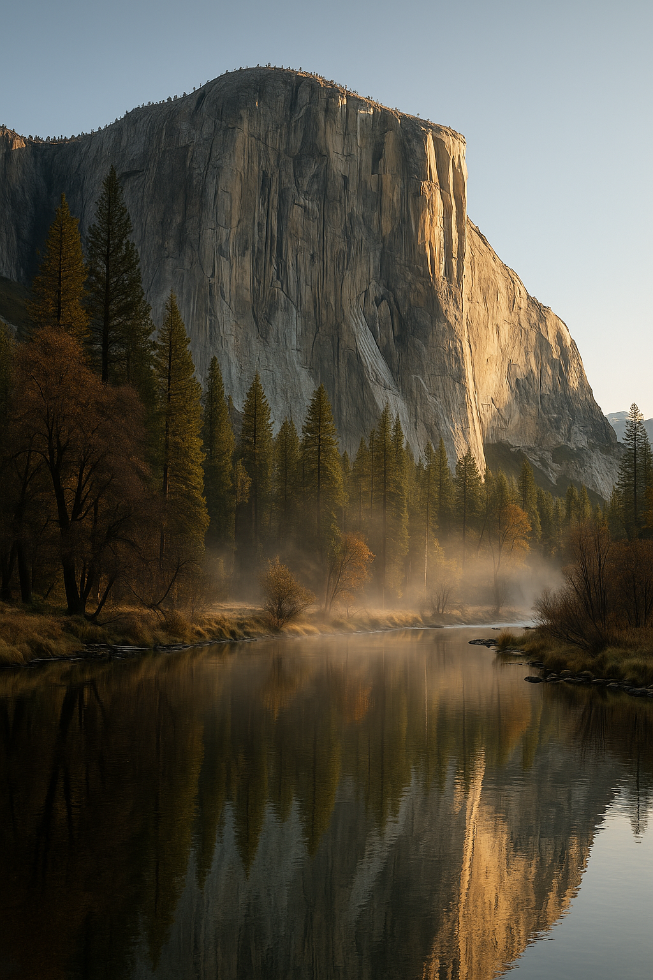
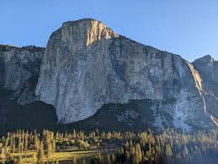
Which is Real?
Notes:
Left is photo, right is AI generated.
Prompt: Ultra-realistic landscape photograph of El Capitan in Yosemite National Park, early morning golden light, mist rising from the Merced River, captured with a 50 mm lens, high dynamic range, 8K detail, natural colors, no people

Slide 14
Creative AI in Writing
AI writes blog posts, product descriptions, and emails.
Tools: Jasper AI, ChatGPT.
Businesses use this for personalized marketing at scale.

Slide 15
Example: Jasper AI
Jasper AI generates blog posts and social media ads.
Marketers use it to brainstorm and save time.
Humans still need to check for tone and accuracy.
Notes:
https://www.jasper.ai/

Slide 16
Interactive: Generate a Slogan
Prompt ChatGPT: 'Write three slogans for a coffee shop.'
Compare results: Which sounds most appealing?
Discussion: What should humans edit or add?

Slide 17
Creative AI in Music
AI composes background music and jingles.
Tool: AIVA composes classical or modern styles.
Businesses use AI music for ads and YouTube videos.

Slide 18
How AI Learns Music
AI is trained on thousands of songs.
It learns patterns: melody, rhythm, harmony.
It creates new pieces by combining these patterns.

Slide 19
Pros and Cons for Musicians
Pro: Easier to create soundtracks quickly
Pro: Reduces cost of licensing music
Con: Risks replacing some musician jobs
Con: Ethical issues about originality
Notes:
Is any music nowadays original? Copyright infringement suits….My Sweet Lord vs He’s So Fine

Slide 20
My Sweet Lord
Summary Table
Aspect | “He’s So Fine” | “My Sweet Lord” | Court Finding
Year Released | 1963 | 1970 | 1976 ruling
Writer | Ronald Mack | George Harrison | —
Similarity | Melody and phrasing | Nearly identical melodic structure | “Subconscious plagiarism”
Outcome | Harrison liable | Damages awarded to Bright Tunes | ~$587,000 final settlement

Slide 21
Creative AI in Video
AI generates training videos and product ads.
Tools: Synthesia (avatars), Runway ML (editing).
This makes video production faster and cheaper.
Notes:
Ended here on Monday 10/27

Slide 22
Example: Synthesia
Businesses generate training videos with talking avatars.
Text input → AI avatar speaks script in chosen language.
Cost is far lower than hiring actors and filming.
Notes:
AI/FX Stunts will probably get wilder when there is no risk of bodily harm!

Slide 23
Interactive: Guess the Video Source
Create two short clips: one human-acted, one AI-generated.
Students guess which is AI.
Discussion: Will viewers care if it’s AI-generated?

Slide 24
Risks in Creative AI
Bias: AI reflects patterns from training data.
Plagiarism: AI may copy too closely from sources.
Copyright: unclear legal protections for AI works.
Misinformation: deepfakes and fake news content.

Slide 25
Ethical Questions
Should AI-created art be labeled?
Who owns AI-generated content?
Is it ethical to replace human creators with AI?

Slide 26
Future Outlook of Creative AI
AI tools will get more realistic and easier to use.
Creative workers will need to learn to collaborate with AI.
Demand will grow for people who can guide AI effectively.

Slide 27
Wrap-Up
Creative AI touches art, writing, music, and video.
It matters to organizations for speed, cost, and innovation.
Students must understand both its power and risks.

Slide 28
Reflection Activity
Question: What surprised you most about Creative AI?
Write down one opportunity and one concern you see.
Share answers with a partner.

Slide 29
Notes:
Finished here 10/29/25 on Wednesday

Slide 30
Wednesday
Creative AI

Slide 31
Case Study: Coca-Cola Advertising
Coca-Cola launched a global campaign using AI to create digital ads.
AI generated visual art and personalized content for different audiences.
Benefit: Faster production and lower costs.
Challenge: Making sure AI designs still matched Coca-Cola’s brand identity.

Slide 32
Advertising Before AI
Large creative teams required weeks to produce ads.
Multiple rounds of drafts, approvals, and revisions.
Costs for photography, video shoots, and design were high.

Slide 33
Advertising After AI
AI creates quick design drafts in hours instead of weeks.
Allows testing of multiple ad variations with audiences.
Frees human designers to focus on strategy and big ideas.

Slide 34
Discussion: AI in Ads
Question: Does AI make ads more creative or less original?
Question: Would you trust an AI-created ad more or less than a human-created one?

Slide 35
Guided Practice 1: Create a Slogan
Activity: Groups use ChatGPT to create a slogan for a sports brand.
Try 3 different prompts to compare results.
Vote as a class on the best slogan.
Reflect: What made one slogan stronger than another?

Slide 36
Case Study: Nike and AI in Design
Nike uses AI to design sneaker concepts.
AI produces hundreds of variations for colors, materials, and patterns.
Designers then refine the most promising ideas.
Impact: Speeds up design cycles and inspires innovation.

Slide 37
Benefits for Product Design
AI can explore far more design possibilities than a human team.
Designers get inspiration without starting from scratch.
Reduces wasted time on unworkable ideas.

Slide 38
Challenges in Product Design
Risk: AI designs may not be practical for manufacturing.
Risk: Too much reliance on AI could reduce human originality.
Ethical concern: Who owns the design — the AI or the human designer?

Slide 39
Guided Practice 2: Brainstorm Products
Activity: Groups brainstorm 3 new product ideas using ChatGPT.
Discuss: Which idea would be easiest to market?
Which idea would be hardest to make real?
Class shares and compares results.

Slide 40
Case Study: Netflix Entertainment
Netflix uses AI for recommendations and creative development.
AI analyzes viewing habits to suggest new show concepts.
Example: AI spotted rising interest in true crime and reality shows.
Helps Netflix decide what to produce next.

Slide 41
Entertainment Benefits
AI helps companies predict what audiences want.
Cuts down risk of producing unpopular content.
Personalizes user experience for each subscriber.

Slide 42
Entertainment Risks
Over-reliance on AI could reduce originality.
Viewers may get trapped in narrow recommendations.
Writers and producers may feel pressure to follow AI trends.

Slide 43
Discussion: AI in Entertainment
Question: Would you watch a movie written by AI?
Question: Does AI-driven content reduce cultural diversity?
Notes:
Will there be a search through ‘history’ to find and publicize untold stories? How do you develop ‘new’ content with AI?

Slide 44
Occupations Affected by Creative AI
Graphic Designers: AI generates first drafts of logos and posters.
Copywriters: AI drafts ad copy and blog posts.
Musicians: AI creates background music and soundtracks.
Video Editors: AI automates simple editing tasks.

Slide 45
New Skills Needed
Workers must learn how to guide AI tools with effective prompts.
Editing and improving AI output is now a key job skill.
Humans focus more on strategy, creativity, and ethics.

Slide 46
Case: Graphic Designers
AI handles repetitive design tasks like resizing images.
Designers spend more time on branding and storytelling.
Future designers need both artistic and technical AI skills.

Slide 47
Case: Copywriters
AI drafts social media posts, ads, and emails.
Copywriters edit for tone, emotion, and brand voice.
Future: More emphasis on critical thinking and creativity.

Slide 48
Case: Musicians
AI generates background tracks for ads, games, and videos.
Musicians adapt by focusing on live performance and original expression.
Future: Humans and AI co-create music together.

Slide 49
Case: Video Producers
AI automates editing, subtitles, and visual effects.
Producers oversee storytelling and creative direction.
Future: Humans manage projects, while AI does technical work.
Notes:
In all these cases, humans need to understand the technical basics now being done by AI, and learn new skills to guide and use AI!

Slide 50
Future Trends in Creative AI
AI will become faster and more user-friendly.
More industries will adopt AI for creativity and innovation.
Jobs will shift toward managing and guiding AI tools.

Slide 51
Stop and Consider
AI is a partner, not a full replacement.
Businesses use it for speed and cost savings.
Students should prepare for blended human-AI roles

Slide 52
Wrap-Up: Case Studies
Advertising: Coca-Cola shows AI makes campaigns faster.
Design: Nike shows AI can inspire new product concepts.
Entertainment: Netflix shows AI helps predict audience trends.
Occupations: Creative jobs are changing, not disappearing.

Slide 53
Reflection Activity
Question: Which industry will change the most because of AI?
Write one skill you think will be most important for your career.
Share with a partner or small group.

Slide 55
Friday
Creative AI

Slide 56
Lab Introduction
Goal: Use AI tools to create a mini marketing campaign.
Work in groups of three: Navigator, Builder, Scribe.
Deliverable: one slide or document with slogan, ad text, and image.
Optional-music clip

Slide 57
Step 1: Form Groups
Form groups of three students.
Navigator: Guides the group and suggests directions.
Builder: Operates the AI tools and shares screen.
Scribe: Records outputs, reflections, and prepares the final file.

Slide 58
Step 2: Choose a Scenario
Examples of possible businesses:
- A new coffee shop
- A fitness center
- A clothing brand
- A restaurant or bakery
Groups may also create their own scenario.

Slide 59
Scenario Brainstorm
Discuss in your group:
Who is your target audience?
What product or service are you promoting?
What is the brand personality (fun, serious, luxury, etc.)?

Slide 60
Step 3: Generate a Slogan
Use ChatGPT to generate 3–5 possible slogans.
Try different prompts to explore variations.
Navigator guides, Builder prompts, Scribe records outputs.

Slide 61
Slogan Review
As a group, select your favorite slogan.
Edit it if needed to fit your brand personality.
Be ready to explain why you chose it.

Slide 62
Step 4: Create Ad Copy
Use ChatGPT to create a short ad (2–3 sentences).
Ad copy should match the slogan and business type.
Test different prompts to see which tone works best.

Slide 63
Ad Copy Review
Evaluate clarity, persuasiveness, and creativity.
Would this ad appeal to your target audience?
Make small edits if necessary.

Slide 64
Step 5: Generate Visuals
Use Canva AI or Adobe Firefly to create an ad image.
Examples: Logo, poster, social media post.
Builder shares screen while generating designs.

Slide 65
Visual Selection
Choose the most effective image for your ad.
Consider color, style, and clarity of message.
Navigator ensures it matches the brand personality.

Slide 66
Step 6: Optional Music
Use AIVA (AI music generator) to create a short soundtrack.
Choose a mood that matches your product: fun, serious, exciting.
Discuss: How does music affect the ad’s message?

Slide 67
Step 7: Assemble Campaign
Combine slogan, ad copy, and chosen image.
Optionally add soundtrack link or description.
Scribe prepares final slide or document.

Slide 68
Step 8: Prepare to Present
Each group has 2–3 minutes to present.
Explain scenario, slogan, ad copy, and visuals.
Reflect on group process and challenges.

Slide 69
Step 9: Group Presentations
Groups share their campaigns with the class.
Audience notes strengths and suggestions.
Class discussion: What strategies worked best?

Slide 70
Reflection Questions
What was the easiest part of working with AI?
What was the hardest part?
What would you do differently next time?

Slide 71
Risks and Limits
AI can produce biased or repetitive content.
Some outputs may lack originality or accuracy.
Human judgment is always required.

Slide 72
Future Outlook
AI tools will continue to improve in design, text, and video.
Businesses will rely on humans who can guide AI effectively.
Learning prompt skills today will prepare you for tomorrow’s careers.

Slide 73
Lab Wrap-Up
You experienced how to use AI in a real creative task.
You learned how to work in teams with clear roles.
Your final deliverable shows creativity and AI collaboration.

Slide 74
Assignment Reminder
Submit your group’s slide or document to the course site.
Include slogan, ad copy, image, and reflection paragraph.

