Slide 1
Chapter 9
Real Estate Finance: The Laws and Contracts

Slide 2
Some Effects of Mortgage Debt
Households can be homeowners
Businesses have more cash for core activities
Investors can lever and diversify
Home equity credit lines can replace high-cost consumer debt:
  Can be tax favored
  Longer term
  Lower interest rate
Notes:
The Note

Slide 3
This Chapter
What is inside a mortgage?
What happens to a mortgage in trouble?
How can a seller finance a buyer?
What laws control home mortgage lending?
Notes:
The Note

Slide 4
Two Elements of a Mortgage Loan
Note: The exact terms of the financial obligation
Mortgage (deed of trust): Pledges the property as security for the note
Notes:
The Note

Slide 5
The Note – Interest Rates
Fixed rate
  Home loans: monthly charge is 1/12 of annual rate
  Many income property loans: 360-actual interest
    Daily rate is 1/360 of annual rate
    Multiplied by the actual number of days in the month
Adjustable rate
  Index rate: Market-determined rate beyond control of either borrower or lender
    U.S. Treasury Constant Maturity Rate
    SOFR (Secured Overnight Financing Rate)
    WSJ commercial bank prime rate (home equity credit lines)
Notes:
The Note

Slide 6
The Note – Interest Rates (continued)
Adjustable rate (continued)
  Margin: Lender’s markup
    200 to 300 basis points (bp)
    Average is extremely stable at 277 - 278 bp
  Change Date: Date that interest rate changes each time period
    New index rate commonly is the last published rate 45 days, for example, before the change date
  Teaser rate: Initial, temporarily reduced interest rate
Notes:
The Note

Slide 7
The Note – Interest Rates (continued)
Adjustable rate (continued)
  Interest rate caps: Limit on changes in rate charged
    Periodic
    Lifetime
    Important question: Does cap apply to the teaser rate?
  Payment caps: Limit on payment changes rather than interest rate changes
    Can lead to negative amortization: Unpaid interest added to the balance

Slide 8
Payments
Always in arrears (end of month)
Virtually always monthly
Various arrangements for fixed-rate loan:
  Level payment
  Partially amortized (requires two terms)
    Term for amortization
    Term to maturity
    Balloon payment
  Interest only non-amortizing; known as a “bullet” loan
  Negative amortization
Notes:
The Note

Slide 9
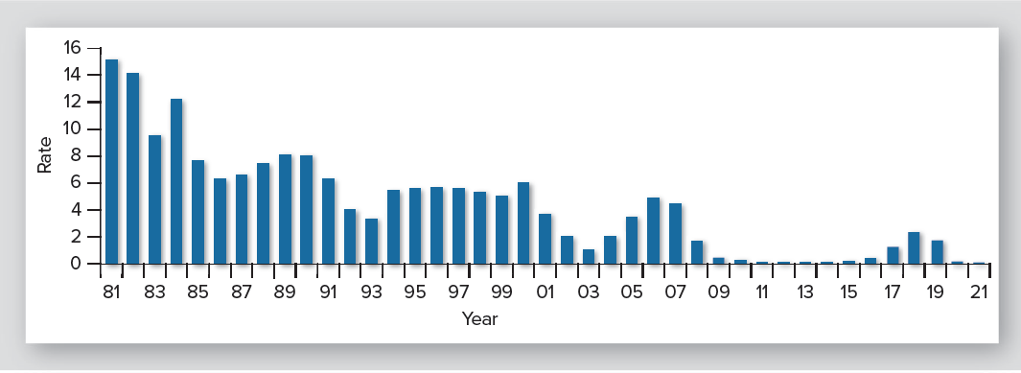
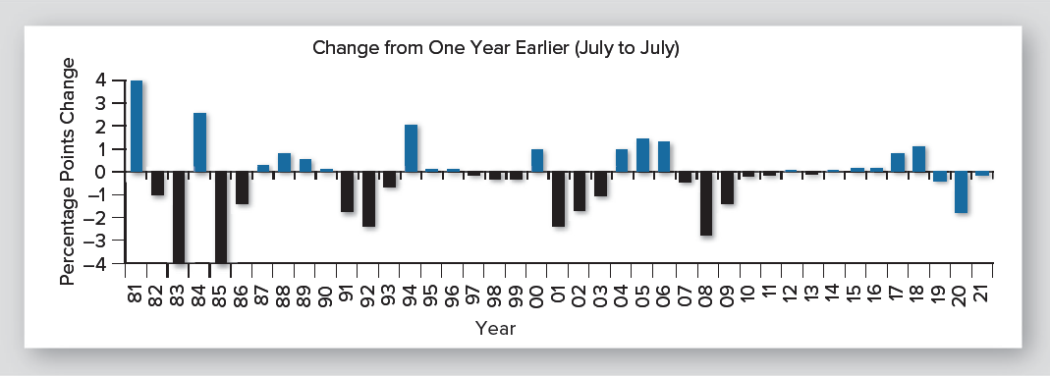
The Most Common ARM Index Rate: One-Year CTM
Notes:
The Note

Slide 10
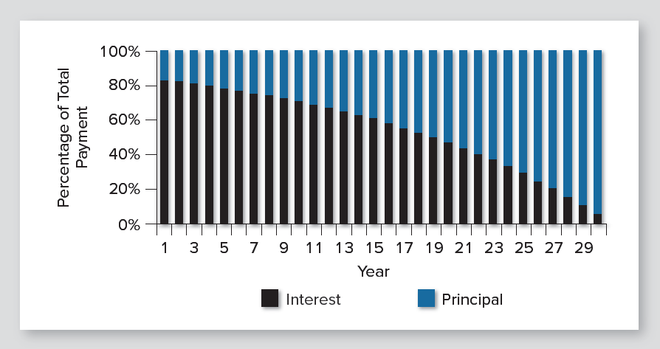
Interest and Principal Payments on a Level Payment Loan
Notes:
The Note

Slide 11
The Note: Right of Prepayment
Traditional common law:
Cannot prepay unless explicitly allowed
Modern statutory case:
Can prepay unless explicitly prohibited
Loans with right to prepay:
  All “conforming” and FHA/VA loans
  Home equity credit lines

Slide 12
The Note: Right of Prepayment
(continued)
Loans with restricted right of prepayment:
  Subprime home loans
  “Jumbo” home loans
  Most income property mortgage loans
Prepayment penalties
  Percentage of outstanding balance
  Yield maintenance
  Defeasance
Notes:
The Note

Slide 13
The Note: Other Terms
Nonrecourse loan: No personal liability
  Exculpatory clause
Demand clause: Right of lender to require immediate prepayment
Inclusion of mortgage clauses by reference
Notes:
The Note

Slide 14
Mortgage (Deed of Trust)
Mortgagor: Borrower
Mortgagee: Lender
Title vs. lien theory
  Title theory: Mortgage is a temporary transfer of title
  Lien theory: Mortgage is a lien
  Historic difference was lender’s claim to rents and possession in case of default
Notes:
The Mortgage or Deed of Trust

Slide 15
Some Important Mortgage (Deed Of Trust) Clauses
Description of the property
Insurance clause
Escrow clause
Acceleration clause
Due-on-sale clause
Hazardous substances clause
Preservation and maintenance clause

Slide 16
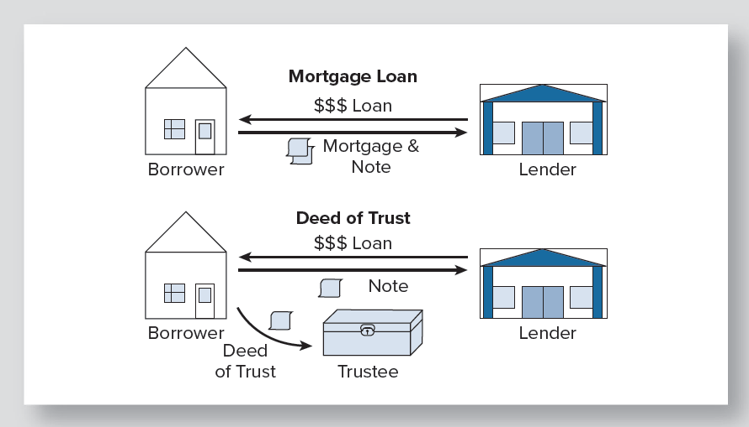
Mortgage versus Deed of Trust
Notes:
The Mortgage or Deed of Trust

Slide 17
When Things Go Wrong
Default: Failure to meet requirements of the note or mortgage
  Technical default: Any violation of terms
  Substantive default: (typically) three missed payments (90 days)
Notes:
When Things Go Wrong

Slide 18
Non-Foreclosure Responses to Default
Counseling and debt reorganization
Temporary reduction of payments
Assisted sale
Short sale
Deed in lieu of foreclosure
  Advantages: quick, quiet, cheap
  Disadvantages:
    Other liens remain
    Bankruptcy can nullify and wipe out mortgage
Notes:
When Things Go Wrong

Slide 19
Foreclosure
Foreclosure: Legal process of terminating all claims of ownership and all inferior liens
Negatives
  Risk of failing to notify a claimant
  Presence of superior liens
  Costly and time consuming
  Distressed sale
Importance of lien priority
Recourses of the defaulted mortgagor
  Equity of redemption
  Statutory right of redemption
Notes:
When Things Go Wrong

Slide 20
Importance of Loan Priority
Superior lien preempts any junior liens
Example:
  Balance on defaulted first mtg. loan $100,000
  Balance on second mtg. loan: $20,000
  Net foreclosure sale proceeds: $100,000
  Second mortgagee receives nothing
Notes:
When Things Go Wrong

Slide 21
More Foreclosure (continued)
Deficiency judgment: Judgment against mortgagor for unrecovered balance
  Example:
    Net foreclosure auction proceeds: $100,000
    Remaining loan balance: $120,000
    Deficiency : $20,000
Judicial foreclosure vs. power of sale
  Judicial foreclosure: Court-administered public auction
  Power of sale: Public auction by trustee or mortgagee
    Preferred by lenders
Notes:
When Things Go Wrong

Slide 22
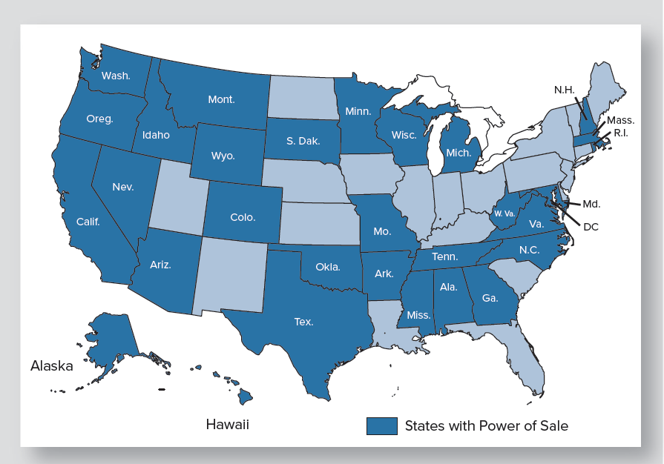
Power of Sale States
Notes:
When Things Go Wrong

Slide 23
Bankruptcy
May prevent lender from foreclosing
Three forms of bankruptcy
  Chapter 7: Liquidation
  Chapter 11: Court supervised “workout”
  Chapter 13: Wage-earner’s proceeding
No bankruptcy can set aside a mortgage lien
Chapters 11 and 13 can result in delays
Service members Civil Relief Act (2003) will intervene for active service persons (Note: this is not discussed in the text, but the instructor may want to include it, depending on the class)
Notes:
When Things Go Wrong

Slide 24
Acquiring Property with Existing Debt
“Subject to”: Buyer does not sign mortgage note
  No personal liability for mortgage loan
  Property still is subject to the mortgage
Assumption: Buyer adds signature to note
  Personal liability for loan
  Property subject to mortgage
Notes:
Acquiring a Property with an Existing Debt

Slide 25
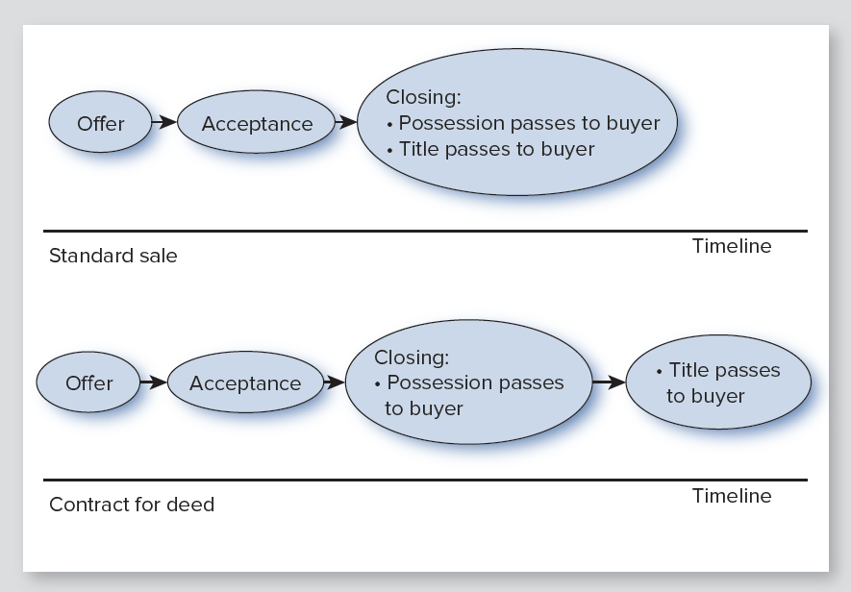
Debt without a Mortgage
Notes:
Real Estate Debt without a Mortgage

Slide 26
Laws Regulating Home Mortgage Lending
Equal Credit Opportunity Act
Federal Truth-in-Lending Act (TILA)
Real Estate Settlement Procedures Act (RESPA)
Other laws
  Home Ownership and Equity Protection Act
  Home Mortgage Disclosure Act
  Community Reinvestment Act
Dodd-Frank Wall Street Reform and Consumer Protection Act of 2010
Notes:
Regulation of Home Mortgage Lending

Slide 27
Equal Credit Opportunity Act
Prohibits discrimination in lending by:
Race
Color
Religion
National Origin
Sex
Marital status
Age
Source of income (public assistance or part-time)
Notes:
Regulation of Home Mortgage Lending

Slide 28
Federal Truth-in-Lending Act (TILA)
Statement of Annual Percentage Rate (APR)
  Cost of borrowing
  Computed as yield to maturity
Disclosures:
  Demand clause
  Assumability
  Variable rate
  Hazard insurance requirement
  Late charges
  Prepayment charge
Right of rescission for 3 business days for non-purchase, non-business home mortgage loans

Slide 29
Real Estate Settlement Procedures Act (RESPA)
Applies to almost all standard home loans
Requires:
  Standard format closing statement (Now CFPB Closing Disclosure)
  Presentation of HUD booklet explaining RESPA (Now CFPB web-based your home loan tool kit: a step-by-step guide)
  Good-faith estimate of loan closing costs within 3 days of applying (Now CFPB Loan Estimate)
  Closing statement (Loan Disclosure) available for inspection 3 days before closing
  Prohibits kickbacks from closing service vendors
Notes:
Regulation of Home Mortgage Lending

Slide 30
Other Laws Regulating Home Mortgage Lending
Home Ownership and Equity Protection Act (HOEPA)
  Targeted at abuses in subprime lending
  Subprime: Loan to a borrower not qualifying for standard “prime” financing
  Level of APR triggers certain requirements
    Disclosure of fees
    Prepayment fee for only 3 years
    No balloon payment for 5 years
    No negative amortization
    No pattern of loans to persons with inadequate income
Home Mortgage Disclosure Act
Community Reinvestment Act
Notes:
Regulation of Home Mortgage Lending

Slide 31
Dodd-Frank Act Creates Consumer Financial Protection Bureau
Given oversight and enforcement power for:
  All federal consumer financial protection laws
  Anti-discrimination laws in consumer finance
  To restrict unfair, deceptive or abusive practices
  Receive consumer complaints
  Promote financial education
  Power to monitor emerging consumer financial risks
Centralizes a multitude of regulators within one for home mortgage lending
Notes:
Regulation of Home Mortgage Lending

Slide 32
Consumer Financial Protection Bureau
www.consumerfinance.gov/mortgage-rules-at-a-glance
www.consumerfinance.gov/know-before-you-owe
www.consumerfinance.gov/owning-a-home/loan-estimate

