Slide 1
Chapter 8
Valuation Using the Income Approach

Slide 2
The Income Approach to Appraisal
Rationale:
  Value = present value of anticipated income
Often called “income capitalization”
  Capitalize: to convert future income into a present value
Note: All of the discussion in this chapter refers to existing properties. Development is discussed in Chapter 23

Slide 3
Two Approaches to Income Valuation
Direct capitalization (with an “overall” cap rate)
Discount all expected future cash flows (CFs) at discount rate (“DCF”)
    A multi-year analysis

Slide 4
Two Approaches to Income Valuation
Direct capitalization (with an “overall” cap rate)
  Find value as a multiple of first year net income (NOI)
  “Multiple” is obtained from sales of comparable properties
  Similar in spirit to valuing a stock using a price/earnings multiple

Slide 5
Two Approaches to Income Valuation
Discounted cash flow (DCF)
  Project net annual CFs for a standard holding period
    say, 10 years
  Discount all expected future CFs at required return (IRR)
  Appraiser trying to think like a typical investor!

Slide 6
How Does DCF Differ from Direct Capitalization?
DCF valuation models require:
  estimate of typical buyer’s expected holding period
  estimates of net (annual) CFs over expected holding period, including net income from expected sale of property
  appraiser to select discount rate (required IRR)

Slide 7
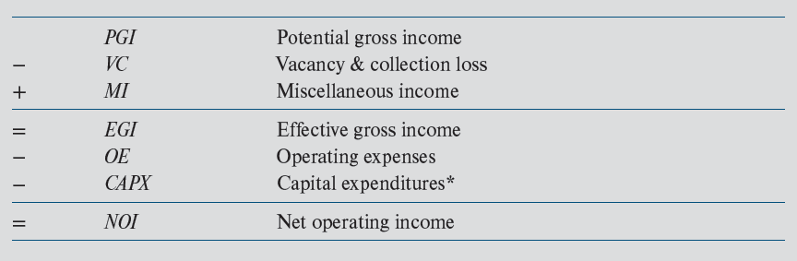
Estimating Net Operating Income
Exhibit 8-1
Pro forma: Sometimes referred to as a “reconstructed” operating statement

Slide 8
Rental Income is Generated By Leases
General types of commercial RE leases:
  Straight lease: “level” lease payments
  Step-up or graduated lease: rent increases on a predetermined schedule
  Indexed lease: rent tied to an inflation index; ex., consumer price index
  Percentage lease: rent includes percentage of tenant’s sales
Apartment leases?

Slide 9
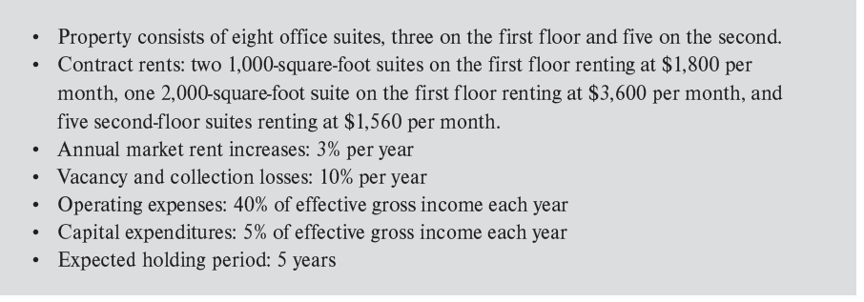
Example: Centre Point Office Building
Exhibit 8-2
Note: Some leases will expire during 5-year holding period; how would that be handled?

Slide 10
Potential Gross Income (PGI)
Potential gross income:
  Rental income assuming 100% occupancy
  Sometimes referred to as potential gross revenue (PGR)
  Is equal in any year to:
    Contract rent from in-place leases +
    Rent that could be collected on vacant space if it were leased at current market rental rates

Slide 11
Potential Gross Income: Centre Point Office Building
First Floor
1,000 sq. ft. suites: 2 × $1,800 × 12 mos. = $43,200
2,000 sq. ft. suite: 1 × $3,600 × 12 mos. = $43,200
Second Floor
800 sq. ft. suites: 5 × $1,560 × 12 mos. = $93,600
Potential Gross Income = $180,000
Note: Estimating first-year contract rent is not usually this easy!

Slide 12
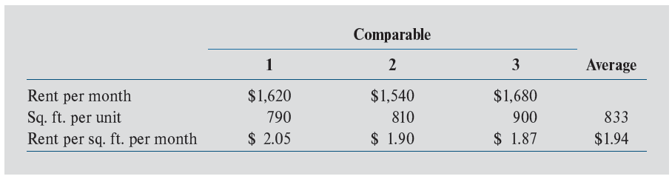
Using Rent Comparables to Estimate Rental Rates (Exhibit 8-3)
Example: Survey of rental rates for other second-floor offices in market:
Exhibit 8-3
Implications: 2nd floor rents in Centre Point average $1.95 /month/sq ft. ($93,600/12/5/800); this is consistent with current market rates of $1.94
How does the appraiser use this information?

Slide 13
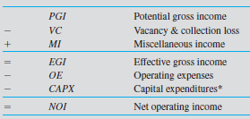
Effective Gross Income
VC-vacancy & collection loss is based on:
  Historical experience of subject property
  Competing properties in the market
  “Natural vacancy” rate:
    Vacancy rate that is expected in a stable or equilibrium market

Slide 14
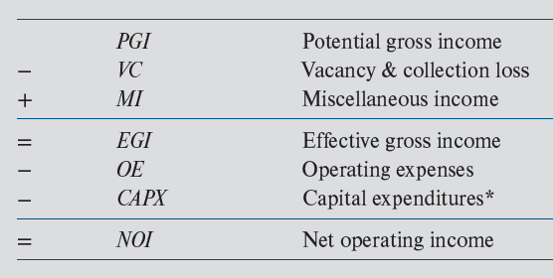
Effective Gross Income
Miscellaneous income
  Garage rentals & parking fees (office)
  Laundry & vending machines (apts., office)
  Clubhouse rentals (apts.)

Slide 15
Effective Gross Income: Centre Point
Potential gross income (PGI) $180,000
− Vacancy & collection loss (VC) 18,000 (@10%)
+ Miscellaneous income (MI) 0
= Effective gross income (EGI) $162,000

Slide 16
Operating Expenses
Operating Expenses:
  Ordinary & regular expenditures necessary to keep a property functioning competitively
  Fixed: Expenses that do not vary with occupancy (at least in the short-run)
    hazard insurance
    local property taxes
  Variable: Expenses that tend to vary with occupancy
    Utilities
    Maintenance & supplies

Slide 17
Operating Expenses
Do not include:
  Mortgage payments
  Tax depreciation
  Capital expenditures
  Leasing commissions

Slide 18
Capital Expenditures (CAPX)
CAPX: Non-recurring expenditures that increase value of structure/prolong its useful life:
  Roof replacement
  Additions
  HVAC Replacement
  Resurfacing of parking areas
Tax motivation for classifying a cash expenditure as an OE (versus CAPX) if possible?

Slide 19
Special Problem in Income Property Analysis: CAPX
Most appraisers treat CAPX as “above line” expense (see Exhibit 8-4).
Above Line
EGI
- OE
- CAPX
= NOI
Institutional investors usually treat CAPX as “below line” expense.
Below Line
EGI
- OE
= NOI
CAPX
= Net Cash Flow

Slide 20
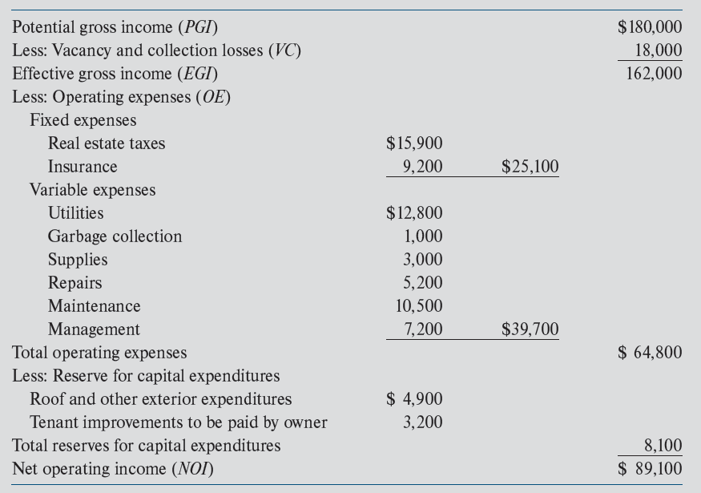
First-Year Pro Forma (next 12 months)
Exhibit 8-4
10% of PGI
40% of EGI
Above-line treatment of CAPX
5% of EGI

Slide 21
Sources of Industry Expense Data
Institute of Real Estate Management (IREM): www.irem.org
  Detailed information on apartments, offices, shopping centers, federally assisted housing and condominiums, co-ops, planned communities.
Building Owners and Managers Association (BOMA): www.boma.org
  Large office buildings

Slide 22
Sources of Industry Expense Data
International Council of Shopping Centers (ICSC): www.icsc.org
Urban Land Institute (ULI): www.uli.org
Local market participants
Other pro formas you have seen
Market knowledge is key!!

Slide 23
Net Operating Income
NOI is property's "dividend“
  Why is it not investor’s dividend?
Projected stream of NOI is fundamental determinant of property’s value
NOI must be sufficient to
  service the mtg debt and
  provide equity investor with an acceptable return on equity
Be careful of NOI vs. NCF

Slide 24
Study Question 8-4
Given the following historical information from the current owner, prepare a reconstructed operating statement to obtain an estimate of 1st year (next 12 months) NOI for the property.
The building consists of 10 units that could rent for $550 per month each. Assume: vacancy & collection losses will be 5% of potential gross income; the CAPX reserve will be included “above line”; current operating expenses are a good predictor of next year’s expenses.

Slide 25
Study Question 8-4: Solution
Above-line treatment of CAPX
Tax depreciation and mortgage payments are NOT operating expenses.

Slide 26
Valuation Using Direct Capitalization

Slide 27
First Income Valuation Method:
Direct Capitalization
Basic value equation:
Warning!!!!!!!
R_{o} is a “cap” rate
R_{o} is NOT a discount rate!!!!

Slide 28
Steps in Direct Capitalization
Obtain estimates of cap rates, R_{o,}, from
market using “direct market extraction”
From the sale of a comparable property
Calculate a weighted average of the R_{o}s abstracted from the market
Divide subject’s NOI₁ by the weighted average R_{o} to obtain an estimate of value for the subject

Slide 29
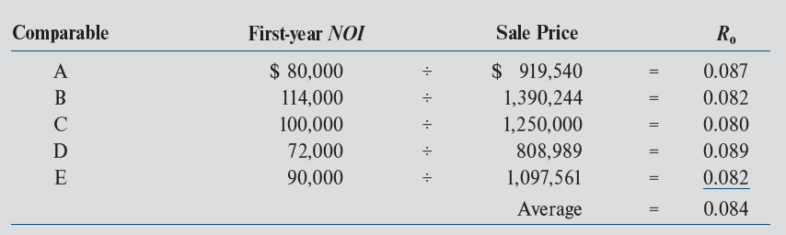
Direct Capitalization: Centre Point Office Building
Step 1: Extract R_{o} from the market
Exhibit 8-5
Note: We have assumed each is equally comparable to subject
From where do you obtain comparable NOIs and sales prices?
Non-disclosure states: Alaska, Idaho, Indiana, Kansas, Louisiana, Maine, Mississippi, Missouri, Montana, New Mexico, North Dakota, Texas, Utah, Wyoming
Defining the “market” for comparable selection is critically important

Slide 30
Direct Capitalization: Centre Point Office Building
Compute estimated market value, using expected first year NOI (i.e., next 12 months):
Which we round to $1,061,00
Which we round to $1,061,00

Slide 31
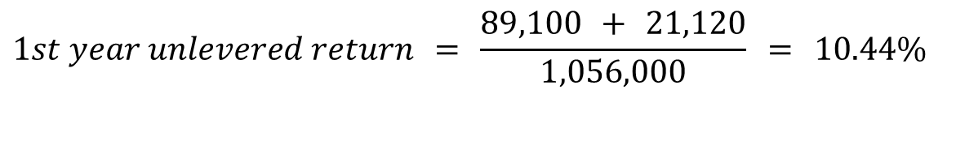

Understanding Cap Rates
Assume the following 1st year CFs for Centre Point:
  Purchase price: $1,056,,000
  NOI: $89,100
  Sale Price at end of year 1: $1,077,120 ($21,120 increase)
  Costs of sale at end of year 1: $0.00
$$1st year unlevered return = \frac{89,100 + 21,120}{1,056,000} = 10.44\%$$
$$= 0.0844 + 0.0200$$
= cap rate + appreciation rate

Slide 32
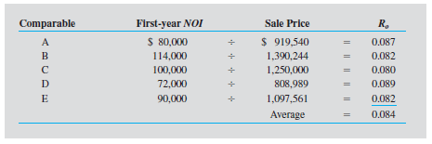
Importance of Understanding Where CAPX are in Pro Forma When Abstracting Cap Rates
What if the NOIs reported for comparables A & B do not include CAPX?
Then…
  NOIs for these properties are inflated relative to NOIs for the other properties
  Inflated NOIs cause abstracted cap rate for these 2 properties to be too high
  Which causes abstracted average to be too high
  Which causes estimated value of subject to be too low

Slide 33
Other Sources of Cap Rates
Situs Real Estate Research Corporation’s Real Estate Report: www.rerc.com
RealtyRates.com: www.realtyrates.com
Grubb & Ellis: www.grubb-ellis.com
Newmark Nigh Frank: (www.ngkf.com)
CoStar (www.costar.com)
Other appraisers & market participants

Slide 34
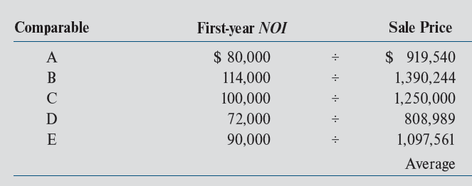
Important Point About Cap Rates
Direct capitalization only uses first year NOI, but R_{o} reflects all future cash flows:
    Why? Because transaction prices of the comparables reflect the value of future cash flows
    In turn, the cap rates extracted from these sale transactions do so as well
Point?
Direct capitalization IS forward looking?

Slide 35
U.S. Cap Rates for 3 Property Types Since 1996:Q1
2022Q1 Pricing
Malls: $1/0.064= $15.63
Apts: $1/0.042= $23.81
Red: CBD office
$23.81/$15.63 = 1.52
Green: Regional malls
6.4
5.6
Apartments
4.2
Cap rates are obtained from the Real Estate Research Corporation’s Real Estate Report, which publishes results from RERC’s quarterly Real Estate Investment Survey. The Real Estate Report summarizes the expected rates of return, property selection criteria, and investment outlook of a sample of institutional investors and managers throughout the U.S. The property level cap rates displayed above are aggregated across all metropolitan markets.

Slide 36
Effective Gross Income Multiplier
EGIM = sale price ÷ effective gross income
Quick indicator of value for smaller rental properties
Requires no operating expense information
Critical assumptions
  Roughly equal operating expense percentages across subject & comparable properties
  Assumes market rents are paid
Best used for properties with short-term leases (apartments & rental houses)

Slide 37
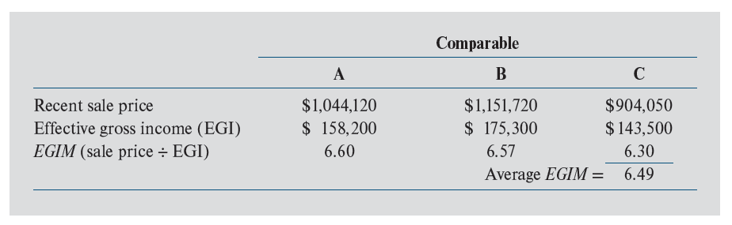
Effective Gross Rent Multiplier Example
Exhibit 8-6
Indicated value of subject
= 6.49 × EGI
= 6.49 × 162,000
= 1,051,380 rounded to $1,051,000

Slide 38
Problems with Valuation by Direct Capitalization
Inadequate data on comparable sales due to:
  Above- or below-market leases
    Ex., comparable office property just sold at a 7% cap rate
    But…comparable has 3 leases at $40/sq ft that expire in next 12 months
    Current market rental rates are $45/sq ft
    Buyer probably paid more for comparable because she expected a substantial bump in rents
    Higher price implies lower cap rate (more per $ of current NOI)
    But all of the subject property’s leases have already “rolled” to $45/sq ft
    Should the comparable’s cap rate be used to value the subject?

Slide 39
Problems with Valuation by Direct Capitalization
Inadequate data on comparable sales due to:
  Above- or below-market leases
  Differing length of leases & rent escalations
    Ex., comparable warehouse with 1 tenant just sold at an 8% cap rate
    But…tenant in comparable has a “flat” 10-year lease at $15/sq ft
    The 1 tenant in the subject property has a 10-year lease with annual escalations of 3%
    Buyer probably paid less for comparable because he was not going to get annual rent bumps
    Lower price implies higher cap rate (less per $ of current NOI)
    But…is it the correct cap rate to use to value the subject?

Slide 40
Problems with Valuation by Direct Capitalization
Inadequate data on comparable sales due to:
  Above- or below-market leases
  Differing length of leases & rent escalations
  Differing distributions of operating expenses between landlord and tenant
    Create your own example

Slide 41
Problems with Valuation by Direct Capitalization
Inadequate data on comparable sales due to:
  Above- or below-market leases
  Differing length of leases & rent escalations
  Differing distributions of operating expenses between landlord and tenant
    Create your own example
Result: DCF analysis can be preferable
  Because above/below-market leases, rent escalations, etc. can be included in valuation

Slide 42
Valuation Using Discounted Cash Flow Analysis

Slide 43
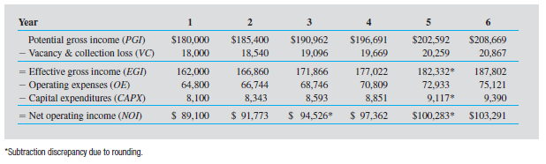
DCF Example: Centre Point
Exhibit 8-7
Very simple lease structure!

Slide 44
DCF Example: Centre Point
Exhibit 8-7
Very simple lease structure!
Sale price at end of Year 5 = NOI₆ ÷ R_{t} = $103,291/0.0875
= $1,180,469
Where R_{t} is a terminal or “going-out” cap rate, slightly higher than R_{o}
Required assumption
Sale price (SP) $1,180,469
− Selling expenses (SE) 47,219
= Net sale proceeds (NSP) $1,133,250
@ 4%

Slide 45
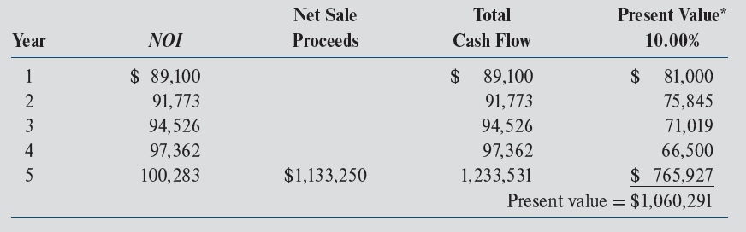
Valuation of the Unlevered Cash Flows: Centre Point
Exhibit 8-8
From Exhibit 8-7
Discount rate presumed to reflect required yield (IRR) in market for unlevered investments of similar risk
For surveys of unlevered yields, see RERC www.rerc.com
Can be solved for using Excel or “CF_{o}” keys on the calculator

Slide 46
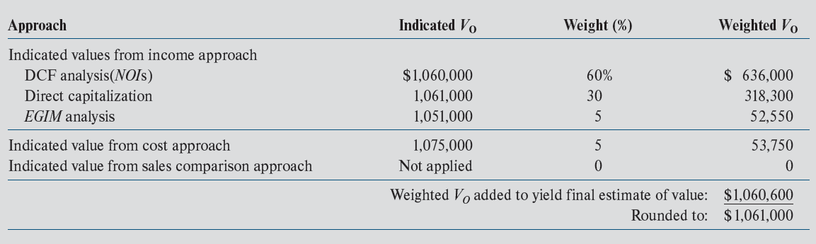
Reconciliation of Value Indicators
Exhibit 8-9
How are these weights determined?

Slide 47
So…What’s Better?
Is direct capitalization using R_{o} superior to valuation by DCF?
  Fewer explicit assumptions and forecasts are required
  What implicit assumption are you making?

Slide 48
Work of Appraiser Requires Analytical AND People Skills
Develop network of data contacts
Collect, read, interpret, and organize data and reports
Be skilled in data analysis and report production
Fight time deadlines

