Slide 1
Chapter 7
Valuation Using the Sales Comparison and Cost Approaches

Slide 2
Decision Making in Commercial Real Estate Centers Around Valuation
Valuation calculations are required when a:
  property acquisition is considered
  structure is
    modernized
    renovated
    abandoned
    demolished
  site is developed
  property is used as collateral for a loan
© MCGRAW HILL LLC. ALL RIGHTS RESERVED. NO REPRODUCTION OR DISTRIBUTION WITHOUT THE PRIOR WRITTEN CONSENT OF MCGRAW HILL LLC.

Slide 3
Real Estate “Estates”--i.e., Interests
Fee Simple
  Absolute ownership unencumbered by any other interest
    Subject to only limitations imposed by governmental powers of taxation, eminent domain, police power
Leased Fee
  Ownership interest held by lessor/owner
  Includes right to receive contract rent plus reversionary rights when lease(s) expires
Leasehold
  Right held by lessee/tenant to use & occupy RE for a stated term & under conditions specified in lease
© MCGRAW HILL LLC. ALL RIGHTS RESERVED. NO REPRODUCTION OR DISTRIBUTION WITHOUT THE PRIOR WRITTEN CONSENT OF MCGRAW HILL LLC.

Slide 4
Value Concepts
Market value:
  Most probable selling price, assuming “normal” sale conditions
Investment value:
  Value to a particular individual (investor)
Transaction price:
  Price actually paid for a specific property

Slide 5
Who Uses Market Value Appraisals?
Buyers
Sellers
Corporate acquisitions, mergers or dissolutions
Courts
  Divorces
  Eminent domain cases
  Settlement of estates
  Bankruptcy
Mortgage Lenders

Slide 6
Why Do We Have To Estimate Market Value?
In markets with perfect competition & investment value revelation, all transactions take place at true market value
In such markets, no need for buyers & sellers to search for “true” market value of an asset;
  Why not?
    Because it is continuously revealed by transaction prices of perfect substitutes
  Simon Property Group (SPG) example in book
    Stock price on 8/24/22: $106.84 (http://finance.yahoo.com)
Note: market value may not be fundamental value

Slide 7
What About Private Real Estate Markets? (where property transactions occur)
Every property is unique
  Unique location
  Many & varied attributes
These unique assets trade in:
  Illiquid
  highly segmented &
  informationally inefficient
  local markets
Search costs associated with matching buyers & sellers are significant
Search costs in the stock market…?

Slide 8
Implications of These Imperfections?
Even the few transactions of comparable properties that we do observe may not be indicative of value of the “subject” property
  What does transaction price tell us?
Thus…..we need an army of “fee appraisers” to estimate the market value of RE assets
  Do we need appraisers of market value in the stock market?
Difference between informal & formal appraisal?

Slide 9
Uniform Standards of Professional Appraisal Practice (USPAP)
Required & followed by all states & federal regulatory agencies
  Appraisers are state certified
  MAI designation?
Imposes ethical obligations & minimum appraisal standards
Maintained by the Appraisal Foundation
  Non-profit industry group that Congress (in 1989) charged with setting minimum requirements for all (state) certified appraisers
To comply with USPAP, appraisers must follow the following process…

Slide 10
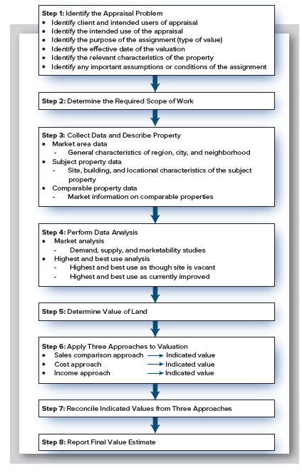
Uniform Standards of Professional Appraisal Practice (USPAP)
Exhibit 7-1
The Valuation Process

Slide 11
Uniform Standards of Professional Appraisal Practice (USPAP)
1. Identify the appraisal problem
  Client & intended uses of appraisal
  Date of valuation
  Rights to be valued (fee simple, etc.)
  Type of value to be estimated
    market, insurance, or taxable value?
    Most common type of valuation?
  Important assumptions or conditions

Slide 12
Uniform Standards of Professional Appraisal Practice (USPAP)
2. Determine the required scope of work
  Time & personal requirements
  Outline of proposed appraisal report
  Data & procedures used to complete required tasks

Slide 13
Uniform Standards of Professional Appraisal Practice (USPAP)
3. Collect data and describe property
  Market area data
    Characteristics of region, city, and neighborhood
  Subject property data
    Site, building, & locational characteristics
  Comparable property data
    Key to Appraisal?

Slide 14
Uniform Standards of Professional Appraisal Practice (USPAP)
4. Perform data analysis
  Market analysis
    Demand & supply
  Highest & best use; i.e., use which is:
    legally permissible
    physically possible
    financially feasible
    most profitable (yields highest residual value to land)
  Highest & best use as though vacant
    considers any possible use
  Highest & best use as improved
    must consider any cost of demolition

Slide 15
Uniform Standards of Professional Appraisal Practice (USPAP)
5. Determine value of land
  Important to value separately from improvements

Slide 16
Uniform Standards of Professional Appraisal Practice (USPAP)
6. Apply 3 approaches to valuation
  Sales comparison approach
  Cost approach
  Income approach
7. Reconcile indicated values from 3 approaches
  Weight based on relative reliability of the three approaches

Slide 17
Uniform Standards of Professional Appraisal Practice (USPAP)
8. Report final value estimate
  Report writing is an extremely important function
  Must meet requirements of 1 of 2 reporting options
    Appraisal report
      Form reports or longer narrative reports
      For appraisals of homes, usually use form instead of narrative
    Restricted appraisal report
      Minimum discussion of appraisal with references to internal file documentation
      Intended only for use of the client

Slide 18
Three Approaches to Estimating Market Value
Chapters 7 and 8 focus on Step 6:
  Sales comparison approach
  Cost approach
  Income approach

Slide 19
Valuation Using Sales Comparison Approach

Slide 20
Sales Comparison Approach
Basic Idea:
  Value of RE can be determined by analyzing the sale prices of similar properties
Why?
  In a competitive market, close substitutes should sell for similar prices
Major difficulty?
  How many truly close substitutes exist & how many of these have sold recently?

Slide 21
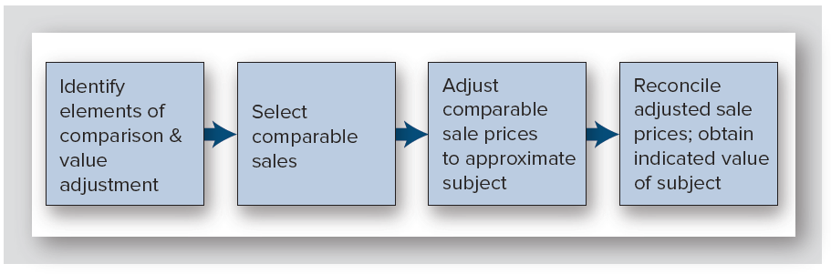
Steps in Sales Comparison Approach
Exhibit 7-3
What housing attributes seem to matter most?
1. Lot size
2. House size
3. Age
4. Location

Slide 22
Selecting Comparable Sales
Must be properties that prospective buyers would consider substitutes for subject property
Should be arms-length transactions
  Fairly negotiated prices that occurred under “normal” conditions
    For example, not a distressed sale
Select to minimize required physical & locational adjustments

Slide 23
Selecting Comparable Sales
Data sources:
  Public records (e.g., county property tax assessor)
    Alachua County (www.acpafl.org)
  Multiple listing service (MLS)
  Private vendors (title companies, others)
    CoStar for commercial properties (www.costar.com)
    Real Capital Analytics (RCA: www.rcanalytics.com)
Importance of personal relationships
Fee appraisers are researchers!

Slide 24
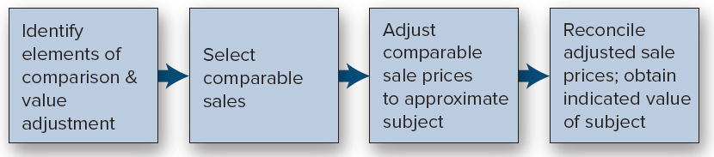
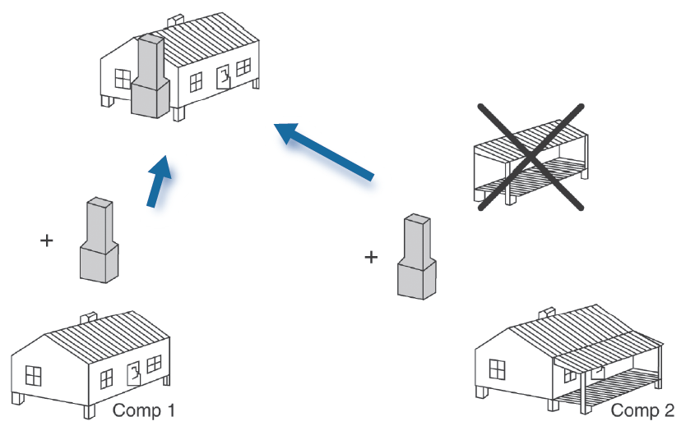
Adjustments to Comparable Sale Prices
Goal?
  Convert characteristics of each comparable to an approximation of subject.

Slide 25
Adjustments to Comparable Sale Prices
Sequence of adjustments
  Transactional adjustments
  Property adjustments

Slide 26
Adjustments to Comparable Sale Prices
Transactional Adjustments
  Concern the nature & terms of the deal
    Property rights conveyed
      If buyer of comparable purchased a different legal estate, should be dropped
    Financing terms
      ex., below rate financing
    Conditions of sale (arm’s length or not?)
      Parents sell to daughter
    Expenditures made immediately after purchase
      Buyer probably received price concession
    Market conditions
      i.e., changes in values since sale of comparable

Slide 27
Adjusting for Market Conditions Using a Price Index
Sources of house price indices
  Freddie Mac:
  www.freddiemac.com/research/indices/house-price-index.html
  Federal Housing Finance Agency (FHFA): www.fhfa.gov/DataTools/Downloads/Pages/House-Price-Index.aspx
  S&P CoreLogic Case-Shiller Home Price Indices http://us.spindices.com/index-family/real-estate/sp-case-shiller
  National Association of Realtors www.realtor.org/research/research/metroprice
Application: Derive monthly rates of change from most relevant series, & apply to comparables

Slide 28
Adjustment to Comparable Sales Prices
Property Adjustments
  Location
  Physical characteristics
  Economic characteristics (not applied to residences)
    Important economic characteristics of income producing properties: operating expenses, lease terms, tenant mix
  Use
    If comparable use if different from best use of subject, better not use as a comparable
  Non-realty items (personal property)
    Furniture
    Sound/stereo/TV equipment
How easy is this?

Slide 29
Practice
A comparable property sold six months ago for $150,000. The adjustments for the various elements of comparison have been calculated as follows:
Financing terms: -$2,600
Market conditions: +8 percent
Location: -5 percent
Physical characteristics: +$12,500
Non-realty: -$3,000
Other conditions of sale: 0
Legal characteristics: 0
Use: 0
Making the adjustments in the order they are listed above, what is the comparable’s final adjusted sale price?

Slide 30
Practice: Solution
Adjustments: Financing terms: -$2,600; market conditions: +8 percent; location: -5 percent; physical characteristics: +$12,500; non-realty items: -$3,000; other conditions of sale: 0; legal characteristics: 0; use: 0.

Slide 31
Sequence of Adjustments (USPAP)
Transactional adjustments 1st…in order listed above
Property adjustments 2nd…in no particular order
Caution: mixing dollar & percentage adjustment

Slide 32
Sequence of Adjustments
Transactional adjustments 1st…in order listed above
Property adjustments 2nd…in no particular order
Caution: mixing dollar & percentage adjustment
Adj. first for non-realty items
247,000 × 0.02
+
Adj. first for ∆ market values (250,000 × 0.02)
+

Slide 33
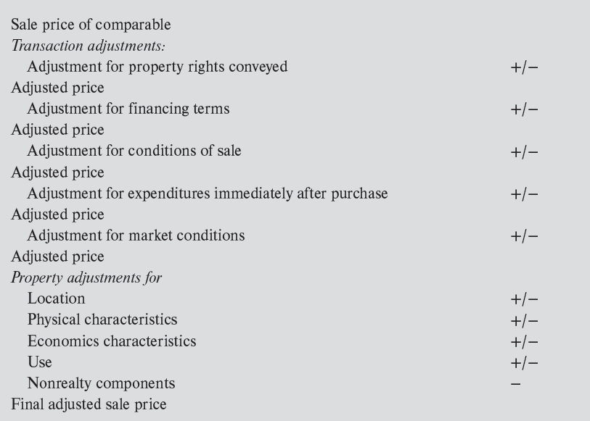
Exhibit 7-5: Sequence of Adjustments
According to USPAP….
Each adjustment is made to the prior adjusted price, not sale price of comparable

Slide 34
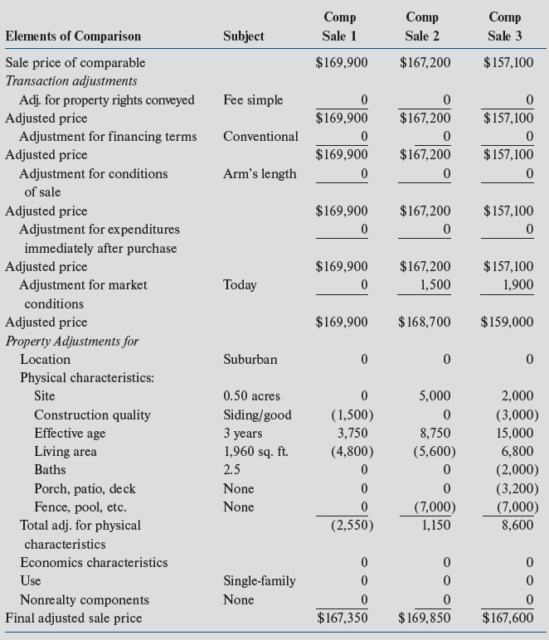
Adjustment Grid: 2380 Appletree Ct
Exhibit 7-7

Slide 35
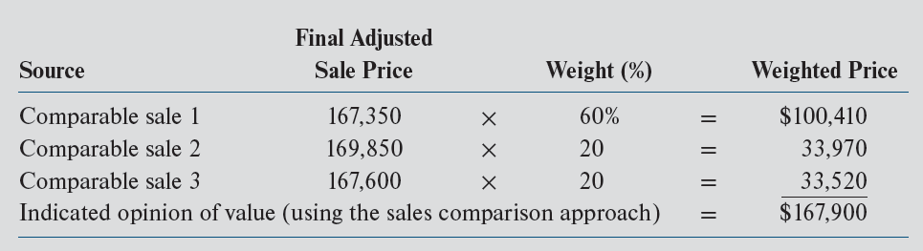
Reconciliation of Adjusted Sale Prices
Exhibit 7-8: 2380 Appletree Ct
Note: Appraisers do not actually assign weights when reconciling; they just discuss their weighting in the document

Slide 36
Valuation Using the Cost Approach

Slide 37
Cost Approach
Procedure
  Estimated reproduction cost of improvements
  − Estimated accrued depreciation
  = Depreciated cost of building improvements
  + Estimated value of site
  = Indicated value by the cost approach
Major Assumption?:
  Cost of creating a property is related to its market value

Slide 38
Cost Approach (continued)
Two concepts of “cost”:
  Replacement cost:
    Cost to create something of equal utility (functionality)
  Reproduction cost:
    Cost of an exact physical replica
    Complication in application?

Slide 39
Cost Approach (continued)
Methods to estimate replacement cost
  Quantity survey method
    most accurate; reflects quantity & quality of all materials and all labor costs
  Cost per square foot or cubic foot
    estimate of cost per unit of area; uses costs of similar structures
  Unit in place
    estimate of cost per building component

Slide 40
Cost Approach (continued)
Sources of replacement cost estimates
    R.S. Means www.rsmeans.com
    Consulting firms
    Builders/contractors
Is estimating replacement cost doable?

Slide 41
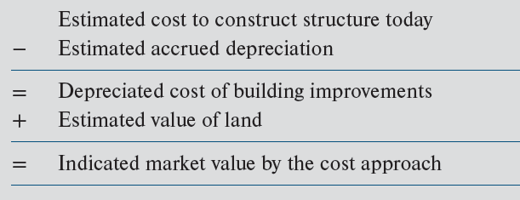
Accrued Depreciation
Not tax depreciation
Difference between replacement cost & market value of improvements
Types of accrued depreciation that must be considered:
  Physical deterioration
  Functional obsolescence
  External (economic) obsolescence
Cost approach procedure

Slide 42
Types of Accrued Depreciation (continued)
Physical deterioration:
  Loss in market value due to aging, decay & ordinary use
Functional obsolescence:
  Loss in value due to changes in tastes, preferences, technological innovations, or market standards
  Examples?

Slide 43
Types of Accrued Depreciation (continued)
External (economic) obsolescence:
  Loss in value due to changes beyond property boundaries (neighborhood effects)
    Increased traffic congestion in area
    Conversion of residential neighborhood from owner-occupied to rental
    Environmental issues
    Decline in desirability/demand fro neighborhood
Is it hard to estimate accrued depreciation?

Slide 44
Study Question 7-6
Has used-up 21% of its economic life
(accrued)
Assuming “straight-line” depreciation

Slide 45
Appraisal Assignments Where Cost Approach is Heavily Weighted?
New buildings
Insurance appraisals
Specialty buildings

Slide 46
Chapter 7
Appendix: Automated Valuation Models

Slide 47
Automated Valuation Models (AVMs)
Example: Freddie Mac: Home Value Suite
https://sf.freddiemac.com/tools-learning/home-value-suite/overview
Based on model developed using millions of sales
Uses complex multiple regression models
Regression is used to predict value of subject property
See:
  Industry Issues 7-2

Slide 48
Use One of These AVMs to Value a Relative’s Home
Smartzip
https://smartzip.com/avm
http://zillow.com

Slide 49
Multiple Regression Analysis (MRA)
MRA
  For (large) sample of transactions, regress transaction prices on a set of property characteristics
    Time-series variation in transaction prices controlled for with time “dummy” variables
  Save estimated coefficients on property characteristics
  Multiply estimated coefficients by characteristics of the “subject” property
  Predicted price is the estimated value of subject property
  This is what Zillow & others do

Slide 50
Appendix: Regression-Based Appraisal
Price (Y) = B₀ + B₁ x₁ + B₂ x₂ + B₃ x₃ +… B_{n} x_{n} + e
Regression often estimated with millions of sale observations
X_{1,} X₂, X₃, etc. are characteristics of properties in the sample of sales
  e.g., size, age, quality, location
B₁…B_{n} are estimated coefficients representing dollar value contributed toward price per unit of x_{i}
B_{i} may be the value of having a particular attribute if x_{i} is a 0/1 dummy/attribute variable (e.g., pool or not)

Slide 51
Example: Estimated Regression Model Statistics
Dependent variable (Y) is sale price…equation is estimated with a sample of comparable sales transactions
How are the coefficient estimates (the Bs) interpreted?

Slide 52
Use Coefficient Estimates to “Predict” Value of Subject Property
$164,156
More explanatory variables than the three above are used
Controlling for location is especially important/difficult

Slide 53
Multiple Regression Analysis (MRA)
Requires thousands (if not millions) of sales transactions
The availability of required data has increased significantly in recent years
Possible to estimate using Excel

Slide 54
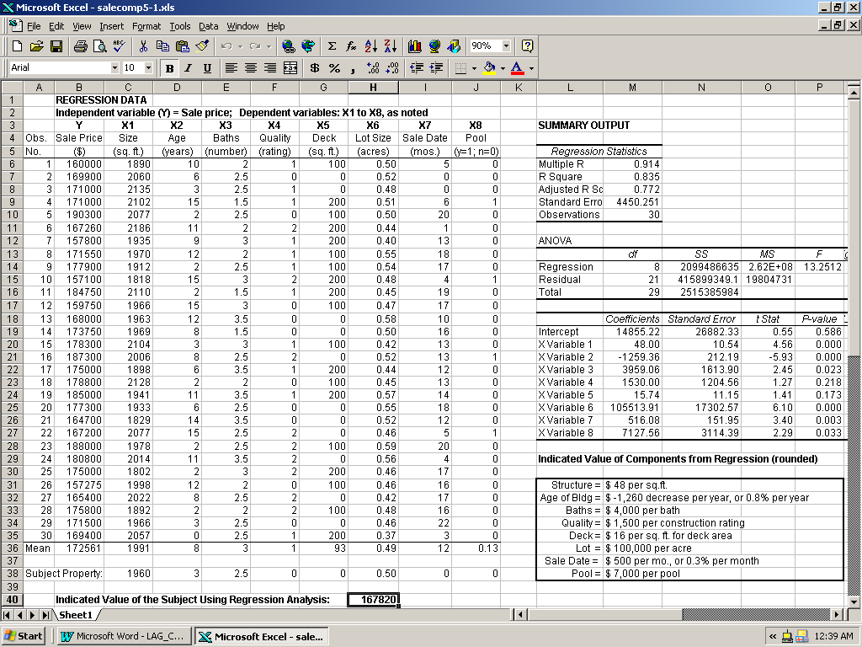
Application to Appletree Court Ex. In Ch 7
Data on 30 transactions
All occurred in Parkway Estates…where the subject property is located
  no other controls for location
Quality NOT a “dummy” variable, set equal to 0, 1, or 2 (is a continuous var.)
Pool is a dummy variable set equal to 0 or 1
All other variables are “continuous”

Slide 55
Application to Appletree Court Ex. In Ch 7
R Square measures how well the regression model fits the data
  Model explains 83.5% of the variation in observed sale prices
Each B coefficient represents the marginal contribution of each characteristic to the predicted value
  Controlling as much as possible for existence of other site, building, and location characteristics
Example: each additional square foot contributes $48 to value (on average)
Appraiser’s subjective adjustments are replaced with quantitative adjs.

Slide 56
Application to Appletree Court Ex. In Ch 7
# of months
size age baths quality deck lot size since sale pool
To estimate market value of subject property, list the estimated coefficients of the regression equation:
V_{o} = 14,855 + 48x₁ − 1,259x₂ + 3,959x₃ + 1,530x₄ + 15.74x₅ + 105,514x₆ + 516x₇ + 7,128x₈
The estimated value of the subject property is therefore:
V_{o} = 14,855 + 48(1,960) − 1,259(3) + 3,959(2.5) + 1,530(0) + 15.74(0) + 105,514(0.5) + 516(0) + 7,128(0)
  V₀ = $167,820

Slide 57
Application to Appletree Court Ex. In Ch 7
# of months
size age baths quality deck lot size since sale pool
To estimate market value of subject property, list the estimated coefficients of the regression equation:
V_{o} = 14,855 + 48x₁ − 1,259x₂ + 3,959x₃ + 1,530x₄ + 15.74x₅ + 105,514x₆ + 516x₇ + 7,128x₈
The estimated value of the subject property is therefore:
V_{o} = 14,855 + 48(1,960) − 1,259(3) + 3,959(2.5) + 1,530(0) + 15.74(0) + 105,514(0.5) + 516(0) + 7,128(0)
  V₀ = $167,820

Slide 58
Application to Appletree Court Ex. In Ch 7
# of months
size age baths quality deck lot size since sale pool
To estimate market value of subject property, list the estimated coefficients of the regression equation:
V_{o} = 14,855 + 48x₁ − 1,259x₂ + 3,959x₃ + 1,530x₄ + 15.74x₅ + 105,514x₆ + 516x₇ + 7,128x₈
The estimated value of the subject property is therefore:
V_{o} = 14,855 + 48(1,960) − 1,259(3) + 3,959(2.5) + 1,530(0) + 15.74(0) + 105,514(0.5) + 516(0) + 7,128(0)
  V₀ = $167,820

Slide 59
Application to Appletree Court Ex. In Ch 7
# of months
size age baths quality deck lot size since sale pool
To estimate market value of subject property, list the estimated coefficients of the regression equation:
V_{o} = 14,855 + 48x₁ − 1,259x₂ + 3,959x₃ + 1,530x₄ + 15.74x₅ + 105,514x₆ + 516x₇ + 7,128x₈
The estimated value of the subject property is therefore:
V_{o} = 14,855 + 48(1,960) − 1,259(3) + 3,959(2.5) + 1,530(0) + 15.74(0) + 105,514(0.5) + 516(0) + 7,128(0)
  V₀ = $167,820

Slide 60
Application to Appletree Court Ex. In Ch 7
# of months
size age baths quality deck lot size since sale pool
To estimate market value of subject property, list the estimated coefficients of the regression equation:
V_{o} = 14,855 + 48x₁ − 1,259x₂ + 3,959x₃ + 1,530x₄ + 15.74x₅ + 105,514x₆ + 516x₇ + 7,128x₈
The estimated value of the subject property is therefore:
V_{o} = 14,855 + 48(1,960) − 1,259(3) + 3,959(2.5) + 1,530(0) + 15.74(0) + 105,514(0.5) + 516(0) + 7,128(0)
  V₀ = $167,820

