Slide 1
Chapter 6
Forecasting Ownership Benefits and Value: Market Research

Slide 2
Multiple Factors Affect Real Estate Demand
Needs for access (“linkages”)
  “location, location, and location”
Non-locational factors
  Housing: style, floorplan, size; financing available
  Retail: tenant mix; parking facilities, visibility; store dimensions (bay depth)
  Offices: visibility, design, floor plate size; amenities and services; electrical and communications service
Notes:
Market Research: Slipperiest Step in Real Estate Analysis

Slide 3
Market Segmentation
Market segmentation: Differences in preferences or needs among market subgroups
Implications for market analysis:
Must focus on relevant market segments
Corollary 1: Most real estate data is irrelevant in studying a particular market segment
Corollary 2: Most important data for a particular market segment may not be readily available
Notes:
Market Research: Slipperiest Step in Real Estate Analysis – Market Segmentation

Slide 4
Challenges Posed by Market Segmentation
Market segmentation is an empirical notion:
  The results of prior investigation and grouping
  Important factors of segmentation may vary with location, property type and available information
Market analysis must adapt to this variation
Implication: No simple, universal procedure
Notes:
Real Estate Market Research as Storytelling

Slide 5
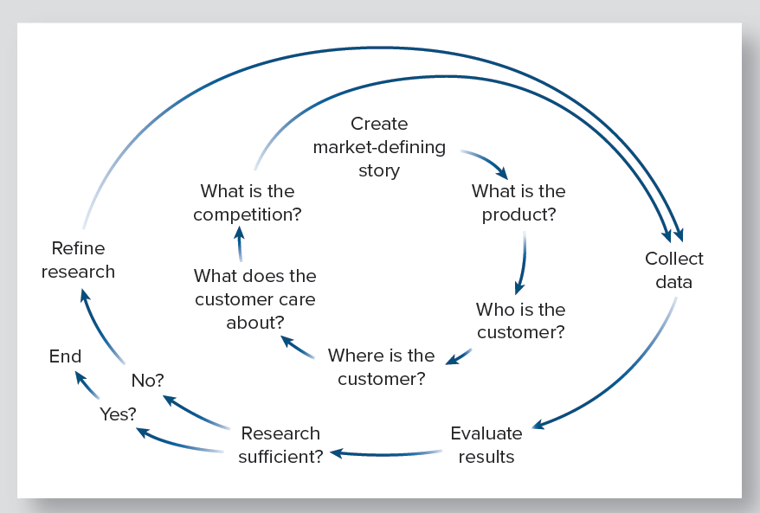
The Cycle of Market Research
Notes:
Real Estate Market Research as Storytelling

Slide 6
Writing a Market Story
Objective: Create a story (estimate) of critical market parameters (future rental rates, sales projections, etc.)
All market analysis is someone’s story about:
  Segmentation
  Deriving the relevant parameters
There are simplifying assumptions in every story
  Conscious and unconscious
  Watch for them!
Clues on market segments are in industry literature (ex: Urban Land Institute, trade groups)
Initial collection of data should depend on the assumptions about segmentation
Notes:
Real Estate Market Research as Storytelling

Slide 7
Writing a Market Story (continued)
First analysis
  What are the critical parameters needed?
  What range of critical parameters is implied by data?
  Is the range narrow enough to be useful?
  Is more research necessary? Worthwhile?
Refining the research
  What factors affect critical parameters the most?
  What information can illuminate those factors?
Notes:
Real Estate Market Research as Storytelling

Slide 8
Story Approach vs. Conventional
Market Research
Story approach:
  Begin with property and its market segments
  Build links to larger economy
Conventional approach:
  Start with the state of the world
  Then nation
  Then state
  Then city
  Then property
Notes:
Real Estate Market Research as Storytelling – A Reverse to Conventional Market Research

Slide 9
Three Valuable Techniques for Market Analysis
Excluding the irrelevant
Finding proxy variables
Using analogy
Notes:
Three Important Techniques in Market Analysis

Slide 10
Excluding the Irrelevant
Example: Data on housing units
Problem:
  People don’t buy a “housing unit”
  They buy:
    A specific dwelling in a specific neighborhood
    Such as a condo near a popular retail area.
Strategy:
  Work with local real estate sources to get the relevant data
Notes:
Three Important Techniques in Market Analysis

Slide 11
Finding Proxy Variables
Example: Data on student apartments
Problem:
  Student and non-student demand differ
  Yet there is no such official classification
Strategy:
  Student apartments tend to use a contract with each individual occupant
  Websites or calls to representatives can reveal which properties do this
  These can proxy for all student apartments
Notes:
Three Important Techniques in Market Analysis

Slide 12
Using Analogy
Example: Prospects for non-student apartments in a student neighborhood
Problem:
  No non-student apartments there now
Strategy:
  Search other student intensive communities for examples of non-student apartments in student neighborhoods
  Investigate the experience of those properties
Notes:
Three Important Techniques in Market Analysis

Slide 13
Three Examples of Property Market Research
Elysian Forest – planned unit development
Palm Grove – proposed office building
Plane Vista – proposed apartment expansion
Why look only at development projects?
  No difference in market analysis questions between existing and proposed properties
  Development projects reveal more of the challenging data issues
Notes:
Three examples of Market Research

Slide 14
Elysian Forest: Proposed
Planned Unit Development (PUD)
PUD characteristics
  Mixed density (single family to townhouses)
  Smaller individual lots for single family
  Common areas and recreation facilities
Elysian Forest - bold and big for University City
  First PUD in University City
  900 units - several times the size of typical development
Notes:
Three examples of Market Research – Elysian Forest

Slide 15
Elysian Forest: Projected Sales and Market
 | Projected Sales of Elysian Forest
Year | 1 | 2 | 3 | 4 | 5
All unit types* | 88 | 212 | 236 | 260 | 104
* Condos, townhouses, patio homes, small-lot single family
 | Estimated Sales in the University City Housing Market
Year | 1 | 2 | 3 | 4 | 5
All sales | 1,500 | 1,500 | 1,550 | 1,600 | 1,700
New units | 500 | 600 | 850 | 900 | 1,100
Notes:
Three examples of Market Research – Elysian Forest

Slide 16
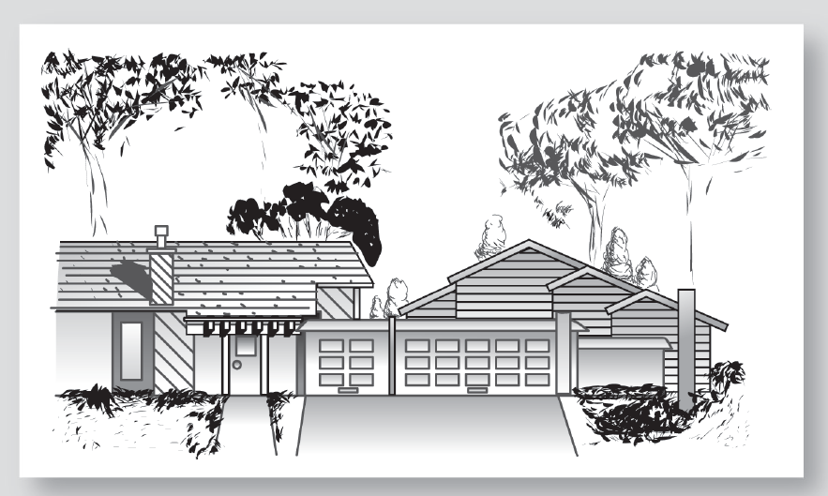
Typical Elysian Forest Patio Home Pair
Notes:
Three examples of Market Research – Elysian Forest

Slide 17
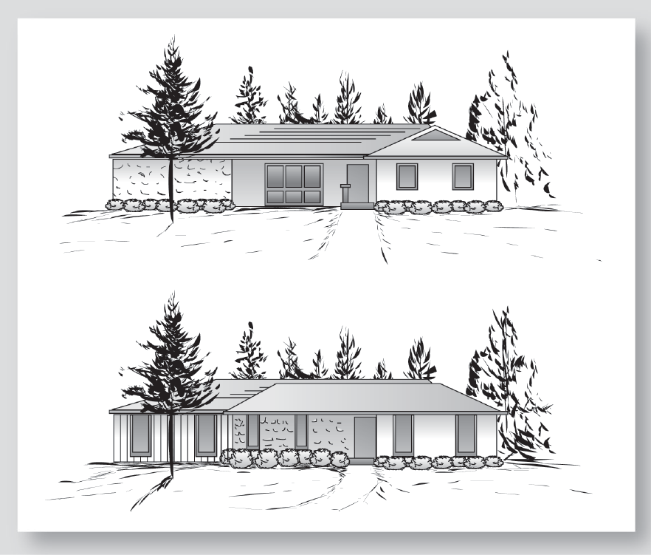
“Competitive Norm” from Local Parade of Homes
Notes:
Three examples of Market Research – Elysian Forest

Slide 18
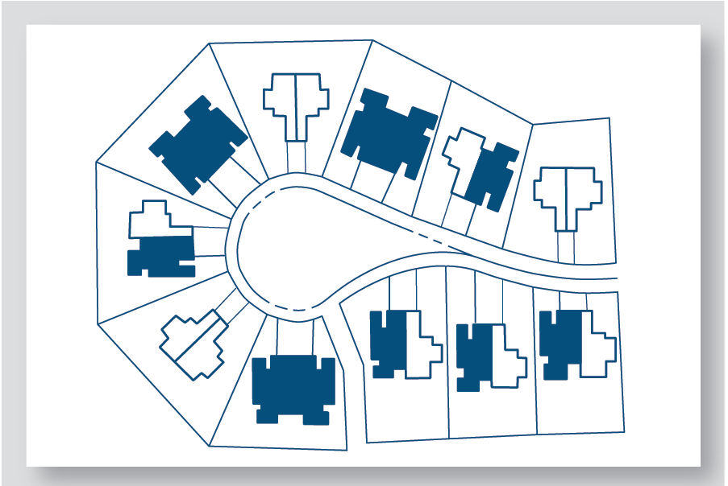
Typical Elysian Forest Patio Home Cluster
Notes:
Three examples of Market Research – Elysian Forest

Slide 19
Market Defining Story for Elysian Forest
What is the product?
  Upper income, high-density ownership residences
Who are the customers?
  Top 30% of household income, but not top 8%; not traditional family with children at home
Where are the customers?
  Retirement buyers; “empty nesters”; single parents, other adults (mixed sources)
What do customers care about in Elysian Forest?
  Good access to work; good recreation and social facilities; distinctive, contemporary design
What is the competition?
  No other comparable projects; Parade of Homes

Slide 20
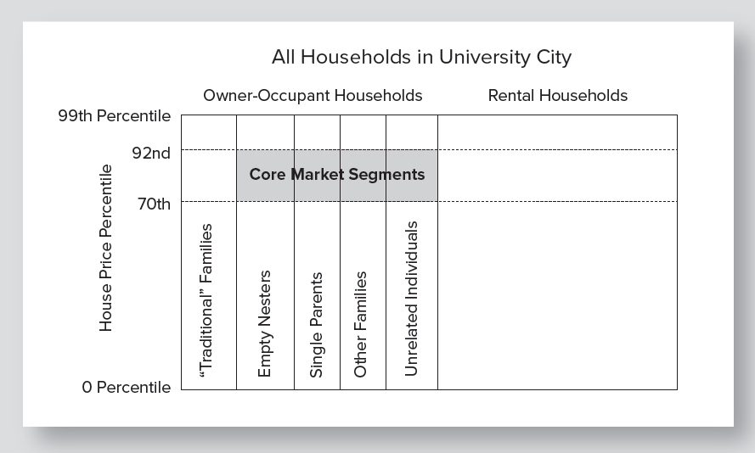
Core Market Segments for Elysian Forest
Notes:
Three examples of Market Research – Elysian Forest

Slide 21
Initial Data Collection
Basic source: U.S. Census, American Community Survey (ACS)
  Table B25118 Tenure by Household Income in the past 12 months (income intervals for the 22% of households targeted for Elysian Forest)
  Table B19131 Family Type by Presence of Own Children Under 18 Years by Family Income in the past 12 months. (portion of each type of household that is income eligible; portion of traditional households with children at home)
Notes:
Three examples of Market Research – Elysian Forest

Slide 22
Core Market Segments for Elysian Forest
Owner Occupant Households: 48,084
10,121
99
92
Core Market Segments
Core Market Share
6,642 ÷ 48,084
= .1381
or 13.81%
3,479
10,121 – 3,479 = 6,642
70
House Price Percentile
“Traditional” Families
Unrelated Individuals
Single Parents
Empty Nesters
Other family
0
Notes:
Three examples of Market Research – Elysian Forest

Slide 23
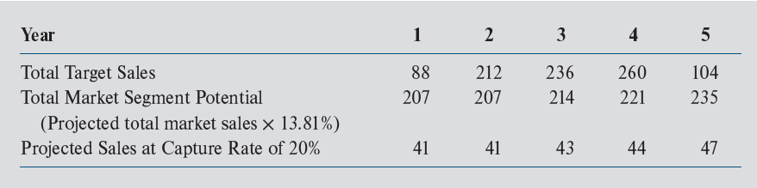
Implications of Analysis for Elysian Forest Sales
Notes:
Three examples of Market Research – Elysian Forest

Slide 24
Actual Outcome for Elysian Forest
Built 20 speculative units
Staffed a sophisticated and expensive sales center
Never sold one unit
Project went to foreclosure
Firm went into bankruptcy
Notes:
Three examples of Market Research – Elysian Forest

Slide 25
Case 2: Palm Grove Office Complex
Proposed Project: 2 office buildings:
  Each one 40,000 sq. ft., 4 floors of 10,000 sq. ft. size
  “Glass block” design
  Located in mixed-use area
    retail
    high school
    car dealer
    strip offices
    no other large office buildings
Largest “speculative” office project ever proposed in University City
Notes:
Three examples of Market Research – Palm Grove Office Complex

Slide 26
Market Defining Story for Palm Grove Office Complex
What is the product?
  General purpose offices:
    No special plumbing or equipment for medical or laboratory
Who are the customers?
  General purpose office users with at least 25 employees
    Finance and insurance
    Nonresidential real estate brokerage/management
    Engineering and consulting
    Accounting
    Computer services and programming
    Management consulting
    Market and public opinion research
Notes:
Three examples of Market Research – Palm Grove Office Complex

Slide 27
A Market Defining Story (continued)
Where are the customers?
  Already in University City
    Large offices seldom move to the city
What would tenants want from Palm Grove?
  Small firms: Street exposure and easy parking
  Large firms: Easy employee commuting, proximity to office support services
Tentative market defining conclusions
  General purpose office users
  More than 25 employees
  Prospective tenants will come from the city

Slide 28
Initial Data Collection
Alternative 1: Canvass the business community
  Advantage: Could also serve as a marketing effort
  Disadvantage: Time and cost
Alternative 2: Examine data from U.S. Census, County Business Patterns
  Advantages: Free and no need to leave your desk
  Disadvantage: May be dated information
Notes:
Three examples of Market Research – Palm Grove Office Complex

Slide 29
Initial Market Analysis
From County Business Patterns: Fewer that 10 general purpose office firms have 25 employees
Conclusion: No chance for the project
Actual experience:
  Only one building completed, which sat largely vacant for life of the building
  Developer has disappeared
  Building partially deconstructed

Slide 30
Case 3: Plane Vista Apartments
Proposed project: Expand apartments from 500 to 900
Existing project:
  Four years old
  High quality, wide variety of floor plans
  Indoor gymnasium with large weight room
  Diverse mix of tenants
  Location: Immediately north of Orlando airport
  Weakness: Edge of city (at the time); no special amenities
Notes:
Three examples of Market Research – Plane Vista Apartments

Slide 31
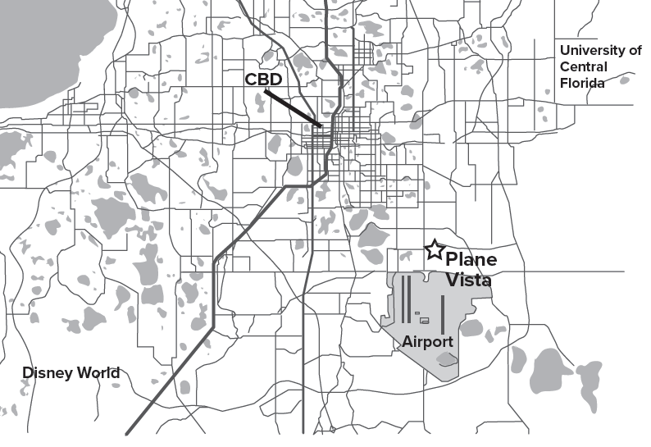
Location of Plane Vista in Orlando
Notes:
Three examples of Market Research – Plane Vista Apartments

Slide 32
Market Defining Story for Plane Vista
What is the product?
  Standard design, broad appeal; high-quality “market rate” apartments
Who are the customers?
  Assume a broad spectrum of working rental households
  Upper third of rental household income distribution
Notes:
Three examples of Market Research – Plane Vista Apartments

Slide 33
Market Defining Story for Plane Vista
(continued)
Where are the customers?
  Initial assumption: Persons employed throughout east, south and central Orlando
  Influenced by commuting distance to work
What do customers like about Plane Vista?
  Should be well known from existing project
  Easily determined by asking tenants
Notes:
Three examples of Market Research – Plane Vista Apartments

Slide 34
Initial Data Collection
Key question: How does Plane Vista compare to other apartment projects for job commuting?
Must examine:
  Locations of new, high-quality apartments
    Obtained apartment locations from real estate data firm
  Where jobs are concentrated
    No simple information on job locations

Slide 35
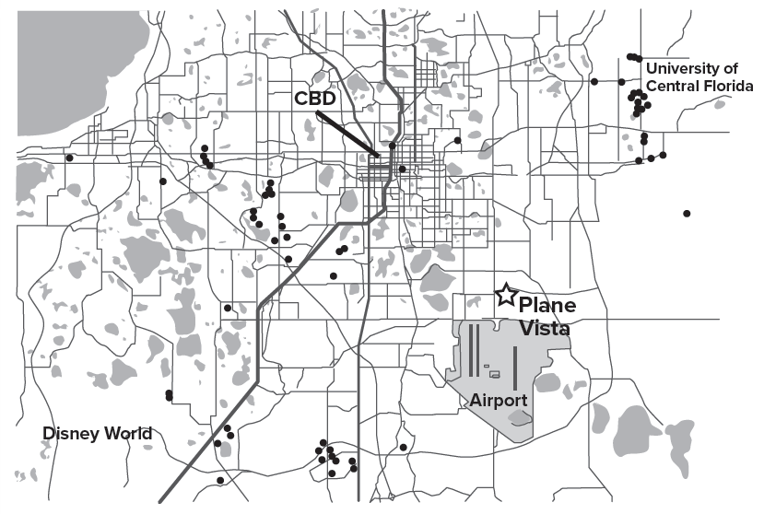
Locations of Recently Built Apartments
Notes:
Three examples of Market Research – Plane Vista Apartments

Slide 36
Constructing Estimates of Job Locations
Available job-related data:
  Property appraiser’s database on 43,000 business and government properties
    Square footage of structures
    Location by geographic coordinates
    Classified by over 200 land use categories
  U.S. Bureau of Labor Statistics website:
    County employment by NAICS detailed category
Notes:
Three examples of Market Research – Plane Vista Apartments

Slide 37
Constructing Estimates of Job Locations (continued)
For 20 major categories of land use compute:
Total county
building space
Total county
employment
per category
Space
per worker
÷
=
Example:
Total general
office space
Total general
office employment
Office space
per office worker
÷
=
For each property compute:
Space
per worker
Est. no. of
workers at
property
Space
÷
=
Example:
Space per
office worker
Est. office
workers at
property
Office space
÷
=
Notes:
Three examples of Market Research – Plane Vista Apartments

Slide 38
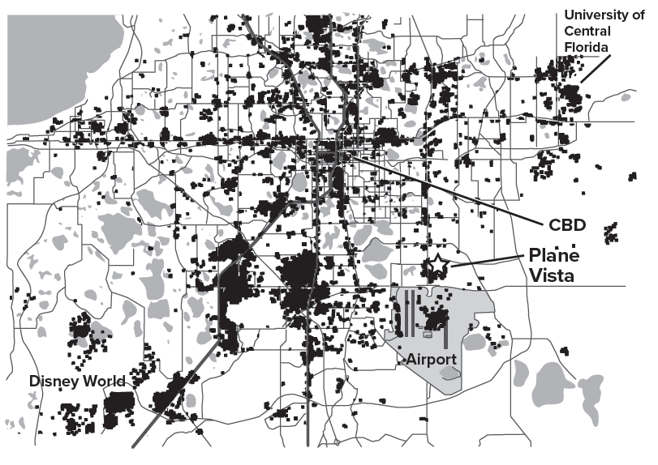
Where People Work in Orlando

Slide 39
Initial Market Analysis
Pattern of new apartments is a surprise:
  Most new apartments are distant from Plane Vista
  Plane Vista seems isolated from larger Orlando
Jobs map shows a similar clustering:
  Jobs concentrated at airport and directly north
  Jobs scarce in immediate south, west, and east
Notes:
Three examples of Market Research – Plane Vista Apartments

Slide 40
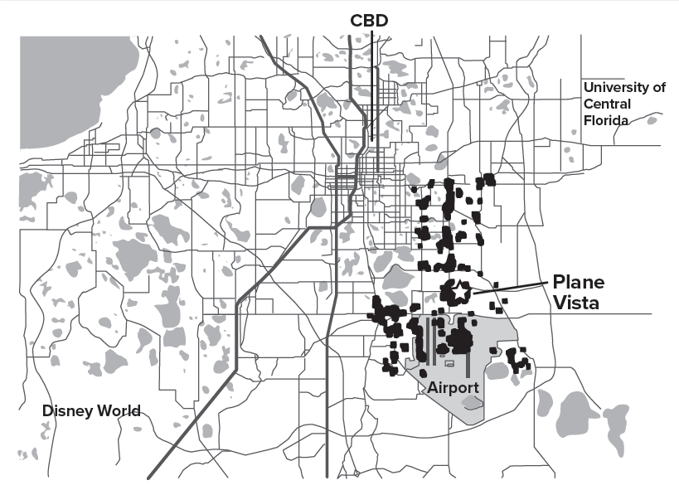
Revised Market Defining Story: “Airport Island”
New Assumption:
75% of Plane Vista occupants work on “airport island.”
Future of Plane Vista market depends on
“airport island”
“Airport
Island”
Notes:
Three examples of Market Research – Plane Vista Apartments

Slide 41
Data Collection: Round Two- Focus on Airport Island
New job research for airport island:
  Total of jobs on airport island is 25,000
  Airport expects to add 750 per year
  New firms will add 550 jobs in next year
  Summary: Near-term job growth at 5.2% per year
  Compares favorably to Orlando job growth of 2.5%
New apartment research for airport island
  Construction permits for other apartments are zero
  Competitive units total about 3,500 with 90% occupancy
  Market appears able to “absorb” 5.2% (175) growth in competitive units per year over next 3 years
Notes:
Three examples of Market Research – Plane Vista Apartments

Slide 42
Final Market Analysis: Key Assumptions
All else equal, apartment rental rates grow at the rate of inflation
Job growth drives apartment demand on airport island
No other new apartments for two years

Slide 43
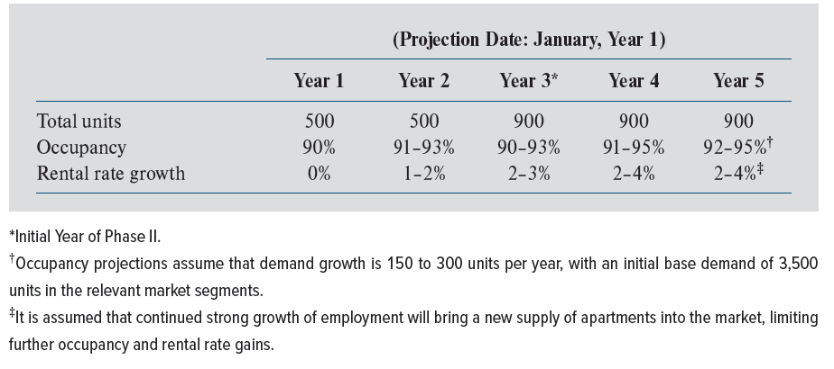
Projections of Critical Parameters for Plane Vista
Notes:
Three examples of Market Research – Plane Vista Apartments

Slide 44
Questions about the Plane Vista Analysis
Which of the key assumptions seems most vulnerable to error?
What could be done to reduce its riskiness?
Does the projection of job growth on “Airport Island” seem safe?
Notes:
Three examples of Market Research – Plane Vista Apartments

Slide 45
Some Final Observations on the Plane Vista Analysis
A market analysis is always a story
  No market analysis is purely numbers
  Goal: Put together as much objective evidence as possible before making final judgments
  Articulate the key assumptions as clearly as possible (Example: Airport growth was crucial to the Plane Vista story)
Final step: Translating assumptions and data into an estimate of value/future rental income
Notes:
Three examples of Market Research – Plane Vista Apartments

Slide 46
A Perspective on Real Estate Value
James Graaskamp: “When you buy real estate, you are buying a set of assumptions about the future”
We have set out our assumptions and projections about Plane Vista
Notes:
Three examples of Market Research – Plane Vista Apartments

Slide 47
Some Final Notes on Market Research
Every market analysis is somewhat unique
  Unique character and circumstances
  Unique perceptions and assumptions of the analyst
  Involves knowledge, skill and inspiration
Ways to improve your capacity
  Observe and analyze successes and failures
  Compare notes with other observers
  Go to the site in question; observe it and the activity around it
Notes:
Some Final Notes on the Process of Market Research

Slide 48
Some Points about Real Estate Market Cycles
Real estate markets differ in cyclicality
  Office demand follow business cycles, and is very cyclical
  Apartments are less so - households must live somewhere
  Buildings with long leases can be the least cyclical
Longer construction lead time means more cyclicality
Poorer market information means more cyclicality
Notes:
Market Projections and Real Estate Cycles

Slide 49
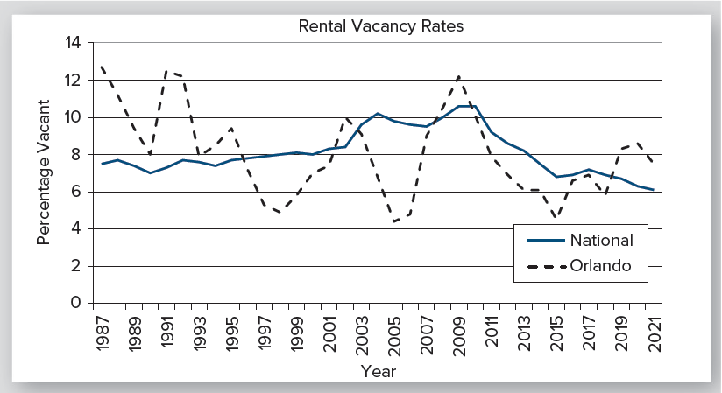
Example of Market Cycles: Apartment Vacancy Rates
Notes:
Market Projections and Real Estate Cycles

Slide 50
High-Tech Tools for Real Estate Market Research
Geographic information systems (GIS)
  Made analysis of Plane Vista possible
  Widely used in store location research
Psychographics
  Market segmentation research seeks to relate product preferences to “attitudes, interests, opinions, and values, and to demographics
  Much used for retail real estate, but can also apply to housing
Notes:
Some Tools of Market Research

Slide 51
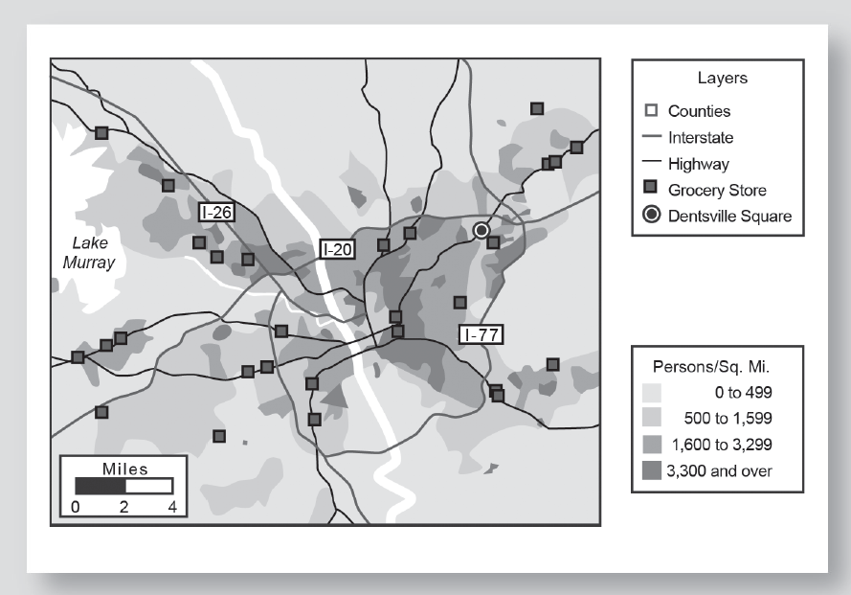
GIS in Store Location Research:
Columbia, SC
Notes:
Some Tools of Market Research

Slide 52
Survey Research
Potentially powerful tool if used thoughtfully
Example applications
  Beach-side Condo design: How many bedrooms do prospective buyers want? What amenities?
  Plane Vista: Where do current residents really work?
Risk: Ending up with meaningless questions or a meaningless sample
Key preventative tools:
  Obtain review and advice from experienced survey researchers
  PRETEST and PRETEST
Notes:
Some Tools of Market Research

