Slide 1
Chapter 5:
Market Determinants of Value

Slide 2
Ways to Minimize Market Risk
Avoid projects with high market risk
Most hotels and motels
Restaurants and entertainment facilities
Avoid projects with prospective major change
Lease rollover for major tenants
Major renovations
Study urban markets
Notes:
Introduction

Slide 3
Urban Real Estate Markets Derive from the Urban Economy
Urban growth causes real estate market growth
Urban decline causes real estate market decline
Urban change causes real estate market change
Urban land use patterns dictate real estate location patterns

Slide 4
Demand for Access: The Gravity that Creates Cities
Demand for access causes urban clustering
Competition for access creates the patterns of urban land uses

Slide 5
Where Cities Occurred
Preindustrial: Fortress or religious center
Transition points in trade routes
From river to ocean (New York, New Orleans, Hamburg, Rotterdam)
Intersection of rivers (Pittsburgh, St Louis)
From water to rail (New York, Chicago, St Louis)
From rail to rail (Chicago, Atlanta)
Natural Resources
Mining (San Francisco, Denver, Pittsburgh)
Oil (Houston, Dallas, Beaumont-Port Arthur)
Notes:
The Creation, Growth, and Decline of Cities

Slide 6
Greatest Cities Have Experienced Sequence of “Bases”
Minneapolis and Chicago
Trapping and fur trade, agriculture, industrial, service, finance and control
Pittsburgh
River trade, coal and iron, steel, commerce and services, research and health care
Detroit
Fur and agricultural trade, iron and steel, automobiles
Notes:
The Creation, Growth, and Decline of Cities

Slide 7
Economic Base
Economic Base: Activities that bring income into a city
Export activities: Products or services provided to the outside world (most manufacturing; higher education and research, advanced health care, entertainment industries)
Activities that attract money (retirement, tourism)
Secondary (Local) Activities: Activities that recirculate income in a city (local government, local merchants and services)
Notes:
The Creation, Growth, and Decline of Cities – Economic Base

Slide 8
Economic Base Multiplier
The idea: As goes the base, so goes the city
Multiplier effect: Base income is respent, producing additional income
Multiplier effect is greater as city is:
More isolated
More diversified
Larger
The base activity uses more local goods and services

Slide 9
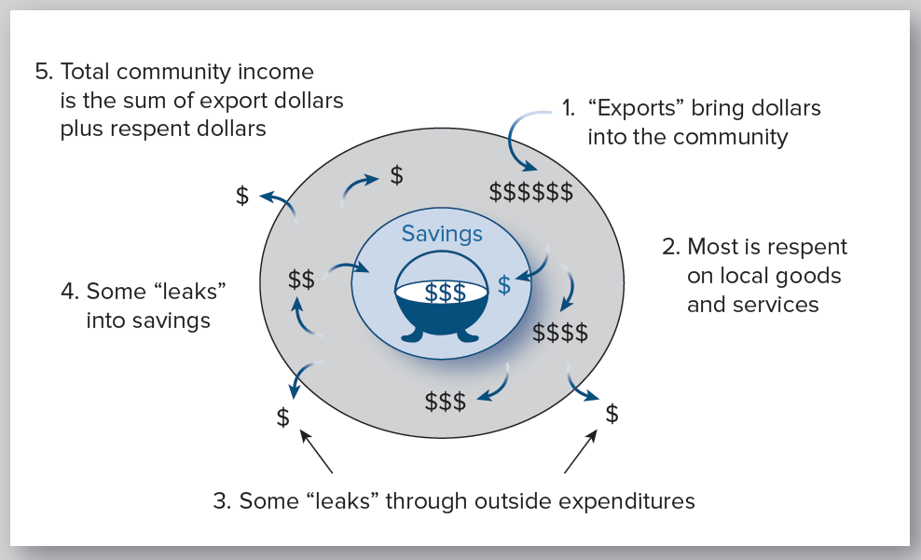
The Economic Base Multiplier
Notes:
The Creation, Growth, and Decline of Cities – Economic Base

Slide 10
Indicators of an Economic Base
Quick Indicators
USA Counties in Profile
www.statsamerica.org/
More Detailed Indicator
U.S. Census Detailed Tables
www.census.gov/quickfacts/
County Business Patterns (employment by industry and establishment size)
www.census.gov/programs-surveys/cbp.html
Notes:
The Creation, Growth, and Decline of Cities – Economic Base

Slide 11
Location Quotient as a Quick Indicator of Economic Base
Compute percent of total local workers in a given industry
Example: Suppose education employment is 20%
Compute the same percentage for the national economy
Suppose education in the national economy is 9%
Compute the ratio of local to national percentage:
Location quotient = 20% ÷ 9% = 2.22
Interpretation: Local economy has 2.22 times the normal education employment; excess is presumed to be export employment
Notes:
The Creation, Growth, and Decline of Cities – Economic Base

Slide 12
Supply Factors Affecting a Community Economic Base
Labor force characteristics
Special skills and experience
Education level
Unionization
Work ethic
Other?
Quality of life
Leadership
Financial support
Government support (subsidies, land use regulation)
Notes:
The Creation, Growth, and Decline of Cities – The Supply Side of Urban Growth

Slide 13
Additional Supply Factors-Industry Economies of Scale
Industry economies of scale: Efficiencies of production due to scale of local industry
Supply of specialized labor
Publishing specialties in New York,
Aircraft specialties in Wichita, Kansas,
Computer software and design in “Silicon Valley,”
Performing arts in New York, Los Angeles, Nashville
Supply of vendors and materials
Automobile industry
Higher education and research
Medicine and health
Oil and gas
Notes:
The Creation, Growth, and Decline of Cities – The Supply Side of Urban Growth

Slide 14
Additional Supply Factors- Agglomeration Economies
Agglomeration economies: Efficiencies in production due to multiple local, large-scale industries
Airport service
Financial services and banking
Communications and media
Medicine and health
Education and research

Slide 15
Implications of Industry and Agglomeration Economies
Cities with industry economies may be more resistant to downturns due to cost advantage
Cities with agglomeration economies may have long-term advantages:
Incubator for new businesses
Cost advantage for emerging industries
Notes:
The Creation, Growth, and Decline of Cities – The Supply Side of Urban Growth

Slide 16
What Shapes a City? Role of Demand for Access and Location Rent
Assumptions for location rent (bid-rent) model
All employment and exchange is at city center (CBD)
One road to CBD, with residential lots on both sides
Residential lots are 100 feet wide
Hourly wage rate is $20
Round-trip travel to CBD is at 20 mph
One worker per household
Households rent lots for motor homes
Workers make 20 round-trips per month to CBD
Total of 318 households
Notes:
The Shape of a City – Demand for Proximity and Bid-rent Curves

Slide 17
What Workers Bid to Be Closer
1. What is the time cost of travel?
Answer: At 20 mph, with a wage rate of $20 per hour, $1.00 per mile
2. How much time cost per month is saved by
living one mile closer to the CBD?
Answer: 20 round-trips × 2 × $1 = $40
Conclusion: Workers will bid $40 per month to live 1 mile closer to CBD
Notes:
The Shape of a City – Demand for Proximity and Bid-rent Curves

Slide 18
The Implied Bid-Rent Curve
Bid-rent
$120
$80
$40
Distance
from CBD
CBD
1 mi.
2 mi.
3 mi.
What factors affect a bid-rent curve?
Number of bidders (commuters or firms)
Wage rate (time cost) of commuters
Speed of travel
Frequency of trips
Notes:
The Shape of a City – Demand for Proximity and Bid-rent Curves

Slide 19
Case with Drivers and Walkers
Suppose 106 of the 318 houses have workers who walk to work
Walking speed: 3 mph
Effects:
Walkers’ time cost per mile is $6.67 ($20 ÷ 3)
Walkers will pay $266.67 ($6.67 × 20 × 2) per mile per month to be closer
All walkers will always outbid drivers for any lot

Slide 20
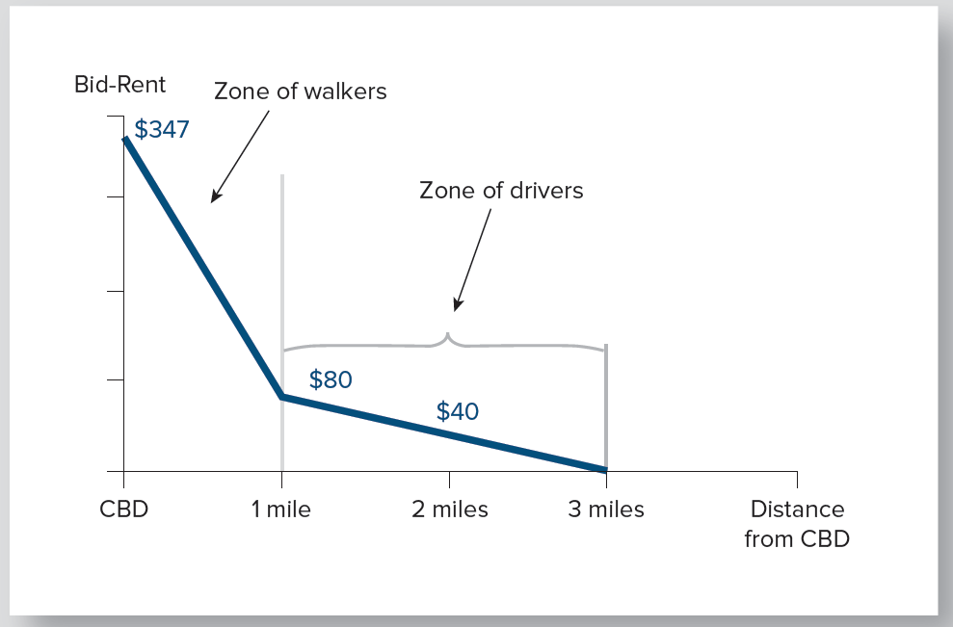
Bid Rent Curve with Drivers and Walkers
Notes:
The Shape of a City – Demand for Proximity and Bid-rent Curves

Slide 21
Case with Drivers, Walkers and Doctors
Suppose (of 318 households), 108 are walkers and 26 are doctors
Doctors’ commuting speed is 20 mph
Doctors’ wage rate is $200 per hour
Effects:
Doctors’ time cost per mile is $10 (200 ÷ 20).
Doctors will pay $400 ($10 × 2 × 20) to live 1 mile closer
Doctors outbid all others to be closer to the CBD

Slide 22
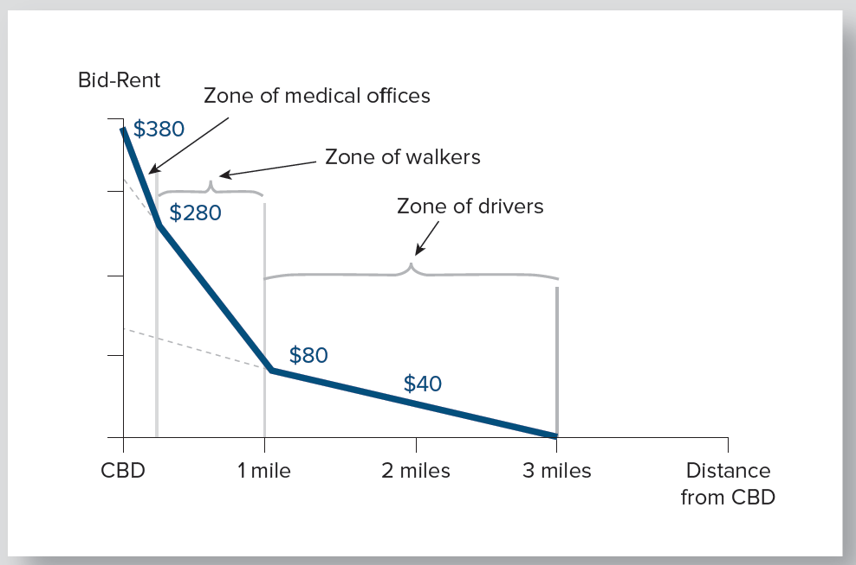
Bid-Rent Curve with Drivers, Walkers and Doctors
Notes:
The Shape of a City – Demand for Proximity and Bid-rent Curves

Slide 23
Case with Medical Center Outside CBD
Relative demand for access to medical center:
Highest demand for access: Doctors
Next highest demand for access: Pharmacies, labs, equipment vendors, and other supporting activities
Third highest demand for access: Residences of medical community

Slide 24
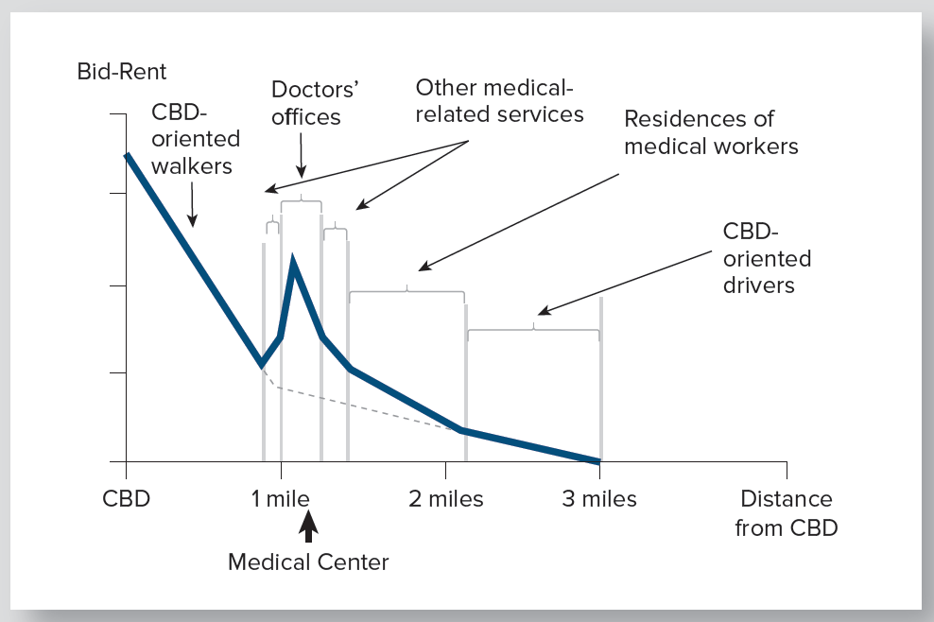
Bid-Rent Curve with Medical Center Outside CBD
Notes:
The Shape of a City – Demand for Proximity and Bid-rent Curves

Slide 25
Bid-Rent Curve with Medical Center Outside CBD: Effect
All medically oriented firms and households outbid all drivers to CBD
Medically oriented land use outbids some walkers to CBD
Three zones of medical land use results:
Doctors’ offices
Other medical firms
Residences of medical personnel

Slide 26
Bid-Rent Curves vs. Reality of Urban Land Use
Bid-rent analysis
Explains how urban land uses are determined
Assumes all commuters have one demand for access (a single “linkage”)
Real World
Households and firms have many linkages
Competition for land use is vastly more complex
Determination of land rent /value is also more complex
Demand for access still is fundamental driver
Notes:
The Shape of a City – Demand for Proximity and Bid-rent Curves

Slide 27
Three Observed Patterns of Urban Form
Burgess Concentric Circle Model, 1923
Hoyt Sector Model, 1939
Harris and Ulman Multinuclei model, 1945
Notes:
The Shape of a City - Changing Transportation, Changing Technology, and Changing Urban Form

Slide 28
Observed Patterns of Urban Form
Burgess: Concentric Circle Model, 1923
1. Industrial and Downtown
2. Warehouse
2
4
5
3. Transition
1
3
6
4. Blue Collar
5. White Collar Clerical
6. Executive
Notes:
The Shape of a City - Changing Transportation, Changing Technology, and Changing Urban Form

Slide 29
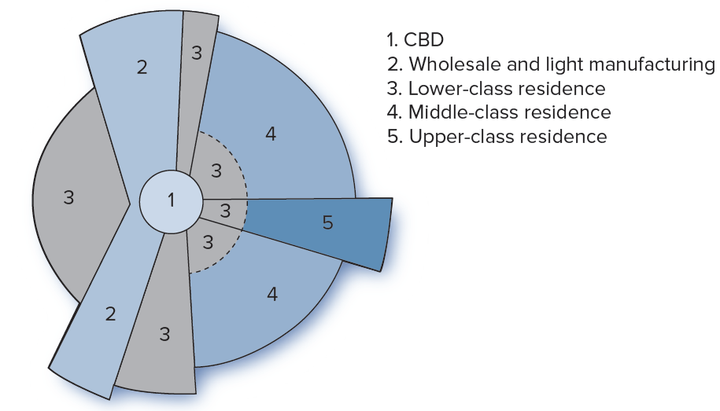
Observed Patterns of Urban Form
Hoyt: Sector Model, 1939
Notes:
The Shape of a City - Changing Transportation, Changing Technology, and Changing Urban Form

Slide 30
Multinuclei City: Changing Urban Form
Multinuclei pattern observed by Harris and Ullman by 1945
CBD no longer the single center of activity
Question: What is causing change in urban form?
What will it lead to?
Notes:
The Shape of a City - Changing Transportation, Changing Technology, and Changing Urban Form

Slide 31
Technical Changes from 1920 to the Present
Automotive revolution
1920: One car per 13 persons
1930: One car per 5 persons
2003: More than one car per driver
Birth and advancement of the truck
Expansion of highways
Half of all roads were hard surface by 1940
Interstate system beginning in 1955

Slide 32
Technical Changes from 1920 to the Present (continued)
Production revolution
Birth of the assembly line
Horizontal rather than vertical processes
Effect of the telephone on decentralization
Recent decades
Automation
Robotics
Computer controls
Internet
Smart phones
Notes:
The Shape of a City - Changing Transportation, Changing Technology, and Changing Urban Form

Slide 33
Technical Changes from 1920 to the Present (continued)
Advances for offices and retailing
Air conditioning
Fluorescent lighting
Self-service retailing (rise of packaging and advertising)
Data processing and communications
Advances in telephones
Birth of computers
Explosion of “cyberspace”
Smart phones, etc.

Slide 34
Effects of Technological Change on Urban Form
Dispersion of employment/urban life to suburbs
Obsolescence of older structures
Vertical manufacturing facilities
Low-ceiling, small-depth buildings
Non-air-conditioned office and retail buildings
Very slow but profound change in streets and technology of transportation system
Notes:
The Shape of a City - Changing Transportation, Changing Technology, and Changing Urban Form

Slide 35
Variations in Intraurban Location Patterns
“Convenience” goods and services
Users tend to go to the closest source
Sandwich shops
Coffee shops
Barber and beauty shops
Drug stores
Convenience grocery stores
Automotive service stations
Neighborhood shopping centers
Gyms?
Other?
Locational pattern: Tends toward uniform dispersion
Distance of separation depends on customer concentration and minimum required market size
Notes:
Differing Location Patterns of Urban Land Uses

Slide 36
Maximum
Market Area
Notes:
Differing Location Patterns of Urban Land Uses

Slide 37
Idealized Location Pattern of Convenience Goods and Services
Circles are maximum market perimeter for each provider
Straight lines demarcate equal-access “ridges” between providers
Notes:
Differing Location Patterns of Urban Land Uses

Slide 38
Variations on Intra-urban Location Patterns
Comparison goods and clustering
Buyers want to compare many goods
Rationale for shopping malls
Motivation for “New car row”
Industry economies of scale and clustering
Suburban office parks
Research universities
Tourist attractions? (International Drive in Orlando)
Other?
Notes:
Differing Location Patterns of Urban Land Uses

Slide 39
Some Implications for Real Estate Market Analysis
Location within the urban matrix is what matters
Distances from related activities
Relevant linkages depends on type of land use
Urban growth is not uniform; there are both emerging and declining nuclei
The transportation network and urban patterns respond to technical and market changes, but very slowly – over many years
Notes:
The Role of Urban Analysis in Real Estate Decisions

