Slide 1
Chapter 20
Income Taxation and Value

Slide 2
Federal Income Taxation
If RE investors are successful, the federal (& usually state) government shares in that success
If RE investors lose, federal government may not share in losses
Income taxes have a significant effect on returns that can ultimately be consumed or invested by investor/taxpayer
Result?
  Market values/prices significantly affected by tax law

Slide 3
Taxation of Individuals vs. Corporations
For investing in CRE…
    The double taxation of income renders C corporations a less desirable form of ownership than “flowthrough” entities such as LLCs & LPs
      Effects of Tax Cuts & Jobs Act (TCJA) of 2017?
      What about REITs?
We therefore focus on the taxation of individuals who invest in CRE via flow-through entities

Slide 4
IRS Tax Classifications for Real Estate
RE held
  as a personal residence
  for sale to others (dealer property)
  for use in trade or business (section 1231 assets)
  for investment (capital assets)

Slide 5
IRS Tax Classifications
Important because they:
  determine if depreciation is allowed
    personal residences & “dealer” property can’t be depreciated
  may affect taxes due on sale
    Net gains from sale of trade or business property (held for a year) are taxed at capital gain tax rates*
    Net losses on “trade or business” property are deductible w/o limit against ordinary income
    *However, the net gain on 1231 assets is treated as ordinary income to the extent of the taxpayer’s net 1231 losses clamed during the most recent 5 years

Slide 6
IRS Tax Classifications
Investment property
  Losses on sales of investment assets are generally limited
  Generally can’t be depreciated
Is rental RE “investment property” or “trade or business” (Section 1231) property?
www.irs.gov/index.html
IRS website

Slide 7
Income Subject to Taxation
Active Basket
Portfolio Basket
rrrrrrrrrrrr
Passive Basket
+ Salary Income
+ Consulting Income
+ Sales
Commissions
= Net Active
Income
+ Interest
+ Dividends
+ Annuities
+ Cap Gains on
Stocks
- Interest incurred in
Producing Income
= Net Portfolio
Income
+ Taxable Income from
Business in which no
“Material Participation”
+ Any Rental Income
Any Expenses from
Producing Rental
Income
= Net Passive Income
Taxed at ordinary rates
Taxed at ordinary or capital gain rates
Ordinary, capital gain, and/or recapture rates

Slide 8
Passive Activity Loss Restrictions: Summary
Taxable income & losses (not CFs) on all passive activities are first netted
If net passive income is negative, it cannot be used to offset active or portfolio income

Slide 9
Income Subject to Taxation
Active Basket
Portfolio Basket
rrrrrrrrrrrr
Passive Basket
+ Salary Income
+ Consulting Income
+ Sales
Commissions
= Net Active
Income
+ Interest
+ Dividends
+ Annuities
+ Cap Gains on
Stocks
- Interest incurred in
Producing Income
= Net Portfolio
Income
+ Taxable Income from
Business in which no
“Material Participation”
+ Any Rental Income
Any Expenses from
Producing Rental
Income
= Net Passive Income
Taxed at ordinary rates
Taxed at ordinary or capital gain rates
Ordinary, capital gain, and/or recapture rates
Can’t use net passive losses to reduce active income subject to taxation

Slide 10
Passive Activity Loss Restrictions: Continued
Disallowed passive losses are carried forward until taxpayer has sufficient passive income to deduct deferred losses
To use losses from a passive investment, taxpayer needs other passive activities that are producing positive taxable income in that year
  i.e., “PALs” need “PIGs”
Corporations not subject to PAL restrictions

Slide 11
Two Other Exemptions
(1) $25,000 annual exemption for taxpayers with AGI < $100,000 (not changed since 1986)
  Note: With inflation should now be about $190,000
For every $1.0 over $100K in AGI, taxpayer losses $0.50 of the $25K exemption
  AGI $100K $110K $125K $140K $150K
  Lost exemption $ 0K $ 5K $12.5K $ 20K $ 25K
  Remaining exemption $ 25K $ 20K $12.5K $ 5K $ 0K

Slide 12
Examples of $25,000 Exemption Phase Out

Slide 13
Two Other Exemptions, Cont.
(2) If taxpayer’s primary business is “real estate” (at least 750 hours per year),
  …net tax losses from RE rental activities can be used to offset income from providing the following RE services:
  Development, Construction, Acquisition, Management, Brokerage, Leasing, and others

Slide 14
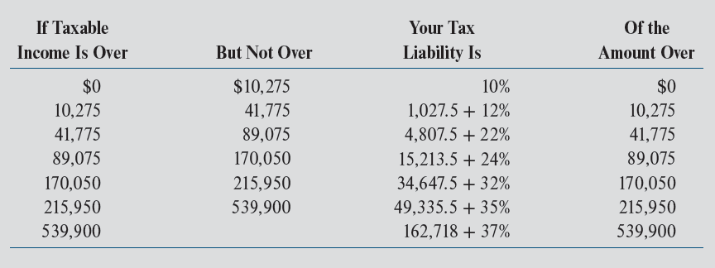
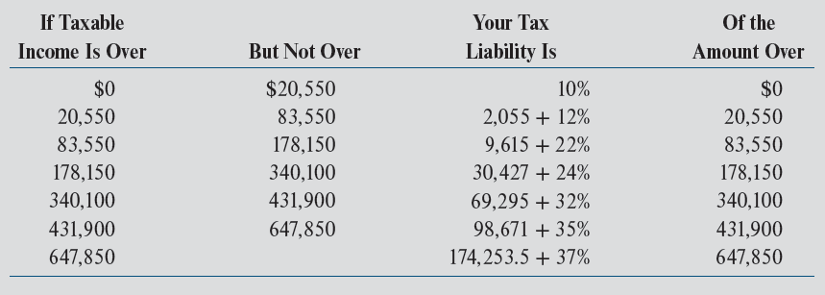
Federal Tax Rates: 2022
Exhibit 20-1: Single Taxpayers
TCJA: Maximum statutory rate fell from 39.6% to 37.0%
Exhibit 20-2: Married Taxpayers

Slide 15
Average vs. Marginal Tax Rates
If single taxpayer has $80,000 in 2022 taxable income, total federal tax
= $4,807.5 + 0.22 ($80,000 – $41,775)
= $13,217
Marginal Rate:
= 22%
Average Rate:
= $13,217/$80,000 = 0.1652 or 16.5%
Which tax rate matters for investment valuation/decision making?

Slide 16
Deduction for “Qualified Business Income” as a Result of TCJA (IRS Sec 199A)
TCJA greatly reduced max. tax rates for corporations (from max of 35% to 21%)
Congress decided qualified business income (QBI) earned by pass-through entities (partnerships, limited liability companies, etc.) should also receive tax rate reductions
So…in addition to modest reductions in personal statutory rates, TCJA allows a 20% exclusion of taxable income for many owners/investors in pass-through entities
  Note: exclusion is at taxpayer level
If allowed full exclusion, effective max. marginal rate on that income is:
= [37% * (1 – 0.20)] = 29.6%

Slide 17
Deduction for “Qualified Business Income” as a Result of TCJA
Determination of QBI is quite complex
  Limitations on deduction for married HHs with > $315,000 in taxable income (before QBI deduction) and single HHs with > $157,500 in TI
  For these HHs, deduction is limited to 25% × (entity’s W-2 wages) + (2.5% of the initial depreciable basis of property owned by the entity)

Slide 18
Deduction for “Qualified Business Income” as a Result of TCJA (not req.)
Example:
  Alice, a single person, owns a duplex she rents out
  In 2018, she earns a total profit (TI) of $20,000 (not net CF)
  Alice is a sole proprietor
  She reports her rental income & expenses on IRS Schedule E
  She adds her $20,000 rental profit to her other sources of income & pays tax on it at her individual tax rate
  In 2018, her marginal (federal) tax rate is 24%, so she would pay $4,800 (0.24 × $20,000) in tax on her rental profit w/o the QBI deduction

Slide 19
Deduction for “Qualified Business Income” as a Result of TCJA (not req.)
Example, cont.:
  Assume Alice had $100,000 in taxable income in 2018, which is < $157,500
    So, no limitation on deduction, which = $4,000 (20% × $20,000 rental income)
    This saves her $960 ($4,000 × 0.24) in income tax
  Assume Alice had $250,000 in total taxable income in 2018
    No employees in her rental business; so deduction is limited to 2.5% of depreciable basis of property she uses in her rental activities, which consist of just the duplex
    Her initial depreciable basis (purchase price - land value) = $100,000
    Her pass-through deduction is limited to 2.5% × $100,000 = $2,500
    This saves her $600 ($2,500 × 0.24) in income tax
In a LLC, each investor is allocated a pro rata share of the (2.5% x property value)

Slide 20
Estimating Tax Liabilities from Rental Operations
© MCGRAW HILL LLC. ALL RIGHTS RESERVED. NO REPRODUCTION OR DISTRIBUTION WITHOUT THE PRIOR WRITTEN CONSENT OF MCGRAW HILL LLC.
20

Slide 21
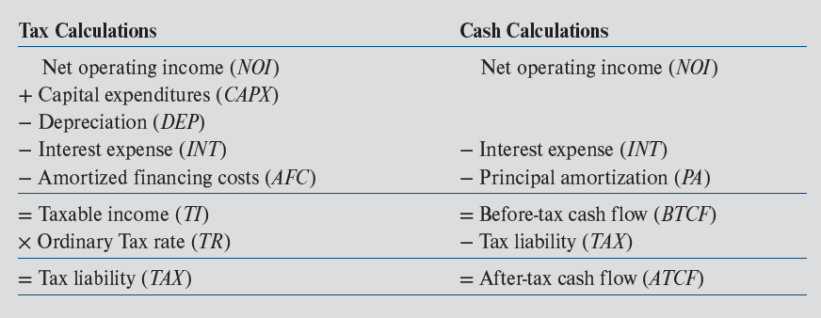
Estimating Tax Liabilities from Operations: Exhibit 20-3
Need to review Chapters 8 and 18
Investors are concerned with CFs, but tax calculations are required to get to the net CFs received by investor
Because all CAPX was subtracted from EGI in the calculation of NOI, all CAPX must be added back in the cash calculations. Why? Because CAPX are not deductible in the year in which they are incurred (they are depreciated)

Slide 22
Estimating Tax Liabilities from Operations: Exhibit 20-3
Mortgage payment
Big driver of difference between TI and BTCF? Depreciation

Slide 23
Cost of Mortgage Financing
Mortgage interest generally deductible in year paid
Repayment of loan principal is not
Up-front financing costs on trade or business properties or investment properties are amortized over life of loan
  If loan is prepaid before up-front costs are fully deducted, remaining costs can be deducted in year of sale
Note: TCJA may limit full interest deductibility for some investors

Slide 24
Calculating Tax Depreciation
What is "conceptual" basis for tax depreciation?
What determines amount of tax depreciation?
1. Original depreciable basis
2. Cost recovery period
3. Method of depreciation

Slide 25
Depreciable Basis of Existing Property
Starting point is original cost basis, which is equal to total acquisition price of property:
  Land, building, & personal property
Original depreciable basis for existing property:
  Original cost basis - land value
Depreciable basis of the real property:
  Original depreciable basis minus value of personal property

Slide 26
Depreciable Basis of Existing Property
Original cost basis (typically, price + acquisition costs)
- Land value
= Original (total) depreciable basis
  - Value of personal property
= Depreciable basis of real property

Slide 27
Cost Recovery Periods
Cost recovery periods for real (not personal) property:
  27.5 years for "residential" income property
  39.0 years for "non-residential" income property
  (31.5 if placed in service before May 13, 1993)
Distinction between residential & non-residential income property?
What determines amount of tax depreciation?
1. Original depreciable basis
2. Cost recovery period
3. Method of depreciation

Slide 28
Methods of Depreciation
Straight-line method
For 27.5 year residential:
For 39 year commercial:
Depreciation tables supplied by IRS
“Mid-month” convention?

Slide 29
Methods of Depreciation for Personal-Not Real-Property
Declining balance methods (i.e., accelerated)
For 150% declining balance & 15-year recovery period:

Slide 30
Depreciation of Personal Property
Cost recovery periods for personal (not real) property:
  Carpeting & draperies: 3 years, 200% declining balance.
  Office equipment & fixtures: 7 years, 200% declining balance
  Landscaping & sidewalks: 15 years, 150% declining balance
What is “cost segregation”?
  see Industry Issues 20-1

Slide 31
Depreciation Creates Tax Shelter
Rental Income
Owner’s Cash Flow
Owner’s
view
Loan Payments
(Interest only Loan)
Operating Expenses
1 2 3 4 5 Year
Taxable Cash Flow
IRS
view
Depreciation
Loan Payments
Operating Expenses
1 2 3 4 5 Year

Slide 32
Other Taxing Issues
Treatment of operating expenses vs. capital expenditures
Substantial improvements
  CAPXs made after initial purchase are treated as a separate building or improvement
    Depreciation begins in year of expenditure
      Subject to mid-month convention

Slide 33
Tax Credits
© MCGRAW HILL LLC. ALL RIGHTS RESERVED. NO REPRODUCTION OR DISTRIBUTION WITHOUT THE PRIOR WRITTEN CONSENT OF MCGRAW HILL LLC.
33

Slide 34
Tax Credits
Tax law allows taxpayers to take credits against tax liability for
  rehabilitation of older & historic structures
  construction & rehabilitation of qualified low-income housing

Slide 35
Tax Credits
A tax credit is a dollar-for-dollar reduction in tax liability (not taxable income)
  A $1 deduction for investor in a 30% tax bracket saves $0.30 in taxes
  A $1 credit save $1.0 in taxes

Slide 36
Rehabilitation Tax Credits
A 20% one-time credit may be taken for rehab expenditures on residential or nonresidential structures so long as
  they are at least 50 years old, and
  listed on National Register of Historic Places or located in a registered historic district
Credit reduces depreciable basis $ for $

Slide 37
Low Income Housing Tax Credits
LIHTC is a federal tax credit for development or acquisition of “affordable” rental housing
Credits are:
  allowed each year for 10 years and
  in addition to regular depreciation deductions
Created by Congress in 1986
Designed to provide incentives for private equity investment in low-income housing
  Accounts for ≈ 7% of all new apartment construction since 1986
http://portal.hud.gov/hudportal/HUD?src=/program_offices/fair_housing_equal_opp/lihtcmou
HUD website on LIHTC

Slide 38
LIHTCs: How Are They Administered?
LIHTC governed by federal tax code but administered by each state’s Housing Finance Agency (HFA)
  States have wide discretion
  Qualified Allocation Plans (QAPs)
      details state’s selection criteria & application requirements
  About 1/5 to ½ of projects that apply receive credits from state
Maximum amount of credits each state can approve in 2020 = Max ($2.8125 × state population, $3,217,500)

Slide 39
LIHTC: How is it Calculated?
For new construction not receiving other federal subsidies…
  Fixed credit is approximately 9% of “qualified” basis
    % is published monthly by IRS
    set such that PV of credits = 70% of qualified basis
For acquisition of existing buildings or new construction receiving other federal subsidies
  Fixed credit is approximately 4% of qualified basis

Slide 40
So…How Big are the Credits? Example
Local developer has applied for tax credits to build 70 units of low-income rental housing. No federal funds will be used. Project will not be located in a “QCT” or “DDA.” 100% of the units will be set aside for low & rent restricted HHs.
Land acquisition $1,000,000
Dwelling construction 3,400,000 Site improvements 535,000
Architectural/engineering 40,000
Other eligible soft costs 25,000
Total development costs $5,000,000
Eligible basis = $4,000,000 (total dev. cost – land cost)
Qualified basis = $4,000,000 (eligible basis × 100%)
Annual credit = $360,000 ($4,000,000 × 9% credit)
Total credits = $3,600,000 ($360,000 × 10)

Slide 41
So…How Big are the Credits? Example
Land acquisition $1,000,000
Dwelling construction 3,400,000 Site improvements 535,000
Architectural/engineering 40,000
Other eligible soft costs 25,000
Total development costs $5,000,000
Assume investors/limited partners agree to purchase credits from developer for 75 cents on the dollar for a total of $2,700,000 ($3,600,000 × 0.75)
% of total development costs covered by selling credits = 54% ($2,700,000 / $5,000,000)
Credit purchaser must be part of the ownership entity
In QCTs or DDAs, credit is based on 130% of the qualified basis

Slide 42
LIHTCs: Maximum HH Incomes & Rents
Properties are required to meet certain tests that restrict the
  income of eligible HHs, and the
  amount of rent that is paid by tenant

Slide 43
LIHTCs: What are the Economics?
Developers/syndicators sell the tax credits by creating a LP or LLC
Why does it work?
  Without credits, rents would need to be MUCH higher to induce private investment
    Result? No new construction
  With credits, adequate returns can be earned even with rent restrictions
Majority of LIHTC projects receive other subsidies from local and/or state governments
  Below-market mortgage rates

Slide 44
LIHTC: Main Drawbacks
Required to meet 30-yr compliance period
  Although some states encourage developers to pledge longer periods of rent restrictions
Credits subject to “recapture” with interest if
  criteria are not continuously satisfied for 30 years or if
  project is sold before end of 30-year compliance period
Passive activity loss rules limit ability of individual investors to use credits
  Credits purchased by c-corporations
    Who are not subject to PAL restrictions

Slide 45
Centre Point Example
© MCGRAW HILL LLC. ALL RIGHTS RESERVED. NO REPRODUCTION OR DISTRIBUTION WITHOUT THE PRIOR WRITTEN CONSENT OF MCGRAW HILL LLC.
45

Slide 46
Centre Point Office Building
Tax assumptions contained in Exhibit 20-5
  80% of $1,056,000 price (original cost basis), or $844,800, is allocated to depreciable real property
  20% allocated to land (i.e., no personal property)
  Investor in 30% tax bracket on ordinary income
Total up-front financing cost of $23,769 ($792,000 × 0.03) are amortized over loan term (30 years)

Slide 47
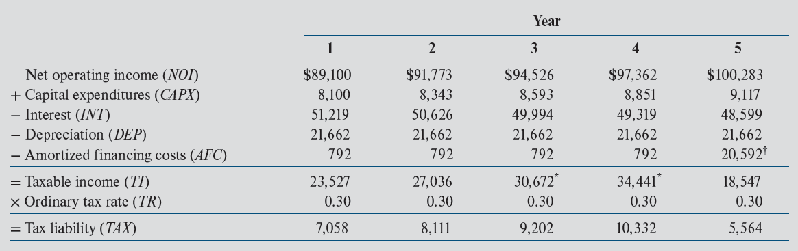
Centre Point Office Building: Estimated Taxes From Operations
Exhibit 20-6
CFs over the next 12 months—not next calendar year
Why ANNUAL CFs?

Slide 48
Centre Point Office Building: Estimated Taxes From Operations
Exhibit 20-6
792 = $23,769/30
Assuming, for simplicity, that CAPX are added to tax basis but not depreciated; thus, the constant $21,662 depreciation deduction is based on the original depreciable basis of $844,800 ($844,800/39 = $21,662). Calculation ignores mid-month convention.

Slide 49
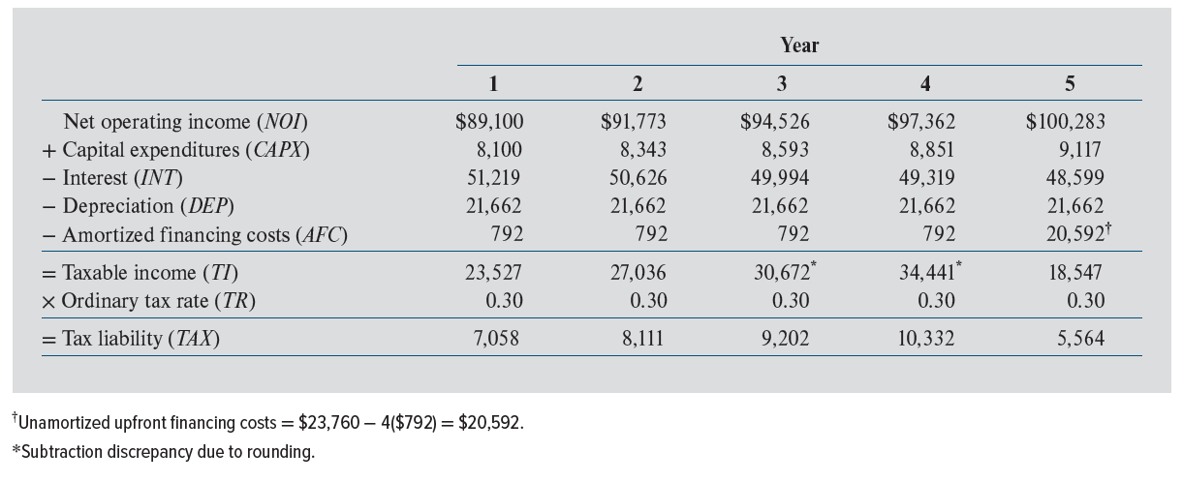
Centre Point Office Building: Estimated Taxes From Operations
Exhibit 20-6
Includes unamortized up-front financing costs

Slide 50
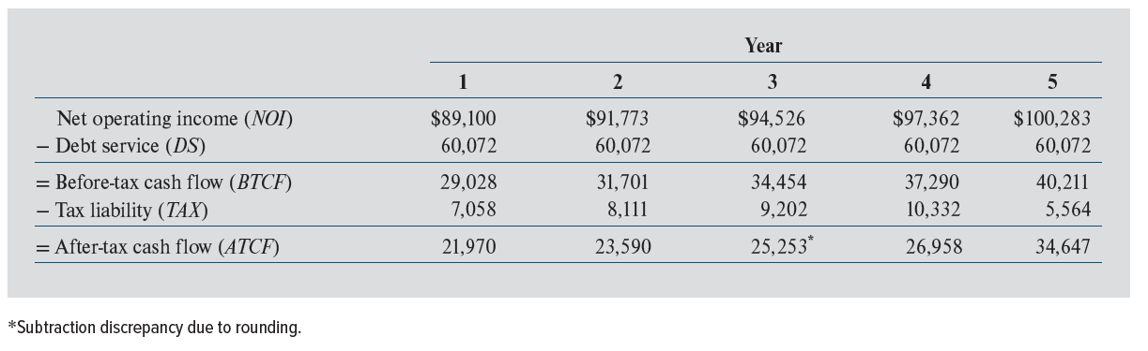
Centre Point: Estimated After-Tax Cash Flows From Operations
Exhibit 20-7
From Exhibit 20-6

Slide 51
Estimating Tax Liabilities from Property Sales
© MCGRAW HILL LLC. ALL RIGHTS RESERVED. NO REPRODUCTION OR DISTRIBUTION WITHOUT THE PRIOR WRITTEN CONSENT OF MCGRAW HILL LLC.
51

Slide 52
Estimating Tax Liabilities from Sale
Fully taxable transactions
  When seller receives full payment from buyer in sale year
Tax-deferred transactions
  Section 1031 “like-kind “exchanges
  “Opportunity Zone” investments (TCJA)

Slide 53
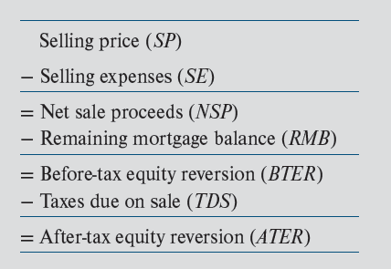
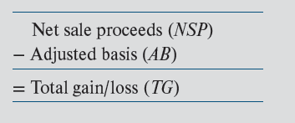
Fully Taxable Sale
Cash Calculations
Exhibit 20-9
Tax Calculations
Exhibit 20-11
Includes land
Important!! Total gain/loss (TG) is NOT equal to BTER!!!

Slide 54
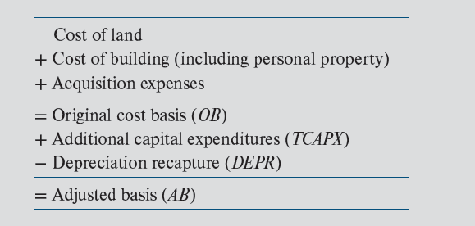
Calculating the Adjusted Tax Basis
Exhibit 20-10

Slide 55
Types of Income Generated by Sale of Property
Total gain/loss from sale of real property (TG) must be allocated to the following categories:
  Ordinary income
    Pre-TCJA: 39.6% max. federal rate
    Post-TCJA: 37% (ignoring QBI exclusion)
  Capital gain income
    20% max. statutory federal rate
  Depreciation recapture inc. income
    25% max. statutory federal rate
Exhibit 20-11

Slide 56
Types of Income Generated by Sale of Property
Total gain/loss from sale of property (TG) must be allocated to the following categories:
  Ordinary income
    Pre-TCJA: 39.6% max. federal rate
    Post-TCJA: 37%
  Capital gain income
    20% max. statutory federal rate
  Depreciation recapture inc. income
    25% max. statutory federal rate
Exhibit 20-11
As a result of legislation passed year-end of 2012:
In addition, married HHs with AGI > $250,000 owe an “Obama Care” (NIIT) surcharge of 3.8% on investment income, including rental income, dep. recapture income & capital gain income
Results: max rate on CG income, 23.8% (20%+3.8%); on rental income, 40.8% (37.0% + 3.8%); on depreciation recapture income, 28.8% (25% + 3.8%)

Slide 57
Good News and Bad News at Sale of Investment Real Estate
Net Sale
Price
Net Sale Price: Price
less expenses of sale
Acquisition
Cost
Long-term Capital Gain
Appreciation
Taxed favorably
Total Depreciation Claimed
Taxed unfavorably
Acquisition Cost:
Price plus other
acquisition expenses
Depreciated Value
0 1 2 3 4 5 6 7 8 9 10 Year

Slide 58
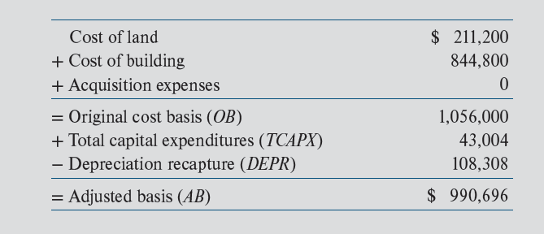
Adjusted Tax Basis: Centre Point
Exhibit 20-14
Don’t forget to include land
5 × $21,661.5
Note: $43,004 is total amount of CAPX over 5-year holding period; it is assumed for simplicity that CAPXs were added to the tax basis each year but NOT separately depreciated

Slide 59
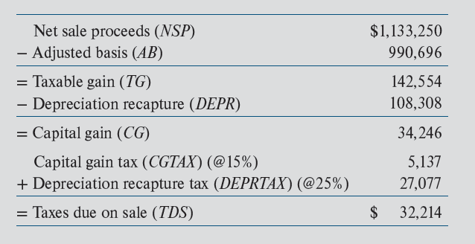
Taxes Due on Sale: Centre Point
Exhibit 20-15
From Exhibit 20-15
0.25 × 108,308

Slide 60
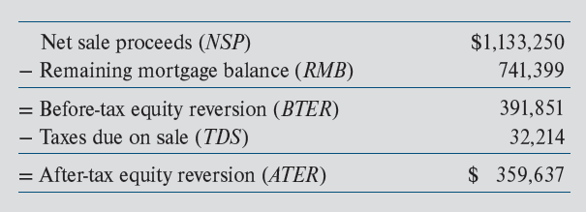
After-Tax Equity Reversion: Centre Point
Exhibit 20-16
Note: Total Taxable Gain is $142,554 (Exhibit 20-16), which is $249,297 less than the estimated $391,851 BTER!

Slide 61
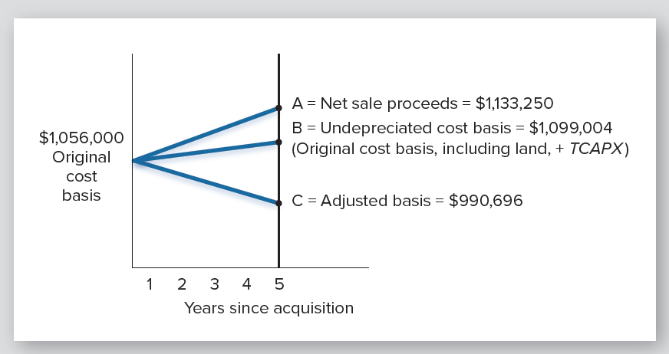
Components of Taxable Gain on Sale: Centre Point
Exhibit 20-17

Slide 62
Practice Problem
5 years ago you purchased a small apartment complex for $1 million (original cost basis).
The original depreciable basis was $750,000
Annual depreciation deduction = $27,272.73
Total depreciation-5 yrs = 5 × $27,272.73 = $136,364
No capital expenditures have been made since acquisition.
If you sell the property today for $1,270,000, what will be the taxes due on sale?
  Assume 6% selling costs, 33% ordinary income tax rate, a 15% capital gains tax rate, and a 25% recapture rate.

Slide 63
Practice Problem: Solution

Slide 64
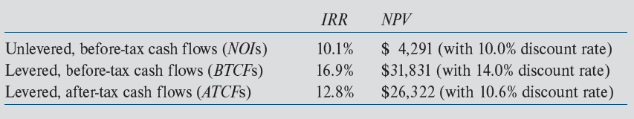
Effects of Debt & Taxes on Centre Point IRR & NPV
Exhibit 20-19
Why 10.6% after-tax discount rate?
10.6% = 14.0% (1 – 0.24)
After-tax opportunity cost of equity always < before-tax
Overall effective tax rate = 24 percent
= [(16.9% – 12.8%) ÷ 16.9%)]

Slide 65
Deferring Taxes on Property Sales
© MCGRAW HILL LLC. ALL RIGHTS RESERVED. NO REPRODUCTION OR DISTRIBUTION WITHOUT THE PRIOR WRITTEN CONSENT OF MCGRAW HILL LLC.
65

Slide 66
Do You Remember This Slide?
Types of dispositions…….
Fully taxable transactions
  When seller receives full payment from buyer in sale year
Tax-deferred transactions
  Section 1031 “like-kind “exchanges
  “Opportunity Zone” investments (TCJA)

Slide 67
Section 1031 Exchanges
Exchanges are performed under Section 1031 of Internal Revenue Code, which states that:
    "no gain or loss shall be recognized if property held for productive use in trade or business or for investment is exchanged solely for property of a like kind to be held either for productive use in trade or business or for investment"

Slide 68
Section 1031 Exchanges
Involved 50% or more of all transactions in some markets (prior to market downturn, 2008-2012)
Note: Creates tax deferral, NOT tax exclusion!
  How different from owner-occupied housing?

Slide 69
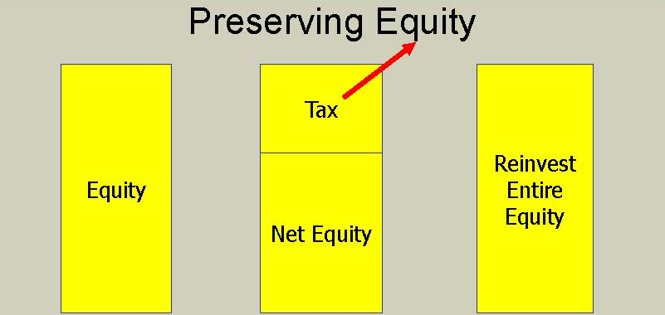
Why Exchange?
Conserve cash by deferring recognition of part or all of realized gain
  Deferred taxes are akin to interest free loan from Treasury
MV – mortgage amount
w/o exchange
with exchange

Slide 70
Why Exchange?
Strategically alter RE holdings w/o incurring taxes
Which allows taxpayer to
  Alter the location of properties in her portfolio
  Alter the types of properties in her portfolio

Slide 71
Basic Requirements for an Exchange
Must be an exchange -- i.e., a reciprocal transfer of property
Both assets must be held
  for productive use in a trade or business, or
  as an investment
Does not apply to personal residences (Section 1034)
Must involve "like-kind" property
  RE for RE meets like-kind requirements, regardless of any improvements/quality

Slide 72
Potential Drawbacks of Exchange?
You take your old depreciable basis AND depreciation deductions into new property
If you sell the replacement property later, your taxable gain will be larger to the extent of the gain you deferred when you did the exchange

Slide 73
“Opportunity Zones”
Created by TCJA of 2017
Designed to direct private investment capital to “low-income, high poverty census tracts”
  As designated by each state/certified by U.S. Treasury
  ≈ 12-15% of all U.S. neighborhoods (census tracts)…

Slide 74
“Opportunity Zones”
If proceeds from sale of RE, stocks, securities, etc. are invested in entity (QOF) that is investing in a QOZ:
  Capital gain (not depreciation recapture) tax on asset sale is deferred until
    the QOZ investment is sold, or
    December 31, 2026, whichever comes first

Slide 75
“Opportunity Zones””
In addition to tax deferral on old/sold asset, investors can avoid capital gain tax on sale of new property(s)
How?
  If QOZ investment is held for > 10 years, tax basis is increased to fair market value of the new property(s) when sold
    which means no capital gain will be recognized

Slide 76
Tax Factors Affecting Homeowners
© MCGRAW HILL LLC. ALL RIGHTS RESERVED. NO REPRODUCTION OR DISTRIBUTION WITHOUT THE PRIOR WRITTEN CONSENT OF MCGRAW HILL LLC.
76

Slide 77
Tax Factors Affecting Homeowners
Deduction of Mortgage Interest:
  Benefit is proportional to owner’s marginal tax bracket
  After-tax cost of pmt = pmt - tax savings
= pmt - (interest x tax rate)
Pre-TCJA: maximum indebtedness on which interest was deductible = $1M
Post-TCJA: maximum indebtedness = $750,000; interest on home equity lines of credit….?

Slide 78
Tax Factors Affecting Homeowners
Deduction of Property Taxes:
  Assume: 6,000 in taxes; 28% marginal tax rate
After-tax cost of pmt = pmt - tax savings
= $6,000 - ($6,000 × 0.28)
= $4,320
Post-TCJA: Deduction for local property taxes + state & local income taxes + state & local sales taxes can’t exceed $10,000
Limitation on SALT deductions will/is have big effect in states with high house prices & property taxes!!

Slide 79
Tax Factors Affecting Homeowners
Exclusion of Capital Gains Tax for Homeowners
  Individuals can exclude $250,000 ($500,000 for married filing jointly) of taxable gain realized on sale of personal residence
    Taxable gain = NSP – adjusted basis
  To qualify, taxpayer must have owned & used property as his/her/their personal residence for at least two years during prior five years before sale

Slide 80
Tax Factors Affecting Homeowners
Discount Points Paid at Loan Origination
  Fully deductible in year paid
Discount Points Paid on Mortgage Refinancing
  Amortized over life of loan
Other "Closing Costs" Charged by the Lender
  Added to tax basis (i.e, not deductible)
    Examples: Origination fee, credit checks, property appraisal, lender's attorneys fees
Costs Associated with Acquiring Property (Not the Mortgage)?
    Added to tax basis (i.e., not deductible)

Slide 81
Deduction of Mtg. Interest is NOT Primary Homeowner Tax Benefit
Assume household has $400,000 in wealth invested at average rate of 5%, generating $20,000 in investment income
Household purchases $200,000 home with all cash
  Tax effect? TI reduced by $10,000 (0.05 × $200,000)
2. Household purchases $200,000 home with $40,000 cash & $160,000, 5% mortgage
  Tax effect? TI reduced by $10,000
  $ 2,000 = decrease in invest. income (0.05 × $40,000)
  $ 8,000 = int. deduction (0.05 × $160,000)
  $10,000 = Total reduction in taxable income

Slide 82
Deduction of Mtg. Interest is Not Primary Homeowner Tax Benefit
So….if cost of mortgage is ≈ borrower's opportunity cost of invested equity (a reasonable assumption), replacing equity financing with more debt financing does NOT reduce tax liability
Moreover, increase in standard deduction as a result of TCJA will reduce mortgage interest tax savings for many HHs

Slide 83
So….What is Primary Tax Benefit of Owner-Occupied Housing?
The non-taxation of return on equity….
  Periodic “implicit” rental income is not taxed if you own a home & rent it to yourself
  Capital gains are, effectively, not taxed for most households

