Slide 1
Chapter 2:
Legal Foundations to Value

Slide 2
The Real Property Bundle of Rights: A Few Questions
What do we mean by rights?
What are property rights?
What is real property?
What is personal property?
What do we do when the difference is unclear?
Notes:
Nature of Rights

Slide 3
What Are Rights?
Claims the government is obligated to enforce
Derived from the Constitution
Differs from raw power
Non-revocable
But subject to public health, safety, and welfare
Enduring
Not limited to the memory of owners or others
Cannot be “erased” by other citizens or by government
Notes:
The Nature of Rights

Slide 4
Personal Rights vs. Property Rights
Personal rights
Freedoms guaranteed by Constitution
Supreme Court interpretations of Constitution
Property rights
Exclusive possession
Enjoyment of the use or benefit: Use, collect rents, harvest
Freedom to dispose as one pleases: sell, convert, rebuild
Within the limits of safety
Notes:
The Nature of Rights

Slide 5
Real Property vs. Personal Property
Real property: Rights in land and its permanent structures
Surface of the earth and improvements
Air, up to reserved air space or tallest structure
Beneath the earth: minerals, oil and gas, water
Personal property: All other property
Personal and household goods
Intellectual property
Music

Slide 6
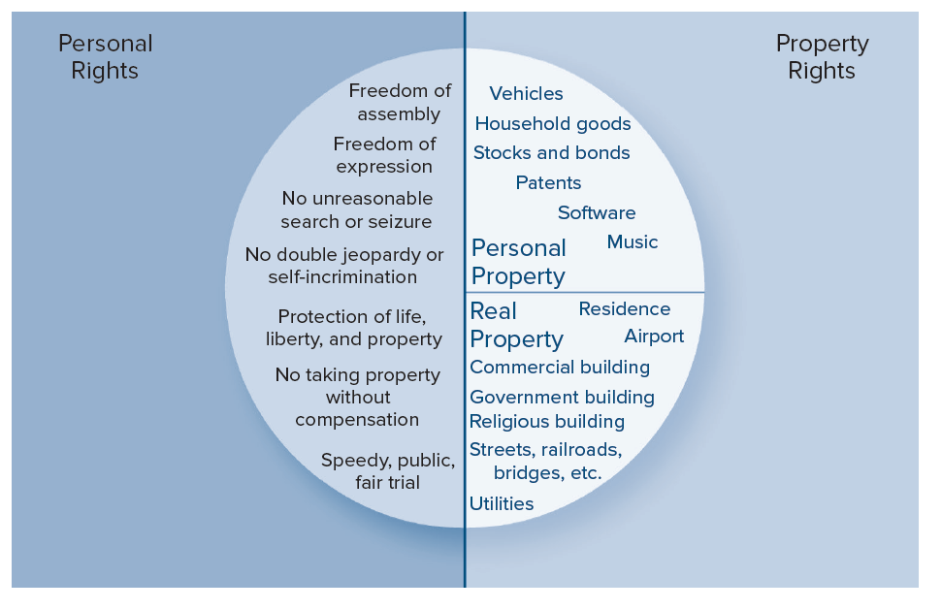
Rights in Our Society
Notes:
The Nature of Rights

Slide 7
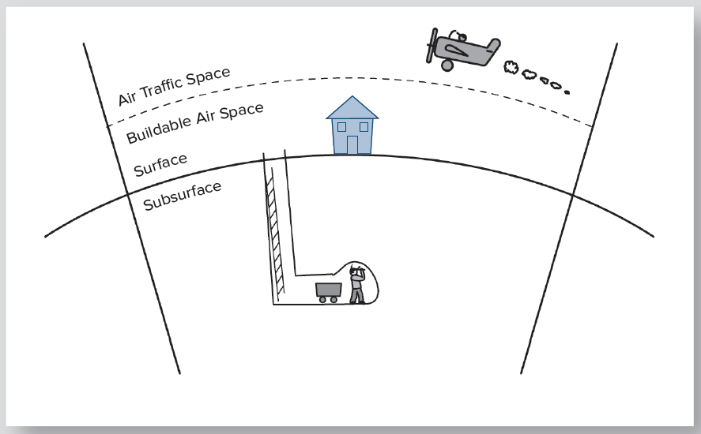
Real Property: Rights in Three Dimensions

Slide 8
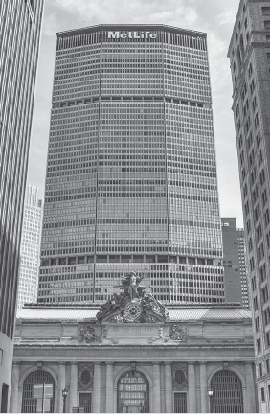
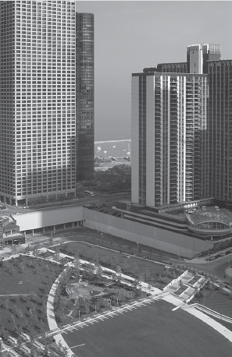
Built on Air Rights
MetLife Building, New York
New East Side, Chicago
Notes:
The Nature of Rights

Slide 9
Fixtures
Fixture: Real property that formerly was personal property
Rules for identifying a fixture:
Manner of attachment
Character of the article and manner of adaptation
custom screens or storm windows
church pews
custom designed furniture
Notes:
Real Property and Personal Property: The Problem of Fixtures

Slide 10
Fixtures - continued
Intention of the parties
Dominant rule
Customary assumptions of the realm
Ex: Kitchen appliances – owned home vs. apartments
Relation of the parties
Variant of rule of intention
Trade fixtures of a commercial tenant (personal property)
Fences installed by a tenant farmer (personal property)
Items installed by a residential tenant (personal property)
Notes:
Real Property and Personal Property: The Problem of Fixtures

Slide 11
Importance of Fixtures
In every real estate transfer, fixtures lurk
Fixtures automatically go with the real property
Be careful to identify possible fixtures
Explicitly state whether they stay with the property or not

Slide 12
Real Property Interests
Interest: Any “bundle” of rights in real property
Estate: An interest with the right of exclusive possession
Nonpossessory interests:
Easements
Restrictive covenants
Liens
Notes:
The Real Property Bundle of Rights

Slide 13
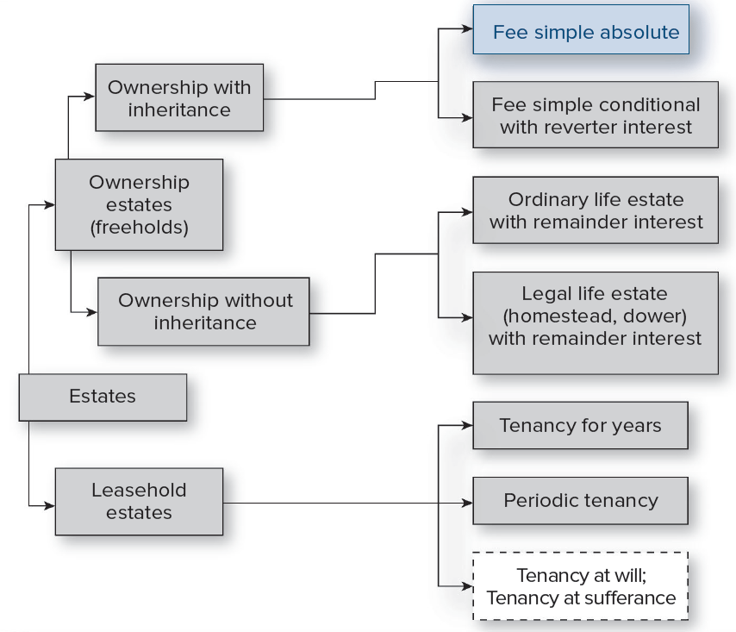
Estates
Notes:
The Real Property Bundle of Rights: Estates

Slide 14
Ownership (Freehold) Estates
Estates with indefinite length
Fee simple absolute - contains all possible rights
Fee simple conditional - all rights, but revocable if specific condition is violated
Notes:
The Real Property Bundle of Rights

Slide 15
Ownership (Freehold) Estates
Life estate with remainder interest
Ordinary – created by the owner
Legal – Imposed by law
Special problem in Florida with homestead:
At death of spouse,
Surviving spouse gets life estate
Any minor children get vested remainders
Notes:
The Real Property Bundle of Rights: Estates

Slide 16
Leasehold Estates
Estates with definite ending
Tenancy for years
For a specific interval of time (few days to decades)
Must be written if for more than one year
Written lease contract governs entirely
Periodic tenancy
Most commonly monthly (can be weekly, quarterly)
Automatically renews until either party terminates
Often by oral agreement
State law governs notice of termination
Time required is usually half of the payment period
Notes:
The Real Property Bundle of Rights: Estates

Slide 17
Modernizing Leasehold Law
Leasehold law derived from agrarian society
Landlord’s obligation: Simply grant possession
Tenant’s obligation: Pay the rent
Concepts and precedents were inadequate for a modern apartment setting
Landlord is providing shelter and related services
Tenants’ actions affect each other
States adopted residential landlord and tenant laws to solve this problem
Notes:
The Real Property Bundle of Rights: Estates

Slide 18
Model Residential Landlord – Tenant Act
Establishes a more equitable relationship between landlords and tenants

Slide 19
Non-Possessory Interests in Land
Easements
Liens
Restrictive Covenants
Notes:
The Real Property Bundle of Rights: Non-possessory interests

Slide 20
Easements
Easement: The right to use land for a specific and limited purpose
Notes:
The Real Property Bundle of Rights: Non-possessory interests

Slide 21
Easement Appurtenant
Right of use a (dominant) parcel of land “enjoys” over an adjacent (servient) parcel
Always a dominant and servient parcel involved
Affirmative easements:
Driveway or access right-of-way
Sewer line
Drainage
Common wall
Negative easements:
Light and air easement
Scenic easement
“Runs with the land”: Rights and obligations are inseparable from the parcels involved
Notes:
The Real Property Bundle of Rights: Non-possessory interests

Slide 22
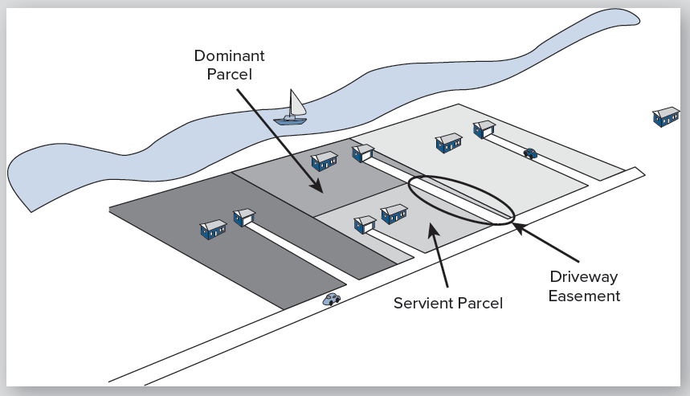
An Easement Appurtenant Involves a Dominant Parcel and a Servient Parcel
Notes:
The Real Property Bundle of Rights: Non-possessory interests

Slide 23
Easements in Gross (“Commercial Easements”)
Right to use land, unrelated to any other parcel
Extract minerals or oil and gas
Build a roadway or railway
Lay a pipeline, power line, or cable
Run an irrigation ditch
Place and maintain a billboard or communications tower
Harvest timber or crops
Conservation easement for wetlands preservation
Hunt, fish, snowmobile
Transferable separately from land title or ownership (Does not “run with the land.”)
No dominant parcel – only servient parcels
Notes:
The Real Property Bundle of Rights: Non-possessory interests

Slide 24
More Easement Concepts
Exclusive & nonexclusive easement in gross
Exclusive: Conveys all rights of the easement
recipient can extend access to others
Nonexclusive: Rights limited to one user only
Recipient cannot extend access to others
Owner can convey access to others
License: Like an easement in gross, but conveys permission rather than right
Revocable
Terminates at the death of the grantor or sale of the land

Slide 25
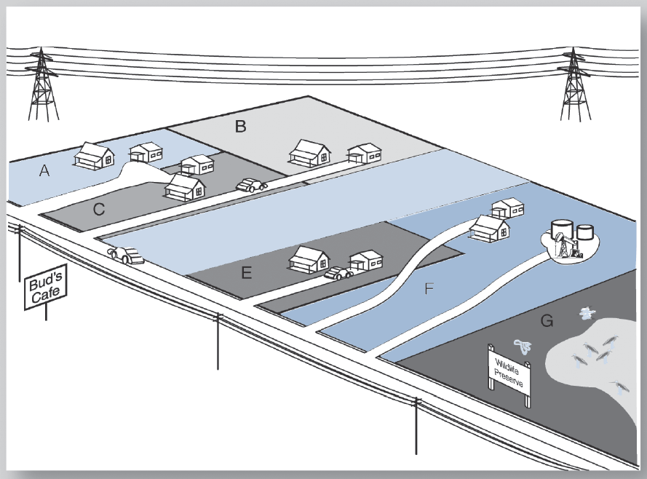
How Many Easements in This Scene?
Notes:
The Real Property Bundle of Rights: Non-possessory interests

Slide 26
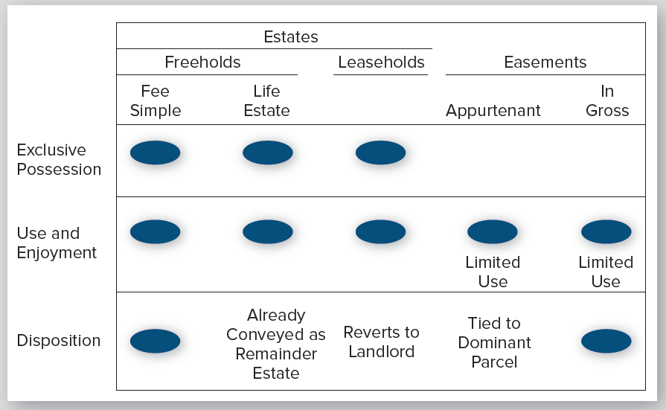
Rights Included in Various Real Property Interests
Notes:
The Real Property Bundle of Rights: Overview

Slide 27
Restrictive Covenants (Deed Restrictions)
Private restrictions on land use
Created at conveyance of land to a new owner
Examples:
Setback lines, height restrictions, minimum floor area
No freestanding structures
No chain-link fences
No RVs or boats parked in view of the street
No cars regularly parked in the driveway
No garage door facing the street
Required architectural review
No external antenna, satellite dish or clothesline
Required use of professional lawn service
Notes:
The Real Property Bundle of Rights: Non-possessory interests

Slide 28
Restrictive Covenants - continued
Two methods of creation:
Restriction in a deed conveying a single parcel of land
Restrictions placed on all parcels of a subdivision
A list of restrictions recorded as a separate document
Mutually binding on all purchasers in the subdivision
Notes:
The Real Property Bundle of Rights: Non-possessory interests

Slide 29
Restrictive Covenants: Enforcement
Enforced by court injunction
Enforcement only by “parties at interest”
Isolated deed restriction:
Grantor or grantor’s heirs
Subdivision restrictions:
Owners, mortgage holders, renters
Courts reluctant to enforce in case of:
Delayed enforcement (abandonment)
Changed neighborhood
Changed public policy
Mandatory retirement in some states
Notes:
The Real Property Bundle of Rights: Non-possessory interests

Slide 30
Liens
Lien: A security interest for an obligation
Usually a debt
General Liens: Arise from events unrelated to the property
Court awarded damages
Federal tax liens
Specific liens: Arise from ownership and use of the property
Mortgage
Mechanics’ lien
Property tax, assessment, or CDD lien
Notes:
The Real Property Bundle of Rights: Non-possessory interests

Slide 31
Three Levels of Liens on a Personal Residence
Notes:
The Real Property Bundle of Rights: Non-possessory interests

Slide 32
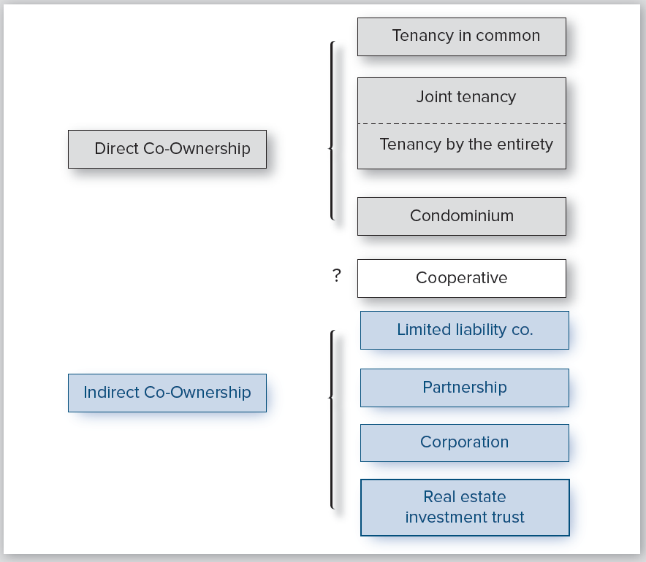
Forms of Co-Ownership
Notes:
Forms of Co-Ownership

Slide 33
Indirect Co-ownership
General Partnership
Entity holds title
Ownership passes through the entity
Undivided interest
Limited
Partnership
Limited Liability Co.
Corporation (Co-op)
Trust
Notes:
Forms of Co-Ownership

Slide 34
Forms of Direct Co-ownership
Example: A house with multiple owners
All share the right of exclusive possession
Cannot obstruct each other’s use
May hold different sizes of shares
Tenancy in common
Joint Tenancy
Tenancy by the entirety
Condominium
Notes:
Forms of Co-Ownership

Slide 35
Direct Co-ownership
Joint Tenancy (Survivorship)
Tenancy in
Common
Tenancy by the
Entireties
Notes:
Forms of Co-Ownership

Slide 36
Forms of Direct Co-ownership
Tenancy in common:
Default form except in special cases
Multiple owners of same fee simple interest
Each owner can sell or mortgage their interest independently
Can be different size shares
Can be created in multiple transactions
Bad form for owning an operating business
Poor form for multiple investors
Notes:
Forms of Co-Ownership

Slide 37
Forms of Direct Co-ownership
Joint tenancy
Defining feature: “right of survivorship” restricts inheritance to heirs of the last surviving owner
Difficult to create and easily disrupted
Prevented or restricted by law in some states
Tenancy by the entirety
Joint tenancy for husband and wife
Solves Florida problem of homestead life estate
Problem arises when household includes minor children
Protected against liens arising from either spouse alone, including judgments

Slide 38
Direct Co-ownership - continued
Condominium
Combines single ownership and tenancy in common
Created by condominium declaration
Bylaws define owner rights:
Share of all obligations
Restrictions on sale or rental
Methods of altering bylaws
Creates additional level of (private) government
History of owners not understanding the restrictions
Notes:
Forms of Co-Ownership

Slide 39
Direct Co-ownership: Condominiums
Undivided
Ownership of
Common Elements
Through
Tenancy in
Common
Fee
Simple
Fee Simple
Fee Simple
Notes:
Forms of Co-Ownership

Slide 40
Why would you want a condo?
Price
Amenities
Security, both when you are in residence, or away
Others do the maintenance and upkeep
Interesting social context and/or location
Notes:
Forms of Co-Ownership

Slide 41
What special risks do you buy into?
Design and construction
Noise issues
Privacy
Parking and storage limits
Common area and structure maintenance costs
Rules that may be frustrating
Exterior decoration and use of patio or balcony
Guest policies
Right to rent out
Quality of management? (professional or not?)
Property reputation
Notes:
Forms of Co-Ownership

Slide 42
Condo documents You Want to Examine
Declaration
By-laws
Minutes from recent board meetings
Any pending legal actions
Association budget
Maintenance reserves
Notes:
Forms of Co-Ownership

Slide 43
Cooperative
Corporation owns property
Each owner holds shares and a proprietary lease (no term and no rent)
Cannot mortgage individual interests
Owner’s mutually liable for any specific liens
Notes:
Forms of Co-Ownership

Slide 44
Cooperative
Corporation holds title to all land, improvements
Shares
Corporation
Proprietary Leases

Slide 45
Automatic Ownership from Marriage: Early Forms
Dower/curtesy
Automatic one-third life estate for a surviving spouse in real property of a decedent spouse
Common law roots (traditional English)
Dower is widow’s claim; curtesy is widower’s
Covers all real property ever owned during the marriage
Problems with dower (widow’s interest):
Life estate unmarketable
Much of modern wealth not in real property
Real property may be in multiple states
Notes:
Forms of Co-Ownership

Slide 46
Automatic Ownership from Marriage: Modern Forms
Elective share
Modern substitute for dower
Surviving spouse receives up to one-third of all decedent’s personal property and in-state real property
Must chose by explicit “election” within specified time
Adopted in some form by 25 states

Slide 47
Automatic Ownership from Marriage: Modern Forms
Community property
One-half interest in all property acquired “out of the fruits of the marriage”
Not property owned before the marriage
Not gifts or inheritances to one spouse
May include income generated from “separate” property
Found in states of Spanish tradition, plus Louisiana, Wisconsin and Alaska
Growing in acceptance as a superior arrangement to elective share
Notes:
Forms of Co-Ownership

Slide 48
Exhibit 2-10 Two Main Forms of Marital Property Rights
 | Elective Share | Community Property
Mainly used in: | English heritage states | Mainly Spanish/French heritage states
Spousal share: | One-third | One-half
How triggered: | Explicit declaration | Automatic
Wealth coverage | Varies up to all wealth | All wealth created in the marriage
Number of States | About 25 | Ten states, with influence in more
Notes:
Forms of Co-Ownership

Slide 49
Timeshare
Common interval is a week
Range in “quality” of ownership:
Condominium share
Leasehold
License
Choice of floating time intervals (e.g. within three months) and choice of resorts
Industry with a questionable history
Never a financial investment
Note that the developer has all the market information and the buyer has none
Key is ability of developer to sustain services promised
Notes:
Forms of Co-Ownership

Slide 50
Issues in Rights to Water
Who owns the land under a body of water?
Who controls use of land under a body of water?
Who has the right to use the surface?
Who has the right to use the water itself?
Who has the right to use groundwater?
For answers, see on-line appendix to text
Notes:
Rights Related to Water

Slide 51
Rights to Oil, Gas, and Minerals
Rights carry implied easement for removal
In some states, mineral rights imply ownership of the space being mined
Oil rights have two forms
Traditional “rule of capture” (If you could remove it, it was yours)
Unitization states: Regardless of the point of extraction, oil is allocated to the properties from which it likely came.
Notes:
Rights to Oil, Gas, and Minerals

Slide 52
Summing Up
There is real property and personal property
….and the problem of fixtures
Real estate is a bundle of rights:
Exclusive possession
Enjoyment
Disposition
This bundle has many variations
Estates – freehold or leasehold
Non-possessory interests – easements, restrictive covenants, liens

Slide 53
More Summing Up
There can be more than one direct owner
Tenancy in common, joint tenancy, tenancy by the entirety
Condominium, cooperative
There can be automatic marital co-ownership
Community property
Dower, elective share

