Slide 1
Chapter 19
Investment Decisions: NPV & IRR

Slide 2
Overview
Major theme: most RE decisions are made with an investment motive
  magnitude of expected CFs—and the values they create—are at the center of investment decision making
Chapter 18 focuses on widely used, single-year, return measures, ratios, & income multipliers
These criteria are relatively easy to calculate & understand—an advantage in the eyes of many industry professionals

Slide 3
Overview
Limitation of these single-year return measures & ratios?
  They don’t explicitly incorporate the income producing ability of property beyond 1st year of rental operations
    May lead to suboptimal investment decisions

Slide 4
Overview
Many investors also perform multi-year analyses of potential acquisitions
When using multi-year discounted CF decision making methods, investor must
  estimate how long she expects to hold property
  make explicit forecasts of:
    property’s net CF for each year,
    net CF produced by expected sale of property
  Select rate of return at which to discount all future CFs

Slide 5
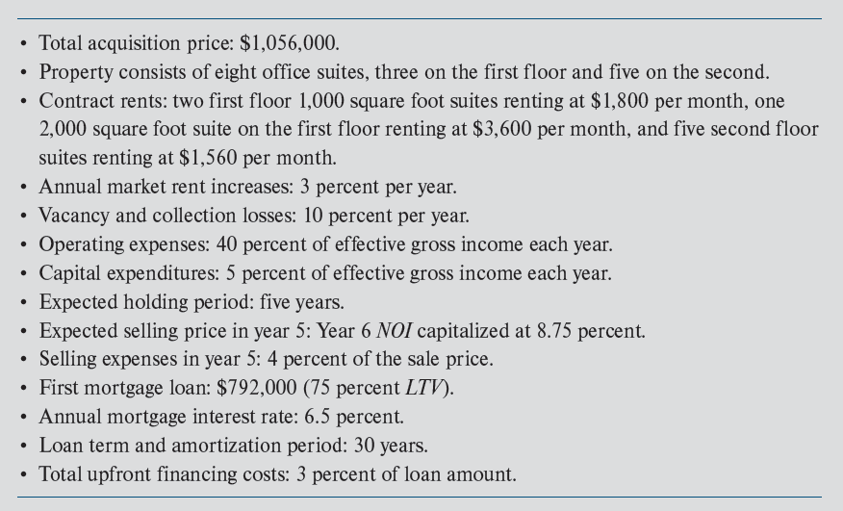
Centre Point Office Building
Exhibit 19-1
Mortgage financing assumptions

Slide 6
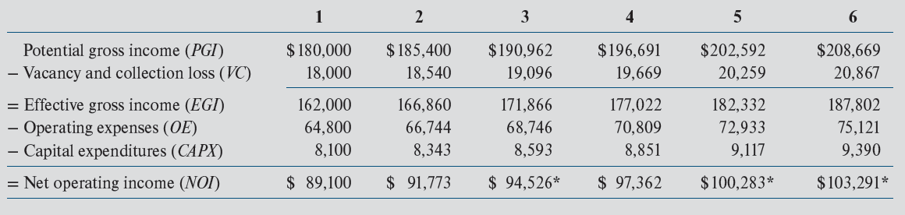
Centre Point: 5-Year Pro Forma
Rent expected to be collected from the 8 tenants would be separately estimated and then aggregated
Exhibit 19-2
Very simple lease structure
PGI is projected to grow 3% per year, the assumed rate of growth in market rents
If the purchased property is subject to one or more leases, the contract rent on these leases would have to be incorporated into PGI projections
  i.e., “potential“ rental income is limited by existing leases

Slide 7
Effects of Leverage on Centre Point Cash Inflows & Outflows
Loan Terms
  75% loan, 30 years, 6.5% annual interest rate, total up-front fees = 3% of loan amount
Net loan proceeds:
= $792,000 − (0.03 × 792,000)
= $768,240
Required equity = $1,056,000 − $768,240 = $287,760
Payment: $5,005.98 or $60,072 per year
= $23,760

Slide 8
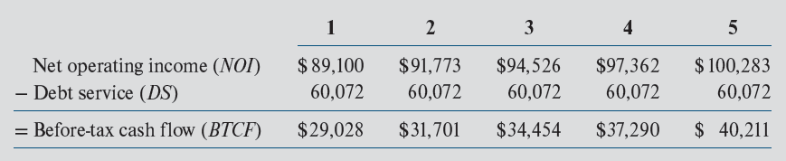
Centre Point w. Mortgage Financing
Exhibit 19-4
BTCFs are “levered” cash flows
Lender(s) has first claim on the property’s cash flows
  Owner’s claim on a property’s CFs refereed to as a “residual claim”?
Valuation of the CFs to the equity investor is accomplished by discounting the projected levered CFs
  At the required levered rate of return

Slide 9
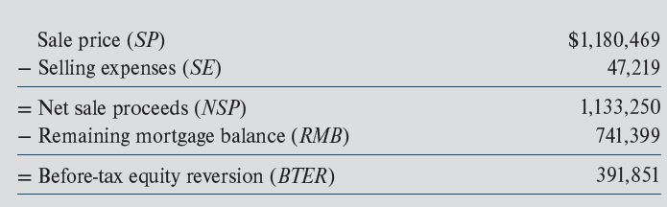
Centre Point w. Mortgage Financing
Exhibit 19-4
Exhibit 19-5
Yr 6 NOI “capped” at 8.75%
= $103,291/0.0875
= $1,180,469

Slide 10
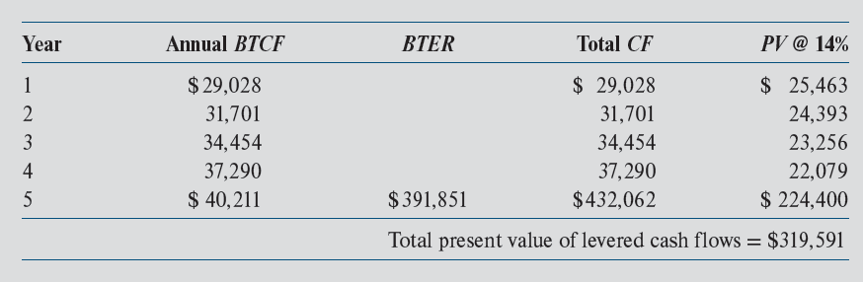
Present Value of Levered Cash Flows
Exhibit 19-6
“Levered” CFs
Justification for increasing discount rate from 10.0% to 14.0%?
Levered CFs are more risky than unlevered CFs
Keystrokes: CF₀=0; CF₁=29,028, CF₂=31,701; etc., I/YR=14; “shift NPV”

Slide 11
So…From Where Do Discount Rates Come?

Slide 12
Selecting Discount Rates
Review of Chapter 14
Discount rate is composed of two parts:
E(R_{j}) = r = R_{f} + RP_{j}
  R_{f} = risk-free rate
    yield/return available on U.S. Treasury securities with maturity equal to expected holding period of the property
    This benchmark rate is readily observable
  RP_{j} is risk premium for “subject” property
    This component of discount rate is difficult to determine

Slide 13
U.S. Example: Class A (least risky) Apartment Properties (through 2021Q2)
Source: quarterly survey conducted by Real Estate Research Corporation (www.RERC.com)
Required unlevered apartment return
10-Year Treasury Yield
Difference (the risk premium)
(unlevered!)

Slide 14
Selecting Discount Rates
Since risk premiums vary, so do required yields
  High quality, relatively safe RE investments: currently 6-8% required returns
  Development deals: 15%-30% or more
So…how do investors determine required risk premiums (RP_{j}s)?

Slide 15
Net Present Value of Centre Point
NPV = PV_{in} − PV_{out}
PV_{out} in this example is equal to original equity investment of $287,760
NPV = $319,591 − $287,760
NPV = $31,831
From Exhibit 19-6
Keystrokes: CF₀=-287,760; CF₁=29,028, CF₂=31,701; etc., I/YR=14; “shift NPV”
Decision:
  Accept Centre Point investment opportunity because doing so will increase equity investor’s wealth by $31,831
  ∆ in wealth vs. ∆ in cash holdings?

Slide 16
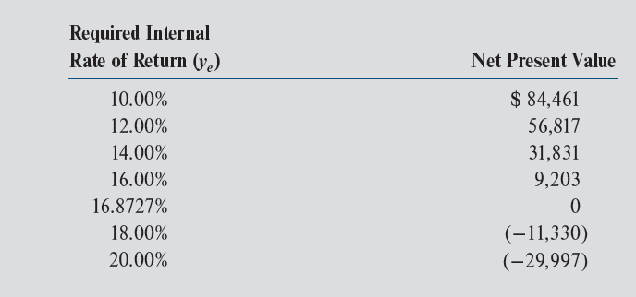
Effect on NPV of Variation in Discount Rate
Exhibit 19-7
Holding everything else constant
Base-case
At a discount rate of 16.8727%, NPV = 0, this is the going-in IRR

Slide 17
Why IRR Is Technically Inferior to NPV as an Investment Criterion
IRR & NPV will always give the same accept/reject signal w.r.t. an individual investment
But…..
  IRR may rank investment opportunities differently than NPV
    NPV ranking is always consistent with wealth maximization
  If projected CFs change signs more than once over expected holding period, there may be multiple IRRs
    And you will not know this!

Slide 18
Understanding the Effects of Leverage

Slide 19
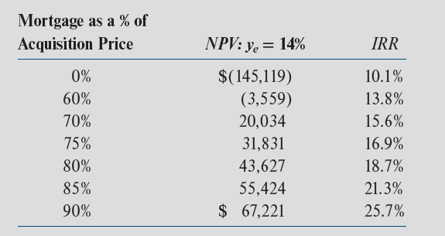
Effects of Leverage on NPV & IRR
Increased leverage usually increases both NPV & IRR—holding mortgage rate & all other assumptions constant
Exhibit 19-8
Holding everything else constant
Base-case
But…leverage also increases risk to equity investor, thus required equity return should increase with leverage

Slide 20
When Will Leverage Increase NPV & IRR?
Holding everything else constant…..
Increased leverage will increase calculated NPV when….
  opportunity cost of equity capital (discount rate) exceeds effective borrowing cost
Increased leverage will increase going-in IRR when….
  unlevered going-in IRR exceeds effective borrowing cost

Slide 21
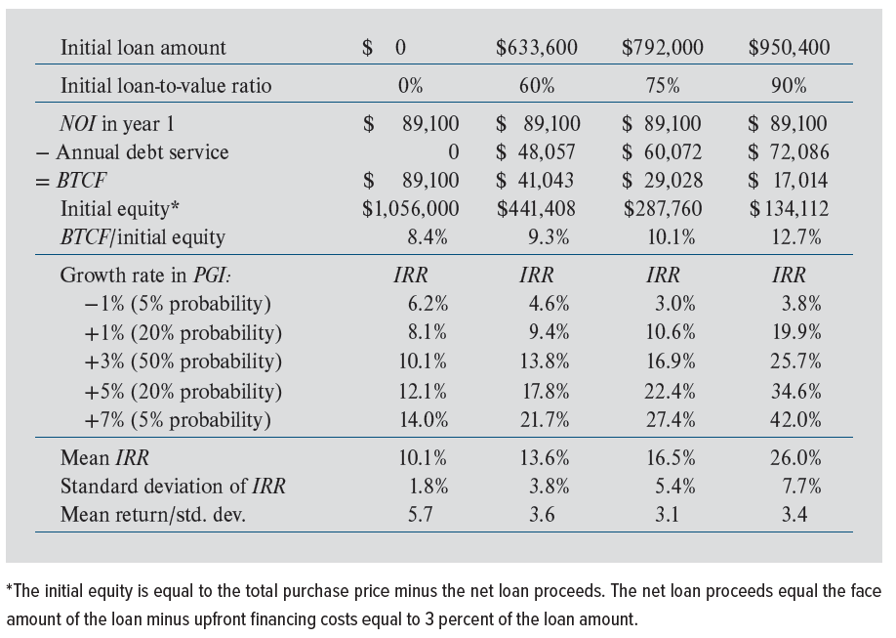
Impact of Leverage on Risk of Equity Investment (Exhibit 19-9)
The mean (expected) IRR increases with leverage
But…risk/ variability of the expected IRR on equity increases with leverage
Result: expected (mean) IRR PER UNIT OF RISK decreases for 0% to 75% leverage

Slide 22
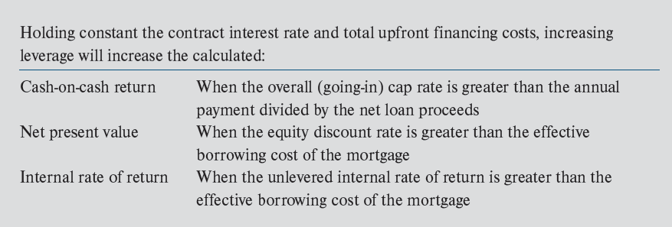
Summary: The Effects of Leverage
Exhibit 19-10

Slide 23
The Effects of Income Taxes
© MCGRAW HILL LLC. ALL RIGHTS RESERVED. NO REPRODUCTION OR DISTRIBUTION WITHOUT THE PRIOR WRITTEN CONSENT OF MCGRAW HILL LLC.

Slide 24
Income Taxes, Cash Flows & Returns
Cash flows & returns most important to investors are after-tax cash flows & returns
The following after-tax analysis assumes a 24% income tax rate
  A combination of the tax rate on wage and salary income and the tax rate on capital gain income
More detail on tax calculations is provided in Chapter 20

Slide 25
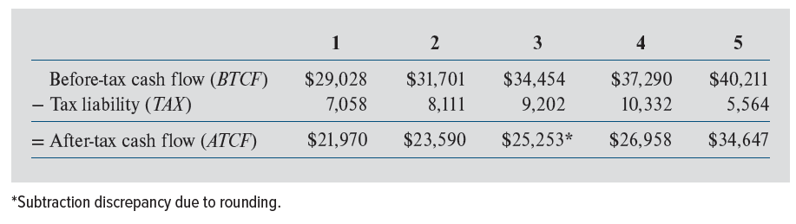
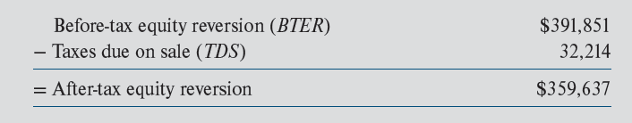
Centre Point: After-Tax Cash Flows
Exhibit 19-11
Important: Tax liability is NOT = BTCF × tax rate!
Exhibit 19-12

Slide 26
How is Required After-Tax Discount Rate Determined?
Assume: required levered before-tax return on equity = 14%
Assume a weighted average of the tax rate on wage income & tax rate on capital gain income = 24%
After-tax required return = 14% − (0.24 × 14%)
= 14% × (1 − 0.24)
= 10.6%
That is, a reasonable assumption is:
required after-tax return = before-tax return × (1−TR)
where TR is investor’s effective tax rate on CRE taxable income

Slide 27
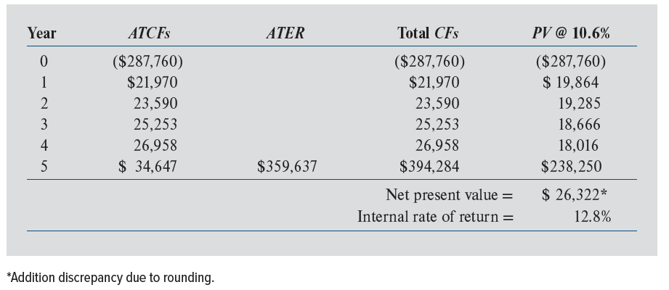
Centre Point: After-Tax NPV & IRR
Exhibit 19-13
Note: IRR falls 24%: (16.9 – 12.8) ÷ 16.9 = 0.24 or 24%

Slide 28
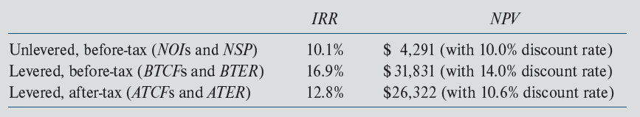
Comparison of Three Scenarios
Exhibit 19-14
Some important conclusions:
Leverage increases expected Centre Point equity returns
  But expected returns may not be realized
Taxes significantly reduce investor CFs & equity returns

Slide 29
More Detailed Cash Flow Projections
The pro formas detailed in Exhibits 19-2 - 19-13 display major categories of revenues & expenses
However, most RE pro formas provide significantly more detail on projections of
  revenue sources
  vacancies
  operating expenses
  capital expenditures
See Exhibit 19-15 for an example

Slide 30
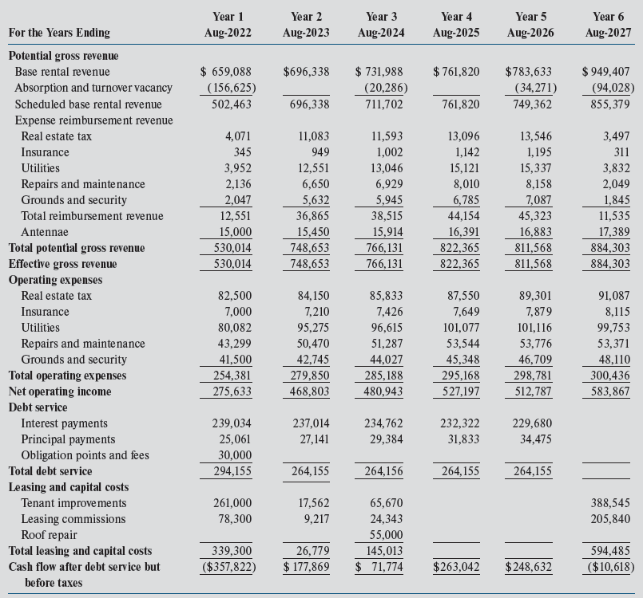
Exhibit 19-14
ARGUS Enterprise Pro Forma
Note: a below-line treatment of CAPX

Slide 31
Risk Analysis: Varying the Assumptions
Sensitivity analysis
  Most likely scenario
  Worst-case scenario
  Best-case scenario
Value of computer
  Excel spreadsheets
  Specialized software such as ARGUS Enterprise

