Slide 1
Chapter 18
Investment Decisions: Ratios

Slide 2
Decision Making in Real Estate Centers Around Valuation
We examined the concept of market value in Chapters 7 & 8
As noted, professional RE appraisers are paid to estimate the market value of a property
Market value
  is the basis for economic transactions
  buyer does not want to pay more than market value of property…seller does not typically want to take less

Slide 3
Decision Making in Real Estate Centers Around Valuation
But…for many investors market value is not the whole story
Most RE decisions are made with an investment motive

Slide 4
Chapter 18 Overview
Chapter introduces framework for making single-property RE investment decisions
Focus is on a set of widely used ratios & multipliers
These measures are:
  relatively easy to calculate but…
  do not explicitly consider cash flows beyond 1st year of the analysis
Many investors also perform multi-year discounted cash flow (DCF) analyses, discussed in Chapter 19

Slide 5
A Word of Caution
This chapter & Chapter 19 focus on quantitative decision tools
Although quantitative tools are widely used, their usefulness is limited by the quality of the cash flow assumption used by the analyst.
In short, the “garbage in, garbage out” maxim applies to RE investing

Slide 6
Why Investment Value Differs from Market Value
Investors have different required returns
  Different risk assessment/opportunity cost of invested equity
Different expectations about future:
  rental rates
  vacancies
  operating expenses
  etc.

Slide 7
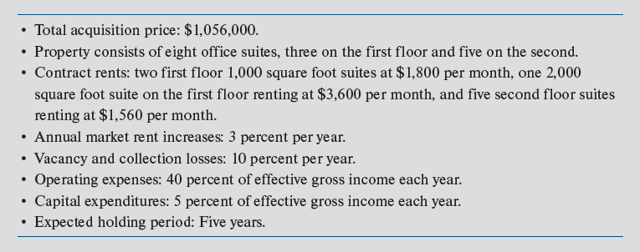
Centre Point Office Building: Review of Assumptions
Exhibit 18-1

Slide 8
1st Step in Investment Analysis: Estimating NOI Over Next Year
PGI Potential Gross Income
VC Vacancy & Collection Loss
+ MI Miscellaneous Income
= EGI Effective Gross Income
OE Operating Expenses
CAPX Capital Expenditures
= NOI Net Operating Income
Same “first step” as income approach to valuation
Note the “above-line” treatment of CAPX

Slide 9
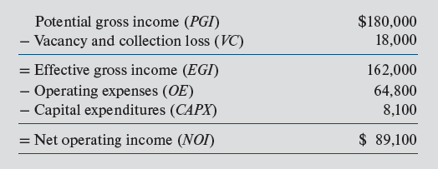
Centre Point: Projected 1st-Year NOI
Exhibit 18-2
(10% of PGI)
(40% of PGI)
(5% of PGI)
NOI is an “unlevered” CF
Forecast for next 12 months

Slide 10
More on Net Operating Income
NOI: $'s that flow out of the property
NOI is the property's expected "dividend“
  Assuming an above-line treatment of CAPX
Projected stream of NOI is the fundamental determinant of value
NOI must be sufficient to:
  service the mortgage debt and
  provide investor with an acceptable return on equity

Slide 11
Operating vs. Capital Expenditures
Operating expenses:
  Keep property operating & competitive in its local market
  Do not increase value or extend useful life
  Examples: minor roof repairs, air conditioner servicing, lawn maintenance, utilities, etc.
Capital Expenditures:
  Increases market value of property/extend useful life
  Examples: roof replacement, air-conditioner replacement, installation of new landscaping

Slide 12
How Are Capital Expenditures Treated in Pro Forma? (It Depends)
Appraisal Terminology and Pro Forma:
(“Above line”)
PGI
− VC
= EGI
− OE
− CAPX Reserve
= NOI
Investment Terminology
and Pro Forma:
(“Below line”)
PGI
− VC
= EGI
− OE
= NOI
− CAPX
= Net cash flow
For consistency, we will assume an “above-line treatment throughout the book

Slide 13
Borrowing (Leveraging)
Why do investors borrow?
  Limited financial resources/wealth
  Leverage amplifies equity returns (& risk)
  Also permits more portfolio diversification
Cash flow effect of borrowing:
Net operating income
− Debt service
= Before-tax cash flow (BTCF)

Slide 14
Debt Financing for Centre Point
Loan terms
  75% LTV, 30-year term, 6.5% contract rate, up-front fees = 3% of loan amount
Net loan proceeds to borrower:
= $792,000 − (0.03 × $792,000)
= $792,000 − $23,760
= $768,240
Initial equity investment = $1,056,000 − $768,240 = $287,760
Payment: $5,005.98 or $60,072 per year
= 0.75 × $1,056,000

Slide 15
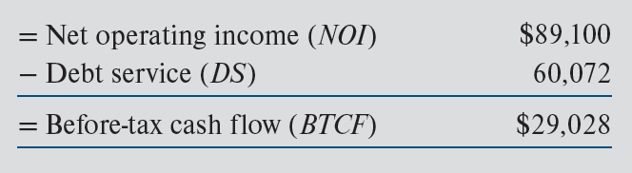
Centre Point: Estimated Before-Tax Cash Flow (BTCF)
Exhibit 18-3
Levered vs. unlevered CFs?

Slide 16
Evaluating Cash Flow Estimates
Are income & expenses items appropriate?
  Include only income & expenses that relate directly to income producing ability of property
Have trends for each item been carefully considered?
  Should not just extrapolate recent trends
  Importance of rental rate growth & vacancy assumptions

Slide 17
Evaluating Cash Flow Estimates
What about comparable properties?
  Should obtain as much information as possible on comparable/substitute properties
What are social & legal environments?
  Zoning, land use, & environmental controls change quickly at state & local levels
  How has subject’s neighborhood been changing?
  Are local public officials pro or anti-growth?
  Trends in property taxes?
  Trends in insurance premiums?

Slide 18
Partnerships, Limited Liability Companies, etc.
Centre Point pro forma displays expected total CFs from property available for distribution to investors
When using partnerships & limited liability companies, all CFs & income tax consequences are allocated and “flow through” to individual investors
Thus, further analysis is usually required to determine expected CFs & returns earned by various equity investors
  complicated unless all distribution are based on investors’ pro rata share of contributed equity

Slide 19
Traditional Single-Year Investment Criteria
Profitability ratios
  Capitalization rate (R_{o})
  Cash-on-cash return (COC)
Multiplier
  Effective gross income multiplier (EGIM)
Financial risk ratios
  Operating expense ratio
  Loan-to-value ratio (LTV)
  Debt coverage ratio (DCR)
  Debt yield ratio (DYR)

Slide 20
Profitability Ratios: Capitalization Rate
Capitalization rate (going-in)
Centre Point example:
R_{o} is return on funds supplied by both equity investor(s) and lender; as such, it measures overall income producing ability of property.

Slide 21
Profitability Ratios: Capitalization Rate
Is 8.44% an acceptable overall cap rate?
Question can only be answered by comparisons to cap rates on similar properties
Investors should rely on cap rate information abstracted from comparable transactions in the local market
However, regularly published surveys may also provide useful information on cap rate trends

Slide 22
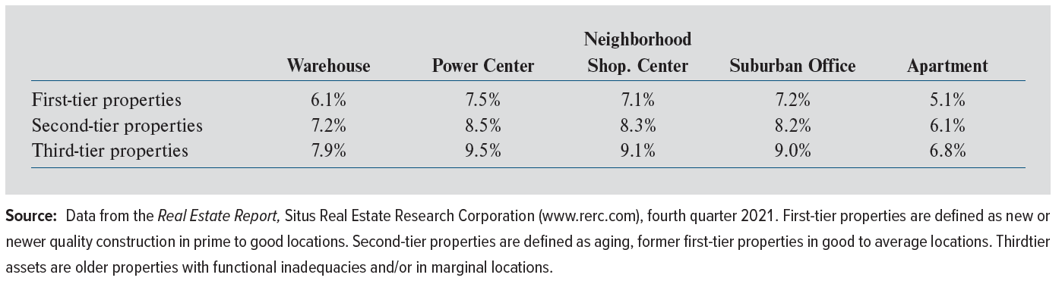
Example: Real Estate Research Corporation Cap Rate Survey
Exhibit 18-5
Cap rates vary inversely with quality (i.e., “class”)
Cap rates vary by property type risk

Slide 23
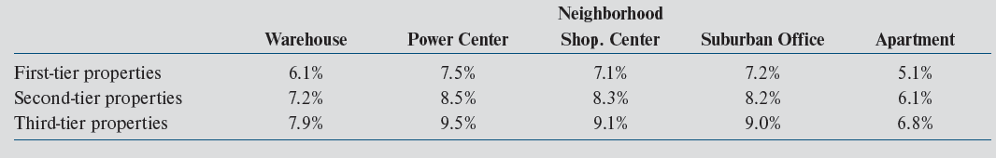
Example: Real Estate Research Corporation Cap Rate Survey
Exhibit 18-5
$1/0.061 = $16.39 $1/0.079 = $12.66 $16.39/$12.66 = 1.29 or 29% diff
First-tier warehouse properties sell for 29% more, per dollar of in-place NOI, than third-tier properties

Slide 24
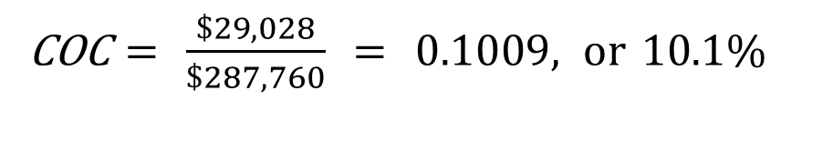
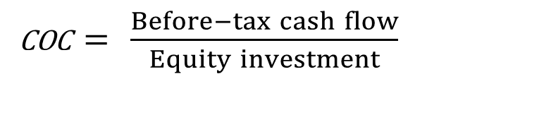
Profitability Ratios: Cash-on-Cash Return
Cash-on-Cash Return (COC):
COC$= \frac{Before−tax cash flow}{Equity investment}$
Centre Point example:
COC$= \frac{\$29,028}{\$287,760} = 0.1009, or 10.1\%$
Residual cash flow return to equity investment
Common reference point for smaller investments

Slide 25
Effective Gross Income Multiplier
Effective gross income multiplier (EGIM):
Centre Point Example:
Caution:
  - Use only among properties with similar operating expenses and CAPX

Slide 26
Financial Risk Ratios: Operating Expense Ratio
Operating expense ratio:
Centre Point example:
Seasoned analysts watch for deviations
from normal

Slide 27
Financial Risk Ratios: Loan-to-Value Ratio
Loan-to-value ratio (LTV):
Centre Point example:
Lenders generally want LTV of first mortgage loan to be no greater than 65–75% of acquisition price, although 2nd mortgage could push total LTV much higher

Slide 28
Financial Risk Ratios: Debt Coverage Ratio
Debt coverage ratio (DCR):
Centre Point example:
Primary risk assessment ratio used by most lenders
Indicates amount of “cash flow cushion” above that which is needed to pay debt service

Slide 29
Financial Risk Ratios: Debt Yield Ratio
Debt yield ratio (DYR):
Centre Point example:
Primary risk assessment ratio used by lenders who are originating loans that will be packaged together & used as collateral for the issuance of a CMBS

Slide 30
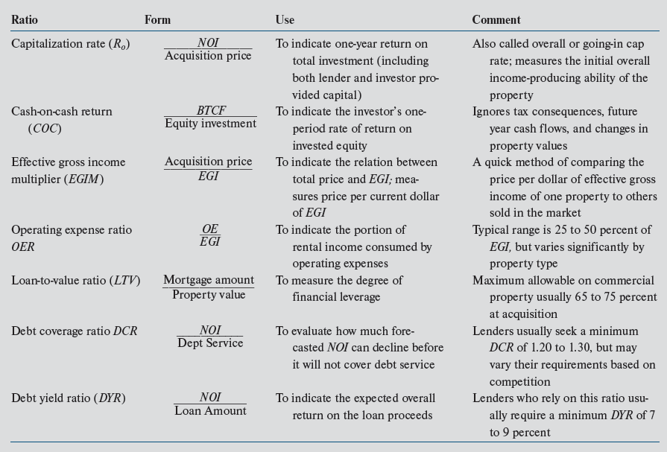
Exhibit 18-6: Common Ratios

Slide 31
Example 18-1
You are considering purchasing a small office building for $1,975,000
Your expectations include:
  First-year gross potential income of $340,000;
  Vacancy & collection losses equal to 15% of PGI;
  Operating expenses = 40% of EGI;
  Capital expenditures = 5% of EGI
  $1,481,250 mortgage (75% LTV) @ 7%
  Mortgage will be amortized over 25 years with a monthly payment of $10,469.17
  Total up-front financing costs = 2% of the loan amount
  Required equity investment is $523,375 [$1,975,000 – ($1,481,250 + $29,625)]
= 0.02 × $1,481,250

Slide 32
Example 18-1: 1st Year Projections
(15% of PGI)
(40% of PGI)
(5% of PGI)
($10,469.17 × 12)
Above-line treatment of CAPX

Slide 33
Example 18-1: 1st Year Ratios
Going-in cap rate (R₀):
Cash-on-cash return (COC):
COC$= \frac{Before−tax cash flow}{Equity investment} = \frac{\$33,320}{\$523,375} =0.063 or 6.3\%$
(Effective) gross income multiplier (EGIM):

Slide 34
Example 18-1: 1st Year Ratios
Operating expense ratio (OER):
Debt coverage ratio (DCR):
Debt yield ratio (DYR):

Slide 35
Pros and Cons of Ratios & Multipliers
Pros
  Quick & relatively easy to compute
  Intuitive
  Facilitates comparison with similar properties
  No explicit assumptions about future
Cons
  No clear benchmarks for acceptable range
  Only a partial view of performance
  No explicit assumptions about future

Slide 36
How Are Ratios & Multipliers Used by Most Investors
As screening tools to shift through possible investment opportunities

