Slide 1
Chapter 17
Sources of Commercial Debt
& Equity Capital

Slide 2
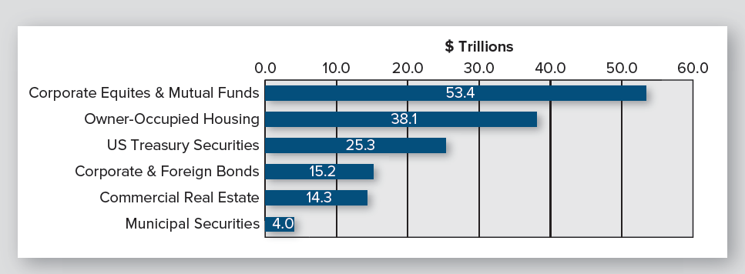
How Large/Valuable is U.S. CRE Market?
Exhibit 17-1
(Year-end 2021)
Source: Data from Flow of Funds Accounts of the United States Federal Reserve, March 10, 2022, various tables, www.federalreserve.gov. Estimate of investible commercial real estate is from LaSalle Investment Management.
Note: $14.3 trillion of investible CRE excludes CRE owned by non-RE companies and by federal, state, and local governments

Slide 3
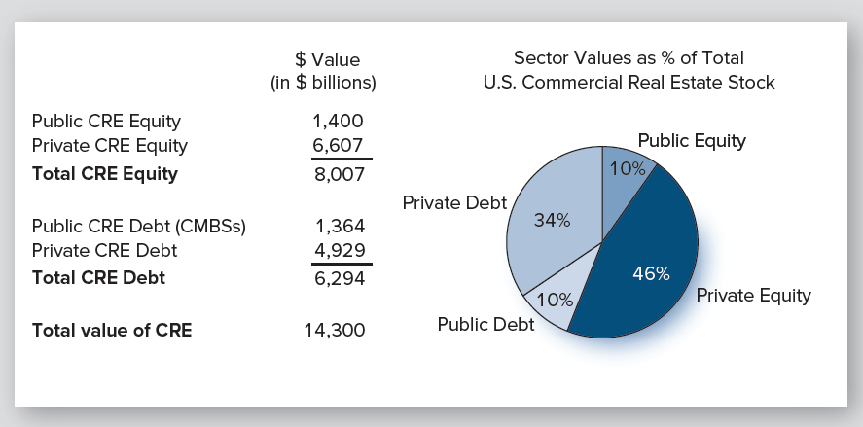
Market Value of U.S. CRE?
Exhibit 17-2
Direct vs. securitized investments?
How leveraged is commercial RE?

Slide 4
Forms of Ownership for Pooled Equity Investments
Due to large size of typical RE investments, investors almost always pool their equity capital
General partnership
Limited partnership
C corporation
S corporation
Limited liability company
REIT

Slide 5
Advantages of Pooling Equity Capital
Allows investors to purchase interests in larger properties
Allows diversification of portfolio
Allows economies of scale in acquisitions, management & disposition
Increases access to cheaper debt capital
Obtain expertise of sponsor/organizer
© MCGRAW HILL LLC. ALL RIGHTS RESERVED. NO REPRODUCTION OR DISTRIBUTION WITHOUT THE PRIOR WRITTEN CONSENT OF MCGRAW HILL LLC.

Slide 6
Disadvantages of Pooling Equity
Usually must relinquish management control to active sponsor/organizer
Must compensate sponsor/organizer with
fees
salary &/or
disproportionate share of equity cash flows
➨ Lower return on equity, holding property-level
CFs constant
© MCGRAW HILL LLC. ALL RIGHTS RESERVED. NO REPRODUCTION OR DISTRIBUTION WITHOUT THE PRIOR WRITTEN CONSENT OF MCGRAW HILL LLC.

Slide 7
What Drives Choice of Ownership Form?
Federal income tax issues/rules
Desire of investors for limited liability
Management control issues
Ability to access debt & additional equity capital
Ability to share risk with other investors
Including “special allocations”
Ability of investors to dispose of their interests

Slide 8
What Drives Choice of Ownership Form?
Federal income tax issues/rules
Desire of investors for limited liability
Management control issues
Ability to access debt & additional equity capital
Ability to share risk with other investors
Including “special allocations”
Ability of investors to dispose of their interests

Slide 9
Multiple Levels of Organizations
Multiple levels of ownership are commonly at work in CRE investments
Ex., office building owned by a limited liability company (LLC) whose two “members,” in turn, are
a separate LLC (the sponsor’s management team)
a publicly-traded REIT

Slide 10
A Quick Tour of Possible Ownership Forms

Slide 11
Private vs. Public Markets
Most ownership (equity) interests in U.S. CRE (≈ 80%-85%) are held by investment vehicles that do not trade on a stock exchange
That is, the majority of U.S. CRE is owned, managed, and traded in private CRE markets
We first examine ownership forms/vehicles that can be used to acquire CRE assets in private markets

Slide 12
General Partnership
Treated as conduit for tax purposes… investors avoid double taxation
All partners can make operating decisions:
How much leverage; when to sell, etc.
No separation between ownership & control; lessens potential conflicts of interest
Share of cash flow & taxable income determined by partnership agreement
“special allocations” permitted

Slide 13
General Partnership-Disadvantages
General partners liable for all debts
Contractual debts, debts arising from legal actions, wrongful acts committed by other partners…
So…personal assets are subject to claims of the partnership’s creditors
Result?
Fairly uncommon & those that are created have few partners

Slide 14
Limited Partnership
Creates 2 types of partners: general & limited
GP who sponsors/organizes venture is usually a knowledgeable builder, broker, or investor
“Flow-through” tax treatment
Limited liability for LPs; unlimited for GP
But GP may be a corporation, LLC, etc.….
LPs give up control of management & policy making
A “principal-agent” relationship is created with its attendant problems

Slide 15
C Corporations
Legal & taxable entity separate from shareholders
Therefore, potential double taxation
All shareholders have limited liability
Can’t lose more than their equity investment
Separation of ownership & control
which creates agency problems
Many non-RE C corporations own real estate, but not a desirable structure for investing in RE

Slide 16
S Corporations
Limited liability for shareholders
S corps pay no taxes; taxable income is passed through to stockholders who pay taxes
≤ 100 shareholders
All CFs & taxable income allocated on a pro rata basis
i.e., “special” allocations are not allowed
Used in some cases by individuals & families to own CRE

Slide 17
Limited Liability Companies
NOT a corporation, partnership, or sole proprietorship
IS a blend of some of best characteristics of corporations, partnerships, & sole proprietorship
➨ a “super passthrough entity”
IS a separate legal entity (like a corporation), but is treated as a partnership for tax purposes

Slide 18
Limited Liability Companies
Relative to LPs, LLCs
permit all owners to participate in management &
have limited liability
Managing member (sponsor) creates “operating agreement” that explains operation & management of entity
Limits decision making ability of passive investors

Slide 19
Real Estate Investment Trusts (REITs)
REITs are a special type of corporation & a creature of the U.S. tax code
Shareholders receive same limited liability protection as shareholders in C corporations
Unlike C corps, REITs are not taxed (at the entity level) if they satisfy a set of restrictive conditions on an ongoing basis
REITs are primary investment vehicle used to acquire CRE when sponsors desire that ownership interests (shares) be listed (traded) on a public stock exchange
But…there are some non-exchanged traded REITs
More on REITs later…….

Slide 20
Optimal Ownership Form?
If the CRE is to be owned, managed, and traded in private CRE markets, LLCs & LPs are the dominant ownership forms
RE private equity funds typically set up as LPs
Other private investment vehicles typically set up as LLCs

Slide 21
Note: Estimating Property-Level CFs is Usually Just 1st Step in Valuation
When using partnerships & limited liability companies, all CFs & income tax consequences are allocated & “flowthrough” to individual investors
Thus, further analysis is usually required to determine expected CFs & returns earned by various equity investors
complicated unless all distribution are based on investors’ pro rata share of contributed equity
© MCGRAW HILL LLC. ALL RIGHTS RESERVED. NO REPRODUCTION OR DISTRIBUTION WITHOUT THE PRIOR WRITTEN CONSENT OF MCGRAW HILL LLC.

Slide 22
Direct vs. Indirect Investment in CRE?

Slide 23
Ultimate Equity Investors
Investors can hold ownership (equity) positions directly or through intermediaries (ex., private equity funds, LLCs, LPs)
But…most “small” investors can’t invest directly
For well capitalized investors, choice of direct vs. indirect involves trade-offs between:
control
access to managerial expertise
liquidity &
risk sharing

Slide 24
Direct Investment
Gives individual & institutional investors complete control:
who leases it, who manages it, how much debt financing is used, when it is sold…
But…investor must supply the expertise
Liquidity of direct investments reflects the liquidity of the underlying property market
i.e., there is no liquidity!

Slide 25
Direct Investment
As size of investor's portfolio increases, the economics of direct ownership make more sense; i.e., easier to
retain in-house experts or hire consultants
diversify risk
create liquidity across assets classes (stocks, bonds, etc.)

Slide 26
Direct Investment
Direct ownership also prevalent at smaller end of investor spectrum
Single-family rental homes, duplexes and fourplexes
Owner-occupied office buildings
Lack of diversification vs. local market knowledge?
But…even “direct” investment should be done through an LLC, not as an individual or as tenancy in common

Slide 27
Investment Through Intermediaries: Other Private Market Investment Vehicles
Open-end “commingled” RE funds
Offered by many banks, life companies, investment banks, RE advisory firms
Typically organized as LPs
Can buy into/sell on a quarterly basis
i.e., some liquidity
Targeted to institutional investors (e.g., pension funds) w/o in-house expertise
Fund manager/sponsor:
pools contributions from multiple investors to purchase multiple properties
Does not invest its own equity capital

Slide 28
Investment Through Intermediaries: Other Private Market Investment Vehicles
Open-end “commingled” RE funds, continued
Fee structure
front-end fees for acquiring properties
% of assets under management (AUM)
1.5% of AUM is most typical
back-end fees
performance fees

Slide 29
Investment Through Intermediaries: Other Private Market Investment Vehicles
Closed-end private equity (PERE) funds
Did not really exist prior to early 1990s
Mostly finite life (typically 7-10 years)
Although manager can typically extend life a year or two
Typically include some degree of side-by-side investment by fund manager/sponsor
Sponsor invests as both GP and LP
Aligns manager’s incentives & returns with investors
Minimum required equity investment?
$1 million or more is typical
Very illiquid

Slide 30
Investment Through Intermediaries: Other Private Market Investment Vehicles
Private equity funds-continued
LPs earn a preferred return (e.g., 8%) before GP earns bulk of its expected fees/return
Once LPs’ IRR exceeds threshold, GP receives a disproportionate share of remaining cash distributions– called “carried interest”
Disproportionate relative to what?
20% is a typical carried interest
which is more than a pro rata share
How is risk being shared?

Slide 31
Investment Through Intermediaries: Other Private Market Investment Vehicles
What about non-institutional & non-high net worth investors?
Most other CRE investors invest in the private market through small, single-property, LLCs sponsored/organized by a local CRE expert
REITs (public market) are also an option
© MCGRAW HILL LLC. ALL RIGHTS RESERVED. NO REPRODUCTION OR DISTRIBUTION WITHOUT THE PRIOR WRITTEN CONSENT OF MCGRAW HILL LLC.

Slide 32
What About Joint Ventures?
After sponsor/operator acquires a track record of success with “local” syndications, he/she may “graduate” to Joint Ventures (JVs) with:
high net worth investors, or
institutional investors
Wall Street firms
Pension funds & endowments
REITs
Private equity funds
Note: JVs are not a form of ownership
Typically organized as LLC or LP
Raising equity capital in larger chunks
© MCGRAW HILL LLC. ALL RIGHTS RESERVED. NO REPRODUCTION OR DISTRIBUTION WITHOUT THE PRIOR WRITTEN CONSENT OF MCGRAW HILL LLC.

Slide 33
Who are the Ultimate Equity Investors in U.S. CRE?

Slide 34
What is an “Institutional Quality” Property?
Properties that are attractive to institutional investors such as pension funds, endowment funds, open-end PERE funds, REITs
We have typically said they had to have values in excess of $10 million; perhaps now +$30 million (or more)
Properties also must low vacancies and are not in need of major renovations/CAPX
i.e., generally, “stabilized” properties
Typically located in one of the 50-60 major metropolitan areas

Slide 35
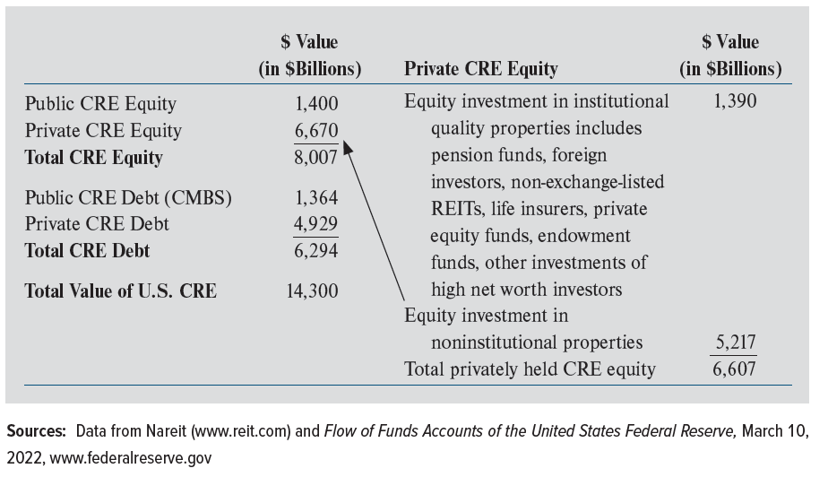
Value of U.S. CRE Equity
Exhibit 17-3
Let’s focus first on equity investors in the private market

Slide 36
Investors in “Institutional Quality” Properties--Private Markets
Pension funds
Long-term liabilities well suited to LT RE investments
Direct purchases as well as acquisitions through funds
Foreign/off-shore investors
Life insurance companies
Long-term liabilities a good match for long-term, illiquid, private CRE investments
But…much more active as CRE lenders than as equity investors

Slide 37
Investors in “Institutional Quality” Properties—Private Markets
High net worth (HNW) investors that invest
“indirectly” in JVs/LLCs/PERE funds organized by others
“directly” (although they form LLCs, etc.) (ex., Collier)
Endowment funds
Universities, charitable organizations
As well as open- and closed-end funds that invest in institutional quality properties

Slide 38
Investors in “Institutional Quality” Properties—Private Markets
Just $1.39 trillion (21%) of $6.6 trillion in private equity is invested in institutional quality properties
Remaining $5.2 trillion (79%) is invested in non-institutional quality properties
It is the “great investor masses” that own most of these non-institutional quality properties
Which are purchased by private “local” CRE syndications that form LLCs
Exhibit 17-3 (partial)

Slide 39
Who Provides Long-Term Debt Financing?

Slide 40
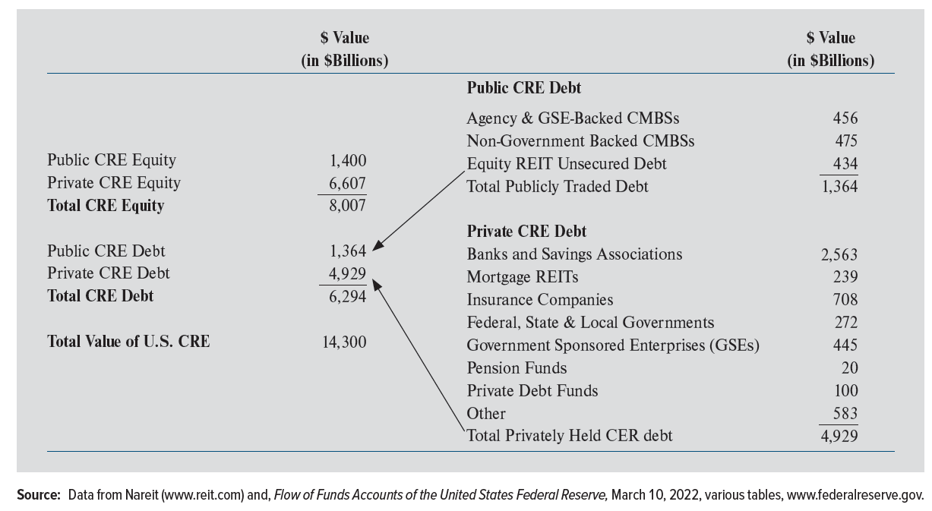
Sources of CRE Debt: Investment Holdings NOT Loan Originations
Exhibit 17-4

Slide 41
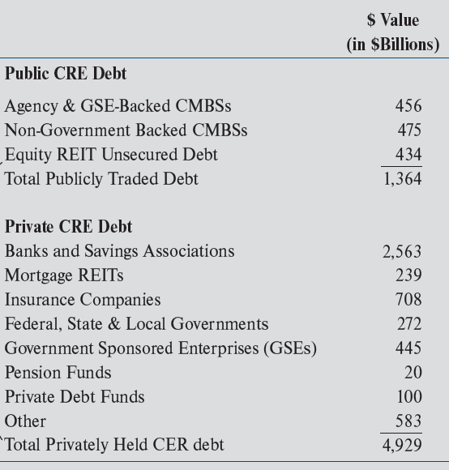
Sources of CRE Debt
78% of outstanding commercial mortgage debt (or $4.9 trillion) is privately held as an investment by individuals & institutional investors:
Commercial banks
Savings associations
Life insurance companies
GSEs: Freddie & Fannie (multi)
State & local governments
Private debt funds

Slide 42
Commercial Banks are Major Holders of Permanent CRE Mortgages
Commercial banks (& savings associations) hold in portfolio 41% ($2.56 trillion/$6.29 trillion) of existing CRE debt
54% of outstanding private CRE debt ($2.56T/$4.929T)
Does not include construction loans

Slide 43
Sources of CRE Debt: Public Market
22% ($1.36 trillion) is publicly traded
GSE-backed commercial mortgage-backed securities (CMBSs)-all multifamily
Non-government backed (“private label”) CMBS
Investment grade unsecured debt of large REITs

Slide 44
So…Can You Tell a “Story” About the Value & Ownership of CRE Debt & Equity?
Exhibit 17-2

Slide 45
Advantages & Disadvantages of Primary Debt Sources

Slide 46
Loans Originated to be Packaged in Commercial Mortgage-Backed Securities
Advantage from borrower’s perspective: CMBS loans allow moderate to high leverage (65–75 percent LTVs), are nonrecourse, and carry a fixed rate for the loan term.
Loan terms of five, seven, and 10 years are available, although 10-year loans are the most common.
30-year amortization is typical; however, some CMBS loans are interest-only for 3-5 years.
Major disadvantage is strict prepayment penalties, which effectively prohibits prepayment
CMBS loans are not suitable for “transitional” properties; that is, those with high vacancy rates or that need major CAPX

Slide 47
Life Insurance Debt
Loans from life insurance companies (LICs) are nonrecourse and carry a fixed rate for the loan term
10-year terms are common with some LICs offering terms of 15 years or longer
Amortization periods of 25-30 years are common
Borrowers can lock in rate when application is completed; avoiding risk of rates increasing before closing
LIC loans have several potential disadvantages:
Max. leverage is typically low (60% or less) & strict prepayment penalties (i.e., yield maintenance) eliminate early prepayment
LIC loans usually take longer to close than CMBS loans
Are generally not suitable for properties with high vacancy rates or that need significant CAPX

Slide 48
Agency (Freddie/Fannie) Debt
Fannie Mae & Freddie Mac dominate the mortgage market for existing apartment (multifamily) loans
Usually offer the highest leverage (typically 75% LTV)
Loans are nonrecourse and carry a fixed rate for the loan term
Loan terms of 5, 7, and 10 years are available, although 10-year loans with 30-year amortization are the most common
Fannie & Freddie can offer lower interest rates than their competitors because they are backed by the full faith & credit of the U.S. government.
A disadvantage is that strict prepayment penalties eliminate the option of early prepayment
Interest rate is not locked-in until loan closing

Slide 49
Banks & Credit Unions
Bank loans typically carry a 5-7 ear term
Borrowers usually able to lock in the rate on the day the loan application is signed
Banks will often negotiate prepayment penalties that are usually stated as a % of the remaining loan balance
Often allow the penalty to decline with time
For example, no prepayment is allowed during the first year; a 3% penalty is applied if the loan is prepaid during year 2; 2% in year 3; 1% in year 4, and no penalty after four years
Trade-off is usually lower max. leverage (65% LTV or less)
In addition, banks often seek some form of recourse from the borrower

Slide 50
Debt Funds
Private equity real estate (PERE) funds that invest in mortgages instead of taking ownership positions in CRE
Typically offer loans with the highest LTVs for “transitional” (non-stabilized) properties
These “bridge” loans (see Chapter 16) are typically nonrecourse, have a floating interest rate, and often have a 3-year initial term
Although these loans provide borrowers with more flexibility than most other debt, they have much higher interest rates and other loan costs.

Slide 51
Quick Notes on Development & Construction Lending
Can be extremely risky
Developer will fail to complete the project in a timely manner or fail to complete it at all
Builders may experience cost overruns, poor weather, strikes, structural or design problems, or difficulties with subcontractors
Builder may simply be a bad manager
Failure to pass various building code inspections may delay ability of tenants to occupy building (and pay rent)

Slide 52
Quick Notes on Development & Construction Lending
All of these risks are assumed by construction lender
Thus, construction lenders must have specialized skills in monitoring and controlling the construction process
Because risks are significant and much different than risks of long-term lending, the capital sources for development & construction loans differ significantly from permanent financing
Construction loan market is dominated by commercial banks

Slide 53
Real Estate Investment Trusts

Slide 54
Real Estate Investment Trusts
Although vast majority of U.S. CRE is owned in private markets, publicly-traded (“listed”) REITs own properties with market values totaling over $3 trillion
Listed REITs can be described as mutual funds for investing in RE
Diversification benefits
Liquidity

Slide 55
What is a REIT?
Operate under same tax, regulatory & financial reporting rules as all corporations
However:
A “qualified” REIT may deduct dividends paid to shareholders from corporate taxable income
Taxes paid by shareholders on dividends
Operating as a REIT is a voluntary election under the Internal Revenue Code (IRC)
© MCGRAW HILL LLC. ALL RIGHTS RESERVED. NO REPRODUCTION OR DISTRIBUTION WITHOUT THE PRIOR WRITTEN CONSENT OF MCGRAW HILL LLC.

Slide 56
What Qualifies as a REIT?
To qualify, must:
be structured as corporation or trust
have ≥ 100 shareholders
pay dividends ≥ 90% of REIT's taxable income (each year)
Not 90% of REIT cash flow
Still face corporate taxation if dividends < 100% of taxable income
i.e., they are not “tax exempt”
© MCGRAW HILL LLC. ALL RIGHTS RESERVED. NO REPRODUCTION OR DISTRIBUTION WITHOUT THE PRIOR WRITTEN CONSENT OF MCGRAW HILL LLC.

Slide 57
What Qualifies as a REIT?, cont.
Stock must be widely held
no more than 50% of shares can be held by 5 or fewer investors
“five or fewer” rule
Company must be in RE “business”
75% or more of assets must be invested in RE, cash, &/or government securities
75% or more of gross income must come from RE
Including income from mortgages & MBS
Requirements must be met on an ongoing basis
© MCGRAW HILL LLC. ALL RIGHTS RESERVED. NO REPRODUCTION OR DISTRIBUTION WITHOUT THE PRIOR WRITTEN CONSENT OF MCGRAW HILL LLC.

Slide 58
Private REITs
Privately issued & narrowly held
Not publicly registered or listed on a stock exchange
“Private placement” sold to accredited investors
Because data are limited to IRS filings, private REIT counts & info are difficult to obtain
≈ 700-800 private REITs
© MCGRAW HILL LLC. ALL RIGHTS RESERVED. NO REPRODUCTION OR DISTRIBUTION WITHOUT THE PRIOR WRITTEN CONSENT OF MCGRAW HILL LLC.

Slide 59
Public Non-Listed REITs (PNLRs)
Publicly registered & publicly offered, but not listed on exchange
Marketed through financial advisors/securities brokers
Minimum investment: $5-$10 thousand
These are NOT private placements
But….they have traditionally had the “look & feel” of closed-end PERE funds
But with higher fees/expenses
Blackstone & Starwood have entered this business in recent years which has increased the visibility and attractiveness of the PNLR REIT market
© MCGRAW HILL LLC. ALL RIGHTS RESERVED. NO REPRODUCTION OR DISTRIBUTION WITHOUT THE PRIOR WRITTEN CONSENT OF MCGRAW HILL LLC.

Slide 60
Types of Listed REITs (as of Sept. 2022)
Percentages Based on Equity Market Capitalizations
96% EQUITY REITs
Own commercial real estate—derive revenues primarily from rents
4% MORTGAGE REITs
Invest in mortgages or MBS— derive revenues primarily from interest payments
Total equity market capitalization

Slide 61
The Importance of the Listed REIT Market
Exhibit 17-5
Measures of importance of REITs include equity and debt offerings and stock market capitalization

Slide 62
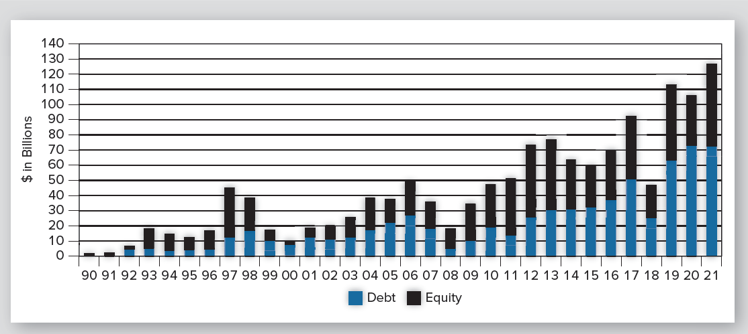
Equity and Debt Security Offerings by Year (in $billions)
Exhibit 17-6
Large surge in capital raising in 97-98, 04-06, and 2011-2013; capital raised by equity REITs is primarily used to acquire properties

Slide 63
REIT Industry: as of Sept. 30, 2022
208 REITs in FTSE NAREIT All REIT Index
164 equity REITs
44mortgage REITs
≈ 90 public, non-listed REITs
Listed REITs own ≈ 535K properties (≈ $2.6 trillion in value)
Listed REITs own ≈ 55K properties (≈ $201 billion) in FL (www.reitsacrossamerica.com)
FTSE is an independent company owned by The Financial Times and the London Stock Exchange. Its sole business is the creation and management of indices and associated data services.

Slide 64
Types of Listed REITs (Sept. 30, 2022)
$1.2 trillion equity market capitalization (listed REITs)
Equity REITs: $1.175 trillion (FTSE NAREIT All Equity REITs)
Mortgage REITs: $50 billion
Apple’s (AAPL) equity market capitalization?
$2.3 trillion (11/10/22)

Slide 65
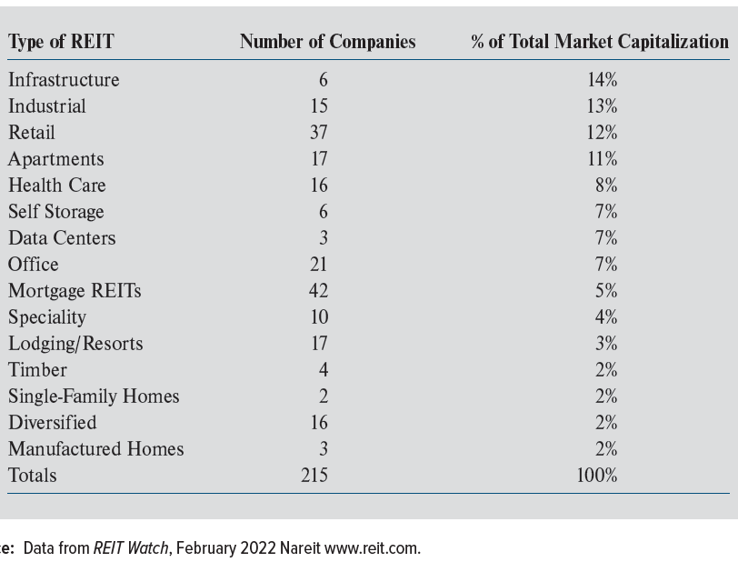
In What Do Listed REITs Invest?
Exhibit 17-7
% based on classification of each REIT & total REIT market cap
Infrastructure property types include fiber cables, wireless infrastructure, communication towers, and energy pipelines
“Core” REITs invest in retail, apartment, office, & industrial properties
But many non-core REITs exist (data centers, self storage, manufactured homes, etc.)

Slide 66
How Does UPREIT Structure Work?
In typical UPREIT, partners in an existing partnerships & a newly-formed REIT become partners in a new LP termed the “operating partnership” (OP)
Owners transferring LP interests into OP receive units in OP w/o triggering a taxable sale
If they received REIT stock or cash it would trigger a taxable gain

Slide 67
How Does UPREIT Structure Work?
Recipients of OP units receive cash distributions from OP
These “dividends” are equal to dividends paid to REIT shareholders
REIT is general partner & majority owner of OP Units

Slide 68
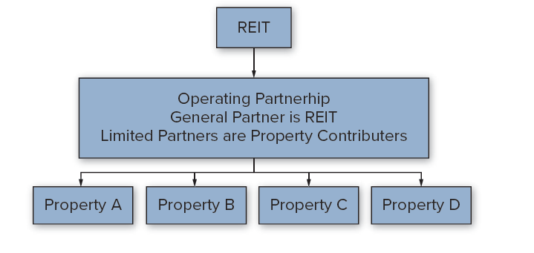
A Typical UPREIT Structure
Exhibit 17-8
© MCGRAW HILL LLC. ALL RIGHTS RESERVED. NO REPRODUCTION OR DISTRIBUTION WITHOUT THE PRIOR WRITTEN CONSENT OF MCGRAW HILL LLC.
68

Slide 69
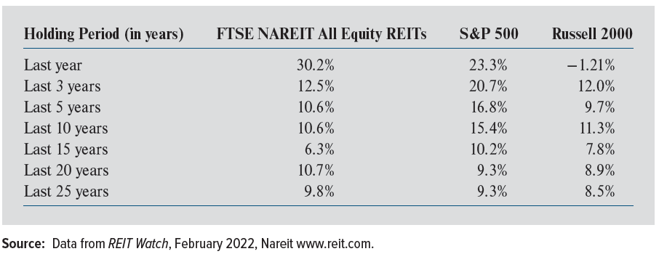
Equity REIT Total Return Performance
Exhibit 17-9
Equity REITs have performed well relative to both large cap (S&P 500) & small cap (Russell 2000) stocks
REITs also help to diversify portfolios that contain only stocks and bonds

Slide 70
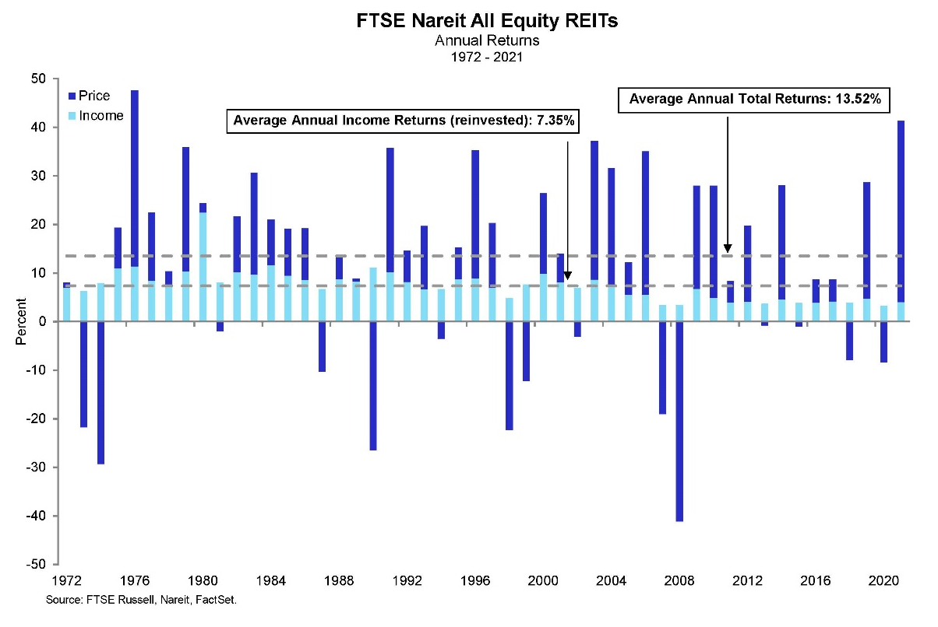
But REIT Returns Have Been Volatile!
FTSE NAREIT All Equity REITs
S&P 500
Return volatility comes from price appreciation
Equity REITs S&P500
2020 -5.1% 18.4%
2021 41.3% 28.7%
2022 (through Sept.) -27.9% -23.9%
© MCGRAW HILL LLC. ALL RIGHTS RESERVED. NO REPRODUCTION OR DISTRIBUTION WITHOUT THE PRIOR WRITTEN CONSENT OF MCGRAW HILL LLC.

Slide 71
Measuring REIT Income: Funds From Operations (FFO)
REIT CF, expressed as “Funds from Operations” (FFO), is used along with accounting (GAAP) net income to
measure past performance
forecast future performance
FFO is a supplemental measure of a REIT's operating performance
© MCGRAW HILL LLC. ALL RIGHTS RESERVED. NO REPRODUCTION OR DISTRIBUTION WITHOUT THE PRIOR WRITTEN CONSENT OF MCGRAW HILL LLC.

Slide 72
Funds From Operations (FFO)
FFO =
Net (accounting) income (excluding gains/losses from sales of property)
+ Depreciation (real property)
+ Amortization of leasing expenses
+ Amortization of tenant improvements
- Gaines/losses from infrequent & unusual events

Slide 73
Funds From Operations (FFO)
FFO =
Net (accounting) income (excluding gains/losses from sales of property)
+ Depreciation (real property)
+ Amortization of leasing expenses
+ Amortization of tenant improvements
Gaines/losses from infrequent & unusual events
Is a better measure than accounting income of the cash flow available to pay dividends
Non-cash outflows
© MCGRAW HILL LLC. ALL RIGHTS RESERVED. NO REPRODUCTION OR DISTRIBUTION WITHOUT THE PRIOR WRITTEN CONSENT OF MCGRAW HILL LLC.

Slide 74
Funds From Operations (FFO)
FFO is different from GAAP net income because commercial RE maintains value to a much greater extent than may other assets
Thus, economic depreciation < tax depreciation
Security analysts judge REIT performance according to FFO growth
Price / FFO multiples reflect underlying RE value, management quality, and growth potential

Slide 75
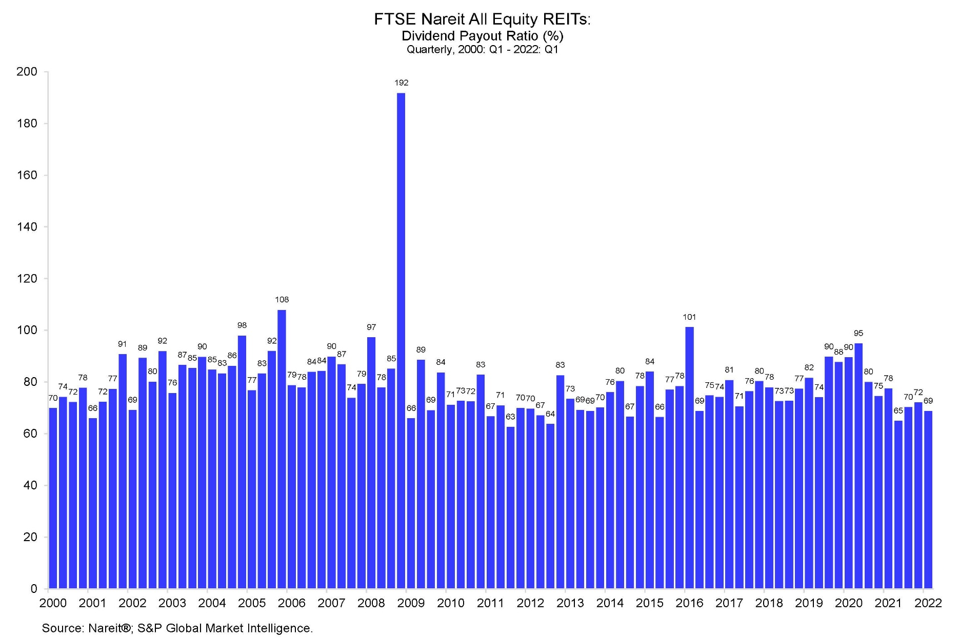
Dividends as a % of FFO
REITs not as cash constrained as some think
Why is taxable income < cash flow?
© MCGRAW HILL LLC. ALL RIGHTS RESERVED. NO REPRODUCTION OR DISTRIBUTION WITHOUT THE PRIOR WRITTEN CONSENT OF MCGRAW HILL LLC.

Slide 76
How Are REIT Stocks Valued?
To determine share values, typical analyses involves one or more of the following criteria:
Management quality;
Current prevailing dividend yield
Anticipated total return from the stock
Capital Sources
Because REITs are obligated to distribute 90% of taxable income, they usually require external funding sources

Slide 77
How Are REIT Stocks Valued?
Investors attempt to forecast dividends REIT will pay out over time
This requires estimates of future FFO
This projected dividend stream is converted into a present value
In practice
Long-term dividend projections are difficult to develop
The appropriate discount rate (cost of capital) is difficult to estimate
© MCGRAW HILL LLC. ALL RIGHTS RESERVED. NO REPRODUCTION OR DISTRIBUTION WITHOUT THE PRIOR WRITTEN CONSENT OF MCGRAW HILL LLC.

Slide 78
Net Asset Value
A commonly used valuation approach centers around concept of net asset value (NAV)
NAV is equal to estimated total market value of a REIT’s underlying assets, less all liabilities (including mortgages)
Converted to a per share amount
NAV:
Difficult to estimate—requires mass appraisal of properties
Unique to CRE investment firms
© MCGRAW HILL LLC. ALL RIGHTS RESERVED. NO REPRODUCTION OR DISTRIBUTION WITHOUT THE PRIOR WRITTEN CONSENT OF MCGRAW HILL LLC.

Slide 79
How is NAV Used to Make Decisions?
If stock price per share > its NAV per share, REIT is said to be selling for a “premium” to NAV
A stock price in excess of per-share NAV may indicate a REIT is overpriced relative to value of assets currently in the portfolio
© MCGRAW HILL LLC. ALL RIGHTS RESERVED. NO REPRODUCTION OR DISTRIBUTION WITHOUT THE PRIOR WRITTEN CONSENT OF MCGRAW HILL LLC.

Slide 80
How is NAV Used to Make Decisions?
Conversely, REITs selling at “discounts” to NAV may signal buying opportunities for investors
Or may reflect that the market belies the company is not well-managed/has low growth prospects
Note:
Can’t value non-CRE firms using stock price ÷ NAV
© MCGRAW HILL LLC. ALL RIGHTS RESERVED. NO REPRODUCTION OR DISTRIBUTION WITHOUT THE PRIOR WRITTEN CONSENT OF MCGRAW HILL LLC.

Slide 81
REITs in S&P 500
In 2001, Standard & Poor’s added Equity Office Properties (EOP) to S&P 500
30 REITs now included (as of Sept. 30, 2022)
www.reit.com/data-research/reit-indexes/reits-sp-indexes
Indicates acceptance of REITs as a mainstream investment
© MCGRAW HILL LLC. ALL RIGHTS RESERVED. NO REPRODUCTION OR DISTRIBUTION WITHOUT THE PRIOR WRITTEN CONSENT OF MCGRAW HILL LLC.

Slide 82
Investing in REITs…?
Can buy shares in a REIT, which are listed on major stock exchanges
Can also purchase shares in a REIT mutual fund or exchange-traded fund (ETF)
Approximately 145 million households are invested in RE through REITs
Many accessing REITs through mutual funds and ETFs in their 401(k)s, IRAs, and pension plans
© MCGRAW HILL LLC. ALL RIGHTS RESERVED. NO REPRODUCTION OR DISTRIBUTION WITHOUT THE PRIOR WRITTEN CONSENT OF MCGRAW HILL LLC.

Slide 83
Global Real Estate Securities?
Following lead of U.S., 41 countries have established REIT regimes during last 40+ years
Comprehensive index for the REIT & global listed property market is the FTSE EPRA/NAREIT Global Real Estate Index Series: www.reit.com/data-research/reit-indexes/real-time-index-returns/enhgeur-ftx
© MCGRAW HILL LLC. ALL RIGHTS RESERVED. NO REPRODUCTION OR DISTRIBUTION WITHOUT THE PRIOR WRITTEN CONSENT OF MCGRAW HILL LLC.

Slide 84
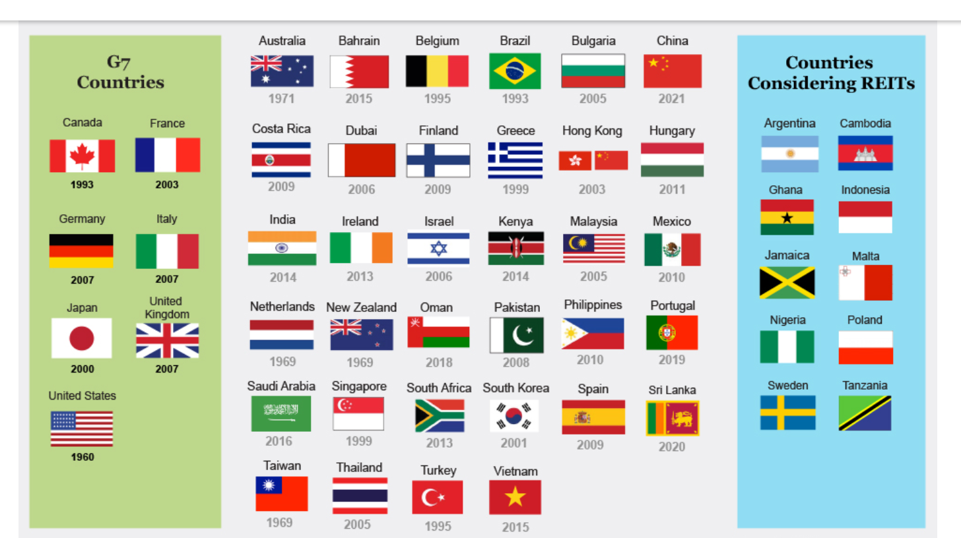
Global Expansion of REIT Market-- Increasing Investment Opportunity
Countries and Regions that Have Adopted the U.S. REIT Approach
© MCGRAW HILL LLC. ALL RIGHTS RESERVED. NO REPRODUCTION OR DISTRIBUTION WITHOUT THE PRIOR WRITTEN CONSENT OF MCGRAW HILL LLC.

