Slide 1
Chapter 16
Commercial Mortgage Types
and Decisions

Slide 2
“Commercial” Mortgage Loans vs. Home Loans
Commercial mortgages & notes for existing properties not as standardized as home loans
Documents are longer & more complex
Often no personal liability:
  Legal borrower often is a single asset entity (usually a LLC or LP)
    Shields sponsor from personal liability unless he/she provides other guarantees
    “Passive” investors always shielded from personal liability

Slide 3
When Do We See Recourse Loans?
Usually on construction loans…
On “permanent” financing, nonrecourse loans dominate pension fund, life company, & CMBS loans
But…commercial banks (CBs) may require some form of credit “enhancement”
  Often a guarantee by organizer/sponsor of investment
    to make lender whole in event lender suffers a capital loss on loan

Slide 4
When Do We See Recourse Loans?
Many lenders also unwilling to relieve borrowers of personal liability if a “willful” act of borrower causes a capital loss for lender
  Examples: borrower fraud, environmental problems, unpaid property tax obligations
How is this accomplished?
  A “carve-out” clause is often included in note
  This “bad boy” clause holds borrower(s) personally liable for lender losses caused by such problems

Slide 5
Fixed Rate CRE Loans (Permanent)
Usually a partially amortized “balloon” mortgage
  25-30 year amortization of principle
  5-10 year loan maturity
  Balance of loan at maturity must be
    refinanced or
    paid off with a “balloon” payment

Slide 6
Attractions of a Fixed-Rate Balloon Mortgage to Lender
Reduces interest rate risk on “permanent” mortgages
  Lowers probability of lender being hurt by an increase in market interest rates
Reduces lender’s credit risk
  Lender’s credit risk is generally much greater for CRE loans than home loans
    Often no personal liability
    No FHA/PMI insurance (as in home mtg. market) to protect lender
    Borrowers are more “ruthless” about exercising their default options than homeowners
  When is borrower’s default option “in-the-money”?
© MCGRAW HILL LLC. ALL RIGHTS RESERVED. NO REPRODUCTION OR DISTRIBUTION WITHOUT THE PRIOR WRITTEN CONSENT OF MCGRAW HILL LLC.

Slide 7
Borrower’s Default Option is “In-The-Money” When Property Value < RMB
Equity at purchase
Prop. value
Original property value
Loan balance
Remaining loan balance
Negative current equity
(borrower is “underwater”)
Current prop. value
Time in years after origination

Slide 8
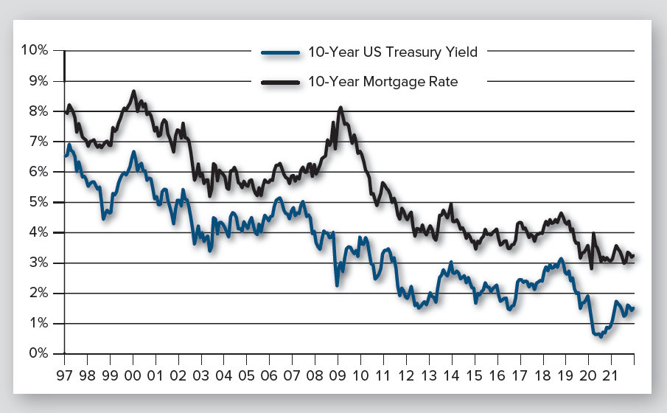
Commercial Mortgage “Spreads” over Treasuries
Exhibit 16-2
CRE mortgages are “priced off the yield curve” with interest rates typically quoted as spreads over Treasuries
Source: H-15 report of the Federal Reserve and the Giliberto-Levey Commercial Performance Index (www.jblevyco.com)
Correlation between monthly rates/yields on 10-yr mortgages & 10-yr Treasury securities: 0.9 from 2000-2021

Slide 9
Restrictions on Prepayment
Lock-out: Prohibition against prepayment for up to, say, 5 years
Prepayment penalties:
  Percentage of loan: Say, 2-4% of loan balance
    Used by commercial banks & other portfolio lenders
  Yield maintenance penalty: Borrower must pay lender PV of losses due to prepayment
    Primarily used by life insurance companies

Slide 10
Restrictions on Prepayment
Prepayment penalties, continued:
  Defeasance penalty: Borrower must replace mortgage loan with a set of U.S. Treasury securities that produce CFs equivalent to those on paid-off mortgage
    Most common form of prepayment penalty on loans used for collateral in CMBS
    see www.defeasance.com for a defeasance calculator
In summary…lender risk on home loans vs. most CRE loans?

Slide 11
Alternative Financing Arrangements

Slide 12
Floating (Adjustable) Rate Mortgage
Rate changes periodically based on ∆s in index rate
Index typically has been LIBOR
  LIBOR is being replaced with the Secured Overnight Financing Rate (SOFR)
    SOFR is broad measure of cost of borrowing cash overnight (loans collateralized by Treasury securities)
CBs most commonly provide floating rate loans
  They better match maturity of their CRE loan assets with maturities of their liabilities

Slide 13
Loan Syndications
Many larger CRE loans (+$100 million) are “syndicated” to a group of banks;
  i.e., multiple lenders provide a portion of the financing
This risk sharing allows participating banks to diversify their exposure to individual borrowers & local property markets
Can involve 2-3 banks (“club deals”) or as many as 10-20 lenders (“true market syndications”)
“Administrative Agents” manage the process for the borrower & charge a fee for their services

Slide 14
2nd Mortgages & Mezzanine Loans
Supplements underlying first mtg. loan
Sometimes is a 2nd mortgage loan
  i.e., secured by property
More often is a non-mortgage loan secured by a pledge of borrowers’ ownership interest(s) in entity
  If borrower defaults, mezz lender takes over borrower’s ownership position
    May give them more control…can negotiate with first lien holder

Slide 15
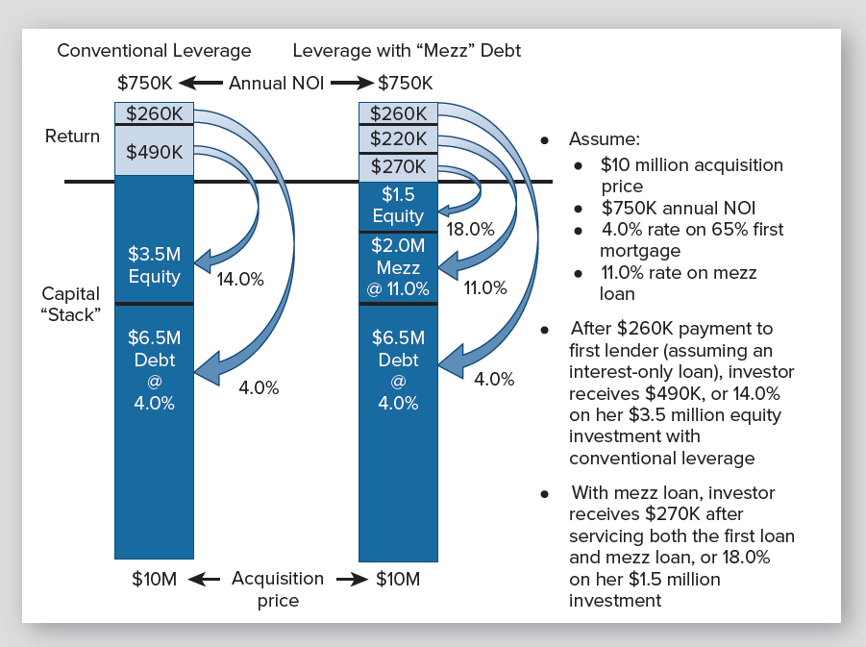
Adding a Mezzanine Loan or 2nd Mortgage to the “Capital Stack”
Exhibit 16-3

Slide 16
Adding a Mezzanine Loan or 2nd Mortgage to the “Capital Stack”
Exhibit 16-3
Why does increased leverage in this example increase expected first year cash-on-cash return?
Weighted average cost of debt
= (6.5/8.5)×0.04 + (2.0/8.5)×0.11
=0.0564 or 5.6%
which is < 7.5% cap rate

Slide 17
Mezzanine Lending
Higher interest rate than 1st mortgage loan
But…may be less expensive than raising additional equity capital
  And…sponsor keeps larger % of equity ownership
Mezz lenders include:
  private equity funds
  off-shore investors
  insurance companies, and
  pension funds

Slide 18
“Bridge” Loans
In recent years, borrowers seeking to acquire and then reposition or renovate CRE have had access to nonrecourse “bridge” loans
  12-36 month loan terms, typically interest-only
  Used for “transitional” properties needing to be repositioned or “stabilized”
  Higher credit risk to lender, thus higher interest rates
  Majority provided by nontraditional lenders (e.g., funds)
  No longer used just by “non-bankable” borrowers with poor credit
© MCGRAW HILL LLC. ALL RIGHTS RESERVED. NO REPRODUCTION OR DISTRIBUTION WITHOUT THE PRIOR WRITTEN CONSENT OF MCGRAW HILL LLC.

Slide 19
Other Forms of Permanent Financing for Existing Properties
FHA-insured loans for investment in low & moderate income multifamily housing www.hud.gov/program_offices/housing/mfh/progdesc
Freddie Mac & Fannie Mae multifamily lending programs
  Many targeted to low & moderate income housing
    ≈ 50% of multifamily units financed by Fannie Mae serve families earning < 80% of area median income (AMI)
    ≈ 50% of multifamily units financed by Fannie Mae were in designated “underserved” markets
  See Fannie & Freddie websites (www.fanniemae.com & www.freddiemac.com)

Slide 20
How is the Size of Loans Determined?

Slide 21
Borrower’s Decision Making Process: Loan Size
Reasons for use of debt by investors:
  Limited financial resources/accumulated wealth
  Debt alters risk & equity return of investment
    “Magnifies” rate of return on invested equity
    This magnification known as positive (or negative) leverage
  Diversify investment portfolio

Slide 22
What Do Borrowers & Lenders Want?
CRE borrowers often want as large a loan as possible
However…lenders are worried about default/credit risk
  But…if lenders want to originate loans, they have to offer borrowers competitive loan terms
This tension between what borrowers and lenders want often leads to negotiation

Slide 23

Loan-to-Value Ratio
An indicator of borrower’s incentive to maintain the loan (i.e., not default)
Higher initial LTVs increase the probability of subsequent default, all else equal
Typical maximum LTV at origination is 75%
Mezzanine & second loans can increase leverage
$$LTV= \frac{Loan Amount}{Acquisition Price}$$

Slide 24

Debt Coverage Ratio
Indicator of “cash flow cushion” from lender’s perspective
where:
NOI₁ is first year (next 12 months) NOI
DS is annual debt service (monthly payment × 12)
Lender’s want DCR to be as high as possible, but typically 1.20 or higher
IF DCR on requested loan is too low, what happens?
$$DCR= \frac{{NOI}_{1}}{DS}$$

Slide 25

Debt Yield Ratio
Indicator of lender’s mortgage “return”
Return lender would enjoy if it foreclosed & took title to property on day of loan origination
Does not consider contract interest rate or amortization period
DYR only considers how large the loan is relative to property's NOI
Lenders typically require a minimum DYR of 9.0% or higher
$$DYR= \frac{{NOI}_{1}}{Loan Amount}$$

Slide 26
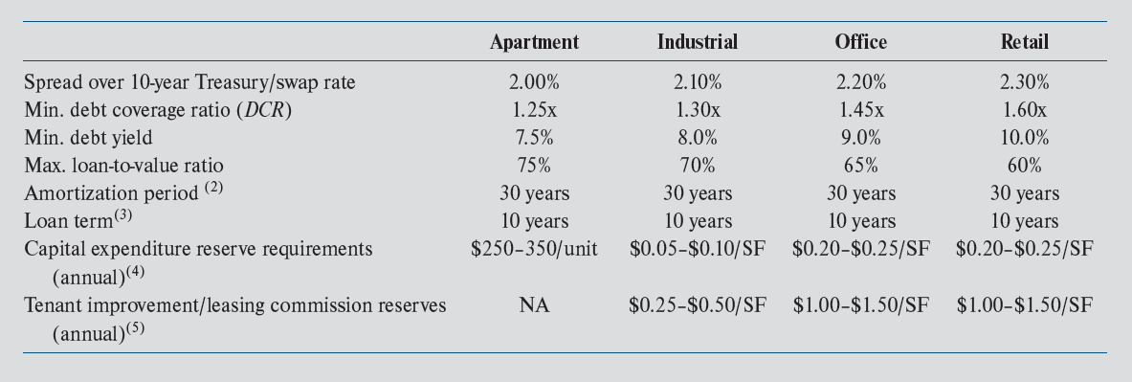
Typical Terms on CRE Mortgages: ( Exhibit 16-1)
Exhibit 16-1
As of April 2022. Underwriting metrics change with market conditions and CMBS bond buyer demand.
Interest loans may be available in some situations.
Although CMBS loans are predominantly 10-year loans, 5- and 7- year loans are also available.
Reflects typical CapEx reserve requirements. A property condition report completed by an engineer will determine the reserve amount
Reflects typical Tenant Improvement and Leasing Commission reserves. During the underwriting process, these will be calculated based upon the re-tenanting costs in the market and remaining average lease term.

Slide 27
The Impact of Leverage on Returns & Risk

Slide 28
When Will Increased Leverage Increase Cash-on-Cash Return?
Cash-on-Cash return (COC) = BTCF₁/Equity investment
Holding everything else constant….
Increased leverage will increase estimated COC when….
  Initial cap rate (overall property return) exceeds cost of debt
© MCGRAW HILL LLC. ALL RIGHTS RESERVED. NO REPRODUCTION OR DISTRIBUTION WITHOUT THE PRIOR WRITTEN CONSENT OF MCGRAW HILL LLC.

Slide 29
Remember This Slide…?
Exhibit 16-3
Why does increased leverage in this example increase expected first year cash-on-cash return?
Weighted average cost of debt
= (6.5/8.5)×0.04 + (2.0/8.5)×0.11
=0.0564 or 5.6%
which is < 7.5% cap rate

Slide 30
When Will Leverage Increase NPV?
Increased leverage will increase estimated NPV when….
  opportunity cost of equity capital (discount rate) exceeds effective borrowing cost (EBC)

Slide 31
When Will Leverage Increase Going-in IRR?
Increased leverage will increase going-in IRR when….
  unlevered IRR exceeds effective borrowing cost (EBC)

Slide 32
Borrower’s Decision Making Process (continued)
Financial risk:
  Risk that NOI will be < mortgage payment
  This negative cash flow may lead to default & foreclosure
  This risk increases with leverage
Leverage also increases variability of equity returns (Exhibit 19-9)

Slide 33
Borrower’s Decision Making Process: Refinancing
Refinancing involves a NPV decision
  Even more focused on NPV than home mortgage refinancing
    More sophisticated borrowers
    Fewer non-financial considerations

Slide 34
Borrower’s Decision Making Process: Refinancing (continued)
Must account for lockout periods and/or prepayment penalty
NPV = PV of payment savings – Refi Cost – Prepay Penalty
  Should discount monthly savings at current market mortgage rate
Expected holding period after refinancing is important assumption

Slide 35
Borrower’s Decision Making Process: Default
For lenders, default/credit risk is the signature risk of commercial mortgages
  Borrower seldom can cover for long the loan payment for a crippled commercial property
  Loan is often (effectively) non-recourse (good for borrower, bad for lender)

Slide 36
Loan Application & Approval Process

Slide 37
Permanent Loan Application & Approval Process
Borrowers seeking to acquire or refinance an existing CRE property may submit loan requests directly to
  commercial banks
  life insurance companies, or
  other direct lenders

Slide 38
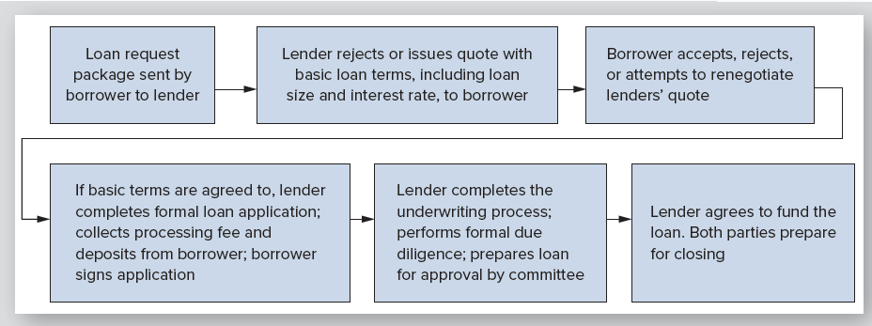
Loan Submission, Application, & Approval: An Illustration
Exhibit 16-4

Slide 39
Permanent Loan Application and Approval Process
Another channel for loan requests is through mortgage brokers
  Brokers specialize in putting together loan applications that meet requirements of both borrowers and lenders
  They also assist borrowers in assembling the loan submission package
  For these services, mortgage brokers receive a fee at loan closing that may range from ½%-1% of loan amount
    if it closes!

Slide 40
Permanent Loan Application & Approval Process
Relative to home loans, underwriting process for CRE loans is:
  more complicated &
  more focused on property used as collateral for loan
Primary reason?
  Payments on CRE loans are expected to come from income (NOI) generated by property
  Result?
    The underwriting process focuses first on property being pledged as collateral for loan
    Although borrower reputation/wealth is important
© MCGRAW HILL LLC. ALL RIGHTS RESERVED. NO REPRODUCTION OR DISTRIBUTION WITHOUT THE PRIOR WRITTEN CONSENT OF MCGRAW HILL LLC.

Slide 41
Permanent Loan Application and Approval Process
Borrowers, perhaps aided by mortgage broker, submit a loan package to a lender (or lenders)
Purpose of loan submission package (executive summary)?
  Provide lenders with information needed to evaluate request
  Package typically contains information on:
    type, size, and location of property
    maps and photographs
    property age
    purchase price
    requested loan amount and other basic loan terms
    recent operating history of property
    current rent roll, and
    estimated PGI over next twelve months

Slide 42
Permanent Loan Application and Approval Process
Based on loan submission package and, perhaps, conversations with borrower or borrower’s broker, lender either (1) rejects loan or (2) issues preliminary quote
Quote
  contains basic terms of proposed loan
  is sometimes referred to as a letter of intent (LOI)
Borrower then choses to reject or accept quote
Or, in some cases, attempt to negotiate better loan terms

Slide 43
Permanent Loan Application and Approval Process
If lender & borrower agree on the basic loan terms
  lender will finalize loan application
  which is then signed by borrower

Slide 44
Permanent Loan Application and Approval Process
Length & details of loan application vary with
  size of loan request
  type of property being used as collateral (e.g., office, apartment)
  whether loan will be held in lender’s portfolio or sold in secondary mortgage market to be used as collateral for the issuance of a CMBS
Loan applications typically contains a great deal of terms & language that will be included in final promissory note/mortgage

Slide 45
Permanent Loan Application and Approval Process
When application is signed, borrower typically pays a non-refundable loan processing fee to cover lender expenses
Fee is usually modest, often < $5,000 even on loans in excess of $15 to $20 million
Lender will also require a “good faith” deposit, which can be 1-2% of loan amount
  Required because lender will now proceed to secure the loan funds, complete loan underwriting process, and issue a loan commitment

Slide 46
From Loan Application to Closing
With signed application, loan processing fee, good faith deposit, and deposit for legal fees & third-party reports in hand, the lender is confident borrower intends to close loan
So…makes sense for lender to incur the additional expenses associated with moving loan forward to formal commitment & closing

Slide 47
From Loan Application to Closing
Lender’s required “due diligence” begins once application is signed
Due diligence process typically includes:
  ordering appraisal, title report, and 3rd party inspection, compliance, and engineering reports
This is also when lender evaluates property’s income producing ability in detail
Lender performs due diligence to make sure borrower did not misrepresent property in any way in original loan submission package

Slide 48
From Loan Application to Closing
If lender uncovers
  an inconsistency or error in information provided by borrower or
  an undisclosed problem with the land, building, title, borrower, etc.,
lender may choose to (1) back out or (2) hold back on final commitment until issue is addressed to satisfaction of lender’s staff
If/when full resolution is obtained, staff prepares a package that is presented to a committee of top executives for final approval

Slide 49
From Loan Application to Closing
Once approved & issued to the borrower, loan commitment is a binding agreement between lender and borrower
A typical permanent loan submission and approval process is summarized in Exhibit 16-5
However, process can vary significantly by property type & size and across borrowers & lenders

Slide 50
So…How Long Does This Take?
A CRE loan may take 90 days from signing of purchase & sale contact until loan closing
But…some loans can be processed in < 45 days
Time depends on numerous factors
Loan application is nonbinding
But…loan commitment is a written agreement that commits lender to make the loan to the borrower provided borrower satisfies terms and conditions of commitment

Slide 51
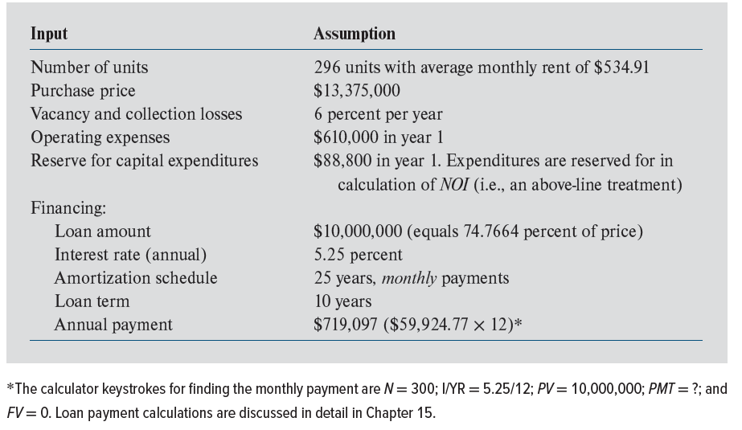
Loan Underwriting: Crunching the Numbers
Exhibit 16-5

Slide 52
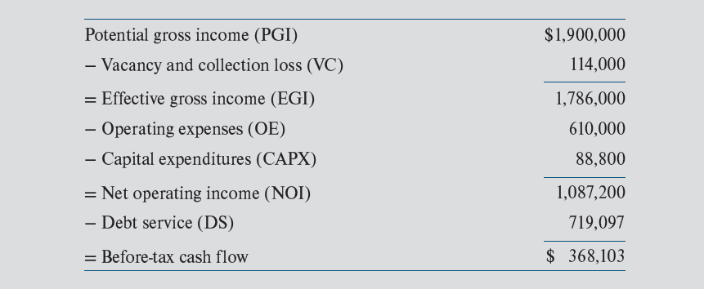
Gatorwood Before-Tax Cash Flow from Operations
Exhibit 16-6
6% of PGI

Slide 53

Gatorwood Debt Coverage Ratio
Expected CF!
$$DCR= \frac{{NOI}_{1}}{DS}= \frac{\$1,087,200}{\$719,097}=1.51$$
NOI in first year of operations is expected to be half again as large as mortgage payment
Thus, there appears to be sufficient protection against a deterioration in the property’s operating performance

Slide 54
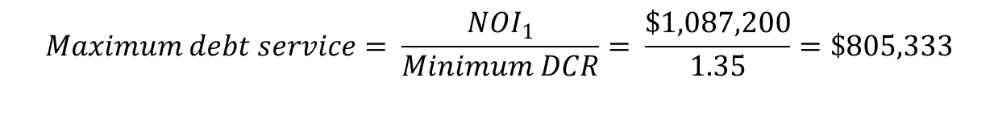
Gatorwood: Determining Maximum Available Loan
$$Maximum debt service= \frac{{NOI}_{1}}{Minimum DCR}= \frac{\$1,087,200}{1.35}=\$805,333$$
You must be given this
Implies a maximum monthly payment of $67,111 ($805,333/12)
With a 5.25% interest rate and 25-year term, implies a maximum loan of $11,199,208 (or 83.7% LTV)
300 5.25/12 67,111 0
N
I
PV
PMT
FV
11,199,208

Slide 55
Gatorwood: Determining Maximum Available Loan
It appears the property’s NOI can support an $11,199,208 loan
However, maximum loan will be determined by lender’s maximum allowable LTV if it is < 83.7% (which is likely)

Slide 56
Construction & Development Financing

Slide 57
Construction & Development Financing
Land acquisition financing
  To finance purchase of raw land
  VERY risky; this is speculative development
    No presale contracts with ultimate buyers of land to reduce risk
  Lenders offer these loans on an exception basis at low leverage (40%-60% LTVs) to their very best clients

Slide 58
Construction & Development Financing
Land development loan
  To finance installation of improvements to the land (sewers, utilities, etc.)—horizontal construction
  If land is ready for development, demand for expected finished product is now less uncertain
  Lenders will typically require presale contracts with homebuilders or ultimate buyers of the land
  Typical leverage: 50%-65% of expected sellout value of land/lots (based on an appraisal)

Slide 59
Construction and Development Financing (continued)
Construction loan
  To finance vertical construction
  Collateral securing construction loan is typically more valuable than collateral securing land acquisition & development loans
    But still much riskier than an existing, well-leased property
  Typical LTV: 65%-75% of expected value of completed property
  Loan proceeds distributed in “draws”
  Typical term: 1-3 years; allow time to construct & lease up project
© MCGRAW HILL LLC. ALL RIGHTS RESERVED. NO REPRODUCTION OR DISTRIBUTION WITHOUT THE PRIOR WRITTEN CONSENT OF MCGRAW HILL LLC.

Slide 60
Construction and Development Financing (continued)
Construction loan, cont.
  Often have preleasing requirements (ex. 50% of space must be preleased)
  Due to risk of these loans, lenders
    Carefully screen experience of developers & the value of their guarantees
    Perform substantial due diligence & market research
      Permitting approval status, construction plans/specs, quality of architect/engineer/general contractor, environmental and soil reports
    Hire an engineer to monitor construction
    May require a “takeout” commitment from a permanent lender upon stabilization or allow loan to convert to an amortizing 3–5-year balloon loan

