Slide 1
Chapter 15
Mortgage Calculations and Decisions

Slide 2
Five Vital Features of a Mortgage
Payment
Remaining balance (at any point in time)
Lender’s yield (internal rate of return-IRR)
Borrower’s effective borrowing cost (EBC)
Present value of the loan payments
Have to be able to calculate all 5!

Slide 3
Valuing a Series of Loan Payments
What would the value of these payments be to a lender who can earn 6% on other loans?
  360 level payments
  $1,000 each
360 6/12 1,000 0
N
I
PV
PMT
FV
166,791.61

Slide 4
Payment on a Loan
What would be the fixed level payment on the following $166,791.61 loan?
  Level payment
  360 months
  6% per year
360 6/12 166,791.61 0
N
I
PV
PMT
FV
1,000

Slide 5
Another Example of Finding a Payment
Loan amount: $100,000
Term:15 years (monthly payments)
Interest rate: 6% annual
Find fixed level payment
180 6/12 100,000 0
N
I
PV
PMT
FV
843.86
Note: (843.86 × 12)/100,000 = 0.1013 is the annual mortgage constant (assuming monthly amortization)

Slide 6
Finding the Remaining Mortgage Balance (RMB)
Balance of a level payment loan at any point in time:
  Equal to the PV of the remaining payments, discounted at the contract interest rate
Balance after one month?
179 6/12 843.86 0
Original term: 180 months
N
I
PV
PMT
FV
99,656.14
$99,656.14 is remaining balance (RMB) after 1 year (12 payments)

Slide 7
Finding the Remaining Balance: Manually
What is the balance (RMB) after two payments?
Principal = $843.86 – Interest
reduction = 843.86 – 498.28 (0.005 × 99,656.14)
= $345.58
Balance after 2 payments
= 99,656.14 – 345.58 = 99,310.56
Confirm with keystrokes…
= 0.06/12
= RMB at end of first month
178 6/12 843.86 0
N
I
PV
PMT
FV
99,310.57

Slide 8
Finding the Remaining Balance: Calculators & Excel
Financial calculators have functions/keystrokes to find remaining loan balance
May also use Excel

Slide 9
Finding RMB: Example
For a loan of $100,000, at 4.0% (annual) interest for 30 years with monthly payments, what will be the balance of the loan at the end of four years?
Months remaining after 4 years
Confirm using the appropriate function of your financial calculator

Slide 10
Mortgage Assumptions
Consider the following level payment mortgage:
  Term: 360 months
  Required discount rate/yield: 4%
  Monthly payment: $954.83
  Initial loan balance: $200,000
  Discount points: 2 or 2.0% of loan amount
    Points = 0.02 × $200,000 = $4,000
  Other up-front financing costs paid to lender (including 1% loan origination fee): $3,000
  Up-front financing costs paid 3rd party service providers (appraiser, surveyor, etc.): $2,000

Slide 11
Calculating Lender’s Yield (IRR)

Slide 12
Lender’s Yield (IRR)
Consider the following mortgage:
  Term: 360 months
  Required discount rate/yield: 4%
  Monthly payment: $954.831
  Initial loan balance: $200,000
  Discount points: 2 or 2.0% of $200,000
Points = 0.02 × $200,000 = $4,000
  Loan proceeds disbursed by lender:
    = $200,000 – $7,000 = $193,000
What lender disburses (net) at loan closing
What payments are based on

Slide 13
Lender’s Yield (continued)
What interest/discount rate makes PV of payments = $193,000
360 -193,000 954.831 0
N
I
PV
PMT
FV
4.30%
(0.35813 × 12)
Implicit yield is 4.30%; that is, lender’s yield (IRR), charging 2.0 discount points and $3,000 in other up-front financing costs, is 4.30%

Slide 14
Calculating Borrower’s Effective Borrowing Cost (EBC)

Slide 15
Effective Borrowing Cost (EBC)
Third-party expenses: up-front expenses incurred by borrower but not paid to lender:
  Mortgage insurance premium
  Lender’s title insurance
  Charges to record your mortgage (county)
  Appraisal
  Survey
  Note: May be “paid” at closing but are NOT received by lender

Slide 16
Effective Borrowing Cost (cont)
Effect of 3rd party payments:
  Borrower net less cash at loan closing than lender’s actual net disbursement to borrower
  Result?
    EBC > lender’s yield/IRR

Slide 17
Effective Borrowing Cost (cont)
Example: Same loan, but with additional borrower expenses
  Up-front financing costs to lender: $7,000
  Borrower’s 3rd party loan expenses: $2,000
  Total deducted from borrower’s loan proceeds at closing: $9,000
Net loan proceeds received by borrower:
= $200,000 – $9,000
= $191,000
Note: net loan proceeds < amount disbursed by lender

Slide 18
Effective Borrowing Cost (cont)
What is EBC? (N = 360; PMT = $954.831)
  Net loan proceeds: $191,000
360 191,000 -954.831 0
N
I
PV
PMT
FV
4.38%
(0.36547 × 12)
With $9,000 in borrower expenses, EBC of loan is 4.38%
Recall lender’s yield is 4.30%
3rd party expenses create a 0.08% “wedge” between EBC & lender’s yield

Slide 19
On Your Own Practice Problem
A mortgage banker is originating a level-payment mortgage with the following terms:
Annual interest rate: 4%
Loan term: 15 years
Payment frequency: monthly
Loan amount: $160,000
Discount points to lender: $2,000
Other up-front financing costs (not paid to lender): $3,000
a. Calculate lender’s yield assuming no prepayment
b. Calculate borrower's effective borrowing cost (EBC) assuming no prepayment

Slide 20
On Your Own Practice Problem
First step: solve for the payment, which is $1,183.50, with the following calculator keystrokes:
(N = 180; I/YR = 4/12; PV = $160,000; PMT = ?; FV = 0)
a. Lender’s yield to maturity is 4.186% (0.34885 × 12)
(N = 180; I/YR = ?; PV = -$158,000; PMT = $1,183.50; FV = 0)
b. Borrower’s EBC is 4.47% (0.37264 × 12)
(N = 180; I/YR = ?; PV = $155,000; PMT = -$1,183.50; FV = 0)

Slide 21
Special Case of EBC: APR
Federal Truth in Lending Act requires disclosure of annual % rate (APR) on most home mortgage loans
APR: Yield to maturity, after adjusting for:
  All loan finance charges
  All compensation to originating brokers
  All other charges controlled by lender
  Premiums for any required insurance
What inadequacy might you see in the APR as a measure of true borrowing cost?

Slide 22
Effect of Prepayment on Lender’s Yield & Borrower’s EBC?
Suppose loan will be prepaid at end of 7 years (84 months)
  Loan balance at end of 7 years?
    Original amount: $200,000
    Interest rate: 4%
    Term: 360 months
    Payment: $954.831
Remaining loan balance at any time = PV of remaining payments, discounting at contract interest rate
276 4/12 954.831 0
# of months remaining after 7 yrs. (23 × 12)
N
I
PV
PMT
FV
172,118.94

Slide 23
Summary of Effect of Prepayment on Lender’s Yield & EBC
Lender’s Yield
84 -193,000 954.831 172,118.94
N
I
PV
PMT
FV
RMB at end of year 7
7-year holding period
4.62% (4.30% w/o prepayment)
(0.38541 × 12)

Slide 24
Summary of Effect of Prepayment on Lender’s Yield & EBC
Lender’s Yield
84 -193,000 954.831 172,118.94
N
I
PV
PMT
FV
4.62% (4.30% w/o prepayment)
(0.38541 × 12)
Be consistent with your “+” and “-”
Effective Borrowing Cost
84 - 191,000 954.831 172,118.94
N
I
PV
PMT
FV
4.81% (4.38% w/o prepayment)
(0.40069 × 12)

Slide 25
On Your Own Practice Problem
On the following loan, what is the effective borrowing cost if the loan is prepaid six years after origination?
Annual interest rate: 7%
Loan term: 15 years (180 months)
Payment frequency: monthly
Loan amount: $100,000
Total up-front financing costs (including fees paid to 3rd parties): $7,000

Slide 26
Chapter 15, Test Problem #9
1st step: solve for the payment, which is $898.828, with the following calculator keystrokes:
(N = 180; I/YR = 7/12; PV = $100,000; PMT = ?; FV = 0)
2nd step: solve for loan balance at end of 6 years, which is $71,870.17
(N = 108; I/YR = 7/12; PV = ?; PMT = $898.828; FV = 0)
3rd step: solve for EBC, which is equal to 8.70% (0.72504 × 12)
(N = 72; I/YR = ?; PV = $93,000; PMT = -$898.828; FV = -71,870.17)
Months remaining on loan after 6 years
Months loan will be outstanding (6*12)

Slide 27
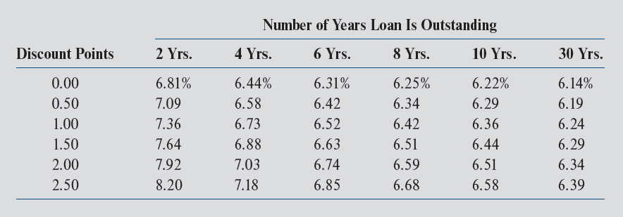
Interaction of EBC, Points, & Holding Period
Exhibit 15-1
Based on 30-year, $200,000, fixed payment mortgage with contract interest rate of 6.0% and other up-front financing costs of $3,000
Note: Interest rate is held constant in Exhibit 15-1; actually, contract interest rates would decrease as points paid by borrower increase

Slide 28
Implications of Up-Front Financing Costs?
Borrowers who expect to move relatively soon should
  pay few or no discount points & a slightly higher contract rate
Borrowers who expect to keep loan outstanding for a long period should
  consider paying discount points to buy down the contract interest rate

Slide 29
Alternative Loan Types

Slide 30
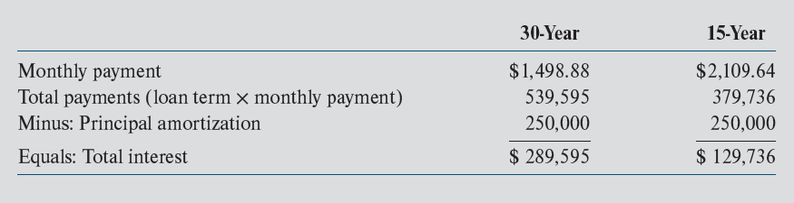
30-Year Loans vs. 15-Year Loans
Exhibit 15-2: Total interest paid on 6% LPM of $250,000
$610.76 difference
Question: Which is the better loan for a borrower?

Slide 31
Implications for 30-Year & 15-Year Loans
What is PV of $250,000, 30-yr loan @ 6%?
What is PV of $250,000, 15-yr loan @ 6%?
Conclusion: borrower is indifferent between the two loans, assuming:
  both loans are at a market interest rate
  borrower is unconstrained in borrowing (i.e., can afford higher monthly payment with 15-year loan)
But…15-year mortgages usually have lower interest rates, all else equal

Slide 32
Alternative Amortization Schedules
Interest-only mortgage
  Not typically observed with home loans
  More common with income property (CRE) loans
Partially amortized mortgage
  Loan maturity/term is shorter than amortization period
  Results in “balloon” payment at end of term
  Very common in CRE lending
Early payment mortgage
  Most home loans allow borrowers to make unscheduled (“extra”) payments along with their monthly payment
  These extra payments go toward reduction of the principal balance

Slide 33
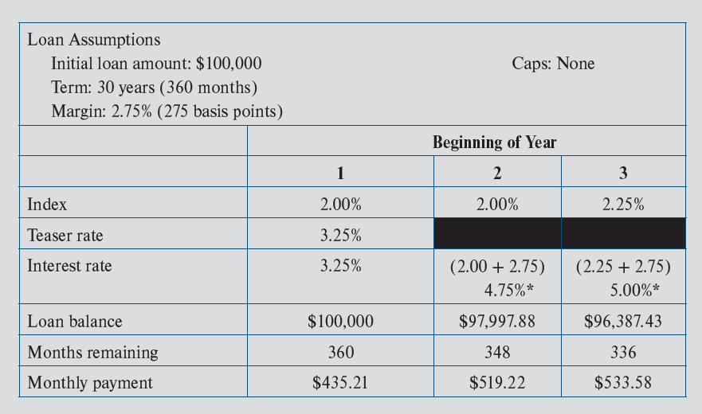
“1/1” Adjustable Rate Mortgages without Caps: Exhibit 15-3
Be sure you can replicate each calculation with your calculator

Slide 34
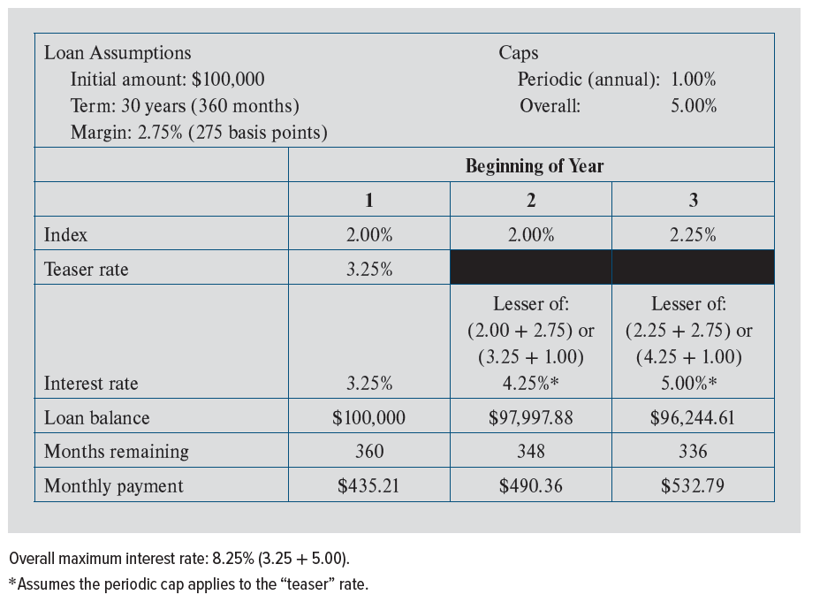
“1/1” Adjustable Rate Mortgages with Caps: Exhibit 15-5

Slide 35
Practice Problem: ARM Mechanics
Assume:
  $120,000 1-year ARM (payment adjusts annually) with a 30-year amortization schedule.
  Interest rate is tied to rate/yield on 1-year Treasury security.
  The margin is 2.75 percentage points.
  The first-year contract rate is 5.6%
  Assume rate/yield on 1-yr T-Bills at the end of Year 1 (beginning of year 2) = 5.4%
Questions:
What is the monthly payment in year 1?
What will be the remaining mortgage balance at the end of year 1?
What will be the mortgage rate in year 2?
What will be the monthly payment in year 2?
What will be the mortgage rate in year two if the loan has 2% annual caps?

Slide 36
Practice Problem: ARM Mechanics
1. Monthly payment in year 1
PMT₁ = $688.895
(N = 360; I/YR = 5.6/12; PV = 120,000; PMT = ? , FV = 0)
2. Remaining mortgage balance at end of year 1
RMB₁ = $118,412.94
(N = 348 I/YR = 5.6/12; PV = ?; PMT = 688.895, FV = 0)
3. Mortgage rate in year 2
i₂ = 1 Yr T-Bill Rate + Margin
= 5.4% + 2.75%
= 8.15%

Slide 37
Practice Problem: ARM Mechanics
4. Monthly payment in year 2
PMT₂ = $888.49
(N = 348 I/YR = 8.15/12; PV = $118,412.94; PMT = ?; FV = 0)
5. Mortgage rate in year 2 with a 2% annual cap
i₂ = Min[5.4% + 2.75%, 5.6% + 2.0%]
= Min[8.15%, 7.6%]
= 7.6%

Slide 38
Adjustable Rate Mortgages: Other Options
3 year/1 year ARM
  Interest rate fixed for 3 years
  Adjusts annually thereafter on the anniversary of loan
  Loan is fully amortized over, say, 25 or 30 yrs.
5/1 ARM—currently most popular
7/1 ARM
10/1 ARM

Slide 39
Other Things to Consider When “ARM Wrestling”
Annual cap on interest rate changes?
Life of loan cap?
# of discount points?
Other up-front financing costs charged by lender?
Remember: Borrowers do not receive benefit of "caps" for free?

