Slide 1
Chapter 14
The Effects of Time and Risk on Value

Slide 2
Value: The Central Idea
Investment value:
Maximum price an investor is willing to pay for an ownership interest in real property or mortgages
Real estate valuation:
Estimate all future net cash flows
Convert into estimate of present value
How are investment decisions made?
By comparing estimate of present value to required (“time zero”) equity investment

Slide 3
Value Depends on…?
Value of a property or mortgage thus depends on:
magnitude of expected cash flows
timing of expected cash flows
riskiness of expected cash flows

Slide 4
Effect of Timing on Value
Initial Cost
Cash Flow
From Operations
Cash Flow At Sale
Why can’t we simply sum the future cash flows to find their value?

Slide 5
Effect of Risk on Value
For which investment, A or B, would you pay the most? Why?
A
B
60,000
50,000
0 3
0 3
40,000
Outcome = $50,000
with certainty
0 3
Investment B: Outcome = $60,000 or $40,000 with even chance Thus, expected outcome = 0.5 * 60,000 + 0.5 * 40,000 = $50,000

Slide 6
Valuation Requires the Use of Time Value of Money Operations
Compounding Operations
Future value of a lump sum
Future value of an annuity
Discounting Operations
Present value of a lump sum
Present value of an annuity

Slide 7
How Money Works: Remember the Compounding Process
0 1 2 3 4
Year Beginning Amount Interest (10%) Ending Amount
1 100 10.00 110.00
2 110 11.00 121.00
3 121 12.10 133.10
4 133.10 13.31 146.41

Slide 8
Why Does Time Affect Value?
$100
$100
A
B
0 1 2 3 4
Why is cash flow A worth more than cash flow B?
If cash flow A can be invested to yield 10% per year, how much is cash flow B worth?

Slide 9
Why Does Time Affect Value?
$100
$100
A
C
0 1 2 3 4
If cash flow A can be invested to yield 10% per year during years 1 & 2, how much is cash flow C worth at time 0?

Slide 10
Why Does Time Affect Value?
Because there is an opportunity cost associated with waiting for future CFs!!

Slide 11
Discounting Brings Future Values Back Down the Compounding Curve
Compounding
A
C
Discounting
Year
0 1 2 3 4

Slide 12
Terminology of Time Value
Present Value (PV): An amount at time “zero”
Future Value (FV): An amount at any future time point
Payment (PMT): A repeating amount of cash inflow, or outflow, normally beginning at end of first period, but sometimes at time zero
Ordinary annuity (A): Another name for PMT
Lump sum: Any future cash inflow or outflow occurring only once

Slide 13
Compounding a Lum Sum Forward

Slide 14
Compounding Example: 5 years at 5% per Year
Initial Deposit (PV): $1,000
Invested at beginning of year
Compounding Process per $
BOY
Starting Ending Year Amount Interest Amount
1 $1.00 + $0.05 = $1.05
2 $1.05 + $0.0525 = $1.1025
3 $1.1025 + $0.0551 = $1.1576
4 $1.1576 + $0.0579 = $1.2155
5 $1.2155 + $0.06078 = $1.27628
Ending Amount (FV): 1,000 × 1.27628 = $1,276.28

Slide 15
The Math of Compounding
Year
1 $1.00 × (1.05) = $1.05
2 $1.05 × (1.05) = $1.1025
3 $1.1025 × (1.05) = $1.1577
4 $1.1577 × (1.05) = $1.2155
5 $1.2155 × (1.05) = $1.27628
or (1.05)⁵ = $1.27628

Slide 16
The Calculator Keystrokes
5 5 1,000 0
N
I
PV
PMT
FV
1,276.28

Slide 17
Compounding Example: 5 Years at 10% per Year
Initial Deposit (PV): $1,000
Compounding Process per $
Starting Ending Year Amount Interest Amount
1 $1.00 + $0.10 = $1.10
2 $1.10 + $0.11 = $1.21
3 $1.21 + $0.121 = $1.331
4 $1.331 + $0.1331 = $1.4641
5 $1.4641 + $0.1464 = $1.6105
Ending amount (FV): $1,000 × 1.6105 = $1,610.50

Slide 18
The Calculator Keystrokes
5 10 1,000 0
N
I
PV
PMT
FV
1,610.50

Slide 19
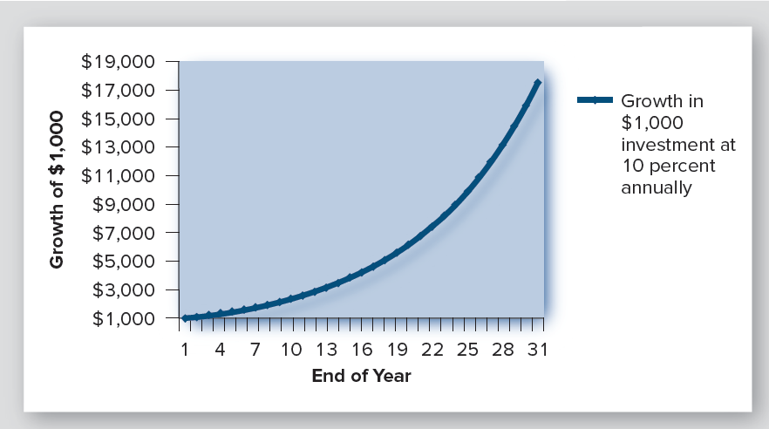
What Will Be the Future Value of Your 401(k)?
Deposit $1,000 at age 25 that will earn 10% (annually)
Exhibit 14-5
= $17,449 at end of year 30

Slide 20
Compounding Forward a Series of Deposits

Slide 21
Accumulated Value of a Series of Deposits (with Compounding)
Deposits: $1,000 at the end of each year
Interest rate: 5%
Deposit Year
1 2 3 4 5 Sum
1 $1,000 $1,000.00
2 $1,050 1,000 $2,050.00
3 $1,102.50 1,050 1,000 $3,152.50
4 $1,157.63 1,102.50 1,050 1,000 $4,310.13
5 $1,215.51 1,157.63 1,102.50 1,050 1,000 $5,525.63

Slide 22
Accumulated Value of a Series of Deposits (with Compounding)
Deposits: $1,000 at end of each year
Interest rate: 5%
5 5 0 -1,000
N
I
PV
PMT
FV
5,525.63
Assumed to occur at the end of each year

Slide 23
Accumulated Value of a Series of Deposits (with Compounding)
What is accumulated value of a monthly deposit of 83.33 ($1,000/12) for 5 years, compounding monthly at 5% annual rate?
60 5/12 0 -83.33
N
I
PV
PMT
FV
5,666.95
vs. 5,525.63 with annual compounding
Why do monthly deposits grow more quickly?

Slide 24
Accumulated Value: Annuity Due
Deposits: $1,000 at the beginning of each year
Interest rate: 5%
Deposit Year
1 2 3 4 5 Sum
1 $1,050 $1,050.00
2 $1,102.50 1,050 $2,152.50
3 $1,157.63 1,102.50 1,050 $3,310.13
4 $1,215.51 1,157.63 1,102.50 1,050 $4,310.13
5 $1,276.28 1,215.51 1,157.63 1,102.50 1,050 $5,801.91

Slide 25
Accumulated Value: Annuity Due
Deposits: $1,000 at the beginning of each year
Interest rate: 5%
5 5 0 -1,000
N
I
PV
PMT
FV
5,801.91
vs. 5,525.63 with end-of-year payments
Use “Begin” mode

Slide 26
What Will Be the Future Value of Your 401(k)?
Deposit $1,000 per year beginning at age 25
= $486,852 at end of year 40
Why is it a curve & not a straight line?

Slide 27
The Keystrokes
40 10 0 1,000
N
I
PV
PMT
FV
486,852

Slide 28
Discounting Future Cash Flows

Slide 29
Discounting: Finding “The Point of Indifference”
$1,276.28
$1,000
?
At 5%, $1,000 compounds in 5 years to $1,276.28 (Begin Mode)
0 1 2 3 4 5
$1,276.28
What amount received now is equivalent to the future $1,276.28?
?
0 1 2 3 4 5
Assuming 5% discount rate

Slide 30
The Math of Present Value
1 1.00 ÷ (1.05) = 0.95238
2 0.95238 ÷ (1.05) = 0.907029
3 0.90703 ÷ (1.05) = 0.863838
4 0.86384 ÷ (1.05) = 0.82270
5 0.82270 ÷ (1.05) = 0.783526
or 1/(1.05)⁵ = 0.783526
PV factor
PV of $1,276.28, five years from now, discounted at 5%:
PV = $1,276.28 × 0.78526
= $1,000.00

Slide 31
The Keystrokes
$1,276.28
?
0 1 2 3 4 5
5 5 0 1276.28
N
I
PV
PMT
FV
1,000
Q: Would investors who want a 5 percent return favor:
A. $1,000 now? B. $1,276.28 in five years?
Q: What if they could buy the future $1,276.28:
A. For $900? B. For $1,100?

Slide 32
Practice Problem
You have been offered an investment opportunity that is expected to generate $4,000 at the end of 3 years. Assume you can earn 10% on investments of this type. What is the most you should be willing to pay today?
PV = FV × PVF (10%, 3 years)
= $4,000 × 0.751315 = $3,005
Keystrokes:
3 10 0 4,000
Why does the $4,000 go in the FV register, not the PMT register?
N
I
PV
PMT
FV
3,005

Slide 33
Present Value of an Annuity
$1,276.28
$1,276.28
1,215.50
1,000.00
?
Year
0 1 2 3 4 5
Payment Present Value Present
Year Payment Factor Value
1 $1,276.28 ÷ (1.05) = $1,215.50
2 $1,276.28 ÷ (1.05)² = $1,157.62
3 $1,276.28 ÷ (1.05)³ = $1,102.50
4 $1,276.28 ÷ (1.05)⁴ = $1,050.00
5 $1,276.28 ÷ (1.05)⁵ = $1,000.00
Sum = $5,525.62

Slide 34
PV of an Annuity of $1,276.28 Per Year For 5 Years…?
$1,276.28
$1,276.28
?
0 1 2 3 4 5
5 5 1,276.28 0
N
I
PV
PMT
FV
5,525.62
End mode
Goes in the PMT register

Slide 35
Annuity vs. Annuity Due
$1,276.28
$1,276.28
Annuity
0 1 2 3 4 5
$1,276.28
$1,276.28
Annuity
due
0 1 2 3 4 5
Value of the annuity due? Two solutions:
A. $5,525.62 × (1.05)
= $5,801.91
B. Switch calculator to
Begin Mode

Slide 36
Practice Problem
What is the PV of a 20-year (net) lease that pays $5,000 per year if you discount at 10%?
PV_{A} = Annuity × PVF_{A} (10%, 20 years)
= $5,000 × 8.513564 = $42,568
Keystrokes:
(Assuming end-of-year payments)
20 10 5,000 0
N
I
PV
PMT
FV
42,568
Assuming beginning-of-year payments, PV = $46,824.6

Slide 37
Practice Problem
What is the present value of $4,000 at the end of each year for 4 years if your opportunity cost is 10%?
PV_{A} = Annuity × PVF_{A} (10%, 4 years)
= $4,000 × 3.169865 = $12,679
Keystrokes:
4 10 4,000 $0
N
I
PV
PMT
FV
12,679

Slide 38
Practice Problem
If I promise to pay $4,000 a year for 30 yrs, and you are a lender who expects a 10% return, what is maximum amount that you would loan me today?
Loan = PMT × PVF_{A}TF (10%, 30 years)
= 4,000 × 9.426914
= $37,707.65 or $37,708
Keystrokes:
30 10 4,000 $0
N
I
PV
PMT
FV
37,708

Slide 39
A Real Estate Application of TVM
Solutions:
$100,000
Find the PVs of six different cash flows and sum the results.
PV of a five-year $10,000 annuity
+ PV of a lump sum of $100,000 in year 5
3. Solve as a combined PV problem.
$10,000
$10,000
$10,000
$10,000
$10,000
0 1 2 3 4 5

Slide 40
Keystrokes: Combined PV Problem
$100,000
5 10 10,000 100,000
N
I
PV
PMT
FV
100,000
Why does the 100,000 go in FV?
Assumed discount rate: 10%
$10,000
$10,000
$10,000
$10,000
$10,000
0 1 2 3 4 5

Slide 41
Valuing a Property with Uneven Cash Flows: Lee Vista
$560,000
Solutions:
Find the PVs of six different cash flows
and sum the results
Use the variable cash flow
capacity of your calculator
3. Spreadsheet (See Chapter Appendix)
50,923
52,451
54,025
48,000
49,440
0 1 2 3 4 5

Slide 42
Calculator Solution for Uneven Cash Flows: Lee Vista
1. Set calculator for one payment per year
2. Clear calculator
$560,000
3. Enter zero for initial cash outlay: 0
CF_{j}
4. Enter first-year cash flow: 48000
CF_{j}
5. Repeat for years 2 through 4
6. Enter sum of year 5 C.F. plus reversion:
54025 + 560000 = 614025
CF_{j}
7. Enter discount rate: 14
I
8. Find PV:
NPV
50,923
52,451
54,025
48,000
49,440
Solution:
$464,479.86
Press “shift” at same time as “NPV”
0 1 2 3 4 5

Slide 43
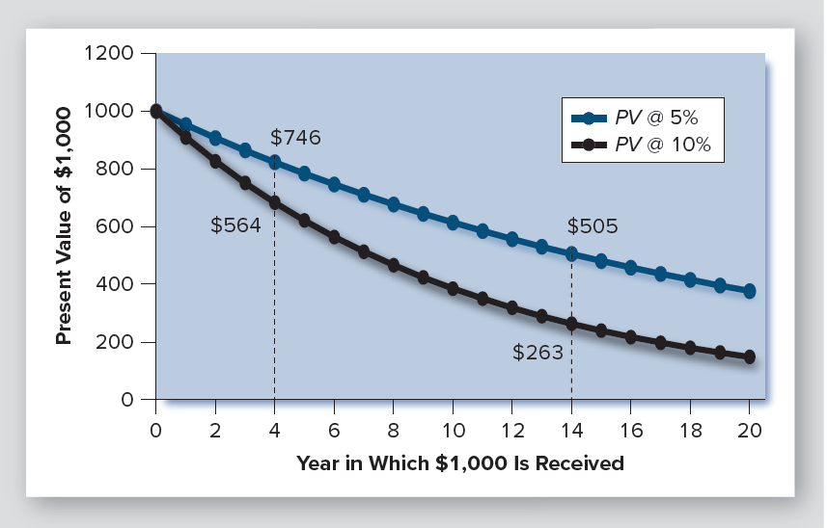
Longer Maturity Makes PV More Sensitive to the Discount Rate
Exhibit 14-9:
PV of $1,000 Lump Sum Payment
What you are willing to pay at time zero

Slide 44
Yield/IRR Also Depends on Selling Price
Purchase for $100,000 and sell for $90,000:
5 -100,000 10,000 90,000
$100,000
N
I
PV
PMT
FV
8.31
Purchase for $100,000 and sell for $110,000:
5 -100,000 10,000 110,000
N
I
PV
PMT
FV
11.59
$10,000 each year
0 1 2 3 4 5

Slide 45
Required Yield Affects Value: The Case of Lee Vista
At a required yield (discount rate) of 14%,
the value of Lee Vista was $464,480.
560,000
Question:
What is its value at these required yields?
10 percent?
$539,841
12 percent?
$500,264
16 percent?
$432,059
50,923
52,451
54,025
48,000
49,440
18 percent?
$402,628
0 1 2 3 4 5
Note: Higher opportunity cost of waiting, lower PV

Slide 46
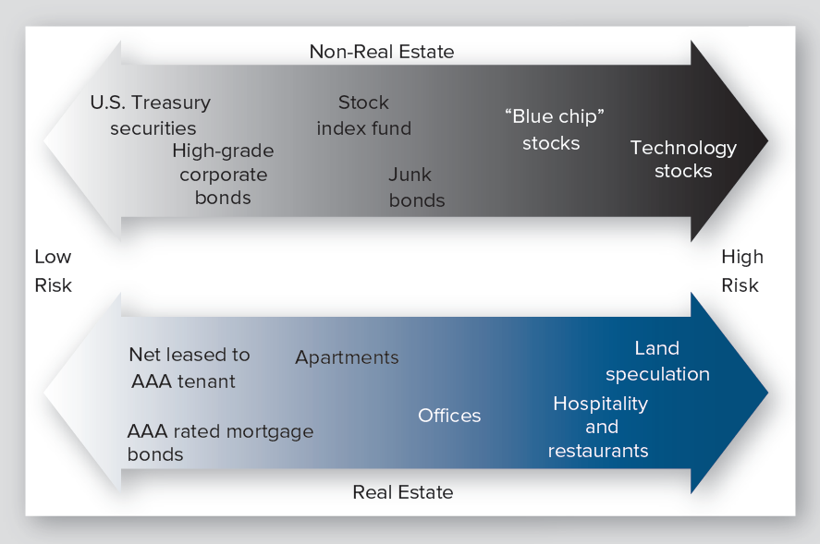
The Spectrum of Risk in Investments
Exhibit 14-10

Slide 47
Information on Required Returns/IRRs
Required yields (discount rates) composed of two parts:
E(R_{j}) = R_{f} + RP_{j}
R_{f} is the risk-free rate (commonly the 10-year U.S. Treasury rate)
RP_{j} is risk premium for a particular property

Slide 48
Information on Required Returns/IRRs
Since risk premiums vary, so do required returns (yields)
High quality, safe real estate investments: 7-8% or less
Development: 30% or more

Slide 49
Lee Vista vs. Colony Park
Lee Vista
Colony Park
$597,000
$560,000
50,923
52,451
54,025
58,835
60,306
61,814
48,000
49,440
56,000
57,400
0 1 2 3 4 5
0 1 2 3 4 5

Slide 50
Comparing Investments with NPV
If an investor requires a yield/return of 14%, which is the better investment? Is further information needed?
Lee Vista
Colony Park
Price: $425,000
Price: $540,000
NPV = Value − Price
NPV = Value − Price
= $464,480 − 425,000
= $39,480
= $510,875 – 540,000
= − $29,125
Colony Park: higher PV, but lower NPV
Note: Assuming both are equally risky

