Slide 1
Chapter 12
Real Estate Brokerage and Listing Contracts

Slide 2
What Do Brokers Do?
Bring buyers and sellers together
In real estate needs
Physically
Emotionally
Collect commission for a successful transaction
Normally, percentage of price
Rarely, net commission: actual price less target price
Notes:
Introduction

Slide 3
What Special Knowledge Can a Broker Offer?
Prices and terms in current market
Marketing approaches that work
Legal obligations of buyers and sellers
Properties in market
Potential customers and their needs
Procedures and requirements of transaction
Notes:
Introduction

Slide 4
Law of Agency and Agents
Law of agency: Governs relationship between a principal (client) and someone charged to act on principal's behalf
Rights and obligations of agent
Rights and obligations of principal
Notes:
Law of Agency

Slide 5
Types of Agents
Universal agent: Power to act for principal in all matters
General agent: Power to act within limits of a business or employment relationship
Special agent: Power to act in a specific event
Notes:
Law of Agency

Slide 6
3 Types of Agents
Universal Agent:
Can act for the principal
in ALL matters
Medical
documents
General Agent:
Can act for principal
within a specific business
Personal agreements
Taxes and other
business with govt.
Property
managers
Special Agent:
Can act for principal
in a specific
transaction
Living
arrangements
Insurance
Brokers
Notes:
Law of Agency

Slide 7
Duties or Fiduciary Responsibilities
Confidentiality: Never betraying confidential information
Obedience: Following instructions of the principal fully
Accounting: Keeping principal informed about financial aspects of assignment
Loyalty: Never subordinating the best interest of principal
Disclosure: Being completely open and honest
Skill and care: Representing principal as agents would represent themselves
“COALDS”
Notes:
Law of Agency

Slide 8
Duties of Principal
Open
Honest
Fair
Notes:
Law of Agency

Slide 9
The Problem of Dual Agency
Natural tendency in brokerage for dual agency
Salesperson works with buyer but not with seller
FTC Study (1984):
74.2% of buyers believed the sales agent worked for them
This misunderstanding appears to be little changed
Broker firm often is engaged with both buyer and seller
Notes:
Law of Agency

Slide 10
The Solution to Dual Agency?
Solutions?
Designated agent: Brokerage representing both sides appoints a separate agent for each party
Buyer agent by law: Salesperson showing a house becomes buyer agent unless declaring otherwise
Transaction broker : Not an agent for buyer or seller
Also called facilitating or intermediary broker
Notes:
Law of Agency

Slide 11
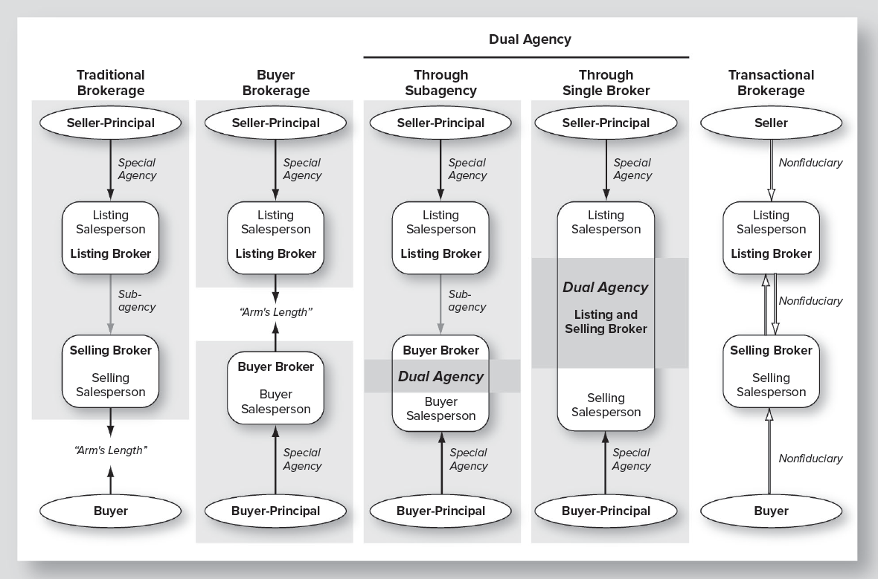
Notes:
Law of Agency

Slide 12
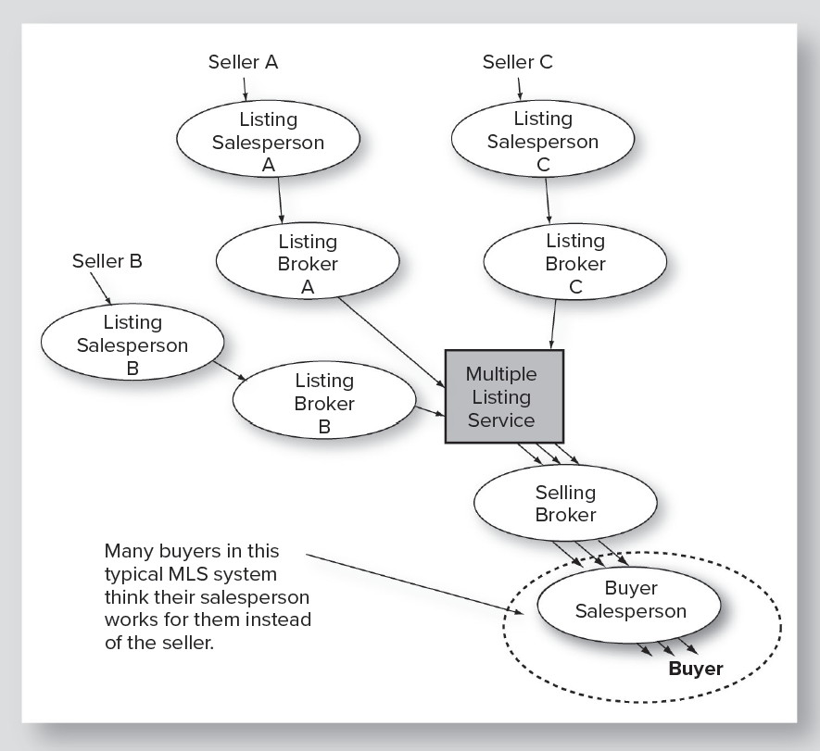
The Problem of Unintended Dual Agency
Notes:
Law of Agency

Slide 13
Brokerage Relationships
Brokerage Relationship: |  | Trans-action | Single Agency | None
Duties to both buyer & seller
 | Honesty and Fairness
 | Accounting for funds
 | Disclosure of all known facts affecting value
Duties to: |  | Customer | Principal | Customer
 | Skill, care and diligence
 | Timely present all offers
Notes:
Law of Agency

Slide 14
Brokerage Relationships
Brokerage Relationship: |  | Trans-action | Single Agency | None
Additional Duties of a Fiduciary: |  | Customer | Principal | Customer
 | Confidentiality | Limited
 | Loyalty
 | Obedience
 | Full Disclosure
Notes:
Law of Agency

Slide 15
Single Agent vs. Transaction Broker
Single Agent
Dealing honestly and fairly
Loyalty
Confidentiality
Full disclosure
Transaction Broker
Dealing honestly and fairly
Limited confidentiality
Disclosing all known facts…affecting value… that are not readily observable to buyer
Notes:
Law of Agency

Slide 16
Licensing of Brokers and Salespersons
Need license to offer real estate services to others:
Buying
Auctioning
Renting
Selling
Appraising
Leasing
Exchanging
(BAR SALE)
Two levels of licensure
Salesperson: Must work for a broker
Broker: Can operate own brokerage agency
Notes:
Licensing of Real Estate Brokers and Salesmen

Slide 17
Licensing of Brokers and Salespersons (continued)
Exemptions from licensure:
Attorneys
Resident managers
Government employees
Trustees
Executors
Those with power of attorney
General requirements for licensure:
Minimum age
High school diploma
Good reputation
Prelicensing education requirement
Pass state licensing exam
Minimum experience (for broker’s license)
Notes:
Licensing of Real Estate Brokers and Salesmen

Slide 18
Industry Certifications or Designations
Realtor® or Realtor-Associate®:
Local association
National Association of Realtors
CCIM: Certified Commercial Investment Member
SIOR: Society of Industrial and Office Realtors
Notes:
Designations in Real Estate Sales and Brokerage

Slide 19
How is Comkmercial Brokerage Different?
Much more emphasis on financial concerns
Income and expense details
Construction of and interpretation of proformas
More contracts involved, and more complex
Commercial Leases
Tenant analysis and relations
Property service contracts
More complex and sophisticated negotiations
More experienced buyers and sellers
More complex issues
More at stake in each deal
Notes:
The Marketing Function

Slide 20
Segmentation Examples in Real Estate Brokerage Markets
Residential
Condo vs single family
Specific neighborhoods
Vacation and second homes vs primary homes
Non-residential
Property type: retail, office, industrial, apartments
Scale and firm size
Geography: local, regional, national, international
Notes:
The Marketing Function

Slide 21
Anti-Discrimination Laws Affecting Real Estate Services
Title VIII of the Civil Rights Act of 1968 prohibits discrimination by race, color, religion, national origin, sex, familial status, and handicap, including:
Refusing to rent or sell
Offering different terms and conditions
Selective advertising
“Blockbusting”
Denying home loans
Denying real estate services
Coercing, intimidating or interfering with exercise of these rights
Notes:
The Marketing Function

Slide 22
Anti-Discrimination Laws Affecting Real Estate Services (continued)
Title VIII exempted owner-occupants in 1-4 family residences
Supreme Court overrode the exemption regarding racial discrimination (Jones v Mayer Co., 1968)
Discrimination by familial status allowed for elderly
In a designated “elderly” residential property, can refuse occupancy to persons under age 62 or to families with children
If 80 percent of units have one occupant 55 or older, can refuse occupancy to persons under age 55.
Notes:
The Marketing Function

Slide 23
Growth Areas in Real Estate Brokerage
Internet Marketing
Residential
www.zillow.com
www.realtor.com
Commercial
www.costar.com
www.loopnet.com
International brokerage
Foreign purchases in the United States
U.S. interests purchasing abroad
Notes:
The Marketing Function

Slide 24
Listing Contracts
A broker earns a commission by finding a ready, willing and able buyer for the specified price and terms
Types of contracts
Exclusive right of sale – agent is compensated if anyone finds a buyer
Exclusive agency – agent is compensated if any agent finds a buyer, but not if owner does
Open listing – agent is compensated only by finding a buyer
Notes:
Listing Contracts & Types of Listing Contracts

Slide 25
Listing Contract
Traditionally created special agent relationship
A contract for services, not for real estate
Usually a contract between seller and broker
Increasingly between buyer and broker
Frequently has involved subagency through MLS
(MLS – Multiple Listing Service)
Sometimes dual agency: Agent to buyer and seller
Notes:
Listing Contracts & Types of Listing Contracts

Slide 26
Innovations in Brokerage
Buyer brokerage
“Unbundling” of brokerage services
Advertising
Document preparation
Administration of transactions
Discount brokerage
Electronic Marketing for local brokerage firms
Notes:
Innovations in Brokerage

Slide 27
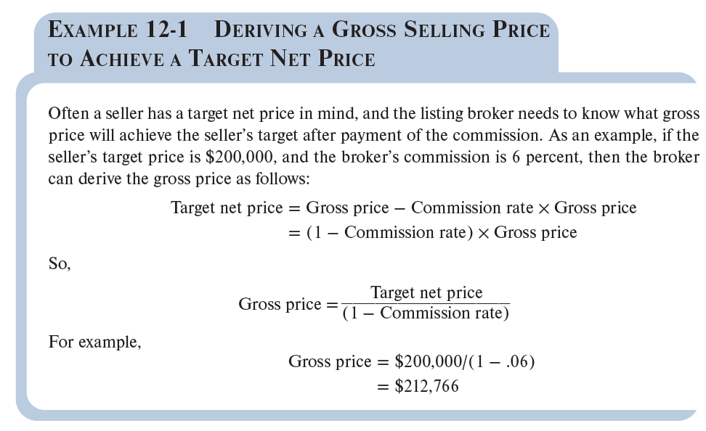
Deriving a Gross Selling Price to Achieve a Target Net Price
Notes:
Listing Contract Provisions

Slide 28
Commission Splitting: Example
Sale of Property $400,000
Commission 6.0% $24,000
Listing Broker Firm 50% of Commission $12,000
Selling Broker Firm 50% of Commission $12,000
Listing Salesperson 50% of Firm’s Commission* $8,400
Selling Salesperson 50% of Firm’s Commission* $8,400
*These Percentages can vary from 50 percent to 90 percent depending on such factors as the length of time the sales person has been with the firm and whether he or she is an officer of the firm.

Slide 29
Considerations in Selecting a Broker
How will the firm market the property?
Amount and type of advertising?
Experience of others with the firm?
General reputation in the community?
Much like the process of selecting any other professional
Notes:
Listing Contract Provisions

Slide 30
Advice about Brokers
As a buyer, use them for the information they can provide, but don’t view them as confidential advisor.
Don’t rely on them for questions adverse to the seller.
In unfamiliar territory consider a buyer’s broker.
Give the broker only information needed to be helpful.

