Slide 1
Chapter 11
Sources of Funds for Residential Mortgages

Slide 2
Mortgages and Mortgage Markets: Mortgage Debt Outstanding by Type
Notes:
The Market for Home Mortgage Loans

Slide 3
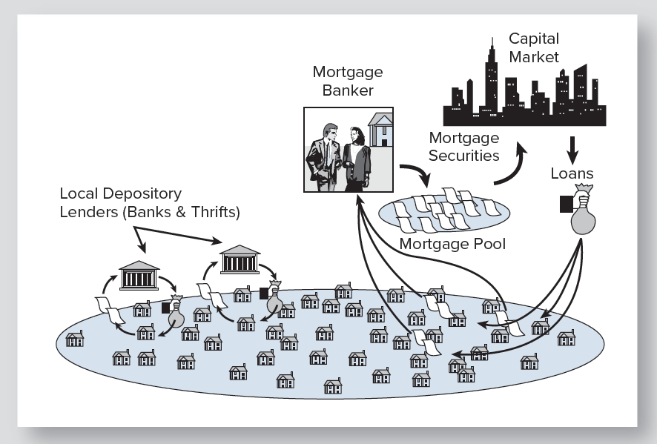
Traditional and Modern Housing Finance
Notes:
The Revolution in Home Mortgage Finance

Slide 4
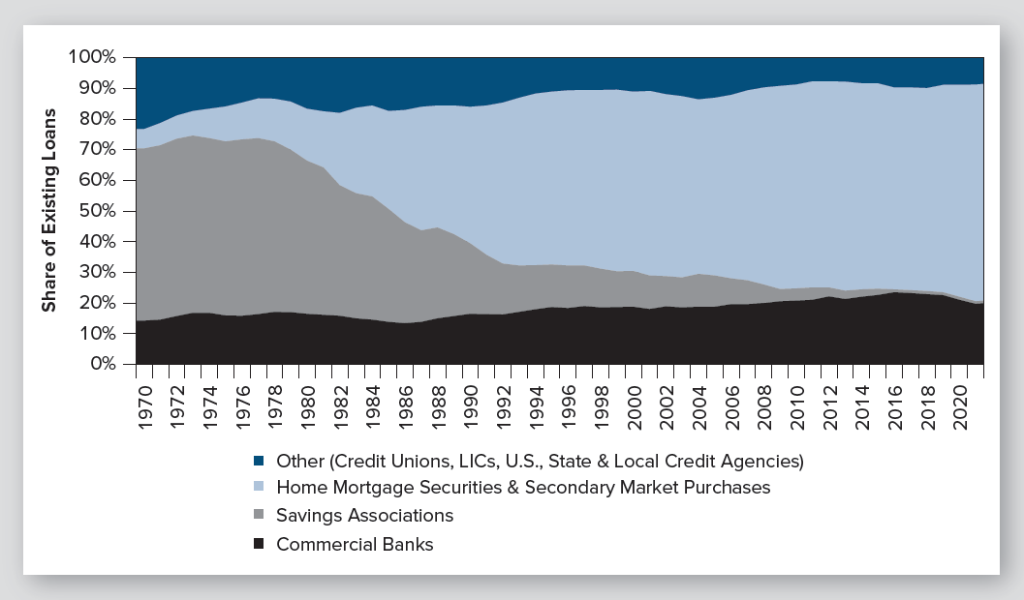
The Revolution in Home Mortgage Finance: From Savings Associations to Securities
Notes:
The Revolution in Home Mortgage Finance

Slide 5
Thrifts (Savings Associations)
Formerly backbone of home mortgage finance
Dominated mortgage lending
Extremely localized
Fatal flaw: Funded long-term loans by short-term savings
Traded freedom for deposit insurance (1930s)
Cocoon of regulations
Unable to adapt to a new financial world
Notes:
The Revolution in Home Mortgage Finance

Slide 6
Thrifts (continued)
Flood of home loans in late 1970s - all fixed rate
Then interest rates soared in war on inflation
Asset-liability mismatch severely damaged thrifts
Almost one-third failed
70% had disappeared by 2001
“Collateral damage” to congress, regulators, taxpayers
Thrifts’ share of home loans fell from 50% to 5% by 2008
Notes:
The Revolution in Home Mortgage Finance

Slide 7
Thrifts Today
Changed approach to regulation
Financial Institutions Reform, Recovery and Enforcement Act of 1989 (FIRREA)
Risk-based capital standards
Most are now banks (acquired or converted)
Others turned to “boutique” roles:
Mortgage banker
Sub-prime lender (in past)
Commercial loan specialist
Multifamily loan specialist
Emphasis on ARM lending (40% of loans)
Notes:
The Revolution in Home Mortgage Finance

Slide 8
Commercial Banks
Historically: Served real estate needs of business clients
Business-related real estate loans
Home loans
Personal investments
Assumed former roles of thrifts
Large-scale construction lending
Notes:
The Revolution in Home Mortgage Finance

Slide 9
Commercial Banks (continued)
“Warehouse” credit lines for mortgage bankers
Effects of bank deregulation
Enormous consolidation of the industry since 1990
Aggressive pursuit of real estate lending
Directly
Through mortgage banking subsidiaries
New powers to reenter real estate:
Investment
Development
Notes:
The Revolution in Home Mortgage Finance

Slide 10
Portfolio and Non-Portfolio Mortgage Lenders
Portfolio Lenders (depository institutions)
Banks
Thrifts
Large credit unions
Non-portfolio lenders
Mortgage bankers
Mortgage brokers
May include credit unions and small banks
Notes:
The Revolution in Home Mortgage Finance

Slide 11
Mortgage Companies
Mortgage banker: Not a bank – accepts no deposits
Originates loans to sell
Retains right to service the loan for a fee
Mortgage broker: Brings borrower and lender together
Collects a fee
Never owns the loan
Notes:
Mortgage Banking and Mortgage Brokerage

Slide 12
Mortgage Banker
Originates loans to sell (“originates to distribute”)
Pools and securitizes loans
Retains contract to service the loans
Servicing contract is core “asset” and profit center
Five-step process:
1. Make Loan
Commitments
5. Service the
loans
2. Close (fund) loans
(Buying the loans)
4. Securitize and/or
sell the pools
3. Pool the loans
Notes:
Mortgage Banking and Mortgage Brokerage

Slide 13
Mortgage Banker as Servicer
Collects monthly loan payments, remits to investor
Collects and escrows funds for obligations:
Property taxes
Hazard insurance
Mortgage insurance
Manages late payments, defaults, foreclosures
Receives fee of 0.19% to 0.44% (19 to 44 bp)
Often takes loss at outset to obtain servicing rights
Notes:
Mortgage Banking and Mortgage Brokerage

Slide 14
Pipeline Risk: Signature Risk of Mortgage Banking
Pipeline risk: From loan offer date to loan sale
Two components:
Fallout risk - If interest rate falls, applicants back out
Interest rate risk - If rates rise, must sell new loans at loss
Mortgage bankers highly leveraged
Very sensitive to pipeline risk
Hedging necessary for survival
Notes:
Mortgage Banking and Mortgage Brokerage

Slide 15
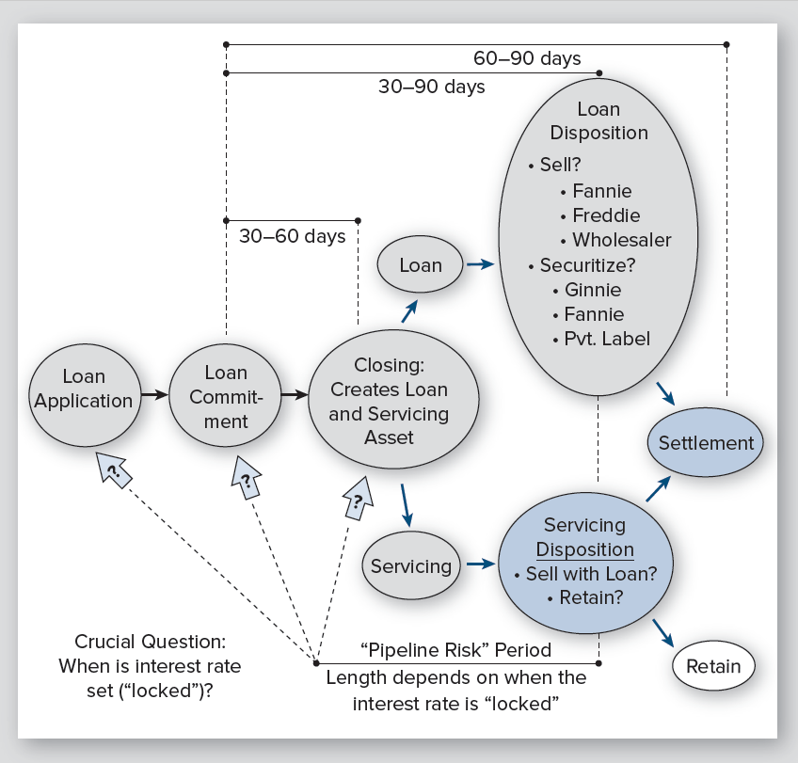
Mortgage Banking Creates Two Financial Assets
Notes:
Mortgage Banking and Mortgage Brokerage

Slide 16
Emergence of Megamortgage Bankers
Megabanks saw home financing as profit center
Cyber electronics imply huge economies of scale
Four modes of operation:
Traditional “face-to-face” or “retail” lending
Wholesale mortgage banking
Internet lending
Lending through brokers
Tremendous consolidation in recent decades
Notes:
Mortgage Banking and Mortgage Brokerage

Slide 17
Changes in Mortgage Banking: Post Great Recession
Resurgence of non-bank mortgage banking
Megabanks drew back
Bad experiences
Increased regulation
More funding for non-banks as economy recovered
Resurgence of FHA loans, a mortgage banking staple
Better non-bank access to Fannie Mae and Freddie Mac
Explosive growth of on-line lenders
Notes:
Mortgage Banking and Mortgage Brokerage

Slide 18
Consolidation and Deconsolidation of Home Mortgage Lending
1989 – 2010
Market share of top 20 lenders goes from 20% to 85%
Market share of top 20 servicers goes from 15% to 75%
2010 to the present
Non-bank & small bank lenders regain market share
Electronic mortgage bankers surge:
Quicken Loans
PennyMac
Other
Notes:
Mortgage Banking and Mortgage Brokerage

Slide 19
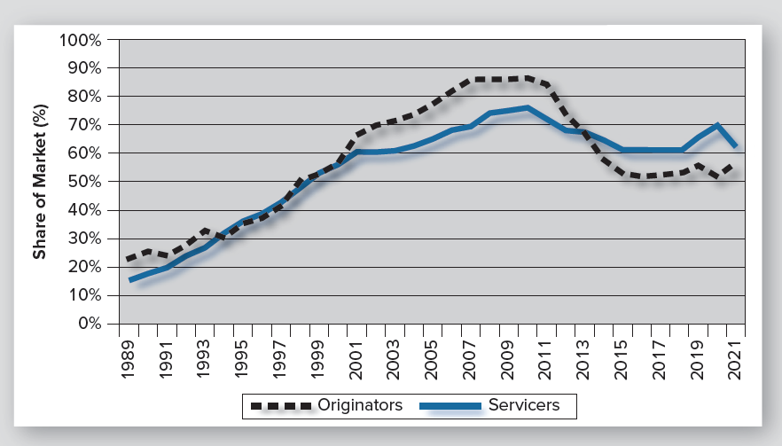
Consolidation of the Top 20 Home Mortgage Lenders
Notes:
Mortgage Banking and Mortgage Brokerage

Slide 20
Mortgage Brokers
“Places” borrower’s loan application with lender
Receives up-front fees
Never owns and never services loan
Expanded rapidly in recent years
Flaws in mortgage brokerage:
“Front-loaded” compensation
Few repeat customers
Low competency requirements
Wide-spread borrower abuse in recent years
Resulting legislation and creation of CFPB
Notes:
Mortgage Banking and Mortgage Brokerage

Slide 21
Evolution of the Secondary Mortgage Market
Pre-1970:
Limited and informal
Lack of loan standardization was a barrier
Large interregional differences in rates (100-200 bps)
Rise in rates could shut down home mortgage lending
Notes:
The Secondary Market for Residential Mortgages

Slide 22
Beginning of the Modern Secondary Mortgage Market
Fannie Mae (1968):
Spun out of HUD
Became a primary purchaser of FHA and VA loans
Ginnie Mae (1968):
Created first “pass-through” mortgage-backed security
Strictly for FHA and VA loans
Freddie Mac (1970):
Created to buy conventional loans from thrifts
Sold the loans using “pass-through” securities
Notes:
The Secondary Market for Residential Mortgages

Slide 23
Mortgage-Backed Securities
All cash flows from many loans form a single pool
Investor gets pro rata share of the cash flows
Loans in a given pool will be similar:
All FHA/VA; all conventional
Same vintage (new or recent loans)
Similar interest rates
64% of new home loans were securitized since 2009*
*Inside Mortgage Finance
Notes:
Mortgage-Backed Securities

Slide 24
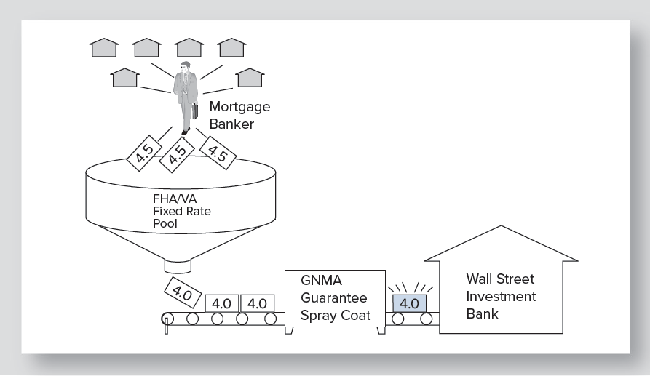
The Ginnie Mae Mortgage-Backed Security Process
Notes:
Mortgage-Backed Securities

Slide 25
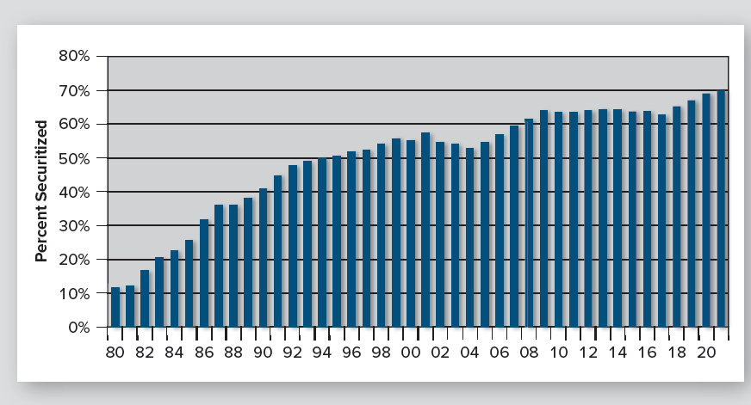
The Growth of Home Mortgage Securitization
Notes:
Mortgage-Backed Securities

Slide 26
Role of Ginnie Mae in the Secondary Mortgage Market
GNMA created first pass-through MBS program
Does not buy mortgages
Guarantees “timely payment of interest and principal” to holders of GNMA securities.
Guarantees only securities based on FHA/VA loans
Notes:
Purchasers of Residential Mortgages in the Secondary Market

Slide 27
Fannie Mae and Freddie Mac
Original mission: Support home affordability by providing a secondary mortgage market
Became privately owned but still U.S. chartered
Public mission for housing
“Backstopped” by U.S. Treasury credit line
Buy conforming conventional home loans
Have securitized over 43% of all home loans*
Taken into conservatorship by U.S. in 2008
Still securitize over 60% of new conventional loans*
*Inside Mortgage Finance
Notes:
Purchasers of Residential Mortgages in the Secondary Market

Slide 28
Importance of Fannie Mae and Freddie Mac
Brought about standardization in:
Mortgages and mortgage notes
Appraisal forms and practices
Underwriting procedures and standards
Influenced practices/standards in nonconforming mortgage markets
Started automated underwriting and automated valuation
Increased liquidity of mortgage markets
No interstate differentials in mortgage interest rates
No home lending disruptions when interest rates rise
New sources of mortgage funds in security investors
Heavily influence what type loans lenders make
Notes:
Purchasers of Residential Mortgages in the Secondary Market

Slide 29
What Went Wrong with Fannie and Freddie?
Not capitalized to withstand declining home values
Said to wield too much political influence
Said to poorly mix private enterprise and housing subsidies
Said to divert efficiency value to the pockets of management
Said to be unnecessary in a world of giant banks
Said to be part of an unnecessary mortgage lending system – for the level-payment fixed rate mortgage
Said to pose a contingent liability to taxpayers
Have returned to extreme “profitability”
Technically, completely “paid back” the U.S. government by 2014.
Notes:
Purchasers of Residential Mortgages in the Secondary Market

Slide 30
Private Mortgage Conduits
Originally for non-conforming “Jumbo” loans
Small market share until sub-primes emerged
Grew explosively, post-2000, due to sub-primes
Diminished rapidly as sub-prime collapsed
Continues as a conduit for “Jumbo” loans
Notes:
Purchasers of Residential Mortgages in the Secondary Market

Slide 31
Holders of Agency MBS (GSE and GNMA MBS, 2021)
Mortgage Market Statistical Annual, 2022
Notes:
Purchasers of Residential Mortgages in the Secondary Market

Slide 32
Other Secondary Market Players
Federal Home Loan Banks
Originally the banking system for thrifts
Now a banking system for small banks and thrifts
Provides liquidity for home mortgage lending
U.S. Government support for rural housing
USDA-Rural Housing Service
Notes:
Purchasers of Residential Mortgages in the Secondary Market

Slide 33
The U.S. Home Mortgage System Today – Four Channels
Depository lending (banks)
FHA/VA – GNMA securitization process
Conforming conventional – GSE process
Non-conforming conventional – private securitizers
Notes:
The Big Picture of Home Mortgage Lending: Four Different Channels

Slide 34
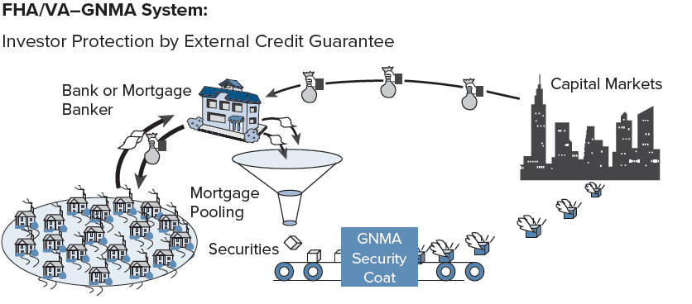
FHA/VA – GNMA Securities
Notes:
The Big Picture of Home Mortgage Lending: Four Different Channel

Slide 35
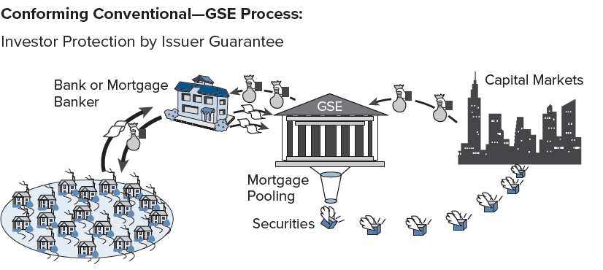
Conforming Conventional – GSE Process
Notes:
The Big Picture of Home Mortgage Lending: Four Different Channels

Slide 36
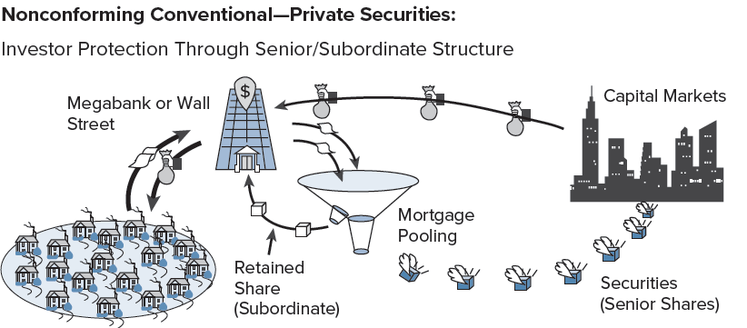
Nonconforming Conventional – Private Process
Notes:
The Big Picture of Home Mortgage Lending: Four Different Channels

Slide 37
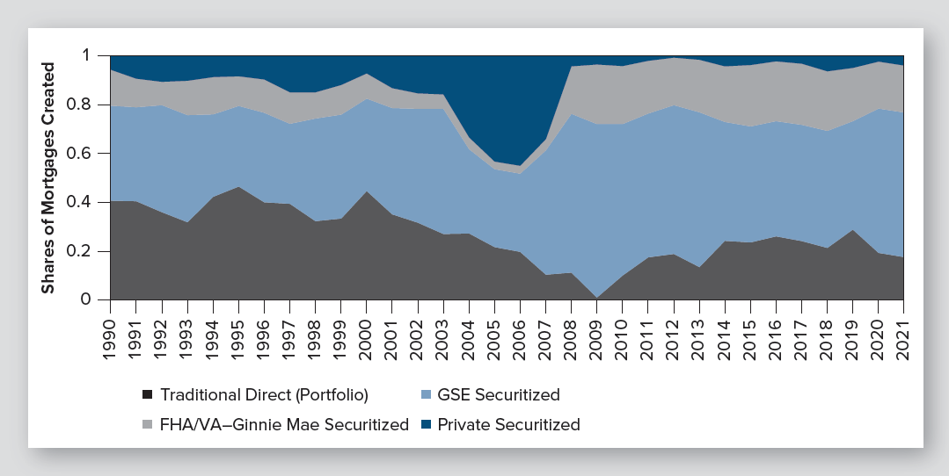
Market Shares of the Four Channels of Home Mortgage Lending
Notes:
The Big Picture of Home Mortgage Lending: Four Different Channels

Slide 38
Where Do You Get a Mortgage Loan in Today’s Complex System?
No simple answer, except to shop aggressively
Portfolio lenders (banks) may offer cost and interest rate advantage
Brokers may offer service and down payment advantage
Depository lenders may have best ARM offers
Non-depositories may have best fixed-rate offers
Rise of web mortgage bankers: Quicken and others
SHOP!
Notes:
Where Does a Borrower Find a Home Loan?

Slide 39
Lenders’ Underwriting Decisions
Underwriting: Process of determining whether the risks of a loan are acceptable
Three “Cs” of traditional underwriting:
Collateral: URAR appraisal
Creditworthiness: Credit report
Capacity: Ability to pay (payment ratios)
Notes:
The Lender’s Mortgage Loan Decisions

Slide 40
Traditional Payment Ratios for Mortgage Underwriting
Housing expense ratio = PITI/GMI
PITI is principal, interest, (property) taxes and insurance
GMI is gross monthly income
Recent convention set maximum at:
28% for conventional loans
29% for FHA
Known as “front-end” ratio

Slide 41
Traditional Payment Ratios for Mortgage Underwriting
Total debt ratio = (PITI + LTO) ÷ GMI
LTO is long-term obligation
Recent convention set maximum at:
36% for conventional loans
41% for FHA
Known as “back-end” ratio and debt-to-income ratio
Note: GMI is critical. Its computation is closely regulated by ECOA (Equal Credit Opportunity Act)
Notes:
The Lender’s Mortgage Loan Decisions

Slide 42
Traditional Home Loan Underwriting
The Three C’s of Mortgage Underwriting
Investment Quality
Borrower Creditworthiness
URAR
Credit Report
Ratios
Collateral
Credit Reputation
Capacity
House value
Down payment
History of repayment
Current account balances
Recent inquiries
New accounts
Age of accounts
Income
Debt
Cash reserves

Slide 43
Modern Home Loan Underwriting
Automated underwriting is generally dominant
Multiple measures yield to single statistical score
URAR appraisal yields to “automated valuation”
Credit report yields to credit score
Single underwriting score incorporates:
House value
Credit score
Income and obligation data
A remaining issue: How important is a cash down payment requirement?
Notes:
The Lender’s Mortgage Loan Decisions

Slide 44
Modern Home Loan Underwriting
The Three C’s of Mortgage Underwriting
Investment Quality
Automated Valuation
FICO Score
Borrower Creditworthiness
Multivariate Underwriting Analysis
Collateral
Credit Reputation
Capacity
House value
Down payment
History of repayment
Current account balances
Recent inquiries
New accounts
Age of accounts
Income
Debt
Cash reserves

Slide 45
Subprime Lending
Many cannot qualify for a standard home loan
Subprime originally mitigated three deficiencies:
Lack of income documentation
Weak credit
Seeking financing for 100% LTV or higher
Polar views of subprime lending:
Fills compelling, legitimate need (beats credit cards)
Hunting ground of predatory lenders
Notes:
Home Financing for Marginal Borrowers

Slide 46
Underwriting Failures of the Great Recession
News of fraud and defaults was widely reported
The main problem: Rejecting established practices
Half of sub-prime loans had limited documentation
Most of Alt-A loans had limited or no documentation (Came to be called “liar loans”)
Private securitizers widely disabled underwriting
Second (lesser) problem: underwriting focuses on comparative risk among borrowers, not future changed in the general level of risk
Notes:
Home Financing for Marginal Borrowers

Slide 47
New Mortgage Classification: Qualified Mortgage
Qualified Mortgage (QM): Home mortgage class from the Dodd-Frank Act that focuses on ability to repay.
Requirements:
Fully amortizing (generally)
No longer than 30 years
Fees of no more that 3 percent (generally)
Debt-to-income ratio no more than 43 percent
Strong verification of borrower income and assets
If ARM, must underwrite to highest possible rate in first five years
Gives lender legal advantage in case of default
(“safe harbor”)

Slide 48
Affordable Housing Programs
GSEs bought an array of affordable home loans
Vary by allowing override of one of traditional underwriting guidelines:
House value
Credit score
Payment ratio
Targeted to different underwriting deficiencies
Notes:
Home Financing for Marginal Borrowers

Slide 49
Affordable Housing Programs (continued)
Programs are enabled by:
Automated underwriting
Accumulated knowledge base on affordable lending
GSE default rates on affordable loans post 2007 appear to have been comparatively good.
Notes:
Home Financing for Marginal Borrowers

Slide 50
Which kind of Loans are Most Accessible: Conforming Conventional? FHA? VA Home Loans?
 | Conforming Conventional | FHA | VA
Max LTV? | w/o Insurance: 80% With Insurance: 97% | 96.5% | 100%
Wait after foreclosure? | 7 years (3 yrs w extenuating case) | 3 years (less w extenuating case) | 2 years (1 yr. w. extenuating case)
Approx. Median FICO Score? | Median: 750 – 760* Min: 620 (can be higher) | Median: 670 – 690* Min: 580-620** | Median: Circa 700 Min: 580 – 620**
Housing Expense Ratio? Debt-to-Income Ratio? | 28% 36% | 31% 43% | Not used 41%
* Urban Institute: Housing Finance at a Glance, Oct. 2022
**Sample of 7 major VA & FHA lenders.
Conclusion: For expense ratios and credit scores, conforming conventional
is the most restrictive, while FHA is the most tolerant. For foreclosure forgiveness,
conforming conventional is the most restrictive, while VA is the most forgiving.
Notes:
Home Financing for Marginal Borrowers

