Slide 1
Chapter 10
Residential Mortgage Types and Borrower Decisions

Slide 2
Mortgage Types and Borrower Decisions: Overview
Role of the secondary market
Mortgage types
  Conventional mortgages
  FHA mortgages
  VA mortgages
  Home equity mortgages
  Other
Role of mortgage insurance
Mortgage decisions
  Mortgage choice
  Amount of mortgage (loan size)
  Refinancing
  Default
Notes:
Introduction

Slide 3
Primary Mortgage Market
Where loans are created (originated)
Retail or street market
Players
  Mortgage bankers
  Mortgage brokers
  Banks
  Thrifts
  On-line lenders (Quicken, Lendingtree, etc.)
Notes:
Introduction

Slide 4
Secondary Mortgage Market
Where existing home loans are resold
Wholesale market among lenders
Impact of loan securitization
Government-sponsored enterprises (GSEs)
  Fannie Mae
  Freddie Mac
Government National Mortgage Association (GNMA or “Ginnie Mae”)
Wholesale mortgage bankers
Other loan securitizers (“Wall Street”)
Notes:
Introduction

Slide 5
Conventional Mortgage Loans
Oldest form
Any standard home mortgage loan
  Not insured by FHA or
  Not guaranteed by Department of Veterans Affairs
Revolutionized in 1950s by private mortgage insurance
Notes:
Prime Conventional Mortgage Loans

Slide 6
The Language of Conventional Mortgage Loans
Conforming conventional home loan: Meets requirements for purchase by Freddie Mac and Fannie Mae
  Standard note
  Standard mortgage
  Standard appraisal
  Size limit: $726,200 in 2023 (higher for high-cost areas)
  Interest rate advantage due to liquidity
    At least 0.25% advantage on average
    Over 1.00% during Great Recession
Nonconforming loan: Does not meet GSE requirements in some respect
  “Jumbo”: Nonconforming in size
Notes:
Prime Conventional Mortgage Loans

Slide 7
Private Mortgage Insurance (PMI)
Protects lender against losses due to default
Generally required for loans over 80% of value
Protects lender for losses up to 25% - 35% of loan
Example terms:
  2.5 percent of loan in single up-front premium
  No up-front premium and 0.5 percent annual premium
  See MGIC website for variation in PMI programs and terms: www.mgic.com/rate-cards
Notes:
Prime Conventional Mortgage Loans

Slide 8
Private Mortgage Insurance (continued)
Insurer may allow termination if:
  Loan falls below 80% of current value
Must allow termination when:
  Loan falls to 80% of original value (Homeowner’s Insurance Act of 1999)
Must terminate when:
  Loan falls to 78% of original value
Borrower must be in good standing in all cases
Notes:
Prime Conventional Mortgage Loans

Slide 9
Private Mortgage Insurance: Example
House price: $200,000
Loan amount: $190,000
PMI, insuring “top 30%”: First $57,000 in losses
Borrower pays down loan to $188,000
Defaults: Foreclosure sale at $180,000 (net)
Lender’s loss: $188,000 – $180,000 = $8,000
With loss less than $57,000, PMI covers it fully
Notes:
Prime Conventional Mortgage Loans

Slide 10
FHA Mortgages (Federal Housing Administration)
Goals of the National Housing Act of 1949:
  Decent home and a suitable living environment for every American family
  Implemented mainly through mortgage markets
    More efficient than subsidies in kind

Slide 11
FHA Mortgages (Federal Housing Administration)
FHA strictly a loan insurance program
  Insures loans from private lenders
Targets first-time and modest income homebuyers
Through 2013 had never needed government funding:
    (In Sept. 2013 $1.7B transferred to FHA insurance fund.)
    Now strong again
Precursor of private mortgage insurance
Notes:
Government Sponsored Mortgage Programs

Slide 12
FHA Mortgages (Federal Housing Administration)
Charges two mortgage insurance premiums:
    Upfront (UFMIP)
    Annual (MIP)
Loans up to 96.5% LTV, plus the amount of UFMIP
Insures 100% of loan
FHA Loan Limits
Notes:
Government Sponsored Mortgage Programs

Slide 13
FHA Insurance
Many FHA insurance programs
  203b: Standard LPM insurance
  245: Insurance for graduated payment mortgages
  ARM insurance (“1 and 3” caps required)
  203k Rehab program for single family houses
  Home equity conversion mortgage (HECM)
Importance of FHA
  Created the level payment mortgage
  Influenced housing and subdivision standards
  Continues to innovate: HECM program
Notes:
Government Sponsored Mortgage Programs

Slide 14
FHA Loan Example
House price: $203,000
Appraised value: $200,000
Non-FHA closing costs: $5,000
Implies “maximum” loan:
$193,000 (200,000 × .965)
UFMIP: 0.0175 × $193,000 = $3,377.50
Total loan:
$193,000 + $3,377.50 = $196,377.50
Actual down payment:
$203,000 – 193,000 = $10,000
Cash required: $5,000 + $10,000 = $15,000
Notes:
Government Sponsored Mortgage Programs

Slide 15
Veterans Affairs Guarantees
Limited to qualified veterans of military service.
Max. guarantee: One-fourth of the GSE loan limit
Loan can be up to 100% of value
Funding fee is based on loan-to-value ratio and service status: 1.5 percent to 2.4 percent
Loan covers funding fee, but not closing costs
Notes:
Government Sponsored Mortgage Programs

Slide 16
Comparison of Conforming Conventional,
FHA and VA Home Loans
 | Conforming Conventional | FHA | VA
Mortgage Insurance Fees? | <= 80% LTV: None required >80% LTV: Upfront, and/or monthly | UFMIP: 1.75% MIP: 15 yr – 0.45% MIP: 30 yr - 0.85% | None
Funding Fee? | None | None | 1.40% - 2.3%
Financeable in loan? | Yes | Generally, UFMIP | Yes,Funding fee
Max. Loan? (except high-cost counties) | 2023: $726,200 | 65% of Conforming Conventional | 2023: $726,200
Max LTV? | w/o Insurance: 80% With Insurance: 97% | 96.5% | 100%
Websites with more PMI, FHA and VA information:
www.rocketmortgage.com/learn/what-is-pmi
www.nerdwallet.com/article/mortgages/pmi-calculator
Notes:
* Urban Institute: Housing Finance at a Glance, Oct. 2022
**Sample of 7 major VA & FHA lenders.

Slide 17
Other Mortgage Types
Purchase money mortgage: Mortgage given by a property buyer simultaneous with receipt of title
  Among real estate brokers:
    Refers to a second mortgage loan from a seller to reduce the buyer’s down payment
    Amounts to installment payments with interest
  Among government agencies:
    Any loan that finances a purchase
Piggyback loan: A second mortgage paired with an underlying 1st mortgage
  Keeps first mortgage below 80 percent LTV
  Avoids required mortgage insurance.
Notes:
Other Mortgage Types and Uses

Slide 18
Other Mortgage Types:
Home Equity Loans
Some are closed-end, fixed-term loans
Most are open-end or line-of-credit loans (HELOC)
Tax deductible interest (for under 20% of borrowers)
House as security gets better terms than personal loan
  Lower rate
  Longer term
Maximum set by total mortgage debt limit
  Max HELOC = max total LTV less 1st mortgage balance
  Example: If $200,000 is total debt limit, and the first mortgage balance is $120,000, then the max. HELOC is $80,000.
Notes:
Other Mortgage Types and Uses

Slide 19
Other Mortgage Types:
Reverse Mortgage
Many older households are income constrained
Over 80% own their home
Most have little or no mortgage debt
Most do not want to sell
Notes:
Other Mortgage Types and Uses

Slide 20
How the Reverse Mortgage Works
Monetizes home equity without needing to move
Requires no payment
  Regular annuity disbursement
  Lump sum disbursement
  Credit line
Mortality risk: Risk that loan will grow beyond value of mortgaged property
  FHA’s HECM program protects the lender
  No foreclosure
Notes:
Other Mortgage Types and Uses

Slide 21
Mortgages
Traditional mortgage
  Building equity through amortization
  Principal payments reduce loan balance
Reverse mortgage
  Liquidating equity through regular disbursements
  Periodic loan draws plus accruing interest increase the loan, and reduce the owner’s equity

Slide 22
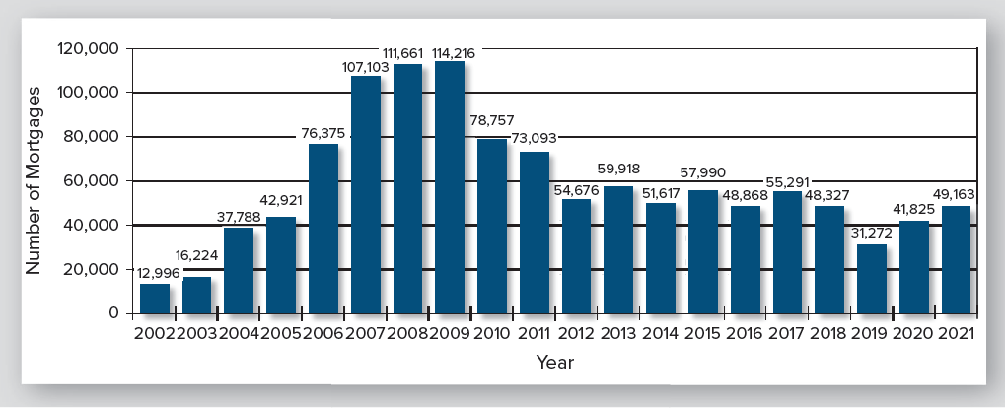
Reverse (HECM) Loans Insured by FHA
Notes:
Other Mortgage Types and Uses

Slide 23
Recent Home Mortgage Forms:
Interest-only
Interest-only Mortgage
  I-O with balloon has interest-only payments for five to seven years, ending with a full repayment of principal.
  I-O amortizing has interest-only payments for up to fifteen years, then converts to a fully amortizing payment for the remainder of the term.
  Note: interest only loans are regularly used for commercial property, but no longer for homes.
Notes:
Home Mortgage Adventurism

Slide 24
Recent Home Mortgage Forms:
Hybrid ARM
Interest rate fixed for some years, then adjustable
Payment is set to be fully amortizing
Fixed rate period ranges from two to ten years
Fixed rate is higher as its term is longer
Notes:
Home Mortgage Adventurism

Slide 25
Recent Home Mortgage Forms:
Hybrid ARM – continued
Inherently superior design:
    Blends borrower’s need for predictable payments with lender’s need for market interest rate.
    Allows a rate between fixed and ARM rate.
  Became infamous in sub-prime lending due to abuses
  Rapidly recovered due to “Dodd-Frank” Act of 2010
  5-year version now dominates ARM lending.
Notes:
Home Mortgage Adventurism

Slide 26
Recent Home Mortgage Forms:
Options ARM Loan
Borrower selects from three types of payments:
  Fully amortizing
  Interest-only
  Minimum – payment too small to cover interest charges
With the minimum payment, balance grows
Most borrowers chose the minimum payment
By 5 years, payment is recast to amortize loan in remaining term.
Result often was insurmountable payment shock
Notes:
Home Mortgage Adventurism

Slide 27
Subprime Loans – What are they?
Not a unique design, but a high-risk use
Mostly 2-28 hybrid, I-O, or option ARM
Almost all were adjustable rate
Wide-spread abandonment of proper underwriting
Started at very high loan-to-value ratio
Low initial payment, large negative amortization
Eventual payment adjustment was extreme
Payment shock left choice of refinancing or default
Notes:
Subprime and Alt-A Loans

Slide 28
Alt-A Loans
More “standard” in type than sub-prime
Usually relaxed one standard loan underwriting requirement:
  Low or no cash down payment
  Weak credit score
  No documentation of borrower’s finances
  Widespread abandonment of standard underwriting
Majority were “no-doc” or “low-doc” loans
  Became known as “liar loans.”
Notes:
Subprime and Alt-A Loans

Slide 29
What are Qualified Mortgages?
Qualified Mortgages: a class of home mortgage loans defined in the “Dodd-Frank Act” of 2010.
Includes roughly 85 percent of all first mortgage home loans.
  Any loan meeting specific “ability-to-repay” tests
  Any conforming conventional, FHA or VA loan
  “Small creditor,” usually rural, portfolio loans meeting the “ability-to-repay” tests
Classification applies to every “dwelling-secured consumer credit transaction, including vacation homes and home equity loans” except HELOCs
Notes:
Qualified Mortgages

Slide 30
What Makes a Qualified Mortgage?
Ability-to-repay standards
  Fully amortizing loan (generally)
  Maximum 30-year maturity
  Maximum fees of 3 percent
  Debt-to-income ratio no greater than 43 percent
  ARM loans to be underwritten for highest possible rate in first five years
    Key factor in transforming ARM lending from one-year ARMs to 5-1 hybrid loans.
  Underwriting information must be verifiable; “no-doc” and “low-doc” loans do not qualify

Slide 31
Why Will Lenders Create Qualified Mortgages?
Any conforming conventional, FHA or VA loan automatically qualifies
ARM loans that are QM are likely more marketable and a better product (5-1 hybrid) for homeowners.
QM status gives the lender “safe harbor” protection in case of default – shield against borrower defenses
Notes:
Qualified Mortgages

Slide 32
Comparing Cost of Loans Using APR
APR: Annual Percentage Rate
Converts regular interest charges plus up-front fees into single equivalent interest expense
Much better than interest rate to compare loans
Still has bias for most applications:
  Treats fees as spread over full maturity of loan
  Most loans are prepaid before term
  APR spreads fees too thin
  Causes APR to understate the true cost of borrowing
Notes:
The Borrower’s Mortgage Loan Decisions

Slide 33
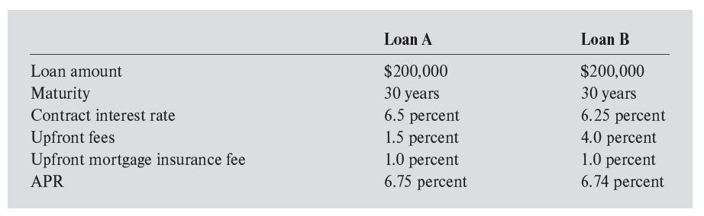
Using APR to Compare Loan Costs
If loans A and B are never prepaid, APR accurately gives the cost of each.
If loans A and B are prepaid before maturity, loan B, with higher fees, will be the more costly of the two
Notes:
The Borrower’s Mortgage Loan Decisions

Slide 34
Mortgage Decisions: How Much Mortgage Debt
APR rises when LTV exceeds 80%
  Mortgage insurance required
  Above 90% LTV rates usually increase
  Above 95% LTV, still higher
Idea: borrow more until the additional cost matches the usefulness of the additional money
Most new households are cash short (borrow heavily)
Established households less cash short (borrow less)
Notes:
The Borrower’s Mortgage Loan Decisions

Slide 35
Mortgage Decisions: Refinancing –
A “Net Benefit” Approach
Refinancing as investment decision: benefit vs cost
Net Benefit = Benefit of Interest Reductions – Cost of Refinancing
First approximation of benefits: sum of all future interest cost reductions
  Replicate your current loan in a calculator (Balance, term, interest rate) – solve for your current payment.
  Change only the interest rate to the current market rate and solve for a new payment.
  Calculate the resulting reduction in payment.
  Multiply reduction by number of expected future pmts.
  Subtract the estimated cost of refinancing.
Notes:
The Borrower’s Mortgage Loan Decisions

Slide 36
The Idea of Net Benefit Analysis
Notes:
The Borrower’s Mortgage Loan Decisions

Slide 37
Mortgage Refinancing:
Example of Net Benefit Analysis
Existing mortgage:
  Amount: $100,000
  Remaining term: 15 years
  Interest rate: 7.0 percent
  Monthly payment: $898.83
New mortgage:
  Amount: $100,000
  Term: 15 years
  Interest rate: 5.5 percent
  Monthly payment: $817.08
Expected time to paying off new loan: 6 years
Cost of refinancing: 5 percent of loan amount
Notes:
The Borrower’s Mortgage Loan Decisions

Slide 38
Mortgage Refinancing: Example (continued)
Monthly reduction: $898.83 – 817.08 = $81.75
Number of months for reduction: 72 months
Approximate benefit: 72 × $81.75 = $5,886.00
Cost of refinancing: 0.05 × $100,000 = $5,000
Approximate Net Benefit of refinancing: $5,886 – 5,000 = $886
Notes:
The Borrower’s Mortgage Loan Decisions

Slide 39
The Effect of Personal Costs on Refinancing
Time and stress cost is significant for persons not comfortable with finance and business
These costs must be weighed against the financial net benefits
This cost probably has fallen significantly in recent years
Notes:
The Borrower’s Mortgage Loan Decisions

Slide 40
The Effect of Income Taxes on Refinancing
Mortgage interest can be deductible for taxes
Example:
  Suppose tax rate on additional income is 25%
  Then $1.00 of deductible interest lowers taxes $0.25
  Net cost of borrowing would be 25% lower
  Interest at 10% costs only 7.5% after taxes
Result: Benefit of refinancing is 25% less
Example: Reduction from 10% interest to 9%:
  Old interest cost: 10% − .25 × 10% = 7.50%
  New interest cost: 9% − .25 × 9% = 6.75%
  Interest reduction after tax: 7.50% − 6.75% = 0.75%
Notes:
The Borrower’s Mortgage Loan Decisions

Slide 41
Adjusting for Income Tax Effects on Refinancing
Assume:
  All interest saved by refinancing is tax deductible
  All payment reductions are from interest savings
  Tax rate on additional income is 25 percent
Approximate after-tax benefit of loan payment reductions for previous example:
After tax benefit = 0.75 × $5,886 = $4,414.50
After tax approximate net benefit of refinancing:
= $4,414.50 – 5,000 = -$585.50
Notes:
The Borrower’s Mortgage Loan Decisions

Slide 42
Caution about Income Tax Effects on Refinancing
Two approaches to deductions in U.S. tax code:
  Take standard deduction (fixed lump sum)
  Itemize deductions
Tax deductions only lower interest costs if:
  Taxpayer Itemizes deductions
  Already has deductions exceeding standard deduction
  Only about 15% of households meet these conditions
Otherwise, in computing benefits of refinancing, taxes should be ignored
Notes:
The Borrower’s Mortgage Loan Decisions

Slide 43
Refinancing Rules of Thumb
Interest rate spread rule: Refinance if “spread” between old loan interest rate and current rate is, for example, 2.0 percent
Payback period rule: Divide cost of refinancing by monthly savings to find “payback period”; then decide if the payback period is short enough
  Net benefit approach here, uses the same information as payback period rule
Notes:
The Borrower’s Mortgage Loan Decisions

Slide 44
Refinancing: Cost of Missing a Better Deal Later
Suppose: 50% chance interest rates will fall further
  Note: A bigger possible fall has a lower likelihood
  Note: Cost cannot exceed cost to refinance again
Thus: Expected cost of missed opportunity (probability ^{x} cost) is less than half the refinance cost
Conclusion: Waiting until benefit exceeds the cost to refinance by, say, one-third probably compensates for the risk of missing a better deal later
  Example: If refinancing costs 6% of the loan amount, do not refinance until the benefit is 8% of the loan amount
Notes:
The Borrower’s Mortgage Loan Decisions

Slide 45
The Option to Default
Historically, few defaults without three preconditions:
  Monthly value of occupancy is less than its cost
  Equity is zero or negative
  “Trigger event”: Divorce, death in family, loss of job
Borrowers regard cost of default as very high
For most households the value of services from their house exceeds the cost of their mortgage payment. (Note, similarly, that many car loans exceed the value of the car, but owners don’t default.)
Notes:
The Borrower’s Mortgage Loan Decisions

