Slide 1
Chapter 1:
The Nature of Real Estate and Real Estate Markets

Slide 2
Real Estate is Property
Two types of property:
  Tangible
    physical assets that can be owned
      Can be real or personal property
  Intangible
    Non-physical assets such as stocks, bonds, mortgages, leases

Slide 3
The Term “Real Estate” Used 3 Ways
1. Real estate as a tangible asset:
  “Raw” land
  Improvements to the land
    Excavation and fill
    Sewers and other utilities
    Roads and driveways
  Structures (improvements on the land)

Slide 4
The Term “Real Estate” Used 3 Ways
2. RE as a bundle of rights
  Exclusive possession of the real property
  Use or enjoyment
    Can use any way you like
  Disposition
  Can be unbundled in many ways
    Ex., owner leases property to renter
Dirt/land is valuable only to the extent it can be put to a productive use!

Slide 5
The Term “Real Estate” Used 3 Ways
3. Real estate as an industry and profession
Brokerage
Development
Leasing
Property management
Asset management
Real Estate Law
Appraisal
Market consulting
Counseling
Planning
Government regulation and taxation
Housing assistance
Mortgage finance
  Construction finance
  Long-term finance
Investment management

Slide 6
Real Estate in the Economy
Quarter of the world’s wealth
Generates over 25% of U.S. gross domestic product (GDP)
  Housing alone accounts for almost 17-18%
Generates a large percentage of local government revenue (property tax)
Creates jobs for nearly 9 million Americans

Slide 7
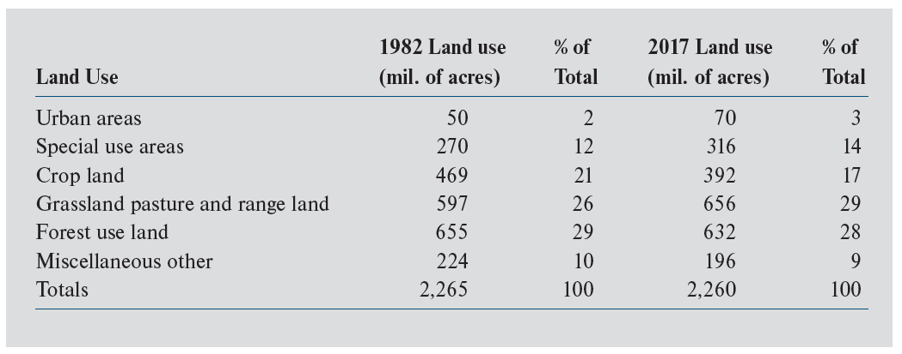
Exhibit 1-1: Land Use in the United States: 2017
Urban areas represent just 6% of land in the U.S.

Slide 8
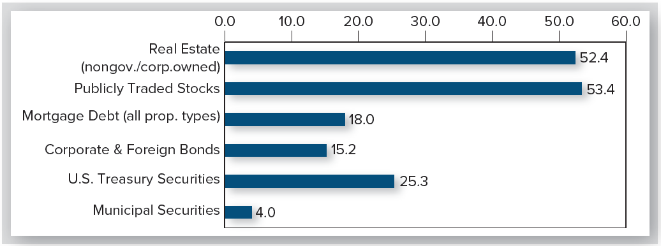
Aggregate Market Values of Selected Asset Categories: 2021Q4
Exhibit 1-2
$Trillions
$Trillions
Nongovernment, non-corporate owned RE
  Includes owner-occupied housing & all “commercial” RE
    “Commercial” RE is all rental/income producing property (including apartments)

Slide 9
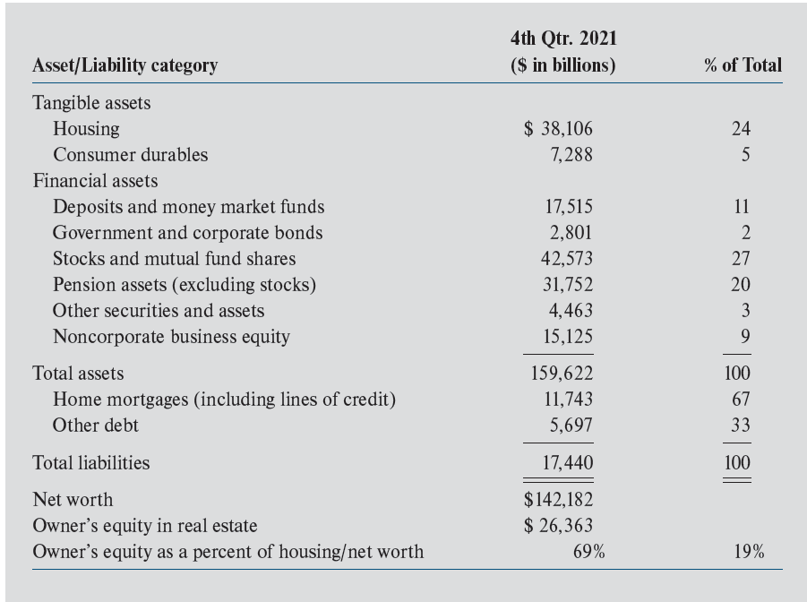
Exhibit 1-3: U.S. Household Wealth: 2021Q4
Households owned housing worth ≈ $36 trillion; had ≈ $26 trillion in housing equity
Average LTV = 31% = $11,743/$38,106
= $38,106 - $11,743
= $26,363/$38,106

Slide 10
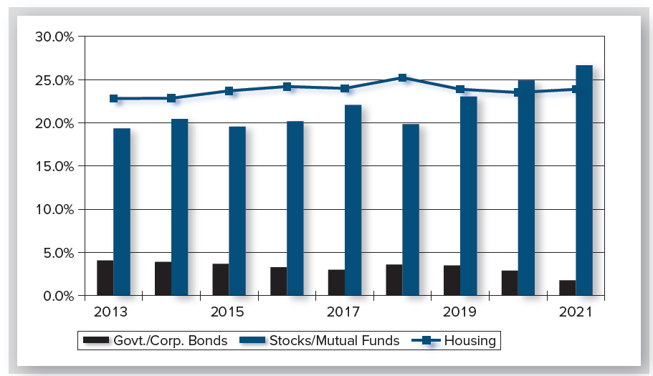
Exhibit 1-4: Selected Household Assets as a Percentage of Total Assets
Housing’s share of assets (typical household) is typically just below 25%

Slide 11
What Determines Real Estate Values?
RE values are determined by interactions of supply & demand in 3 distinct markets/sectors
  User (space) markets
  Capital markets
  Property markets

Slide 12
Space vs. Property vs. Capital Markets
User (space) market:
Market for the physical real estate
“Buyers” receive right to use space
  Called the “space” market or “rental market”
Is where rental rates are determined
These markets are very “local” & usually highly competitive
Separate local markets for various property types: retail, office, industrial, etc.

Slide 13
User Market: Demand & Supply
On demand side:
  individuals, households, & firms who require space either for consumption or production purposes
On supply side:
  real estate owners/operators who rent space to tenants

Slide 14
Segmentation of User/Space Markets
Both demand & supply side of user markets are very specific to location & building type
  Implies user/space markets are highly segmented!
    Compare to nationally integrated markets (gasoline, steel, financial capital; i.e., homogeneous commodities that can be moved from place to place)

Slide 15
Segmentation of User Markets
Because of segmentation, rental prices for physically similar space can vary widely
  across locations, &
  across property types

Slide 16
Capital Markets
RE competes for funds in capital markets with other asset classes, such as stocks and bonds
Investors select a mix of investments based on expected returns & risk
Bidding by investors determines:
  risk-free interest rates of various maturities (i.e., the Treasury “yield” curve)
  required risk premiums for risky investments
    Which can vary significantly
Main takeaway: RE discount rates are largely determined in the capital markets!

Slide 17
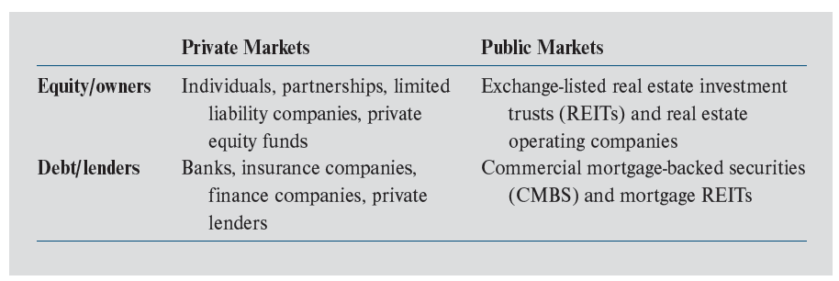
Exhibit 1-5: The 4 Quadrants of RE Capital Markets
Equity participants are the owners of real estate
Debt participants are the lenders
Most (85-90%) of CRE is held by equity investors in private markets

Slide 18
Public Capital Markets
Small homogeneous units (shares) of ownership in assets trade in public exchanges
Many buyers and sellers
Price quotes available for all to see
Characterized by a high degree of liquidity
Informationally efficient

Slide 19
Private Capital Markets
Absence of centralized market (or even price lists)
Assets trade infrequently in private transactions (thus a lack of transparency)
Common for “whole” assets to be traded in a single transaction (indivisibility)
Less liquidity than public markets
Higher transaction costs (typically)

Slide 20
Property Markets
Market for ownership claims to RE assets
Buyers/owners receive rights to cash flows generated by leasing space to tenants
Demand (supply) side of property market is made up of investors wanting to buy (sell) property
Property market is integrated, not segmented like space market
  i.e., investment capital can come from anywhere
  e.g., office space in Manhattan is purchased by investors from around the world

Slide 21
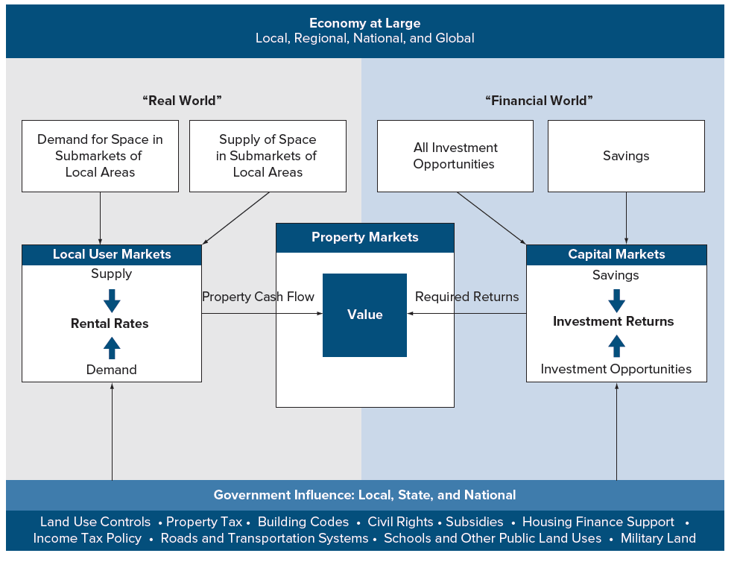
Exhibit 1-6: User Markets, Capital Markets, and Property Markets

