Slide 1
FIN 473: Principles of Real Estate
Topic 0: Course Introduction
Larry Schrenk, Instructor

Slide 2
Overview
Why Real Estate?
Schedule
About the Course

Slide 3
1. Why Real Estate?

Slide 4
Features
Diversification of Investment Portfolio
Alternative Asset Class Analysis
Cash Flow and Income Generation
Market Cycles and Economic Indicators
Financing and Debt Structures

Slide 5
Global Market Size

Slide 6
US Market Size

Slide 7
MIT World Real Estate Forum June 2024
Mixed-use Buildings Thriving
AI will Alter Office Market
Office of the Future will be Highly Flexible

Slide 8
Real Estate Issues 2025
Affordability crisis in major urban centers
Impact of remote work on commercial real estate demand
Sustainable and energy-efficient building practices
Effects of climate change on property values and insurance
Integration of smart home technology and IoT in residential properties
Evolving regulations around short-term rentals (e.g. Airbnb)
Impact of AI and automation on property management
Demographic shifts affecting housing preferences (e.g. aging populations)

Slide 9
2. Schedule

Slide 10
Schedule
Setting the Stage
Legal and Regulatory Determinants of Value
Market Valuation and Appraisal
Financing Home Ownership
Brokering and Closing the Transaction
Time, Opportunity Cost, and Value Decisions
Financing and Investing in Commercial Real Estate

Slide 11
3. About the Course

Slide 12
Web Pages
Course Web Pages (http://larryschrenk.com/)
My Pages
Main Page
Schedule
Exams, Assignments, etc.
D2L Pages
Textbook
MindTap Assignments
E-Mail
Grades
Exams

Slide 13
About Me
?????
Home Page

Slide 14
Tools
S&P Capital IQ
Capital IQ Login
Capital IQ Intro Video (mp4, 27:36)
Capital IQ Resource Page
Financial Resources Page

Slide 15
Note Taking Skills
Here are some web sites that will help, if you want to improve your note taking:
http://www.lifehack.org/articles/productivity/student-guide-effective-note-taking.html
http://www.artofmanliness.com/2012/01/27/write-this-down-note-taking-strategies-for-academic-success/
http://www.techlearning.com/Default.aspx?tabid=67&EntryId=3858

Slide 16
Course Information
FIN 473: Principles of Real Estate
Larry Schrenk, Instructor
Course Page
https://larryschrenk.com/FIN473/FIN473.htm

Slide 17
Contact Information
Office: Somsen 319F
Telephone 507-457-2388
E-Mail
lschrenk@winona.edu
Webpage
http://larryschrenk.com/

Slide 18
Office Hours
Office Hours
8:00-9:00 AM MWF
12:00-1:20 PM MWF
By Appointment/Drop-In
Monday, Wednesday, Friday Campus or Zoom
Tuesday, Thursday (Zoom by appt)
On Campus Policy

Slide 19
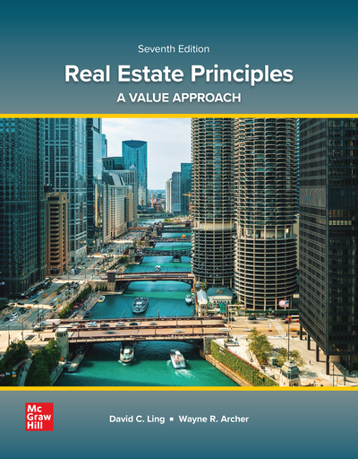
Textbook
David Ling and Wayne Archer. Real Estate Principles: A Value Approach. 7th ed. McGraw-Hill, 2024. With McGraw Hill Connect.
McGraw Hill Connect

Slide 20
Financial Calculator
Acceptable Calculators:
TI 83/84 Graphing
TI BA II Plus, HP 10BII, HP 10BII+
If you want to use a different calculator, see me
Three Methods:
Tables
Formulae
Calculator
On NOT becoming an expert with a financial calculator

Slide 21
Evaluation
Exams (2 @ 15% each) 30%
Connect Assignments 40%
AI Assignments (Group) 10%
Group Case 20%
Participation/Attendance Policy

Slide 22
Exams
Two Exams (15% each)
No Crib Sheets, Formulae Sheets, Etc.
Due dates are on the Schedule Page

Slide 23
Exam Format
Format
100 Points
Short Answer: 10 Questions (50%)
Calculation: 5 Questions (50%)
Not Cumulative
But Later Material Builds on Earlier!

Slide 24
Exam Mechanics
Two D2L exams will be done in class
Lockdown Browser with microphone and webcam
Exam dates on Schedule Page

Slide 25
Assignments
Connect Assignments
In D2L
Group Case
Group assignments under ‘Groups’ in D2L
AI Assignments (Group)
Due dates and details on Schedule Page

Slide 26
AI Policies
AI Policies
Course AI Chatbot
WinSUfin473Chat
AI Uses
AI Day

Slide 27
Feedback
Qualtrics Anonymous Survey
Available
D2L Announcements Page
Weekly Wrap-Up
Uses
Comments, Complaints or Suggestions

Slide 28
Cell Phone Policy
No Cell Phone Use during Class−Muted and in your Backpacks

Slide 29
Syllabus
Syllabus Questions???

