Slide 1
FIN 470: Financial Analysis in Excel
Topic 7.2: Stock Valuation, Excel
Larry Schrenk, Instructor
The slides for this course are adapted from: Timothy R. Mayes, Financial Analysis with Microsoft Excel, 9th Edition. © 2021 Cengage. All Rights Reserved.

Slide 2
Overview
Capital Asset Pricing Model
Spreadsheet Valuation/DDM

Slide 3
1. Capital Asset Pricing Model

Slide 4
CAPM
Capital Asset Pricing Model (CAPM) Equation
E(r_{i}) = r_{f} + β_{i}[E(r_{M}) − r_{f})]
Inputs:
r_{f} = risk-free rate of return
r_{M} = return on the market
β_{ι} = beta of stock i

Slide 5
Risk-Free Rate of Return
Forecast of risk-free rate for next year
Treasury security
Time horizon
Data source: Federal Reserve Economic Data (FRED)
U.S. Treasury Securities at 1-Year Constant Maturity
1- Year average

Slide 6
Return on the Market
Forecast of market return for next year
S&P 500 as proxy
Time horizon
Data source: CapIQ
S&P 500 (^SPX)
10-Year average of annualized monthly returns

Slide 7
Beta
Beta = sensitivity of stock return to market return (S&P 500)
Regress stock return on market return
Data source: CapIQ
10-Year monthly prices/levels
Monthly prices > EAR
Excel regression procedure

Slide 8
Apply CAPM Equation
Capital Asset Pricing Model (CAPM) Equation
E(r_{i}) = r_{f} + β_{i}[E(r_{M}) − r_{f})]
Inputs:
r_{f} = risk-free rate of return
r_{M} = return on the market
β_{ι} = beta of stock I
Graph Security Market Line
Scenario Manager

Slide 9
2. Spreadsheet Valuation/DDM

Slide 10
Spreadsheet Alternative
A spreadsheet is an alternative to using (often complicated) formulae and allows far greater flexibility.
Spreadsheet valuation:
Model each year in a separate column with a terminal value (TV) as the final column.
Growth rates (as well as other factors) can be individually adjusted on a yearly basis
This approach can be adapted to any type of cash flow:
Dividends
Earnings
Free Cash Flow

Slide 11
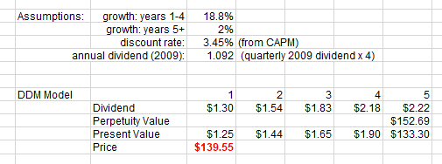
Spreadsheet Alternative: Example

Slide 12
Discounted Dividend Model
DDM as example
Easily change model to earnings or free cash flow as cash flows
Concentrate on Excel modeling

Slide 13
Dividend Data
Data Source: CapIQ
Dividend data is on the Income Statement
Download max years of dividends
It may be easier to use a different data source.

Slide 14
DDM Strategy
Distinguish ST vs LT
Short-Term
However long you can reasonably predict individual dividends
Result: Predictions of individual dividends
Long Term
Period beyond which you can’t reasonably predict individual dividends
Terminal Value
Result: Prediction of the dividend in the terminal period
Capture LT/TV value with a deferred (growing) perpetuity
Price = LT + ST Values

Slide 15
Timing
Divide dividend forecast into two periods:
Short Term Prediction/Horizon (t = 1-3)
Long Term Prediction/Horizon (t = 4+)
Short Term Long Term
0
1
2
3
t
D₀
D₁
D₂
D₃
D₄

Slide 16
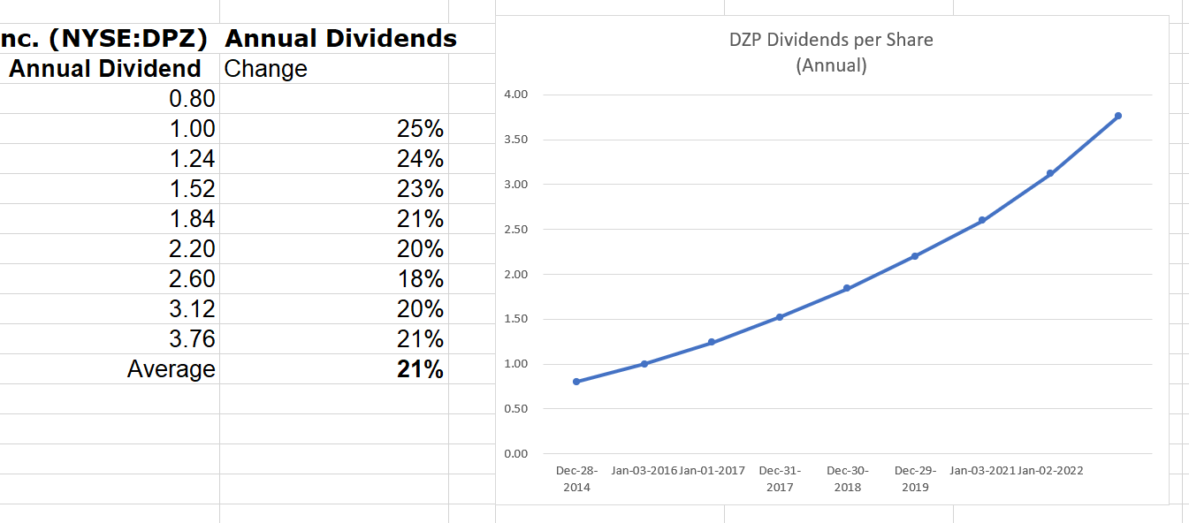
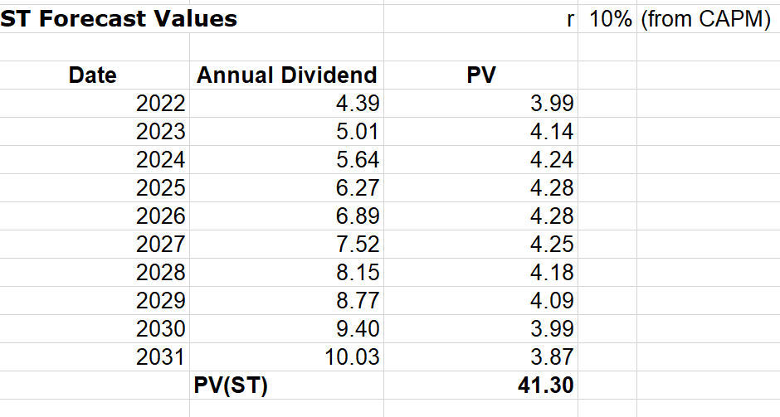
ST Strategy
Graph dividend history
Forecast future dividends:
Pattern
Knowledge of firm, industry, economy
Models:
Constant dividend
Constantly growing dividend
Mixed/multi-stage dividend
Forecast Techniques (examples):
Trend/Trend Lines
Regression
Time Series Forecasting

Slide 17
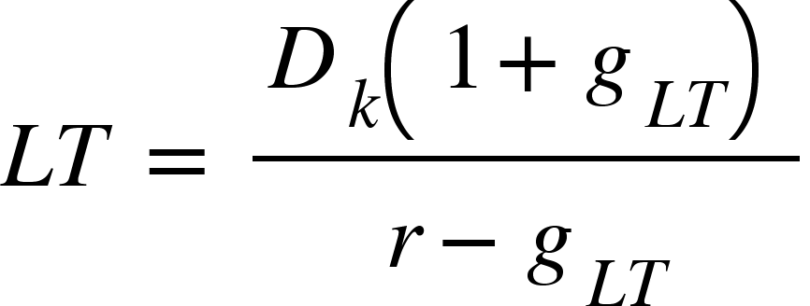
LT Strategy
Determine LT sustainable (infinite) growth rate (g)
One estimate: Estimate LT growth in the entire economy (g_{LT})
Construct growing perpetuity:
Where D_{k} is the dividend from the final period (k) of the ST
Calculate the PV of LT (a deferred growing perpetuity)

Slide 18
LT Strategy (in Excel)
Determine LT sustainable (infinite) growth rate (g_{LT})
One estimate: Estimate LT growth of the entire economy
Construct growing perpetuity =D_{k} * (1 + g_{LT})/(r – g_{LT})
Where D_{k} is the dividend from the final period (k) of the ST
Calculate the PV of deferred perpetuity by embedding it in PV function
=PV(r, k, 0, D_{k} * (1 + g_{LT})/(r – g_{LT}))
LT
NOTE: This is how we did the deferred annuity in Time Value of Money.

Slide 19
Stock Valuation
Add ST + LT
Price = ST Value + LT Value)

