Slide 1
FIN 470: Financial Analysis in Excel
Topic 7.1: Stock Valuation, Theory
Larry Schrenk, Instructor
The slides for this course are adapted from: Timothy R. Mayes, Financial Analysis with Microsoft Excel, 9th Edition. © 2021 Cengage. All Rights Reserved.

Slide 2
Overview
Basics of Valuation
Absolute Valuation
Relative Valuation

Slide 3
1. Basics of Valuation

Slide 4
What Is Value?
“Value” has many different meanings
Most generally, value is the amount that a willing and able buyer agrees to pay for an asset to a willing and able seller
There are several important types of value:
Book value: Original purchase price less accumulated depreciation
Intrinsic value: ‘True’ (in some sense) value of an asset as determined by calculating the present value of expected future cash flows at required rate of return
Market value is the price of an asset as determined in a competitive marketplace
Liquidation value is the value if an asset needs to be sold immediately

Slide 5
Valuation Methodology
Absolute/Discounted cashflow (DCF) valuation, relates the value of an asset to the present value of expected future cashflows on that asset.
Relative valuation, estimates the value of an asset by looking at the pricing of 'comparable' assets relative to a common variable like earnings, cashflows, book value or sales.
Contingent claim valuation, uses option pricing models to measure the value of assets that share option characteristics.

Slide 6
Valuation Issues
Has negative earnings and low revenues in its current financial statements
No history
Non-public
IPOs
No comparables ( or even if they exist, they are all at the same stage of the life cycle as the firm being valued)

Slide 7
Fundamental Analysis
Fundamental analysis models a company’s value by assessing its current and future profitability.
The purpose of fundamental analysis is to identify mispriced stocks relative to some measure of “true” value derived from financial data.

Slide 8
2. Absolute Valuation

Slide 9
Absolute/Discounted Cashflow (DCF) Valuation
Value of an asset is the present value of the expected cash flows on the asset.
Philosophical Basis: Every asset has an intrinsic value that can be estimated, based upon its characteristics in terms of cash flows, growth and risk.
Information Needed: To use discounted cash flow valuation, you need
to estimate the life of the asset
to estimate the cash flows during the life of the asset
to estimate the discount rate to apply to these cash flows to get present value
Market Inefficiency: Markets are assumed to make mistakes in pricing assets across time, and are assumed to correct themselves over time, as new information comes out about assets.

Slide 10
Fundamentals of Valuation
Intrinsic value of an asset is the present value of the expected future cash flows:
Three inputs:
Amount of expected future cash flows
Timing of expected future cash flows
Required rate of return
The value of the asset can be compared to its market price to determine whether the asset is over- or underpriced

Slide 11
Required Rate of Return
Assumption: Investors are risk averse and require higher returns to to take on higher levels of risk
Very simple model to determine the required return:
E(R_{i}) = Base Rate + Risk Premium
= Risk-Free Rate + Risk Premium
For equities, use the Capital Asset Pricing Model (CAPM), which has some theory behind it
E(r_{i}) = r_{f} + β_{i}[E(r_{M}) − r_{f})]
Also, other asset pricing models, Fama-French, APT, etc.

Slide 12
Valuing Common Stocks
Many approaches are simply present value models, discounted cash flow (DCF) models
The difference between them is;
1) Pattern of future cash flows or
2) The type of cash flow, e.g., dividends vs free cash flow
Several discounted cash flow (DCF) models:
The Constant-Growth Dividend Discount Model (DDM)
The Two-Stage Growth Dividend Discount Model (DDM)
Three-Stage Growth Dividend Discount Model (DDM)
The Earnings Model
The Free Cash Flow Model

Slide 13
DCF: Pros and Cons
Pros
Since based on fundamentals, should be less exposed to market moods and perceptions.
If good investors buy businesses, rather than stocks (Buffett), DCF valuation is the right way to think about what you are getting when you buy an asset.
Cons
Requires far more inputs and information than other valuation approaches
Inputs and information are noisy and difficult to estimate, but can be manipulated.

Slide 14
The Constant-Growth Dividend Discount Model (DDM)
The constant growth (Gordon growth) model assumes that future dividends (D_{t}) grow at a constant rate (g) and be discounted at a required return (K_{cs}):
Notes:
Since the growth rate is constant, if we know the most recent dividend then we know all future dividends
g can be 0 or negative
g << k
Very sensitive to the choice of g

Slide 15
Sustainable Growth Rate
Sustainable Growth Rate = ROE x Retention Ratio
= ROE x (1 – Payout Ratio)
Return on Equity (ROE) = Net Income/Equity
Payout Ratio = Proportion of earnings paid out as dividends
Retention Ratio = Proportion of earnings retained for investment

Slide 16
Two-Stage Growth Dividend Discount Model (DDM)
Not many firms do not grow at a constant rate forever
Some may grow at unsustainably high rates, but eventually growth slows to a long-run constant rate
Two-stage dividend discount model allows for these two stages of growth:
Note that the first term is simply the present value of the first $n$ dividends growing at a rate of g₁ and the second term is the present value of all other dividends growing at a rate of g₂

Slide 17
Three-Stage Dividend Discount Models (DDM)
There are also models that allow for three stages of dividend growth:

Slide 18
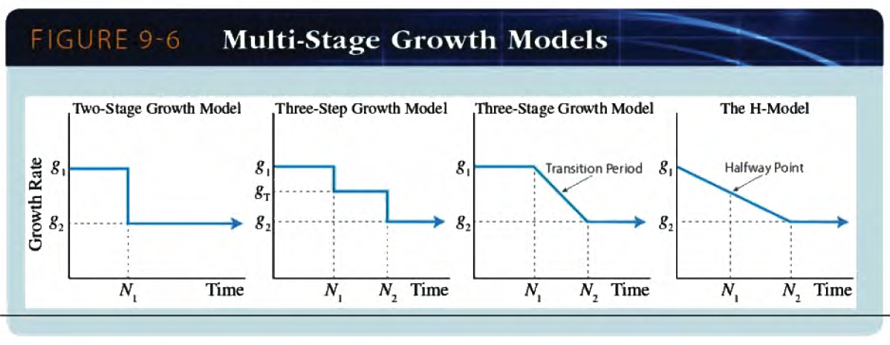
Multi-Stage Growth Models

Slide 19
DDM Implications
The constant-growth rate DDM implies that a stock’s value will be greater:
The larger its expected dividend per share.
The lower the market capitalization rate, k.
The higher the expected growth rate of dividends.
The stock price is expected to grow at the same rate as dividends.

Slide 20
Observations on DDMs
Simple to compute
Not usable for firms that do not pay dividends
Not usable when g > k
Is sensitive to the choice of g and k
k and g may be difficult to estimate accurately.
Constant perpetual growth is often an unrealistic assumption.

Slide 21
Alternative Discounted Cash Flow Models
The Earnings Model uses EPS as the cash flow and emphasizes future earnings and highlights the importance of ROE (r) relative to the required return (K_{CS}):
The Free Cash Flow Model discounts the expected future free cash flows to get the value of the firm, and then subtracts the value of debt and preferred equity to determine market value of equity:

Slide 22
Spreadsheet Alternative
A spreadsheet is an alternative to using (often complicated) formulae and allow far greater flexibility.
Spreadsheet valuation:
Model each year in a separate column with a terminal value (TV) as the final column.
Growth rates (as well as other factors) can be individually adjusted on a yearly basis
This approach can be adapted to any type of cash flow:
Dividends
Earnings
Free Cash Flow

Slide 23
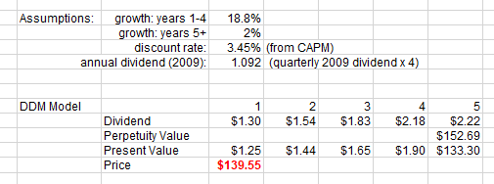
Spreadsheet Alternative: Example

Slide 24
Preferred Stock Valuation
Preferred stock is a form of hybrid security
Ownership claim (like stock)
No maturity date (usually) (like stock)
Does not trigger bankruptcy (like stock)
No benefit from increases in earnings (like bonds)
Cannot (usually) vote in corporate elections (like bonds)
Generally, pays a fixed payment (like bonds)
Since preferred stock is expected to pay a constant dividend forever, value it as a perpetuity:

Slide 25
3. Relative Valuation

Slide 26
Valuation by Multiples
Compare valuation ratios of firm to industry averages.
Ratios like price/sales are useful for valuing start-ups that have yet to generate positive earnings.

Slide 27
Types of Valuation Multiples
Equity Multiples
Enterprise Value (Firm) Multiples

Slide 28
Relative Value Models
Value a stock relative to other similar stocks using ratios such as P/E
These models have two major advantages:
They are easy to use
They can be used to value stocks for which the DCF models fail
The most common relative value model is based on the P/E ratio
Identify a “justified” P/E ratio and multiply by EPS
If earnings negative, use the price to book or price to sales ratios

Slide 29
P/E Ratios
Earnings yield
Inverse of the P/E ratio: earnings divided by price (E/P)
High-P/E stocks are often referred to as growth stocks, while low-P/E stocks are often referred to as value stocks.

Slide 30
Pitfalls in P/E Analysis
Use of accounting earnings
Earnings Management
Choices on GAAP
Inflation
Reported earnings fluctuate around the business cycle

Slide 31
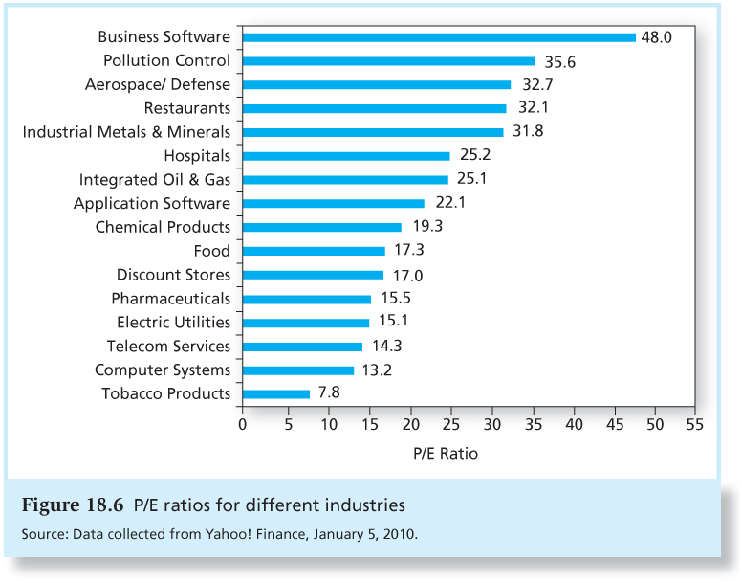
P/E Ratios for Different Industries

Slide 32
Other Multiples: P/CF
P/CF or P/EBITDA
Cash flow is usually taken to be net income plus depreciation
Cash flow can be more informative than net income
Earnings and cash flows that are far from each other may be a signal of poor quality earnings

Slide 33
Other Multiples: P/S, P/B
P/Sales
A high P/S ratio suggests high sales growth, while a low P/S ratio suggests sluggish sales growth.
P/Book (Market Value/Book Value)
A ratio bigger than 1.0 indicates that the firm is creating value for its stockholders.

Slide 34
Other Multiples
Dividend Yield
EV/Sales
EV/EBITDA
EV/Invested Capital
NOTE: EV = Enterprise (Firm) Value

Slide 35
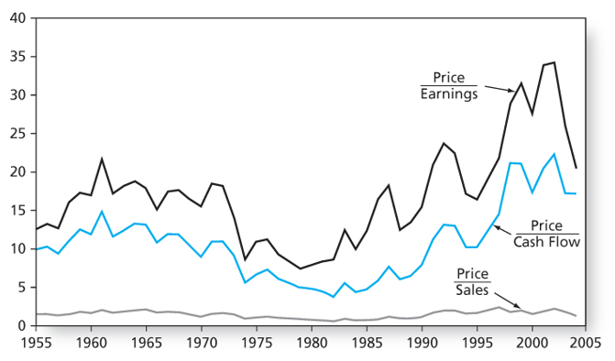
Market Valuation Statistics

Slide 36
Methodology
Based on comparable firms, estimate the appropriate P/E.
Multiply by firm’s expected earnings
Use as estimate of the stock price

Slide 37
Problems with Relative Valuation
Values from these models may differ
Present (not future) focused
Analysts are always forced to make simplifying assumptions

