Slide 1
FIN 470: Financial Analysis in Excel
Topic 5.2: Break-Even, Leverage Analysis II
Larry Schrenk, Instructor
The slides for this course are adapted from: Timothy R. Mayes, Financial Analysis with Microsoft Excel, 9th Edition. © 2021 Cengage. All Rights Reserved.

Slide 2
Overview
Break-Even Analysis
Leverage Analysis
Extended Example
Linking Break-Even and Leverage
Scenario Manager/Data Tables

Slide 3
3. Extended Example

Slide 4
Leverage Analysis: An Example
Sales (30,000 units @ $25) $ 750,000
- Variable costs ($7 per unit) (210,000)
- Fixed costs (270,000)
EBIT $ 270,000
- Interest expenses (170,000)
EBT $ 100,000
- Taxes ( 34,000)
EAT $ 66,000
Given 20,000 shares outstanding:
EPS = $66,000/20,000 = $3.30

Slide 5
Key to Symbols
NOTE: The symbols used in the notes differ somewhat from the symbols used in the text.
P = Price per unit
Q = Sales in units
V = Variable cost per unit
F = Fixed costs
VC = Total variable costs
TC = F + VC = Total costs
S = PQ = Sales dollars
EBIT = S - TC

Slide 6
Break-Even Points: Units
Calculating Breakeven Point in Units:
(1) S - TC = 0
(2) S - F - VC = 0
(3) PQ - F - VQ = 0
(4) PQ - VQ = F
Breakeven Point in Units:

Slide 7
Break-Even Points: Dollars

Slide 8
Breakeven Graph
Thousands of Dollars
S
TC
Thousands of Units

Slide 9
EBIT Graph
Thousands of Dollars
EBIT
Thousands of
Units

Slide 10
Degree of Operating Leverage
NOTE: If F = 0, DOL = 1 (i.e., without any F, the % change in EBIT would be equal to the % change in sales). By employing F, the firm’s % change in EBIT will be greater than the % change in sales.

Slide 11
DOL When Q = 30,000 Units
For every 1% change in sales, EBIT will change 2%.
Operating Leverage is Risky:
If sales increase 5%, EBIT would increase 10%.
If sales decline 7%, a DOL of 2.0, EBIT would decline 14%.

Slide 12
Degree of Financial Leverage
NOTE: If interest expense = 0, DFL = 1.0 (i.e., without any debt financing, the % change in EPS would be equal to the % change in EBIT). By incurring interest expense (debt financing) the firm’s % change in EPS will be greater than the % change in EBIT.

Slide 13
DFL When Q = 30,000 Units
For every 1% change in EBIT, EPS will
change 2.7%
Financial Leverage is Risky:
If EBIT increases 2%, EPS would increase 5.4%.
If EBIT declines 4%, a DFL of 2.7, EPS would decline 10.8%.

Slide 14
Degree of Combined Leverage
NOTE: If F = 0, and I = 0, DCL = 1.0. If F or I > 0, % change in EPS will be greater than % change in sales.

Slide 15
DCL When Q = 30,000 Units

Slide 16
Leverage Effects (for 10% Increase in Sales)
After Before
Sales (33,000 units @ $25) $ 825,000 $ 750,000
- Variable costs ($7 per unit) (231,000) (210,000)
- Fixed costs (270,000) (270,000)
EBIT $ 324,000 $ 270,000
- Interest expense (170,000) (170,000)
EBT $ 154,000 $ 100,000
- Taxes (52,360) (34,000)
EAT $ 101,640 $ 66,000
EPS = $101,640/20,000 = $5.08
EPS = $66,000/20,000 = $3.30

Slide 17
Leverage Effects: DOL, DFL, DCL

Slide 18
4. Linking Break-Even and Leverage

Slide 19
Operating Break-Even and DOL
Solve break-even point equation for fixed costs:
Substitute this into DOL equation:
As sales rise above operating break-even point, DOL will decline.
In general, the lower the fixed costs and the degree of operating leverage, the lower the break-even point

Slide 20
Total Break-Even and DCL
Note:
See textbook for derivation of the equation.
As unit sales rise above total break-even point, DCL will decline.

Slide 21
5. Scenario Manager/Data Tables

Slide 22
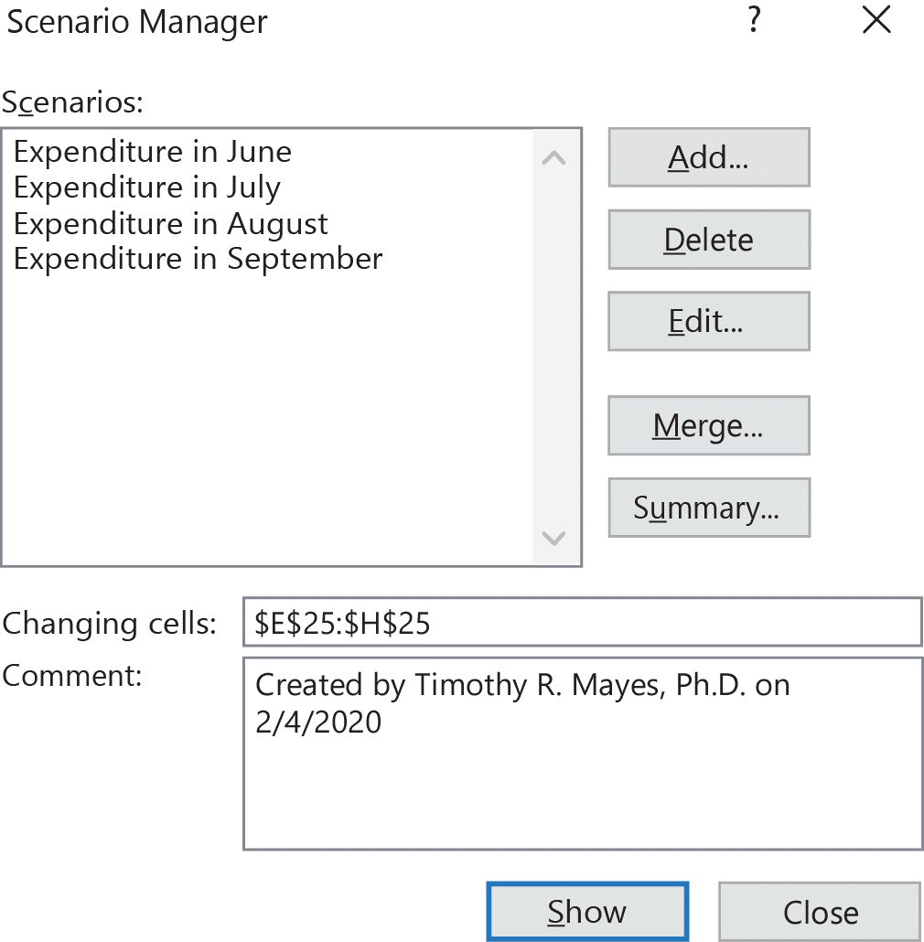
Scenario Manager I
Scenario Manager allows you to store and show alternate “What If” cases
Data > What-If Analysis > Scenario Manager
Once defined, select a scenario and Excel will enter the appropriate numbers and recalculate
To define a scenario:
Click Add
Select cells to change, and
Enter values for that scenario
Always define a scenario that holds the default values

Slide 23
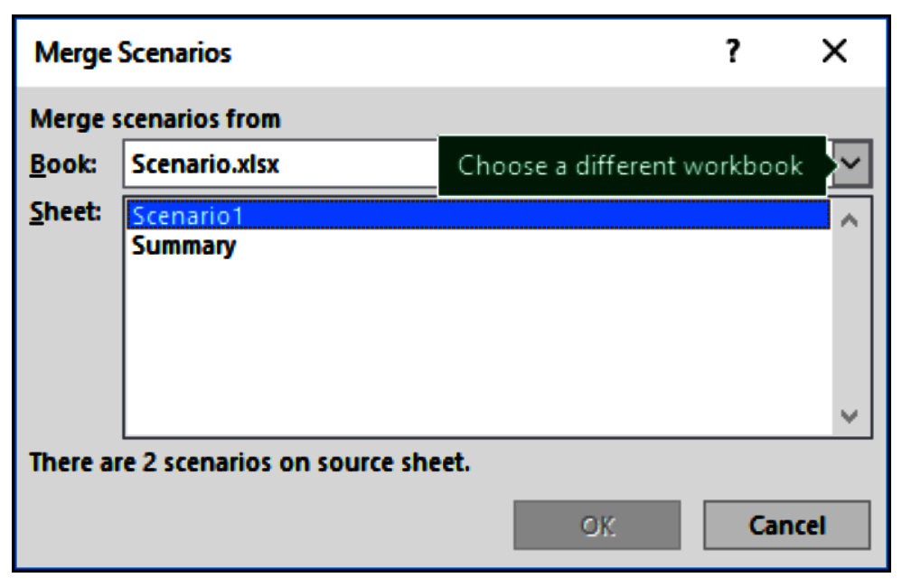
Scenario Manager II
Summary button:
Generate new worksheet with all scenarios
Merge Scenarios
Merge scenarios from different worksheets and workbooks

Slide 24
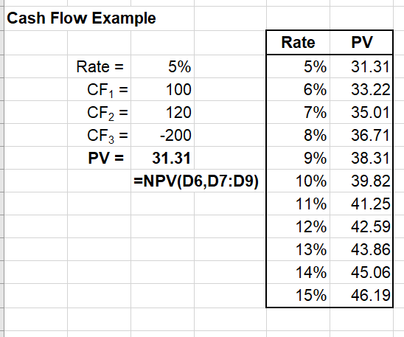
Data Tables
Data table allows you to create a table of alternate “What If” cases
Data > What-If Analysis > Data Tables
Set up a formula.
Create table with range of input values.
Run Data Table to fill in the table.

