Slide 1
FIN 470: Financial Analysis in Excel
Topic 4.2: Time Series Forecasting I
Larry Schrenk, Instructor
The slides for this course are adapted from: Timothy R. Mayes, Financial Analysis with Microsoft Excel, 9th Edition. © 2021 Cengage. All Rights Reserved.

Slide 2
Overview
What is Time Series Forecasting?
Time Series Decomposition
Exponential Smoothing Methods
Time Series Using Regression

Slide 3
What is Time Series Forecasting?

Slide 4
What is Forecasting?
Process of predicting a future event based on historical data
Educated Guessing
Underlying basis of all business decisions
Finance
Production
Inventory
Personnel

Slide 5
What is a Time Series?
A time series is a sequence of observations of a variable ordered by time.
Quarterly G D P
Monthly C P I
Monthly housing starts
Use time structure (contra simple regression)
Example: company’s revenue over time
Amazon quarterly revenue (2011-2018)
NOTE: Trend and Seasonality

Slide 6
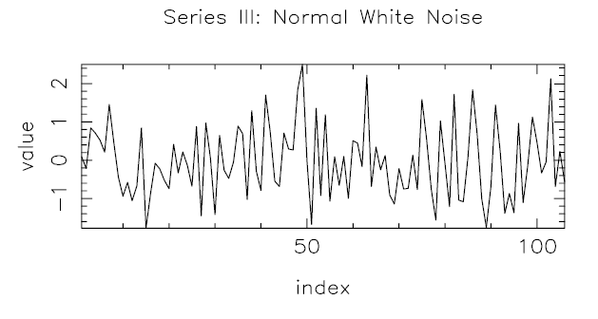
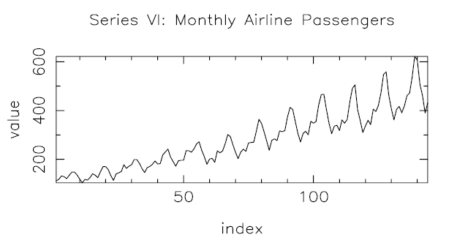
Types of Time Series I
Purely Random Series
No patterns over time; “unpredictable;” “no memory.”
Long-Memory Series
Almost perfectly predictable; past tells future

Slide 7
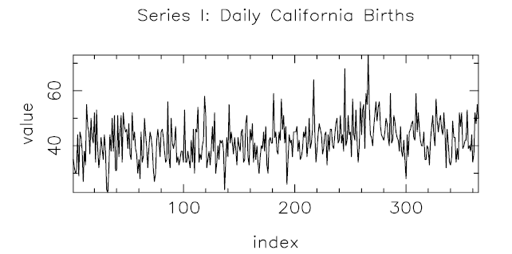
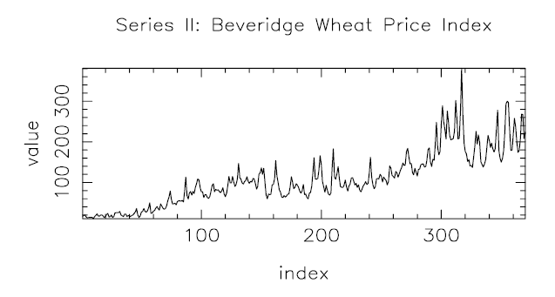
Types of Time Series II
Short-Memory Series
Between purely random and long-memory
Past doesn’t predict future with high precision

Slide 8
Quantitative Forecasting Methods
Quantitative
Time Series
Models
Models
2. Moving
3. Exponential
1. Naive
Average
Smoothing
a) simple
b) weighted
a) level
b) trend
c) seasonality
Notes:
A point you may wish to make here is that only in the case of linear regression are we assuming that we know “why” something happened. General time-series models are based exclusively on “what” happened in the past; not at all on “why.” Does operating in a time of drastic change imply limitations on our ability to use time series models?

Slide 9
Goals of Time Series
Description
How can we succinctly describe a time series?
Inferences
How to make inferences about the patterns, e.g., are there “cycles” in the data?
Prediction
Use the past of a series (or several series) to predict future.
Control
If we can predict the future, can we modify the current value(s) to obtain specific value(s) in the future?

Slide 10
Three Applications
Decomposition of Time Series
Fitting to Time Series
Prediction of Time Series

Slide 11
Product Demand over Time
Trend component
Seasonal peaks
Demand for product or service
Actual demand line
Random variation
Year
1
Year
2
Year
3
Year
4
Notes:
This slide illustrates a typical demand curve. You might ask students why it is important to know more than simply the actual demand over time. Why, for example, would one wish to be able to break out a “seasonality” factor?

Slide 12
Models
Decomposition
Simple Exponential Smoothing (SES)
Holt’s Linear Trend Exponential Smoothing Model (LES)
Holt-Winters Additive Seasonal Model (HWAS)
Holt-Winters Multiplicative Seasonal Model (HWMS)
Holt-Winters Additive Seasonal Model (HWAS) (Using ETS)
Regression Analysis (with Trend)
Regression Analysis (with Trend and Seasonality
(Underlining indicates a model we will do in Excel and for which you are responsible of the Assignment.)

Slide 13
2. Time Series Decomposition

Slide 14
Time Series Decomposition
Decomposition:
Trend Component – Long term behavior
Seasonality Component – Regular fluctuations within a year horizon
Cyclical Component – Fluctuations with period > a year
Irregular Component – Everything not explained by above
Strategy:
Ignore cyclical (business cycles)
Forecast each separately, then
Recombine to forecast whole time series

Slide 15
Isolating Trend
Isolating trend using a moving average
Moving average (M A) – average of last N values
Centered moving average (C M A) is a moving average placed at halfway point
Match C M A period to frequency of the seasonality (typically annual)
Even periodicity – C M A as average of two moving averages

Slide 16
Moving Average (M A)
First Value
Second Value
Centered Moving Average (2 x 4): Average both values and plot at t = 3.

Slide 17
Isolating Seasonality
Seasonal factors show how much seasonal values diverge from trend
Each quarter, calculate how much revenue varies from trend (raw seasonals)
Additive Seasonality – Use difference from trend
Multiplicative Seasonality – Use ratio to trend
Find average raw seasonals to get the seasonal factors
AVERAGEIF function can averaging conditional on the number of the quarter
Normalized seasonal factors – Normalize average of the raw seasonal factorss to sum to 1

Slide 18
Additive vs Multiplicative Seasonality
Additive Seasonality: seasonal fluctuations is relatively constant over the entire time series
Multiplicative Seasonality: seasonal fluctuations grow (or shrink) with the level of the time series
E.g., revenues

Slide 19
Seasonal Factors (Multiplicative)
Raw Seasonals (RS): Calculate difference (or ratio) between each actual value and the trend
RS₁ = (Actual Value₁ – Trend₁)/ Trend₁
Result: RS₁, RS₂, RS₃ …
Seasonal Factors (SF)
Average raw seasonals for each quarter
SF_{Q1} = Average of Q1 Raw Seasonals
AVERAGEIF (range, criteria, average_range)
Result: SF_{Q1}, SF_{Q2}, SF_{Q3}, SF_{Q4},

Slide 20
Isolating Irregular Component
Irregular component – any part of the time series not explained by trend or seasonality components
Multiplicative decomposition:
Solve for irregular component at each point in time:

Slide 21
Amazon Revenue Decomposed

Slide 22
Measuring Forecast Errors
Accurate Forecasts
vs
Well-Fitted Data
Evaluate a model against holdout sample
Continually evaluate forecasts against new data
Error functions
Different penalty implications

Slide 23
Example Forecast Errors

