Slide 1
FIN 470: Financial Analysis in Excel
Topic 3.2: Pro Forma Forecasting, Excel
Larry Schrenk, Instructor
The slides for this course are adapted from: Timothy R. Mayes, Financial Analysis with Microsoft Excel, 9th Edition. © 2021 Cengage. All Rights Reserved.

Slide 2
Overview
The Percent of Sales Method
Pro Forma Forecasting
Other Forecasting Methods

Slide 3
1. The Percent of Sales Method

Slide 4
The Percent of Sales Method
Simplest technique
Many items rise and fall at approximately the rate as sales
Sales ↑ by 10%, COGS ↑ by ≈10%
Sales forecast drives other items
Multiple methods for forecasting sales
See also next topic.

Slide 5
2. Pro Forma Forecasting

Slide 6
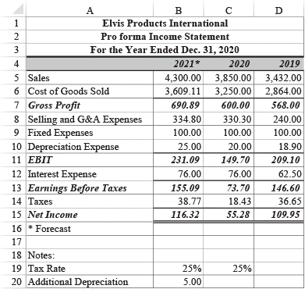
Forecasting the Income Statement
E P I’s income statements (2019-2020) and forecast for 2021
Sales forecast of $4,300,000 given
COGS averaged of 83.93% of sales
Multiply sales by 0.8393 for COGS
SG&A averaged 8.58% of sales
Multiply sales by 0.0858 for SG&A
Fixed Expenses/Interest do not change
Depreciation increased by $5 due to an increase in Gross Fixed Assets
This is unrelated to change in sales

Slide 7
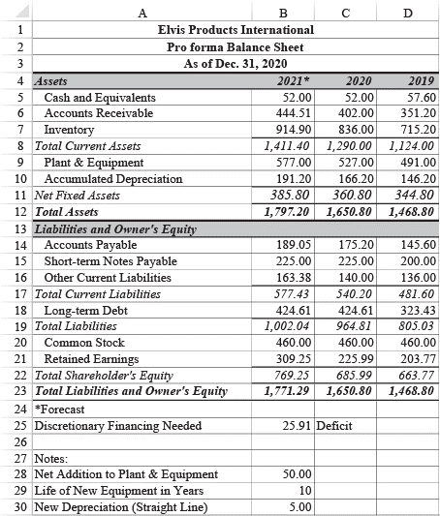
Forecasting the Balance Sheet
EPI’s balance sheets (2019-2020) and forecast for 2021
Assets: Change with sales or no change
Liabilities and Equity:
Spontaneous sources increase with sales, e.g., accounts payable
Discretionary sources are not changed (Decide later how to change based on financing needs)

Slide 8
Discretionary Financing Needed
Also External Financing Needed (EFN) or Additional Financing Needed (AFN)
Balance sheet, almost certainly, will not balance
Amount to balance is Discretionary Financing Needed (DF N)
D F N = (Forecast TA) − (Forecast TL and Equity)
‘Discretionary’ because choice how to raise financing
Short-term notes, long-term debt, or issue new stock
D F N may be negative (surplus of discretionary financing)
Eliminated by paying off debt, additional dividends, investing in ST securities

Slide 9
Using Iteration to Eliminate D F N
Circular errors when a formula refers back to itself
Use circular (iterative) formulas to solve D F N
For example, eliminate the D F N by using LT debt:
Add the D F N to LT debt (but adding debt increases interest)
Increased interest reduces net income, which reduces retained earnings, leading to new DFN
Add new D F N to LT debt and go through the cycle again
After several cycles, D F N will be negligible

Slide 10
3. Other Forecasting Methods

Slide 11
Linear Trend Extrapolation
If items not change at same rate as sales, can’t use percent of sales
Alternative: fit a linear trend line to the past values, and extrapolate
Excel’s TREND function:
TREND(Known_Y’s, Known_X’s, New_X’s, Const)
TREND gives next value on the trend line
NOTE: Omitting optional Known_X’s and New_X’s can lead to errors

Slide 12
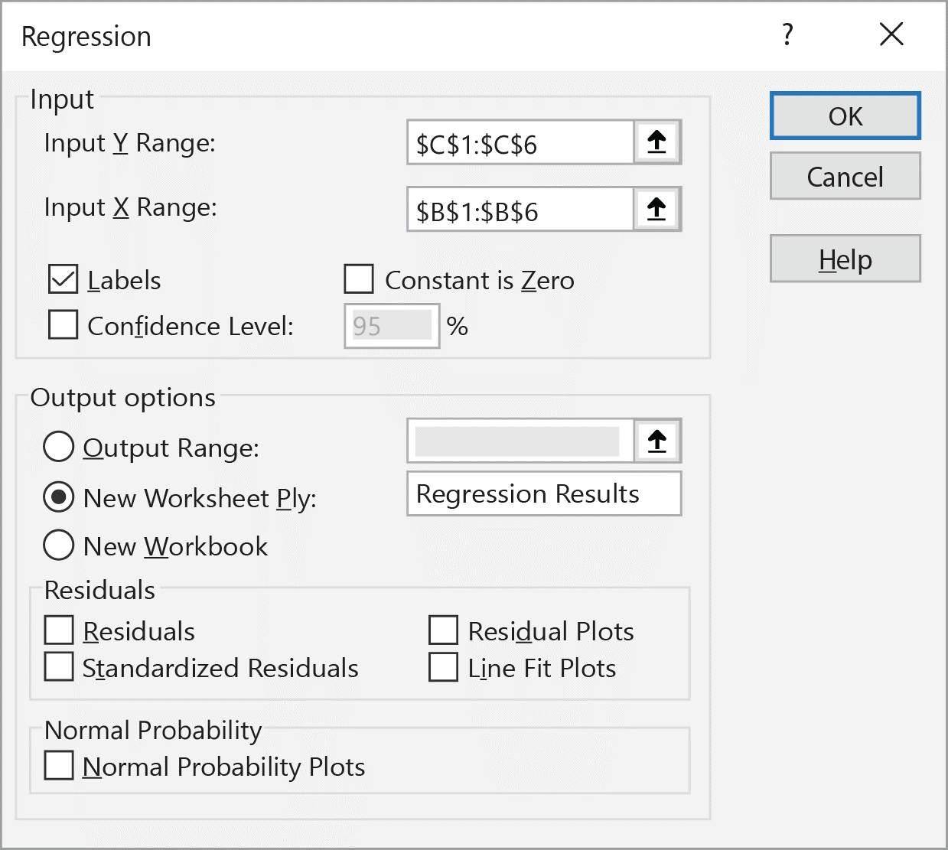
Regression Analysis
Regression Analysis finds best fitting line for data set
TREND implements regression, but also regression tool
Data Tab -> Data Analysis
Regression gives coefficients and diagnostic information (e.g., t statistics)
Is model is statistically significant?
INTERCEPT and SLOIPE also give the coefficient values

Slide 13
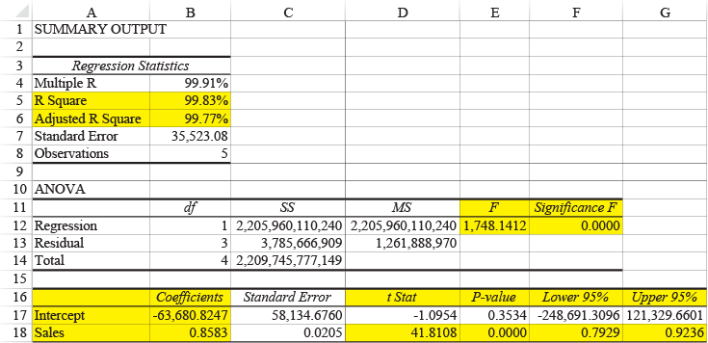
Output of the Regression Tool

