Slide 1
FIN 470: Financial Analysis in Excel
Topic 14.1: VBA
Larry Schrenk, Instructor

Slide 2
Overview
What is VBA?
The VBA Editor
Procedures
Macros
VBA Programming
Best Practices

Slide 3
1. What is VBA?

Slide 4
Introduction to VBA
What is VBA?
Visual Basic for Applications, built‑in programming language in Excel and other Office apps
Enables users to write macros that automate manual tasks
Primary Strengths
Boosts productivity by saving time on repetitive work
Frees you to focus on analysis and strategic decision‑making

Slide 5
Who Benefits from VBA?
Target Users
Administrators, data analysts, accountants, finance professionals, BI teams, STEM roles
Key Advantages
Automate routine data‑management tasks
Improve accuracy and consistency
Scale up built‑in analytics with custom solutions

Slide 6
Real‑World Workflow Examples
Reporting
Auto‑generate and distribute monthly financial reports
Custom Functions
Build user‑defined functions for specialized metrics
Batch Processing
Loop through multiple workbooks to consolidate data

Slide 7
Why VBA Matters for Finance
Automation – Eliminate hours of repetitive spreadsheet tasks
Custom Models – Build pricing and valuation tools tailored to your needs
Data Processing – Handle large datasets that overwhelm manual methods
Accuracy – Reduce human error by replacing manual steps with code
Career Advantage – A differentiating skill in finance job markets

Slide 8
Real-World VBA Applications in Finance
Automating monthly financial reporting packages
Building custom option pricing and Greeks calculators
Backtesting trading strategies across historical data
Automating portfolio rebalancing workflows
Creating custom risk dashboards and sensitivity analyses
Generating loan amortization schedules on demand

Slide 9
Excel Functions vs. VBA
Excel Functions
Pre‑built, single‑purpose calculations (SUM, VLOOKUP, etc.)
Ideal for one‑off or simple analyses
VBA Automation
Custom logic spanning multiple steps
Conditional execution and loops
Direct control over worksheets, charts, formatting

Slide 10
Where VBA Lives in Excel
VBA is built into every copy of Microsoft Excel
Access VBA through the Developer tab on the ribbon
To enable: File → Options → Customize Ribbon → check Developer
The Developer tab gives access to the Visual Basic Editor (VBE)
Keyboard shortcut: Alt + F11 opens the VBE directly
VBA code is stored inside the workbook file (.xlsm format)

Slide 11
The Excel Object Model
Hierarchy of Objects
Application – the Excel program itself
Workbook – individual Excel file
Worksheet – single sheet within a workbook
Range – cell or group of cells
Why It Matters
Precise targeting of elements in your code
Foundation for writing reliable, maintainable macros

Slide 12
2. The VBA Editor

Slide 13
Accessing the VBA Editor
Developer Tab
Hidden by default
Enables ribbon‑based macro tools
Keyboard Shortcut
Alt + F11 opens the VBE instantly
Why Two Methods?
Ribbon for discovery and menus
Shortcut for speed and power users

Slide 14

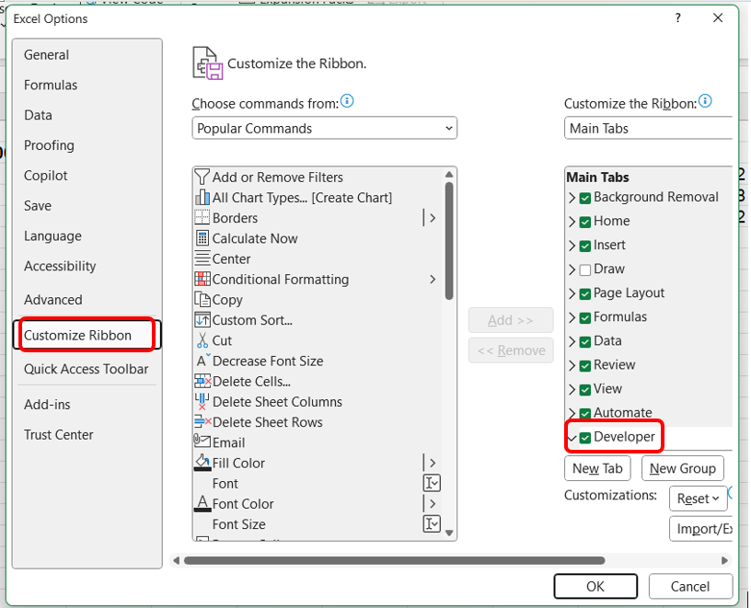
Enabling the Developer
File → Options
Customize Ribbon
Check Developer under Main Tabs
Click OK → Developer tab appears

Slide 15
VBA Editor
Project Explorer
Code Window
├─ VBAProject (Book1.xlsm)
│ ├─ Sheet1
│ ├─ ThisWorkbook
│ └─ Module1
Sub CalculateReturn()
Dim price As Double
price = Range("A1").Value
End Sub
Properties Window
Immediate Window (Ctrl+G)
? 2 + 2
4

Slide 16
The Visual Basic Editor (VBE)
Project Explorer – Shows all open workbooks and their VBA components
Properties Window – Displays properties of the selected object
Code Window – Where you write and edit your code
Immediate Window – Test code snippets and print values (Ctrl+G)
View menu lets you toggle each window on or off

Slide 17
3. Procedures

Slide 18
Writing Your First Procedure
Sub HelloWorld()
MsgBox "Welcome to VBA!"
End Sub
Steps to Create
Developer → Macro → Name → Create
Type the code in the Code Window
Save and Run from Macros dialog
What It Does
Displays a simple message box

Slide 19
Variables, Data Types & Control Structures
Variables
Declare with Dim Hold values for reuse/manipulation
Common Data Types
Integer, Long, Double, String, Boolean, Date
Control Structures
If…Then…Else for decision‑making
For…Next and For Each loops for iteration
Do…Loop for flexible repetition

Slide 20
Saving & Security
Macro‑Enabled Workbook
Save as .xlsm to retain VBA code
Trust Center
File → Options → Trust Center → Trust Center Settings
Enable digitally signed macros; disable all others by default

Slide 21
Best Practices
Comment your code liberally
Use meaningful names for procedures/variables
Organize code into separate modules by function
Regularly back up and version your workbooks

Slide 22
4. Excel Macros

Slide 23
What are Excel Macros?
Definition: Recorded sequences of user actions in Excel
Purpose: Automate repetitive tasks with a single command
No programming required to start—record, save, run
Excel, Word, PowerPoint, Outlook, etc.
Not Web or Mobile Versions

Slide 24
Macros in Financial Analysis
Automate routine report formatting
Speed up standard calculations
Free time for complex analysis
Improve consistency and reduce manual errors

Slide 25
The Macro Recorder
Records your Excel actions and converts them to VBA code
Access: Developer tab → Record Macro
Assigns a name and optional keyboard shortcut to the macro
Useful for learning — see the code Excel generates
Limitation: Records literal steps, not flexible logic
Think of it as a transcript, not a program

Slide 26
Recording Your First Macro
Sub FormatCurrency()
' Recorded macro to format selected cells as currency
Selection.NumberFormat = "$#,##0.00"
Selection.Font.Bold = True
Selection.Font.Color = RGB(0, 100, 0)
End Sub
Sub and End Sub define the beginning and end of a procedure
Lines starting with an apostrophe (') are comments — they are ignored by VBA
Selection refers to whatever cells are currently highlighted
NumberFormat, Font.Bold, and Font.Color are properties being set

Slide 27
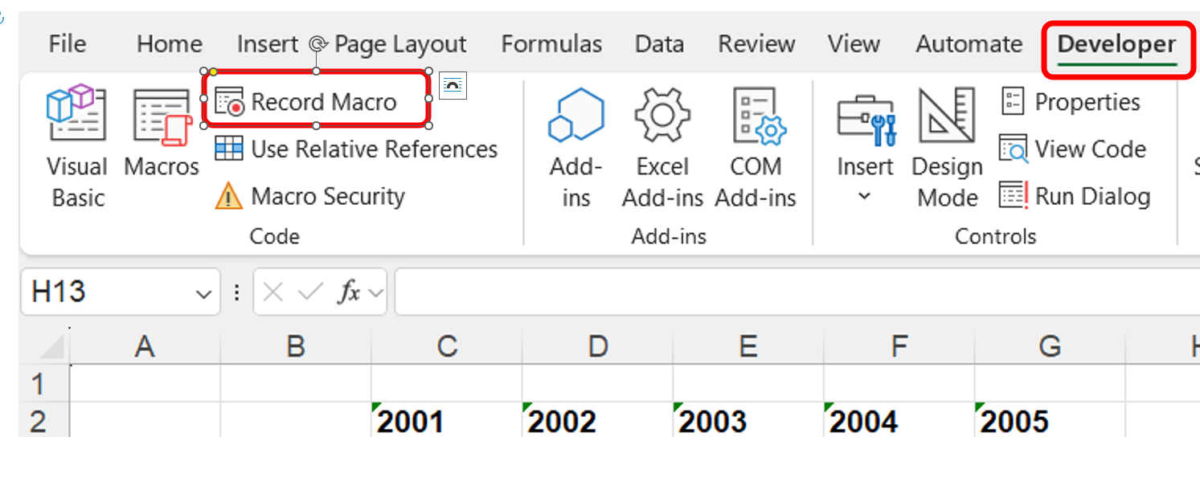
Recording Macros I
Developer → Record Macro

Slide 28
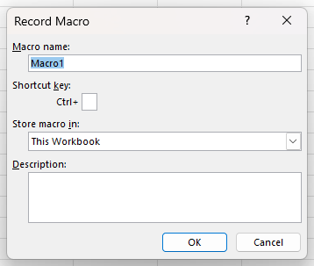
Recording Macros II
Name, Shortcut, Storage Location, OK

Slide 29
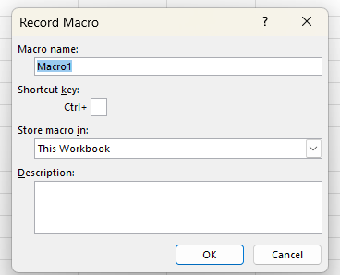
Configuring Macro Properties
Macro Name: use a clear, descriptive name (no spaces; use underscores or CamelCase)
Shortcut Key: optional Ctrl+letter for one‑keystroke execution
Storage Location: Scope
Description: brief summary of what the macro does
Click OK to begin recording

Slide 30
Shortcut Keys
Don’t Overwrite Built‑In Shortcuts
Be Mindful of Scope & Availability
Avoid Conflicts with Other Macros
Consider Keyboard Layouts & Accessibility
Document Your Choices

Slide 31
Performing & Stopping
Execute exactly the steps you want to automate (format cells, enter data, apply formulas)
Avoid extra clicks or keystrokes—Excel records every action
When finished, return to Developer → Stop Recording

Slide 32
From Actions to VBA Code
Excel converts recorded steps into VBA syntax
Recorded code appears in a new module in the VBE (Alt + F11)
Macro serves as a learning tool: see how Excel operations map to code

Slide 33
Macro Security Settings
Excel disables macros by default for security reasons
Security levels: Developer tab → Macro Security
Disable all macros without notification
Disable all macros with notification (recommended)
Enable all macros (not recommended — security risk)
Trusted Locations – Folders where macros always run
Save macro-enabled workbooks as .xlsm (not .xlsx)

Slide 34
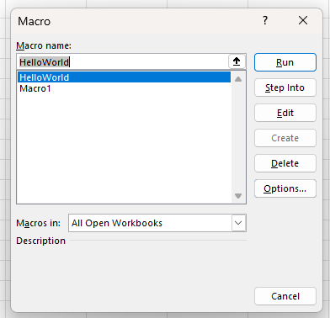
Running Macros
Developer → Macros → Select → Run

Slide 35
Summary
Run Your Macro:
Developer → Macros → Select → Run
Or keyboard shortcut
View/Edit Code: Alt + F11 opens VBE
Next Steps:
Experiment with recording simple tasks
Tweak the VBA to customize behavior
Create macros with AI
Explore writing your own procedures

Slide 36
4.1. Finance Examples
Five Simple Macros − No VBA Editing

Slide 37
5.1 Standardize Layout
Select your statement range (e.g. A1:G30).
Developer → Record Macro → Name FormFin → OK
Apply formatting:
Home → Font: Arial, 12 pt, Bold
Home → Borders → All Borders
Home → Alignment → Center horizontally
Developer → Stop Recording
Run: Developer → Macros → select FormFin → Run.

Slide 38
5.2 Batch Apply Number Formats
Select your revenue range (e.g. B2:B100)
Developer → Record Macro → Name NumForm → OK.
Apply formatting:
Home → Number → Currency.
Stop Recording.

Slide 39
5.3 Highlight Negative Values in Red
Select your financial value range (e.g. C2:C200)
Name: HighNegs
Actions:
Home → Conditional Formatting → Highlight Cell Rules → Less Than… → enter 0 → choose Red Fill

Slide 40
5.4 Freeze Top Row & First Column
Select cell (B2)
Name: Freeze
Actions:
View → Freeze Panes → Freeze Panes

Slide 41
5.5 Insert Chart
Select your range (e.g. A1:F100)
Name: Chart
Actions:
Insert → Column Graph → Select Type
PROBLEM
Developer → Macros → Select Macro → Edit

Slide 42
4.2. Macros by AI

Slide 43
Macros by AI
Convert plain‑English instructions into VBA code
Step‑by‑step prompts while you record a macro
Suggest cleaner, faster code
Explain and a fix any compile or runtime errors
Recommend performance boosts
Generate quick comments so future edits are easier

Slide 44
6.1 Insert Chart I
Prompt: “Create the VBA code for an Excel macro that will create a vertical column graph from a table that has been already selected.”
Sub SelectedTableToColumnChart()
'Creates a clustered vertical column chart from the current selection.
Dim rng As Range
Dim ws As Worksheet
Dim co As ChartObject
'Use the current selection as the chart’s data source
Set rng = Selection
If rng Is Nothing Then Exit Sub 'no selection
Set ws = rng.Parent
'Add an embedded chart to the right of the table
Set co = ws.ChartObjects.Add( _
Left:=rng.Left + rng.Width + 20, _
Top:=rng.Top, _
Width:=375, _
Height:=225)
With co.Chart
.SetSourceData Source:=rng
.ChartType = xlColumnClustered 'vertical column chart
.HasTitle = True
.ChartTitle.Text = "Column Chart"
.Axes(xlCategory).HasTitle = False
.Axes(xlValue).HasTitle = False
End With
End Sub

Slide 45
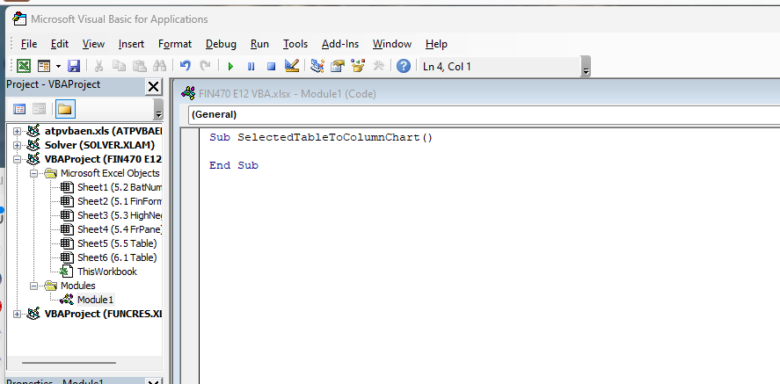
6.1 Insert Chart II
Developer → Macro → Name → Create

Slide 46
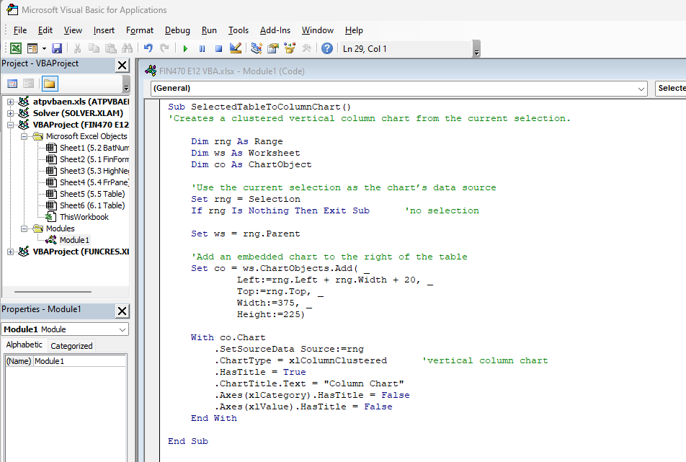
6.1 Insert Chart III
Paste Code Body → Close

Slide 47
6.1 Insert Chart IV
Select Table
Developer → Macro → Select → Run

Slide 48
4.3. Editing Macros

Slide 49
Locating Your Recorded Macro
Developer → Macro → Name → Edit

Slide 50
Macro Code Structure
Subroutine declaration: Sub MacroName() … End Sub
Recorded actions as VBA statements
Comments auto‑inserted by recorder (’…)
Variables/object references (e.g., Range, Cells)
Basic control statements (e.g., With…End With)

Slide 51
Making Simple Edits
Modifying recorded ranges or values
Change Range("A1").Value = … to your target cell
Renaming the macro: update the name after Sub and adjust calls
Changing or adding comments for clarity (’ Your note)
Inserting MsgBox statements for runtime feedback

Slide 52
Adding Logic and Error Handling
Using If…Then…Else for conditional flows
Example: check if a sheet exists before acting
Adding error trapping
On Error GoTo ErrHandler
ErrHandler: section to manage exceptions

Slide 53
Testing/Debugging Techniques
Using Run and Step Into (F8) commands
Setting breakpoints by clicking margin or pressing F9
Inspecting variables in the Watch Window
Printing values in the Immediate Window (Debug.Print)

Slide 54
Best Practices and Maintenance
Organizing code into multiple Subs/Functions
Commenting and naming conventions (CamelCase/SubName)
Avoiding hard‑coded references; use named ranges and variables
Backing up modules before major edits
Saving and distributing your updated macro‑enabled workbook (.xlsm)

Slide 55
Remember
VBA and Macros in…
Excel
Word
PowerPoint
Access
Outlook
Visio
Project
Not Web or Mobile Versions
More Limited on Macs

Slide 56
5. VBA Programming

Slide 57
What Is a Variable?
Named container that stores a value in memory
Variables can hold numbers, text, dates, and other data
Variable value can change as your program runs
Example: A variable called stockPrice might hold 152.75
Variables let your code work dynamically

Slide 58
Data Types in VBA
String – Text values
Integer – Whole numbers up to 32,767
Long – Larger whole numbers up to ~2.1 billion
Double – Decimal numbers
Boolean – True or False
Currency – Fixed-point
Date – Dates and times

Slide 59
Declaring Variables with Dim
Option Explicit ' Force variable declaration
Sub DeclareExample()
Dim stockPrice As Double
Dim ticker As String
Dim tradeDate As Date
Dim numShares As Long
stockPrice = 152.75
ticker = "AAPL"
tradeDate = #3/15/2025#
numShares = 1000
End Sub
Dim declares a variable and its type before use
Option Explicit at the top forces declaration — catches typos
Assign values with the equals sign (=)

Slide 60
Arithmetic Operators
Sub ArithmeticDemo()
Dim pv As Double, fv As Double
Dim rate As Double, periods As Long
pv = 1000
rate = 0.08
periods = 5
' Future Value = PV * (1 + r)^n
fv = pv * (1 + rate) ^ periods
' fv = 1469.33
End Sub
+ Addition - Subtraction * Multiplication
/ Division \ Integer Division ^ Exponentiation
Mod Remainder (e.g., 10 Mod 3 = 1)

Slide 61
Comparison and Logical Operators
Comparison: = <> < > <= >=
Example: If stockPrice > strikePrice Then ...
Logical: And, Or, Not
Example: If rating = "AAA" Or rating = "AA" Then ...
Comparisons return True or False (Boolean values)
Logical operators combine multiple conditions
Note: VBA uses <> for 'not equal' (not != like other languages)

Slide 62
If/Then/Else: Making Decisions
Sub ClassifyReturn()
Dim annualReturn As Double
annualReturn = 0.12
If annualReturn > 0.15 Then
MsgBox "Strong outperformance"
ElseIf annualReturn > 0 Then
MsgBox "Positive return"
ElseIf annualReturn = 0 Then
MsgBox "Break even"
Else
MsgBox "Negative return"
End If
End Sub
VBA evaluates conditions top to bottom and stops at the first True
ElseIf adds additional conditions; Else is the catch-all

Slide 63
Select Case: Multiple Conditions
Sub CreditRating()
Dim rating As String
Dim spread As Double
rating = "BBB"
Select Case rating
Case "AAA", "AA"
spread = 0.005
Case "A"
spread = 0.01
Case "BBB"
spread = 0.02
Case Else
spread = 0.05
End Select
End Sub
Select Case is cleaner than many If/ElseIf chains
Case Else handles any value not matched above

Slide 64
5. VBA Programming

Slide 65
Debugging Techniques
Step Through (F8) – Execute one line at a time
Breakpoints (F9) – Pause execution specific line
Immediate Window – Print values
Watch Window – Monitor variables as code runs
Error Messages

Slide 66
VBA Best Practices
Comment your code
Use meaningful names
Write modular code
Protect workbooks – Lock with a password

Slide 67
Limitations and Next Steps
Limitations
VBA is Windows/Mac-centric; no cloud or web support
Performance limits with very large datasets (100K+ rows)
No native machine learning or advanced statistics libraries
Limited data visualization compared to modern tools
Consider Python for advanced analytics and automation
Resources for further learning:
Excel VBA Programming for Dummies (Walkenbach)
Financial Modeling (Benninga) includes VBA chapters
Microsoft VBA documentation (docs.microsoft.com)
Stack Overflow — search [excel-vba] tag
Practice by automating your own workflows

