Slide 1
FIN 470: Financial Analysis in Excel
Topic 13.1: Pivot Tables
Larry Schrenk, Instructor
The slides for this course are adapted from: Timothy R. Mayes, Financial Analysis with Microsoft Excel, 9th Edition. © 2021 Cengage. All Rights Reserved.

Slide 2
Overview
Excel Tables
Get & Transform (Power Query)
Pivot Tables (and Pivot Charts)

Slide 3
1. Excel Tables

Slide 4
Purpose of this Chapter
Processing raw data (Not a strictly financial topic)
Much of finance depends on gathering raw data from various sources, processing it into a usable form, and then using it
Three very powerful Excel tools:
Tables
Get & Transform (also called Power Query)
Pivot Tables

Slide 5
Creating and Using an Excel Table
Converting data into Excel table allows easy management of data
To create the table
Select any cell within data area
Choose Table from Insert tab
Tables are data sources for Get & Transform or for Pivot
Tables and are a first step in processing a large dataset
Tables allow data processing tasks:
Remove Duplicate Records
Filter the data in the Table to show only relevant items
Sort the data

Slide 6
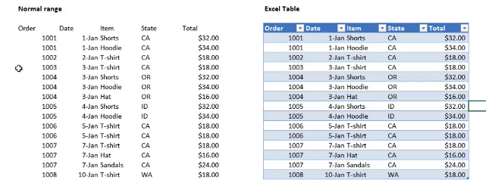
Excel Table: Example

Slide 7
Excel Table (vs Normal Range)
Unique Name (in the name box)
Automatic Formatting (customizable)
Filter Applied (sort and filter data)
Key Features
Automatically expand for new data (updating)
Structured References (below)
Special Row and Column Tools

Slide 8
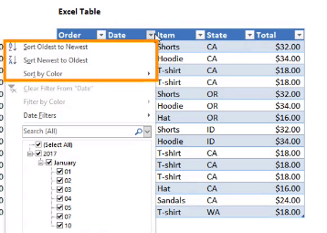
Excel Table Filter: Example

Slide 9
Structured Referencing for Formulas in Tables I
Table formulas use different cell referencing (structured referencing) than A1 style.
Structured referencing allows easy reference to entire columns, to special items (column headers), or to the totals row
Structured references are created by default when you select cell references with a mouse

Slide 10
Structured Referencing for Formulas in Tables II
Structured references have several parts:
The name of the table
The name of the column in square brackets
An @ sign if you wish to refer to a value in the same row as the formula
[#Headers] or [#Totals] to refer to a column name or to a value on a totals row
For example,
=TableName[@[ColumnName]]
refer to the same row in a column named ColumnName from a Table named TableName

Slide 11
2. Get & Transform (Power Query)

Slide 12
Using Get & Transform I
Get & Transform is a powerful ETL (Extract, Transform, Load) tool
Data tab → Get Data
Choose data from many different sources
Query Editor opens to transform the data
Transformations include:
Removing duplicates
Creating new columns, or removing existing columns
Split a column into component parts
Replace values
After transforming, load it into a Table or create a Data Model

Slide 13
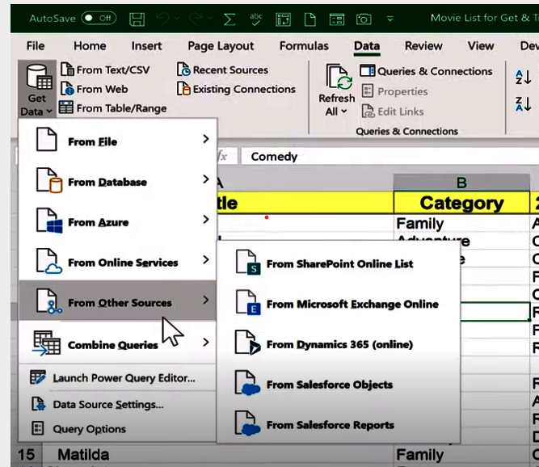
Get & Transform Menu
NOTE: From Table/Range

Slide 14
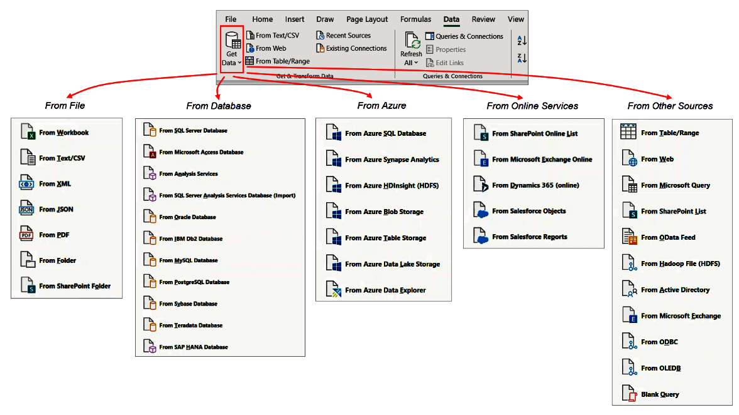
Get & Transform

Slide 15
The Power Query Editor

Slide 16
The Power Query Editor
Query Settings
Name: Name of Table
Applied Steps: List of Changes
Power Query Tabs
Transforms
Formatting
Replace Values
Column (split, merge, new,…)
Many More

Slide 17
3. Pivot Tables (and Pivot Charts)

Slide 18
Pivot Tables
Transform large amounts of data from a table or database into an organized summary report
Ability to rotate and reorganize the information via “drag-and drop”
Ability to filter and sort data as desired

Slide 19
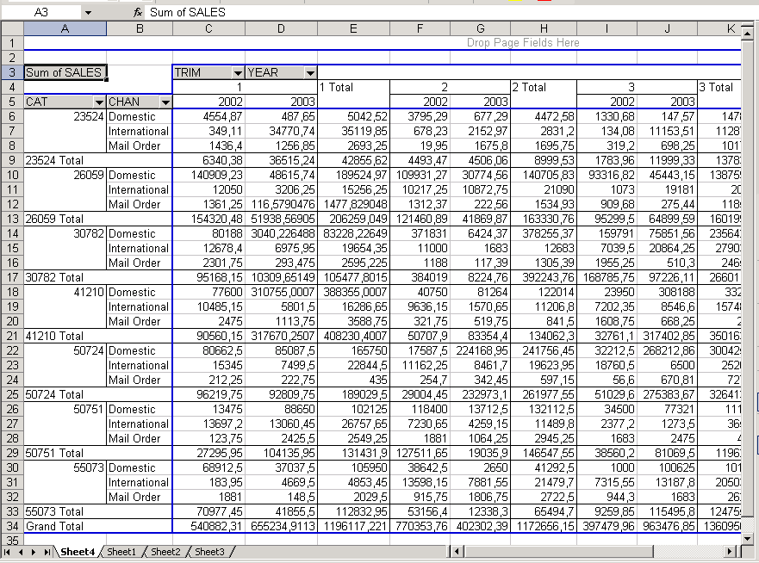
Pivot Table: Example

Slide 20
Creating Pivot Tables
Pivot tables allows us to summarize, filter, and rearrange a dataset using a drag-and-drop interface
Pivot table data can come from a table or range, from an external source, or even from a text file
Insert tab → Pivot Table
If the active cell is in a Table, Pivot Table uses data in the Table
Or, choose the external data from dialog box

Slide 21
Layout
Field buttons

Slide 22
Terminology
Fields are categories of data (these may usually be row or column headings in a table)
Row Fields show each value, or item, in the field as a row
Column Fields show each value as a column heading
Data Area is the main area of the table where comparative values are shown
Grand Totals and Subtotals are sum calculations that appear at the end of relative rows or columns
Page Field is a larger category which can group all of the data in the table

Slide 23
Using Pivot Tables
To get the data from the PivotTable Fields area simply click an item
Or drag the item to another area
Four areas:
Filters – item to examine
Columns – Column headers
Rows – Row headers
Values – Values in the Pivot Table

Slide 24
Pivot Tables for Financial Statements
Data from historical financial statements:
View trends over time
Compare items (e.g., sales and net income)
Group the data by year and/or quarter
Create new variables by combining items
Calculate totals and subtotals (e.g., calculate total sales for the first five years and the second five years)
And much more…
NOTE: Transpose the range so that the dates running down the first column and item names are the column headers

Slide 25
Pivot table template
Page field: creates a filter for your table
Data field: what information do you want to summarize?
Column and Row fields: define how data will be displayed in table

Slide 26
Using Calculated Fields
Calculated fields create new fields by combining data items
To create a calculated field:
Analyze tab → Fields, Items, & Sets button → Calculated Field
Give the Field a name
Enter formula using existing fields
Use the calculated field in your Pivot Table

Slide 27
Filtering Data with Slicers and Timelines
Two tools (Tables or Pivot Tables):
Slicers – Select items
Timelines – Select date ranges
Slicers and Timelines especially useful to create dashboards from your data
Dashboard is a display of key performance indicators (KPIs)

Slide 28
Pivot table Page Field
Operates like row and column fields but provides a third dimension to your data
Without necessarily viewing all its values at the same time (filter)
You can also choose to
display pivot table pages
on separate worksheets

Slide 29
Page Field

Slide 30
Using Pivot Charts
Pivot Chart is chart created from Pivot Table data
To create the Pivot Chart,
Analyze tab → PivotChart button
Insert Chart dialog box will appear
Can perform certain filtering from field buttons on Pivot Chart
Pivot Charts must include all items from the Pivot Table
Otherwise, create new Pivot Table and Pivot Chart

