Slide 1
FIN 450 - Finance and Artificial Intelligence
Topic 9: Return, Risk & Performance Metrics
Larry Schrenk, Instructor

Slide 2
Overview
Return Metrics
Risk Metrics
Risk‑Adjusted Performance
Hands-On Friday: Using AI to Measure Risk, Return & Performance

Slide 3
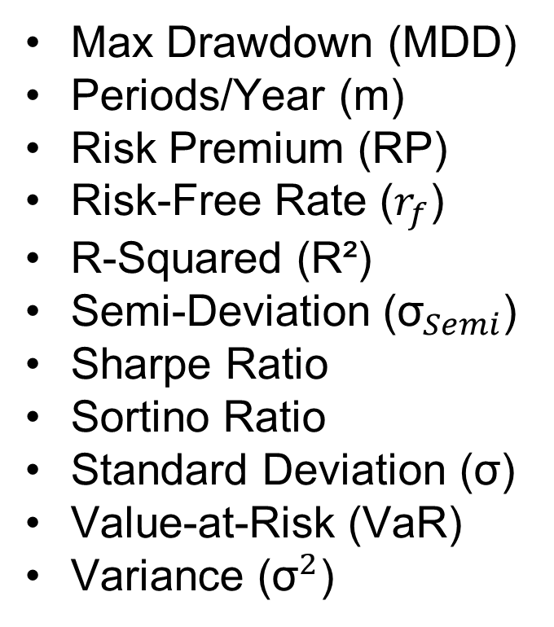
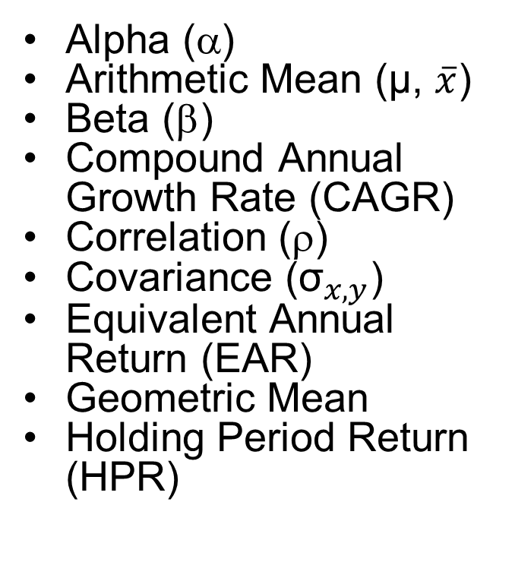
Terms and Abbreviations
Alpha (α)
Arithmetic Mean ($\text{μ}\text{, }\overline{x}$)
Beta (β)
Compound Annual Growth Rate (CAGR)
Correlation ($\text{r}$)
Covariance (${\text{σ}}_{x,y}$)
Equivalent Annual Return (EAR)
Geometric Mean
Holding Period Return (HPR)
Max Drawdown (MDD)
Periods/Year (m)
Risk Premium (RP)
Risk-Free Rate ($r_{f}$)
R‑Squared (R²)
Semi‑Deviation (${\text{σ}}_{Semi}$)
Sharpe Ratio
Sortino Ratio
Standard Deviation ($\text{σ}$)
Value-at-Risk (VaR)
Variance (${\text{σ}}^{2}$)

Slide 4
IMPORTANT NOTES
Do NOT assume that an AI model does even simple calculations correctly. You are expected to check at least one calculation for each prompt.
Financial analysis is based on returns (not absolute dollar amounts), so when you start with price data you normally convert it into the Holding Period Return (HPR) or the Equivalent Annual Return (EAR).
Unless noted otherwise, assume all data is in annual terms and that when you report data you should report it in annual terms.

Slide 5
1. Return Metrics

Slide 6
Return Metrics
Simple/Arithmetic vs Geometric Returns
Arithmetic Mean
Geometric Mean and CAGR
Annualization and Compounding Rules
Excess Return and Benchmarking

Slide 7
Simple/Arithmetic vs Geometric Returns
Period return versus holding period
Arithmetic mean for independent periods
Geometric mean for compounded horizons
Prefer geometric for multi‑year equity series

Slide 8
Arithmetic Mean Basics
Measure average period gain without compounding
Useful for expected value under IID
Biased high when volatility is large
Appropriate for forecasting one‑period payoffs

Slide 9
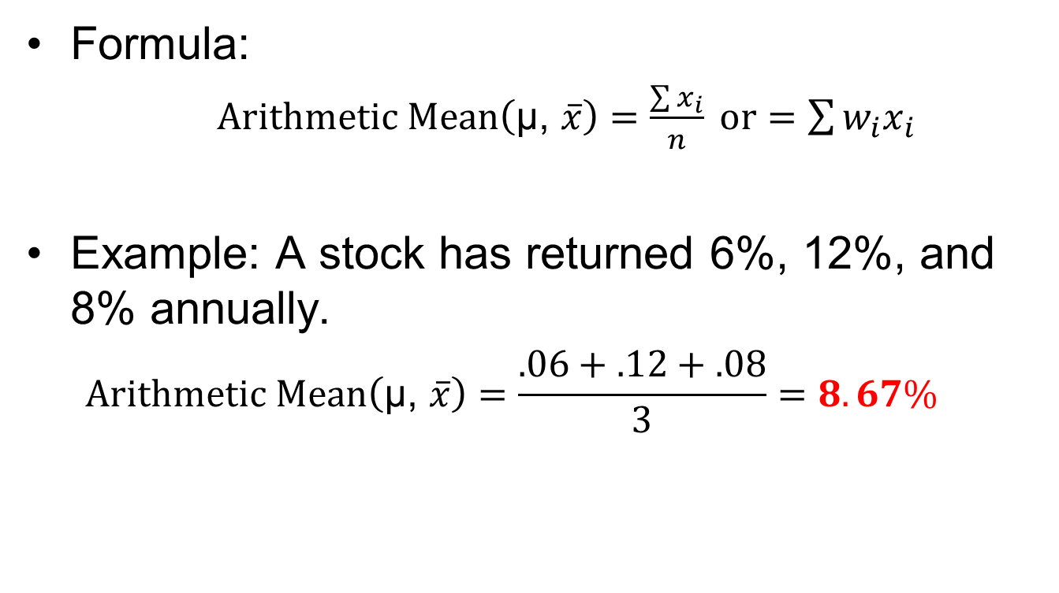
Arithmetic Mean Basics: Notes
Formula:
$Arithmetic Mean\left(\text{μ}\text{, }\overline{x}\right)=\frac{\sum{x_{i}}}{n} or$ $=\sum{{w_{i}x}_{i}}$
Example: A stock has returned 6%, 12%, and 8% annually.
$$Arithmetic Mean\left(\text{μ}\text{, }\overline{x}\right)=\frac{.06+.12+.08}{3}=8.67\%$$

Slide 10
Geometric Mean and CAGR
Capture compounded growth over multiple periods
Compute Compound Annual Growth Rate (CAGR) from initial and terminal values
Penalize volatility through compounding mechanism
Preferred for long‑horizon wealth metrics
Report alongside arithmetic for completeness

Slide 11
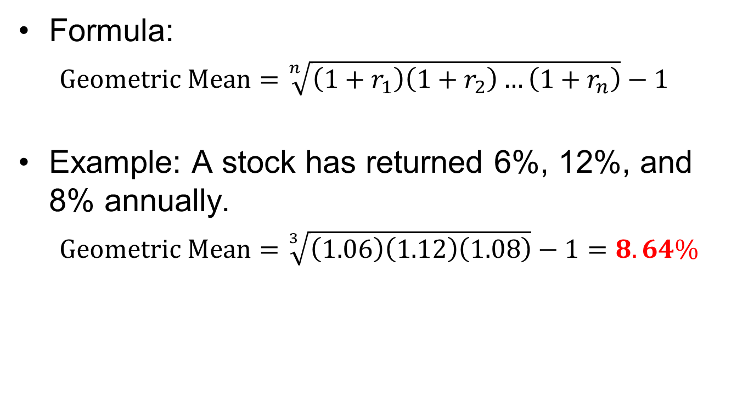
Geometric Mean and CAGR: Notes
Formula:
$$Geometric Mean=\sqrt[n]{\left(1+r_{1}\right)\left(1+r_{2}\right)…\left(1+r_{n}\right)}−1$$
Example: A stock has returned 6%, 12%, and 8% annually.
$$Geometric Mean=\sqrt[3]{\left(1.06\right)\left(1.12\right)\left(1.08\right)}−1=8.64\%$$

Slide 12
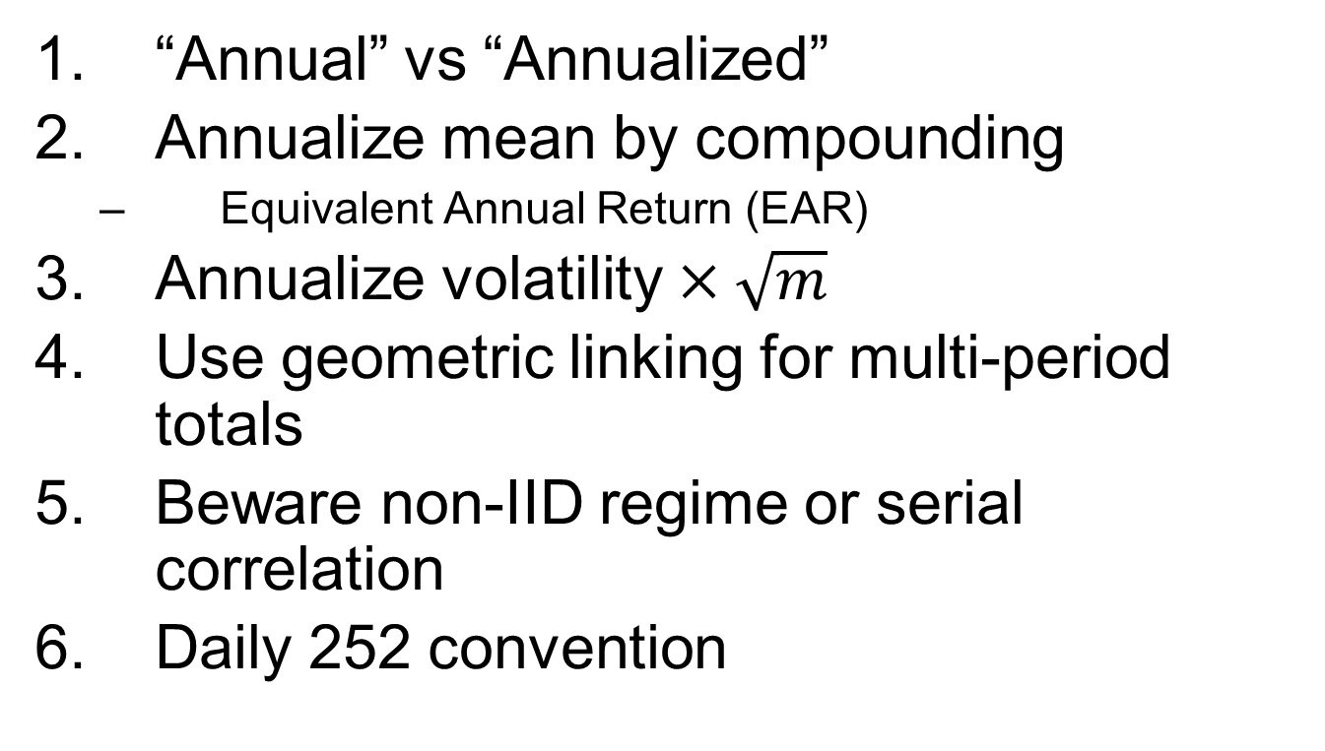
Annualization and Compounding Rules
“Annual” vs “Annualized”
Annualize mean by compounding
Equivalent Annual Return (EAR)
Annualize volatility $×\sqrt{m}$
Use geometric linking for multi‑period totals
Beware non‑IID regime or serial correlation
Daily 252 convention

Slide 13
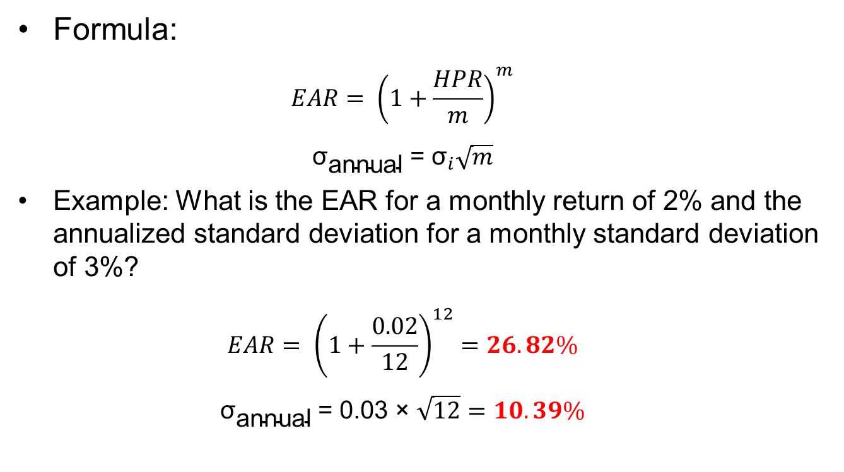
Annualization and Compounding Rules: Notes
Formula:
$$EAR= {\left(1+\frac{HPR}{m}\right)}^{m}$$
$$\text{​}{\text{σ}}_{\text{annual}} \text{=} {\text{σ}}_{i}\sqrt{m}$$
Example: What is the EAR for a monthly return of 2% and the annualized standard deviation for a monthly standard deviation of 3%?
$$EAR= {\left(1+\frac{0.02}{12}\right)}^{12}=26.82\%$$
$$\text{​}{\text{σ}}_{\text{annual}} \text{= }\text{0.03 }\text{× }\sqrt{12}=10.39\%$$

Slide 14
Excess Return and Benchmarking
Define excess return over cash rate
Use active return versus chosen benchmark
Align benchmark with mandate constraints
Report average active return with tracking error (TE)
Needed for alpha and IR calculations

Slide 15
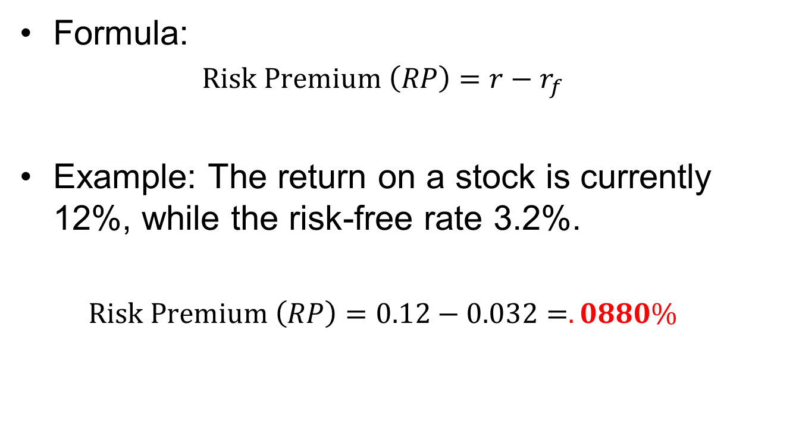
Excess Return and Benchmarking: Notes
Formula:
$$Risk Premium \left(RP\right)=r−r_{f}$$
Example: The return on a stock is currently 12%, while the risk-free rate 3.2%.
$$Risk Premium \left(RP\right)=0.12−0.032=.0880\%$$

Slide 16
2. Risk Metrics

Slide 17
Risk Metrics
Variance and Standard Deviation
Covariance
Correlation and R‑Squared
Beta and Systematic Risk
Max Drawdown and Recovery
VaR
Semi‑Deviation and Downside Risk

Slide 18
Variance and Standard Deviation
Measure dispersion of returns around mean
Use population or sample variance conventions
Volatility underestimates fat‑tail risks
Annualize using √N scaling assumption
Typical equities show 15-25% σ annually

Slide 19
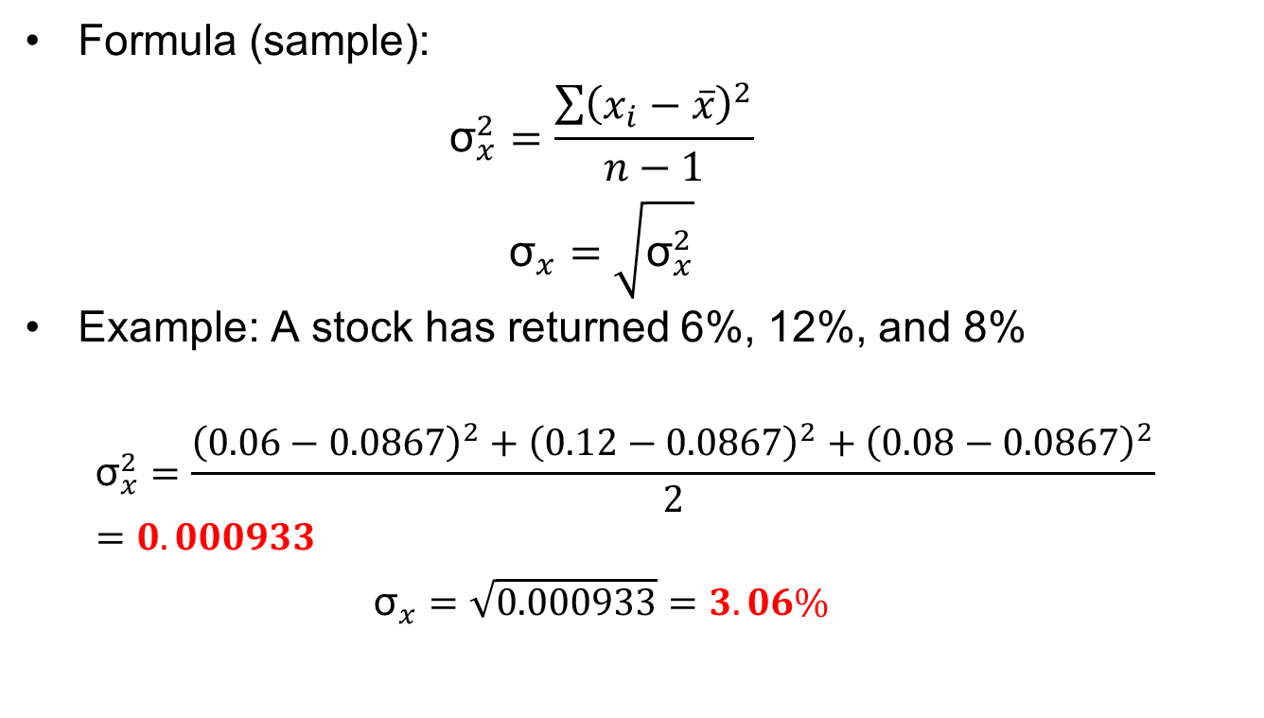
Variance and Standard Deviation: Notes
Formula (sample):
$${\text{σ}}_{x}^{2}=\frac{\sum{{\left(x_{i}−\overline{x}\right)}^{2}}}{n−1}$$
$${\text{σ}}_{x}=\sqrt{{\text{σ}}_{x}^{2}}$$
Example: A stock has returned 6%, 12%, and 8%
$${\text{σ}}_{x}^{2}=\frac{{\left(0.06−0.0867\right)}^{2}+{\left(0.12−0.0867\right)}^{2}+{\left(0.08−0.0867\right)}^{2}}{2}=0.000933$$
$${\text{σ}}_{x}=\sqrt{0.000933}=3.06\%$$

Slide 20
Covariance
How two asset returns move together
Positive together, negative oppositely
Magnitude strength of co-movement; sign direction
Central to portfolio variance and diversification
Sensitive to scale and units

Slide 21
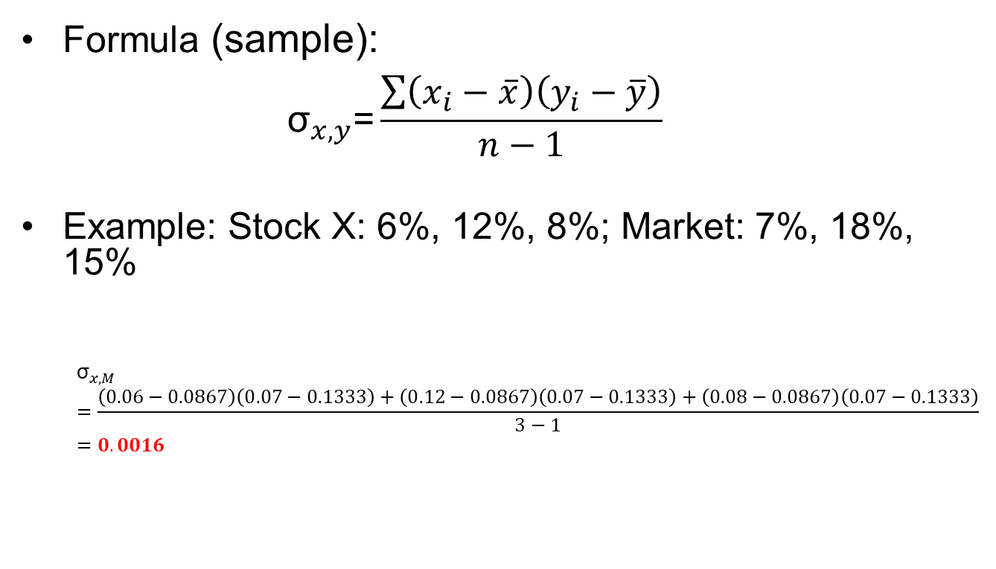
Covariance: Notes
Formula (sample):
$${\text{σ}}_{x,y}\text{=}\frac{\sum{\left(x_{i}−\overline{x}\right)\left(y_{i}−\overline{y}\right)}}{n−1}$$
Example: Stock X: 6%, 12%, 8%; Market: 7%, 18%, 15%
$${\text{σ}}_{x,M}=\frac{\left(0.06−0.0867\right)\left(0.07−0.1333\right)+\left(0.12−0.0867\right)\left(0.07−0.1333\right)+\left(0.08−0.0867\right)\left(0.07−0.1333\right)}{3−1}=0.0016$$

Slide 22
Correlation and R‑Squared
Correlation (ρ) quantifies co‑movement strength
Contrast covariance (σ_{x,y})
R‑squared (R²) shows variance explained by model
Low correlation aids diversification benefits
Beware unstable correlations in crises

Slide 23
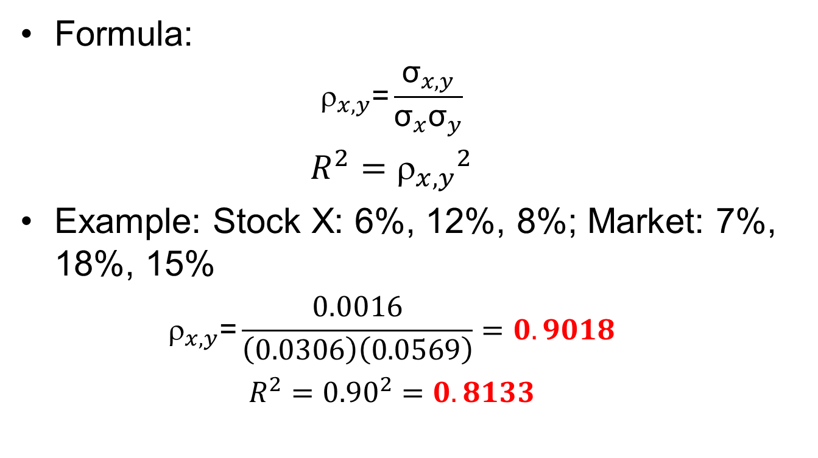
Correlation and R‑Squared: Notes
Formula:
$${\text{r}}_{x,y}\text{=}\frac{{\text{σ}}_{x,y}}{{\text{σ}}_{x}{\text{σ}}_{y}}$$
$$R^{2}={{\text{r}}_{x,y}}^{2}$$
Example: Stock X: 6%, 12%, 8%; Market: 7%, 18%, 15%
$${\text{r}}_{x,y}\text{=}\frac{0.0016}{\left(0.0306\right)\left(0.0569\right)}=0.9018$$
$$R^{2}={0.90}^{2}=0.8133$$

Slide 24
Beta and Systematic Risk
Measure sensitivity to market factor
Estimate via regression slope coefficient
Beta (β) >1 amplifies market moves proportionally
Market portfolio = 1
Sector betas vary: utilities <1, tech >1
Use for CAPM expected return inputs

Slide 25
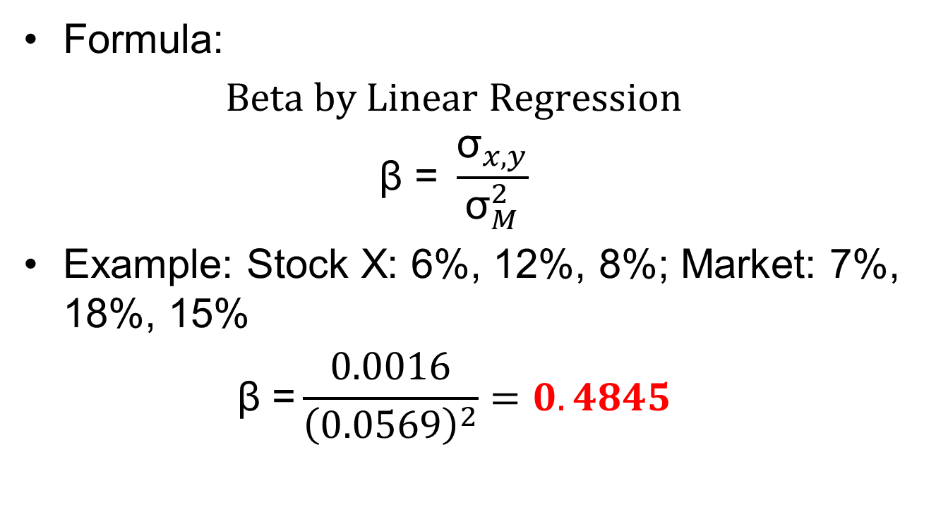
Beta and Systematic Risk: Notes
Formula:
$$Beta by Linear Regression$$
$$\text{β}\text{ = }\frac{{\text{σ}}_{x,y}}{{\text{σ}}_{M}^{2}}$$
Example: Stock X: 6%, 12%, 8%; Market: 7%, 18%, 15%
$$\text{β}\text{ =}\frac{0.0016}{{\left(0.0569\right)}^{2}}=0.4845$$

Slide 26
Max Drawdown and Recovery
Measure peak‑to‑trough portfolio decline
Track time to recovery back to peak
Indicates tail risk beyond volatility view
Use rolling windows for regime detection
Typical risk limit: MDD < −20% equities

Slide 27

Max Drawdown and Recovery: Notes
Formula:
$$MDD= \frac{max\left(Peak −Trough\right)}{Peak}$$
Example:
$$MDD= \frac{100−75}{100}=25.00\%$$

Slide 28
VaR Basics
Value-at-Risk (VaR) estimates loss at confidence percentile
Choose horizon and distributional assumption
Use historical, parametric, or Monte Carlo
Regulators use 99% 10‑day VaR

Slide 29
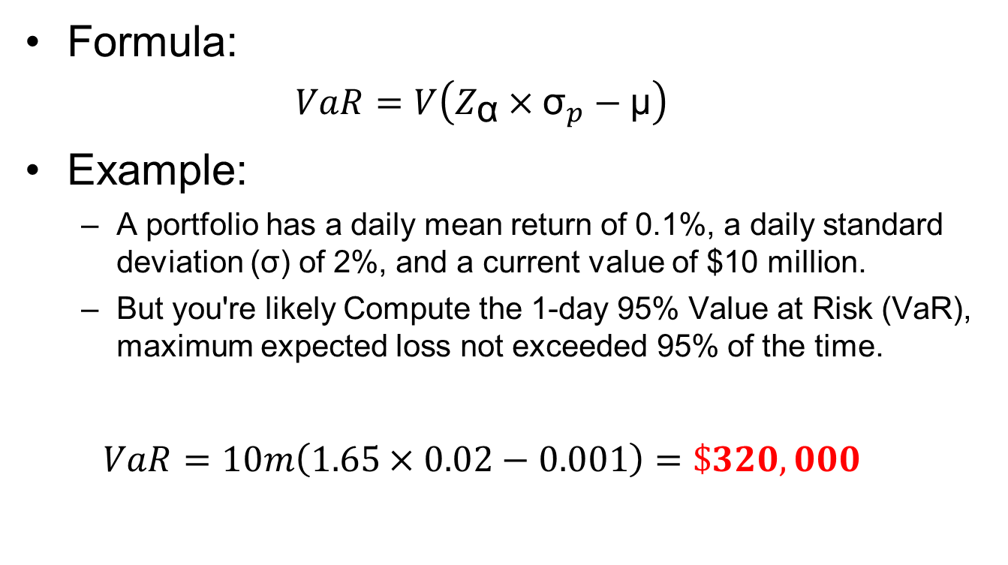
VaR Basics: Notes
Formula:
$$VaR={V\left(Z_{\text{α}}×{\text{σ}}_{p}−\text{μ}\right)}_{\text{​}}$$
Example:
A portfolio has a daily mean return of 0.1%, a daily standard deviation (σ) of 2%, and a current value of $10 million.
But you're likely Compute the 1-day 95% Value at Risk (VaR), maximum expected loss not exceeded 95% of the time.
$$VaR={10m\left(1.65×0.02−0.001\right)=\$320,000}_{\text{​}}$$

Slide 30
Semi‑Deviation and Downside Risk
Focus on deviations below target return
Use target r* often set to 0%
Penalize downside more than upside moves
Inputs for Sortino and downside metrics
Useful for income and capital‑preservation

Slide 31
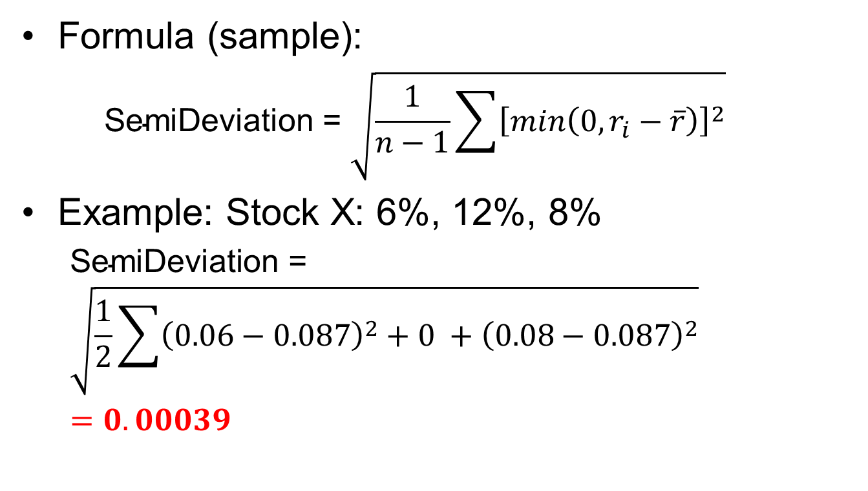
Semi‑Deviation and Downside Risk: Notes
Formula (sample):
$${\text{SemiDeviation} \text{=} \sqrt{\frac{1}{n−1}\sum{{\left[min\left(0, r_{i}−\overline{r}\right)\right]}^{2}}}}_{\text{​}}$$
Example: Stock X: 6%, 12%, 8%
$${\text{SemiDeviation}\text{ = }\sqrt{\frac{1}{2}\sum{{\left(0.06−0.087\right)}^{2}+0 +{\left(0.08−0.087\right)}^{2}}}}_{\text{​}}=0.00039$$

Slide 32
3. Risk‑Adjusted Performance

Slide 33
Risk‑Adjusted Performance
Sharpe Ratio
Sortino Ratio

Slide 34
Sharpe Ratio
Measure excess return per unit volatility
Compare funds across diversified strategies
Values: >0.5 acceptable, >1.0 strong
Sensitive to non‑normal, fat‑tail returns
Annualize using mean and σ annualized

Slide 35
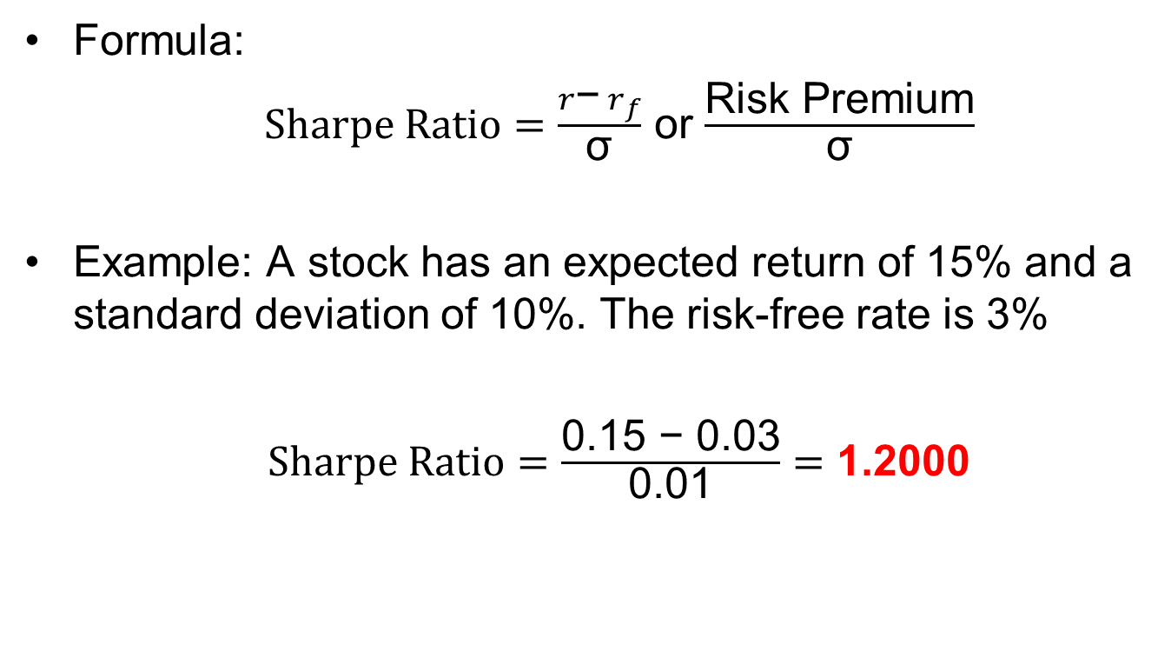
Sharpe Ratio: Notes
Formula:
$Sharpe Ratio=\frac{r\text{−}{ r}_{f}}{\text{σ}}$ or $\frac{\text{Risk} \text{Premium}}{\text{σ}}$
Example: A stock has an expected return of 15% and a standard deviation of 10%. The risk-free rate is 3%
$Sharpe Ratio=\frac{\text{0.15 − 0.03}}{\text{0.}\text{01}}=$ 1.2000

Slide 36
Sortino Ratio
Use downside deviation instead of total σ
Better for skewed or option‑like payoffs
Set target return r* consistent with mandate
Values >1 desirable for income strategies
Highlights asymmetry of downside risks

Slide 37
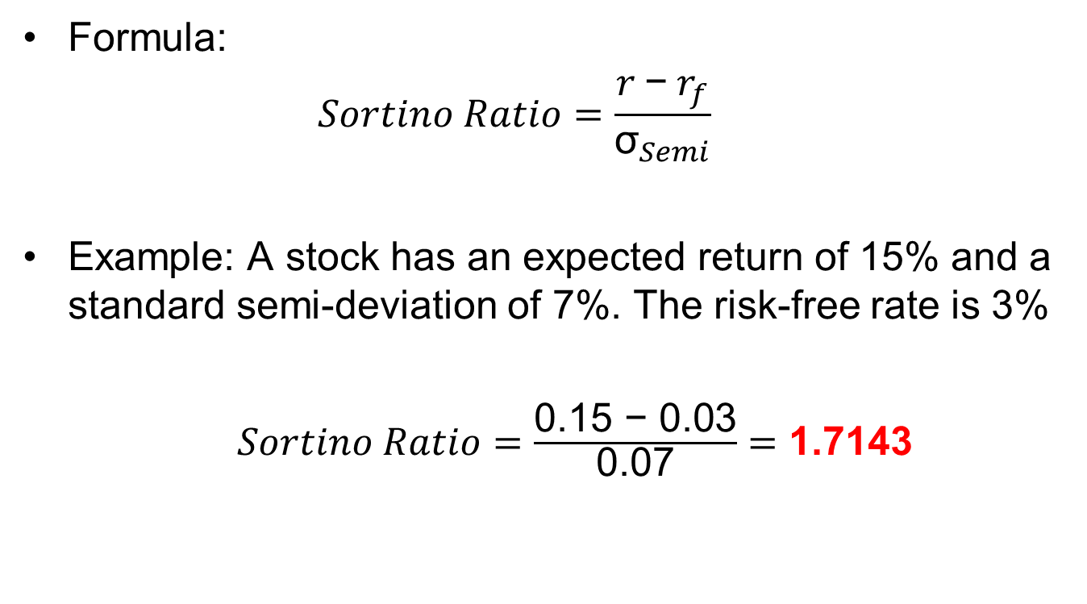
Sortino Ratio: Notes
Formula:
$$Sortino Ratio=\frac{r \text{−}{ r}_{f}}{{\text{σ}}_{Semi}}$$
Example: A stock has an expected return of 15% and a standard semi-deviation of 7%. The risk-free rate is 3%
$Sortino Ratio=\frac{\text{0.15 − 0.03}}{\text{0.07}}=$ 1.7143

Slide 38
5. Hands-On Friday: Using AI to Measure Risk, Return & Performance

Slide 39
Friday Lab Prep
Make sure you can access:
FIN 450 Lab Report 9
Data:
SPX,NVDA.csv
5 years (2020-2024) of monthly stock prices for Nvidia (NVDA) and the S&P 500 Index (SPX)

