Slide 1
FIN 450 - Finance and Artificial Intelligence
Topic 5: AI Finance Agents
Larry Schrenk, Instructor

Slide 2
Overview
Demo: S&P Capital IQ − Fin. Stats.
AI Agents in Finance
Agent Examples
Robo-Advising
Demo: Microsoft Copilot Studio
Hands-On Friday: Create a Finance Agent

Slide 3
1. Demo: S&P Capital IQ − Fin. Stats.

Slide 4
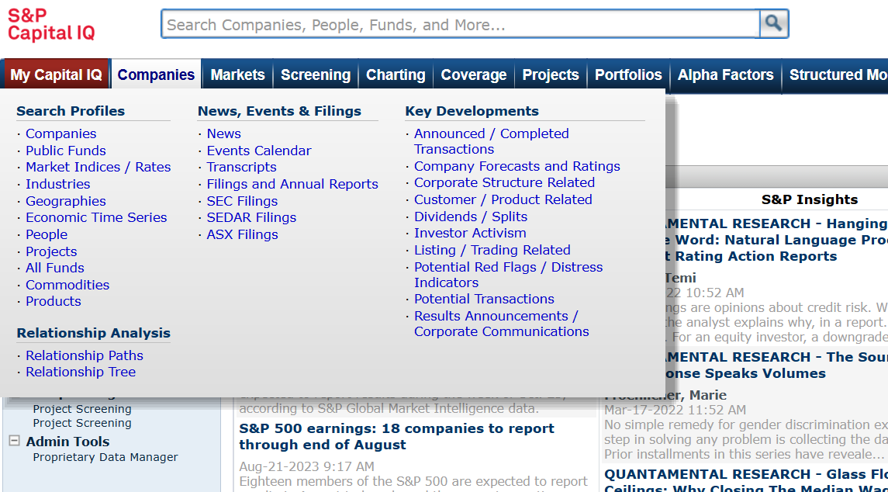
Search for Firm (CapIQ)

Slide 5
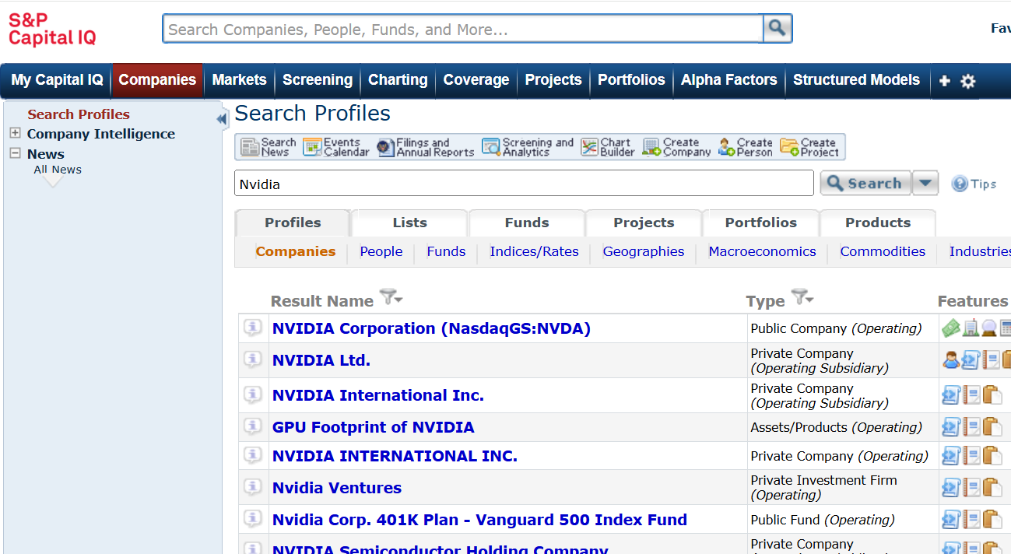
Select Firm

Slide 6
Select Firm

Slide 7
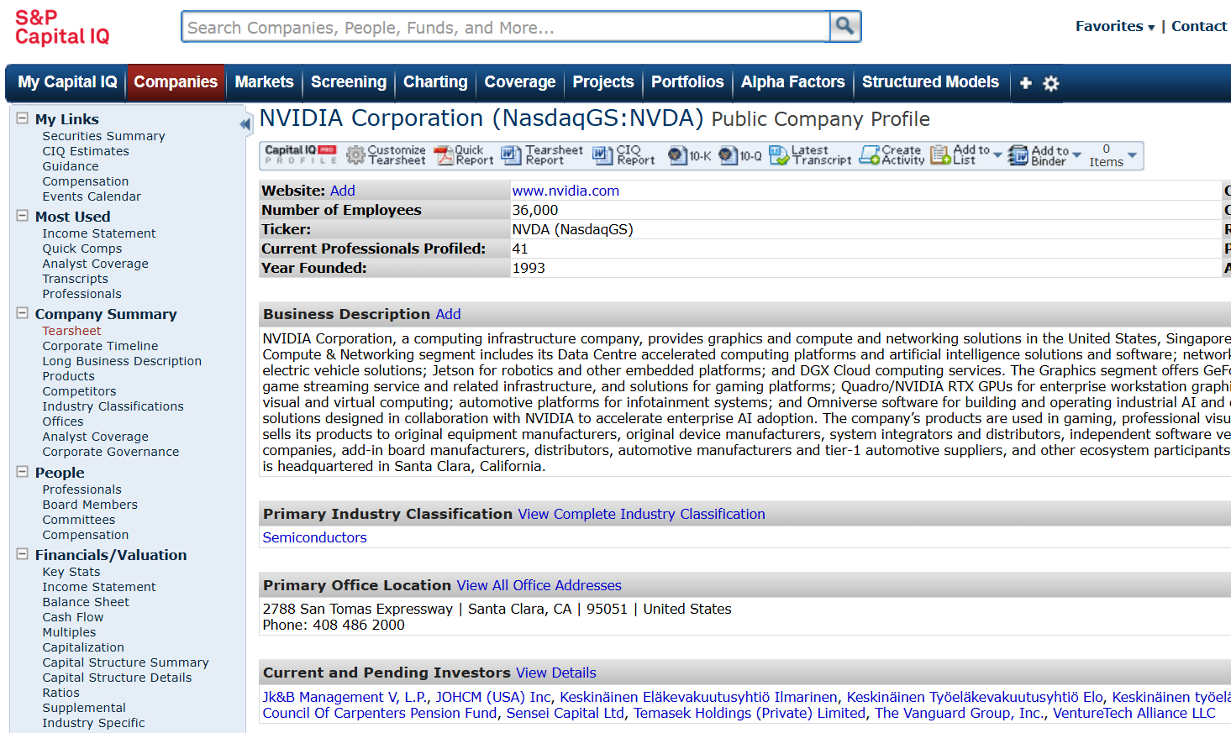
Tearsheet

Slide 8
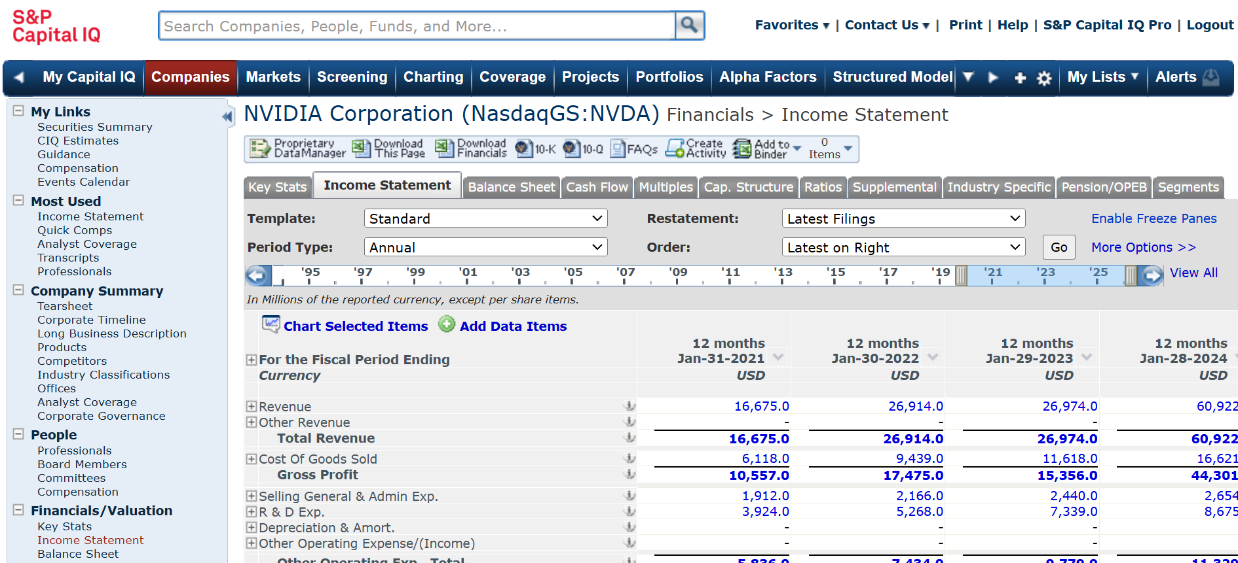
Tearsheet

Slide 9
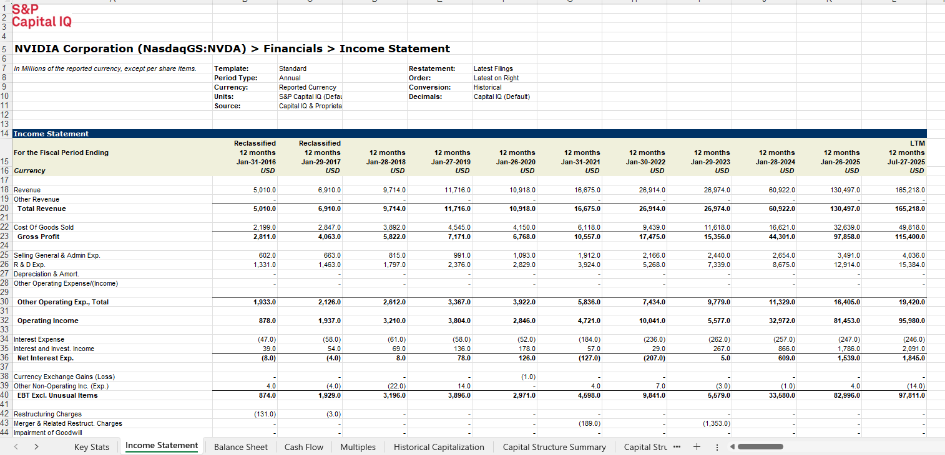
Firm Financials

Slide 10
2. AI Agents in Finance

Slide 11
Finance Agents: Uses and Value
Automate FAQs, workflows, document retrieval at scale
Reduce turnaround time
Lower cost per contact

Slide 12
Core Technologies
Use NLP for intent detection
Leverage LLMs for reasoning, summarization, classification
RAG (Retrieval-Augmented Generation) for facts
Target response latency under 2 seconds
Enable APIs, etc

Slide 13
Customer Service and Support
Increase First Contact Resolution
Cut Average Handle Time
Deflect Tier-1 inquiries to self-service
Escalate complex cases with structured summaries
Deploy omnichannel: web, mobile, IVR, WhatsApp\line

Slide 14
Personal Finance/Wealth Management
Provide portfolio suggestions within IPS (Investment Policy Statement)
Estimate risk using VaR
Trigger alerts on drift from target
Summarize 10-K filings with key ratios
Disclose limitations; require human oversight for trades

Slide 15
Trading and Execution Agents
Aggregate news, earnings, macro data
Summaries, sentiment, risk signals
Accelerate idea-to-ticket cycle
Enforce pre-trade checks, best-execution policies
Log rationale to satisfy compliance requirements

Slide 16
3. Agent Examples

Slide 17
Agent 1: Cash Forecasting & Variance Explanation
Function
  Predicts future cash inflows; analyzes the differences between forecasted and actual cash positions
Value
  Ensures liquidity coverage, reduces reliance on short-term borrowing; enables better capital allocation
AI Advantage
  Speed & accuracy, pattern recognition, scalability, dynamic updates

Slide 18
Agent 2: Budget-to-Actual Driver Analysis
Function
  Compares plan vs. realized financials and explains the gap
Value
  Faster monthly close narratives; variance explanations in hours not days; better forecast accuracy; standardized explanations
AI Advantage
  Speed & scale; accuracy & consistency; explainability & insight quality; proactive detections

Slide 19
Agent 3: Working Capital Optimization
Function
  Enough cash to run the business − but no more
Value
  Reduce cash; avoid liquidity crunches; cut stockouts/expedites; capture early-pay discounts; reduce bad-debt write-offs; smooth seasonal working-capital peaks
AI Advantage
  Faster, more accurate forecasts; granular, dynamic decisions at scale; signal extraction humans miss

Slide 20
Agent 4: Payment Anomaly Detector
Function
  Flags unusual or suspicious transactions
Value
  Reduced fraud loss and chargebacks; fewer duplicate/erroneous payments; faster incident detection; improved cash control and working capital; better customer experience and revenues
AI Advantage
  Speed & scale; accuracy; adaptivity; explainable triage

Slide 21
Agent 5: Earnings Call & 10-K Analysis
Function
  Reviewing company disclosures to assess financial performance, risks, and outlook
Value
  Identify growth drivers, risk exposures, and forward guidance; support investment decisions; benchmark competitors and track industry trends; early detection of red flags; capitalize on market-moving signals faster than competitors; ensure regulatory compliance
AI Advantage
  Speed & accuracy; natural language understanding; integration & summarization

Slide 22
Agent 6: Portfolio Risk Analysis
Function
  Estimates how much a portfolio can lose; measures exposures, model volatility and correlations
Value
  Capital preservation; better position sizing, hedging, and diversification; faster decisions via intraday risk and “what-if” rebalancing
AI Advantage
  Speed & accuracy; unique capabilities: Synthetic scenario generation; autonomous anomaly detection, overcome limitations: nonlinear payoffs, state-dependent correlations, and mixed data at scale

Slide 23
Agent 7: Factor Attribution
Function
  Explains a portfolio’s returns and risk by decomposing them into exposures to systematic “factors” (e.g., market, size, etc) and idiosyncratic residuals
Value
  Source‐of‐alpha diagnostics; separates skill from noise; better portfolio construction; improved client reporting & compliance
AI Advantage
  Speed & accuracy; adaptive modeling; explainability at depth

Slide 24
Agent 8: Corporate Policy Q&A
Function
  Answering questions about internal policies, procedures, and compliance standards.
Value
  Increases organizational transparency, improves compliance, and enhances productivity; reduces misinterpretation of policies (citations)
AI Advantage
  Speed & accuracy; 24/7 availability; dynamic Adaptation

Slide 25
Agent 9: Credit Memo Draft
Function
  Indicates an adjustment that will reduce the amount a customer owes, often due to returns, overbilling, pricing errors, or allowances.
Value
  Faster dispute resolution; fewer write-offs; improved customer satisfaction/retention; tighter revenue recognition alignment; audit-ready documentation
AI Advantage
  Speed & accuracy; proactive insights

Slide 26
Agent 10: Client Meeting Prep
Function
  Involves gathering, organizing, and presenting relevant financial data before engaging with a client.
Value
  More informed, persuasive, and personalized client interactions; prevents client dissatisfaction from outdated/incomplete data; reduces compliance
AI Advantage
  Speed & accuracy; personalized Insights; contextual awareness

Slide 27
4. Robo-Advising

Slide 28
Robo-Advising Basics
Define automated portfolios using low-cost ETFs
Align goals, risk, and expected return
Augment automation with human advisor escalation
Price services at 0.15-0.35 bps AUM
Segment users and sharpen value proposition

Slide 29
Market Landscape and Key Metrics
Measure global AUM near $1T mid-2020s
Target average accounts between $5k–$50k
Customer acquisition cost averaging $100–$400 per client
Reduce churn below 8% via onboarding
Review AUM growth, CAC, retention monthly

Slide 30
Client Onboarding and Profiling
Capture KYC and AML data digitally
Assess risk tolerance with validated questionnaires
Enforce SEC Reg BI suitability checks
Document IPS covering goals, constraints, horizon
Improve completion rates

Slide 31
Portfolio Construction Algorithms and Theory
Optimize target asset weights via mean-variance
Select ETFs by liquidity and expense ratio
Constrain tracking error under 2% annually
Adjust glide paths by age and goals
Require backtests with Sharpe Ratio

Slide 32
Rebalancing and Tax-Loss Harvesting (TLH)
Trigger rebalancing at ±5% portfolio drift
Harvest losses to offset taxable gains
Estimate after-tax alpha at 0.3–1.0%
Schedule daily scans during high volatility

Slide 33
Fees, Performance, And Reporting KPIs
Charge advisory fee 15-35 bps AUM
Report net return versus blended benchmark
Monitor KPIs; Sharpe, drawdown, tracking error
Set service level agreement under 24 hours
Publish quarterly fact sheets; follow GIPS (Global Investment Performance Standards)

Slide 34
Overall Evaluation
Lower fees and low minimums expand access
Automated rebalancing delivers consistent discipline
ETF portfolios track benchmarks efficiently
Tax-loss harvesting and asset location gains
Personalization improving
Behavioral coaching weak
Algorithm transparency strong
Robustness across regimes is mixed
Next wave: LLM chat, holistic data ingestion, and real-time personalization

Slide 35
5. Demo: Microsoft Copilot Studio

Slide 36
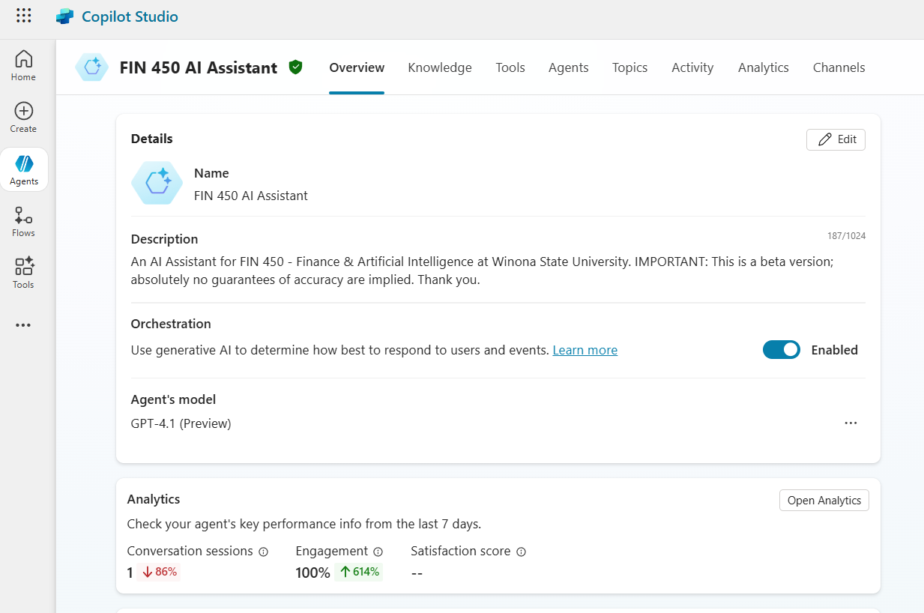
CPS: Overview
Name, Description
Orchestration
Agent’s Model
Analytics
Instructions
Knowledge
Web Search
Tools

Slide 37
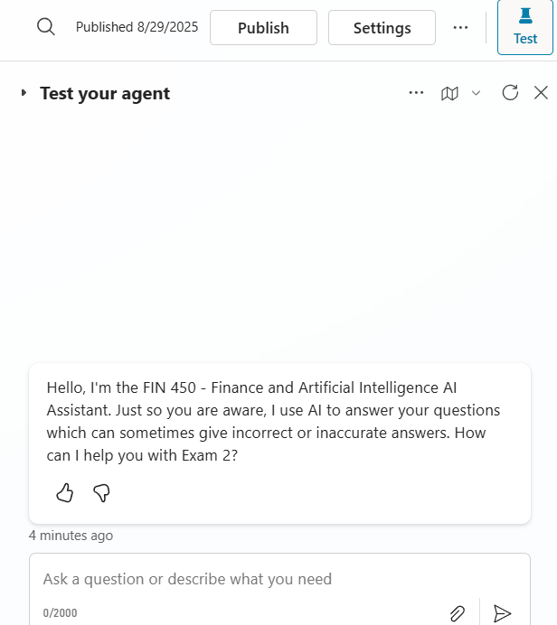
CPS: Test Your Agent
Opening Text
Window
Tracing

Slide 38
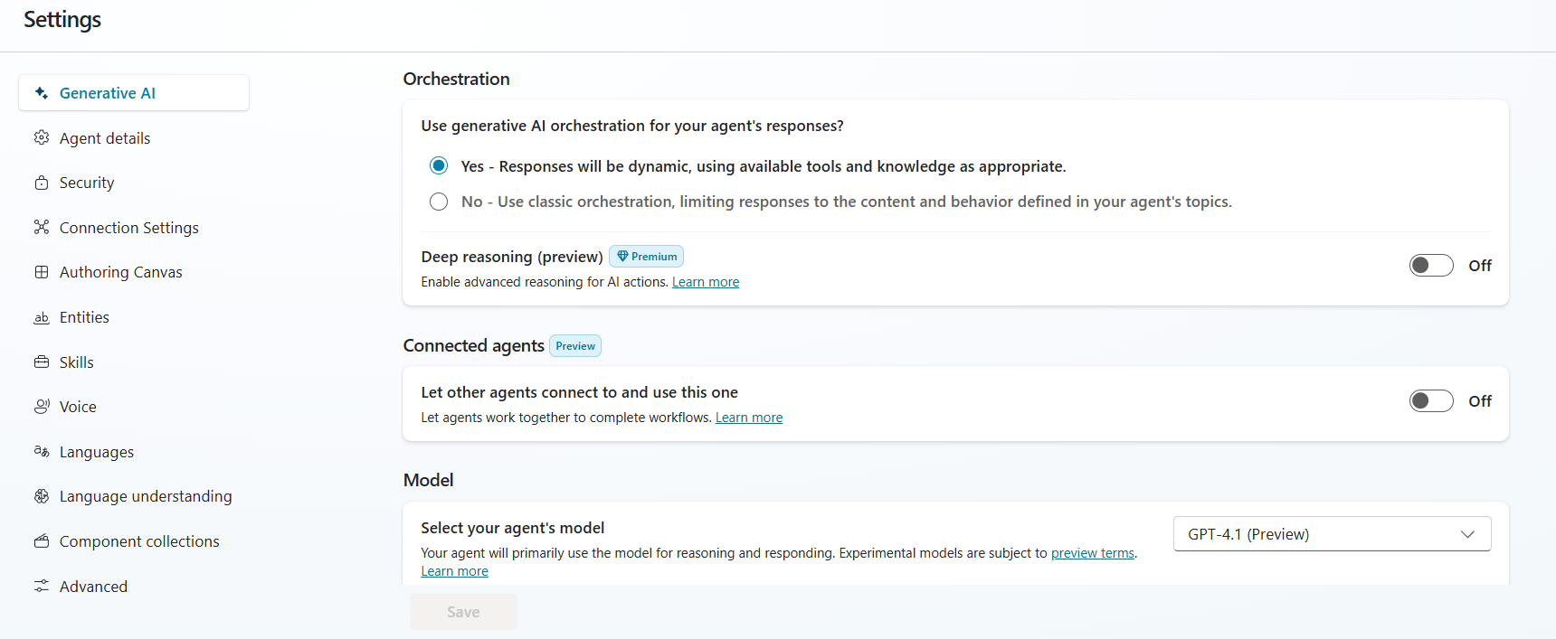
CPS: Settings
Generative AI
Agent Details
Security
Languages

Slide 39
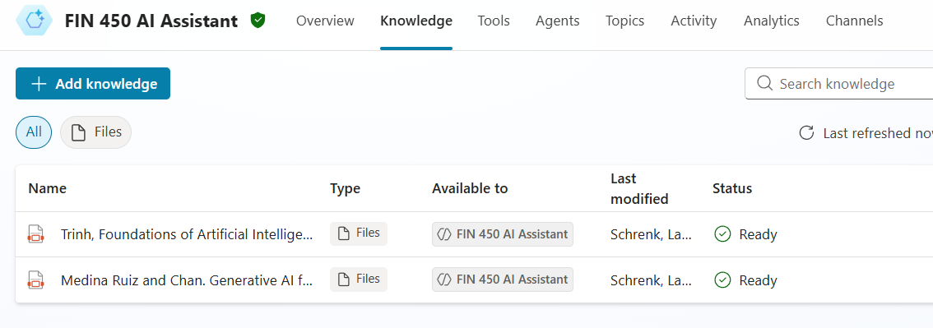
CPS: Knowledge
Files (RAG)
Websites

Slide 40
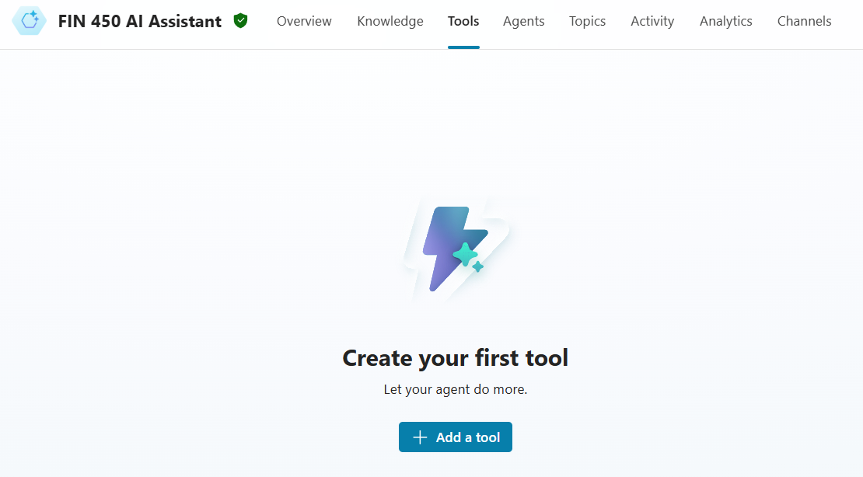
CPS: Tools
Microsoft Graph actions
SharePoint/OneDrive knowledge
Power Automate flow
Custom Connector
Dataverse / Power BI actions

Slide 41
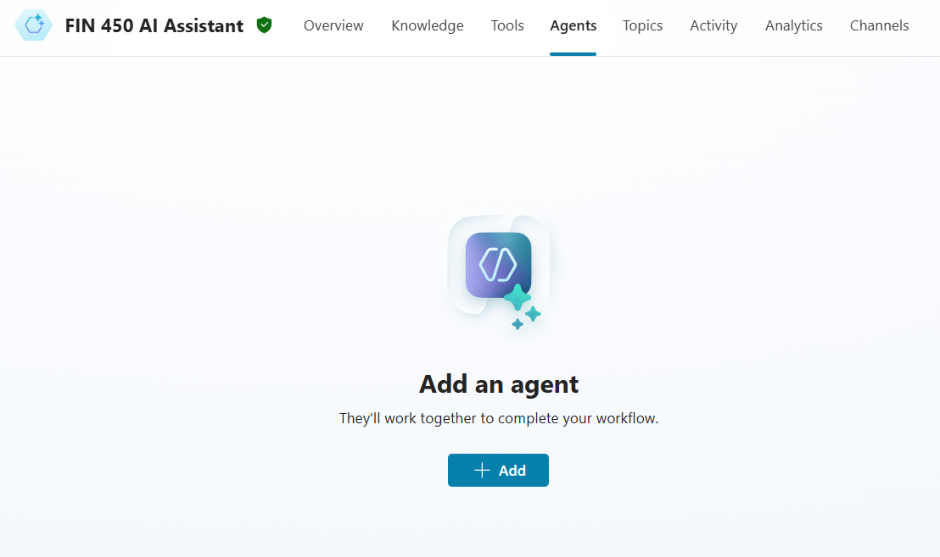
CPS: Agents
Financials Ingest & Normalize
Ratio & Diagnostics (DuPont)
Valuation & Scenario Engine
Risk, Compliance & Suitability (Reg BI/GIPS)
Excel/Sheets Modeling Copilot

Slide 42
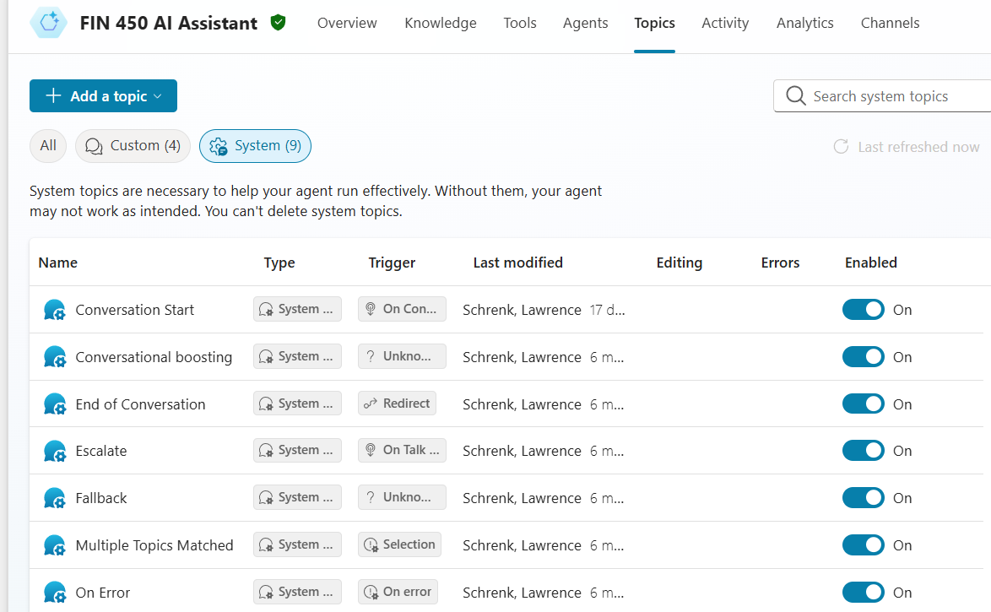
CPS: Topics
System
Custom

Slide 43
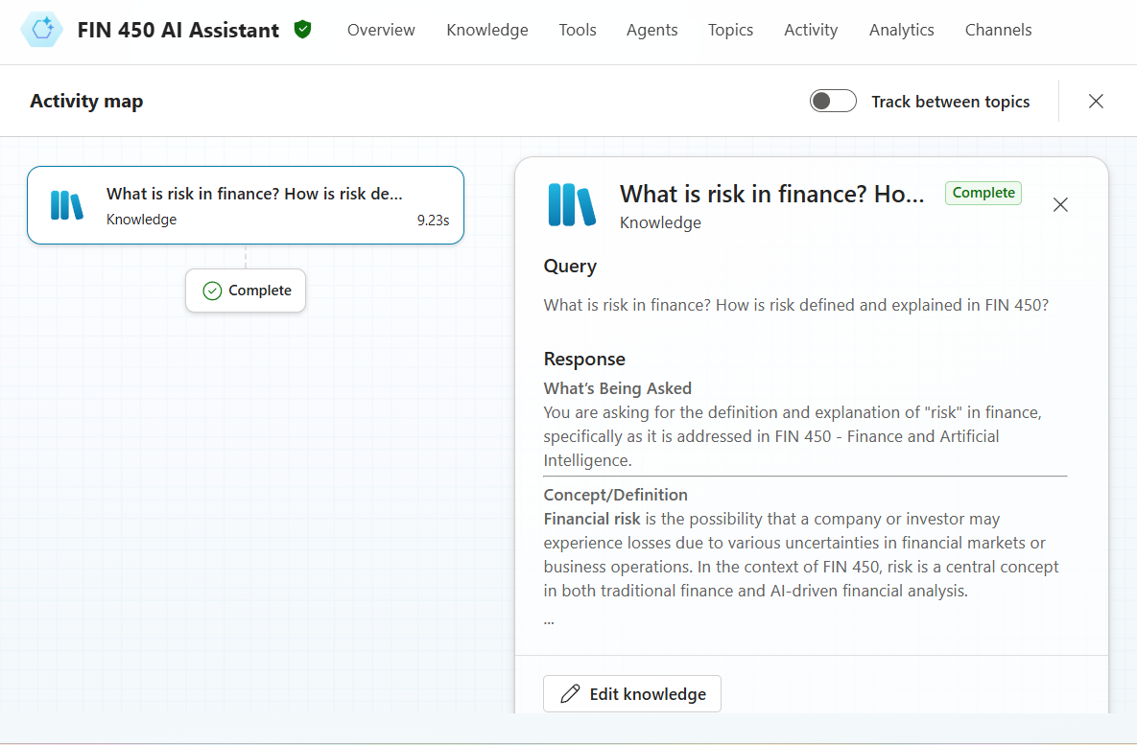
CPS: Activities
Tracing

Slide 44
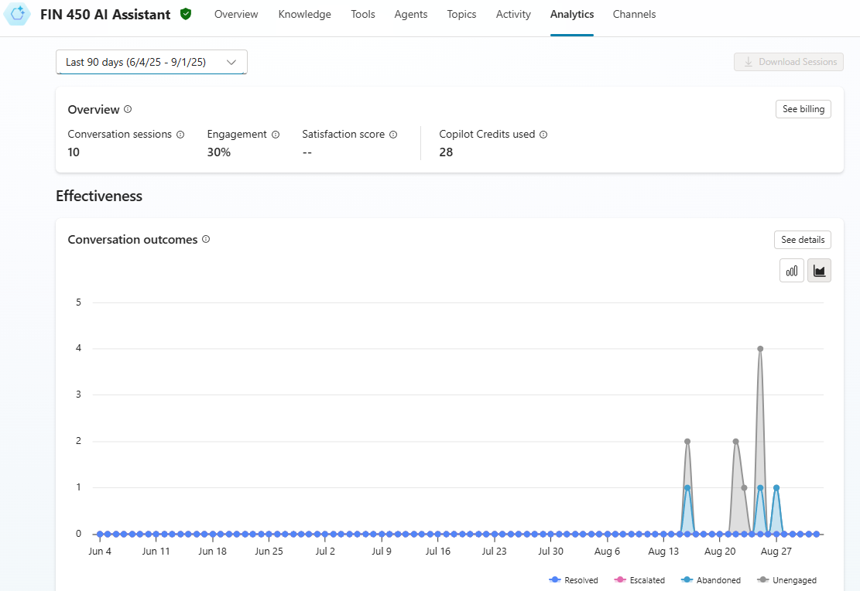
CPS: Analytics

Slide 45
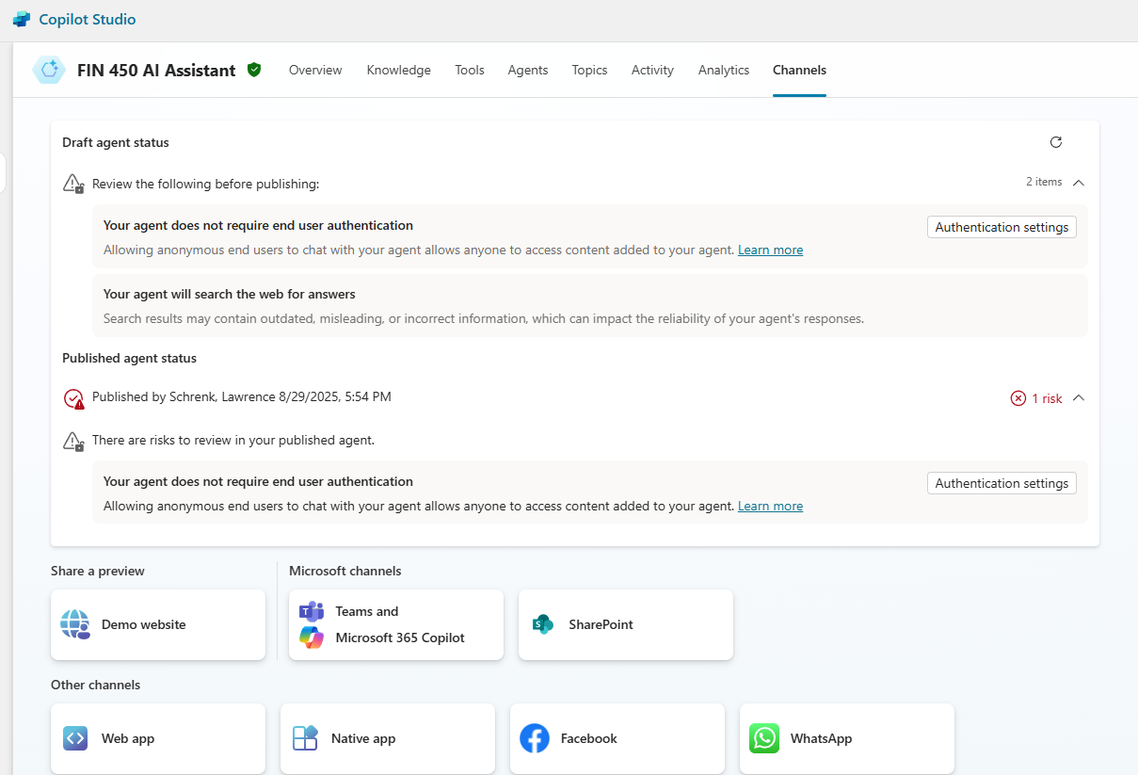
CPS: Channels

Slide 46
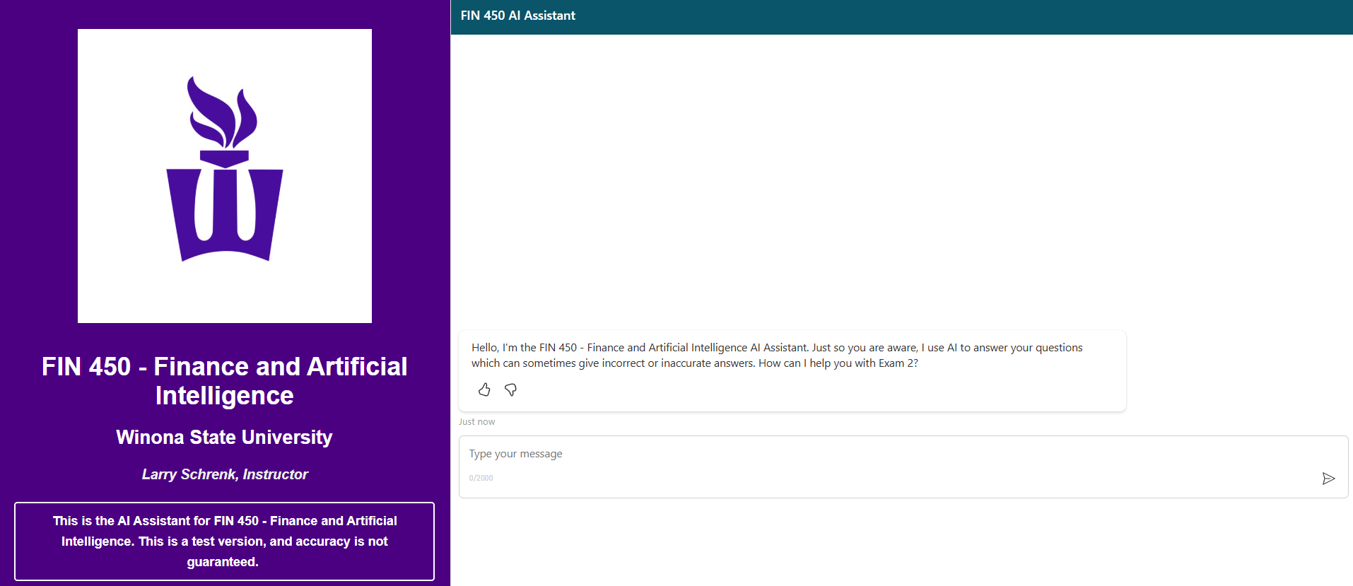
CPS: Website

Slide 47
6. Hands-On Friday:
Create a Finance
Agent in Copilot

Slide 48
Friday Lab Prep
Make sure you can access:
  FIN 450 Lab Report 5
Website: Copilot
  Make sure to sign in with your WSU account.
Knowledge Sources
  Firm webpage(s)
  Relevant firm financial documents, e.g.,
    10K, 10Q, Other SEC Filings (CapIQ)
    Annual Shareholder Report
    Earnings Calls (CapIQ)

