Slide 1
FIN 450 - Finance and Artificial Intelligence
Topic 4: AI Agents:
From Theory to Real-World Applications
Larry Schrenk, Instructor

Slide 2
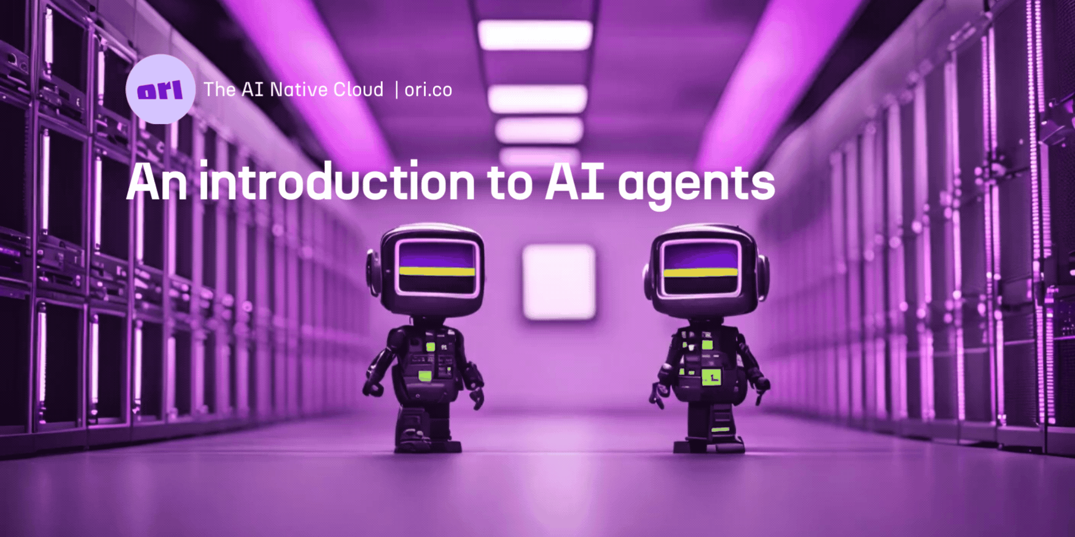
Overview
Foundations of AI Agents
Agent Taxonomy & Core Types
Agent Architectures & Design Patterns
Multi-Agent Systems & Decision Methods
Evaluation, Ethics, and the Future
Hands-On Friday: AI Agents

Slide 3

1. Foundations of
AI Agents

Slide 4
ChatGPT Agent Demo
ChatGPT 5 Thinking Agent:
Plan all aspects of a long weekend vacation to San Francisco for two adults living in Winona, MN travelling over any weekend in November. Emphasize cultural and natural activities. The budget should be moderate.

Slide 5
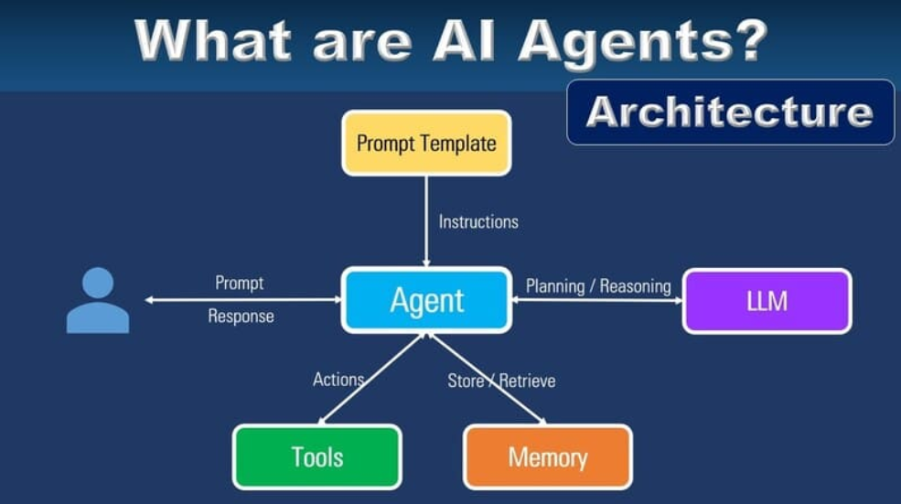
What are AI Agents?
Autonomous interacting with environment
Percept-action cycle
Goal-oriented behavior
Reactive vs proactive agent
Persistent memory

Slide 6
Other Agentic Behaviors
Tool Integration
Multi-Step Planning
Real-Time Adaptation
State Management (Awareness)
Proactive Communication
Error Handling

Slide 7
Why Agents Matter
30% productivity increase
NLP enables 24/7 user support
RL agents optimize decision-making
Agent deployment reduces manual errors and increases ROI
POLL: “Which agents did you use today?”

Slide 8
Common AI Agents
Apple Siri
Google Assistant
Amazon Alexa
Microsoft Cortana
ChatGPT (OpenAI)
Google Bard
Bing Chat
Grammarly
Gmail Smart Reply & Compose
Google Translate
Duolingo AI Chatbot
Spotify Recommendation Engine
Netflix Recommendation Engine
YouTube Recommendation Engine
Waze
Google Maps AI
Adobe Photoshop Neural Filters
Canva Magic Resize & Text-to-Image
Fitbit Coach
Slack AI (Slackbot)

Slide 9
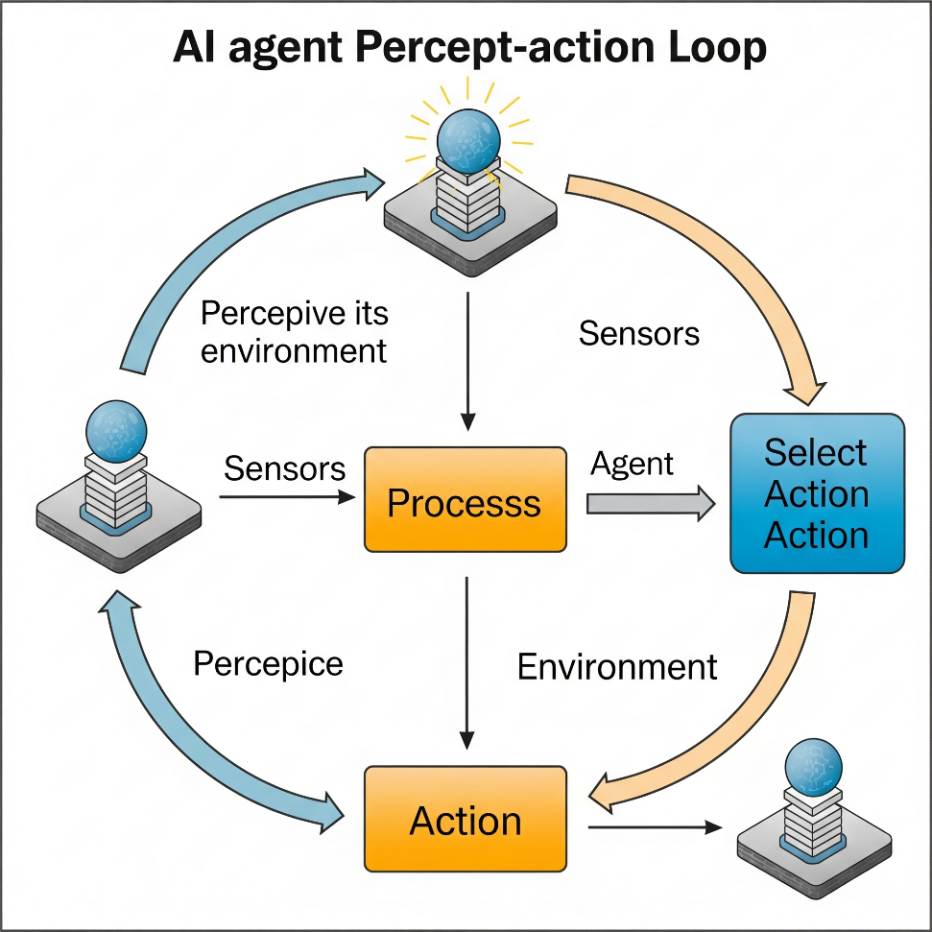
Core Definition
Autonomous tasks in dynamic environments
Processes sensor data
Decision engine applies statistical decision theory
Actuator issues commands
RL drives continuous improvement

Slide 10
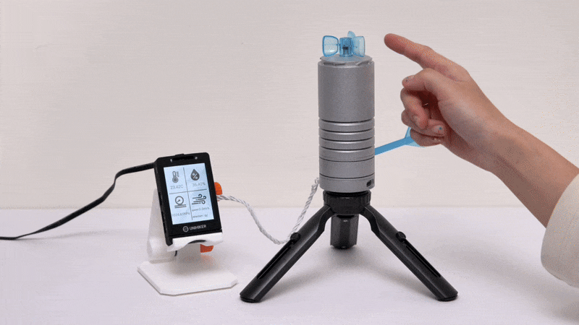
Agent Components
Sensors collect environmental data through interfaces
Knowledge Base stores domain-specific rules and information
Inference Engine processes data using logical reasoning
Actuators execute decisions through commands and outputs
Memory Systems maintain state information across interaction

Slide 11
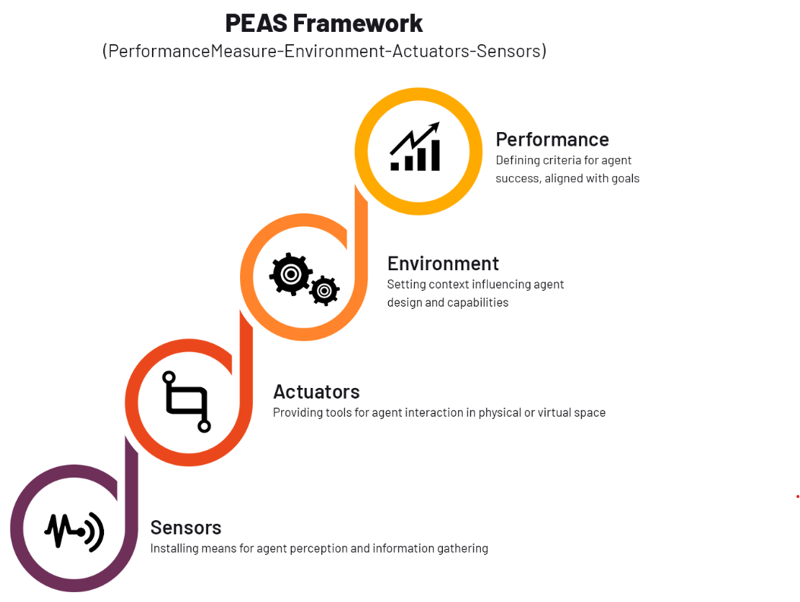
PEAS Framework
Performance, Environment, Actuators, Sensors
Performance measure for success metrics
Model environment for realistic context
Design actuators for actionable interactions
Select sensors for accurate perception

Slide 12
Environment Dimensions
Fully vs. Partially Observable
Deterministic vs. Stochastic
Episodic vs. Sequential
Static vs. Dynamic
Discrete vs. Continuous

Slide 13

Real-World Applications
Customer service chatbots resolve 67% of inquiries automatically
Trading algorithms execute 75% of stock market transactions
Smart home systems optimize energy consumption by 23%
Autonomous vehicles process sensor data at 60 FPS
Recommendation engines drive 35% of e-commerce revenue growth

Slide 14
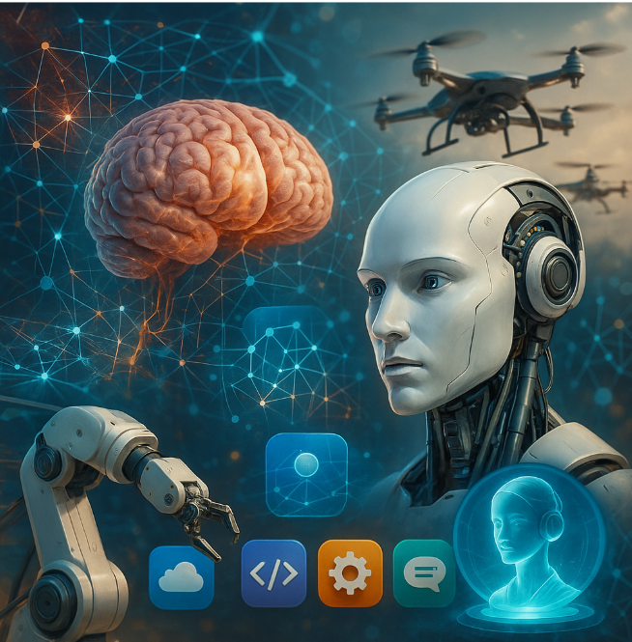
2. Agent Taxonomy
& Core Types

Slide 15
Agent Type Classification
Simple Reflex Agents
  Thermostat triggers heat when < 68°
Model-Based Reflex Agents
  Robot maps room to navigate obstacles
Goal-Based Agents
  Route planner selects path reaching destination
Utility-Based Agents
  Ride-share app maximizes driver earnings utility
Learning Agents
  Reinforcement Learning (RL) boosts game score
Multi-Agent Systems
  Coordinate between distributed intelligent entities

Slide 16
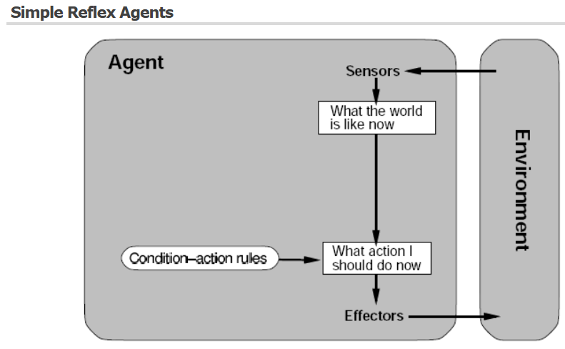
A. Simple Reflex Agents
Sensor data triggers predefined rules
Stimulus-response delivers 30% faster reactions
Sensors feed actuators directly for obstacle avoidance
Simpler rules reduce misclassification errors
Routine rules boost adaptability in uncertain settings
Example: Automatically sliding door

Slide 17
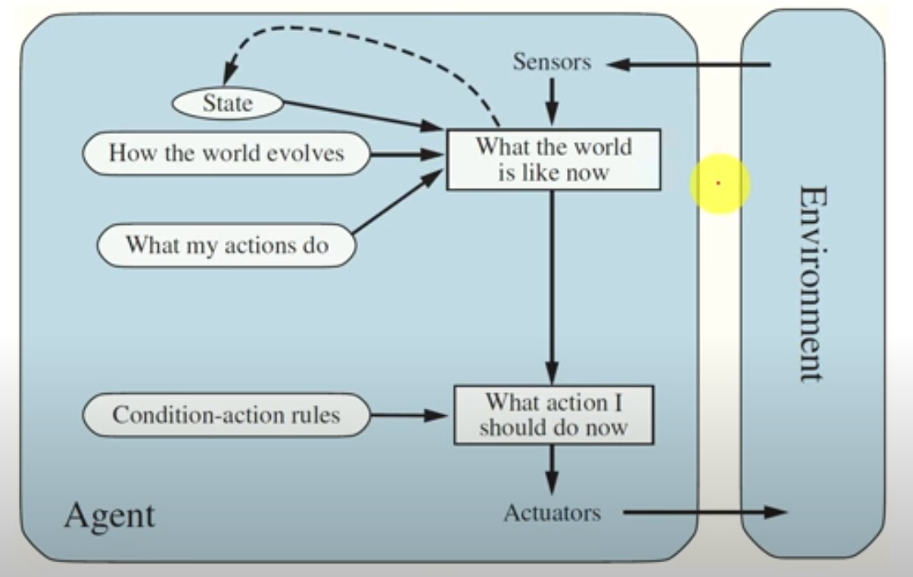
B. Model-Based Reflex Agents
Updated internal model
Captures recent changes
Transition model predicts next state
Environment model manages partially observable worlds
Verification process cuts decision errors
Example: Roomba

Slide 18

Model-Based Reflex Agents: Vacuum Example
Agent senses dirt location using IR sensor
Internal state stores room ID, dirt status
Rule base selects CLEAN or MOVE via actuator
Fast cycles per second enable fast reactions
95% cleanliness in 100 steps

Slide 19
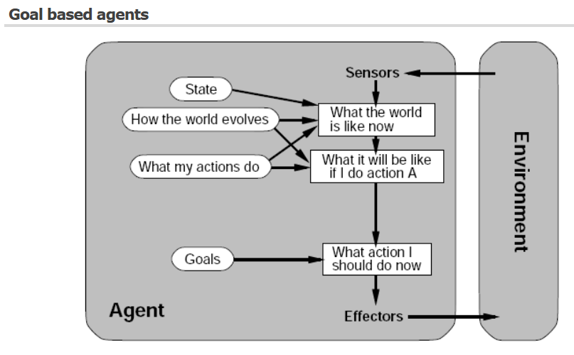
C. Goal-Based Agents
Maintain internal model storing environment state variables
Update state after each percept using transition function
Execute reflex rules
Track up to 10 variables for quick decisions
Select actions through transition model
Example: Autonomous delivery drone

Slide 20
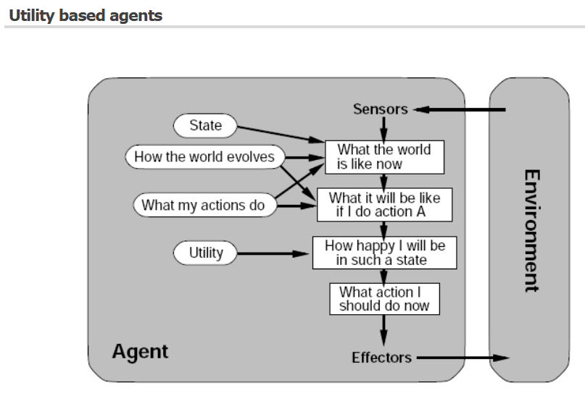
D. Utility-Based Agents
Maps outcomes to utility
Compute Expected Utility (EU)
Rank possible actions
Select action based on EU
Example: Investments (Risk vs. Return)

Slide 21
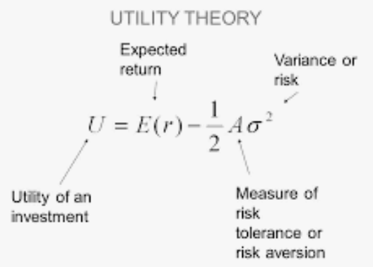
Background: Expected Utility
Numeric value representing preference
Higher utility means outcome more desirable
Utility function converts outcomes into utility scores
Expected utility is probability-weighted average of possible utilities
Choose action with highest expected utility

Slide 22
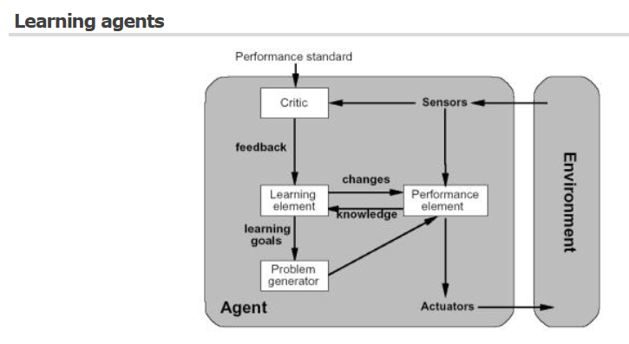
E. Learning Agents
Reinforcement Learning (Trial and Error)
MDP: states, actions, rewards, step loop
Select best action after each step
Repeat…repeat…repeat…Restart…
Select path with highest reward
Example: Atari Games (Google DeepMind)

Slide 23
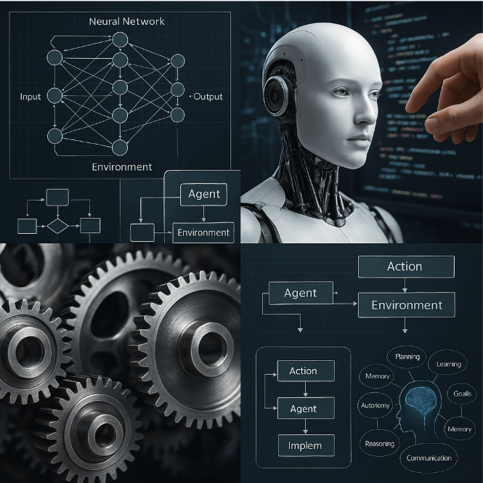
3. Agent Design
Patterns

Slide 24
Design Patterns
Reactive/Subsumption Agents
  Instantly map perceptions to actions without planning
Deliberative Agents
  Plan actions through internal world models and search
Hybrid Agents
  Fuse deliberative planning with fast reactive behaviors for balance
BDI Agents
  Employ Beliefs-Desires-Intentions to mimic goal-driven reasoning

Slide 25
A. Reactive & Subsumption
Instantly map perceptions to actions without planning
Deterministic sensor-action coupling delivers low latency
Subsumption layers hierarchically arbitrate behaviors
Priority encoding + sensor fusion trim actuator jitter
Stateless design needs tiny memory, lacks long-term foresight
Example: Roomba obstacle avoidance

Slide 26
B. Deliberative Architecture
Plan actions through internal world models and search
Symbolic reasoning uses world model for strategic planning
Planner creates goal-directed action sequences quickly
Bayesian beliefs with meta-monitoring cut failures
  Bayesian reasoning revises beliefs by adding new evidence to refine probabilities
Modular architecture
Example: Chess engine explores 1 000 000 moves per second

Slide 27
C. Hybrid Stacks
Fuses deliberative planning with fast reactive behaviors
Planner layer defines goals; reactive layer handles rapid changes
Coordinator merges sensors, planning, reflex overrides
Knowledge Graph + RL raise decision accuracy
Multi-Agent design scales hybrid control across domains
Example: Drone swarm re-routes around wind gusts

Slide 28
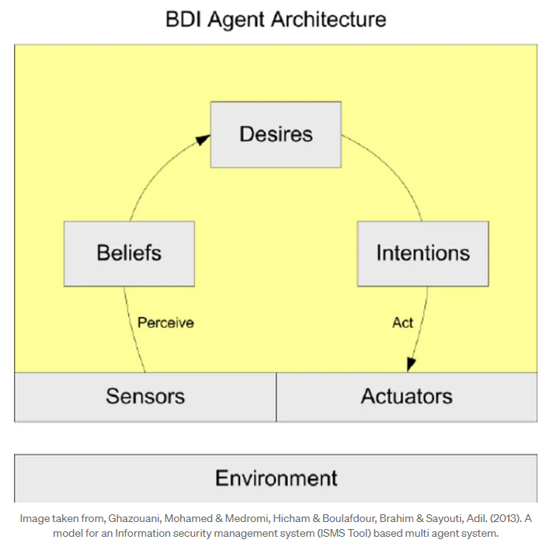
D. BDI Agents
BDI loop: Beliefs → Desires → Intentions for reasoning
Mimic goal-driven reasoning
Intention deliberation algorithm raises plan efficiency
Real-time perceptions update goals and adopt intentions instantly
Modal logic keeps beliefs consistent, pruning conflicting plans
Example: Virtual assistant schedules meetings accurately and quickly

Slide 29
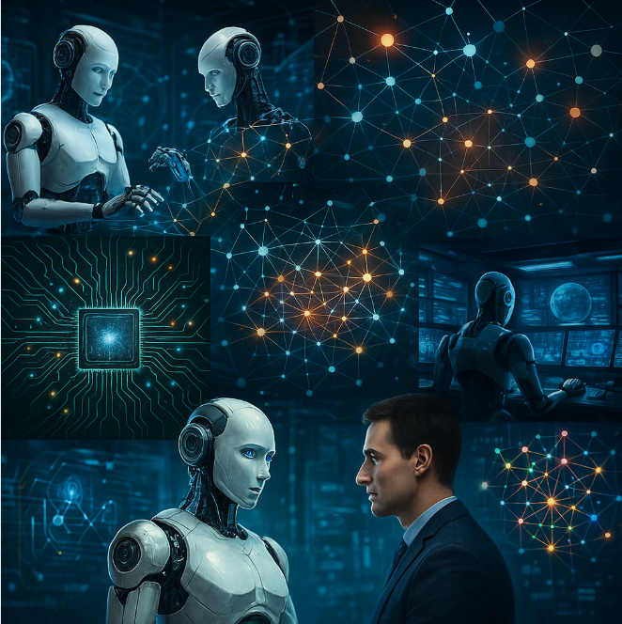
4. Multi-Agent Systems & Decision Methods

Slide 30
Multi-Agent Systems
Fundamentals
Communication and Protocols
Problem-Solving/Learning
Planning & Search

Slide 31
A. Fundamentals
Peer-to-peer coordination
Scales to 100+ autonomous agents seamlessly
Use standard messaging with local knowledge
Resilient, emergent, cooperative behavior
Example: Warehouse, finance, supply-chain robots share paths efficiently

Slide 32
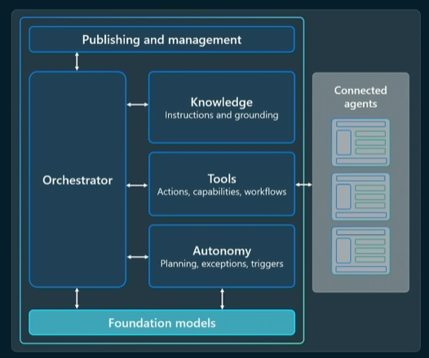
Multi-Agent Organization

Slide 33
B. Communication and Protocols
FIPA-ACL (Agent Communication Language) standardizes message exchange
Contract Net Protocol enables task allocation negotiation
Message passing achieves low latency in distributed environments

Slide 34
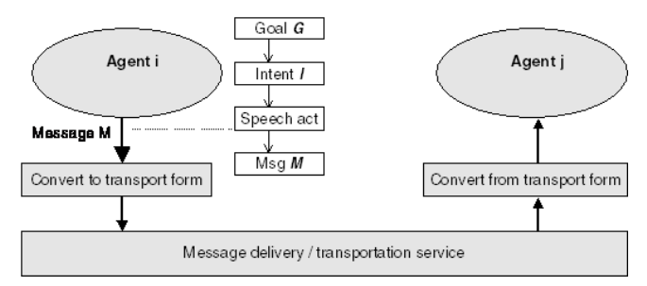
FIPA-ACL: Agent Communication Language Standard
FIPA-ACL (Foundation for Intelligent Physical Agents) standardizes messaging
Shared vocabularies, meaning across agents
Auction allocate scarce resources with competitive bids
Consensus algorithms achieve agreement
Message passing

Slide 35
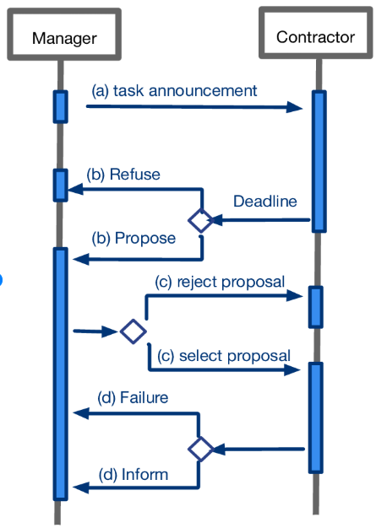
Contract Net Protocol
Auction Task Allocation
Manager agent broadcasts tasks
Contractors bid based on capability
Winning bid chosen via evaluation metric
Protocol conforms to FIPA Contract Net standard
Simulations achieve 98% task assignment success
Approach lowers computation

Slide 36
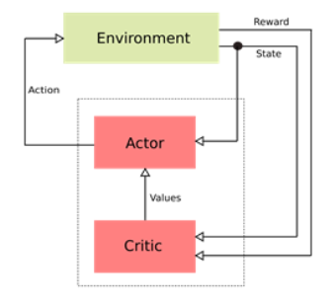
C. Problem-Solving/Learning
Decentralized Learning
  Agents learn locally, no central controller
Actor-Critic (RL)
  Actor picks an action; critic scores it
Train once centrally; agents act on their own

Slide 37
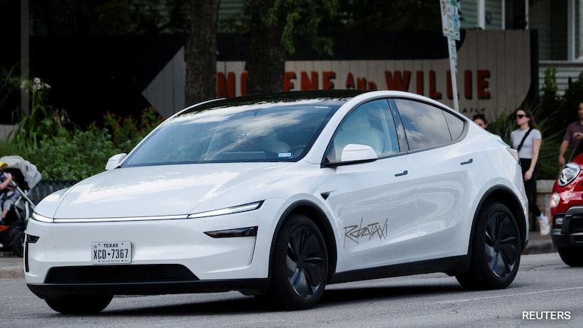
Case 1: Autonomous Vehicle Fleet Coordination
Vehicle-to-Vehicle (V2V) communication prevents collision scenarios
Centralized dispatch algorithms optimize route planning efficiency
Edge computing reduces decision latency to 10 milliseconds
Swarm intelligence manages traffic flow in urban environments
Sensor fusion creates shared environmental awareness maps

Slide 38
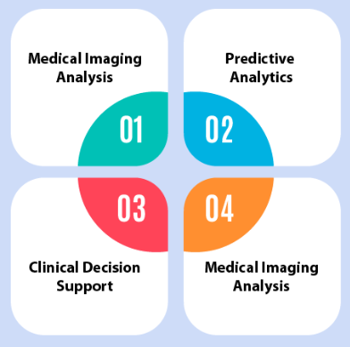
Case 2: Healthcare Resource Allocation Systems
Patient scheduling agents optimize appointment availability by 30%
Medication management bots reduce prescription errors significantly
Emergency response coordination improves ambulance dispatch times
Bed allocation systems maximize hospital capacity utilization
Electronic Health Record (EHR) agents streamline data sharing

Slide 39
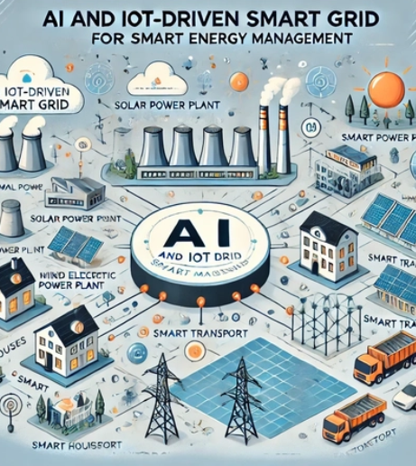
Case 3: Smart Grid Energy Management
Demand response agents balance electricity load across networks
Renewable energy coordination maximizes solar/wind power integration
Grid stability maintained through distributed control mechanisms
Smart meter data enables predictive consumption modeling
Outage management systems restore power 50% faster automatically

Slide 40

5. Evaluation, Ethics, and the Future

Slide 41
Evaluation & Testing
Define metrics: accuracy, F1 score, reward efficiency
  F1: Combines precision (how many right) and recall (how you caught)
Run benchmark suite covering 50 diverse tasks
Measure agent latency; target response
Perform A/B tests comparing new versus baseline agent
  A/B tests: Compare two versions; witch gets better results (more clicks, faster answers, higher scores)

Slide 42
Ethics, Safety & Alignment
Safe MDP (Markov Decision Process) constraints
  Block actions that could cause harm
Use RLHF (human feedback) to guide actions
Monitor anomalies
Audit IEEE P7000; verify ethical compliance yearly
  IEEE P7000: checklist for building technology that respects human values
Publish transparency reports

Slide 43
Current Challenges in AI Agent Systems
Coordination slows after 100+ agents work together
Agents use different, incompatible message formats
Resource clashes cut efficiency 30-40%
Network lag makes fast decisions harder

Slide 44
Future Directions for Agent Coordination
Federated Learning
  Many devices train a shared model locally, then send only updates—so raw data stays private on each device
Blockchain Consensus
  Network nodes follow a shared validation rule ensuring a tamper-proof, transparent ledger
Swarm algorithms
  Many tiny agents follow a few simple local rules, and their combined actions solve big tasks
Explainable AI (Xai)
  Understand key factors and steps an AI used to reach each decision

Slide 45

Last Cat on Roomba Video

Slide 46
6. Hands-On Friday:
From Prompts to Agents: A Practical AI Agent in 50 Minutes

Slide 47
Friday Lab Prep
Make sure you can access:
  FIN 450 Lab Report 4
Website: Copilot
  Check that you are using this URL for Copilot
    https://m365.cloud.microsoft/chat
  Make sure tp sign in with your WSU account.

