Slide 1
FIN 450 - Finance and Artificial Intelligence
Topic 14: AI and Financial Engineering
Larry Schrenk, Instructor

Slide 2
Overview
Fundamentals of Derivative Securities
Traditional Pricing Methods
AI and ML Enhancements
AI‑Enhanced Pricing Workflows
Advanced AI Topics in Derivatives
Practical Considerations and Risks
Hands-On Friday:
XXX

Slide 3
1. Fundamentals of Derivative Securities

Slide 4
Derivatives: Purpose and Underlyings
Define hedging, speculation, arbitrage
List underlyings: equities, rates, FX, commodities, indices
Motivation: manage cash flow volatility, capital efficiency
Example: farmer hedges corn revenue using futures

Slide 5
Options: Calls and Puts Basics
Define call right to buy, put right to sell
Define intrinsic value, time value, moneyness categories
Styles: American early exercise, European expiry only

Slide 6
Distinctions
Futures/Forward vs. Option
Long vs. Short
Payoff vs. Profit
European vs. American

Slide 7
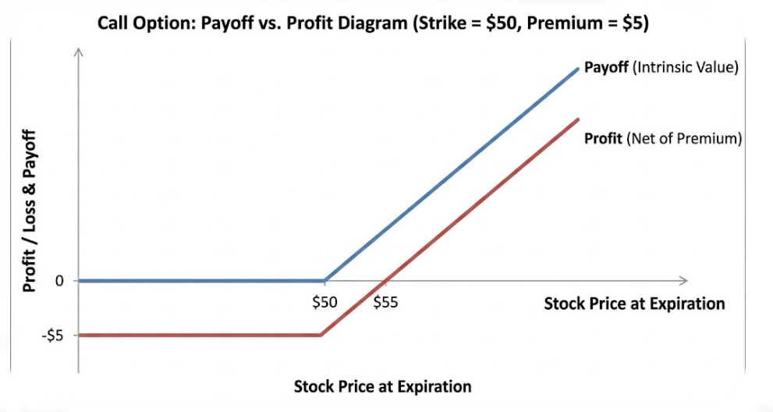
Payoff and Profit: Call

Slide 8
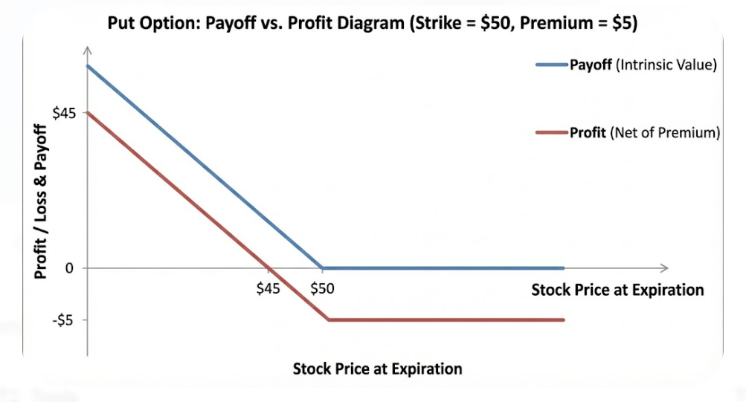
Payoff and Profit: Put

Slide 9
Swaps: IRS, Currency, CDS Overview
Define interest rate swap fixed‑float cash flow exchange
Define cross‑currency swap principal and interest exchange
Define credit default swap protection on reference entity

Slide 10
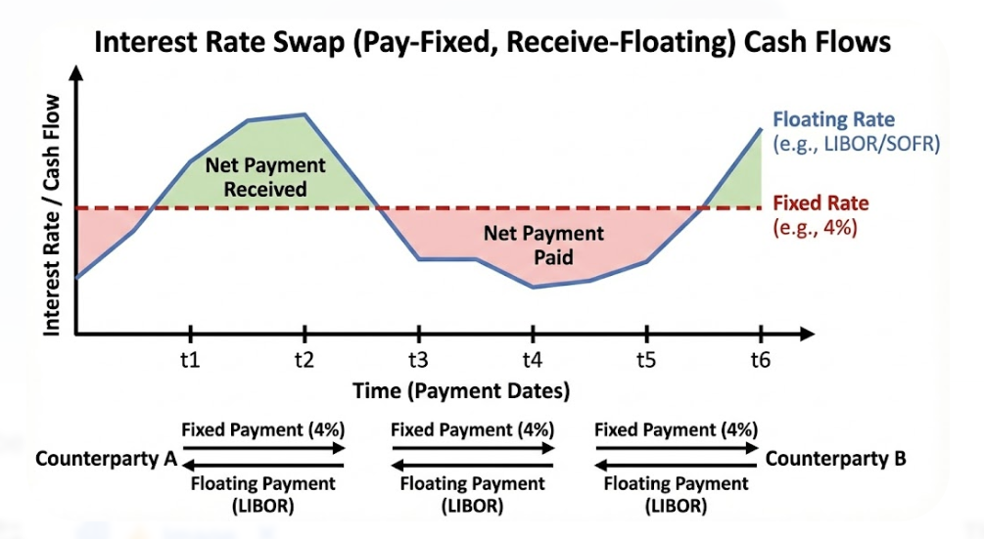
Interest Rate Swap

Slide 11
Exotics: Barriers, Digitals, Asian
Define barrier triggers knock‑in knock‑out conditions
Define digital binary fixed payout upon event
Define Asian average price reduces path volatility
Motivation: tailor payoff to specific risk profile

Slide 12
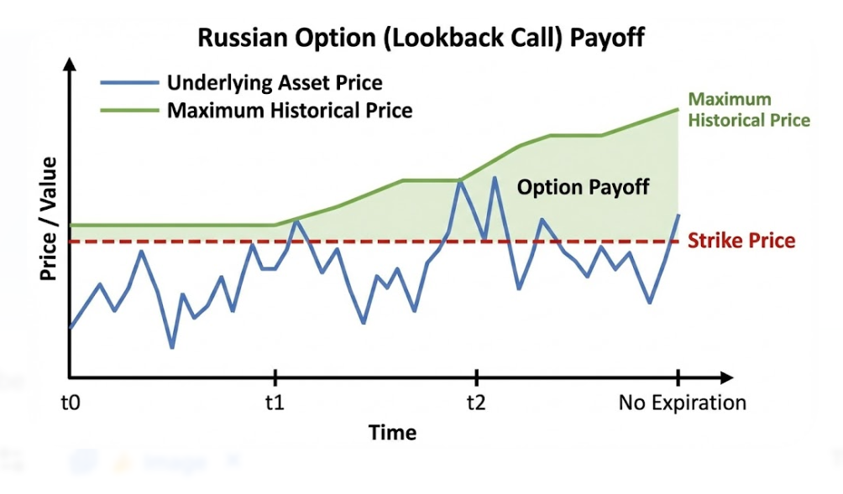
Russian Option

Slide 13
2. Traditional Pricing Methods

Slide 14
No‑Arbitrage and One‑Price Law
Principle: identical cash flows imply identical price
Motivation: prevent free lunch via replication strategies
Insight: basis relationships anchor relative pricing grids

Slide 15
Black‑Scholes Essentials
Inputs:
  S=100
  K=100
  σ=20%
  r=3%
  T=1
Outputs: closed‑form European call and put values
Greeks: delta, gamma, vega, theta, rho sensitivities

Slide 16
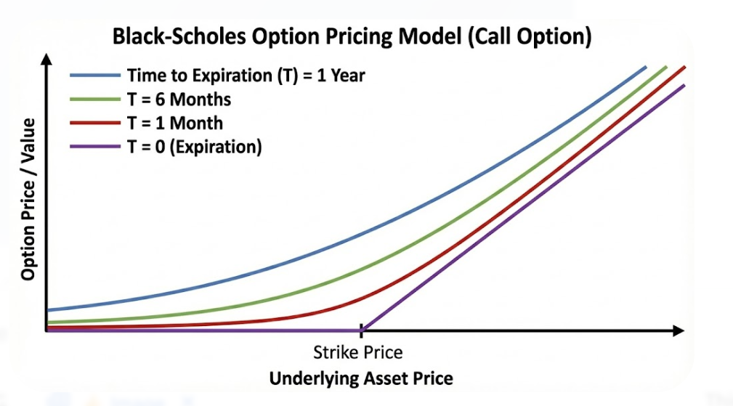
Black‑Scholes Model

Slide 17
The ‘Greeks’
Sensitivity of the option’s price to …
  Delta: Underlying Asset Price
  Gamma: Change in Delta
  Vega: Implied volatility.
  Theta: Time
  Rho: Interest Rate Changes

Slide 18
Binomial and Trinomial Trees
Build discrete recombining lattice for prices
Calibrate up down probabilities
Advantage: handle American exercise early exercise premium

Slide 19
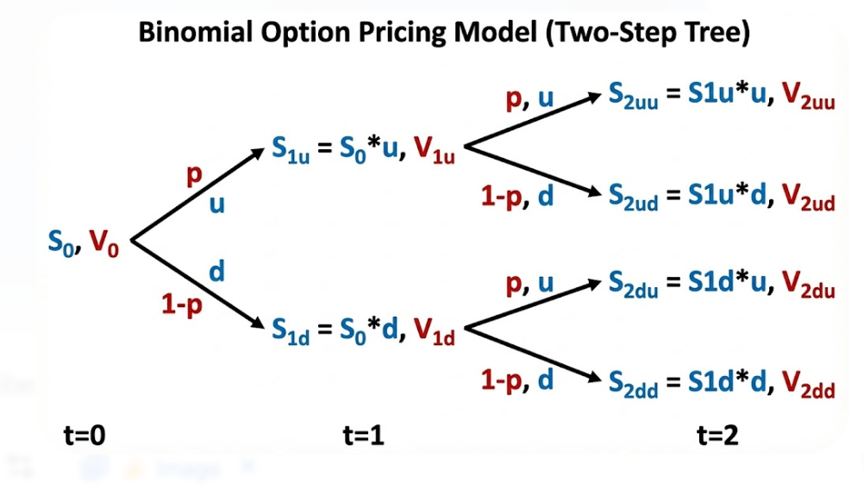
Binomial Tree

Slide 20
Monte Carlo Simulation Pricing
Simulate many paths, average discounted payoffs
Advantage: handle path dependence Asian barriers lookbacks
Variance reduction: antithetic control variates stratification
Example: 100k paths, Asian call estimation precision
Visual: histogram of simulated payoffs with confidence band

Slide 21
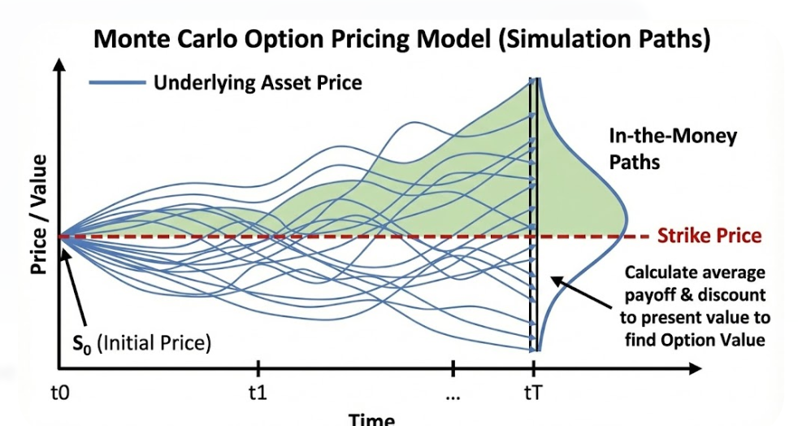
Monte Carlo Simulation Pricing

Slide 22
3. AI and Machine Learning Enhancements

Slide 23
Supervised Learning for Pricing Approximation
Map inputs to price using labeled trade datasets
Features: S K T r σ moneyness skew term
Models: linear trees boosting neural networks ensembles
Example: MAPE < 1% on vanilla options
Visual: predicted versus model price scatter plot

Slide 24
Gradient Boosting for Calibration
Objective: fit model to market implied vol surface
Use XGBoost LightGBM gradient‑based tree ensembles
Data: option quotes across strikes maturities intraday
Outcome: faster calibration than nonlinear least squares
Visual: surface fit true versus fitted volatility

Slide 25
Support Vector Machines for Signals
Classify buy hold sell using margin maximization
Kernels: linear RBF polynomial for nonlinear boundaries
Features: order flow imbalance realized volatility momentum
Metric: F1‑score > 0.6 out‑of‑sample
Visual: decision boundary plot with support vectors

Slide 26
Feature Engineering from Market Data
Construct realized volatility bipower variation jump indicators
Build implied skew slope curvature term structure metrics
Include liquidity depth spreads order book imbalance
Insight: feature stability improves generalization performance
Visual: feature importance bar chart ranked by SHAP

Slide 27
Cross‑Validation and Overfitting Control
Methods: k‑fold time‑series split nested validation
Regularization: L1 L2 dropout early stopping patience
Metric: cross‑validated RMSE stable across folds
Insight: leakage prevention requires proper temporal splits
Visual: learning curves train versus validation error

Slide 28
Deep Networks as Universal Approximators
Use multilayer perceptrons approximate complex pricing maps
Inputs standardized normalized moneyness log‑maturity
Metric: inference latency < 1 ms per option
Insight: deploy as surrogate for Monte Carlo
Visual: network diagram layers widths activations

Slide 29
CNNs for Chart Pattern Recognition
Apply convolutions to candlestick image tensors
Detect local motifs breakouts volatility regime shifts
Metric: precision‑recall improvement versus heuristics
Example: 5‑minute bars classify breakout probability
Visual: activation maps highlighting detected patterns

Slide 30
RNNs and LSTMs for Sequences
Capture temporal dependencies in returns volatility dynamics
Use stacked LSTM with dropout recurrent connections
Metric: one‑step volatility MAE reduced 15%
Example: forecast next‑day σ for option risk
Visual: predicted versus realized volatility time series

Slide 31
Transformers and Attention for Markets
Use attention to weight informative timesteps adaptively
Combine price volume news embeddings multimodal inputs
Metric: Sharpe improvement 0.3 versus LSTM baseline
Insight: longer context windows capture regime changes
Visual: attention heatmap over recent sequence

Slide 32
4. AI‑Enhanced Pricing Workflows

Slide 33
Neural Surrogates for Fast Pricing
Train on Monte Carlo labels for complex exotics
Replace runtime from seconds to milliseconds inference
Metric: 1000× speedup with <1% pricing error
Use emulation for intraday risk recalculation

Slide 34
GPU Acceleration and Parallel Computing
Use CUDA GPU to parallelize path simulations massively
Combine vectorization JIT compilation for throughput
Metric: 50–200× Monte Carlo speedups reported
Insight: enable real‑time intraday portfolio revaluation

Slide 35
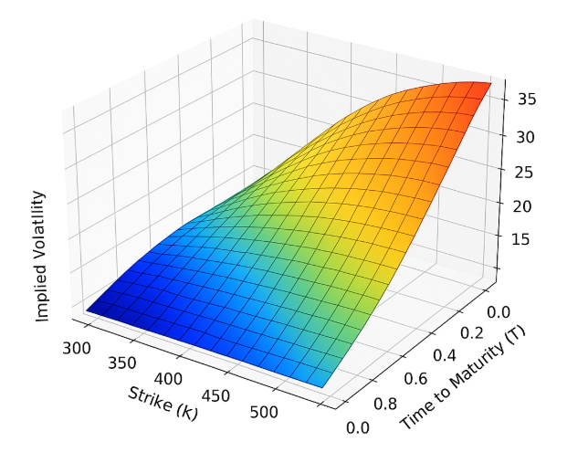
Volatility Surface Prediction with ML
Predict σ surface across K T using spatiotemporal models

Slide 36
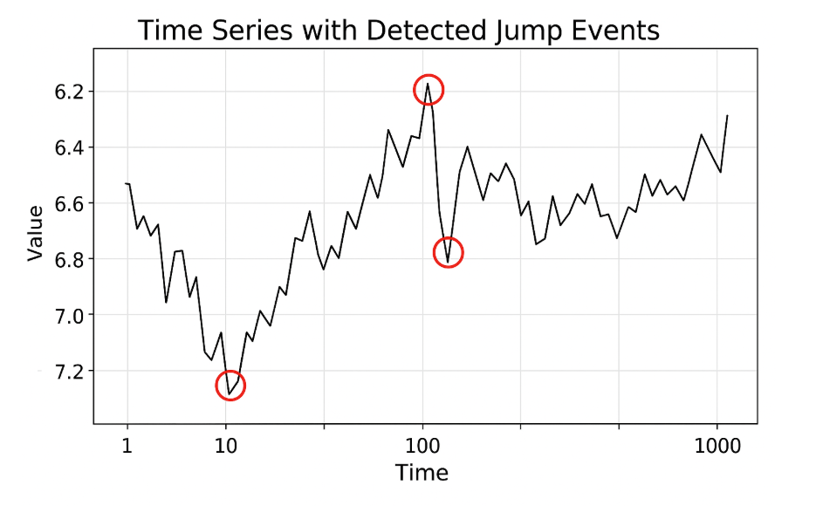
Jump Detection and Volatility Clustering
Identify jumps via bipower variation threshold tests
Insight: account for jumps to price barrier options
Data: jump intensity spikes around macro announcements

Slide 37
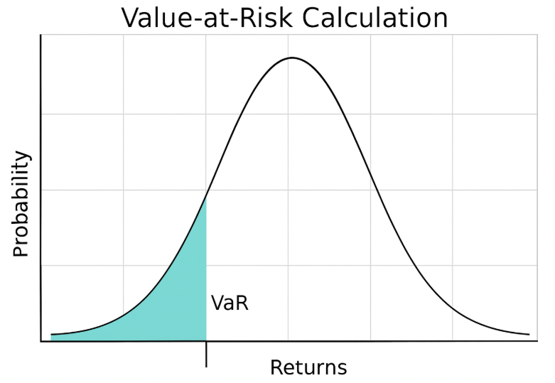
Risk Management with AI Forecasts
Predict VaR ES using quantile regression forests
Application: portfolio optimization using ML forecasts
Metric: backtest exceedance rate near nominal level
Insight: early‑warning signals for crash risk

Slide 38
5. Advanced AI Topics in Derivatives

Slide 39
NLP Sentiment for Volatility Prediction
Extract sentiment from news social media transcripts
Feature: polarity subjectivity uncertainty tone measures
Data: negative sentiment correlates with higher σ
Application: adjust implied vol quotes dynamically

Slide 40
Earnings Calls and Filings Extraction
Parse 10‑K 10‑Q MD&A forward‑looking statements
Detect guidance changes risk disclosures linguistic cues
Insight: tone shifts precede options skew changes
Example: lower guidance increases downside skew demand

Slide 41
Event Detection and Impact Analysis
Detect macro events earnings merges policy surprises
Estimate abnormal returns via local projection models
Insight: event windows reshape hedging strategies
Metric: average move ±2% around earnings announcements

Slide 42
Alternative Data Integrations Overview
Use satellite imagery track inventories production activity
Use card transactions infer consumer demand trends
Web‑scraped indicators augment macro nowcasting signals
Insight: alternative data improves timing of hedges

Slide 43
Combining Structured and Unstructured Data
Join prices fundamentals text audio alternative streams
Build unified feature store with time alignment
Metric: AUC uplift 0.05 on direction classification
Insight: multimodal inputs reduce model uncertainty
Visual: multimodal fusion diagram with embeddings

Slide 44
Explainable AI for Pricing Models
Goal: interpret black‑box predictions for stakeholders
Methods: partial dependence ICE surrogate models
Outcome: transparent drivers of price adjustments
Insight: improves trader trust and governance

Slide 45
SHAP Values and Feature Importance
Compute Shapley‑based local global attributions
Identify features driving price or volatility forecasts
Insight: detect spurious correlations early
Metric: top‑3 features explain 70% variance

Slide 46
Regulatory Compliance and Validation
Align with SR 11‑7 model risk guidance
Document data lineage assumptions limitations governance
Perform backtesting benchmarking challenger models
Outcome: audit‑ready reports satisfy supervisors

Slide 47
Quantum Computing Prospects Overview
Explore quantum algorithms for option pricing speedups
Consider quantum Monte Carlo amplitude estimation advantages
Constraint: noisy hardware limits near‑term benefits

Slide 48
6. Practical Considerations and Risks

Slide 49
Model Validation and Backtesting
Use walk‑forward evaluation rolling windows realistic
Compare benchmarks naive models economic value add
Metric: hit ratio, MAPE, Sharpe, turnover constraints
Insight: avoid overfitting via robust testing protocols

Slide 50
Production Deployment and Monitoring
Containerize models enable CI CD version control
Monitor drift latency errors resource utilization health
Metric: prediction latency under 50 ms target
Insight: alerts trigger retraining or fallback models

Slide 51
A/B Testing AI versus Traditional
Randomize pricing method allocation across instruments
Measure price error slippage fill rate improvements
Metric: statistically significant uplift using AI
Insight: rollout gated by risk appetite governance

Slide 52
Model Risk and Overfitting Dangers
Identify complexity creep fragile parameter sensitivity
Use regularization ensembling conservative priors safeguards
Metric: stability under perturbation stress scenarios
Insight: prefer simpler models with comparable performance

Slide 53
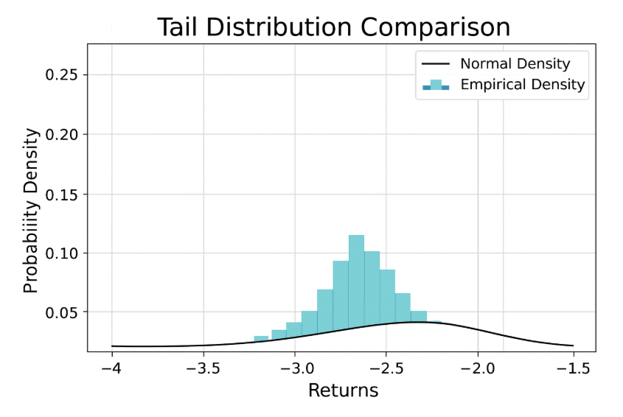
Fat Tails and Extreme Events
Recognize heavy‑tailed returns non‑Gaussian shocks
Incorporate EVT stress scenarios tail risk hedges
Data: kurtosis > 3 common in markets
Insight: protect against gap risk overnight moves

Slide 54
Adversarial Attacks on ML Systems
Threats: data poisoning model evasion inference theft
Defenses: robust training anomaly detection input sanitization
Metric: adversarial success rate reduced substantially
Insight: secure pipelines critical for trading integrity

Slide 55
Systemic Risk from AI Adoption
Concern: herding behavior correlated model decisions
Risk: liquidity drought during stressed conditions
Mitigation: diversity constraints model heterogeneity policies
Insight: scenario planning reduces amplification effects

Slide 56
Regulatory Frameworks and Obligations
Cite Basel III MiFID II Dodd‑Frank applicability
Requirements: transparency controls reporting best execution
Obligation: model documentation change control audit trails
Insight: compliance reduces legal operational reputational risk

Slide 57
7. Hands-On Friday:
XXX

Slide 58
Friday Lab Prep
Make sure you can access:
  FIN 450 Lab Report 14
Data:
  x

