Slide 1
FIN 450 - Finance and Artificial Intelligence
Topic 13: AI in Capital Budgeting Decisions
Larry Schrenk, Instructor

Slide 2
Overview
Traditional Capital Budgeting
  Introduction to Capital Budgeting
  Time Value of Money
  Evaluation Methods
  Cash Flow Estimation
  Risk and Uncertainty
  Capital Rationing and Selection
AI Enhanced Capital Budgeting
  Predictive Cash Flow Modeling
  Advanced Risk Assessment
  Automated Data Pipelines
  Enhanced Scenario Planning
  Optimization and Decision Support
  Market and Competitor Analysis
  Real Options Valuation
  Post Investment Monitoring
  Worked Examples
Hands-On Friday: XXX

Slide 3
1. Traditional Capital Budgeting
A. Introduction to Capital Budgeting

Slide 4
Capital Budgeting: Purpose and Scope
Long-horizon investment screening
Classify projects: expansion, replacement, regulatory, strategic
Align investments with multi-year corporate strategy map
Motivation: allocate scarce capital to maximize value
Value creation = NPV > 0.

Slide 5
Capital Budgeting: Decision Criteria
Compare NPV, IRR, Payback, PI metrics
Prioritize NPV when mutually exclusive projects conflict
Use IRR intuitively for percentage-based return view
Motivation: choose consistent rule under constraints

Slide 6
1. Traditional Capital Budgeting
B. Time Value of Money

Slide 7
Time Value of Money Basics
Define present value (PV) and future value (FV)
Discount using cost of capital reflecting risk
Motivation: compare cash flows across different times

Slide 8
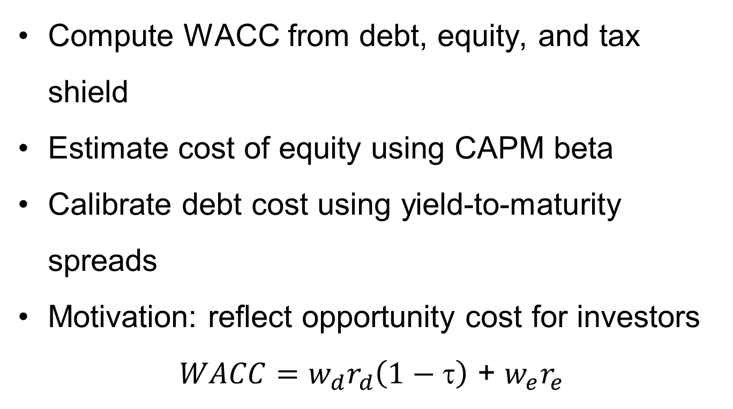
Discount Rates and WACC
Compute WACC from debt, equity, and tax shield
Estimate cost of equity using CAPM beta
Calibrate debt cost using yield‑to‑maturity spreads
Motivation: reflect opportunity cost for investors
$WACC={w_{d}r}_{d}\left(1−\text{t}\right)$ + ${w_{e}r}_{e}$

Slide 9
Risk‑Free Rate and Premiums
Select r_{f} from duration‑matched government securities
Derive equity risk premium (ERP) using market history
Add size, country, and specific risk adjustments
Motivation: align discount rate with project risk

Slide 10
1. Traditional Capital Budgeting
C. Evaluation Methods

Slide 11
NPV Overview
Define Net Present Value (NPV) decision benchmark
Discount free cash flows (FCF) using project WACC
Accept when NPV > 0; reject otherwise
Motivation: maximize shareholder wealth creation

Slide 12
IRR Overview
Define Internal Rate of Return (IRR) break‑even rate
Solve discount rate where NPV equals exactly zero
Compare IRR to hurdle; accept when IRR > hurdle
Motivation: intuitive percentage performance metric

Slide 13
Payback and Profitability Index
Compute Payback time to recover initial outlay
Use Discounted Payback incorporating time value effects
Calculate Profitability Index (PI) = PV inflows/outlay
Motivation: liquidity focus and capital rationing aid

Slide 14
1. Traditional Capital Budgeting
D. Cash Flow Estimation

Slide 15
Cash Flow Estimation: Scope
Identify relevant incremental cash flows only
Exclude sunk costs; include opportunity costs explicitly
Separate operating, investing, and working capital movements
Motivation: avoid overstated project economic benefits

Slide 16
Initial and Operating Cash Flows
Include CAPEX, installation, and net working capital (NWC)
Estimate Operating Cash Flow (OCF) after taxes
Use depreciation tax shield improving FCF
Motivation: capture full investment and operating economics.

Slide 17
Terminal Value and Salvage
Include salvage proceeds net of taxes and disposal
Reverse working capital at project end‑of‑life
Add terminal value if continuing cash flows persist
Motivation: reflect residual economic benefit accurately

Slide 18
1. Traditional Capital Budgeting
E. Risk and Uncertainty

Slide 19
Sensitivity Analysis
Vary one key driver holding all else constant
Measure NPV impact per ±10% driver change
Build tornado chart ranking variable importance
Motivation: identify value drivers and monitoring needs

Slide 20
Scenario Analysis
Construct base, best, worst coherent assumptions sets
Quantify joint changes across correlated variables
Report NPV range and downside probability
Motivation: understand dispersion and contingency planning

Slide 21
Break‑Even Points
Compute price, volume, and margin break‑evens
Identify capacity utilization meeting EBIT = 0 condition
Combine with cost structure for operating leverage view
Motivation: guide pricing, volume, and cost actions

Slide 22
1. Traditional Capital Budgeting
F. Capital Rationing and Selection

Slide 23
Capital Rationing: Ranking Rules
Rank projects by PI under fixed capital budget
Use NPV per dollar when partial investment infeasible
Consider strategic dependencies and real options value
Motivation: maximize portfolio value under constraints

Slide 24
Mutually Exclusive Projects
Choose highest NPV among alternatives with shared resource
Reconcile scale differences using incremental analysis
Resolve timing conflicts via NPV profile intersection
Motivation: ensure efficient resource allocation choices

Slide 25
2. AI Enhanced Capital Budgeting
A. Predictive Cash Flow Modeling

Slide 26
Predictive Cash Flows: Overview
Use ML to forecast revenue and costs
Engineer features: price, promotions, seasonality, macro
Validate with cross‑validation; track MAPE (Mean Absolute Percentage Error), RMSE (Root Mean Squared Error)
Motivation: improve forecast accuracy versus heuristics
Data: MAPE drops from 14% to 6%

Slide 27
Predictive Cash Flows: Inputs
Integrate
  POS (Point of Sale)
  CRM (Customer Relationship Management)
  ERP (Enterprise Resource Planning)
  Macroeconomic series
Use weather, mobility, and sentiment alternative data
Apply lagged features and holiday calendars
Motivation: capture drivers beyond internal ledgers

Slide 28
Predictive Cash Flows: Deployment
Automate monthly retraining with drift detection
Track model performance dashboards and alerts
Integrate forecasts into FCF and NPV models
Motivation: keep planning synchronized with operations

Slide 29
2. AI Enhanced Capital Budgeting
B. Advanced Risk Assessment

Slide 30
AI Risk: Monte Carlo
Sample input distributions; run 10,000 simulations
Model correlations using copulas or Cholesky
Estimate downside metrics: VaR, CVaR of NPV
Motivation: quantify tail risks and resilience

Slide 31
AI Risk: Real‑Time Monitoring
Stream KPIs; detect anomalies using unsupervised ML
Trigger forecast updates on threshold breaches
Prioritize mitigations via influence scores (SHAP)
Motivation: respond faster to risk signals

Slide 32
AI Risk: Volatility Models
Forecast market volatility using GARCH or LSTM
Link volatility to price, cost, and FX assumptions
Stress cash flows under regime‑switching scenarios
Motivation: align discount rate to market regimes

Slide 33
2. AI Enhanced Capital Budgeting
C. Automated Data Pipelines

Slide 34
Automated Data: NLP Research
Use NLP to summarize industry and regulatory news
Extract entities, events, and sentiment signals
Feed features into demand and cost models
Motivation: scale market intelligence beyond manual reviews

Slide 35
Automated Data: Web and APIs
Scrape competitor prices; monitor capacity expansions
Ingest macro series via APIs; schedule ETL
Validate data quality with anomaly checks
Motivation: keep models current and reliable

Slide 36
Automated Financial Analysis
Parse 10‑K/10‑Q for KPIs and guidance
Map metrics into driver‑based FCF templates
Flag accounting changes impacting comparability
Motivation: accelerate close‑to‑plan cycle

Slide 37
2. AI Enhanced Capital Budgeting
D. Enhanced Scenario Planning

Slide 38
AI Scenario Planning: Generation
Generate plausible scenarios using generative models
Combine macro, industry, and firm‑specific shocks
Score scenarios by probability and business impact
Motivation: explore non‑obvious futures systematically

Slide 39
AI Scenario Planning: Dynamics
Update scenarios as signals arrive mid‑quarter
Reweight probabilities using Bayesian updating
Recalculate NPV ranges automatically on change
Motivation: keep decisions aligned with latest facts

Slide 40
AI Scenario Planning: Stress Tests
Construct severe yet plausible multi‑factor shocks
Test liquidity, covenants, and service‑level resilience
Tie actions to triggers and contingency thresholds
Motivation: preplan responses before crises hit

Slide 41
2. AI Enhanced Capital Budgeting
E. Optimization and Decision Support

Slide 42
AI Optimization: Portfolio Choice
Optimize project sets under budget and resource constraints
Use multi‑objective methods for NPV and risk
Enforce dependencies, phasing, and capacity limits
Motivation: maximize value subject to real constraints

Slide 43
AI Optimization: Recommendations
Rank projects using explainable recommendation engines
Surface drivers via SHAP and partial dependence
Provide what‑if impacts for leadership review
Motivation: improve transparency of prioritization

Slide 44
Automated Sensitivity at Scale
Run thousands of perturbations across key variables
Identify nonlinearities and interaction hot spots
Produce tornadoes and heatmaps automatically
Motivation: focus analysis time on critical levers

Slide 45
2. AI Enhanced Capital Budgeting
F. Market and Competitor Analysis

Slide 46
Market and Competitor Analytics
Track competitor CAPEX, capacity, and pricing moves
Map industry cost curves and learning rates
Monitor sentiment from customers and suppliers
Motivation: anticipate market share and margin shifts

Slide 47
Industry Trends and Disruptions
Detect technology shifts using trend analysis
Forecast adoption S‑curves for new products
Quantify cannibalization risk and timing effects
Motivation: avoid stranded assets and write‑downs

Slide 48
Market Sentiment Using NLP
Analyze reviews, forums, and social media posts
Measure polarity, subjectivity, and topic prevalence
Link sentiment to demand and price elasticity
Motivation: include voice‑of‑customer signal

Slide 49
2. AI Enhanced Capital Budgeting
G. Real Options Valuation

Slide 50
Real Options: Concepts
Value flexibility to defer, expand, contract, abandon
Recognize option‑like payoffs in staged investments
Apply when uncertainty and irreversibility both high
Motivation: capture upside while limiting downside

Slide 51
Real Options: Methods
Use binomial lattices or simulation for valuation
Calibrate volatility from project cash flow uncertainty
Combine NPV and option value for total project worth
Motivation: avoid undervaluing flexible strategies

Slide 52
Real Options: Timing Optimization
Trigger investment when NPV crosses threshold band
Use ML to predict optimal exercise timing
Incorporate competitive entry and market signals
Motivation: improve go/no‑go timing precision

Slide 53
2. AI Enhanced Capital Budgeting
H. Post Investment Monitoring

Slide 54
Post‑Investment Monitoring: Variance
Compare actuals vs plan at driver level
Attribute variance to price, volume, mix, cost
Escalate when variance exceeds governance thresholds
Motivation: enable corrective actions early

Slide 55
Post‑Investment Monitoring: Early Warnings
Detect anomalies using control charts and ML
Predict maintenance using sensors and survival models
Recommend mitigations with expected value impact
Motivation: reduce downtime and cost overruns.

Slide 56
Post‑Investment Learning
Capture outcomes; update priors and playbooks
Recalibrate driver ranges and risk distributions
Feed insights into next business cases
Motivation: institutionalize continuous improvement

Slide 57
2. AI Enhanced Capital Budgeting
I. Worked Examples

Slide 58
Worked Example: NPV Decision
Define cash flows: CF0 −$10M; years 1-5 positive
Discount at WACC 9%; compute PV of inflows
Sum PVs minus outlay; compare NPV to zero
Motivation: accept if NPV positive under base

Slide 59
Worked Example: IRR Versus NPV
Compute IRR 13.1%; hurdle rate 9.0%
Compare with alternative project higher NPV
Choose higher NPV when mutually exclusive
Motivation: avoid IRR scale/timing pitfalls
Data: NPV A $3.1M; NPV B $2.6M

Slide 60
Worked Example: Payback Metrics
Build cumulative cash flow by period
Identify payback month crossing zero line
Calculate discounted payback incorporating WACC
Motivation: assess liquidity and risk quickly
Example: PB 3.6 years; DPB 4.1 years

Slide 61
Worked Example: Cash Flow Template
Start with revenue, COGS, SG&A, depreciation
Compute EBIT, taxes, add back depreciation
Subtract CAPEX and ΔNWC to get FCF
Motivation: standardize inputs across business cases
Data: FCF year 1 equals $2.3M

Slide 62
Worked Example: Sensitivity Chart
Vary price, volume, margin, CAPEX ±10%
Recalculate NPV for each isolated change
Rank effects; draw tornado visualization
Motivation: focus management on biggest levers
Data: price elasticity shows NPV swing $5.2M

Slide 63
Worked Example: Scenario Table
Create base, optimistic, pessimistic assumption sets
Link to single scenario selector cell
Compute NPV, IRR, PI for each case
Motivation: align plans with realistic ranges
Example: NPV range −$1.9M to $6.4M

Slide 64
Worked Example: Rationing Portfolio
List projects with NPV, outlay, dependency flags
Optimize selection under $30M budget cap
Choose set maximizing total NPV feasibly
Motivation: allocate limited capital systematically
Data: selected NPV $12.8M vs naïve $9.6M

Slide 65
Worked Example: ML Forecasting
Train XGBoost on sales with holiday features
Evaluate with 5‑fold cross‑validation MAPE
Integrate forecast into FCF model instantly
Motivation: reduce error and bias materially
Data: MAPE cut from 12% to 5.8%

Slide 66
Worked Example: Monte Carlo Runs
Assign distributions: demand, price, cost, FX
Simulate 10,000 trials; store NPV outcomes
Report P10, P50, P90 and CVaR
Motivation: quantify downside risk exposure
Example: P10 −$0.8M; P50 $2.4M; P90 $7.1M

Slide 67
Worked Example: NLP from 10‑K
Extract guidance, risks, and capacity signals
Compute sentiment and topic prevalence scores
Map signals to revenue growth adjustments
Motivation: incorporate external filings efficiently
Data: sentiment +0.2 correlates with +1.1% growth

Slide 68
Worked Example: Portfolio Optimization
Define objectives: maximize NPV, minimize variance
Encode constraints: budget, talent, timing, dependencies
Run NSGA‑II; present efficient project frontier
Motivation: show trade‑offs clearly to executives
Data: frontier boosts NPV +15% at equal risk

Slide 69
Worked Example: Real Options Case
Stage investment; include option to expand later
Build binomial lattice using calibrated volatility
Combine static NPV with option premium value
Motivation: justify pilot before full‑scale rollout
Example: option adds $0.9M to project value

Slide 70
3. Hands-On Friday:
XXX

Slide 71
Friday Lab Prep
Make sure you can access:
  FIN 450 Lab Report 13
Data:
  x

