Slide 1
FIN 450 - Finance and Artificial Intelligence
Topic 12: Credit Risk
Larry Schrenk, Instructor

Slide 2
Overview
Fundamentals of Credit Risk
Traditional Credit Scoring Methods
Data for Credit Risk Modeling
Machine Learning Approaches
Explainability and Interpretability
Regulatory and Ethical Considerations
Case Studies and Applications
Hands-On Friday: XXX

Slide 3
1. Fundamentals of Credit Risk

Slide 4
Consumer Credit
Revolving credit includes credit cards, unsecured debt
FICO score (Fair Isaac) indicates default risk
Delinquency rate signals credit stress; US 90+ days 2.5%
Installment loans include auto, student
Amortization schedules
Debt-to-income ratio

Slide 5
Corporate Credit
Corporate credit includes term loans and bonds
Leverage measured by Debt/EBITDA ratio
  Ideal <3xICR (interest coverage ratio) ability to pay interest
Covenants protect lenders
Perform stress tests; model cashflow shortfalls to mitigate risk

Slide 6
Secured versus Unsecured Credit
Secured credit backed by collateral
  Debenture
  Recovery rate ~60%
Unsecured credit lacks collateral
  Mortgage
  Recovery rate ~10%
Loan-to-value (LTV) influences loss severity
Seniority

Slide 7
Credit Risk: Definition and Types
Define
  Default
  Obligor
  Counterparty
  Concentration risk types
Obligatory default 90+ days past due

Slide 8
Key Credit Risk Terms
PD - Probability of Default
  Chance obligor defaults over model horizon (usually 1 year).
LGD - Loss Given Default
  Share of exposure lost after recoveries (expressed as decimal).
EAD - Exposure At Default
  Dollar amount outstanding when default happens.
EL - Expected Loss
  Dollar Loss over horizon

Slide 9
Key Credit Risk Metric
EL = PD × LGD × EAD
Mortgage Example
  PD = 2%, LGD = 60% , EAD = $100,000
  EL = 2% × 60% × $100,000
  = $1,200 expected loss

Slide 10
Credit Risk Management Cycle
Identification → Measurement → Monitoring → Mitigation
Identification
  Find exposures
Measurement
  Quantify risk size and likelihood
Monitoring
  Track risk changes
Mitigation
  Reduce expected loss and control downside

Slide 11
2008 Mortgage Default Contagion
Defaults clustered in subprime ZIP codes
Triggers loose underwriting, adjustable-rate mortgages (ARMs)
Contagion via securitization, liquidity runs, counterparty links
Effect local foreclosures drove nearby price declines ~30%
30-89 DPD (days past due) hotspots

Slide 12
2. Traditional Credit Scoring Methods

Slide 13
Credit Bureaus
Equifax, Experian, TransUnion
  Build credit reports
  Provide data and scores
Credit report
  Identifying info
  Tradelines: account type, balance, limit, etc.
  Payment history: on-time, 30/60/90+ days past due markers
  Inquiries: hard pulls (applications) and soft pulls (checks)
  Public records and collections where applicable.

Slide 14
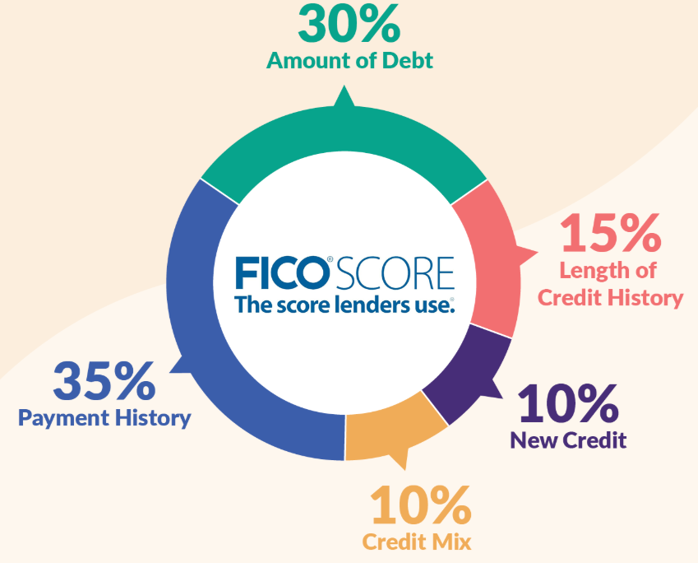
FICO Score (300-850)
Five-factor weightings
  Payment history - 35%
    On-time payments most important for score
  Amounts owed (utilization) - 30%
    Balances vs limits drive next largest effect
  Length of credit history - 15%
    Longer history increases score stability
  New credit (inquiries/opens) - 10%
    Recent accounts and hard pulls lower short-term score.
  Credit mix - 10%
    Variety of installment and revolving accounts modestly helps score.

Slide 15
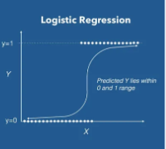
Logistic Regression for Credit Scoring
Probability of default (PD) from borrower features
Use PD for pricing, approval, provisioning, and monitoring

Slide 16
Logistic Regression Inputs
Identifying/demographic fields - age, years on file, employment length, income
Bureau/tradeline metrics - number open accounts, balances, credit limits
Payment history indicators - months since late payment
Utilization measures - revolving utilization overall and card max
New-credit signals - hard inquiries in 30/90 days
Public-record flags - bankruptcy, tax lien, judgment
Loan-specific terms - loan amount, interest rate, LTV for secured
Behavioral / transactional data - recent deposits, NSF events
Macroeconomic context - local unemployment, house price index
Engineered features - debt-to-income ratio, balance trend slope

Slide 17
Credit Scorecards
What a scorecard is
  Predictive table turns borrower features into single risk score
  Higher score lower probability of default (PD)
Why lenders use them
  Fast, interpretable
  Easy to explain to auditors and to follow SR 11-7 governance.

Slide 18
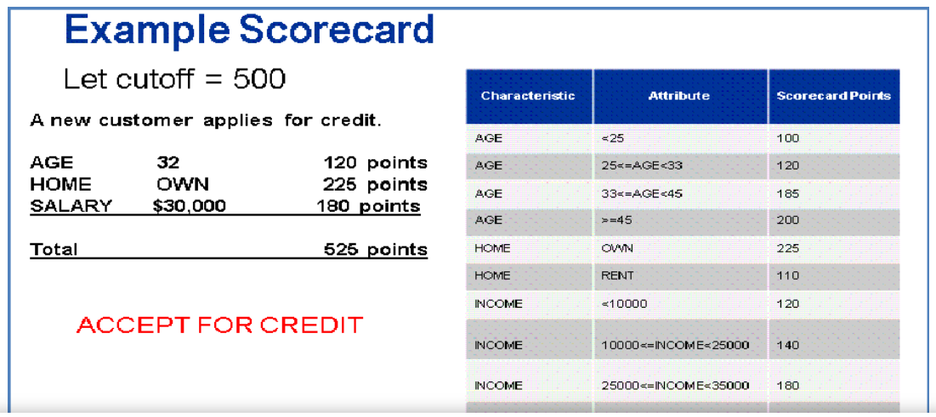
Credit Scorecards

Slide 19
Application vs Behavioral Scorecards
Application Scorecard
New applicants
Approve, price
Demographics
One-time
Behavioral Scorecard
Existing customers
Changes, retention
Payment history
Periodic

Slide 20
3. Data for Credit Risk Modeling

Slide 21
Traditional/Alternative Raw Data
Traditional Data
Credit bureaus
Lenders
Bank statements
Public records
Employment/income docs
Alternative Data
Payment app data
  Rent, utilities, phone bills showing payment timeliness
Transactional/behavioral data
  Cash flow patterns, recurring deposits, spending trends
Digital footprint
  Device signals, IP stability, social graph proxies
Marketplace/platform data
  Seller ratings, gig-economy earnings, booking histories.

Slide 22
Feature Engineering for Credit Applications
Creating new inputs from raw data
Core feature categories:
  Payment history features
  Utilization features
  Capacity features - debt-to-income ratio (DTI) and income volatility
  Collateral features - LTV (loan-to-value) and appraisal age
  Behavioral features - autopay on/off, direct deposit
  Application features - requested amount, purpose code
  Bureau features - #open accounts, #active accounts
  Macro/context features - local unemployment
  Flags/public records - bankruptcy, tax lien
  Engineered interactions - income × employment length.

Slide 23
Fair Lending Data Considerations
Protected classes: Race, national origin, etc. Public assistance, military status, etc.
Permitted: income, assets, employment, credit history, LTV, DTI
Prohibited: direct use of protected attributes in decisions.

Slide 24
Privacy‑Preserving Data Techniques
Minimize-risk of re-identification while keeping analytic value for PD/LGD/EAD models
Maintain regulatory compliance (consent, data minimization, audit trail)
Preserve ability to test fairness and calibration.

Slide 25
4. Machine Learning Approaches

Slide 26
Decision Trees and Random Forests
Decision tree
  Flowchart model that splits borrowers by rules to predict risk
Random forest
  Many decision trees combined; final prediction is average (probability) or majority vote

Slide 27
Decision Trees
Build tree with features separating defaulters vs non-defaulters
Two branches until one outcome
Leaf gives predicted PD (e.g., 25% default if 10 of 40 in leaf defaulted).

Slide 28
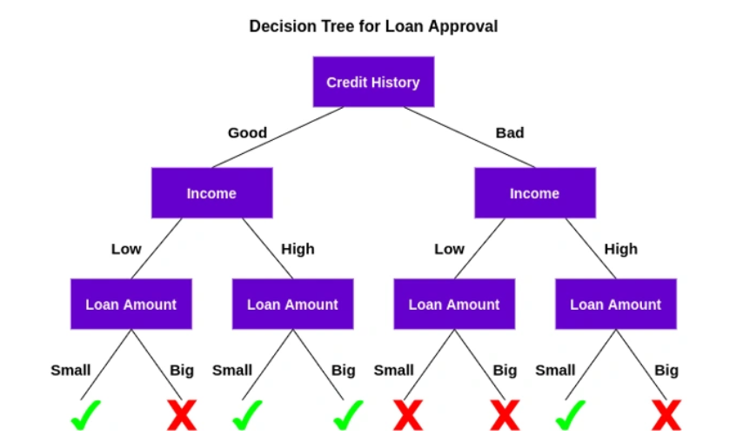
Decision Tree

Slide 29
Random Forests
Train many trees on random subsets of data
Each tree votes; for PD prediction take average of tree probabilities
Reduces overfitting and instability of single trees
Produces feature importance (which features helped most).

Slide 30
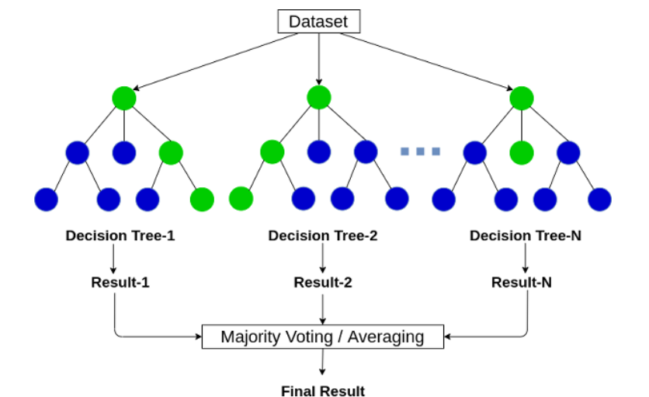
Random Forests

Slide 31
Support Vector Machines for Scoring
Classifies borrowers by finding a boundary that best separates defaulters from non-defaulters
Uses only a few data points (support vectors) that sit closest to that boundary
Can produce non-linear boundaries using a kernel (map features into higher dimension)

Slide 32
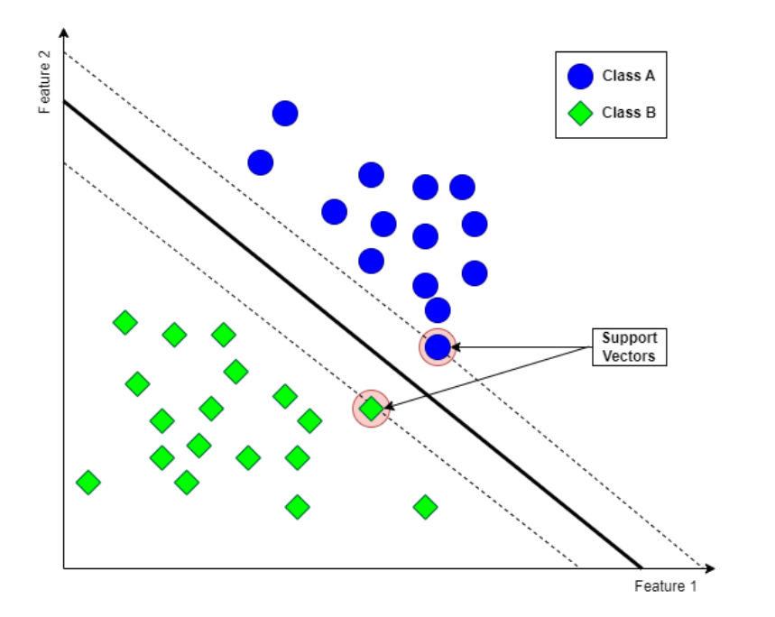
Support Vector Machine

Slide 33
Kernel SVM: Kernel Trick
Can produce non-linear boundaries using a kernel
Transform data so a curved boundary separates classes

Slide 34
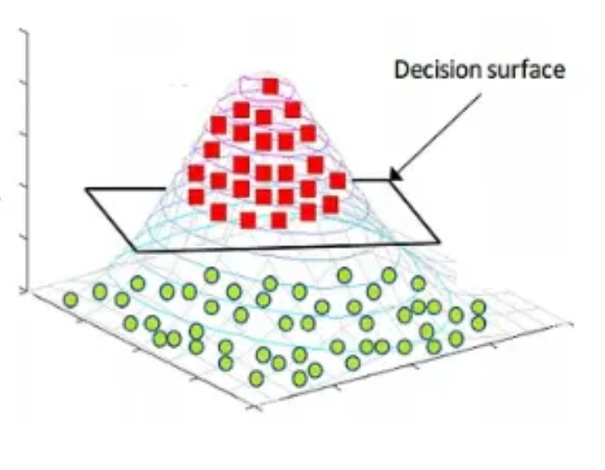
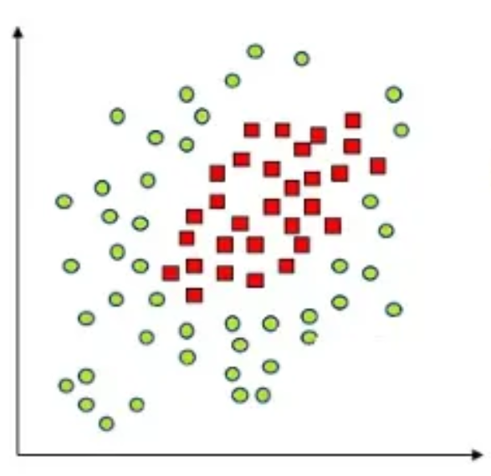
Kernel SVM: Kernel Trick

Slide 35
Neural Networks for Credit Assessment
Learn complex nonlinear relationships and feature interactions automatically
Produce probability-like outputs that can map to PD for pricing and provisioning
Work well with large, rich datasets

Slide 36
Neural Networks: I/O
Inputs
  Payment history, utilization, delinquencies, DTI, loan terms
  Transactional/behavioral sequences
  Engineered features (bins, trends, ratios)
Output & interpretation
  Sigmoid node → value between 0 and 1 → interpreted as PD after calibration

Slide 37
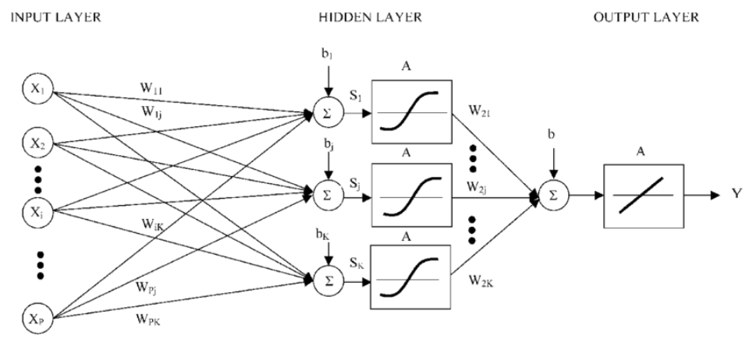
Neural Networks

Slide 38
Ensembles and Stacking for Credit
Ensembles:
  Combine multiple models
  Reduce single-model errors and improve stability.
Stacking:
  Train several different base models on same data
  Generate predictions from base models
  Train a simple meta-model on those predictions
  Meta-model learns best way to combine base-model outputs into final PD

Slide 39
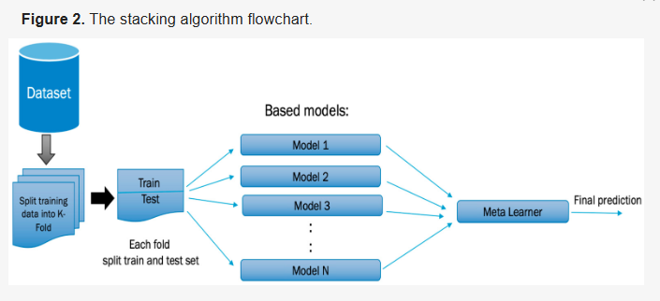
Ensembles and Stacking for Credit

Slide 40
5. Explainability and Interpretability

Slide 41
AI as Black Box
Internal decision process is hard/impossible to understand
You see inputs and outputs but not why the model made that specific decision

Slide 42
Black Box Issues
Opaque logic
  Rules or weights not human-readable
Complex structure
  Deep neural nets or large ensembles
Hard to trace
  Individual prediction paths difficult to explain
Possible instability
  Small input changes can give big output changes.

Slide 43
Why Interpretability Matters in Credit
Regulatory compliance
Actionable decisioning
Dispute resolution
Fairness testing
Debugging and improvement
Calibration & reliability
Trust and adoption
Operational resilience
Legal defensibility

Slide 44
Mitigate black-box risks
Use interpretable models first
Add explainability tools
  SHAP
Create surrogate rules
  Extract a simple decision tree/rule list that approximates model
Calibrate outputs
  Map raw scores to reliable PDs
Keep model documentation
Independent
Human-in-the-loop

Slide 45
SHAP Values for Credit Models
SHAP (SHapley Additive exPlanations)
Each features fair
SHAP value says how much it pushed the score up or down
SHAP values sum to model’s output

Slide 46
LIME for Local Explanations in Credit
LIME = Local Interpretable Model-agnostic Explanations
Fit simple, local surrogate model (usually linear)
Model-agnostic: works with any black-box
LIME coefficients = local feature contributions

Slide 47
Performance versus Interpretability Trade‑Offs
More complex models (NN) → higher predictive power
Simpler models (logistic, scorecard) → higher interpretability
Impact considerations
  Regulatory or legal risk
  High-dollar or systemic decisions
  Frequent consumer disputes or audit scrutiny
  Need for fast human review

Slide 48
6. Regulatory and Ethical Considerations

Slide 49
Equal Credit Opportunity Act (ECOA) US
Prohibits discrimination on protected bases
Requires clear adverse-action notices
Specific reasons for denial.
Regulation B implements these rules

Slide 50
Fair Housing Act (FHA) US
Prohibits discrimination in housing and housing-related credit on protected bases
Applies to lenders making residential mortgage decisions.

Slide 51
General Data Protection Regulation (GDPR) Europe
Lawful basis for processing
Data subject rights: access, rectification, erasure (right to be forgotten), restriction, objection, portability
Data protection by design and by default: incorporate privacy into systems and minimize data
Breach notification: report personal-data breaches to supervisory authority (usually within 72 hours) when required.

Slide 52
Basel III Capital/Liquidity Rules
Common Equity Tier 1 (CET1) minimum 4.5% of risk-weighted assets (RWAs).
Total capital minimum 8% of
Capital conservation buffer (CCB) 2.5% (CET1) sits above the 4.5% minimum
Countercyclical buffer up to 2.5%

Slide 53
Model Risk Management under SR 11‑7
Define roles: owners, validators, governance committees
Require conceptual soundness and outcome analysis
Work example: issues closed within 90 day window Action: track remediation through centralized register

Slide 54
SR 11-7, U.S. Supervisory Guidance (2011)
Expectations for model risk management
Governance, independent validation, monitoring, and control
Ensure models reliable and auditable
Any quantitative method, tool, or process used to make decisions

Slide 55
7. Case Studies and Applications

Slide 56
Consumer Lending
Credit cards: utilization drives PD sensitivity
Auto loans: LTV and term affect risk materially
Mortgages: DTI, LTV, FICO strong predictors

Slide 57
Small Business Lending and Fintech
Use cashflow data from accounting integrations
Alt‑data lifts thin‑file approvals 5-10%
Fintechs deploy rapid e‑KYC automated underwriting

Slide 58
Peer‑to‑Peer Lending Models
Estimate PD using platform investor performance
Loan grades target Gini 30-50 across cohorts

Slide 59
BNPL (Buy Now, Pay Later) and Microfinance Credit Models
BNPL approvals rely behavioral micro‑signals
Short tenor reduces LGD, raises repeat usage
Microfinance uses group lending mitigating default

Slide 60
8. Hands-On Friday:
XXX

Slide 61
Friday Lab Prep
Make sure you can access:
  FIN 450 Lab Report 12
Data:
  x

