Slide 1
FIN 450 - Finance and Artificial Intelligence
Topic 11: NLP in Finance
Larry Schrenk, Instructor

Slide 2
Overview
Introduction to NLP in Finance
Sentiment Analysis
SEC Filings: Sentiment
SEC Filings: Analysis
Earnings Calls
News and Social Sentiment
Financial/Economic News
Other Financial Texts
Advanced NLP Applications
Practical Considerations
Emerging Trends and Tools
Hands-On Friday: Applied AI NLP

Slide 3
1. Introduction to NLP in Finance

Slide 4
Why NLP Matters In Finance
Unlocks unstructured text across financial ecosystems
Speeds insight extraction versus manual reading by 10×
Supports trading, risk, compliance with auditable pipelines
Enhances decision quality under information overload conditions
Work example: Analyst reading 200 pages vs NLP summarizing 10‑K.

Slide 5
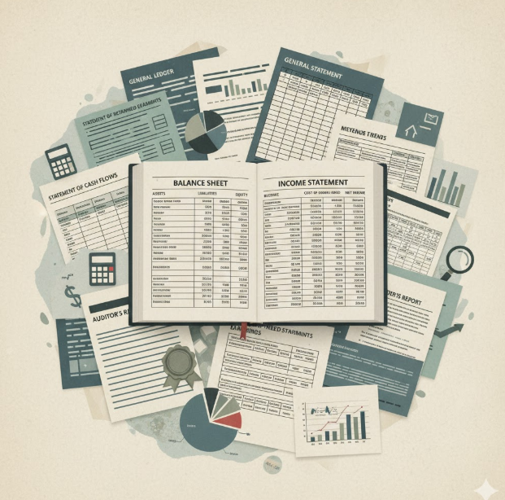
Financial Text Data Landscape
10‑K, 10‑Q, 8‑K filings
Earnings calls, press releases, transcripts
News, social media, macro commentary
Regulator statements, Fed minutes, guidance

Slide 6
NLP Pipeline
Ingest: Cleanses normalizes documents for analysis
Tokenization: Stems lemmatization reduce noise
Feature Engineering: Builds TF‑IDF, embeddings, topics
TF‑IDF (term frequency–inverse document frequency)
Modeling: Applies classifiers, regressors, sequence models

Slide 7
Key Assumptions and Limits
Language varies across industries and cycles
Sarcasm, negation, polysemy distort naive models
Domain adaptation improves precision and recall
Backtesting guards against look‑ahead bias
Target F1 ≥ 0.75.
F1: Single score balances model's precision (how few false alarms) and recall (how few misses)

Slide 8
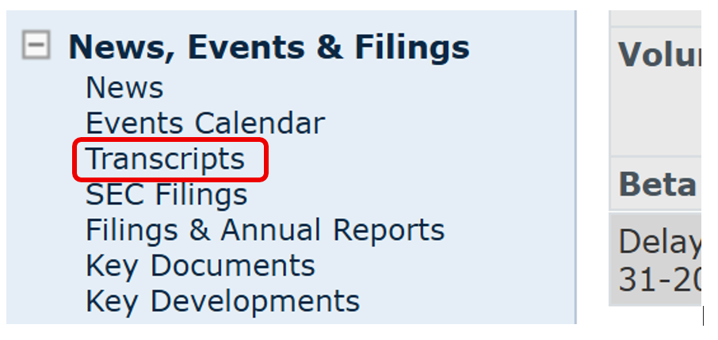
Example Data: Domino’s (DPZ)
10-Ks (2020-2024)
Company Website
(Shareholder Reports (2020-2024))
Company Website
News Items (2020-2024)
ChatGPT 5
Earnings Calls (2020-2024)
S&P Capital IQ
Note: About 2,600 pages
Model: ChatGPT 5 Thinking mini

Slide 9
2. Sentiment Analysis

Slide 10
Sentiment Basics and Definitions
Polarity scores quantify positive neutral negative tone
Lexicon approaches use curated finance word lists
ML approaches learn sentiment from labeled corpora
Transformer models capture contextual semantics
FinBERT achieves ~85% F1 on finance sentiment.

Slide 11
Sentiment Metrics in Practice
Document score aggregates sentence‑level polarities
Confidence intervals quantify signal stability ranges
Event windows align sentiment with return windows
Sharpe improvements benchmark predictive utility gains
Metric: ΔSharpe +0.10 acceptable.

Slide 12
2.A SEC Filings: Sentiment

Slide 13
10-K Structure
Part I
Item 1 Business
Item 1A Risk Factors
Item 1B Unresolved Staff Comments
Item 2 Properties
Item 3 Legal Proceedings
Item 4 Mine Safety Disclosures
Part II
Item 5 Market for Registrant’s Common Equity, …
Item 6 Selected Financial Data
Item 7 Man. Discussion & Analysis (MD&A).
Item 7A Disclosures about Market Risk
Item 8 Financial Statements/Supplementary Data
Item 9 Changes/Disagree. with Accountants
Item 9A Controls and Procedures
Item 9B Other Information
Part III
Item 10 Directors, Executive Officers,…
Item 11 Executive Compensation
Item 12 Security
Item 13 Certain Relationships/Transactions
Item 14 Accountant Fees and Services
Part IV
Item 15 Exhibits
Item 16 Signatures
Footnotes

Slide 14
Foundations
Tone, uncertainty, readability for disclosures
Use Loughran‑McDonald finance lexicons (LM)
Lexicons for sentiment analysis in financial texts
Compute Fog Index readability across sections
Years of education required
Fog > 18 → heavy complexity
Compare MD&A tone versus risk factors tone
Cross‑year sentiment

Slide 15
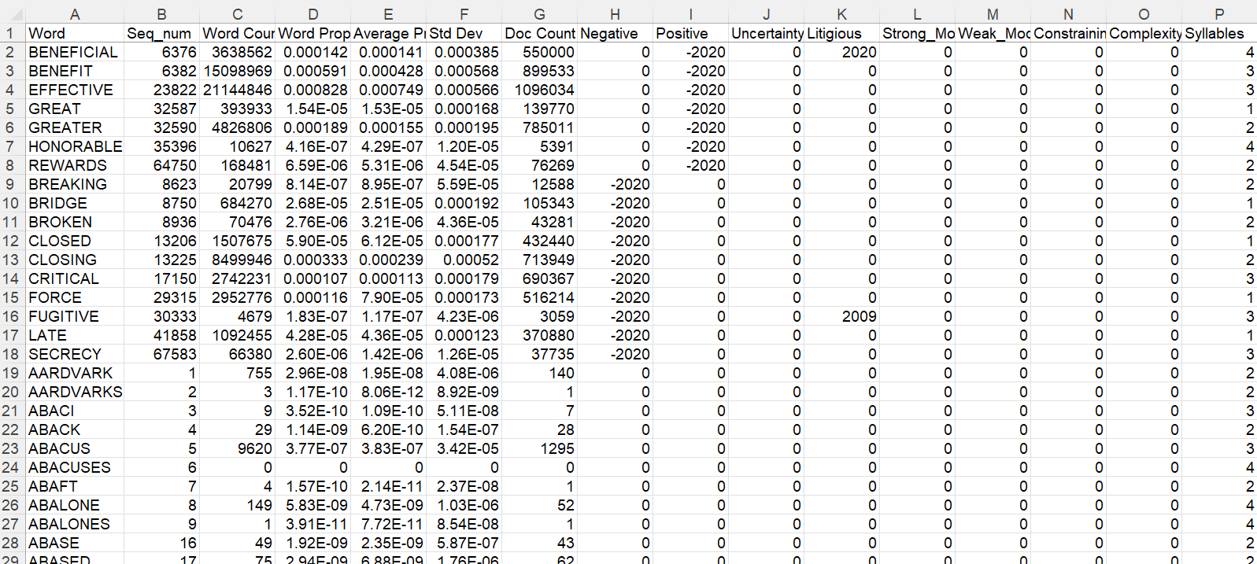
Loughran‑McDonald Finance Lexicons (LM)
About 86,000 words

Slide 16
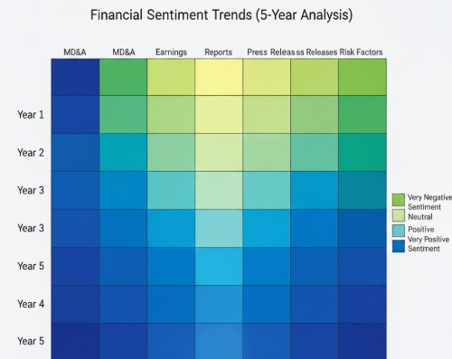
Examples
Consumer staples steadier tone
Biotech risk sections spike negative terminology
Utilities maintain stable readability metrics
Heatmaps show cross‑year tone drift patterns

Slide 17
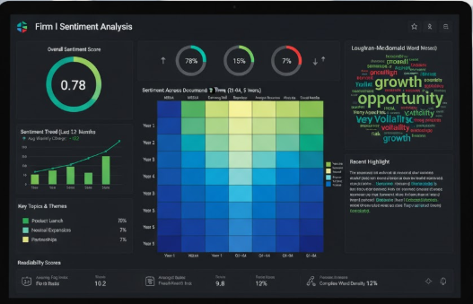
Finance Applications
Capital budgeting adjust hurdle rates by uncertainty
Credit analysis link tone to spread changes
Equity valuation update multiples after tone shifts
Risk dashboards track disclosure sentiment quarterly

Slide 18
Inputs and Outputs
Inputs: Filings text, section boundaries, dates
Calculations: Polarity, uncertainty, readability indices
Outputs: Scores, trends, alerts, backtest results
Decisions: Rebalance, hedge, engage management

Slide 19
AI‑Enhanced Approach
FinBERT embeddings capture domain contextual nuance
LLM summarization extracts material changes precisely
Active learning improves label efficiency 50-70%

Slide 20
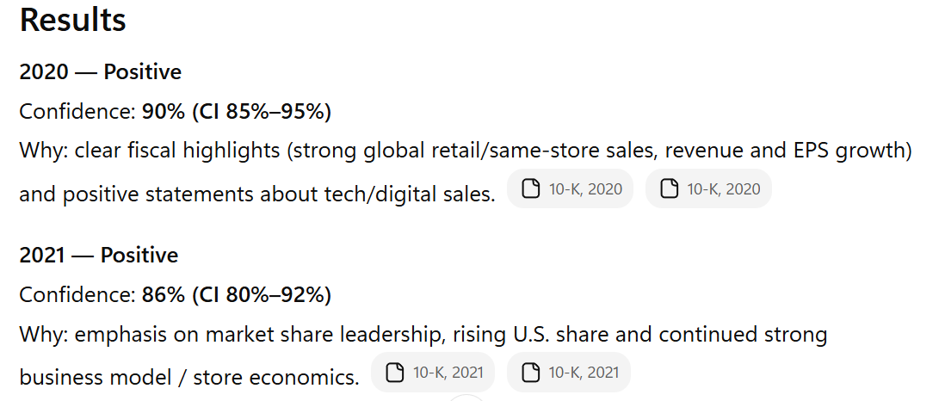
10-K Sent: DPZ Example 1
Classify the sentiment of each 10K into positive, neutral, negative and provide confidence intervals.

Slide 21
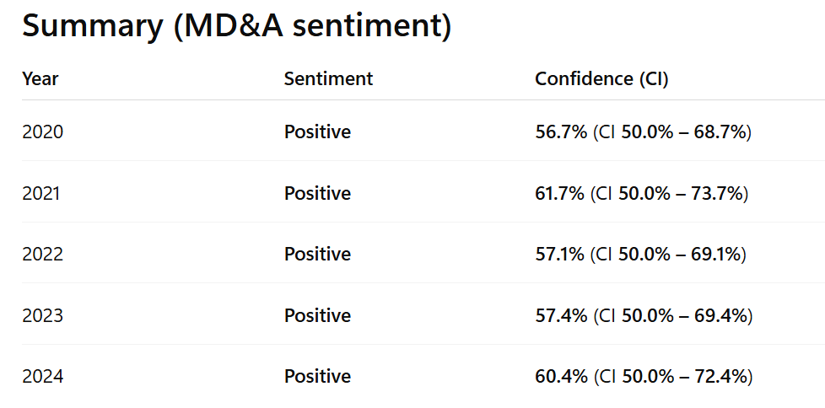
10-K Sent: DPZ Example 2
Classify the sentiment of the Management’s Discussion & Analysis (MD&A) section of each 10K into positive, neutral, negative and provide confidence intervals.

Slide 22
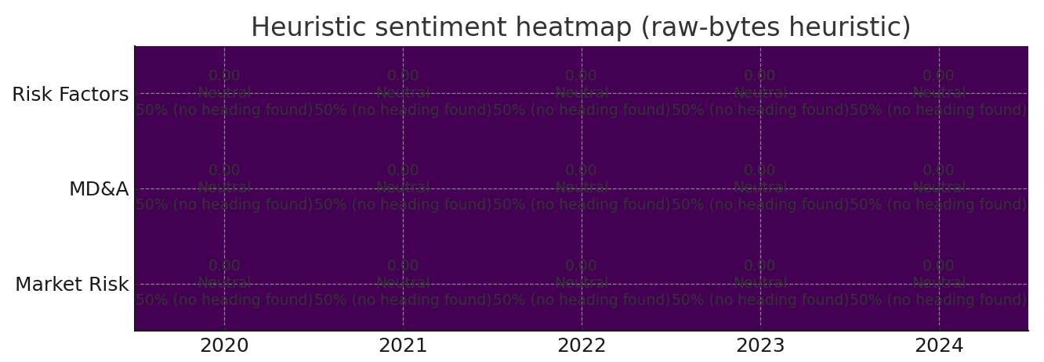
10-K Sent: DPZ Example 3
Create a heat map of the sentiment of the i) Risk Factors, ii) Management’s Discussion & Analysis (MD&A), and iii) Disclosures about Market Risk sections of each 10K.

Slide 23
2.B SEC Filings: Analysis

Slide 24
Examples and Visuals
Identify covenant terms within credit agreements
Extract segment revenue disclosures by geography
Detect related‑party transactions within footnotes
Flag non‑GAAP reconciliation inconsistencies quickly

Slide 25
Foundations
Section segmentation: MD&A, risks, footnotes
NER tags entities, instruments, jurisdictions
NER = Named Entity Recognition
Relation extraction links events and participants
Change detection highlights cross‑year edits.

Slide 26
Finance Applications
Valuation models update revenue mix
Covenant monitoring automates surveillance
Risk teams score litigation exposure language
Audit teams triage disclosure anomalies early

Slide 27
Inputs and Outputs
Inputs: HTML filings, exhibit links, XBRL tags
Calculations: Entity spans, relations, change deltas
Outputs: Knowledge graphs, alerts, dashboards
Decisions: Revise forecasts, adjust reserves, escalate

Slide 28
AI‑Enhanced Approach
Domain‑tuned transformers improve extraction
RAG answers targeted filing questions reliably
Auto‑summaries provide executive brief within minutes

Slide 29
Traditional versus AI
Rule engines brittle across format changes
AI models generalize across issuers and years
Maintenance costs decline under model retraining
Explainability improves via SHAP attribution
SHAP (SHapley Additive exPlanations) assigns feature’s contribution value to a prediction

Slide 30
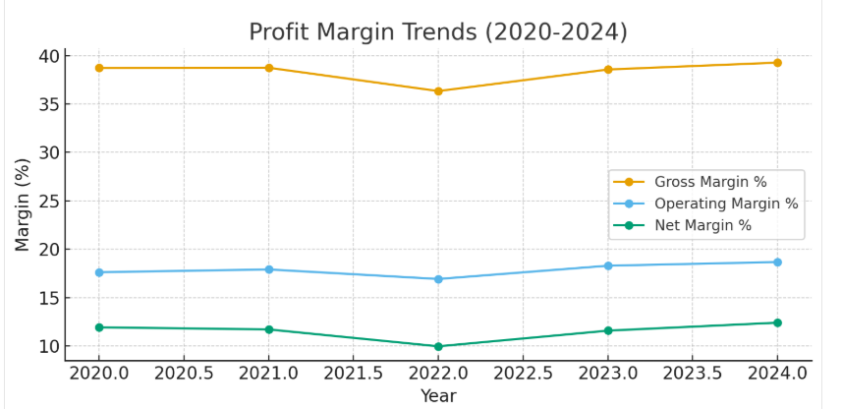
10-K Anal: DPZ Example 1a
Compare the profit margins (gross, operating, and net) across all five years. What trends do you see, and what factors does management cite as driving margin expansion or compression?

Slide 31
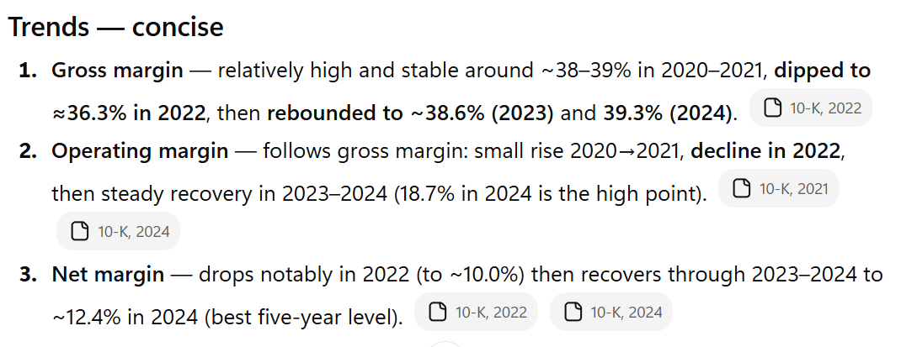
10-K Anal: DPZ Example 1b
Compare the profit margins (gross, operating, and net) across all five years. What trends do you see, and what factors does management cite as driving margin expansion or compression?

Slide 32
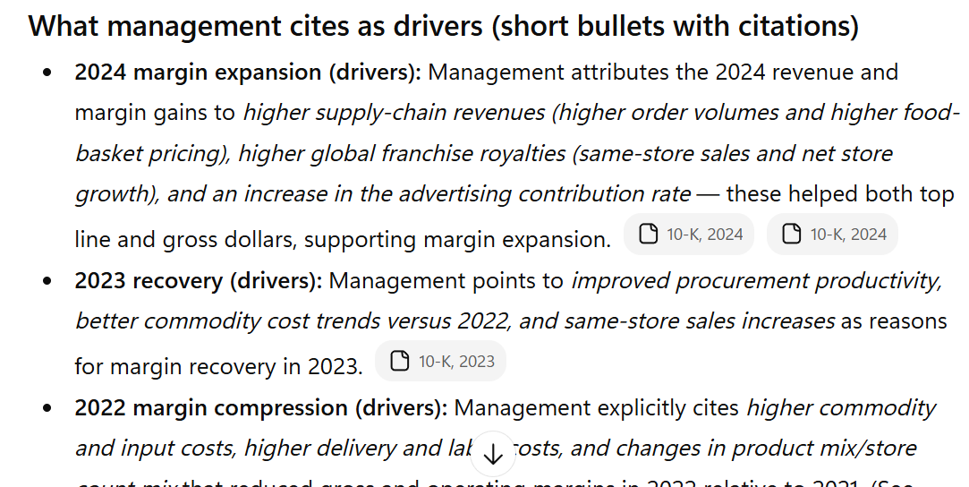
10-K Anal: DPZ Example 1c
Compare the profit margins (gross, operating, and net) across all five years. What trends do you see, and what factors does management cite as driving margin expansion or compression?

Slide 33
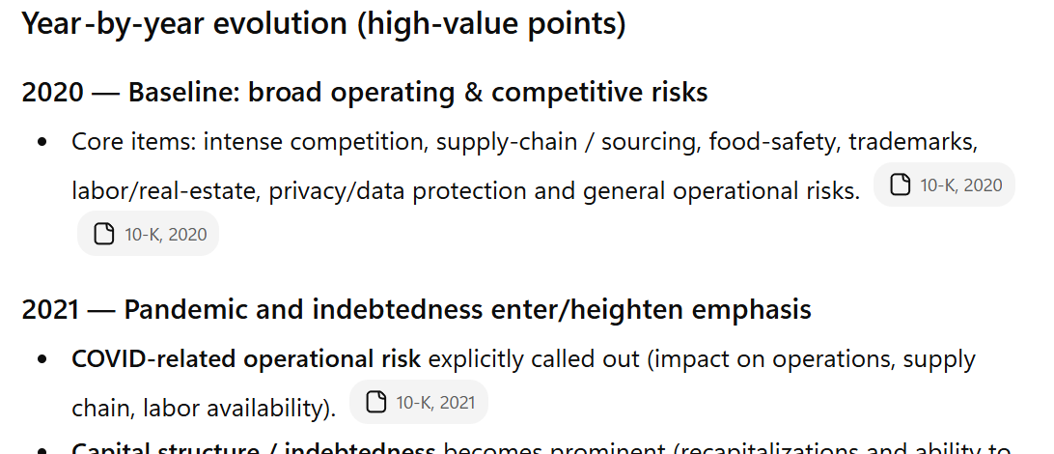
10-K Anal: DPZ Example 2
Track how the 'Risk Factors' section has evolved year-over-year. What new risks have emerged, which have disappeared, and which have become more prominent?

Slide 34
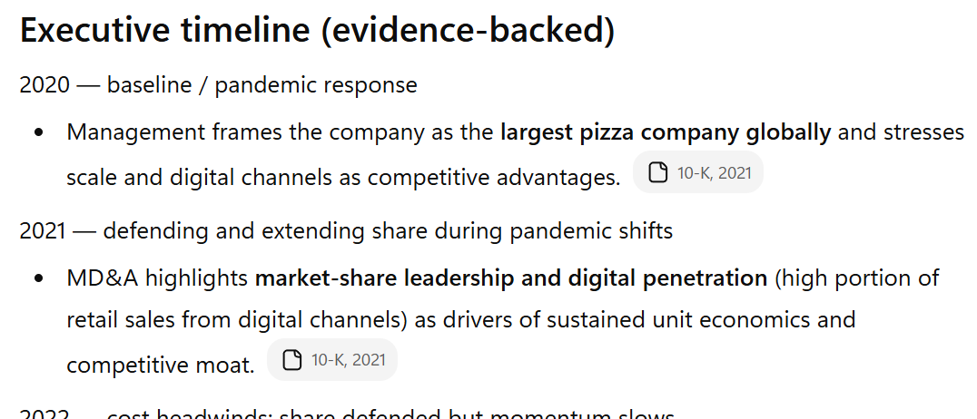
10-K Anal: DPZ Example 3
Analyze the competitive landscape discussion across all 5 years. How has the company's competitive positioning evolved, and what market share gains/losses are evident?

Slide 35
2.C Earnings Calls

Slide 36
What are Earnings Calls?
Executives report results and forward guidance.
Prepared remarks, then Q&A
Market-moving events
Key signals: Revenue/earnings surprises, margin commentary, cash flow outlook, and any guidance revisions.
Analyzed via transcripts
IMPORTANT: Q&A only unscripted info.

Slide 37
Foundations
Transcripts split by speaker and section
Audio cues beyond text semantics
Q&A tone diverges from prepared remarks
Obfuscation detection flags evasive responses

Slide 38

Examples
CEO confidence spikes before guidance raise events
CFO hedging language precedes expense surprises
Analyst follow‑ups indicate unresolved uncertainty
Word clouds reveal shifting strategic themes

Slide 39
Finance Applications
Sentiment changes →Trading signal
Risk models adjust VaR with tone shocks
Portfolio overweight improving tone cohorts
IR teams prioritize outreach by concern themes

Slide 40
Inputs and Outputs
Inputs: Audio, transcript, timestamps, speakers
Calculations: Sentiment, uncertainty, evasiveness indices
Outputs: Alerts, factor exposures, alpha scores
Decisions: hedge earnings, trim positions, re‑weight

Slide 41
AI‑Enhanced Approach
ASR convert audio with WER < 10%
Emotion recognition augments text sentiment scores
LLM agents auto‑draft investor call summaries
RAG retrieves guidance history for comparisons

Slide 42
Traditional versus AI
Manual note‑taking slower, inconsistent across analysts
AI notes standardized, timestamped, queryable
Productivity gains reduce review time by 70%
Governance improves via full audit trails

Slide 43
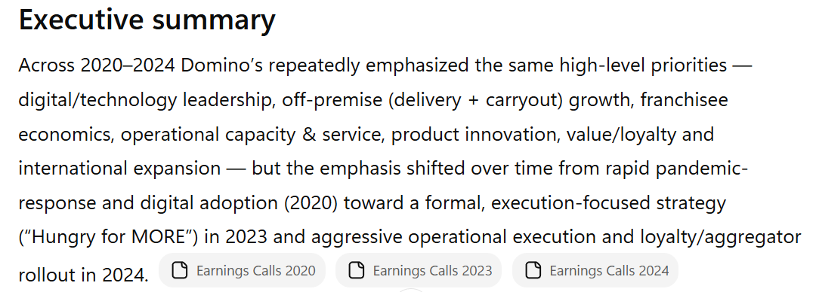
Earnings Call: DPZ Example 1a
Identify and track recurring themes, priorities, and strategic initiatives mentioned across all earnings calls. How have the company's stated priorities evolved over this period?

Slide 44
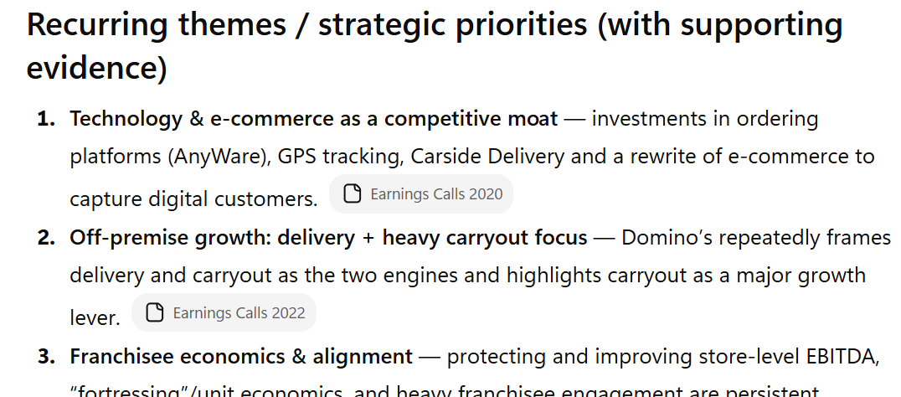
Earnings Call: DPZ Example 1b
Identify and track recurring themes, priorities, and strategic initiatives mentioned across all earnings calls. How have the company's stated priorities evolved over this period?

Slide 45
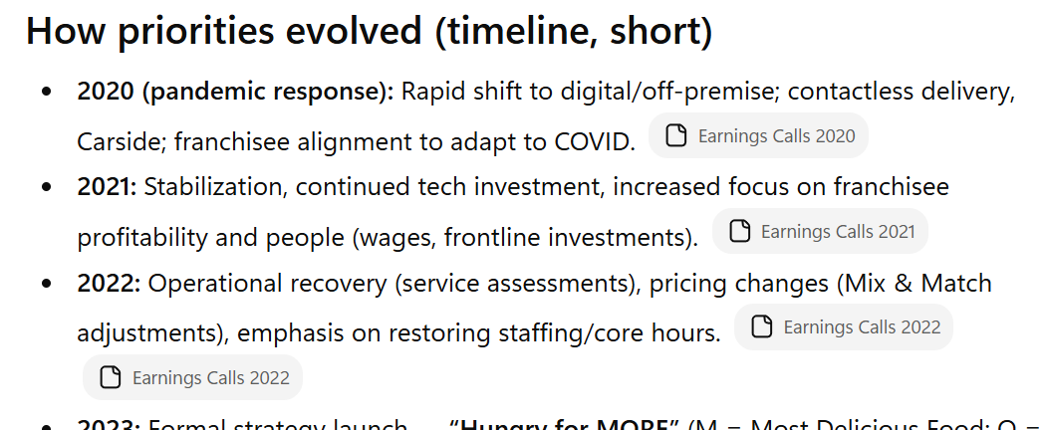
Earnings Call: DPZ Example 1c
Identify and track recurring themes, priorities, and strategic initiatives mentioned across all earnings calls. How have the company's stated priorities evolved over this period?

Slide 46
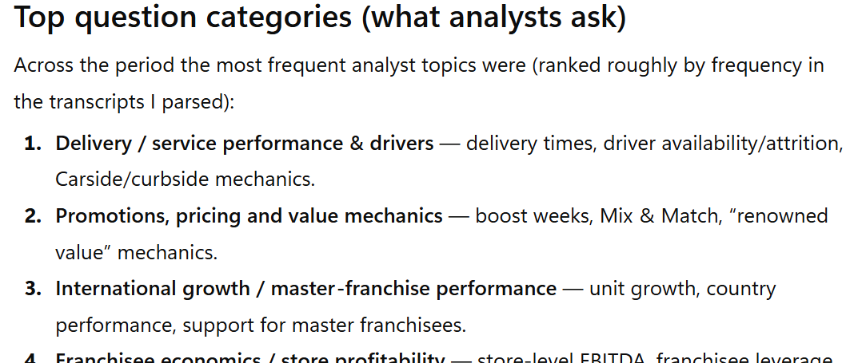
Earnings Call: DPZ Example 2a
Categorize the questions analysts ask each quarter. What topics receive the most scrutiny? Are there questions management consistently deflects or avoids?

Slide 47
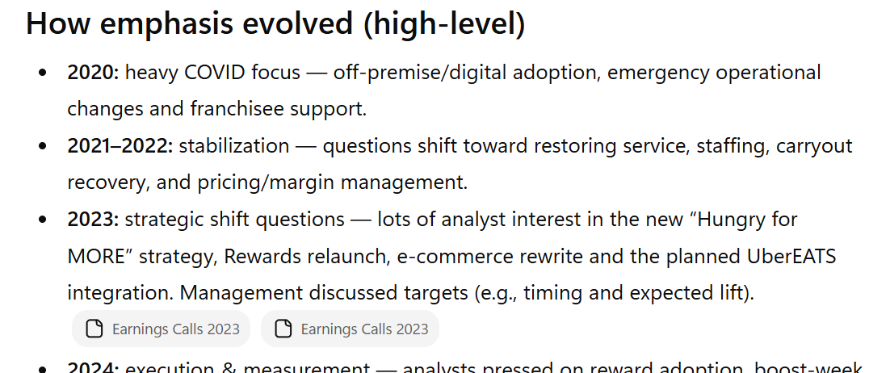
Earnings Call: DPZ Example 2b
Categorize the questions analysts ask each quarter. What topics receive the most scrutiny? Are there questions management consistently deflects or avoids?

Slide 48
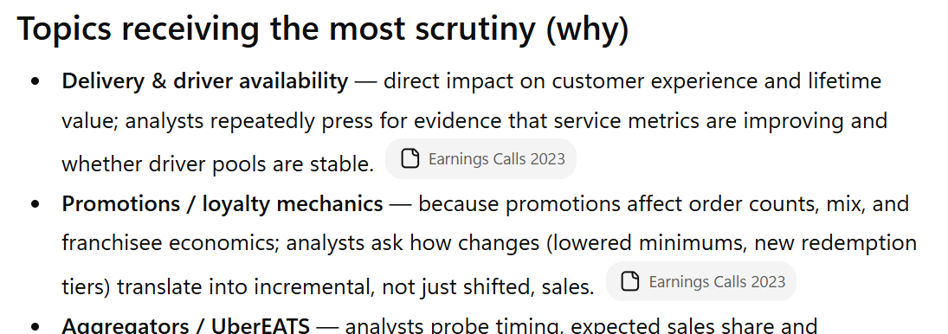
Earnings Call: DPZ Example 2c
Categorize the questions analysts ask each quarter. What topics receive the most scrutiny? Are there questions management consistently deflects or avoids?

Slide 49
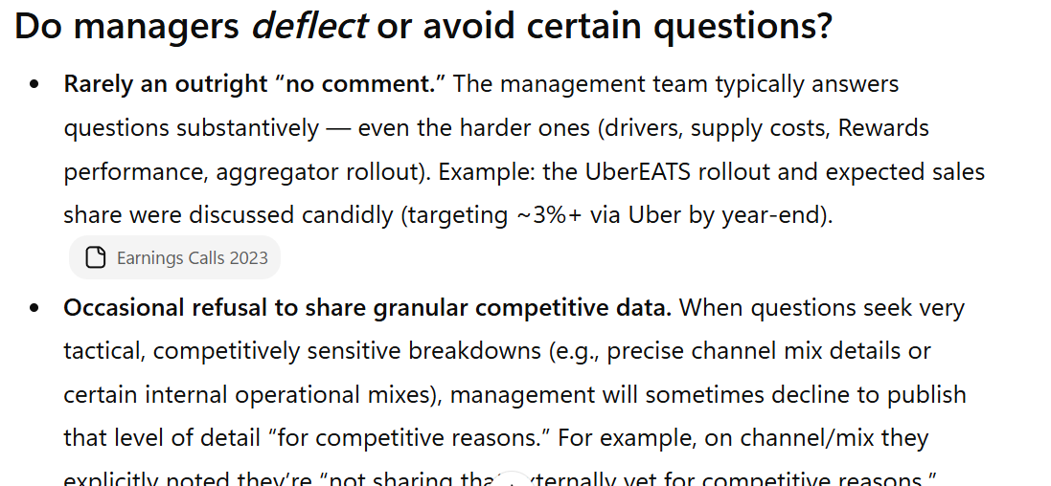
Earnings Call: DPZ Example 2d
Categorize the questions analysts ask each quarter. What topics receive the most scrutiny? Are there questions management consistently deflects or avoids?

Slide 50
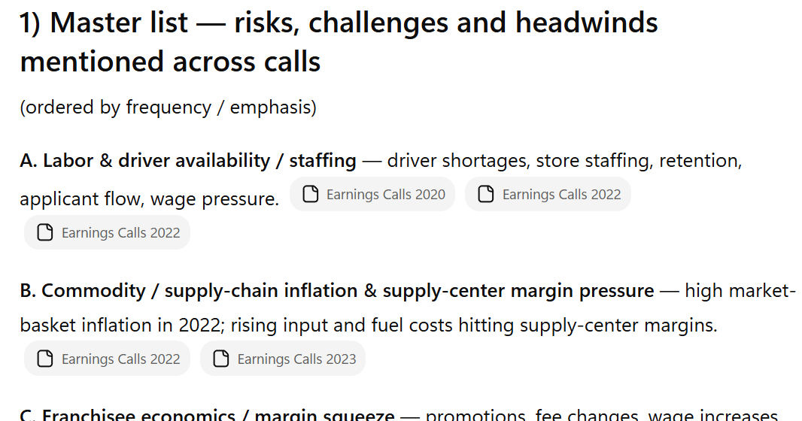
Earnings Call: DPZ Example 3a
Compile all risks, challenges, and headwinds mentioned across calls. Which risks materialized? Which disappeared? What new risks emerged?

Slide 51
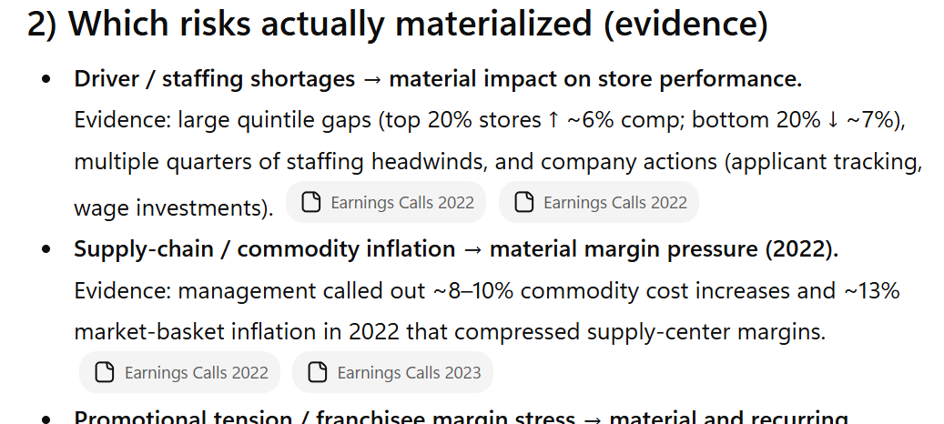
Earnings Call: DPZ Example 3b
Compile all risks, challenges, and headwinds mentioned across calls. Which risks materialized? Which disappeared? What new risks emerged?

Slide 52
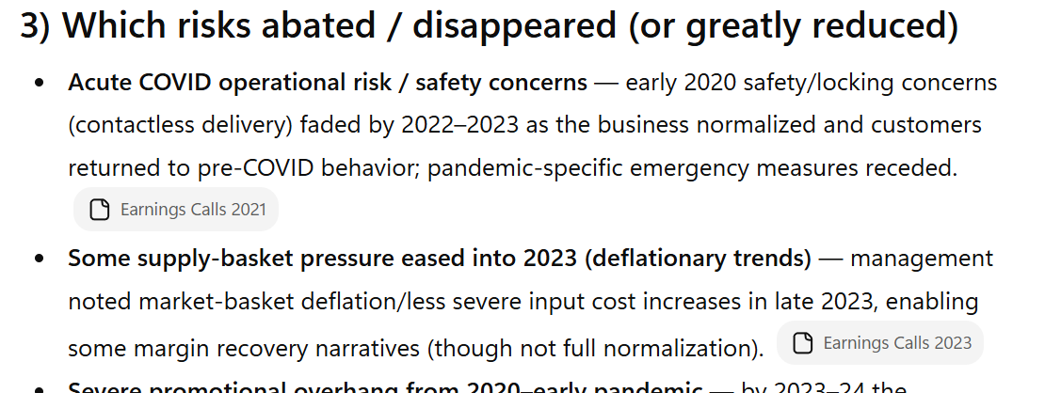
Earnings Call: DPZ Example 3c
Compile all risks, challenges, and headwinds mentioned across calls. Which risks materialized? Which disappeared? What new risks emerged?

Slide 53
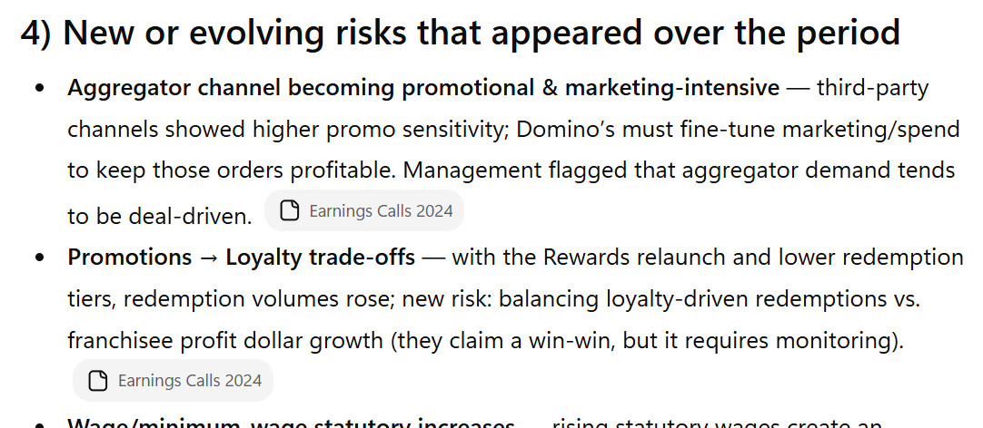
Earnings Call: DPZ Example 3d
Compile all risks, challenges, and headwinds mentioned across calls. Which risks materialized? Which disappeared? What new risks emerged?

Slide 54
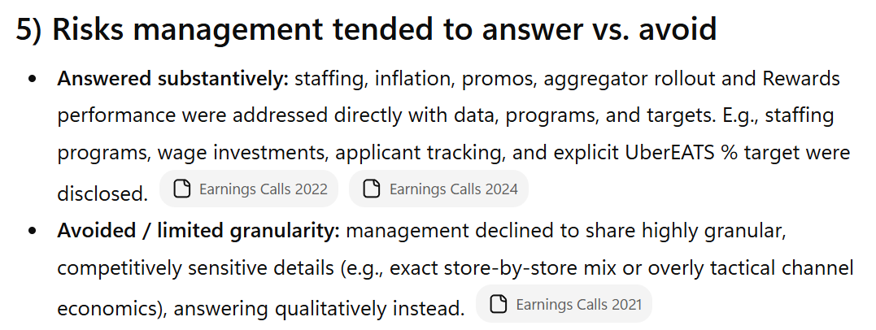
Earnings Call: DPZ Example 3e
Compile all risks, challenges, and headwinds mentioned across calls. Which risks materialized? Which disappeared? What new risks emerged?

Slide 55
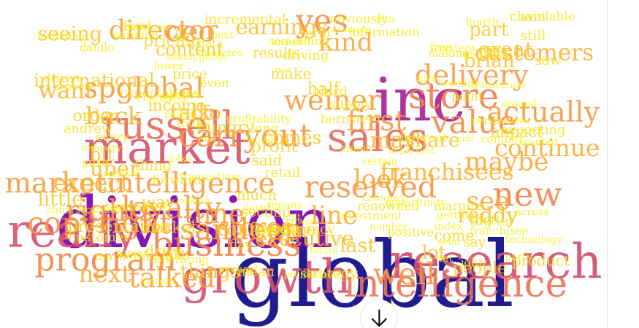
Earnings Call: DPZ Example 4
Create a Word Cloud from the Earning Calls for 2024.

Slide 56
2.C News and Social Sentiment

Slide 57
Foundations
Real‑time ingestion handles millisecond latency constraints
De‑duplication clusters syndicated wire stories
Entity linking resolves tickers, aliases, parents
Bot filtering cleans social spam accounts

Slide 58
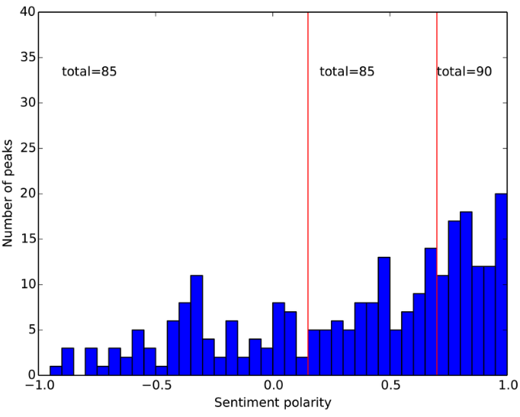
Examples
Macro headlines shift FX within minutes
M&A rumors spike options implied volatility
ESG news moves utilities spread levels
Retail chatter drives meme stock volatility

Slide 59
Finance Applications
Event detectors trigger stop‑loss risk controls
Thematic baskets rebalance on sustained tone shifts
Compliance monitors misinformation amplification risks

Slide 60
Inputs and Outputs
Inputs: Headlines, posts, tickers, timestamps
Calculations: Sentiment, novelty, velocity metrics
Outputs: Scores, alerts, routing priorities
Decisions: Quote, hedge, route, pause trading

Slide 61
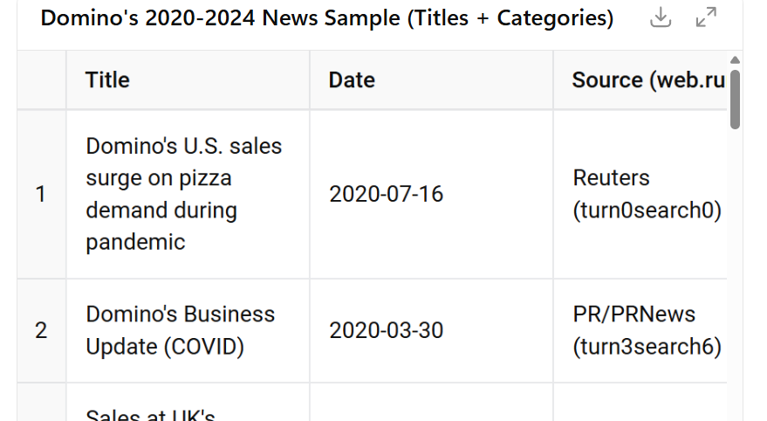
News: DPZ Example 1a
Categorize all news articles about Domino’s Pizza from 2020 to 2024. Provide a table and a pie chart.

Slide 62
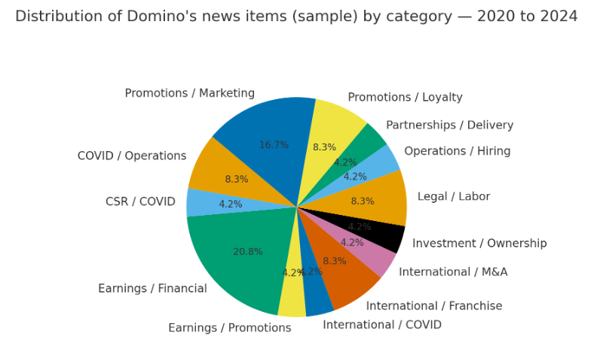
News: DPZ Example 1b
Categorize all news articles about Domino’s Pizza from 2020 to 2024. Provide a table and a pie chart.

Slide 63
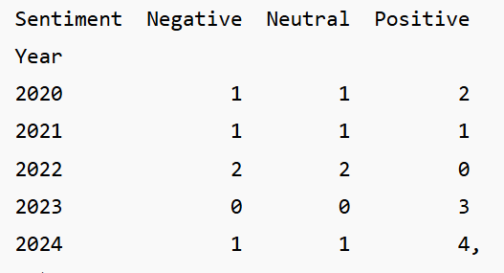
News: DPZ Example 2a
Determine the sentiment (positive, neutral, negative) of all news articles about Domino’s Pizza from 2020 to 2024 and create a vertical bar graph by year.

Slide 64
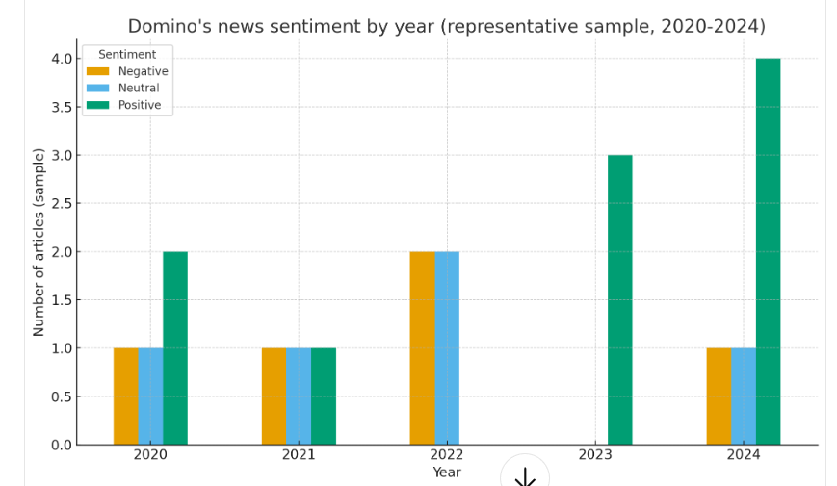
News: DPZ Example 2b
Determine the sentiment (positive, neutral, negative) of all news articles about Domino’s Pizza from 2020 to 2024 and create a vertical bar graph by year.

Slide 65
2.E Financial/Economic News

Slide 66
Foundations
Topic models cluster stories by themes
Zero‑shot labels apply taxonomy without training
Multilabel tagging handles overlapping categories
Entity disambiguation aligns company families

Slide 67
Examples
Group earnings beats, misses, guidance changes
Cluster macro prints: CPI, jobs, PMI releases
Separate M&A rumors from confirmed transactions
Distinguish regulatory actions from proposals

Slide 68
Finance Applications
Build factor exposures by thematic frequencies
Backtest topic drift versus returns and vol
Drive newsletter personalization for clients

Slide 69
Inputs and Outputs
Inputs: Headlines, full text, publisher metadata
Calculations: Topic probabilities, label confidence
Outputs: Tags, themes, coverage breadth statistics
Decisions: Coverage focus, resource allocation, timing

Slide 70
AI‑Enhanced Approach
Encoder‑decoder models summarize category rationales
Prompted LLMs validate ambiguous headlines reliably
Continual learning adapts to new macro regimes
Human feedback raises calibration reliability

Slide 71
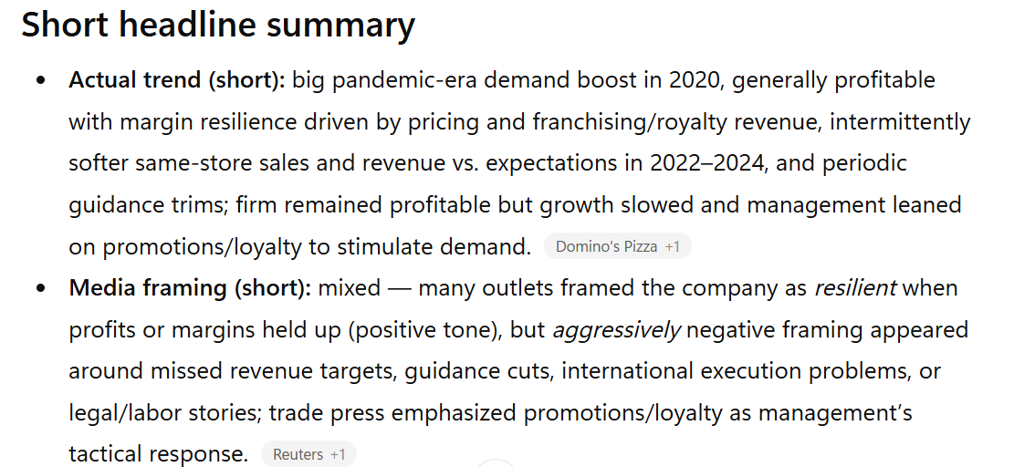
Financial News: DPZ Example 1a
Summarize how the Domino’s (DPZ) reported financial metrics (revenue, profit, margins, etc.) have been portrayed in media coverage. Compare actual performance trends with how aggressively or conservatively the media framed them.

Slide 72
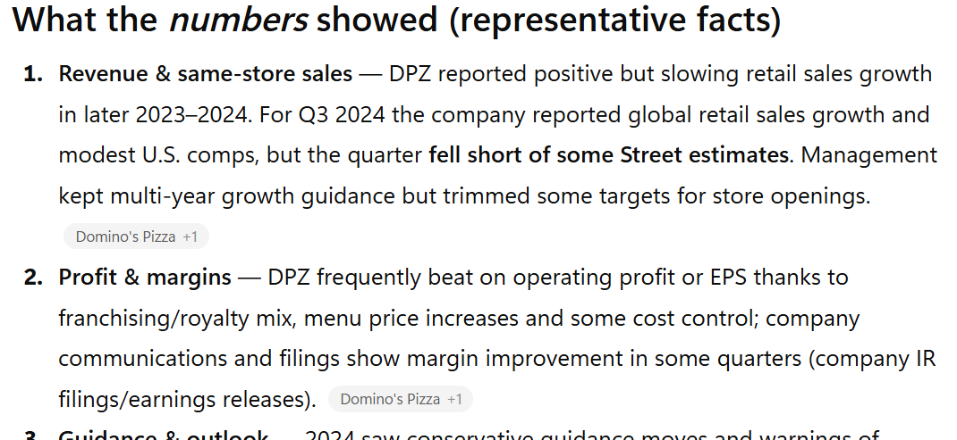
Financial News: DPZ Example 1b
Summarize how the Domino’s (DPZ) reported financial metrics (revenue, profit, margins, etc.) have been portrayed in media coverage. Compare actual performance trends with how aggressively or conservatively the media framed them.

Slide 73
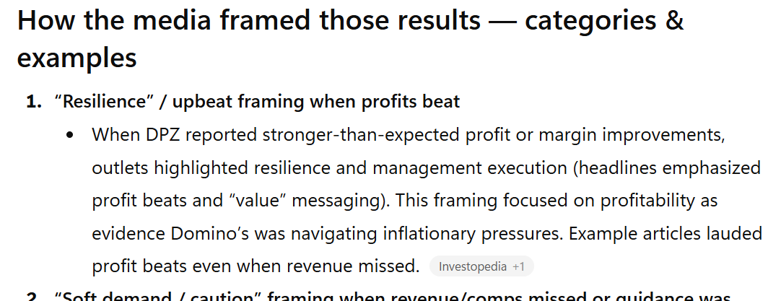
Financial News: DPZ Example 1c
Summarize how the Domino’s (DPZ) reported financial metrics (revenue, profit, margins, etc.) have been portrayed in media coverage. Compare actual performance trends with how aggressively or conservatively the media framed them.

Slide 74
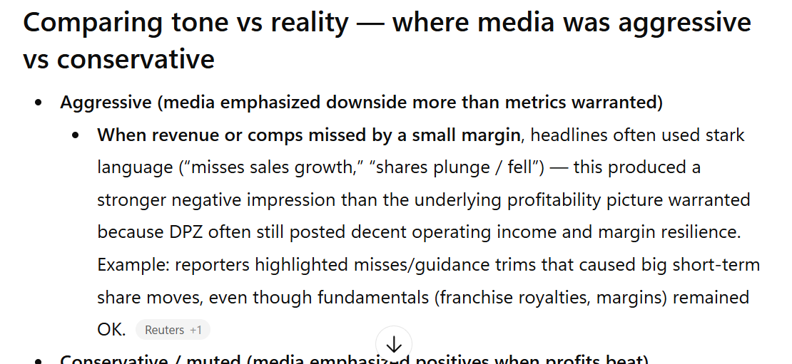
Financial News: DPZ Example 1d
Summarize how the Domino’s (DPZ) reported financial metrics (revenue, profit, margins, etc.) have been portrayed in media coverage. Compare actual performance trends with how aggressively or conservatively the media framed them.

Slide 75
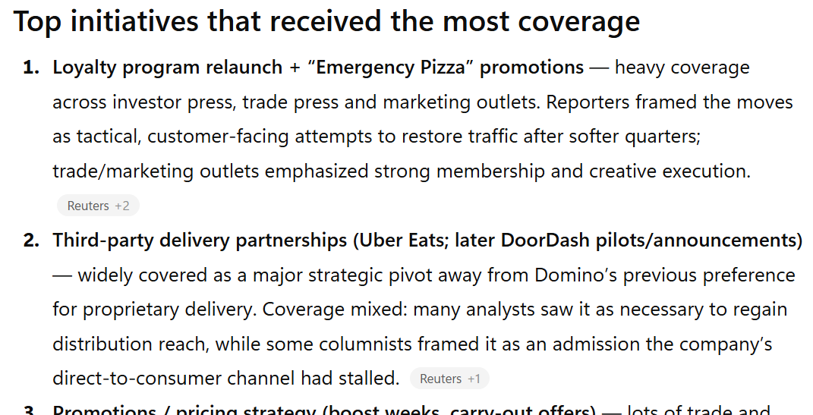
Financial News: DPZ Example 2a
Analyze how articles discuss Domino’s (DPZ) leadership decisions and strategic pivots. What initiatives received the most coverage, and how did expert commentary evaluate their success?

Slide 76
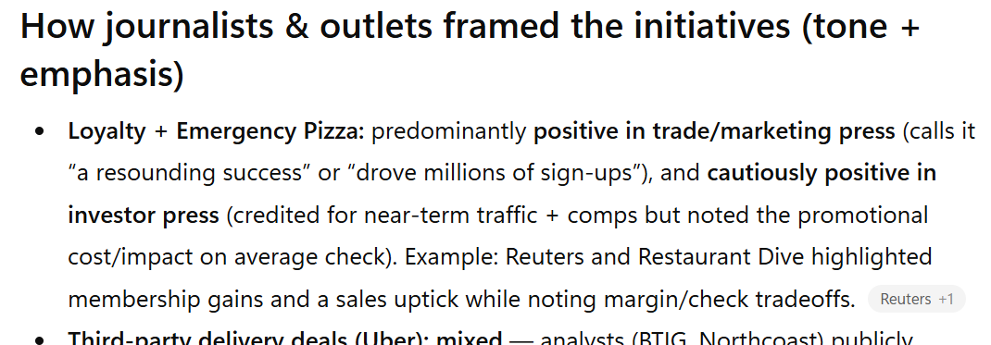
Financial News: DPZ Example 2b
Analyze how articles discuss Domino’s (DPZ) leadership decisions and strategic pivots. What initiatives received the most coverage, and how did expert commentary evaluate their success?

Slide 77
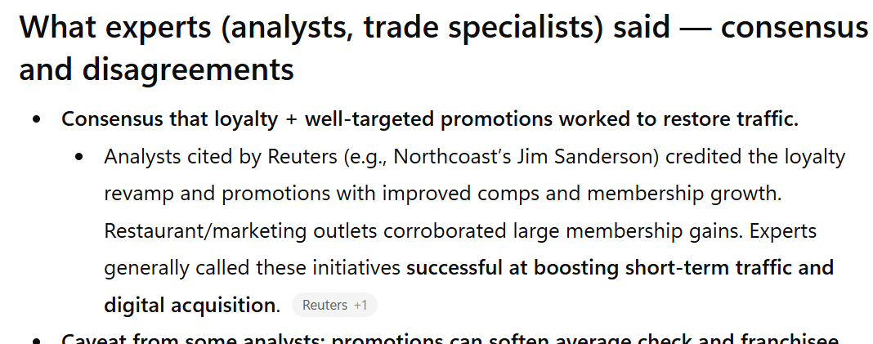
Financial News: DPZ Example 2c
Analyze how articles discuss Domino’s (DPZ) leadership decisions and strategic pivots. What initiatives received the most coverage, and how did expert commentary evaluate their success?

Slide 78
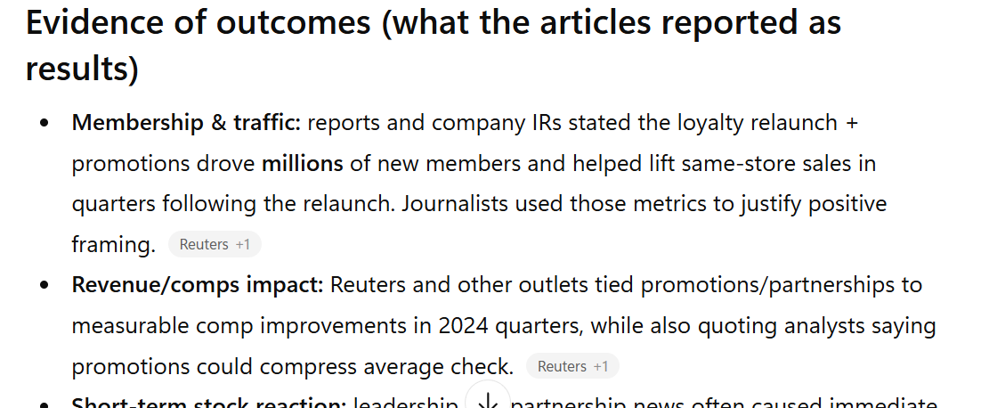
Financial News: DPZ Example 2d
Analyze how articles discuss Domino’s (DPZ) leadership decisions and strategic pivots. What initiatives received the most coverage, and how did expert commentary evaluate their success?

Slide 79
2.F Other Financial Texts

Slide 80
Central Bank Communication
Track hawkish/dovish tone around rate decisions
Align tone shifts with yield curve movements
Map forward guidance to inflation expectation changes
Compare speeches across FOMC members systematically

Slide 81
Analyst Reports and Recommendations
Extract rating changes and target price deltas
Link thesis language to factor exposures shifts
Detect herding behavior across research houses
Quantify conviction using intensity and specificity

Slide 82
Corporate Press Releases
Identify material events within boilerplate text
Classify guidance range updates and revisions
Detect crisis language and remediation steps
Trigger disclosure monitoring and escalation workflows

Slide 83
3. Emerging Trends and Tools

Slide 84
Large Language Models in Finance
Domain‑tuned LLMs power drafting and analysis
Prompt engineering improves reliability and control
Cost declines via quantization and distillation
Risk managed through evals and red‑teaming

Slide 85
Multimodal and Explainability
Combine text with tables, charts, images
Attention maps and SHAP improve transparency
Counterfactuals test sensitivity to key phrases
Reports include rationales for regulator review

Slide 86
4. Hands-On Friday: Applied AI NLP

Slide 87
Friday Lab Prep
Make sure you can access:
FIN 450 Lab Report 11
Data:
10-Ks (2020-2024)
Company Website
(Shareholder Reports (2020-2024))
Company Website
News Items (2020-2024)
ChatGPT 5
Earnings Calls (2020-2024)
S&P Capital IQ

