Slide 1
FIN 422: Student Managed Investment Fund
Topic 8: Evaluation of Portfolio Performance
Larry Schrenk, Instructor

Slide 2
Overview
18.1 The Two Questions of Performance Measurement
18.2 Simple Performance Measurement Techniques
18.3 Risk-Adjusted Portfolio Performance Measures
18.4 Application of Portfolio Performance Measures
18.5 Holdings-Based Portfolio Performance Measurement
18.6 The Decomposition of Portfolio Returns
18.7 Factors That Affect Use of Performance Measures
18.8 Reporting Investment Performance

Slide 3
Learning Objectives
What are the two main questions of performance measurement?
What are the peer group comparison and portfolio drawdown methods of evaluating an investor’s performance?
What are the Sharpe and Treynor ratios?
What is Jensen’s alpha, and how can it be adapted to include multifactor models of risk and expected return?
What are the information ratio and the Sortino ratio, and how are they related to the other performance measures?
When evaluating a sample of portfolios, how do you determine how well diversified they are?
How can investment performance be measured by analyzing the security holdings of a portfolio?
What is attribution analysis, and how can it be used to distinguish between a portfolio manager’s market timing and security selection skills?
What are customized benchmarks, and what are the important characteristics that any benchmark should possess?
What are time-weighted and dollar-weighted returns, and which should be reported under the CFA Institute’s Global Investment Performance Standards?

Slide 4
Readings
Reilley, et al., Investment Analysis and Portfolio Management, Chap. 18

Slide 5
18.1 The Two Questions of Performance Measurement

Slide 6
18.1 The Two Questions of Performance Measurement
Actual return split into:
Return given capital commitment and risk in the portfolio
Incremental return due to superior skills (alpha)
Three ways to estimate expected returns:
Peer group of comparably managed portfolios
Contemporaneous return to an index
Return estimated by a risk factor model

Slide 7
18.1 The Two Questions of Performance Measurement
Two main performance:
How did manager actually perform?
Why did the manager perform as they did?

Slide 8
18.1 The Two Questions of Performance Measurement

Slide 9
18.2 Simple Performance Measurement Techniques

Slide 10
18.2.1 Peer Group Comparisons
Collects peer returns over a specific period in simple boxplot format
Potential problems
No adjustment for risk
Difficult to form a comparable peer group
Relative returns lose sight individual objectives

Slide 11
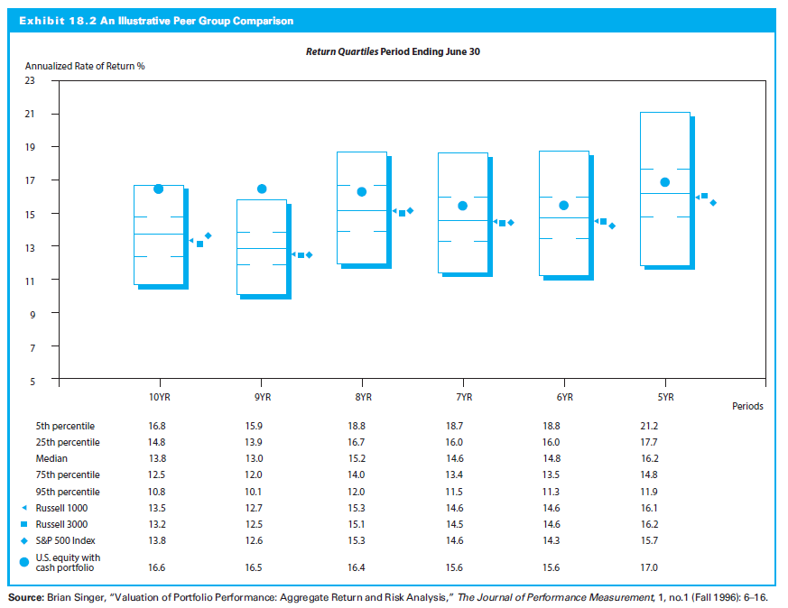
18.2.1 Peer Group Comparisons

Slide 12
18.2.2 Portfolio Drawdown
Portfolio drawdown: How investor protected against losses over time
Maximum drawdown: Maximum percentage decline (peak to trough) over time horizon

Slide 13
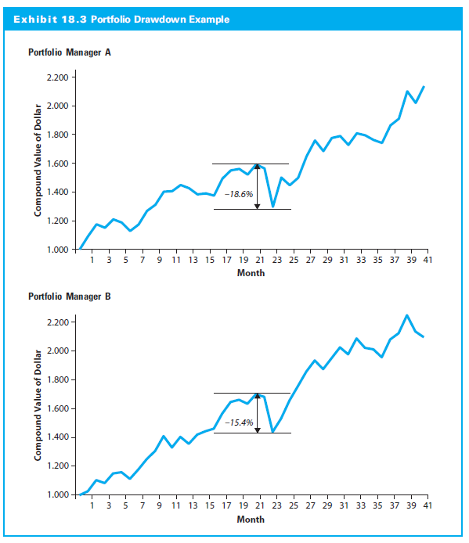
18.2.2 Portfolio Drawdown

Slide 14
18.3 Risk-Adjusted Portfolio Performance Measures

Slide 15
18.3 Risk-Adjusted Portfolio Performance Measures
Five major risk/return measures:
Sharpe Ratio
Treynor Ratio
Jensen’s Alpha
Information Ratio
Sortino Ratio

Slide 16
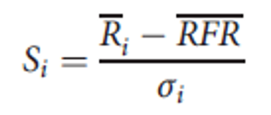
18.3.1 Sharpe Ratio
Risk premium of the portfolio by using the standard deviation of returns
Where:

Slide 17
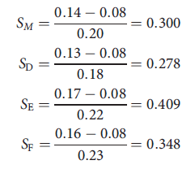
18.3.1 Sharpe Ratio
Risk-adjusted performance of the following portfolios:
Sharpe ratio for each of these funds:

Slide 18
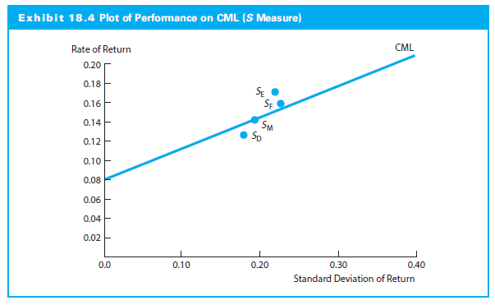
18.3.1 Sharpe Ratio

Slide 19
18.3.2 Treynor Ratio
Treynor (1965)
Two components of risk:
Risk from general market fluctuations
Risk from unique fluctuations
Introduced the characteristic line
Risk free asset combined with different portfolios formed portfolio possibility line
Rational investors would always prefer the portfolio line with the highest slope

Slide 20
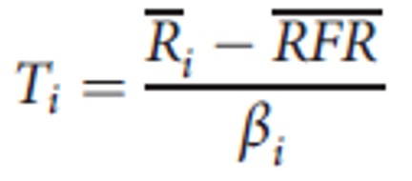
18.3.2 Treynor Ratio
Slope (T) of portfolio possibility line:
Where:
β_{M} = slope of the fund’s characteristic line during that time period

Slide 21
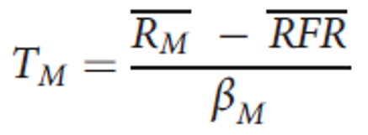
18.3.2 Treynor Ratio
Comparing portfolio’s T with market’s T indicates whether portfolio above security market line (SML)
Calculate T for aggregate market:
Where:
β_{M} = 1.0 (the market’s beta)
T_{M} = slope of the SML

Slide 22
18.3.2 Treynor Ratio
Demonstration of Comparative Treynor Ratios
Assume again that R_{M} = 0.14 and RFR = 0.08
Deciding between different portfolios, based on performance:

Slide 23
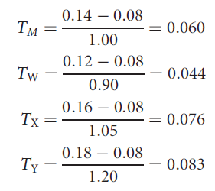
18.3.2 Treynor Ratio
T values for market vs. individual portfolios:

Slide 24
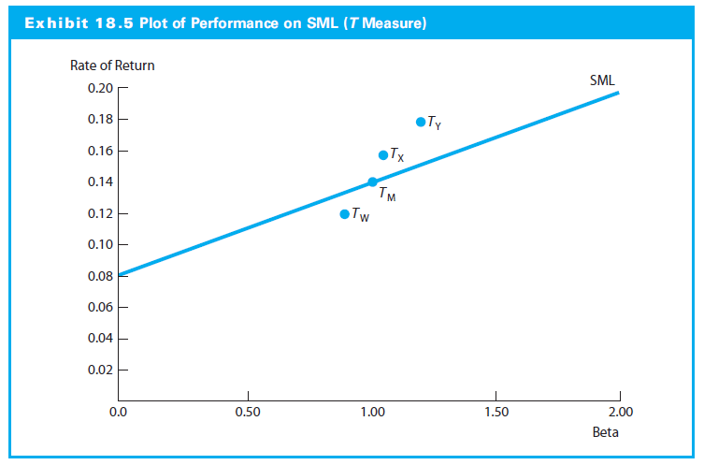
18.3.2 Treynor Ratio

Slide 25
18.3.3 Jensen’s Alpha
The Jensen’s alpha (Jensen, 1968) was originally based on CAPM:
Positive α_{j} indicates superior or inferior performance

Slide 26
18.3.3 Jensen’s Alpha
Applying the Jensen’s Alpha
Jensen’s alpha requires different RFR for each time interval
It does not consider diversification, because it calculates risk premiums in terms of systematic risk
Risk-adjusted performance (α) can be computed relative to any multifactor model:

Slide 27
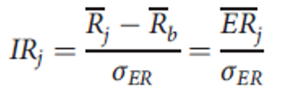
18.3.4 Information Ratio
Information ratio is portfolio average return in excess of benchmark divided by standard deviation of excess return:
Where:

Slide 28
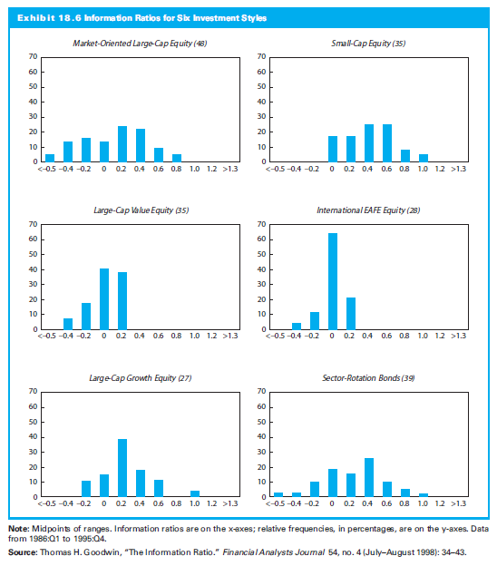
18.3.4 Information Ratio Performance Measure

Slide 29
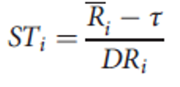
18.3.5 Sortino Ratio
Sortino and Price (1994) :
Where:
τ = minimum acceptable return threshold specified for the time period
Dr_{i} = downside risk coefficient for Portfolio i during the specified time period

Slide 30
18.3.5 Sortino Ratio
Downside risk:
Volatility fall below some hurdle rate
Measures volatility of shortfall if investment return lower than anticipated
Measures only downside risk
Popular measure is the semi-deviation; portfolio’s average (expected) return as hurdle rate:

Slide 31
18.3.5 Sortino Ratio
Sortino differs from Sharpe in two ways:
Measures average return in excess of a minimum acceptable return (often RFR)
Sortino ratio captures just downside risk (DR) in the portfolio; Sharpe focuses on total risk.

Slide 32
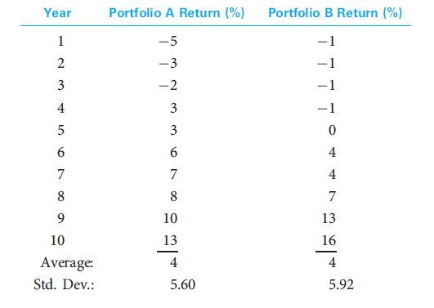
18.3.5 Sortino Ratio
Comparing the Sharpe and Sortino Ratios

Slide 33
18.3.5 Sortino Ratio
Using semi-deviation to compute DR for portfolios:
When only less-than-expected return considered, A now riskier due to more extreme negative returns

Slide 34
18.3.5 Sortino Ratio
Assuming 2% threshold to match the Sharpe ratio, Sortino ratios indicate B superior performer:

Slide 35
18.3.6 Summarizing the Risk-Adjusted Performance Measures
Each risk-adjusted performance statistic widely used in practice and has strengths and weaknesses

Slide 36
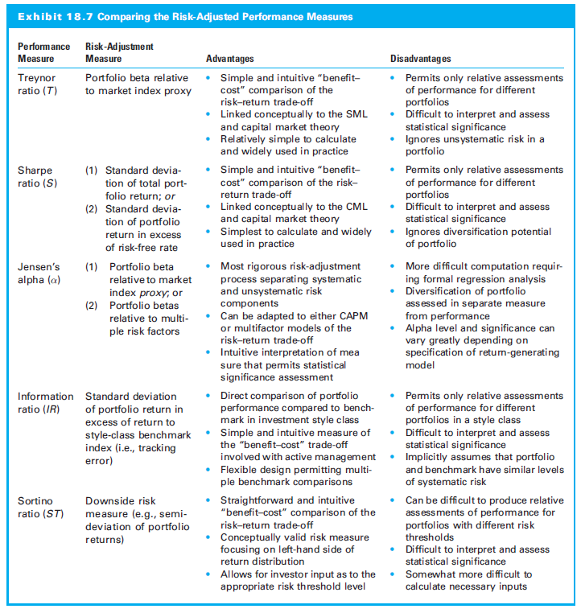
18.3.6 Summarizing the Risk-Adjusted Performance Measures

Slide 37
18.4 Application of Portfolio Performance Measures

Slide 38
18.4 Application of Portfolio Performance Measures
Total rate of return on a mutual fund
Where
R_{it} = Total rate of return on Fund i during month t
EP_{it} = Ending price for Fund i during month t
Div_{it} = Dvidend payments made by Fund i during month t
Cap.Dist._{it} = Capital gain distributions made by Fund i during month t
BP_{it} = Beginning price for Fund i during month t

Slide 39
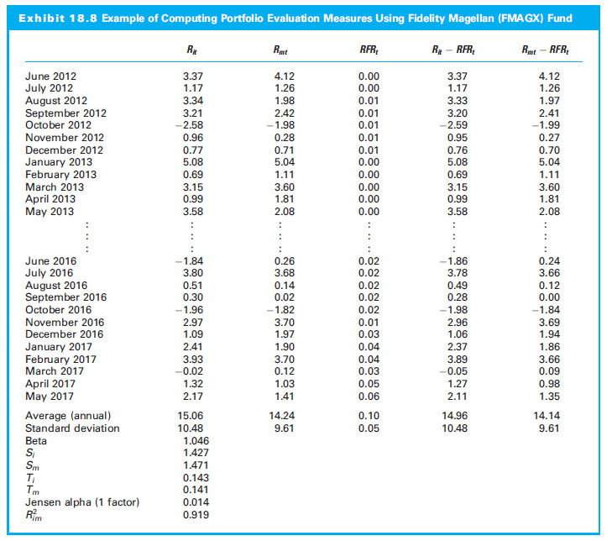
18.4 Application of Portfolio Performance Measures

Slide 40
18.4 Application of Portfolio Performance Measures
Total Sample Results
30 open-end mutual funds; nine investment styles; monthly data July 2005 to June 2010
Active fund managers performed much better than earlier studies
Primary factor: Abnormally poor performance of index
Performance measures ranked the individual funds consistently

Slide 41
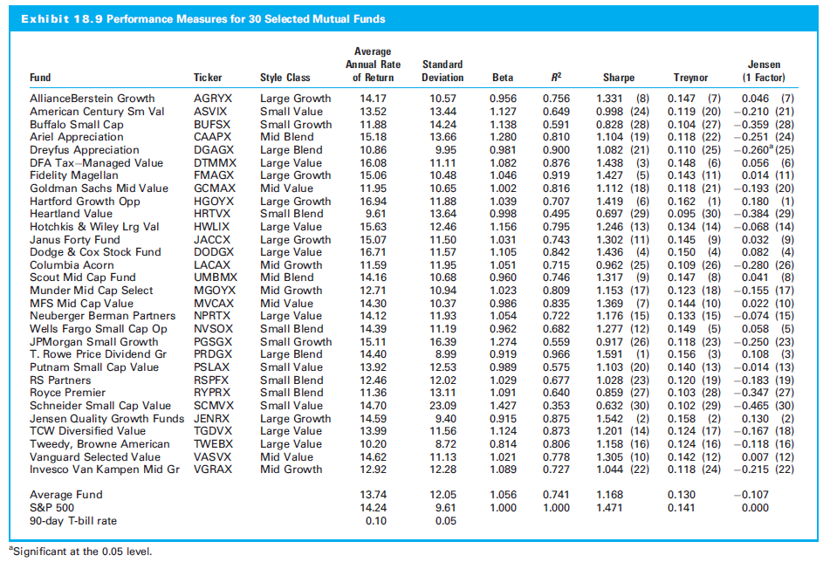
18.4 Application of Portfolio Performance Measures

Slide 42
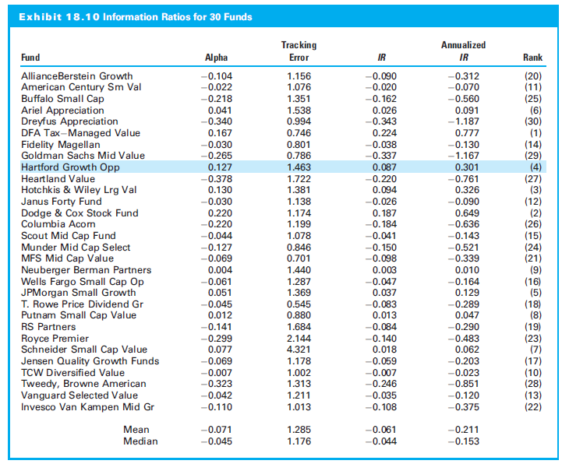
18.4 Application of Portfolio Performance Measures

Slide 43
18.4 Application of Portfolio Performance Measures
Measuring Performance with Multiple Risk Factors
Jensen’s alpha for 30 mutual funds using two versions of Fama-French/Carhart:

Slide 44
18.4 Application of Portfolio Performance Measures
Jensen’s alphas relative to:
Fama-French three-factor model: (R_{m} - RFR), firm size (SMB), and relative valuation (HML) variables
Carhart four-factor model: Also includes the return momentum (MOM) variable
One-factor and multifactor Jensen’s alphas produce similar but distinct performance rankings

Slide 45
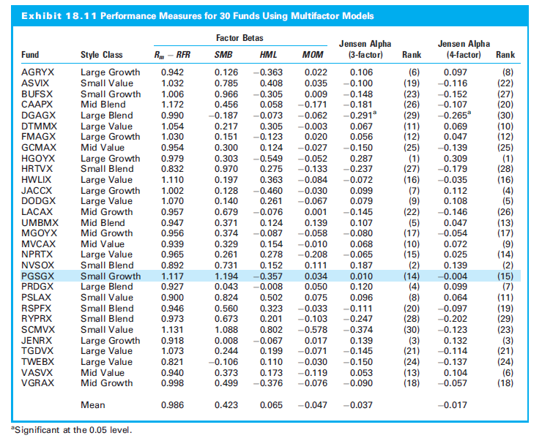
18.4 Application of Portfolio Performance Measures

Slide 46
18.4 Application of Portfolio Performance Measures
Relationship among Performance Measures
Implications of high positive correlations:
Remain distinct at an individual level
Best to consider these composites collectively
User must understand what each means

Slide 47
18.4 Application of Portfolio Performance Measures

Slide 48
18.5 Holdings-Based Portfolio Performance Measurement

Slide 49
18.5 Holdings-Based Portfolio Performance Measurement
Two advantages of assessing with investment returns:
Returns are easy to observe on a frequent basis
Represent investor benefits
View investment performance in terms of securities bought or sold from the portfolio
Holdings-based measure provides additional insights about performance

Slide 50
18.5.1 Grinblatt-Titman Performance Measure
Assess quality by adjustments to portfolios
Grinblatt-Titman performance measure (GT) :
Where:
(wjt, wjt–1) = the portfolio weights for the jth security at the beginning of Period t and Period t - 1, respectively
R_{jt} = the return to the jth security during Period t, which
begins on Date t - 1 and ends on Date t

Slide 51
18.5.1 Grinblatt-Titman Performance Measure
Computed without reference to any specific benchmark
Fails to reward or penalize for portfolio adjustments in which the share price changes in later period

Slide 52
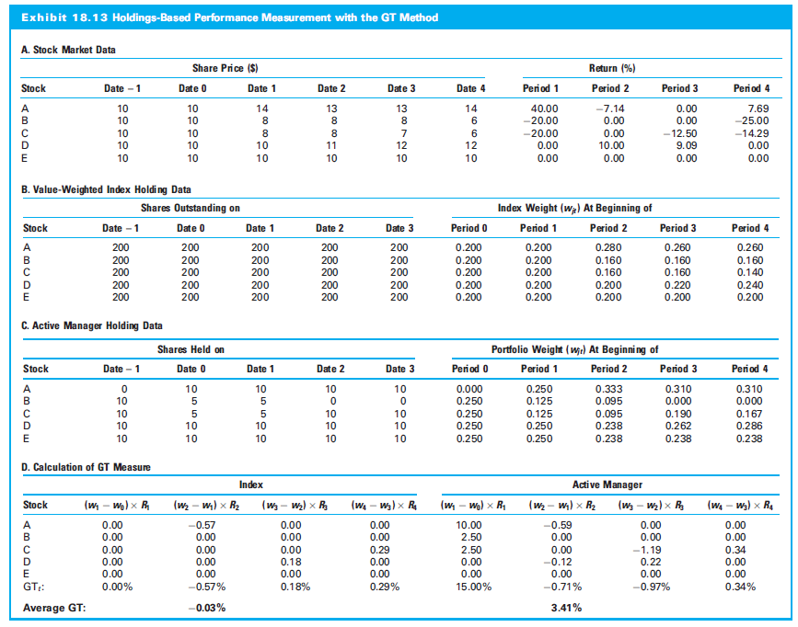
18.5.1 Grinblatt-Titman Performance Measure

Slide 53
18.5.2 Characteristic Selectivity Performance Measure
Compares stock returns in actively managed portfolio to return of benchmark with same aggregate characteristics
Characteristic selectivity performance statistic (CS):
Where:
R_{Bjt} = the Period t return to a passive portfolio whose investment characteristics are matched at the beginning of Period t with those of Stock j

Slide 54
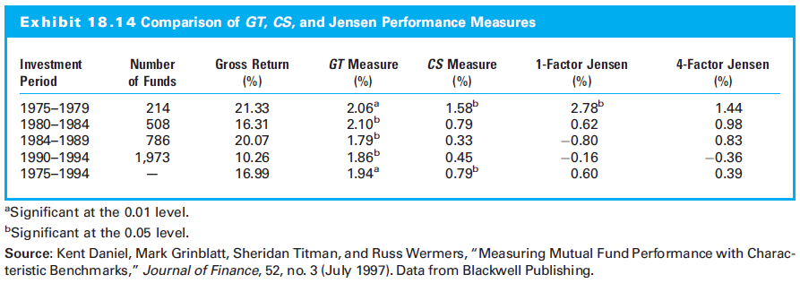
18.5.2 Characteristic Selectivity Performance Measure

Slide 55
18.6 The Decomposition of Portfolio Returns

Slide 56
18.6 The Decomposition of Portfolio Returns
Risk-adjusted and holding-based measures answer first question: How did the portfolio manager actually perform?
Second question: Why did the manager perform as they did? Requires decomposition of portfolio returns

Slide 57
18.6.1 Performance Attribution Analysis
Attribution analysis finds source of performance
Compares total return to the return for benchmark portfolio and decomposes the difference into allocation and selection effect
Where:
w_{pi}, w_{bi} = the investment proportions of the ith market segment the manager’s portfolio and the policy portfolio, respectively
R_{pi}, R_{bi} = the investment return to the ith market segment in the manager’s portfolio and the policy portfolio, respectively
R_{bi} = total return to the benchmark portfolio

Slide 58
18.6.1 Performance Attribution Analysis
Example
Top-down portfolio strategy has two decisions:
Broad allocation across three asset classes: U.S. stocks, U.S. long-term bonds, and cash equivalents, such as Treasury bills
Choosing which specific stocks, bonds, and cash instruments to buy
Hypothetical portfolio: 60% allocation to S&P 500 Index, 30% investment in the Barclays Aggregate Bond Index, and 10% allocation to three-month T-bills

Slide 59
18.6.1 Performance Attribution Analysis
An Example (continued)
Investor believes equity inflated relative to fixed-income
Decides to underweight stocks and overweight bonds and cash: 50% equity, 38% bonds, and 12% cash; concentrates equities in interest rate-sensitive sectors, e.g., utilities and financial companies, while limiting technology and consumer durables sectors
Buys shorter-duration bonds of a higher credit quality than in benchmark bond index and commercial paper rather than T-bills

Slide 60
18.6.1 Performance Attribution Analysis

Slide 61
18.6.1 Performance Attribution Analysis
Performance Attribution Extension
Attribution methodology distinguishes security selection from other decisions
Manager might decide which economic sectors before selecting preferred companies in those sectors

Slide 62
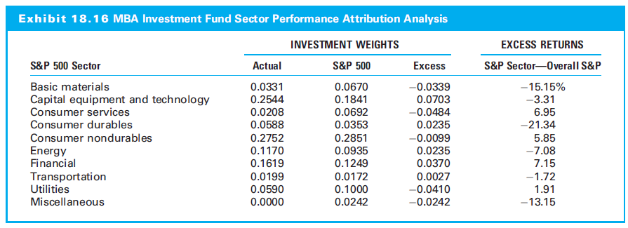
18.6.1 Performance Attribution Analysis

Slide 63
18.6.1 Performance Attribution Analysis
Measuring Market Timing Skills
Tactical asset allocation (TAA) trys to produce active value-added returns by market timing
Attribution analysis is ill-suited:
TAA indexes asset class investments; selection effect is not relevant
TAA might entail dozens of changes, so attribution effect computed on average holdings could be meaningless
So use regression-based method for TAA

Slide 64
18.6.2 Fama Selectivity Performance Measure
Performance, in excess of the risk-free rate:
Overall Performance = Excess return
= Portfolio Risk + Selectivity
Selectivity is return beyond that of unmanaged portfolio with identical systematic risk
Selectivity assesses investment ability

Slide 65
18.6.2 Fama Selectivity Performance Measure
Evaluating Selectivity
Return due to selectivity:
Where:
R_{a} = the actual return on the portfolio being evaluated
R_{x}(β_{a}) = the return on the combination of the riskless asset and the market portfolio that has risk β_{x} equal to β_{a}
Overall performance:
Overall Performance = Selectivity + Risk

Slide 66
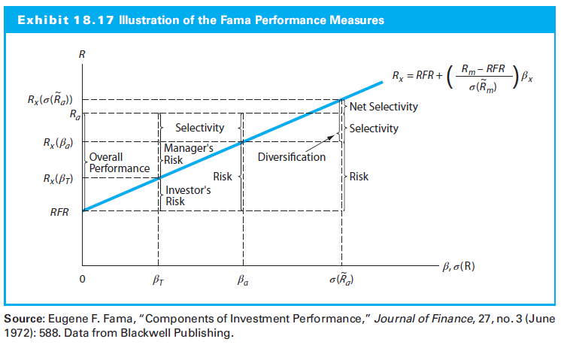
18.6.2 Fama Selectivity Performance Measure

Slide 67
18.6.2 Fama Selectivity Performance Measure
Evaluating Diversification
If manager selecting undervalued stocks gives up some diversification, you can measure additional return necessary to justify this decision.

Slide 68
18.6.2 Fama Selectivity Performance Measure
Portfolio’s gross selectivity is net selectivity plus diversification:
Or:
Where:
R_{x}(σ (R_{a})) = return on the combination of the riskless asset and the market portfolio that has return volatility equivalent to that of the portfolio being evaluated

Slide 69
18.6.2 Fama Selectivity Performance Measure
Example of Fama Performance Measure
Market return is 22.96% and risk-free rate 5.28%
Portfolio with 0.815 beta should have 19.69% return
Suppose portfolio actually returned 19.67%
Return for selectivity is 0.02: Difference between actual excess performance (19.67-5.28) = 14.39 and required excess return for risk 14.41 (=19.69-5.28)
Manager fell slightly short of matching expectations consistent with the actual risk level of the portfolio

Slide 70
18.6.2 Fama Selectivity Performance Measure
Example of Fama Performance Measure (cont’d)
What if manager did not fully diversify the portfolio?
Market standard deviation 14.95%; portfolio 13.41%
Ratio of total risk per unit of market total risk is 0.897 = (13.41/14.95)
Because beta (0.815) lower, portfolio contains of unsystematic risk
Selectivity measure of 0.02 understates true performance shortfall

Slide 71
18.6.2 Fama Selectivity Performance Measure
Example of Fama Performance Measure (cont’d)
Adjust selectivity measure for lack of diversification
Required return is 21.14 [=5.28+0.897 (22.96-5.28)]
1.45 (=21.14-19.69) difference between the required returns using total versus systematic risk is added return required because of imperfect diversification
Subtract from selectivity measure for net selectivity performance of -1.47 (=-0.02 – 1.45)
Considering cost of incomplete diversification, performance substantially below market line

Slide 72
18.7 Factors That Affect Use of Performance Measures

Slide 73
18.7 Factors That Affect Use of Performance Measures
Problem of realistic market proxy
Benchmark portfolios
Performance evaluation standard
Usually a passive index or portfolio
Benchmark for entire portfolio and separate benchmarks for segments to evaluate individual managers
Benchmark error
Can effect slope of SML
Can effect calculation of beta
Greater concern with global investing
Problem is one of measurement

Slide 74
18.7.1 Demonstration of the Global Benchmark Problem
Example, world equity market as market portfolio proxy
There are two major differences in the various beta statistics:
Beta estimates change greatly over time
Mean and median for the U.S. and world beta similar
BUT substantial differences for same stock using different benchmark portfolio

Slide 75
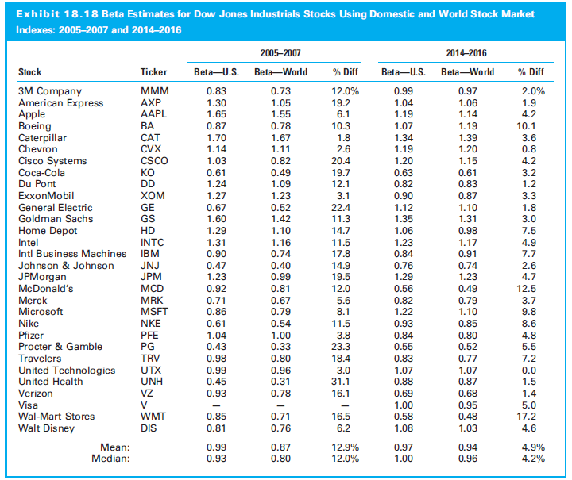
18.7.1 Demonstration of the Global Benchmark Problem

Slide 76
18.7.2 Implications of the Benchmark Problems
Problems do not negate the value of CAPM as normative model of equilibrium pricing
Need to find a better proxy or adjust measured performance for errors
Multiple markets index (MMI) is major step toward a comprehensive world portfolio

Slide 77
18.7.3 Required Characteristics of Benchmarks
Characteristics of good benchmark:
Unambiguous
Investable
Measurable
Appropriate
Specified in advance
Owned

Slide 78
18.8 Reporting Investment Performance

Slide 79
18.8 Reporting Investment Performance
How should the returns be reported?
Two dimensions:
How returns computed for portfolio with infusions and withdrawals of cash
Presentation standards created by CFA Institute

Slide 80
18.8.1 Time-Weighted and Money-Weighted Returns
Holding period yield/return (HPY/HPR):
Dollar-weighted and time-weighted returns same when no interim investment contributions
Adjusted for contributions holding period yield is:
Where:
DW = factor represents the portion of the period that the contribution is actually held in the account

Slide 81
18.8.2 Performance Presentation Standards
Performance Presentation Standards (PPS) (CFA 1987)
Global Investment Performance Standards (GIPS) (CFA 1999) :
To establish investment industry best practices for calculating and presenting investment performance
To obtain worldwide acceptance of a single standard for the calculation and presentation of investment performance
To promote the use of accurate and consistent investment performance data
To encourage fair, global competition among investment firms without creating barriers to entry
To foster the notion of industry “self-regulation” on a global basis

Slide 82
18.8.2 Performance Presentation Standards
Fundamental Principles of GIPS
Total return must be used
Time-weighted rates of return must be used
Portfolios must be valued at least monthly, and periodic returns must be geometrically linked
Composite return performance (if presented) must contain all actual fee-paying accounts
Performance must be calculated after deduction of trading expenses
Taxes must be recognized when incurred
Annual returns for all years must be presented
Disclosure requirements must be met

Slide 83
18.8.2 Performance Presentation Standards
CFA Institute also encourages managers to disclose
Volatility of the composite return and
Identify benchmarks that parallel the risk or investment style the composite tracks

Slide 84
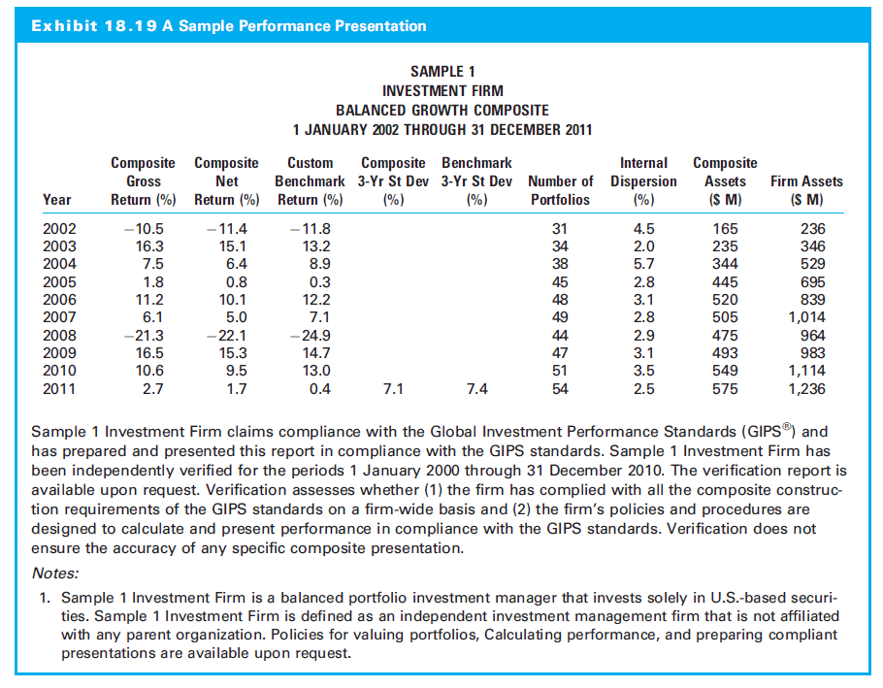
18.8.2 Performance Presentation Standards

Slide 85
18.8.2 Performance Presentation Standards

