Slide 1
FIN 422: Student Managed Investment Fund
Topic 7: Professional Portfolio Management, Alternative Assets, and Industry Ethics
Larry Schrenk, Instructor

Slide 2
Overview
17.1 The Asset Management Industry
17.2 Private Management and Advisory Firms
17.3 Organization and Management of Investment Companies
17.4 Investing in Alternative Asset Classes
17.5 Ethics and Regulation in the Professional Asset Management Industry

Slide 3
Learning Objectives
What are the different ways that professional money management firms can be organized, and how has the structure of the industry changed over time?
Who manages the portfolios at investment advisory firms and investment companies, and how are those managers compensated?
How do you compute the net asset value (NAV) for investment companies?
What is the difference between closed-end and open-end investment companies?
What are load fees, 12b-1 fees, and management fees, and how do they influence investment company performance?
How are funds classified by investment objective, and which groups have experienced relative growth or decline?
What are hedge funds, and how do they differ from other professionally managed investment products?
What investment strategies do hedge funds employ, and what has been the performance of those fund types over time?
What attributes do private equity investments possess that make them a unique asset class?
How do venture capital and buyout-oriented private equity investments differ from one another, and what has been their historical performance?
What are some of the ethical dilemmas involved in the professional money management industry?
What functions should investors expect professional asset managers to perform?

Slide 4
Readings
Reilley, et al., Investment Analysis and Portfolio Management, Chap. 17

Slide 5
17.1 The Asset Management Industry

Slide 6
17.1 The Asset Management Industry: Structure and Evolution
Two structures:
Contract directly with a management/advisory firm
Commingling of capital of several clients
Differences:
Personal relationship with clients, versus
General solution

Slide 7
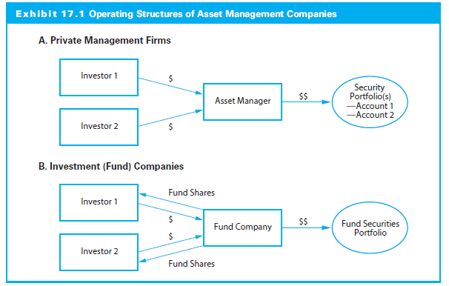
17.1 The Asset Management Industry: Structure and Evolution

Slide 8
17.1 The Asset Management Industry: Structure and Evolution
Contract directly with a management and advisory firm
Relationship with client
Assets under management (AUM)
Separate accounts
Customized
Commingling of investment capital of several clients in an investment company
Pool of funds belonging to many individuals
New shares represent proportional ownership of the fund

Slide 9
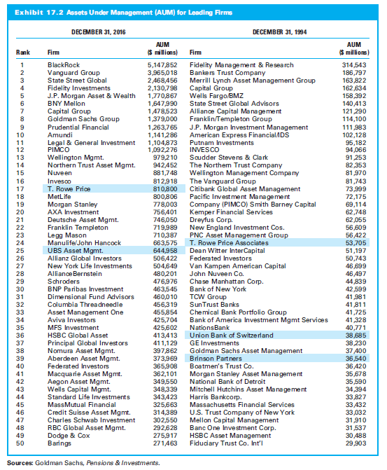
17.1 The Asset Management Industry: Structure and Evolution

Slide 10
17.2 Private Management and Advisory Firms

Slide 11
17.2 Private Management and Advisory Firms
Majority of private management and advisory firms small
Many narrowly focused on a particular niche
Investment Strategy
Each client’s assets are held in a separate account
Portfolio guided by firm’s overall investment philosophy
Same fundamental orientation applied to all accounts

Slide 12
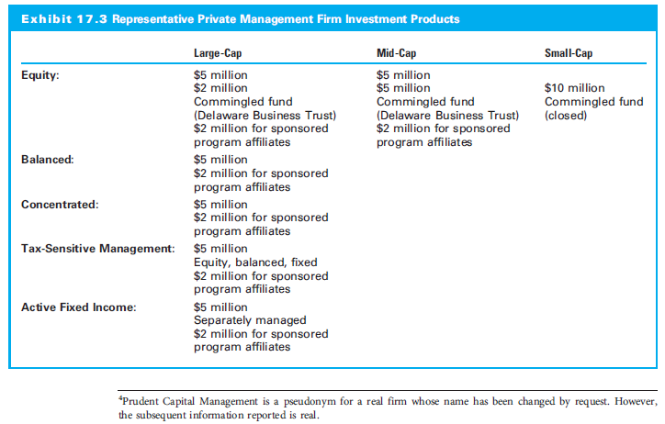
17.2 Private Management and Advisory Firms (slide 2 of 3)

Slide 13
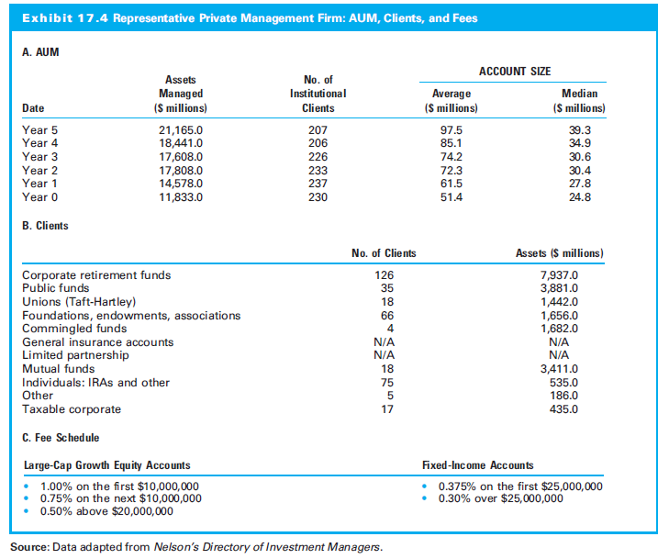
17.2 Private Management and Advisory Firms

Slide 14
17.2.1 Investment Strategy at a Private Money Management Firm
Client’s assets are held in a separate account
Portfolios formed for each client but guided by overall investment philosophy
Prudent Capital Management (PCM):
Two model portfolios: equities and fixed-income securities
Large-cap growth primarily in technology companies
Specific stock allocations might vary among clients
Fixed-income product split between government and investment-grade corporate

Slide 15
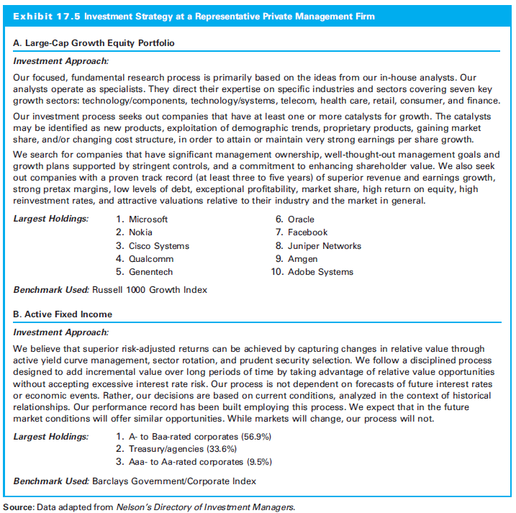
17.2.1 Investment Strategy at a Private Money Management Firm

Slide 16
17.3 Organization and Management of Investment Companies

Slide 17
17.3 Organization and Management of Investment Companies
Financial intermediaries that pool
Major duties
Investment research
Management of the portfolio
Administrative duties
Management fee as percentage of total value
Family of funds economies of scale

Slide 18
17.3.1 Valuing Investment Company Shares
Net Asset Value (NAV) is analogous to the share price
NAV increases as value underlying assets increase

Slide 19
17.3.2 Closed-End versus Open-End Investment Companies
Closed-end investment company:
Stock trades on secondary market
Does not issue new or redeem shares
Price different from its NAV
Puzzle why close-end funds often sell at discount from NAV
Means of investing in foreign country

Slide 20
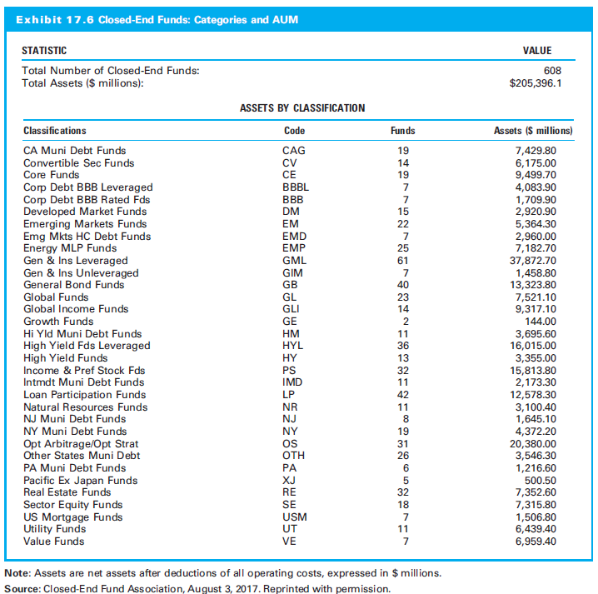
17.3.2 Closed-End versus Open-End Investment Companies

Slide 21
17.3.2 Closed-End versus Open-End Investment Companies
Open-end investment company:
Open-end investment companies, or mutual funds, continue to sell and repurchase shares
Sell additional shares at NAV
Substantial growth in both number of funds and assets under management (AUM)

Slide 22
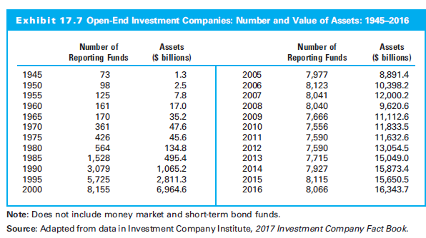
17.3.2 Closed-End versus Open-End Investment Companies

Slide 23
17.3.2 Closed-End versus Open-End Investment Companies
Load versus No-Load Funds
Offering price a load fund equals NAV plus sale charge
No-load fund has no initial sales charge
Several variations between full- and no-load
Low-load fund
12b-1 plan
Funds have contingent, deferred sales loads

Slide 24
17.3.3 Fund Management Fees
All have annual management fees
Fee typically is percentage of average net assets (0.25 to 1.00%)
Fees are a major factor in new funds
Fees down due to industry consolidation

Slide 25
17.3.4 Investment Company Portfolio Objectives
Mutual fund can be created around any assets
Tend to exist for only liquid asset classes, such as stocks and bonds
There are four broad categories:
Common stock funds
Bond funds
Hybrid funds
Money market funds

Slide 26
17.3.4 Investment Company Portfolio Objectives
Equity funds
Invest almost exclusively in common stocks
Bond funds
Concentrate on various types of bonds to generate high current income with minimal risk
Balanced funds
Diversify outside a single market by combining common stock with fixed income securities
Money market funds
Invest in diversified portfolios of short-term securities

Slide 27
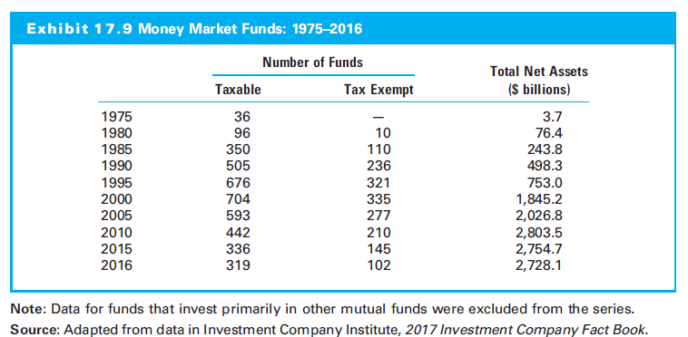
17.3.4 Investment Company Portfolio Objectives

Slide 28
17.3.5 Breakdown by Fund Characteristics
Major means of distribution
Sales force or investment professional
Direct purchase or direct marketing
By investment objective
Equity funds
Equity funds
Hybrid funds
Money market funds

Slide 29
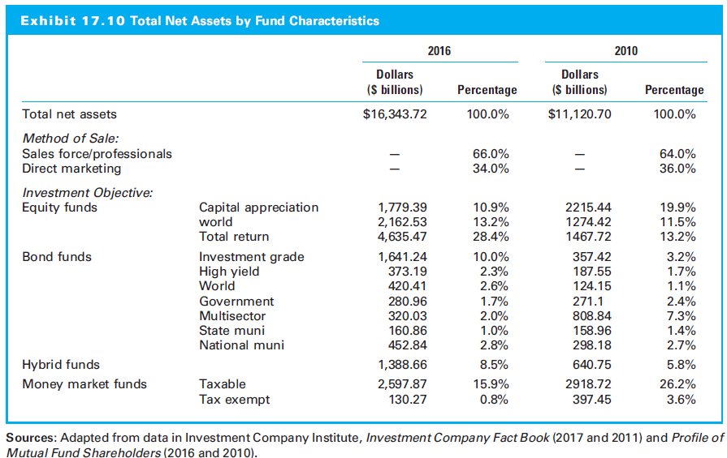
17.3.5 Breakdown by Fund Characteristics

Slide 30
17.3.6 Global Investment Companies
International or global funds invest in non-U.S. securities
Familiar categories: money funds, government and corporate bond funds, and equity funds
Most open-end funds, but significant number closed-end to minimize trading of illiquid foreign securities
Many non-U.S. investment companies offer both domestic and global products in their local markets

Slide 31
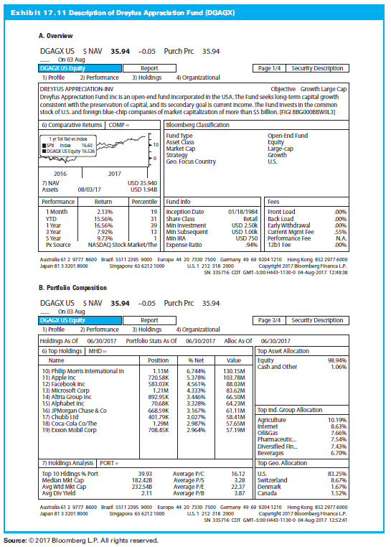
17.3.7 Mutual Fund Organization and Strategy: An Example

Slide 32
17.4 Investing in Alternative Asset Classes

Slide 33
17.4 Investing in Alternative Asset Classes
Alternative asset classes:
Hedge funds
Private equity
Real estate
Natural resources and commodities
Management Structure
Usually structured as a limited partnership
“Alpha”
Excess returns generated by the fund, implying superior performance

Slide 34
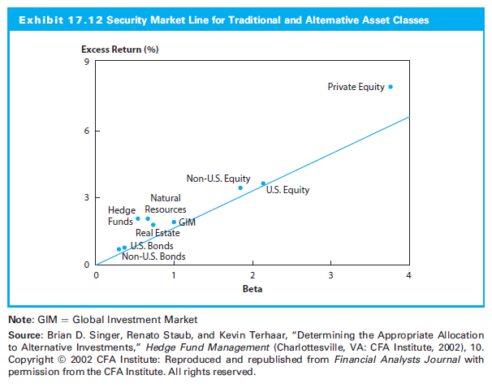
17.4 Investing in Alternative Asset Classes

Slide 35
17.4.1 Hedge Funds
Significant development over past 20 years
Why ‘hedge’ fund
Traced to 1949 as a partnership structure with an incentive fee for superior performance
Long and short and financial leverage; potential returns superior to traditional structures

Slide 36
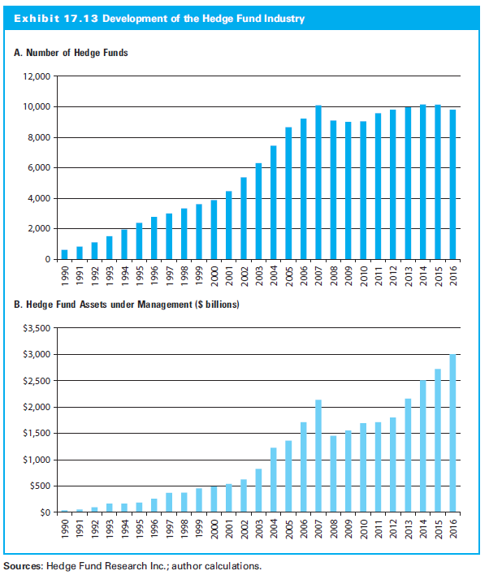
17.4.1 Hedge Funds

Slide 37
17.4.2 Characteristics of a Hedge Fund
Hedge funds:
Less restricted and fewer regulations
Less correlated with traditional investments
Far less liquid
Severe limitations on when and how often investment capital contributed or removed
High-water mark: Investors usually require past losses be recouped before managers receive additional payouts

Slide 38
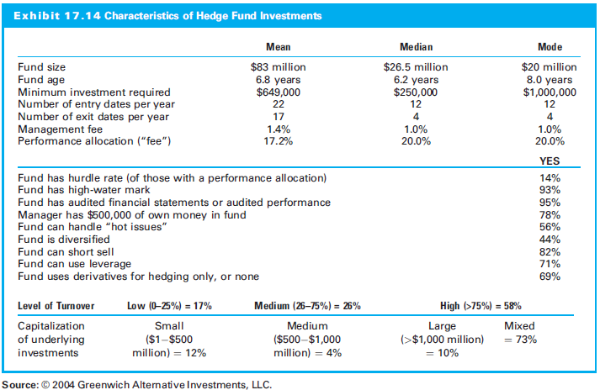
17.4.2 Characteristics of a Hedge Fund

Slide 39
17.4.3 Hedge Fund Strategies
Equity-Based Strategies
Long-short equity: Undervalued long positions and overvalued short positions
Equity market neutral: Offsetting risk positions on the long and short side often involving derivative positions

Slide 40
17.4.3 Hedge Fund Strategies
Arbitrage-Based Strategies
Fixed-income arbitrage: Bond pricing disparities from changing market events, investor preferences, or market fluctuations
Convertible arbitrage: Disparities between convertible bonds and underlying common stock
Merger (risk) arbitrage: Magnitude of the spread on merger transactions

Slide 41
17.4.3 Hedge Fund Strategies
Opportunistic Strategies
High yield and distressed bonds
Global macro: Changes in global economies
Managed futures: Long and short futures
Special situations: Bankruptcies, spinoffs, etc.
Multiple strategies
Fund of funds: Invest in a number of funds

Slide 42
17.4.4 Risk Arbitrage Investing: A Closer Look
Equity positions in target of a merger/takeover
Compare own subjective judgment of success with the success implied by the market price of target stock
If takeover more than market expects, buy target firm
Short deal is less likely to be completed

Slide 43
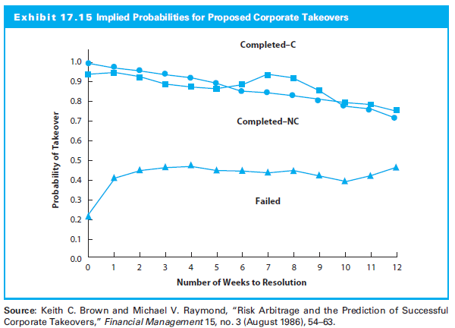
17.4.4 Risk Arbitrage Investing: A Closer Look

Slide 44
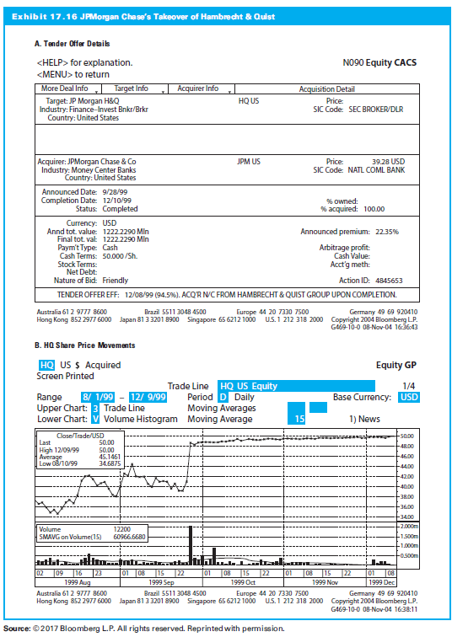
17.4.4 Risk Arbitrage Investing: A Closer Look

Slide 45
17.4.5 Hedge Fund Performance
Hedge funds differ in risk/return
Returns variable:
1990-2010, positive “alpha”
Emerging markets worst performing 1995 (16.9%); best performing strategy 1996 (+34.5%)
Long/short equity profitablein 2003-2007, but lost money in 2002 & 2008

Slide 46
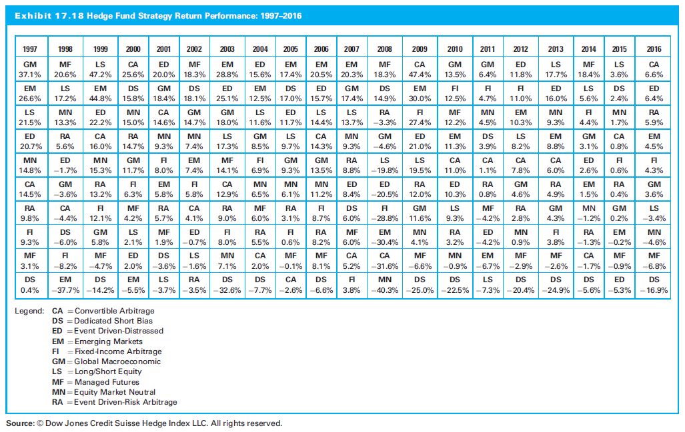
17.4.5 Hedge Fund Performance

Slide 47
17.4.6 Private Equity
Assets not publically tradable
Typically new companies or established firms that change structure or in financial distress
Generally far less liquid than public stock holdings, i.e., long-term positions
Characteristics
Higher return and low liquidity
Good sources of diversification

Slide 48
17.4.6 Private Equity

Slide 49
17.4.6 Private Equity
Private Equity Market
Began in United States in 1946
Subcategories:
Venture Capital
Seed
Early stage
Later stage
Buyouts
Special Situations
Distressed Debt
Mezzanine Financing

Slide 50
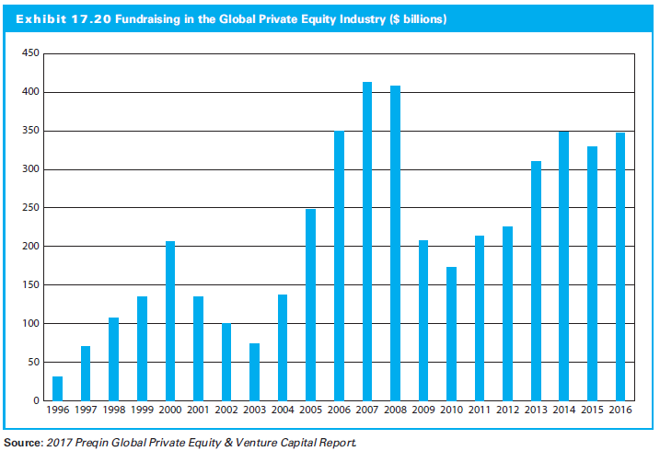
17.4.6 Private Equity

Slide 51
17.4.6 Private Equity
The Private Equity Investment Process
Zero-stage capital: Personal savings and bank loans
Venture capital: For seed and early-stage funding, venture capital firm receives equity
Venture capital firm will liquidate their equity
Buyout
IPO

Slide 52
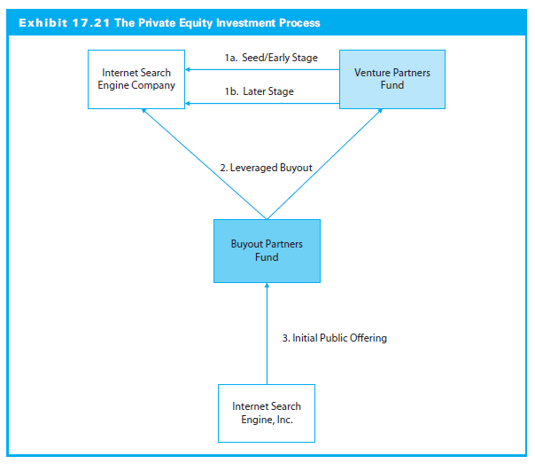
17.4.6 Private Equity

Slide 53
17.4.6 Private Equity
Returns to Private Equity Funds
Long-term, highly illiquid investments
“J-curve effect”
Average annual returns be quite high over time
Initial years usually produce negative returns
Huge dispersion in returns, i.e., good vs. bad performance

Slide 54
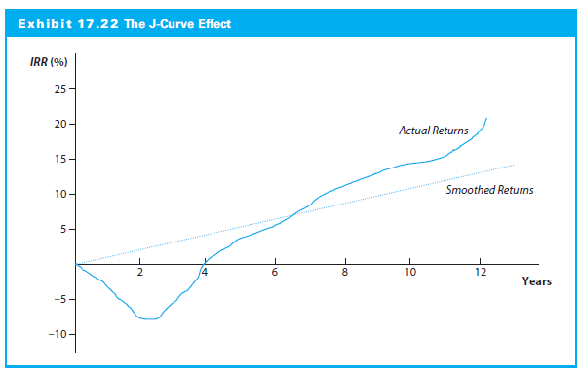
17.4.6 Private Equity

Slide 55
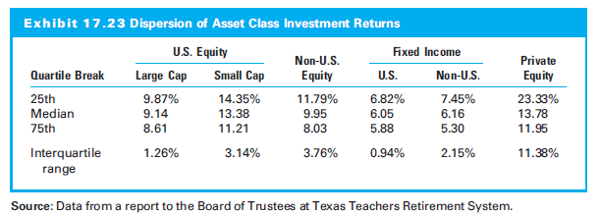
17.4.6 Private Equity

Slide 56
17.5 Ethics and Regulation in the Professional Asset Management Industry

Slide 57
17.5 Ethics and Regulation in the Professional Asset Management Industry
Ethical issues any time one person looks after another’s interests
Principal-agent problem
Agency conflict frequent in financial relationships

Slide 58
17.5.1 Regulation in the Asset Management Industry
Principal securities laws
Securities Act of 1933
Securities Exchange Act of 1934
Investment Company Act of 1940
Investment Advisers Act of 1940
Employee Retirement Income Security Act of 1974
Pension Protection Act of 2006
Dodd-Frank Wall Street Reform and Consumer Protection Act of 2010

Slide 59
17.5.1 Regulation in the Asset Management Industry
Regulatory agencies
U.S. Securities and Exchange Commission (SEC)
U.S. Department of Labor
Financial Industry Regulatory Authority (FINRA)
Commodity and Futures Trading Commission
U.S. Internal Revenue Service

Slide 60
17.5.2 Standards for Ethical Behavior
Four general principles for conduct:
Act with integrity and in an ethical manner
Financial analysis in a professional, ethical manner
Competence and strive to improve
Proper care and independent professional judgment
CFA Code of Ethics and Standards of Professional Conduct
Code of Ethics expands on the four themes

Slide 61
17.5.2 Standards for Ethical Behavior
Asset Manager Code (CFA)
Minimum standards:
Act in a professional and ethical manner at all times
Act for the benefit of clients.
Act with independence and objectivity
Act with skill, competence, and diligence
Communicate with clients in a timely and accurate manner
Uphold the applicable rules governing capital markets

Slide 62
17.5.3 Examples of Ethical Conflicts
Incentive Compensation Schemes
Mutual fund managers with the worst relative performance midway through a compensation period were more likely to increase the risk of the portfolio in an effort to increase their final standing
Soft Dollar Arrangements
Soft dollars are generated when a manager commits the investor to paying a brokerage commission that is higher than the simple cost of executing a security trade in exchange for the manager receiving additional bundled services from the broker

