Slide 1
FIN 422: Student Managed Investment Fund
Topic 6: Equity Portfolio Management Strategies
Larry Schrenk, Instructor

Slide 2
Overview
11.1 Passive versus Active Management
11.2 An Overview of Passive Equity Portfolio Management Strategies
11.3 An Overview of Active Equity Portfolio Management Strategies
11.4 Value versus Growth Investing: A Closer Look
11.5 An Overview of Style Analysis
11.6 Asset Allocation Strategies

Slide 3
Learning Objectives
What are the two generic equity portfolio management styles?
What are three techniques for constructing a passive index portfolio?
How does the goal of a passive equity portfolio manager differ from the goal of an active manager?
What is a portfolio’s tracking error and how is it useful in the construction of a passive equity investment?
What is the difference between an index mutual fund and an exchange-traded fund?
What are the three themes that active equity portfolio managers can use?
How does factor investing differ from fundamental approaches to active management?
What is active share and how can the measure help identify an investor as being active or passive?
What stock characteristics do momentum-oriented investors look for?
How can an investor measure the tax efficiency of an actively managed portfolio?
What stock characteristics differentiate value-oriented and growth-oriented investment styles?
What is style analysis and what does it indicate about a manager’s investment performance?
What techniques do active managers use in an attempt to outperform their benchmarks?
What are the differences between the integrated, strategic, tactical, and insured approaches to asset allocation?

Slide 4
Readings
Reilley, et al., Investment Analysis and Portfolio Management, Chap. 11

Slide 5
11.1 Passive versus Active Management

Slide 6
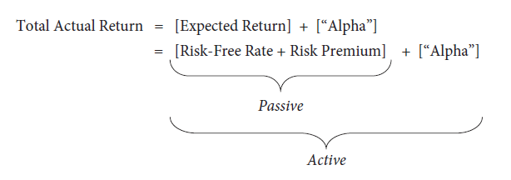
11.1 Passive versus Active Management
Equity portfolio management strategies are passive or active
Decomposition of total actual return:

Slide 7
11.1 Passive versus Active Management
Passive equity portfolio management
Long-term buy-and-hold strategy
Tracks an index
Matches market performance
Evaluation: How well they track the target index
Active equity portfolio management
Attempts to outperform passive benchmark
Seeking “alpha”

Slide 8
11.1 Passive versus Active Management

Slide 9
11.2 An Overview of Passive Equity Portfolio Management Strategies

Slide 10
11.2 An Overview of Passive Equity Portfolio Management Strategies
Replicate the performance of an index
Slightly underperform due to fees and commissions
Rationale for this approach
Can’t overcome active management costs (1-2%)
Different market indexes
S&P 500 Index
NASDAQ Composite Index

Slide 11
11.2.1 Index Portfolio Construction Techniques
Three basic techniques:
Full replication
Sampling
Quadratic optimization

Slide 12
11.2.1 Index Portfolio Construction Techniques
Full replication
All securities in proportion to weights in index
Ensure close tracking
Increases transaction costs, particularly with dividend reinvestment

Slide 13
11.2.1 Index Portfolio Construction Techniques
Sampling
Representative sample of stocks according to weights in index
Lower commissions and transaction costs
Tracking error

Slide 14
11.2.1 Index Portfolio Construction Techniques
Quadratic optimization (programming techniques)
Algorithms using historical prices
Minimize tracking error with the benchmark
Assumes historical correlations (which may change over time)

Slide 15
11.2.1 Index Portfolio Construction Techniques
Completeness funds:
Complement active portfolios that do not cover the entire market
Use passive funds to “fill the holes” left by active managers
If active portfolios are overweighted in certain market sectors or stock types

Slide 16
11.2.2 Tracking Error and Index Portfolio Construction
Passive goal: Minimize tracking error
Tracking error
Return differential (Δ_{t}) in time period t
Where
R_{pt}= return to the managed portfolio in Period t
R_{bt}= return to the benchmark portfolio in Period t
Tracking error (TE) is measured as the annualized standard deviation of the return differential (Δ_{t})

Slide 17
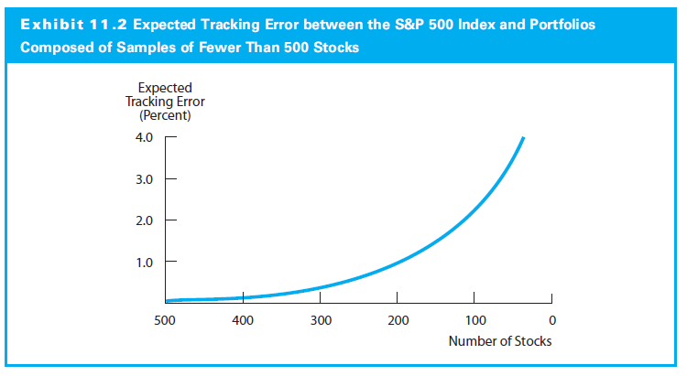
11.2.2 Tracking Error and Index Portfolio Construction

Slide 18
11.2.3 Methods of Index Portfolio Investing
Index Funds
Attempt to replicate index exactly
Buy exact securities in exact weights
Change positions when index changed
Low trading and management expense ratios
Inexpensive diversified portfolio

Slide 19
11.2.3 Methods of Index Portfolio Investing
Exchange-Traded Funds (ETF)
ETFs are depository receipts:
Pro rata claim on capital gains and cash flows
Securities in deposit by a financial institution
Bought and sold (and short sold) like common stock
Examples
Standard & Poor’s 500 Depository Receipts (SPDRs)
iShares
Sector ETFs

Slide 20
11.3 An Overview of Active Equity Portfolio Management Strategies

Slide 21
11.3 An Overview of Active Equity Portfolio Management Strategies
Beat passive benchmark portfolio (net of transaction costs) on a risk-adjusted basis
Need to select an appropriate benchmark
Practical difficulties
Transactions costs
Higher risk-taking can also increase needed performance

Slide 22
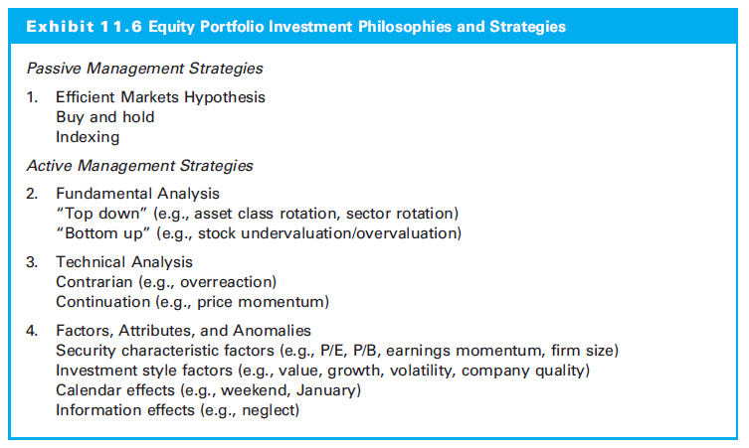
11.3 An Overview of Active Equity Portfolio Management Strategies

Slide 23
11.3.1 Fundamental Strategies
Top-Down vs Bottom-Up Approaches
Top-Down
Broad country and asset class allocations
Sector allocation decisions
Individual securities selection
Bottom-Up
Securities selection (No market/sector analysis)
Purchased portfolio at discount to to value

Slide 24
11.3.1 Fundamental Strategies
Market timing:
Shifting funds into and out of stocks, bonds, and T-bills
Sector rotation strategy:
Shift funds among different equity sectors and industries or among investment styles
Stock picking
Select individual issues to find undervalued stocks

Slide 25
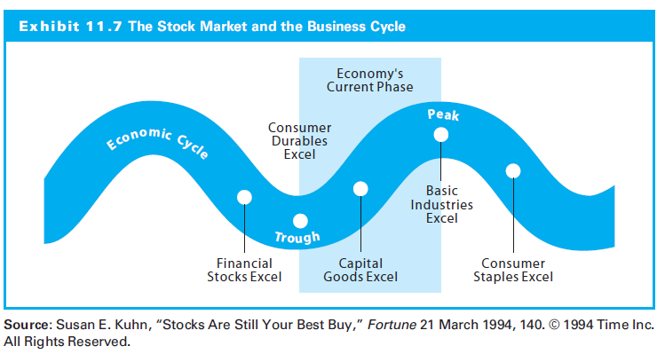
11.3.1 Fundamental Strategies

Slide 26
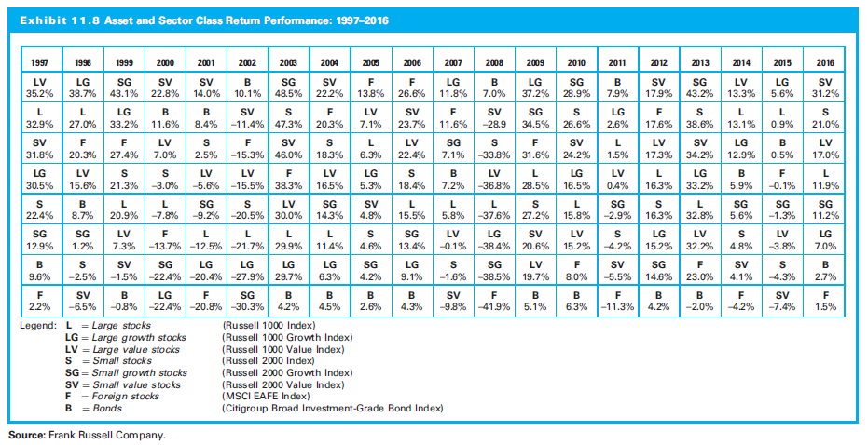
11.3.1 Fundamental Strategies

Slide 27
11.3.1 Fundamental Strategies
The 130/30 Strategy
Long positions 130% and short positions 30%
Short positions leverage
Increased risk and expected returns
Allows managers to short overvalued as well as buy undervalued stocks

Slide 28
11.3.2 Technical Strategies
Contrarian Investment Strategy
Buy (sell) stock is when majority are most bearish (bullish)
Mean reversion
Overreaction hypothesis
Price Momentum Strategy
Focus on past price trends
Assume trends in past prices continue

Slide 29
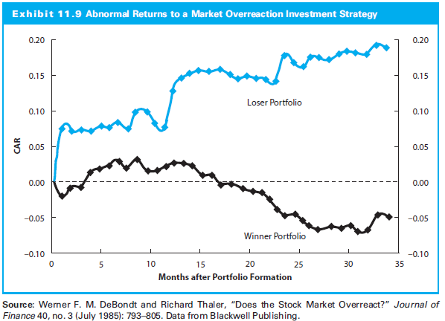
11.3.2 Technical Strategies

Slide 30
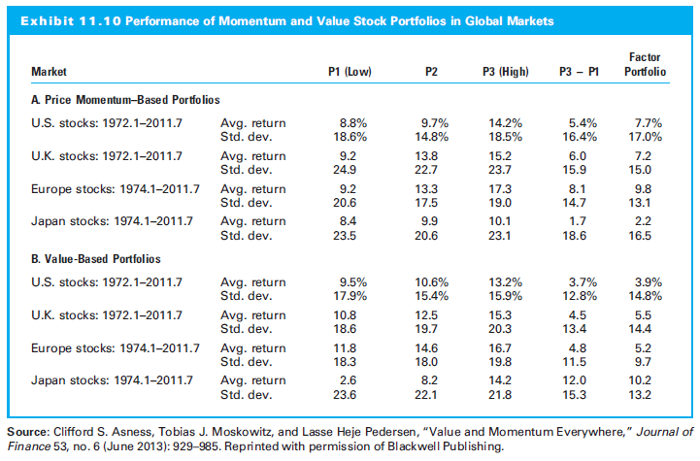
11.3.2 Technical Strategies

Slide 31
11.3.3 Factors, Attributes, and Anomalies
Factor Investing
Portfolios emphasize characteristics‒firm size, relative valuation, low return volatility, momentum, or company quality‒believed to produce higher risk-adjusted returns
Risk premia of factor portfolios allow superior returns with better diversification

Slide 32
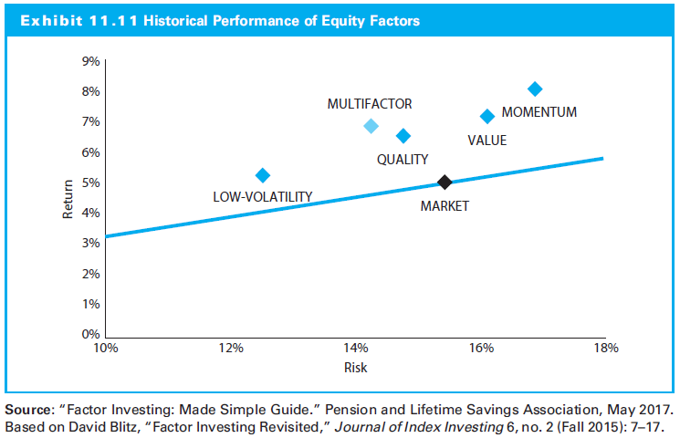
11.3.3 Factors, Attributes, and Anomalies

Slide 33
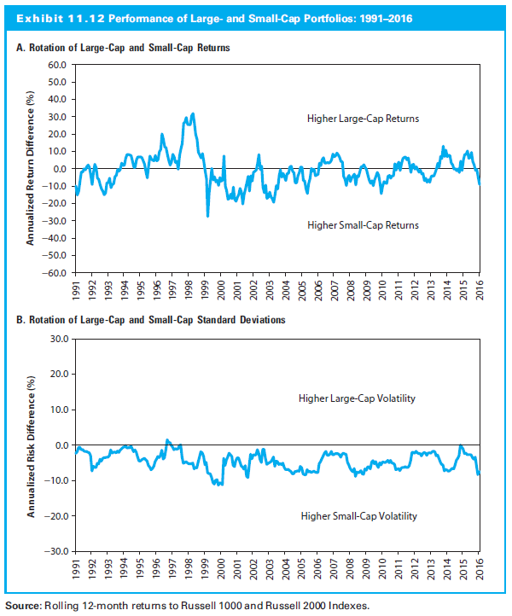
11.3.3 Factors, Attributes, and Anomalies

Slide 34
11.3.3 Factors, Attributes, and Anomalies
Earnings Momentum Strategy
Momentum measured by actual vs. expected EPS
Purchase stocks with accelerating earnings and sell/short stocks with disappointing earnings
Calendar-Related Anomalies
The Weekend Effect
The January Effect
Firm-Specific Attributes
Firm Size
P/E and P/BV ratios

Slide 35
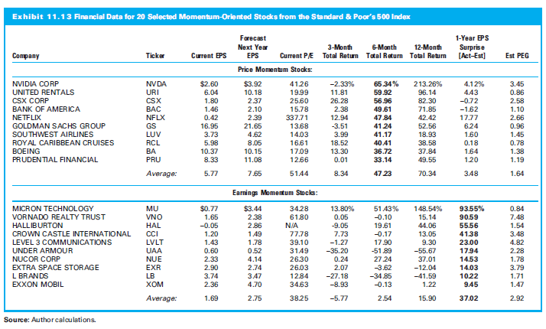
11.3.3 Factors, Attributes, and Anomalies

Slide 36
11.3.5 Tax Efficiency and Active Equity Management
Taxes (when deciding to sell or hold)
If profit, capital gains paid and less to reinvest
New security must have return to offset taxes
Depends on expected holding period and the cost basis (and amount of capital gain)

Slide 37
11.3.5 Tax Efficiency and Active Equity Management
Measures of Tax Efficiency
Tax Cost Ratio
Percentage of assets lost to taxes due to the trading strategy
Where
PTR = pretax return
TAR = tax-adjusted return

Slide 38
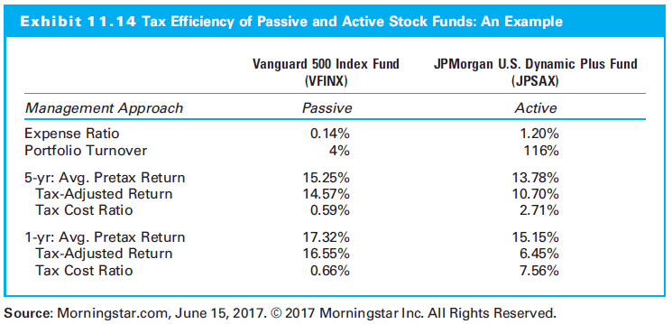
11.3.5 Tax Efficiency and Active Equity Management

Slide 39
11.3.6 Active Share and Measuring the Level of Active Management
Compare portfolio’s holdings with benchmark
Active share measure:
Where:
[w_{p,i}, w_{b,i}] = the investment weight of the ith security in the managed portfolio (p) and benchmark index (b), respectively

Slide 40
11.3.6 Active Share and Measuring the Level of Active Management
Active share statistic
The percentage of security holdings in the manager’s portfolio that differ from those in the benchmark index

Slide 41
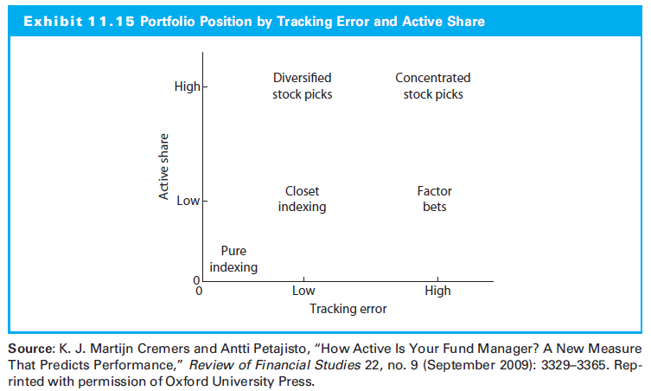
11.3.6 Active Share and Measuring the Level of Active Management

Slide 42
11.4 Value versus Growth Investing: A Closer Look

Slide 43
11.4 Value versus Growth Investing: A Closer Look
Growth: Focus future economic “story” with less regard to share valuation
Value: Focus on share price in anticipation of a market correction and improving fundamentals.
Value generally higher returns than growth
Not consistent over time

Slide 44
11.4 Value versus Growth Investing: A Closer Look
Growth:
Focus on EPS and economic determinants
Look for companies with rapid EPS growth
Assumes constant P/E ratio
Value:
Focus on the price component
Not care much about current earnings
Assume the P/E ratio is below its natural level

Slide 45
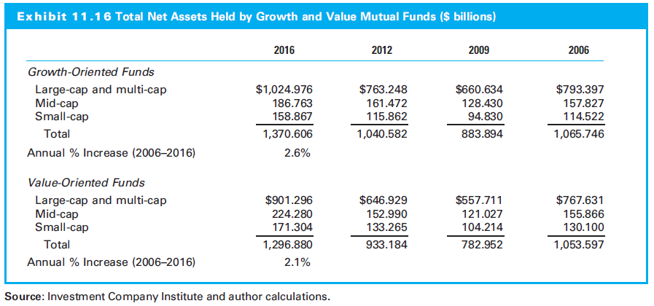
11.4 Value versus Growth Investing: A Closer Look

Slide 46
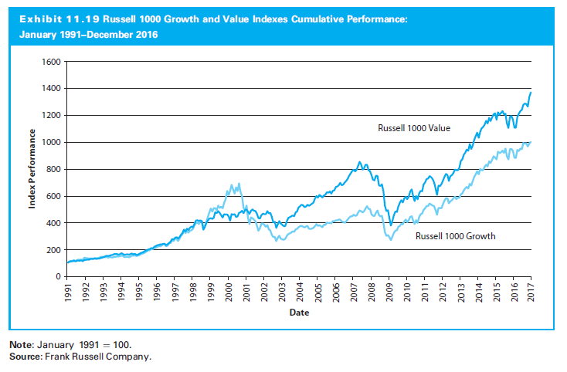
11.4 Value versus Growth Investing: A Closer Look

Slide 47
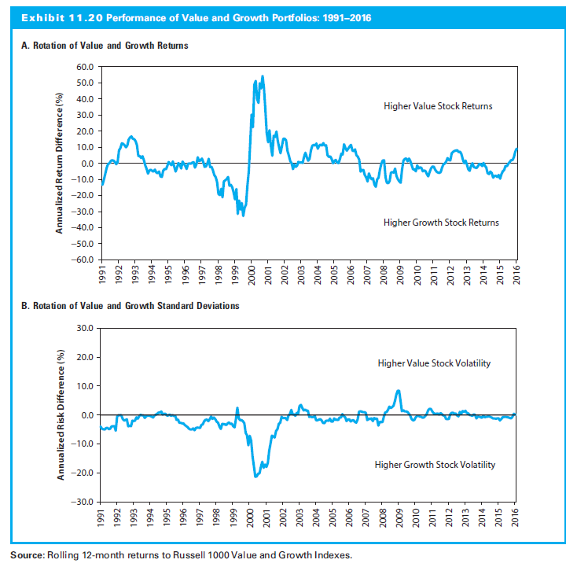
11.4 Value versus Growth Investing: A Closer Look

Slide 48
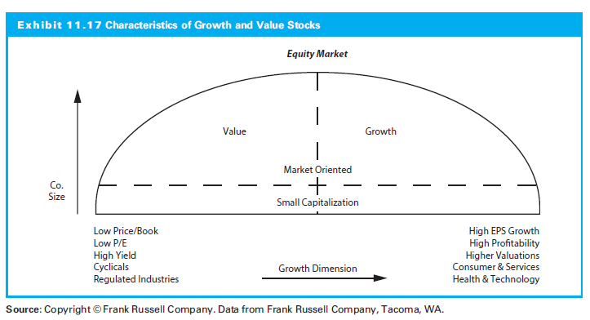
11.4 Value versus Growth Investing: A Closer Look

Slide 49
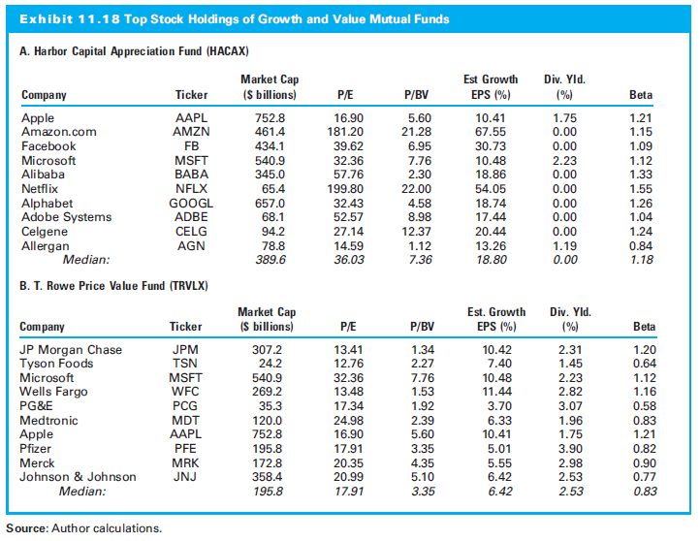
11.4 Value versus Growth Investing: A Closer Look

Slide 50
11.5 An Overview of Style Analysis

Slide 51
11.5 An Overview of Style Analysis
Style analysis:
Explain variation in portfolio returns by movements of ‘style index portfolios’
Combination of long positions in passive indexes mimicking portfolio
E.g. style grid classifying performance along two dimensions: firm size and value/growth

Slide 52
11.5 An Overview of Style Analysis
Constrained least squares procedure
Portfolio returns as the dependent variable
Returns of style index portfolios as independent variables
Three constraints:
No intercept term
Coefficients must sum to one
Coefficients nonnegative

Slide 53
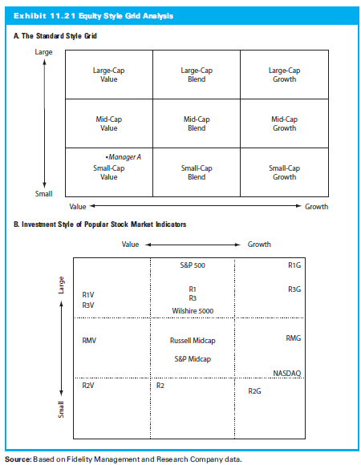
11.5 An Overview of Style Analysis

Slide 54
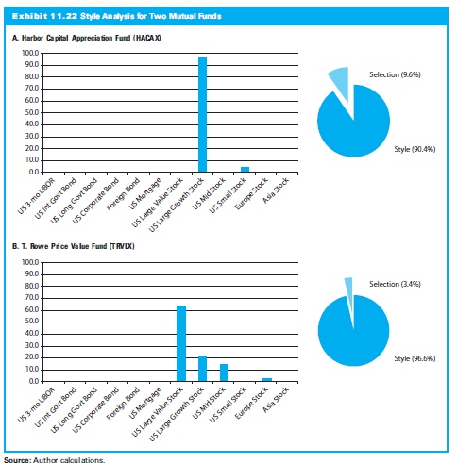
11.5 An Overview of Style Analysis

Slide 55
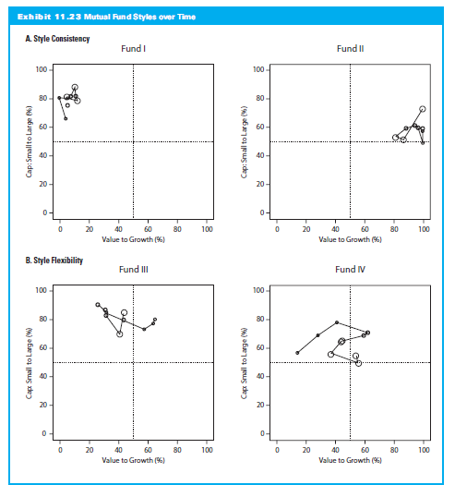
11.5 An Overview of Style Analysis

Slide 56
11.6 Asset Allocation Strategies

Slide 57
11.6 Asset Allocation Strategies
Equity portfolio part of overall investment portfolio
Mix of asset classes in entire portfolio
Four general asset mix strategies:
Integrated
Strategic
Tactical
Insured

Slide 58
11.6.1 Integrated Asset Allocation
Examines separately :
Capital market conditions
Investor’s objectives and constraints
Factors are combined for asset mix meeting the investor’s needs

Slide 59
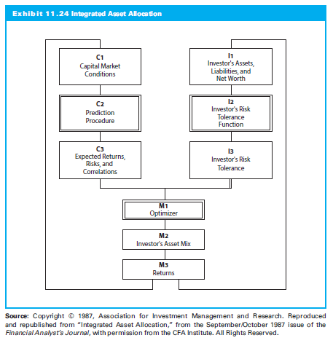
11.6.1 Integrated Asset Allocation

Slide 60
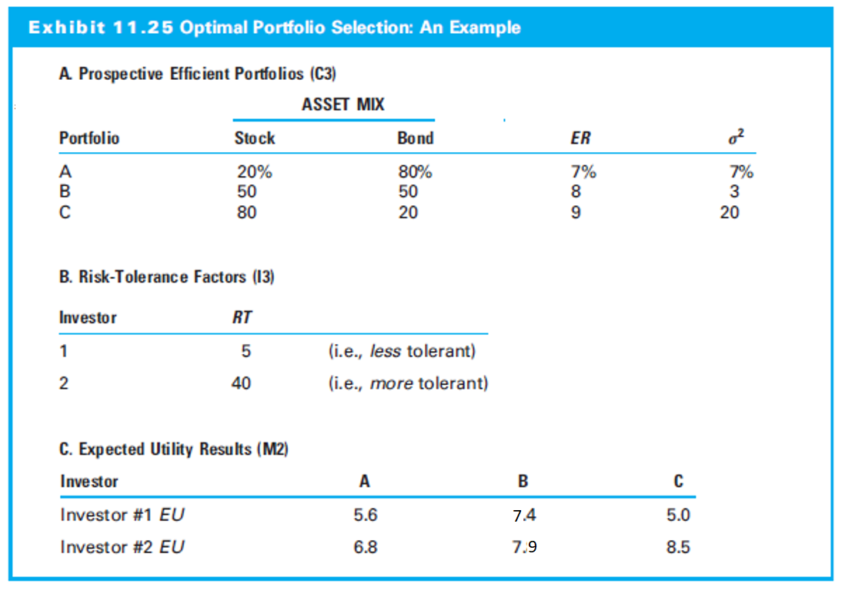
11.6.1 Integrated Asset Allocation

Slide 61
11.6.2 Strategic Asset Allocation
Determine long-term asset weights in portfolio
Long-term returns, risk, and covariances used to estimate future capital market results
Construct efficient frontier, and investor decides on asset mix
Constant asset allocation with periodic rebalancing

Slide 62
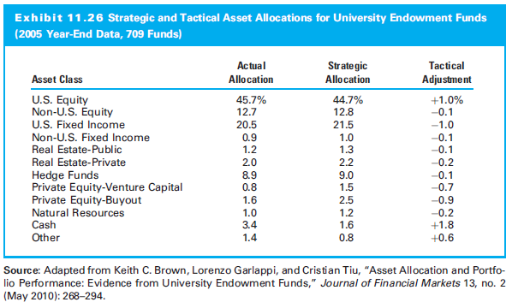
11.6.2 Strategic Asset Allocation

Slide 63
11.6.3 Tactical Asset Allocation
Adjusts the asset mix for changing market conditions
Adjustments driven by relative values of asset classes
Often based on mean reversion
Contrarian method of investing

Slide 64
11.6.4 Insured Asset Allocation
Frequent adjustments in allocation
Assumptions:
Expected market returns and risks are constant
Investor objectives and constraints change as wealth position changes
Involves only two assets, such as common stocks and T-bills
As stock prices rise (fall), the asset allocation increases (decreases) stock component

