Slide 1
FIN 422: Student Managed Investment Fund
Topic 5: Ratio Analysis
Larry Schrenk, Instructor

Slide 2
Overview
Methodology
Ratio Classification
DuPont Equation
Ratio Applications

Slide 3
Learning Objectives
@

Slide 4
Readings
@

Slide 5
1. Methodology

Slide 6
Purpose
Whether the firm’s position has been improving or deteriorating
Other firms in the industry
Leadings firms in the industry
The previous year of the same firm
Ratio analysis can also help plan for the future

Slide 7
My Principles
Consider the Perspective
Toolbox Approach
Annualization
Anomalies/Accounting Numbers
Red Flags
Customized Ratios
No Rules

Slide 8
2. Ratio Classification

Slide 9
Classification
Short-Term Solvency (Liquidity)
Long-Term Solvency (Leverage)
Efficiency
Profitability
Market Value

Slide 10
2.A Short-Term Solvency

Slide 11
Short-Term Solvency: Analysis
Form
Purpose
Short-Term Liquidity
Can the Firm Meet Current Obligations?
A liquid asset is one that can be easily converted into cash at a fair market value

Slide 12
Short-Term Solvency: The Ratios
Cash Ratio
Quick Ratio
Current Ratio

Slide 13
Short-Term Solvency: Walmart
Cash Ratio
Quick Ratio
Current Ratio

Slide 14
Short-Term Solvency: Net Working Capital
Net Working Capital
Net Working Capital as % of Total Assets

Slide 15
Short-Term Solvency: Walmart
Net Working Capital
Net Working Capital as % of Total Assets

Slide 16
Liquidity Ratio Analysis
Liquidity–Ability to Convert Assets to Cash with Significant Loss of Value
Differing Time Horizons for Liquidity
Cash Ratio???
Quick Ratio???
Current Ratio???

Slide 17
2.B Long-Term Solvency

Slide 18
Long-Term Solvency
Measures of the Long-Term Viability of the Firm
Two Metrics
Degree of Leverage
Coverage

Slide 19
Long-Term Solvency: Degree of Leverage Analysis
Form
Purpose
Long-Term Liquidity
Is the Total Amount of Debt Reasonable?
Can the Firm Remain Solvent?

Slide 20
Long-Term Solvency: Degree of Leverage Ratios
Total Debt Ratio
Debt/Equity Ratio
Equity Multiplier

Slide 21
Long-Term Solvency: Walmart
Total Debt Ratio
Debt/Equity Ratio
Equity Multiplier

Slide 22
Long-Term Solvency: Degree of Leverage Ratios
Conversions

Slide 23
Long-Term Solvency: Degree of Leverage Ratios
LT Debt Ratio
NOTE: Excludes current liabilities

Slide 24
Long-Term Solvency: Walmart
LT Debt Ratio

Slide 25
Long-Term Solvency: Coverage Analysis
Form
Purpose
Short-Term Liquidity
Can the Firm Service its Long-Term Obligations?
Is Bankruptcy a Concern?

Slide 26
Long-Term Solvency: Coverage Ratios
Times Interest Earned (TIE)
Cash Coverage

Slide 27
Long-Term Solvency: Walmart
Times Interest Earned (TIE)
Cash Coverage

Slide 28
2.C Efficiency

Slide 29
Efficiency: Analysis
Form
Purpose
How Efficiently does the Firm Use the Value Invested in each Asset?
Balance Sheet Assets as Portfolio
Liquidity-Return Trade-Off
Turnover versus ‘Days Sales’
Do we have too much investment in assets or too little investment in assets in view of current and projected sales levels?
Assets as a portfolio

Slide 30
Turnover Analysis
Sales as Goal
Total Asset Turnover Ratio–Sales versus a Dollar Spend on Total Assets
Example
Total Asset Turnover Ratio = 5x
$1.00 in Assets Generates $5.00 in Sales on Average.

Slide 31
Efficiency: The Inventory Ratios
Inventory Turnover
Days’ Sales in Inventory

Slide 32
Efficiency: Walmart
Inventory Turnover
Days’ Sales in Inventory

Slide 33
Efficiency: The Receivables Ratios
Receivables Turnover
Days’ Sales in Receivables

Slide 34
Efficiency: Walmart
Receivables Turnover
Days’ Sales in Receivables

Slide 35
Efficiency: The Asset Ratios
Total Asset Turnover
Fixed Asset Turnover

Slide 36
Efficiency: Walmart
Total Asset Turnover
Fixed Asset Turnover

Slide 37
Customized Efficiency Ratios
Denominator
Any Balance Sheet Asset
Numerator
Any Firm Goal

Slide 38
2.D Profitability

Slide 39
Profit Margins vs. Return Ratios
Profit margins look at profits or earnings as a fraction of sales.
Return ratios measure profits earned as a fraction of the assets used.

Slide 40
Profitability: Analysis
Form
Purpose
Is the Firm Generating Reasonable Earnings Relative to
Total Assets
Equity
NOTE: Accounting Measures

Slide 41
Profitability: The Margins
Net Profit Margin
Gross Profit Margin
Operating Gross Profit Margin

Slide 42
The Margins: Walmart
Net Profit Margin
Gross Profit Margin

Slide 43
Profit Margins: Walmart
Operating Gross Profit Margin

Slide 44
Profitability: The Ratios
Return on Assets (ROA)
Return on Equity (ROE)
NOTE: Book Values

Slide 45
Return Ratios: Walmart
Return on Assets (ROA)
Return on Equity (ROE)

Slide 46
2.E Market Value Ratios

Slide 47
Market Value: Analysis
No Common Form
No Common Purpose
Commonality: Market Data

Slide 48
Market Value: Analysis
PE Ratio

Slide 49
PE Ratio: Walmart
Share Price (9/27/18) $94.93
PE Ratio

Slide 50
Market Value: Analysis
Market-to-Book Ratio

Slide 51
Market-to-Book Ratio: Walmart
Market-to-Book Ratio

Slide 52
3. DuPont Equation

Slide 53
The Du Pont System
DuPont Equation (ROE)

Slide 54
Du Pont Equation: Walmart

Slide 55
DuPont Equations: Analysis
Decomposition
Analysis, Not Calculation

Slide 56
The Du Pont System
DuPont Equation (ROA)

Slide 57
Du Pont Equation: Walmart

Slide 58
Extending the DuPont Equation

Slide 59
4. Ratio Application

Slide 60
Comparisons
Time-Trend Analysis
Firm’s Performance over Time
Peer Group Analysis
Similar Companies or Industry Analysis
Forecasting
Future Ratios

Slide 61
Walmart: Time-Trend and Peer Analysis
Note: This section uses Compustat annual data rather than EDGAR quarterly data, so the ratios may not agree with the earlier calculations

Slide 62
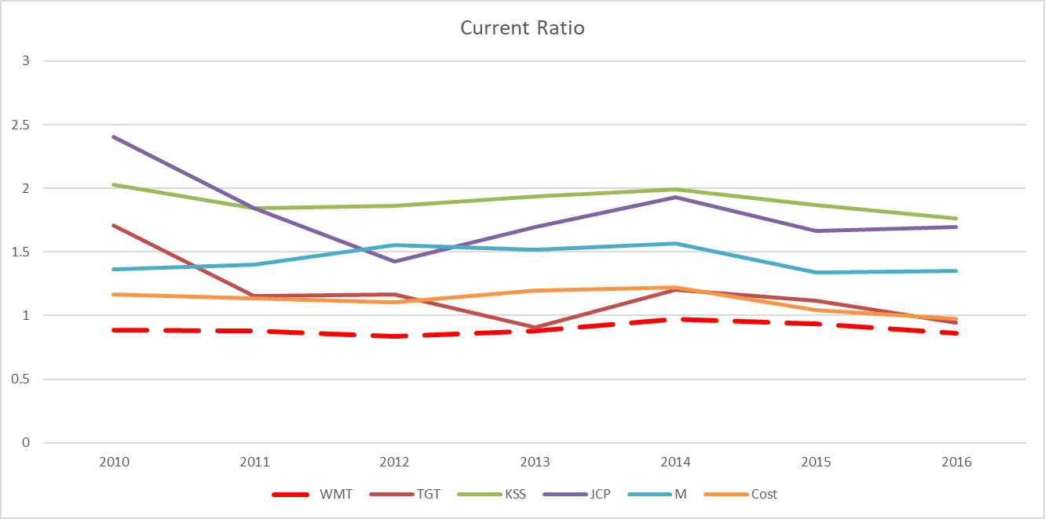
Time-Trend and Peer Analysis Current Ratio

Slide 63
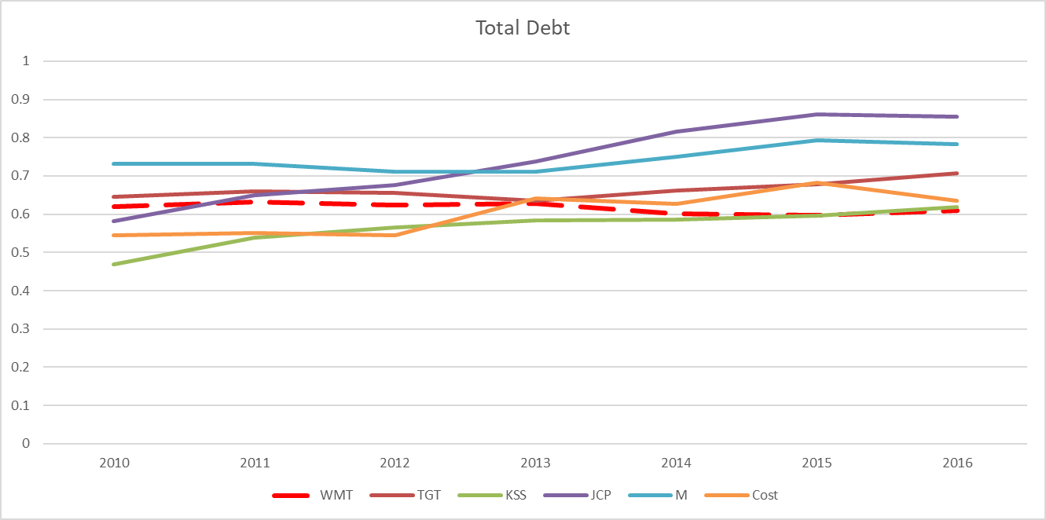
Time-Trend and Peer Analysis Total Debt Ratio

Slide 64
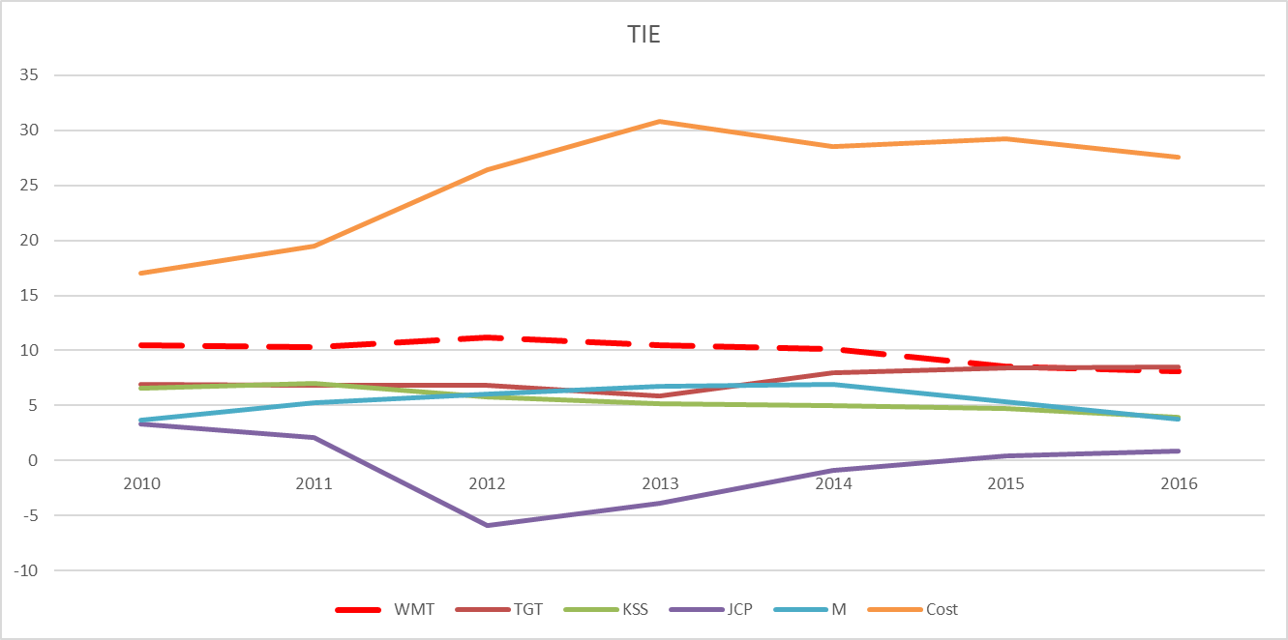
Time-Trend and Peer Analysis Times Interest Earned

Slide 65
Time-Trend and Peer Analysis Total Asset Turnover

Slide 66
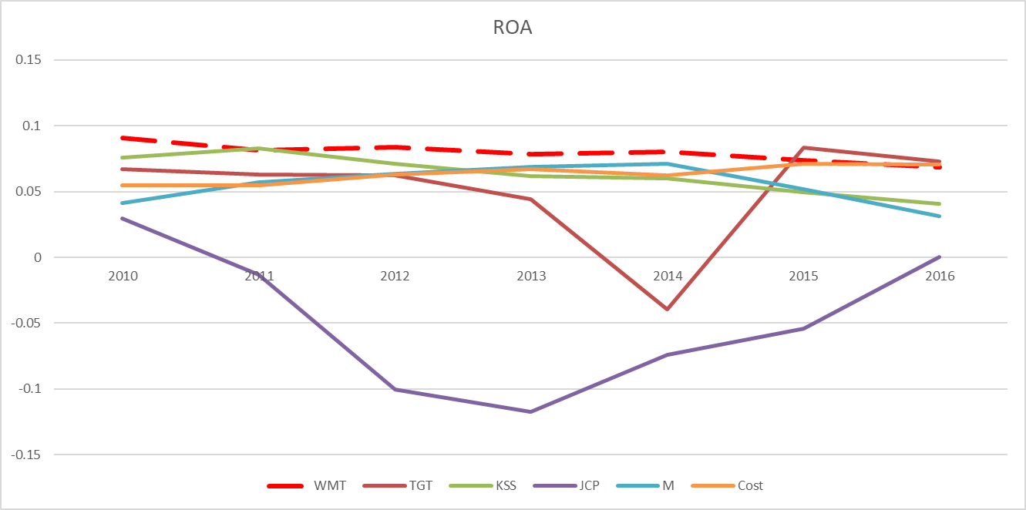
Time-Trend and Peer Analysis ROA

Slide 67
Time-Trend and Peer Analysis ROE

Slide 68
Some Cautions
No Underlying Theory
Diversified Firms
Globalization
Varying Accounting Procedures
Different Fiscal Years
Developing/Using Comparative Data
Notes to Financial Statements
Interpretation of Results
Window Dressing
Effects of Inflation
Comparison with industry averages is difficult if the firm operates many different divisions.
‘Average’ performance is not necessarily good.
Seasonal factors can distort ratios

