Slide 1
FIN 422: Student Managed Investment Fund
Topic 3: The Top-Down Approach to Market, Industry, and Company Analysis
Larry Schrenk, Instructor

Slide 2
Overview
9.1 Introduction to Market Analysis
9.2 Aggregate Market Analysis (Macroanalysis)
9.3 Microvaluation Analysis
9.4 Introduction to Industry Analysis
9.5 Industry Analysis
9.6 Estimating Industry Rates of Return
9.7 Global Industry Analysis
9.8 Company Analysis
9.9 Connecting Industry Analysis to Company Analysis
9.10 Calculating Intrinsic Value
9.11 Lessons from Some Legends

Slide 3
Learning Objectives
What is the relationship between stock prices and the economy (as represented by GDP)?
What methodologies can be used to value the overall market?
What are leading economic indicators?
What are coincident indicators?
What are lagging indicators?
How do interest rates impact stock prices?
What arguments support the importance of performing industry analysis?
How do the business cycle, structural issues, the industry life cycle, and competitive forces impact an industry?
What’s the difference between a growth company and a growth stock?
How do competitive strategies and SWOT analysis help company analysis? What is the growth duration model?

Slide 4
Readings
Reilley, et al., Investment Analysis and Portfolio Management, Chap. 9

Slide 5
9.1 Introduction to Market Analysis

Slide 6
9.1 Introduction to Market Analysis
The first stage of top-down analysis is attractiveness of a particular market
The two components:
Macroanalysis of relationship between aggregate securities markets and aggregate economy
Microvaluation of the stock market employing the valuation approaches

Slide 7
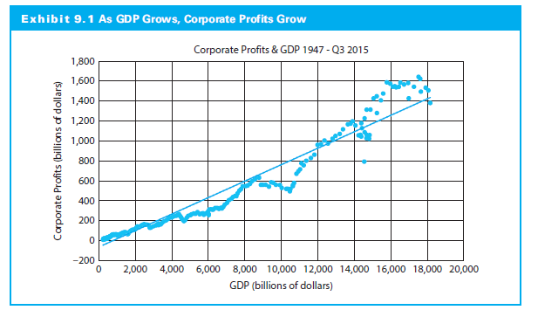
9.1 Introduction to Market Analysis

Slide 8
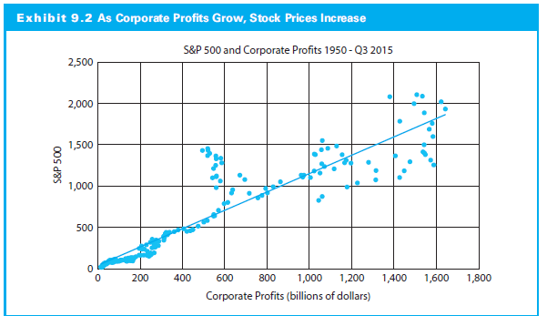
9.1 Introduction to Market Analysis

Slide 9
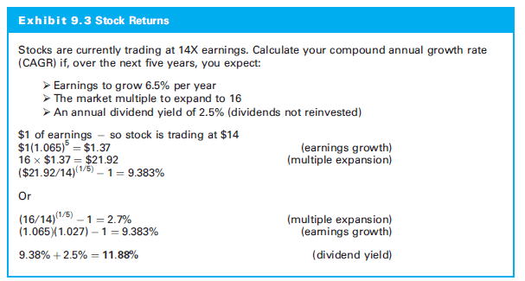
9.1 Introduction to Market Analysis

Slide 10
9.2 Aggregate Market Analysis (Macroanalysis)

Slide 11
9.2 Aggregate Market Analysis (Macroanalysis)
Economic growth leads to higher stock prices
An easy conclusion: Study GDP growth to predict stock prices
Problems with this approach:
GDP data is released after each quarter ends
Preliminary GDP data will be revised
Stock market moves ahead of the economy

Slide 12
9.2 Aggregate Market Analysis (Macroanalysis)
Other measures of the economy:
The leading, coincident, and lagging economic indicators
Sentiment indicators
Interest rates

Slide 13
9.2.1 Leading, Coincident, and Lagging Indicators
Leading Indicators
Economic series that usually reach peaks or troughs before aggregate economic activity
Coincident indicators
Economic time series that have peaks or troughs coinciding with economic activity
Lagging indicators
Economic series that usually reach peaks or troughs after aggregate economic activity

Slide 14
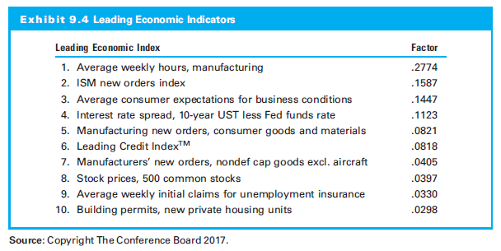
9.2.1 Leading, Coincident, and Lagging Indicators

Slide 15
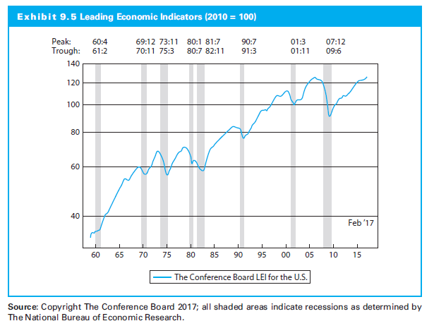
9.2.1 Leading, Coincident, and Lagging Indicators

Slide 16
9.2.1 Leading, Coincident, and Lagging Indicators

Slide 17
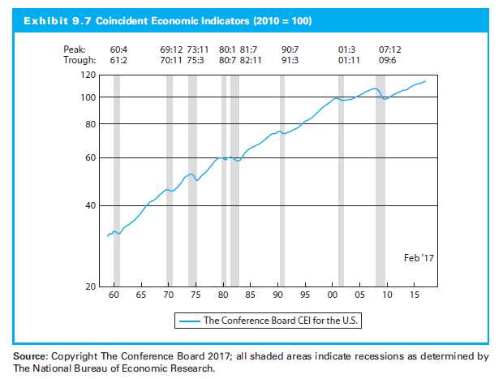
9.2.1 Leading, Coincident, and Lagging Indicators

Slide 18
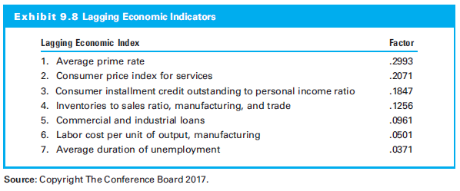
9.2.1 Leading, Coincident, and Lagging Indicators

Slide 19
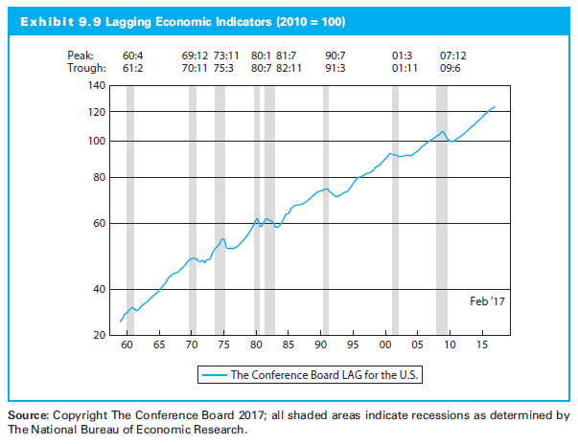
9.2.1 Leading, Coincident, and Lagging Indicators

Slide 20
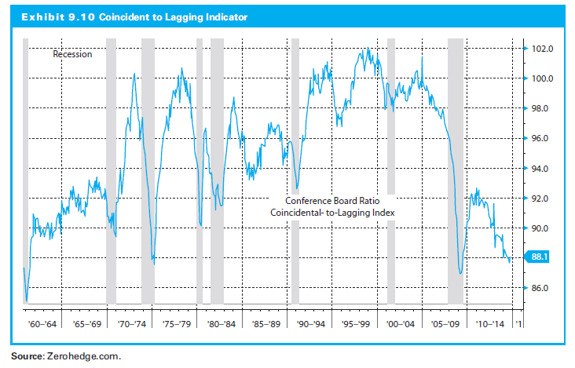
9.2.1 Leading, Coincident, and Lagging Indicators

Slide 21
9.2.1 Leading, Coincident, and Lagging Indicators
No perfect indicators
Limitations (Koenig & Emery, 1991):
False signals
Timeliness of the data and revisions
Economic sectors not represented

Slide 22
9.2.2 Sentiment and Expectations Surveys
Consumer expectations
Consumers must have confidence in order to spend
Consumer spending is approximately 70% of GDP
Monthly surveys of consumer expectations:
University of Michigan Consumer Sentiment Index
Conference Board Consumer Confidence Index

Slide 23
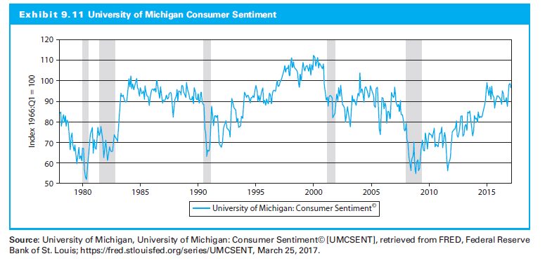
9.2.2 Sentiment and Expectations Surveys

Slide 24
9.2.3 Interest Rates
The real federal funds rate
The yield curve (the term spread)
The risk premium between Treasury bonds and BBB bonds
The Fed model

Slide 25
9.2.3 Interest Rates
The Real Federal Funds Rate
Federal funds rate and whether it is intended to stimulate or restrict the economy
The natural/neutral rate is the rate that would neither stimulate nor restrict
Is Fed policy is accommodative or restrictive?
Accommodative, then trying to increase growth
Restrictive, then trying to slow the economy (to control inflation)

Slide 26
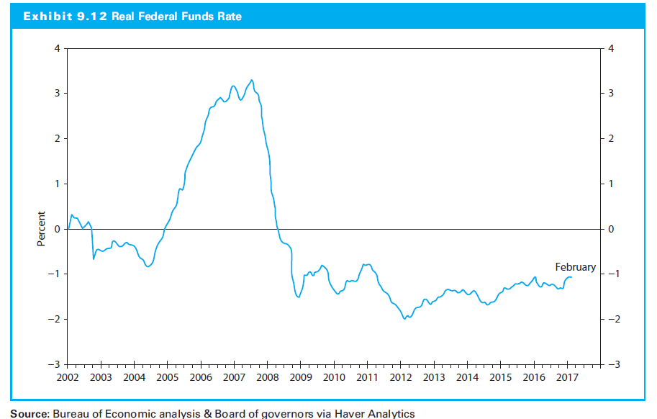
9.2.3 Interest Rates

Slide 27
9.2.3 Interest Rates
The Yield Curve
Most important economic indicator
Normal yield curve increasing
Flat yield curve flat
Inverted yield curve decreasing
The yield curve has inverted prior to every recession since 1970

Slide 28
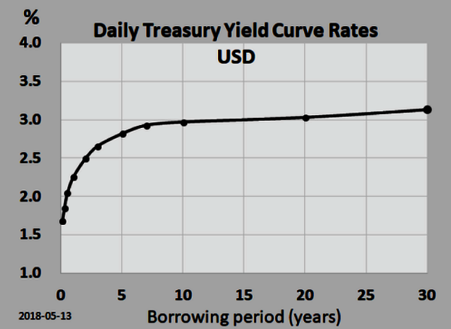
9.2.3 Interest Rates
The Yield Curve

Slide 29
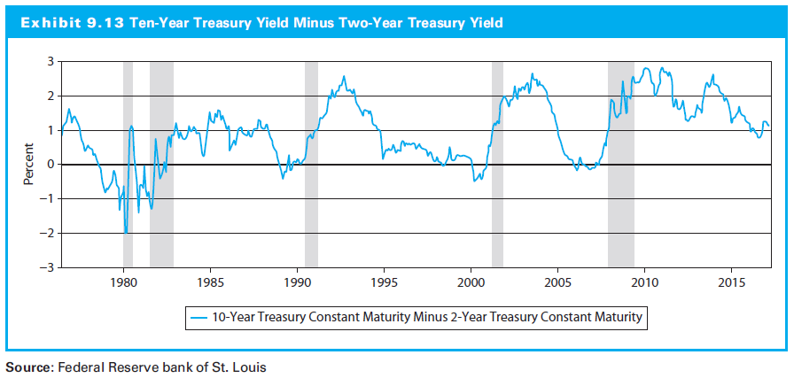
9.2.3 Interest Rates

Slide 30
9.2.3 Interest Rates
Risk Premium
Difference between BBB corporate bonds and the yield on U.S. Treasury bonds
Larger spread indicates fear in the markets and investors requiring additional compensation for taking risk (more risk averse)

Slide 31
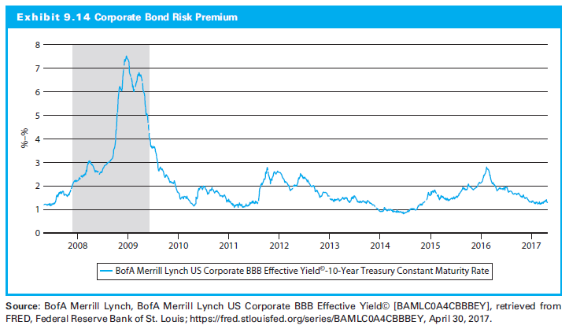
9.2.3 Interest Rates

Slide 32
9.2.3 Interest Rates
The Fed Model
Greenspan’s Monetary Report to Congress 1997
S&P 500 should be worth next year’s earnings divided by the yield on the 10-year Treasury bond
For a long period of time, the correlation between this model’s predicted value for the S&P 500 and actual stock prices was very high

Slide 33
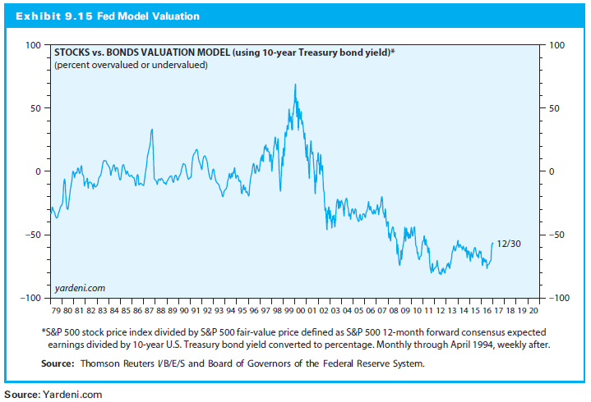
9.2.3 Interest Rates

Slide 34
9.3 Microvaluation Analysis

Slide 35
9.3 Microvaluation Analysis
Calculate actual value of the market
Valuation techniques:
Free cash flow to the equityholder (FCFE) model
Relative valuation
Shiller’s cyclically adjusted price-earnings (CAPE) ratio

Slide 36
9.3.1 FCFE to Value the Market
FCFE inputs:
Estimate of next year’s cash flows and
Discount rate

Slide 37
9.3.1 FCFE to Value the Market
Cash Flows
Use consensus estimates for earnings per share
Use the consensus estimate for earnings per share for the S&P 500
Build a model organically by estimating:
Growth rate of sales
Operating margin
Interest expense
Tax rate

Slide 38
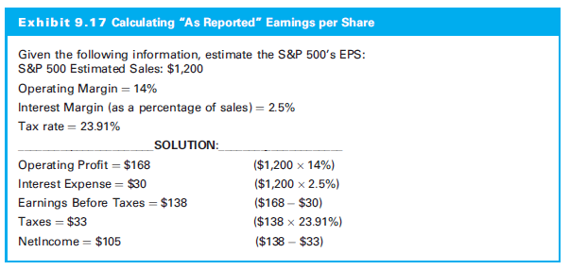
9.3.1 FCFE to Value the Market

Slide 39
9.3.1 FCFE to Value the Market
Growth Rate of Sales per Share
Sales per share for the year ended and estimate growth of sales
Operating Margin
For operating profit, multiply the sales per share by the operating margin
Consider economic factors that impact the operating margin and how they are changing

Slide 40
9.3.1 FCFE to Value the Market
Interest Expense
Interest expense deducted from operating profit
Interest expense depends on debt amount and interest rate
Tax Rate
Current tax rate and any possible change
Weigh the trend in which goods are produced and sold (due to the difference in tax rates in different jurisdictions)

Slide 41
9.3.1 FCFE to Value the Market
The Discount Rate
Use the cost of equity for the overall market
Using CAPM: the risk free rate and the risk premium is needed

Slide 42
9.3.1 FCFE to Value the Market

Slide 43
9.3.2 Multiplier Approach
P/E Multiple
Estimate:
Earnings per share and
Multiplier
To estimate the multiplier use:
The growth rate
The cost of capital
The return on equity

Slide 44
9.3.2 Multiplier Approach

Slide 45
9.3.3 Shiller P/E Ratio
Cyclically adjusted price–earnings (CAPE) multiple
Numerator value of the S&P 500 (as before)
Denominator inflate past earnings to the current year (and then average them)

Slide 46
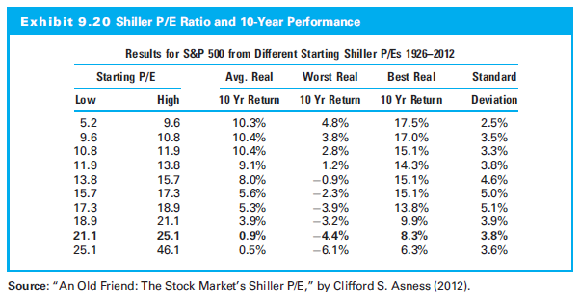
9.3.3 Shiller P/E Ratio

Slide 47
9.3.4 Macrovaluation and Microvaluation of World Markets
Each global market is different‒economies are growing at different rates, different economic data may exist for each country, risks are different, accounting standards are different, and different types of companies may inhabit the public markets
Three important factors:
Basic valuation model and concepts apply globally
Input values can and will vary dramatically
Additional variables or constraints:
Exchange rate risk
Country risk

Slide 48
9.4 Introduction to Industry Analysis

Slide 49
9.4 Introduction to Industry Analysis
Industry analysis matters
Returns vary among industries and even for stocks within an industry, and risk varies among industries
But an industry’s overall risk can be relatively stable over time

Slide 50
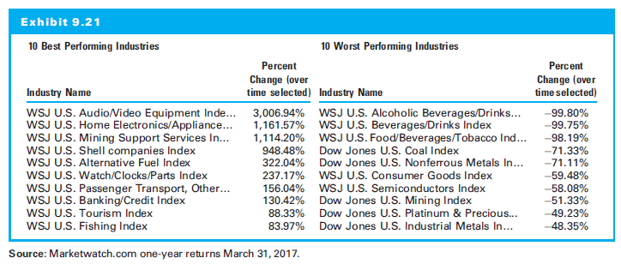
9.4 Introduction to Industry Analysis

Slide 51
9.5 Industry Analysis

Slide 52
9.5 Industry Analysis
Macroanalysis of industries:
Cyclical impacts
Structural impacts
The life cycle of the industry
The competitive forces within an industry (Porter analysis)

Slide 53
9.5.1 The Business Cycle and Industry Sectors
The business cycle
Output peaking
Contracting (in a recession)
Recovering to prior peak (recovery), and
Grows further (expansion)
Industries
Different industries perform differently in different parts of the business cycle
Sector rotation: their investments among sectors as economic trends change

Slide 54
9.5.1 The Business Cycle and Industry Sectors
Sector rotation examples:
After a recession, financial stocks often recover first
This did not happen in 2009, and it serves as evidence that every cycle is different
Consumer durable goods do well as the economy recovers
Capital goods do well as economy moves into expansion
Cyclical companies move in anticipation of the cycle
Consumer staples outperform during slowdown

Slide 55
9.5.2 Structural Economic Changes Impact the Industry (Noncyclical Factors)
Demographics: Demand side (consumption) and supply side (particularly labor)
Lifestyles: How people live, work, form households, consume, enjoy leisure, and educate themselves
Technology: Affect industry factors, including and new technology can completely change an industry
Politics and Regulation: Impact on industries; reflects social values

Slide 56
9.5.3 Industry Life Cycle
View the industry over time and dividing its development into stages
How long does the industry remain in a stage of the life cycle?

Slide 57
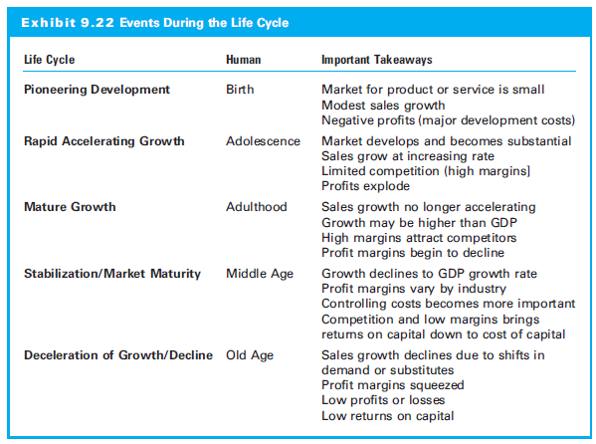
9.5.3 Industry Life Cycle

Slide 58
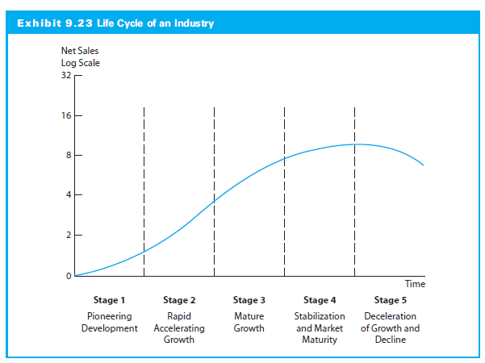
9.5.3 Industry Life Cycle

Slide 59
9.5.4 Industry Competition
Competition impact on profitability
Michael Porter’s competitive strategy is search for a favorable competitive position
Examine the basic competitive structure of its industry

Slide 60
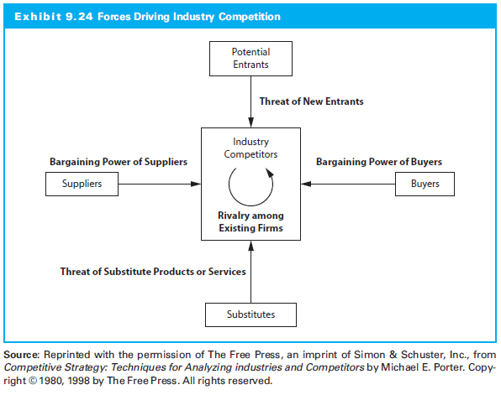
9.5.4 Industry Competition

Slide 61
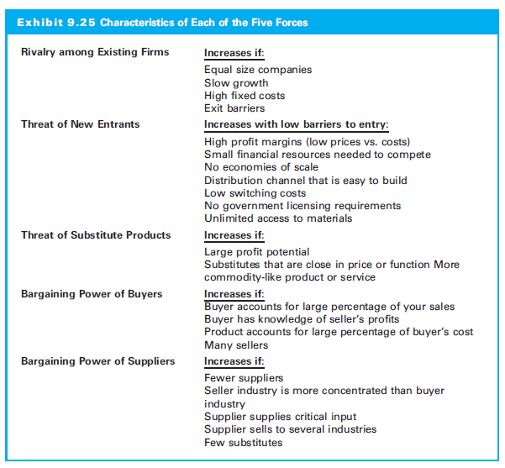
9.5.4 Industry Competition

Slide 62
9.6 Estimating Industry Rates of Return

Slide 63
9.6 Estimating Industry Rates of Return
Value industry just as overall market was valued
Use discounted cash flows or relative valuation
Build a model or use multiples

Slide 64
9.6.1 Estimating the Cost of Capital
Calculate k with the CAPM.
For beta, regress the returns of industry against market index
Estimate the cost of capital by considering all of the significant risks: business risk, financial risk, liquidity risk, exchange rate risk, and country risk

Slide 65
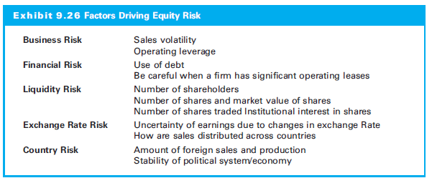
9.6.1 Estimating the Cost of Capital

Slide 66
9.6.2 Sales Growth Estimates
Three approaches to sales growth:
Time series analysis:
Overlaying industry sales with the business cycle and estimating changes
Input/output analysis:
Long-run sales outlooks for supplies and customers
Industry–economy relationship:
Identifying most significant economic variable for industry demand

Slide 67
9.6.3 Other Considerations
Ideas specific to industry analysis:
Difficult to apply regression and time-series analysis
Industry tax rate different from thmarket tax rate
Relative valuation compares industry with market multiple
Understand fundamentals that drive a multiple

Slide 68
9.7 Global Industry Analysis

Slide 69
9.7 Global Industry Analysis
Include the effects of foreign firms on industry returns
Global industry analysis is growing in importance, as documented by Cavaglia, Brightman, and Aked (2000)
Country factors dominate industry factors in terms of explaining equity returns
Industry factors growing in importance and may dominate country factors (Cavaglia et al.)

Slide 70
9.8 Company Analysis

Slide 71
9.8 Company Analysis
Which are the best companies within these desirable industries?
What is the intrinsic value of the firm’s stock?
How does the intrinsic value compare with the market value?

Slide 72
9.8.1 Growth Companies and Growth Stocks
Growth Companies
Above-average increases in sales and earnings
Return greater than required rate of return
Growth Stocks
Stocks of growth companies
Higher return than stocks with similar risk
Superior risk-adjusted rate of return due to market undervaluation

Slide 73
9.8.2 Defensive Companies and Stocks
Defensive Companies
Future earnings more likely to withstand downturn
Low business risk
No excessive financial risk
E.g., public utilities or grocery chains
Defense Stocks
Return doesn’t decline or declines less than market return
Low or negative systematic risk

Slide 74
9.8.3 Cyclical Companies and Stocks
Cyclical Companies
Sales and earnings will be heavily influenced by business cycle
E.g., steel, auto, or heavy machinery
Cyclical Stocks
Greater changes in return than the overall market return
High betas

Slide 75
9.8.4 Speculative Companies and Stocks
Speculative Companies
Great risk; possibility of great gain
E.g., oil exploration
Speculative Stocks
High probability of low or negative returns
E.g., growth company with high P/E ratio

Slide 76
9.8.5 Value versus Growth Investing
Growth
Positive earnings surprises
Above-average risk adjusted rates of return (undervalued?)
Value
Undervalued for reasons besides earnings growth potential
Low P/E ratio
Low price to book ratio

Slide 77
9.9 Connecting Industry Analysis to Company Analysis

Slide 78
9.9 Connecting Industry Analysis to Company Analysis
Company analysis is the final step
Search for companies that will be favorably influenced by these economic and structural factors
The company must have an attractive valuation

Slide 79
9.9.1 Firm Competitive Strategies
Company’s competitive strategy
Defensive: Positioning the firm to deflect the effect of the competitive forces in the industry
Offensive: Use its strengths to affect the competitive forces in the industry
Porter’s (1980a, 1985) two major competitive strategies:
Low-cost
Differentiation

Slide 80
9.9.1 Firm Competitive Strategies
Low-Cost Strategy
Low-cost producer and cost leader in industry
Differentiation Strategy
Identify itself as unique in area important to buyers
Focusing a Strategy
Where it will focus this strategy?
A firm must tailor strategy to specific segments

Slide 81
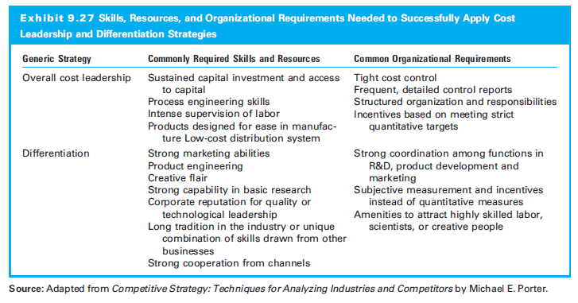
9.9.1 Firm Competitive Strategies

Slide 82
9.9.2 SWOT Analysis
Internal Analysis
Strengths
Give comparative advantage in the marketplace
Perceived strengths, e.g., good customer service, high-quality products, strong brand image, customer loyalty, innovative R&D, market leadership, or strong financial resources
Weaknesses
Competitors have exploitable advantages

Slide 83
9.9.2 SWOT Analysis
External Analysis
Opportunities
Environmental factors favoring firm
E.g., growing market, shrinking competition, favorable exchange rate shifts, or new market or product segment
Threats
Environmental factors hindering firm
E.g., slowing domestic economy, government regulation, industry competition, threats of entry

Slide 84
9.10 Calculating Intrinsic Value

Slide 85
9.10 Calculating Intrinsic Value
Absolute valuation
Dividends,
FCFE, or
FCFF
Relative valuation
Multiples

Slide 86
9.10.1 Some Additional Insights on Valuation
Blindly using historic growth rates or margins
Consider how the sales mix is changing
Growth rate influenced by its life cycle, structural changes, industry competition, and economic trends
Distinguish organic from acquired growth

Slide 87
9.10.1 Some Additional Insights on Valuation
Remember what your cost of equity represents
Understand the competitive strategy (low cost or differentiation) when estimating the profit margin
Have quarterly estimates for the next year
In relative valuation, compare the company to its historic multiple, competitors in the industry to an overall industry multiple, and the market multiple

Slide 88
9.10.2 Analyzing Growth Companies
Growth company can reinvest significant amounts of at return higher than its cost of capital
Three issues:
Amount of capital invested in growth investments
Relative rate of return earned on funds retained
The time period for these growth opportunities

Slide 89
9.10.2 Analyzing Growth Companies
Constant growth model makes strong assumptions:
Earnings and dividends growing at a constant rate
Firm is investing more in projects with returns greater than cost of capital
The firm can do this infinitely

Slide 90
9.10.2 Analyzing Growth Companies
Growth duration model evaluates P/E ratio by relating P/E ratio to the rate and duration of growth
A stock’s P/E ratio is a function of three factors:
Firm’s expected growth of earnings per share
Stock’s required rate of return
Firm’s dividend payout ratio
Two assumptions:
Equal risk between the firms that you are analyzing
No significant differences in the payout ratios

Slide 91
9.10.2 Analyzing Growth Companies)
Assumption: P/E ratios are proportional to ratio of composite growth rates raised to the Tth power
Solve for T by using the following equation
G = growth
D = Dividends
g = high-growth company
a = slower growth company

Slide 92
9.10.2 Analyzing Growth Companies
Growth duration model: How long the earnings of the growth stock must grow at this expected high rate, relative to the nongrowth stock, to justify its P/E ratio?

Slide 93
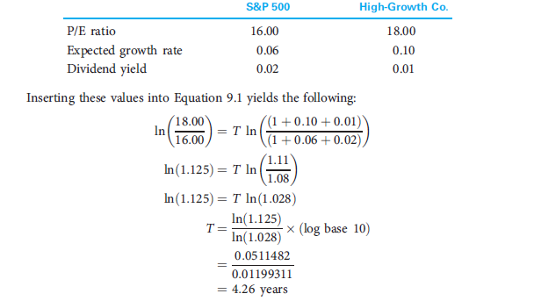
9.10.2 Analyzing Growth Companies

Slide 94
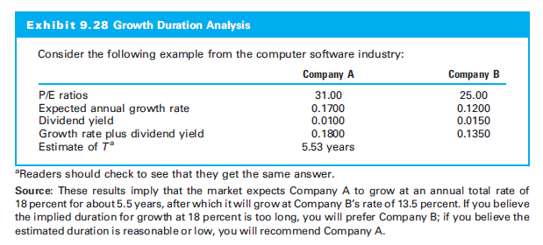
9.10.2 Analyzing Growth Companies

Slide 95
9.10.2 Analyzing Growth Companies
An Alternative Use of T
Instead of solving for T and then deciding whether the figure derived is reasonable,
Use this formula to compute a reasonable P/E ratio for a security given other expected inputs

Slide 96
9.10.2 Analyzing Growth Companies
Factors to Consider
Technique assumes equal risk for the firms
Which growth estimate should be used? Generally growth based on the factors that affect g
Assumes stocks with higher P/E ratios have higher growth rates

Slide 97
9.10.2 Analyzing Growth Companies
Inconsistency between the expected growth and P/E ratio could be due to:
Difference in the risk involved
Growth rate estimates inaccurate
Low P/E stock relative to its expected growth is undervalued
High P/E stock relative to its expected growth is overvalued

Slide 98
Timelines in Excel
Excel Tutorial
Timeline Prediction

Slide 99
9.11 Lessons from Some Legends

Slide 100
9.11 Lessons from Some Legends
Three investing legends:
Peter Lynch
Warren Buffett, and
Howard Marks

Slide 101
9.11 Lessons from Some Legends
Peter Lynch
Product is not faddish; consumers will continue to purchase over time
Sustainable comparative competitive advantage
Industry or product has market stability
Possible cost reductions
Firm buys back its shares or management purchases shares

Slide 102
9.11.2 Tenets of Warren Buffett
Business Tenets
Business simple and understandable?
Business have a consistent operating history?
Business have favorable long-term prospects?
Management Tenets
Management rational?
Management candid with its shareholders?
Management resist the institutional imperative?

Slide 103
9.11.2 Tenets of Warren Buffett
Financial Tenets
Focus on return on equity, not earnings per share
Calculate “owner earnings”
Look for companies with high profit margins
For every dollar retained, make sure the company has created at least one dollar of market value
Market Tenets
What is the intrinsic value of the business?
Can the business be purchased at a significant discount to its fundamental intrinsic value?

Slide 104
9.11.3 Tenets of Howard Marks
From book: The Most Important Thing
To succeed, engage in second-level thinking
Have an accurate sense of intrinsic value
Times when some investors must sell
Risk is the risk of permanent capital loss
Risk is greatest when other investors say that there is no risk
Almost everything in business is cyclical

Slide 105
9.11.3 Tenets of Howard Marks
Market is a pendulum that swings between fear and greed
Avoid greed, fear, envy, dismissal of logic, and ego
Understand intrinsic value
Buy when other investors are selling
Keep a list of potential investments
Exercise patience
Understand what you know and do not know
Always have context

