Slide 1
FIN 422: Student Managed Investment Fund
Topic 2: The Practice of Fundamental Investing
Larry Schrenk, Instructor

Slide 2
Overview
10.1 Initial Public Offerings
10.2 Buy-Side Analysts and Sell-Side Analysts
10.3 Capital Allocation
10.4 Corporate Governance

Slide 3
Learning Objectives
What should an investor know about the management of an initial public offering?
Why does underpricing occur in the IPO market?
Why are there many more bookbuilt offerings as opposed to auctions?
What does a sell-side analyst do?
What does a buy-side analyst do?
How do investors analyze the capital allocation of management? Where are the seven places that a company’s management can allocate capital?
When should a company pay a dividend as opposed to repurchase shares?
What are the three main corporate governance issues that analysts think about?
What are the key elements of a stock pitch?

Slide 4
Readings
Reilley, et al., Investment Analysis and Portfolio Management, Chap. 10

Slide 5
10.1 Initial Public Offerings

Slide 6
10.1.1 Why Go Public
Reasons for going public:
Company needs capital to finance growth
Investors and management want liquidity
Have public stock to acquire other companies
Public stock as compensation vehicle
Prestige
Signaling/monitoring function

Slide 7
10.1.1 Why Go Public
Disadvantages of going public:
Answer to outside shareholders; shorter-term focus
Time meeting with analysts
More disclosure of its strategy
Direct costs, e.g. Sarbanes-Oxley compliance

Slide 8
10.1.2 The IPO Process
Investment bank leads company through process
Either firm commitment or a best efforts offering
Firm Commitment: Bank (underwriter) purchases the shares from the company and has the risk
Best Efforts: Bank to use its best efforts to find buyers for the shares

Slide 9
10.1.2 The IPO Process
Prospectus (Most significant part of the S-1, registration statement (S-1):
Discussion of past performance, management’s plans, financial information, how the company will use the proceeds from the offering, the dividend policy, management compensation, and critical accounting issues
Preliminary prospectus often called a red herring because of the warning on its cover that is printed in red ink

Slide 10
10.1.2 The IPO Process
After the S-1, underwriter takes the issuing company’s management to meet potential investors, a ‘road show’
Bankers receive indications of interest from investors
SEC reviews the registration statement and usually asks for additional information from the issuing firm

Slide 11
10.1.2 The IPO Process
When SEC is satisfied all necessary information disclosed, the offering is effective (the offering can be sold to the public)
Investment bank and firm have a pricing meeting, and based on road show feedback, a price is set for the stock

Slide 12
10.1.2 The IPO Process
A successful offering is oversubscribed
After shares distributed to initial investors, trading in the secondary market
A fee is paid to the underwriter:
For most offerings in the United States, the fee is 7 percent of the offering proceeds
Bank receives $1.05 of a $15 share; it’s the gross spread, or the underwriting spread

Slide 13
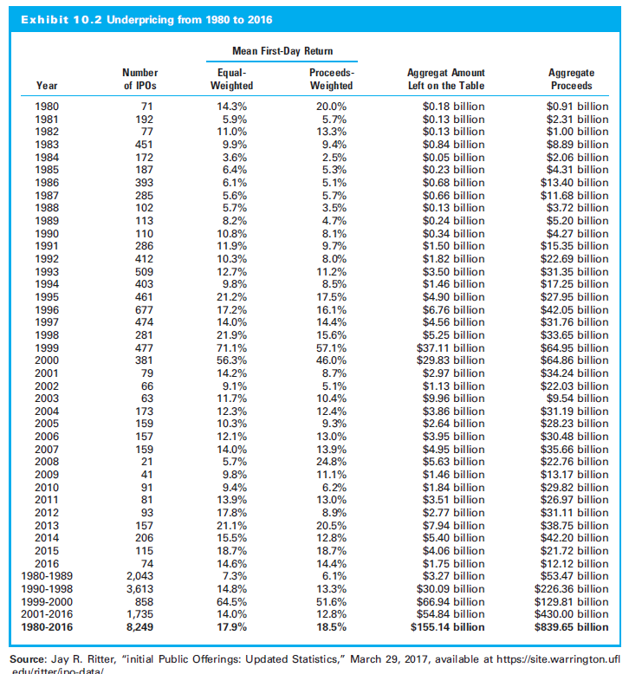
10.1.3 Underpricing
Stock often ends its first day of trading at price higher than IPO price

Slide 14
10.1.5 Reasons for Underpricing
Compensate institutional investors for providing pricing information
Winner’s curse
Anyone who wins an auction must have bid too much
Investor trusts the banker to systematically underprice security

Slide 15
10.1.5 Reasons for Underpricing
Firm managers estimate their personal wealth based on the midpoint of the initial range
Easier to adjust up, than down
Minimize their litigation risk and/or to protect their reputational capital
Banks receive “kickbacks” from allocating cheap IPOs to some clients

Slide 16
10.1.7 Longer-Term Performance of IPOs
Measured from the first-day closing price, IPOs seem to have a poor performance record
Many studies show new public stocks underperform the market over the next three year

Slide 17
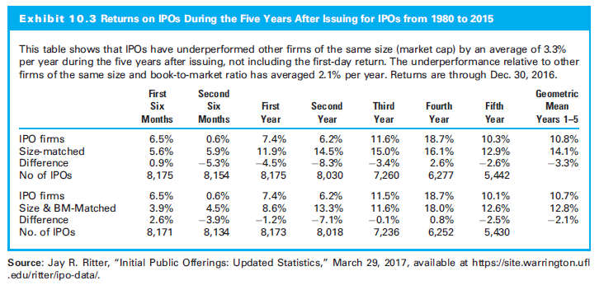
10.1.7 Longer-Term Performance of IPOs

Slide 18
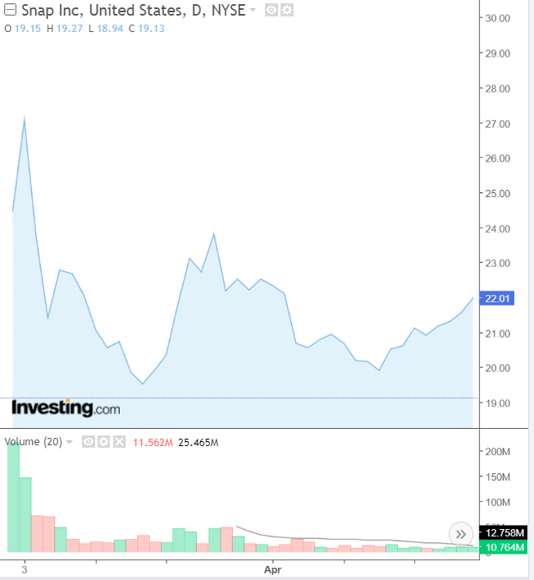
Snap Stock Price: IPO

Slide 19
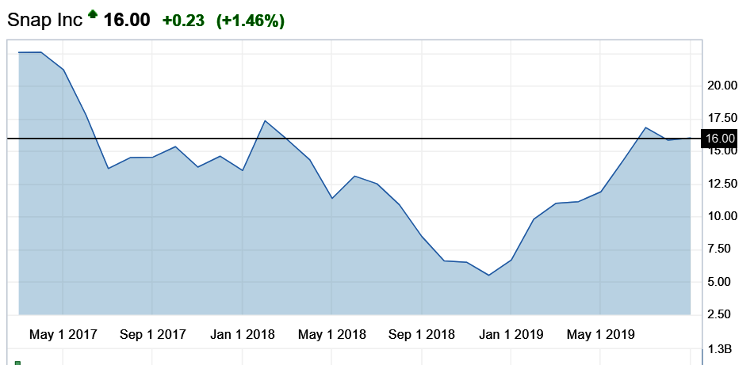
Snap Stock Price: IPO-Present

Slide 20
10.2 Buy-Side Analysts and Sell-Side Analysts

Slide 21
10.2 Buy-Side Analysts and Sell-Side Analysts
Sell side: Firms that facilitate securities transactions
Investment banks and brokerage firms
Buy side: Firms that invest in securities
Mutual funds, hedge funds, trust companies, pension funds, and endowments

Slide 22
10.2.1 Sell-Side Analysts
Sell Side Forecasts: Analysts use their industry knowledge to make earnings forecasts
Sell Side Coverage: Stocks that their clients demand coverage on and companies that have investment banking relationships with the firm
Sell-Side Analyst Motivation:
Win banking business
Management is likely more accessible

Slide 23
10.2.1 Sell-Side Analysts
Sell Side Firm Compensation
Buy-side pays fixed amount for research
Buy side directs trades to the sell-side firm
Sell-Side Analyst Issues
Buy side demands accurate information
Evidence that companies dfon’t provide access to sell-side analysts who make negative statements

Slide 24
10.2.1 Sell-Side Analysts
Sell Side Management Pressure
Pressure to understand management’s view of the company and recent events
Pressure to produce an earnings forecast that the company will beat
Side Value
Access to management

Slide 25
10.2.2 Buy-Side Analysts
Buy Side Use of Sell Side Research
Values the information more than actual buy or sell recommendation
Stock Coverage
Buy-side analysts have broader coverage than sell-side

Slide 26
10.2.2 Buy-Side Analysts
Buy-Side Interest in Sell-Side
Needs a meeting with a management team that the sell side follows closely
Expensive data that the buy side may not have
Buy-side analysts may mix bullish and bearish sell-side analysts
Sell-side analyst can help a buy-side analyst quickly learn about an industry or a company

Slide 27
10.2.2 Buy-Side Analysts
How Sell Side Helps Buy Side
Sell side as a hub of information
Gather that information by talking to the sell side
Sell side talks to more investors and executes more trades

Slide 28
10.2.2 Buy-Side Analysts
Buy-Side Analyst
They gather credible information
predict the future with imperfect information
Buy-Side Analyst Compensation
quality of their recommendations

Slide 29
10.2.3 Financial Analyst Forecasting Literature
Key ideas of Ramnath, Rock, and Shane (2008):
Sell-Side Research Clearly Matters
Analysts Obtain Much Value from Segment Reports
Sell-Side Analysts Tend to Rely On Multiples (for Valuation) More Than Discounted Cash Flow
Forecast Accuracy Seems to Improve with Experience and Decrease When an Analyst Follows Too Many Industries and Firms
As an Investor, It Is Particularly Interesting When There Is a Wide Dispersion of Analyst Forecasts

Slide 30
10.2.4 Snap Inc. IPO and Analysts
In the first quarter of 2017, Snap Inc. went public (ticker SNAP)
First 11 sell-side analysts rated it as a sell or a hold (not including syndicate analysts)
Once the 25th day arrived, analysts from the underwriting firms issued bullish reports on the company potential
Mostly positive reports pushed stock higher in late March
SNAP released first earnings in early May 2017
Earnings very disappointing; price dropped more than 20%

Slide 31
10.3 Capital Allocation

Slide 32
10.3 Capital Allocation
Capital allocation: Uses resources to create shareholder value
How managers select the best projects and financing them as inexpensively as possible

Slide 33
10.3.1 The Seven Places That Capital Can Be Allocated
Seven primary ways to allocate capital:
Mergers and acquisitions
Capital expenditures
Research and development
Working capital
Dividends
Repurchase shares
Return cash to debtholders
Invest in Firm
Return Value to Investors

Slide 34
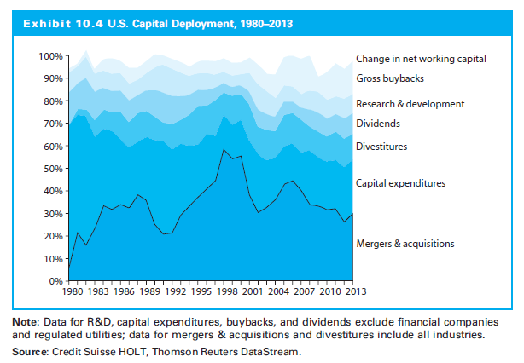
10.3.1 The Seven Places That Capital Can Be Allocated

Slide 35
1. Mergers and Acquisitions
Cyclical
High price for your stock → company’s cost of equity low
Acquisition Issues:
Purpose
Method of payment
Price paid

Slide 36
2. Capital Expenditures
Capital expenditures are investment in business
Distinguish maintenance versus growth capital expenditures
Depreciation is estimate of maintenance capital expenditures
Additional capital expenditures generate growth

Slide 37
3. Research and Development
Reinvestment in company
Varies by industry
Firm R&D trend
Market that the R&D focuses on
Historical success of the company

Slide 38
4. Net Working Capital
Least analyzed decision with respect to capital allocation
Distinguish investing in net working capital from simply accumulating cash

Slide 39
5. Dividends
Cash payments to all shareholders
Dividends as the firm’s last alternative
They don’t create value for shareholders
Many firms pay dividends on a regular basis; dividends are rarely cut

Slide 40
Dividends Advantages
Investors value the income
Reduce the agency conflict by removing free cash flow
Signal that
Future cash flows high
Management will be more disciplined
Board controlling the empire-building
Keep leverage high

Slide 41
Dividends Timeline
Declaration Date: Dividend is announced
Date of Record: Transfer agent “closes the book”
Ex-dividend Date: Stock starts trading without the right to the dividend
Payment Date: Dividend distributed

Slide 42
6. Share Repurchases
In strong economic times, companies often have significant residual cash
Share prices are the highest and when companies often do the most repurchases
Buying back expensive shares gift to exiting shareholders at expense of remaining shareholders
Analyze repurchase behavior to understand management’s view on capital allocation

Slide 43
Share Repurchases (continued)
Repurchases do not always create value
Sometimes announced but not executed
Companies can attempt a positive signal, yet never actually repurchase the shares
Or, repurchases are executed, but the company’s share count never decreases
The repurchased shares are issued to management as a result of option grants

Slide 44
Dividends versus Repurchases
Repurchase shares when below intrinsic value; pay dividend when shares above intrinsic value
If stock is trading at intrinsic value, indifferent between a repurchase and a dividend

Slide 45
7. Returning Cash to Debtholders
Debt is a low-cost source of capital
If higher than optimal level of debt, then value-creating to return capital to the debtholders

Slide 46
What Do Investors Want to See?
Management engaged in value creation
Management understands valuation and behaves opportunistically
Purchasing shares when cheap
Using equity when expensive, and
Acquiring targets as a first-mover in the industry
Compensation structured towards long-term value creation

Slide 47
10.4 Corporate Governance

Slide 48
10.4 Corporate Governance
Rules, policies, and procedures used to direct and control a company
Tools used to align the interest of management with that of shareholders
Integrating environmental, social, and governance (ESG) factors

Slide 49
10.4.1 The Board of Directors
CEO/Chair of the Board
Board chair other than the CEO
Board Size
Not be too large
Diverse set of experiences and knowledge
Approximately 9 members within S&P 500
Board Independence
Beyond any legal definition
Directors who will voice their opinion, who are not beholden to the CEO or board chair
Concern board members never take a stand contrary to the CEO

Slide 50
10.4.1 The Board of Directors
Board Compensation
Approximately half of S&P 500 compensation > $250,000/year
May require directors to hold stock in the company
Align the directors’ interests with shareholders
Compensating directors with stock can result in directors overlooking bad acts and may defeat the purpose of the board
Responses to Shareholder Proposals
How boards respond to shareholder proposals, particularly from large activist investors
Sometimes, ideas that may benefit the long-term value
Or ideas that will simply impact the short term

Slide 51
10.4.2 Anti-Takeover Provisions
Poison pills
Supermajority to approve selling firm
Selling the most profitable part of the company
Staggered board

Slide 52
10.4.3 Compensation
Remedy the principal–agent conflict
Three areas – Callahan and Mauboussin (2014):
Management controlling resources that do not create value
Management (not diversified) may take too little risk
Compensation is often short-term focused
Three goals – Gressle and O’Byrne (2013):
Strong incentives to create shareholder value
Retain key talent
Limit compensation to levels maximizing shareholder wealth

Slide 53
10.4.3 Compensation
Level of Compensation
The three goals resulted in compensation that many consider very high
Kaplan (2013) argues that the market for top executives is competitive, and compensation of other professionals is growing even faster
Others complain that the variability in compensation is not significant
Compensation is being set by a group that the CEO may have had a hand in selecting

Slide 54
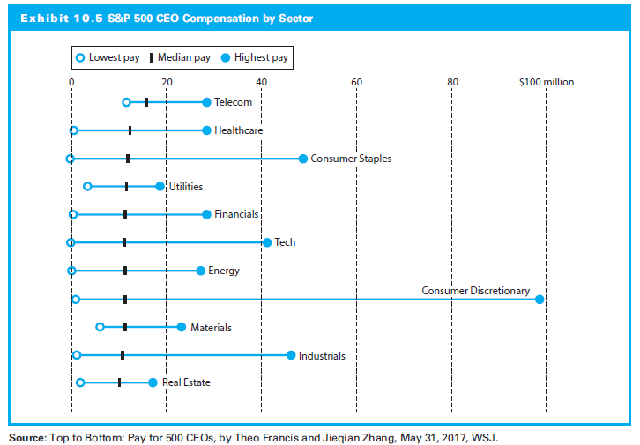
10.4.3 Compensation

Slide 55
10.4.3 Compensation
How Compensation Is Set
Compensation committee of the board of directors
NYSE rules require the compensation committee to be composed completely of independent directors

Slide 56
10.4.3 Compensation
Compensation Information
Compensation of the top five earners in the proxy statement
This includes disclosure of amounts ands types of compensation, the financial goals used to judge management

Slide 57
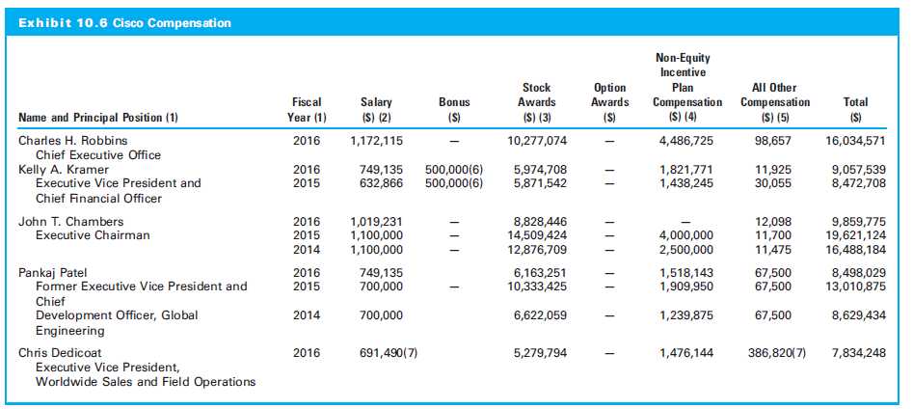
10.4.3 Compensation

