Slide 1
FIN 422: Student Managed Investment Fund
Topic 0: Course Introduction
Larry Schrenk, Instructor

Slide 2
Overview
The Key Question
Some Syllabus Details
About the Course
Equity Reports

Slide 3
1. The Key Question

Slide 4
The Key Question
What is the prime characteristic to look for in an investment?
Growing Firm?
Strong Firm?
Growth Potential?
Bad Firm?

Slide 5
The Key Question
What is the prime characteristic to look for in an investment?
A Mispriced Firm

Slide 6
What is Mispricing?
Market Price
≠
Intrinsic/True Value

Slide 7
Sources of Mispricing
Only Some Examples
Miscalculation of Growth
Product
Firm
Industry
Market Imperfections
Unpriced Subsidy
Unpriced Tax Advantage
Modelling Error

Slide 8
Criteria for Successful Investment
Identify Mispricing
Market Must Correct Itself
Active
Passive
NOTE: Time Horizon

Slide 9
Criteria for Successful Presentation
‘Story’
+
Numbers

Slide 10
Course Sequences
Intro to Finance
Investments
Security Valuation
Portfolio Theory
SMIF
Intro to Finance
Investments
Security Valuation + Portfolio Theory + SMIF

Slide 11
3 vs. 1 Credit
3 Credit
All Classes
Exams
Report
1 Credit
Friday Class
Report(s)

Slide 12
Schedule
Financial Market Analysis
Financial Statement Analysis
Advanced Portfolio Management

Slide 13
Schedule
Financial Market Analysis
Efficient Capital Markets, Behavioral Finance, and Technical Analysis
The Practice of Fundamental Investing
The Top-Down Approach to Market, Industry, and Company Analysis
Free Cash Flow Analysis

Slide 14
Schedule
Financial Statement Analysis:
Ratio Analysis

Slide 15
Schedule
Advanced Portfolio Management
Equity Portfolio Management Strategies
Professional Portfolio Management, Alternative Assets, and Industry Ethics
Evaluation of Portfolio Performance

Slide 16
2. Syllabus: The Boring Part

Slide 17
Introduction
FIN 422: Student Managed Investment Fund
Larry Schrenk, Instructor
Course Page
http://larryschrenk.com/FIN422/FIN422.htm
Syllabus (Questions Next Class)

Slide 18
Contact Information
Office: Somsen 319F
Telephone 507-457-2388
E-Mail
lschrenk@winona.edu
Webpage
http://larryschrenk.com/

Slide 19
Office Hours
Office Hours
9:00-9:50 AM MWF
12:00-1:00 PM MWF
Zoom Office Hours TR
By Appointment/Drop-In
Monday, Wednesday, Friday Campus or Zoom
Tuesday, Thursday (Zoom by appt)
On Campus Policy

Slide 20
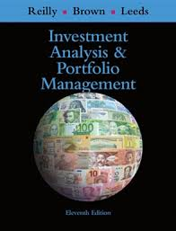
Textbook
Reilley, et al., Investment Analysis and Portfolio Management. Cengage.
Cengage Unlimited
MindTap

Slide 21
Financial Calculator
Acceptable Calculators:
TI 83/84 Graphing
TI BA II Plus, HP 10BII, HP 10BII+
If you want to use a different calculator, see me
Three Methods:
Tables
Formulae
Calculator
On NOT becoming an expert with a financial calculator

Slide 22
AI Policies
AI Policies
Course AI Chatbot
FIN422Chat
AI Uses
AI Day

Slide 23
Attendance
Five permitted absences
Additional, unexcused absence = 1 point from course score
Daily Qualtrics Attendance Survey
Start Next Week

Slide 24
Evaluation
Exams (2 @ 20% each) 40%
Mindtap Assignments 30%
Report/Presentation 30%
Participation/Attendance

Slide 25
Exams
Two Exams (20% each)
No Crib Sheets, Formulae Sheets, Etc.
Due dates are on the Schedule Page

Slide 26
Exam Format
Format
3 Short Essay
5 Calculation
Not Cumulative
But Later Material Builds on Earlier!

Slide 27
Assignments
MindTap Assignments
In D2L
What is ‘intermediate rounding’? (IMPORTANT)
Firm Report
Analyst’s Report Evaluating a Firm as Possible Investment
Groups
CFA Format (CFA Institute Equity Research Report Essentials, pdf)
Due dates and details on Schedule Page

Slide 28
Feedback
Qualtrics Anonymous Survey
Link
Available
D2L Announcements Page
Weekly Wrap-Up
Uses
Comments or suggestions
‘Muddiest Point’

Slide 29
Cell Phone Policy
No Cell Phone Use during Class−Muted and in your Backpacks

Slide 30
3. About the Course

Slide 31
Fund Management
Foundation Fund
Consulting Role
$100,000
$340,000
Group Presentation & Report
Date: TBA (end of semester)

Slide 32
Fund Reports
New Positions
Reevaluation of Positions
Portfolio Analysis

Slide 33
Firm Criteria
Russell 2000
Long Position
Portfolio Diversification

Slide 34
Tools
Capital IQ
Mergent
Online
Intellect
Archives
Financial Resources Page

Slide 35
Opportunities
CFA Research Challenge (Fall)
Student Managed Investment Fund Conference (SMIFC) (Fall)
Voleo Portfolio Competition (Fall)
Southeastern Hedge Fund Competition (Spring)

Slide 36
Textbook
Reilley, et al., Investment Analysis and Portfolio Management. Cengage.
Cengage Unlimited
MindTap

Slide 37
Two Goals
Financial Knowledge
Security Selection
Portfolio Management
Experience

Slide 38
4. Equity Reports

Slide 39
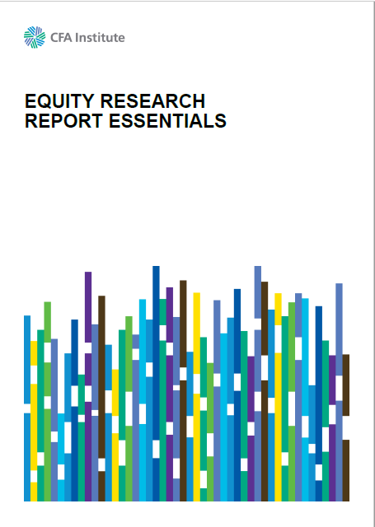
CFA Guide
CFA Institute, Equity Research Report Essentials (pdf)

Slide 40
Outline
Basic Information
Investment Summary
Business Description
Management and Governance
Industry Overview and Competitive Positioning
Valuation
Financial Analysis
Investment Risks
Environmental, Social & Governance (ESG)

Slide 41
1. Basic Information
Name and Ticker
Exchange
Sector and Industry
Final Recommendation
Current and Target Stock Price
Market Capitalization
Major Shareholders
Liquidity Issues (if relevant)
Unusual or noteworthy issues

Slide 42
2. Investment Summary
Brief description of the company
Significant recent developments
Earnings forecast
Valuation summary and recommended action
Concise explanation of any mispricing
Catalyst to prompt the market to reprice the security

Slide 43
3. Business Description
Detailed description of company, its products and services
The company’s economics, including drivers of revenues and expenses.
Sources:
Financial statements
Regulatory filings
Industry publications

Slide 44
4. Management & Governance
Critique of the firm’s management and board
Senior management’s history with the firm and their record of capital allocation
Compensation and incentive plans
Levels of stock ownership
Succession plan in place for senior management?
A review of the independence of the company’s board of directors

Slide 45
5. Industry Overview And Competitive Positioning
Competitive analysis of the industry and competitive environment
Comparison with peer firms
Frameworks such as Porter’s Five Forces or SWOT analysis
Analysis of production capacity levels, pricing, distribution, market share, etc. (if relevant)
Competitive advantages and disadvantages, e.g., strength of brand, cost leadership, and access to technology or resources that are protected

Slide 46
6. Valuation
Thorough valuation analysis of the company using conventional valuation metrics and formulas.
Equity valuation models using either absolute or relative methofs
Absolute valuation models using discounted cash flow models, such as free cash flow
Relative valuation models based on different metrics, including price/sales, price/earnings, price/cash flow, and price/book value.
Multiple valuation models should be used.

Slide 47
7. Financial Analysis
Detailed analysis of the company’s historical financial performance
Forecast of future performance
Careful analysis of historical and forecast ratios including industry-specific and custom financial ratios
Sensitivity analysis

Slide 48
8. Investment Risks
Address potentially negative industry and company developments that could pose a risk to the investment thesis, e.g.,
Operational risks
Economics risks
Financial risks
Regulatory issues
Legal proceedings

Slide 49
9. Environmental, Social & Governance (ESG)
Environmental Issues
Social Issues
Governance Issues

Slide 50
Syllabus
Syllabus Questions???

