Slide 1
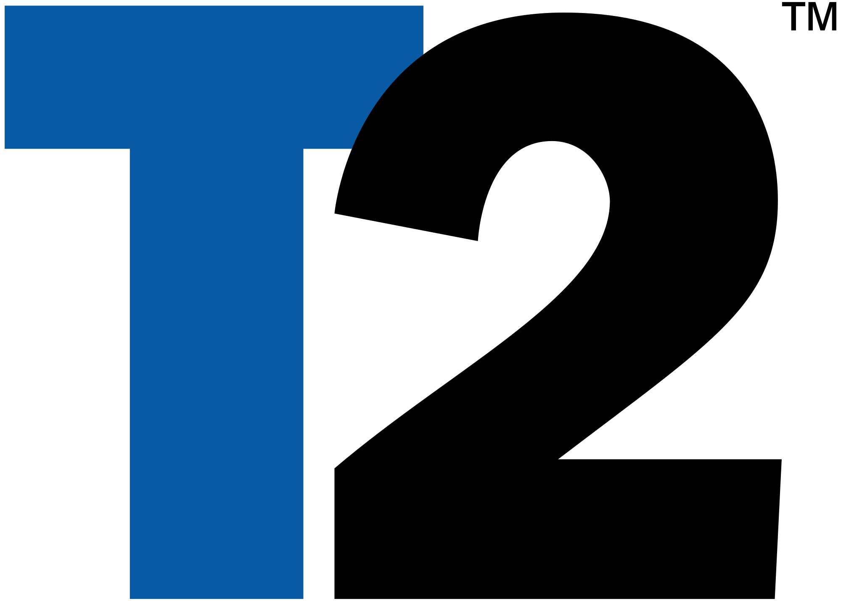
Take-Two Interactive Software
Jake VanderBroek, Brent Bushman,
Tenner Stoe, Janak Sethi

Slide 2
Basic Information
Founded in 1993
Assets equal $2.6 Billion (2016)
Take-Two wholly owns publishers Rockstar Games and 2K Games
Entering the mobile game market
BUY recommendation based on growth
$39.99
$59.99
Released Annually
Fall 2017
Release
Notes:
Tenner

Slide 3
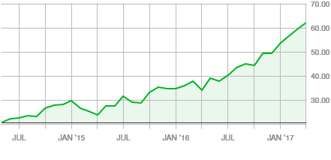
3 Years, Steady Growth
Notes:
Tenner

Slide 4
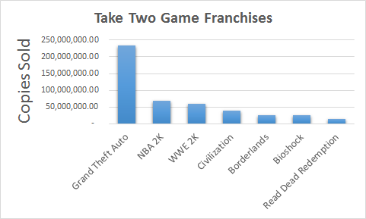
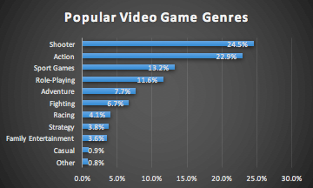
Game Franchises
Console
Grand Theft Auto
NBA 2K
WWE 2K
Borderlands
Bioshock
Read Dead Redemption
PC
Civilization
Notes:
Brent

Slide 5
Consumer Base Growth
160 million Americans play Video Games
Half of all American adults play
Target market is ages 14-30
Average consumer is 35 years old
Average consumer has played 13 years
Trend towards playing games instead of watching TV or movies
Notes:
Growing consumer base, spending more time playing- Jake

Slide 6
Peer Comparison
Market Cap
6.3B
37.5B
28.3B
Shares Outstanding
101.4M
751.8M
308.3M
Revenue (2016)
1.41B
6.60B
4.39B
Notes:
Brent- Smaller than competition, market share will increase, potential growth opportunities,
T2- 1993
ATVI- 1979
EA- 1982

Slide 7
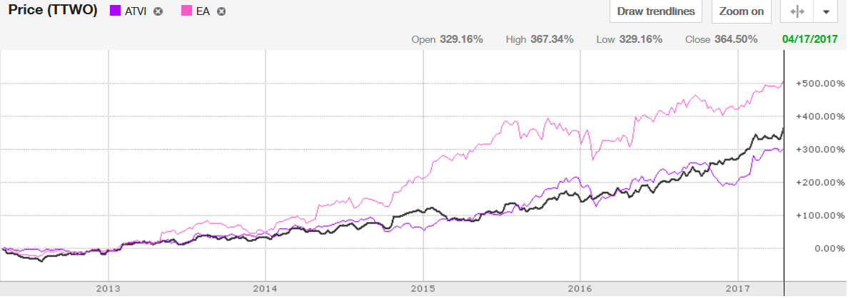
5-Year Stock Comparison
Growth in the video game industry
Notes:
Brent- Industry has grown, TTWO outperforms ATVI, EA entered mobile game market early

Slide 8
SWOT Analysis
Strengths
Game recognition
Continuous revenue from games released annually (2K)
Weaknesses
Dependant on success of “hit” games
Opportunities
New Game franchises
Mobile Gaming
Downloadable content
Threats
Potential slowing demand for franchise games
Notes:
Tenner

Slide 9
Largest Shareholders
Institutional investors provide stability and credibility to the company
Notes:
Jake- Institutional ownership adds stability and credibility

Slide 10
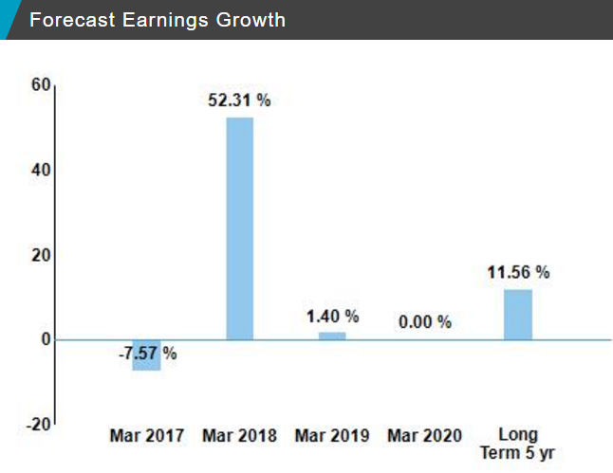
Forecasts
After the release of Red Dead Redemption 2 (Fall 2017), earnings are expected to grow dramatically.
Video game industry is very cyclical
NASDAQ Forecast
Notes:
Jake, every few years a big game is released

Slide 11
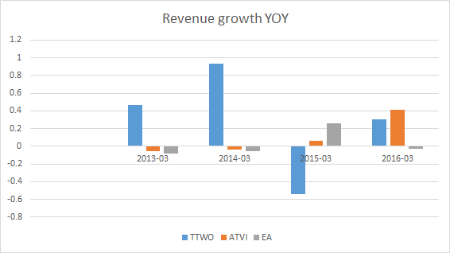
Financials and Competition
Notes:
Even though growth is less in 2015

Slide 12
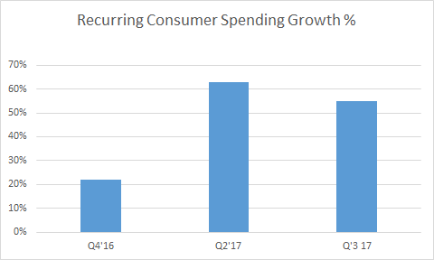
Operational Metrics
FY ended 03/31
Notes:
Janak- Graphs

Slide 13
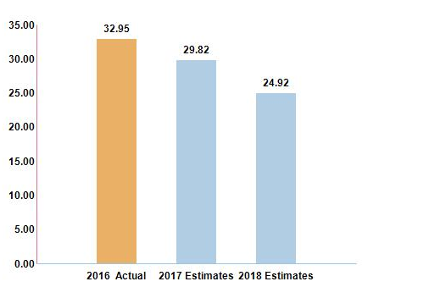
PE Ratio

Slide 14
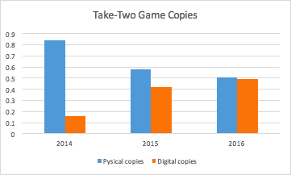
Industry Changes
Physical vs. Digital Games
Growth in Mobile Phone Games
Acquisition of Social Point
Increasingly cyclical stream of revenue
Notes:
Brent- Social point= Social and mobile devices

Slide 15
Risks in the industry
The cost of game development is going up, increasing risk
Average development cost is between $18 to $28 million
“If you’re not making a game in the top 20 of monthly sales, you’re probably losing money” -John Schappert, CEO of Electronic Arts
Acquiring intellectual property is expensive
Take Two is a smaller company, and more susceptible to volatility in year to year revenue
Notes:
Jake

Slide 16
Summary
Steady growth pattern
Take-Two is smaller than competition, market share will grow
Entering mobile game industry - Acquisition of Social Point which develops free-to-play games
New acquisitions add diversity
We recommend to BUY TTWO.
Notes:
Janak

