Slide 1
Ticker: SFIX
FIN 422:
Student Managed Investment Fund
Group Members:
Rachel Glazier, Jacob Rivera, Riley Chouanard, & Sede Ali
Date:
December 9th, 2019

Slide 2
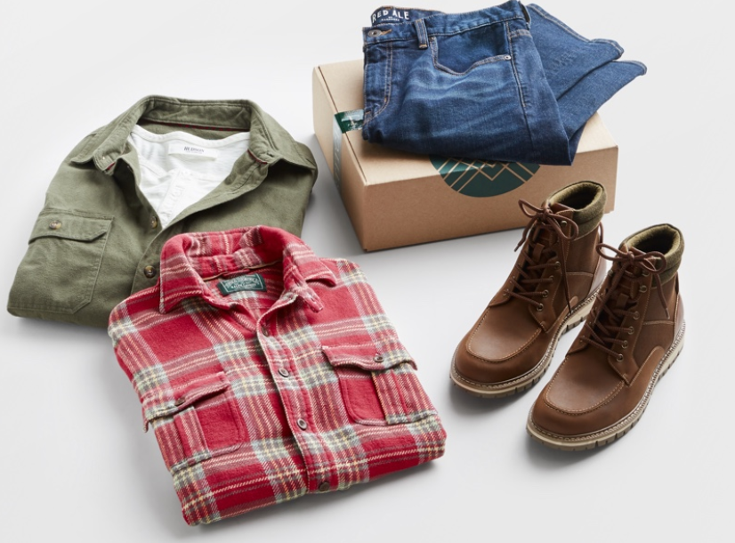
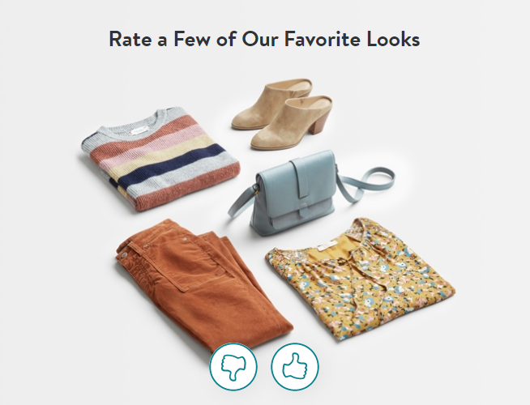
Everyone gets stitches
Not just snitches.
Subscription-based clothing service
Stitch Fix fits your style
Alternative shopping experience
Notes:
What does a stitch fix shipment look like?
Stitch fix has experienced a lot of growth since its founding in 2011.
Stitch Fix launched mens styles in 2016
womens plus sizes in 2017.
Kids can shop with their parents based on their interests
Shopping with kids can be dificult
Here is an example of a mens and womens shipment

Slide 3
The First Stitch
IPO in November 2017
Combination of algorithms & human stylists
Over 125 full time data scientists
Founded in 2011 by Harvard grad Katrina Lake.
Notes:
A subscription based clothing service means no recievables
It also means that there is a reliable amount of cash coming each month
The algorithm engineers have over 200 million data points to work with

Slide 4
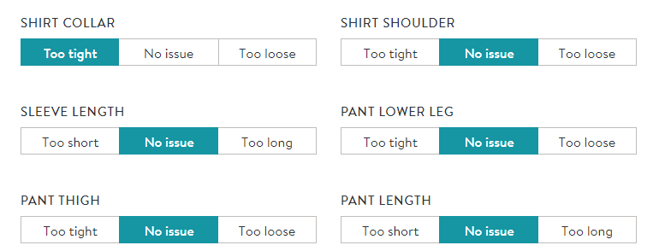
Style Profiler
We all have quirks, but Stitch Fix has it sewn up.
Notes:
You can be as picky as you want
Personally I'm not very picky but as soon as I put on a tie I feel like the collar is trying to kill me.
This style profiler is so much stronger than it looks
It has generated over 200 million data points which gives stitch fix a competitive advantage
It is for these reasons that we believe that Stitch fix is a disruptor.
Stitch fix doesn't have any direct competitors that are public companies.

Slide 5
Data advantage
Client data is provided directly from the client, not external sources
Over 90 data points provided by each customer throughout order
Over 85% of shipments have received direct client feedback
Style Shuffle ~ Used by 2.25 million
125 data scientists
5,100+ employee stylists
Data Includes:
Basics
Item measurements
Personalized preferences
Nuanced descriptions
Client feedback

Slide 6
SFIX faces immense growth
18%
Continual growth in active clients
New opportunities within the UK market
Competitive advantage due to unique data science
25%
31%
93%
232%

Slide 7
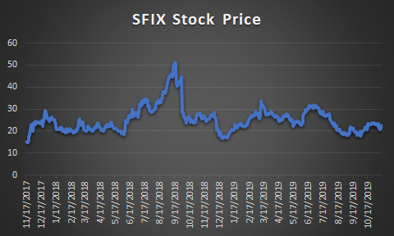
Financial analysis
Notes:
Ipo 15
Drop was 16 after market correction
Now we are at 22

Slide 8
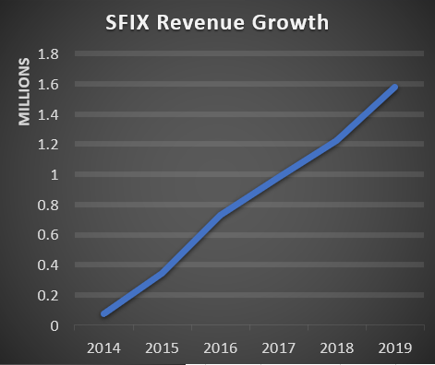
Growth
29%
Significant revenue growth within the last 6 years
26%
34%
113%
368%
Notes:
Revenue growth from $73,200 in 2014 to $1,577,558 in 2019

Slide 9
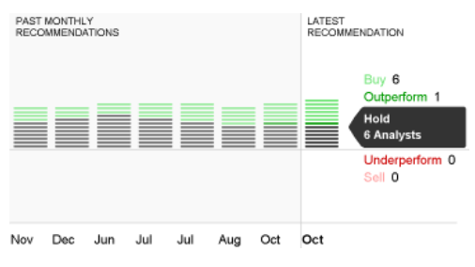
Stitch Fix (SFIX) Background Information
Stitch Fix is a personalized, e-commerce styling service
Market Cap: $2.171 Billion
Current Revenue: $1.578 Million
Stock Price: 23.64 (As of 12/4)
P/E Ratio: 63.56
ROE: 0.121
*November 2018 to October 2019 data

Slide 10
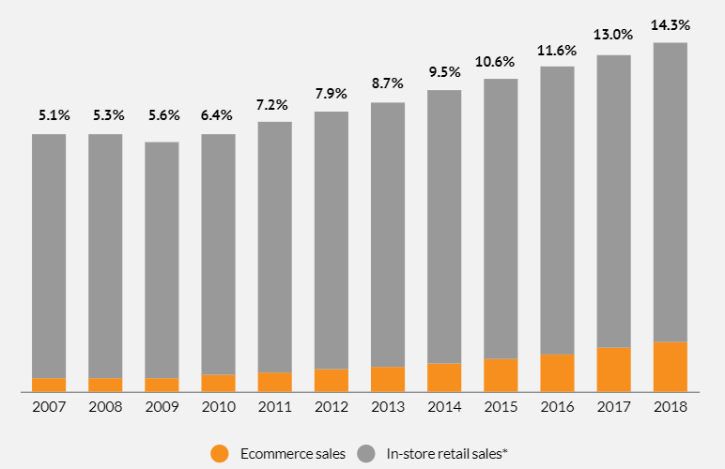
Industry Overview
SFIX is part of the online retail B2C segment of the Ecommerce industry
The Ecommerce portion of total retail sales have increased
Ecommerce sales represent 51.9% of all retail growth
Notes:
Stitch fix is part of the online retail Business to consumer segment of the ecommerce industry.
Looking at this graph it is showing the portion of sales retail ecommerce represent vs total retail sales.
This graph is form U.S. Commerce Department and it shows that not only are ecommerce retail sales are increasing but also retail sales in general.
Over the past 12 years there has been a 9 percent increase in ecommerce retail portion of sales vs total retail sales.
Also according U.S. Commerce Department ecommerce retail sales represented more than half, or 51.9%, of all retail sales growth.
This shows that the Ecommerce industry is a growing market and stitch fix has room to grow
According to SFIX 10-K report, Euromonitor expects the eCommerce portion of the retail market to grow a CAGR of 13.8% by 2022
Euromonitor is a Market research provider

Slide 11
PE ratio deconstructed
SFIX
PE Ratio: 61.88
*Internet, Mail Order, & Online Retail Industry P/E Ratio is 76.38
High PE due to growth
Growth in active clients
Growth in revenue
Expansion of market share
Expansion of the Ecommerce industry

Slide 12
Swot
Strengths​ E-commerce and personalization​ Convenience ​ Growing exposure and building a brand name​ Continuously innovating / data science | Opportunities​ Ecommerce is a growing Industry Expand their price range Expand their features such as "shop your look".​ Overall increase in both internet and social media.​
Weaknesses​ Fashion trends are always changing​ Logistical errors​ ​ | Threats​ New subscription-based services (Nordstrom's trunk club)​ ​

Slide 13
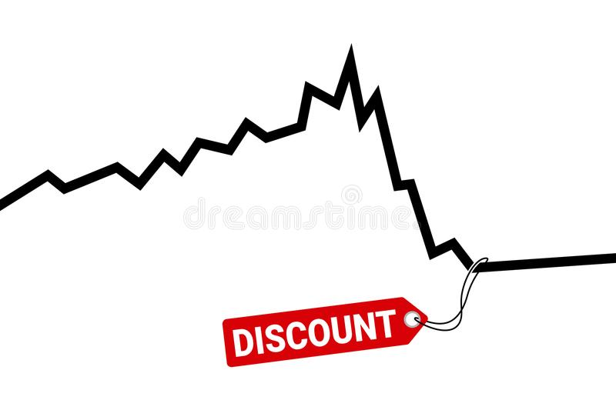
Our low profitability ratios are an opportunity
Low profitability due to recent UK expansion
Why our stock is currently underpriced
Net Profit Margin: 2.34%
A lot of profit goes back into data collection
Gross Profit Margin: 44.57%

Slide 14
Portfolio recommendation
The SMIF will remain diversified with BOTH Stitch Fix and Columbia
SFIX has a correlation of 0.16 with COLM
Average correlation of SFIX with current SMIF stocks is 0.12

Slide 15
summary
SFIX encompasses a unique, personalized clothing service
The online retail industry continues to grow
SFIX has shown growth in both customers and revenue
SFIX faces growth opportunities with their data science usage and new international opportunities
Analyst Target Stock Price: $28
*SFIX fits the SMIF portfolio because it lacks a presence in the Online Retail Industry
Buy the SFIX stock!
Current Price: $23.67
*As of 12/4/2019
Notes:
$28 from CNN business (median target stock price)
High estimate of $38, and low estimate at $16

Slide 16
Sources
Yahoo finance
Edgar SEC Government
CNBC
Forbes
CNN Money
CNN Business
CSIMarket.com
The Motley Fool
SFIX 2018 10-K report

