Slide 1
NeoPhotonics
Lorraine Christianson & Xin Zhou

Slide 2
Company Snapshot (April 21, 2017)
Founded: 1996 as NanoGram Corporation
Sector: Information Technology
Industry: Semiconductor and Semiconductor Equipment
Exchange: NYSE (NPTN)
Stock Price: $8.63
Recommendation: Buy or Hold
Notes:
Lorraine
Explain dips

Slide 3
Business Description
Leading designer and manufacturer of photonic integrated circuit based modules and subsystems for bandwidth-intensive, high-speed communications networks
Light/lasers and electricity to increase bandwidth
Allows businesses to handle larger internet volumes of high traffic
Shape of light is the center of this technology
Facebook Example
Leading the research and development of optical technology
Notes:
Bit of History
Lorraine

Slide 4
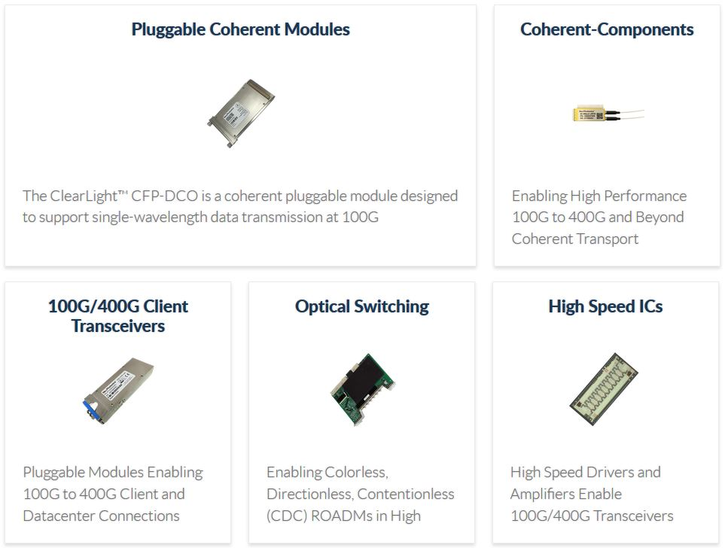
Products
High product turnover
100G products main source of revenue
Notes:
lorraine

Slide 5
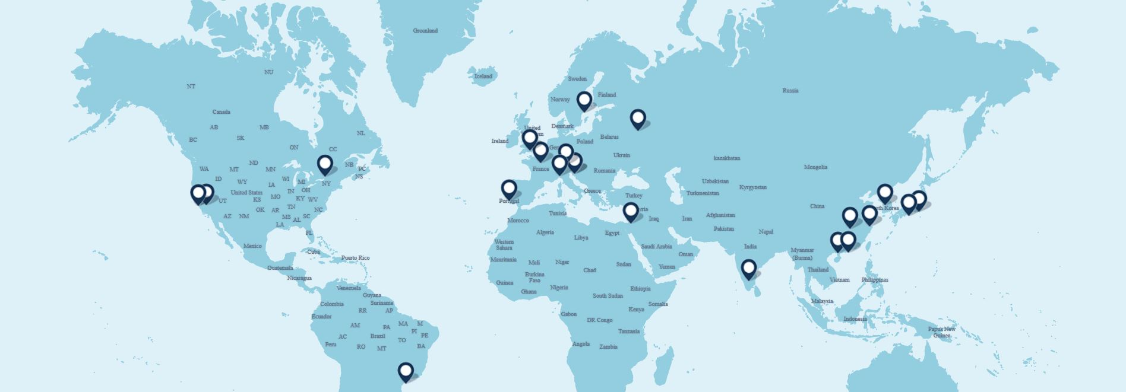
Locations
Notes:
Lorraine
NeoPhotonics has research and development facilities in Dongguan, Shenzhen and Wuhan, China, Ottawa, Canada, and Moscow, Russia. These facilities coordinate with the wafer fabrication facilities in San Jose and Fremont, California and in Tokyo, Japan. NeoPhotonics is a vertically integrated company. They use proprietary design tools and design-for-manufacturing techniques to align their design process. They are we are one of the highest volume Photonic Integrated Circuit, or PIC, manufacturers in the world and have the ability to expand their manufacturing capacity to meet market needs.

Slide 6
Competitive Environment
Factors:
Ability to retain customers
Ability to provide leading edge technology
High quality, reliable, customizable
Produce high volumes quickly
Price to performance characteristics
Competing favorably with respect to these factors
Notes:
Lorraine
Top 10 customers accounted for:
86% of revenue in 2013
88% of revenue in 2014
91% of revenue in 2015
NeoPhotonics sells their products to the world’s leading network equipment and optical module companies. These customers serve the telecom market and also the datacenter market, represented by companies including Amazon, Facebook, Google and Microsoft. It is these companies that NeoPhotonics focuses their strategy and market position on due to their important positions in high speed and related communications networks markets.
Sales of NeoPhotonic products are made pursuant to purchase orders, often with short lead times. These purchase orders are typically made without deposits and may be subject to revision or cancellation. The quantities actually purchased by our customers, as well as the shipment schedules, are frequently revised to reflect changes in our customers’ needs.
Top Customers:
Ciena Corporation,
Cisco Systems, Inc.,
HiSilicon Technologies, Ltd.,
Huawei Technologies Co., Ltd. (collectively “Huawei”) and
Nokia Corporation (formerly Alcatel-Lucent SA which was acquired by Nokia Corporation in January 2016).
Huawei and its affiliate HiSilicon Technologies, accounted for approximately 40% of the revenue in 2015 and 50% of the revenue in 2016. Ciena accounted for approximately 25% of the revenue in 2015 and 15% of the revenue in 2016.
NeoPhotonics is very dependent on these customers. A reduction of orders from any of these companies would have an impact on revenue.

Slide 7
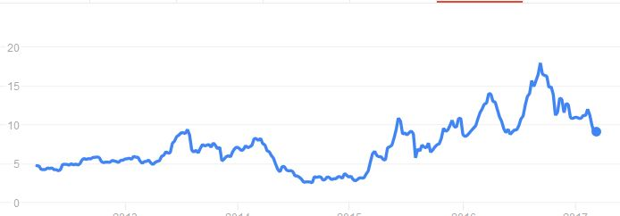
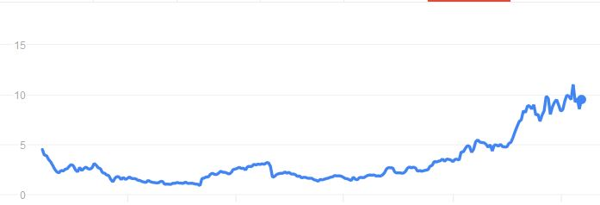
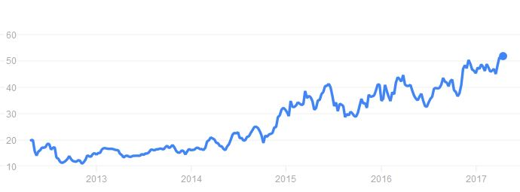
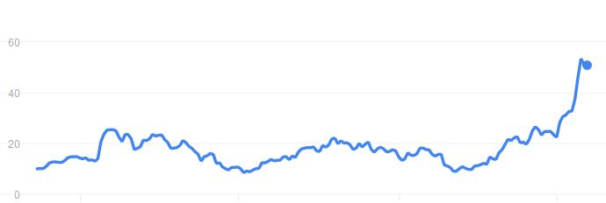
Stock Price (5 year trend)
NeoPhotonics
Oclaro
MA/COM
Applied Optoelectronics
Notes:
Lorraine
Normalize
Whay are they se

Slide 8
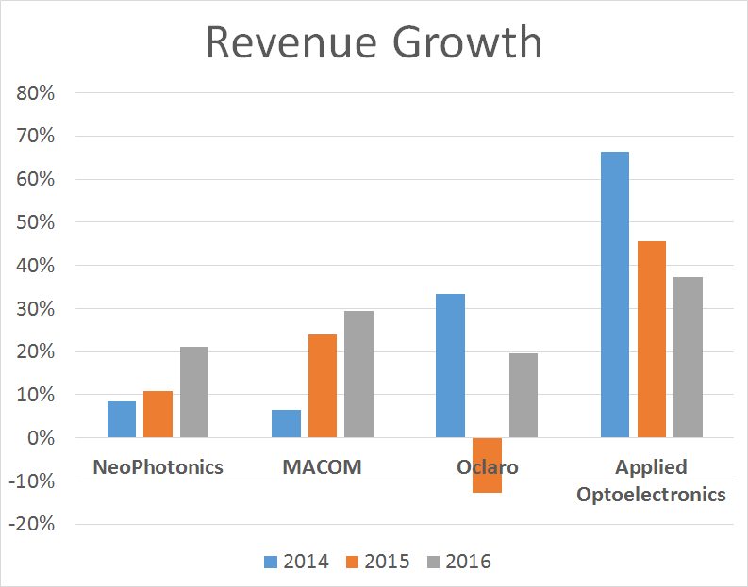
Top Competitors, 2016
 | 2014 | 2015 | 2016
NeoPhotonics | -110% | 5895% | 106%
MACOM | -31% | 32% | 135%
Oclaro | 7% | 43% | 114%
Applied Optoelectronics | 210% | -310% | 476%
Cash From Operations Growth

Slide 9
Investors
30.55% shares held by insider and 5% owners
57.50% shares held by institutional & mutual fund owners
Top Institutional holders:
Oak Management Corp $45.9M 13.16%
Dimensional Fund Advisors LP $21.5M 6.17%
Wellington Management Company,LLP $19.1M 5.50%
Notes:
xin

Slide 10
Direct Holders
Carano Bandel L (Managing Partner of Oak Investment Team) $45.07M
Jenks Timothy Storrs (President & CEO) $1.45M
Sitler Benjamin Lee (Vice President of Global Sale) $.63M
Abbe Charles J (Independent Director) $489.7K
Wupen Yuen (Vice President and General Manager) $180.5K
Company insiders must own at least 10% (currently 14.54%) of the company's outstanding shares
Notes:
xin
Use percentages or dollar amount

Slide 11
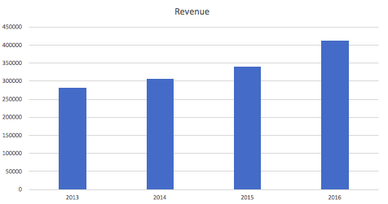
Revenue Growth
Sale of NPTN has been consistently grown over past four years:
current: $411.4M
2015: $339.4M
2014: $306.2M
2013: $282.2M
Confident about growing and positive earning forecast and stock price.
Notes:
xin

Slide 12
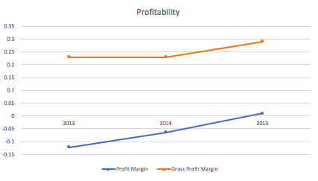
Financial Margins
Profit margin consistently increasing:
2015: 1.08%
2014: -6.44%
2013: -12.17%
Sign of good management and a healthy and competitive enterprise.
Test of the quality of a company−can they sustain this up-trend of margin.
Notes:
xin

Slide 13
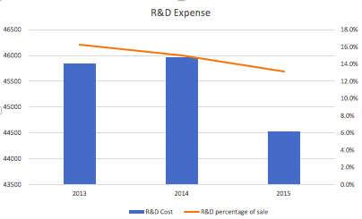
R&D
NeoPhotonics as high-tech company.
Consistently investing in research and development similar with competitors is a good sign.
Major competitors invest between 12%-20% of sale into R&D activities.
Notes:
xin

Slide 14
Tax Considerations
Income Taxes 2015 2014 2013
Provision for income taxes (3,104) (2,519) (1,204)
Effective tax rate 46% (15)% (4)%
The effective tax rate in 2015 was 31 percentage points higher than the 2014
Exposuring to exchange risks because of not entering into any hedging position
Chinese exchange control regulations that may restrict ability to convert foreign capital back to home country.
Notes:
Change layout
A large portion of business is conducted through subsidiaries in China.
Significant portion of revenue is in U.S. dollars, a significant portion of cost of goods sold are in RMB.
Not entered into any hedging transactions in an effort to reduce exposure to foreign currency exchange risk.
Chinese exchange control regulations that may restrict ability to convert RMB into foreign currency.
xin
Loss of any of its key customers
Fundamental changes in the technology underlying Company products
New product designs by competitors
Performance of subsidiaries and regulation, taxation in foreign market
Successful and timely completion of products

Slide 15
Recommendation
What makes NeoPhotonics Special? Potential Growth.
The investment recommendation for NeoPhotonics stock is to buy or hold under the assumption that the investor will pay close attention to developments within NeoPhotonics and the industry as a whole
High risk, but offers a high reward.
Notes:
Lorraine
What makes them special – Summary
-for such a small company they are very competitive, making similar revenue as much larger companies
-retain customers

