Slide 1
Innoviva
Ticker on NYSE: INVA
Nick Cimaglia, Isaac Westlake, Brittany Schyvinck, Sam Kohnle, and Trent Seagren

Slide 2
Presentation Overview
Company Background
Industry Overview
Management Team
Royalties
S&P Comparison
Ratios
SWOT Analysis
Reasons to Invest

Slide 3
Company Overview
Strong science teams with good financial management
Royalty management
Main patents in respiratory medicine
Low corporate costs

Slide 4
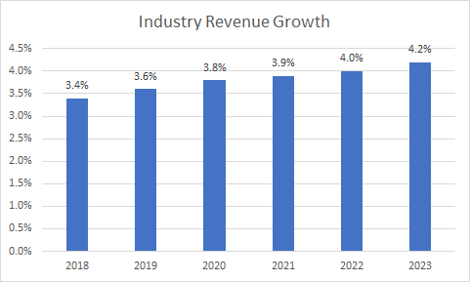

Slide 5
Management Team
Board of Directors
Chairperson: Odysseas Kostas, M. D.
Chairman of the Board of Directors since April 2018.
He is currently a member of the Audit and Nominating/Corporate Governance Committee.
Engaged as a consultant to various biotechnology strategies
Management
Interim Principal Executive Officer: Geoffrey Hulme
Started this position in May, 2018.
Prior to his hiring, served as the owner and manager of Steel Valley Capital LLC and served as Director of Research for Amici.
25 year career in finance and investment management with a record of creating and maximizing shareholder value.

Slide 6
Innoviva’s Royalties
Pharmaceutical company with big emphasis in Respiratory Medicine and royalty management
Has 3 major patents sold to GlaxoSmithKline
Portfolio includes the respiratory assets partnered with Glaxo Group Limited (“GSK”)

Slide 7
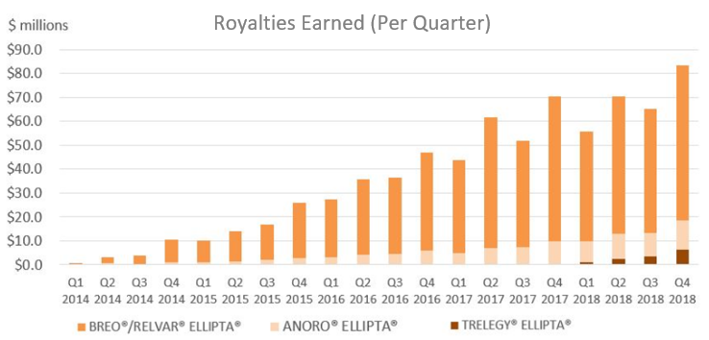
Notes:
Go into the companies that we receive royalties from and then kind of more about how GlaxoSmithKline
Go into the three patents and what exactly they do and why they are going to stay relevant

Slide 8
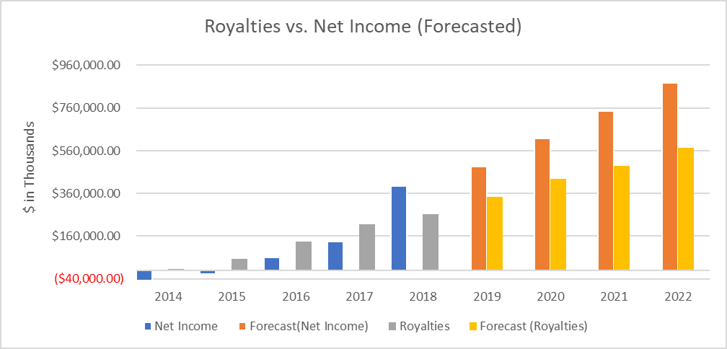
Notes:
After taking out all expenses including tax on royalties, they are also taking out an income tax expense, but in 2018 it became a tax benefit amounting in 406,328. From there net income is found after they take out net income attributable to non-controlling interest

Slide 9
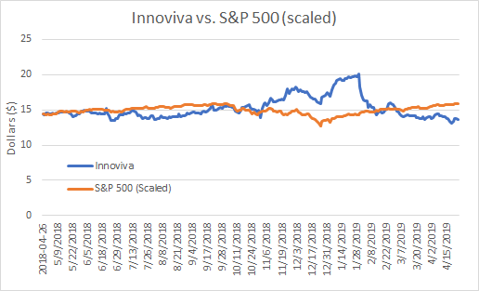
Notes:
Past stock prices -- High: $20.54 , Low: $13.26
Why the stock price went down and why it not going to continue to go down

Slide 10
Average Ratios of Competitors vs Innoviva
Average of Competitors
P/E Ratio: 16.66
Quick Ratio: 0.9
EPS: 3.27
Innoviva
P/E Ratio: 4.14
Quick Ratio: 34.77
EPS: 3.53

Slide 11
SWOT Analysis
Strengths | Weaknesses
Growing company Increase in revenue and net income | Smaller than most in the industry
Opportunities | Threats
Expanding market for pharmaceutical drugs Driven by desire to cure illness Need to discover and market new drugs | Getting drugs FDA approved Trump’s proposal to reduce pharmaceutical drug prices
Notes:
Brit

Slide 12
Reasons to Invest in Innoviva
Opportunity to invest at such a low stock price
Heavily royalty managed company
Exceptional management team
Increasing pharmaceutical industry demand
Partnered with strong companies
Increasing Expected Growth

