Slide 1
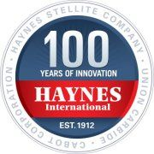
Haynes International
Presented by:
Aric Becker, Mike Strand, Omar Khader, Garrett Peterson, Yu Xi

Slide 2
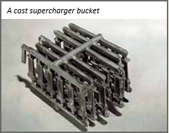
Company Overview
Formed in 1912
One of the largest developers, manufacturers, and distributors of high-performance alloys in the world.
Vital role in providing the U.S. with the best tarnish-resisting materials and supplies during WWI and WWII
Haynes STELLITE® Division
By combining a STELLITE® alloy with the casting process
the company was able to produce a turbine blade.
Over 25 million buckets were produced during the World War II
Notes:
Mike -
The 1930s were a time of rapid advancement in the aircraft industry. New, higher horsepower, air-cooled, gasoline piston engines kept pushing altitude ceilings and speed barriers.
By combining a STELLITE® alloy with the precision casting process, the company was able to produce a turbine blade, also called a “bucket” that could withstand the high temperatures and stresses encountered in the supercharger. This was absolutely crucial to the U.S. military because the supercharger, with the STELLITE® alloy buckets, allowed allied bombers to fly above anti-aircraft fire.

Slide 3
Company Overview (cont.)
Extensive Research and Development
On-going development of patent-protected alloys positions them as the industry leader in R&D-driven products
Technology-driven
Making efforts to implement efficient manufacturing
processes to support a seamless production & distribution
Various product functions
Enable the production of cancer-fighting drugs
Used in parts for almost every commercial airline plane flying today
Alloys produced have flown on every Apollo and space shuttle flight.
Notes:
Mike
Research and development remains an important part of Haynes business and they continue to invent new alloys.
Haynes alloys enable the production of cancer-fighting drugs, as well as the common aspirin. Haynes products are used in parts for almost every commercial airline plane flying today, as well as in military aircraft for the United States and its Allies. Alloys invented and produced throughout our history have flown on every Apollo and space shuttle flight.

Slide 4
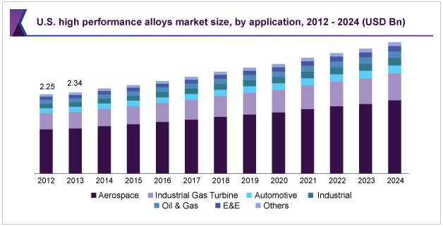
Industry Outlook
Industries in which they operate are:
Aerospace Power generation Chemical processing Emerging technologies
Notes:
Mike - Provides millions of highly resistant alloys to the U.S. and international defense operations/stations each year. Having the resources and ability to operate in various markets and industries gives them a competitive edge over more focused firms that are not.
As you can see from the graph: Industry is expected to grow slowly, this forecast is based on normal market activity. If there were to be another war then Haynes would be heavily relied on as they have provided millions of high-performance materials and units to U.S. personnel in the past.

Slide 5
Industry SWOT Analysis
Strengths | Weaknesses
Increasing demand for high-performance alloy Availability of raw materials Has a long steady history Low labor costs | High manufacturing costs Difficult to adapt to the rapid changes in the tech and manufacturing High capital costs Expensive R&D
Opportunities | Threats
Growing demand from the aerospace & defense industry North America is expected to have the most market demand Developed supply-chain operations | High price sensitivity Tough competitors looking to “one up” each other
Notes:
loda

Slide 6
Liquidity
Current liability: (accounts payable + short term debt + other current liabilities)/total liability
24.34% compared to 62.20% NDAQ
Working capital to debt ratio: (cash + accounts receivable + inventory - accounts payable)/debt
3598.55% compared to 12.11% NDAQ
Haynes: Very low debt and high inventory
https://www.nasdaq.com/symbol/hayn/financials
Notes:
https://www.nasdaq.com/symbol/hayn/financials?query=balance-sheet
(9802 + 80677 + 273045 - 59698) / 8443 (no short term debt)

Slide 7
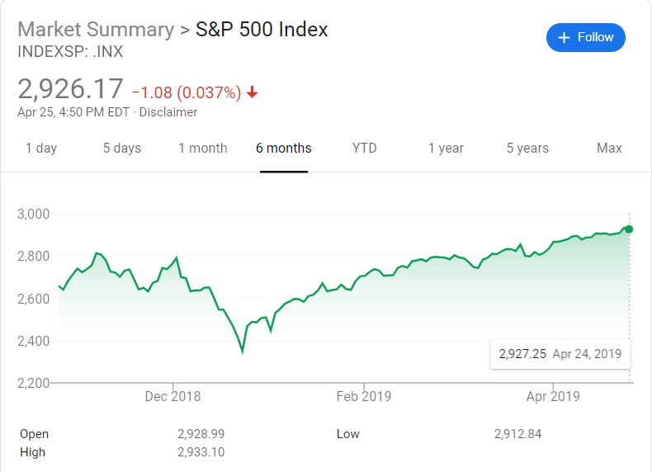
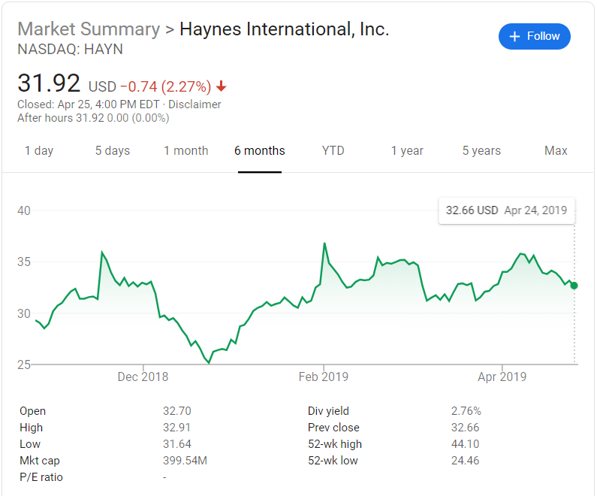
Stock History
Previous 6 months
Stock fell in December 2018 along with the S&P 500
Generally consistent with the S&P 500
Growing market-demand of high performance alloys to raise stock value

Slide 8
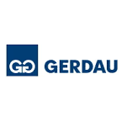
Competitors
Haynes International
440 M annual revenue
Allegheny Tech - specialty metals manufacturer
$3.9 B annual revenue
Carpenter Tech - steel manufacturer
$2.3 B annual revenue
Gerdau - long steel producer
$12.9 B annual revenue
Notes:
More detail on who these competitors are? If they focus in one area of operation as opposed to Haynes?

Slide 9
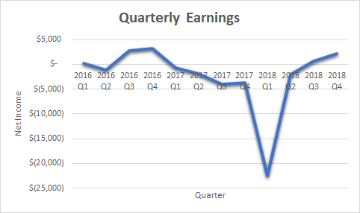
Earnings Report

Slide 10
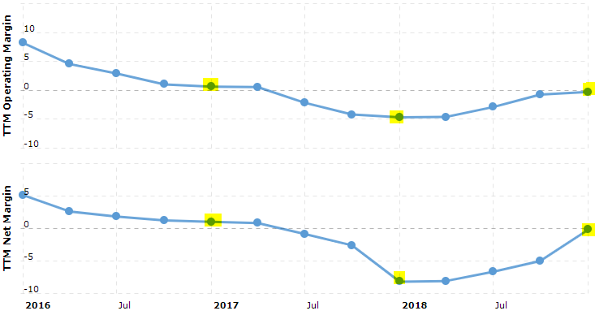
Profitability Ratios
Net Profit Margin & Net Operating Margin
Industry outlook is promising as aerospace, global defense, and increasing extractions of oil & gas, and alloys
Net Profit Margin:
2016: 2.63%
2017: .84%
2018: -8.08%
End of 2018: -.16%
Net Operating Margin:
2016: 4.59%
2017: .49%
2018: -4.79%
End of 2018: -.22%

Slide 11
Importance of Ratios Increasing
Net Profit Margin and Net Operating Margin returning to positives at the end of 2018
Due to the expanding industry, Haynes stands a higher chance of retaining these increases
Indicating that its current price is much less than it is truly worth assuming these percent increases stay steady

Slide 12
Conclusion - Reasons to Buy
Safe liquidity ratios for the uncertain investors
Long steady history
Strong future industry outlook
Undervalued with rising net income

