Slide 1
EGCO Group Electricity Generating Public Company
Nick Thrune, Sam Williams, Connor Bendt, Kendra Jensen and Caroline Shen
Notes:
Include a graph of stock price
Include stock price before recommendations
30 point font

Slide 2
Overview
Company Overview
Currency Overview
Ratio Analysis
Free Cash Flow
Stock Price
Recommendations
Notes:
SWOT
Growth
Competitiors
Full Names

Slide 3
Company Overview
Background of Energy Industry
Stong growth
Long term Potential
Background of our company
First independent power company in Thailand
Unique company so no comparison to its competitors
The company has operations in 6 countries
Current Operations
This year the company invested significant in operations overseas
The company has 8 current sources of energy
Notes:
Industry
Growth opportunities occurring right now
EGCO
Established in 1992
6 Operating Countries :
Thailand, Lao, Philippines, Indonesia, Australia and South Korea
$1 Billion in overseas operations

Slide 4
Energy Sources for EGCO
Geothermal
Natural Gas
Coal
Biomass
Waste
Hydro
Solar
Wind

Slide 5
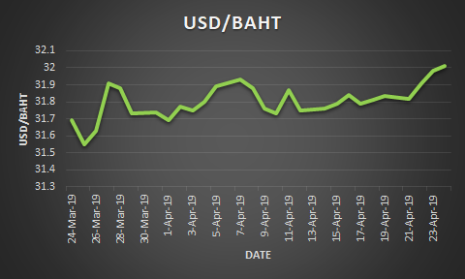
Currency Overview
Notes:
Currently the Bhat is on an upward trending, so when we convert these financials it will be worth more.
(Out of the countries EGCO does business in all currencies look stable besides the BAHT to PESO has increased due to politics)
In 2006, there was a control system in place to keep the currency stable but it was lifted in 2008.

Slide 6
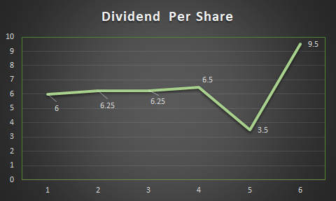
Ratio Analysis-DPS
2013 | 2014 | 2015 | 2016 | 2017 | 2018
Notes:
So we can see here that their dividend per share went down in 2017 and that is because they took that money and invested it back into growth opportunities, we can see the payout of that growth in 2018 as they increased dividends again significantly.
On quarterly basis
Show both if it tells a story
Don’t use "took a hit:"

Slide 7
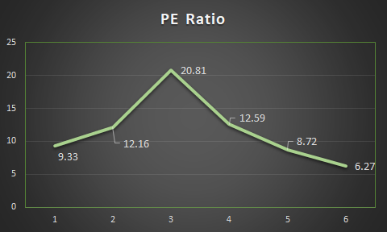
Ratio Analysis- PE Ratio
2013 | 2014 | 2015 | 2016 | 2017 | 2018
Notes:
Since EGCO is investing in growth opportunities people aren't valuing their stock correctly, therefore PE is going down,
We expect that once people see that EGCO is growing globally that should correct itself and go back up.
We also looked into the source of PE declining
The Price (P) is not growing as fast as the earnings (E)

Slide 8
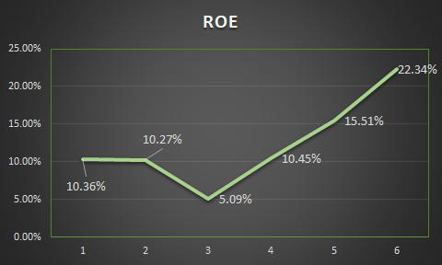
Ratio Analysis- ROE
2013 | 2014 | 2015 | 2016 | 2017 | 2018
Notes:
As we see their ROE has grown since they have invested in growth opportunities which is why they chose to decrease their dividend.
"Which is exactly what they invested in"
PE to ROE peak in 2015, explanation????? -Wolf

Slide 9
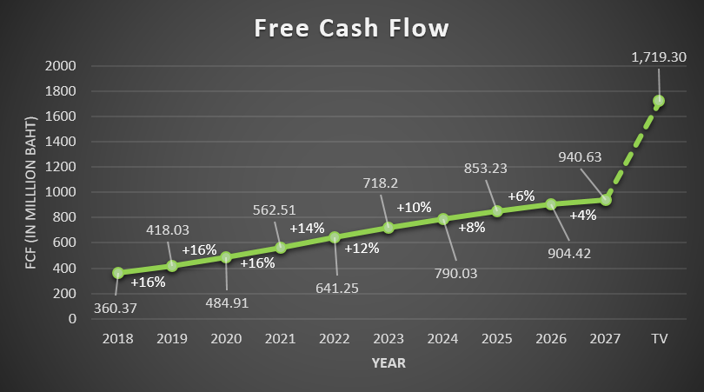
Free Cash Flow
Notes:
Current Stock Value: $297
Intrinsic Value: $403.37
Undervalued by 35.81%
… along that projection as if it will continue at that 4%

Slide 10
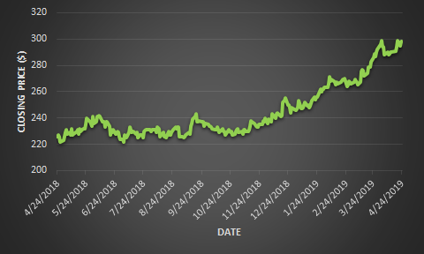
Stock Price

Slide 11
EGCO Strategies
Firms commitment to sustainability
Very diverse business model
Growing financially and geographically

Slide 12
EGCO Strategies cont.
Strong ratios showing growing stock prices
Positive swing in our currency exchange rates
Strong and stable industry
Notes:
Keep graphs off last page
We are missing futures prices for thai baht exchange
[
Put current add a dotted line based on futures
Mispricing- EXPLAIN THIS ESPECIALLY IN THE CONCLUSION. WHY DOESN'T THE CURRENT PRICE REFLECT ALL OF THIS? Why is it underpriced?
Why did the market get it wrong?

Slide 13
Recommendations
Mispricing:
Stock price is rising slower than the earnings.
Investment-to-asset
Recent expansions and investments skewing future forecasting
Intrinsic Value
Real value of the company should be much higher
Notes:
Value line on EGCO

